Slide 1


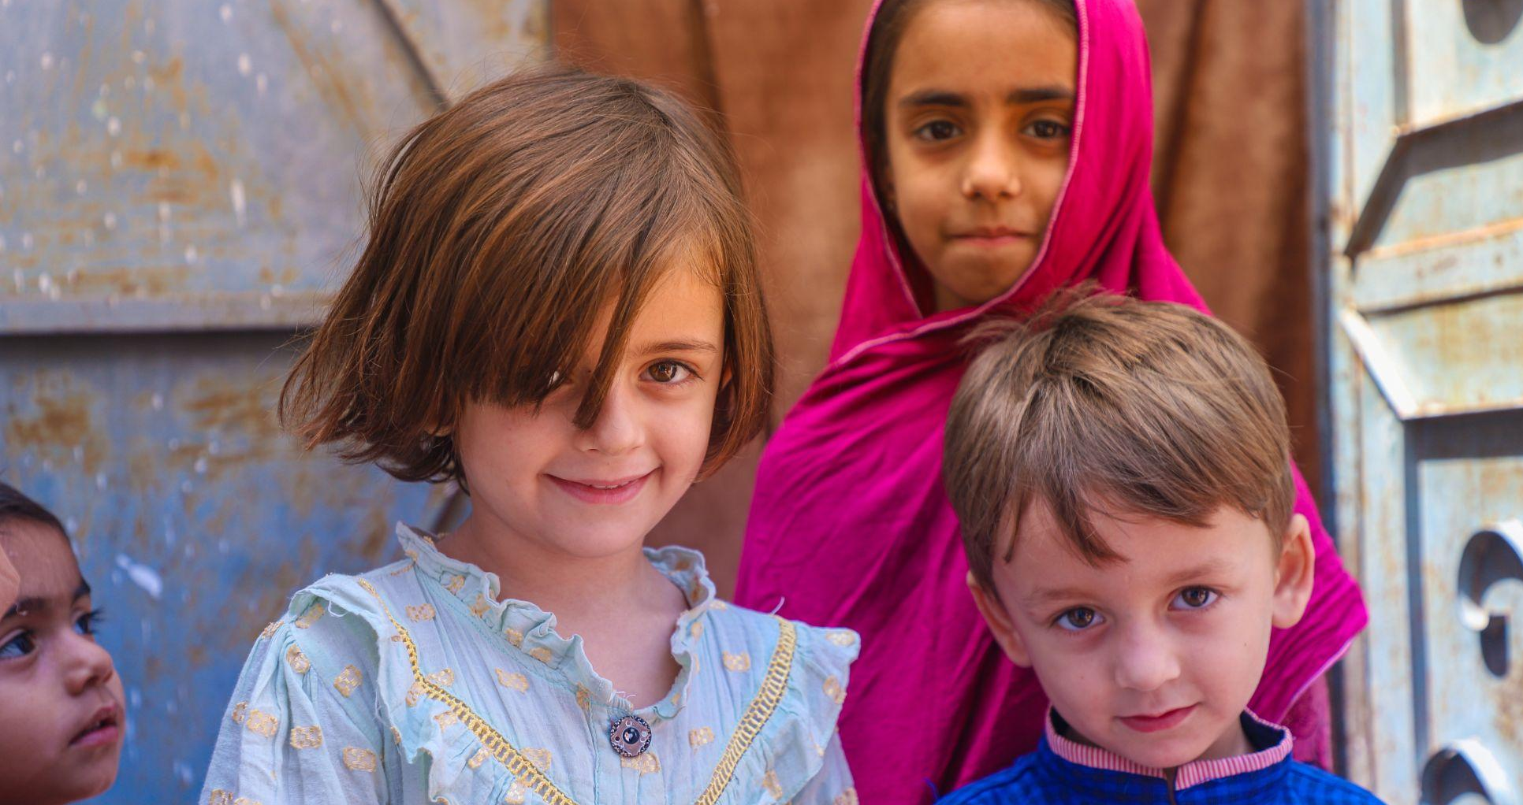

For the Lord is good;
God’s steadfast love
endures forever and
God’s faithfulness
to all generations.
Psalm 100:5

Slide 2


Make an impact that will last
generations
Through PWS&D, our church demonstrates God’s love and faithfulness in some
of the most marginalized corners
of our global community.

Slide 3
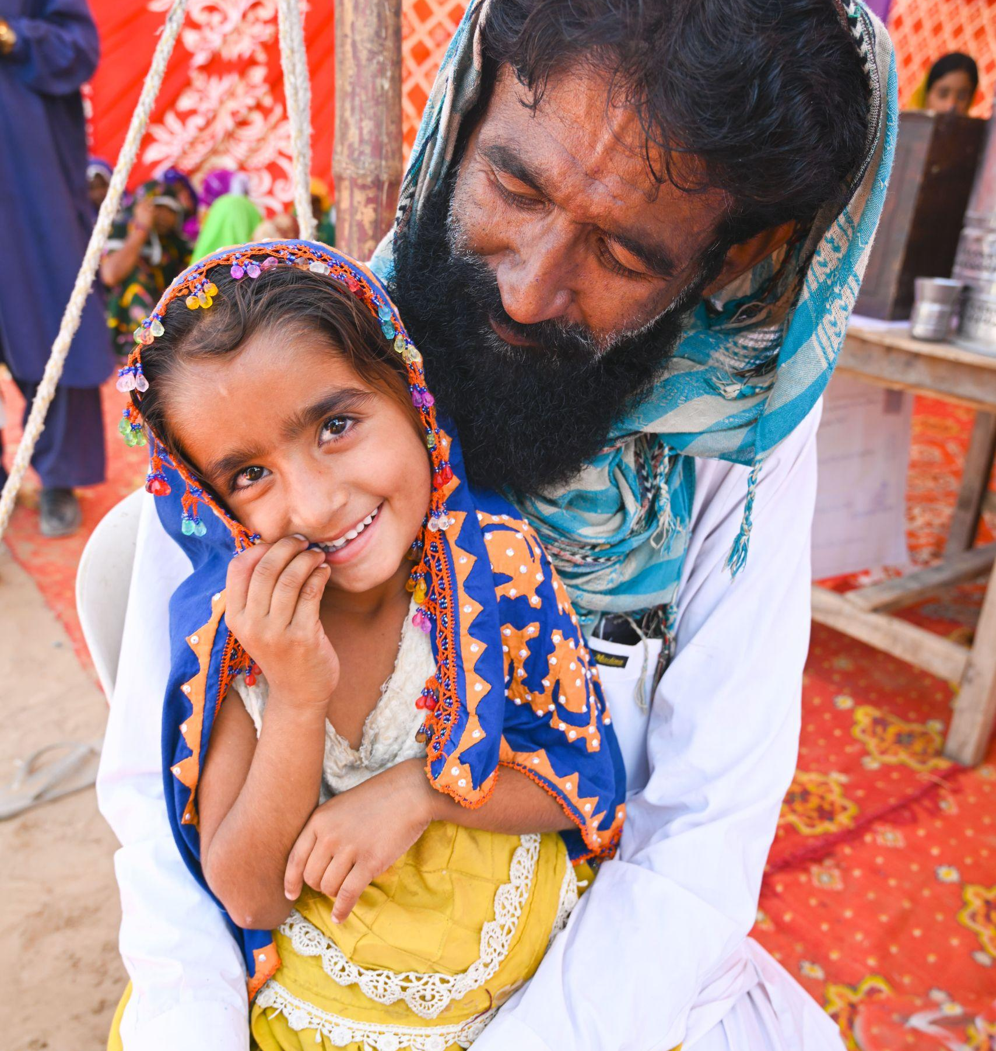
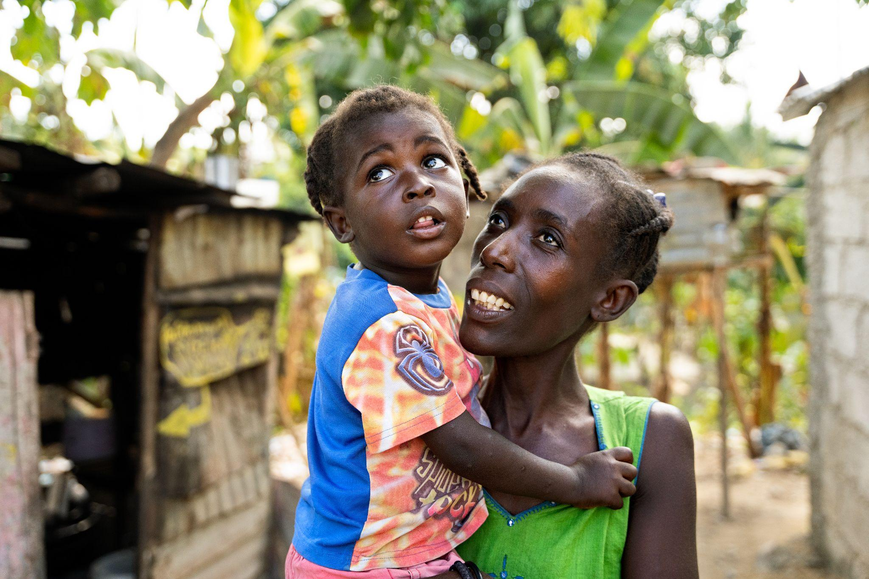
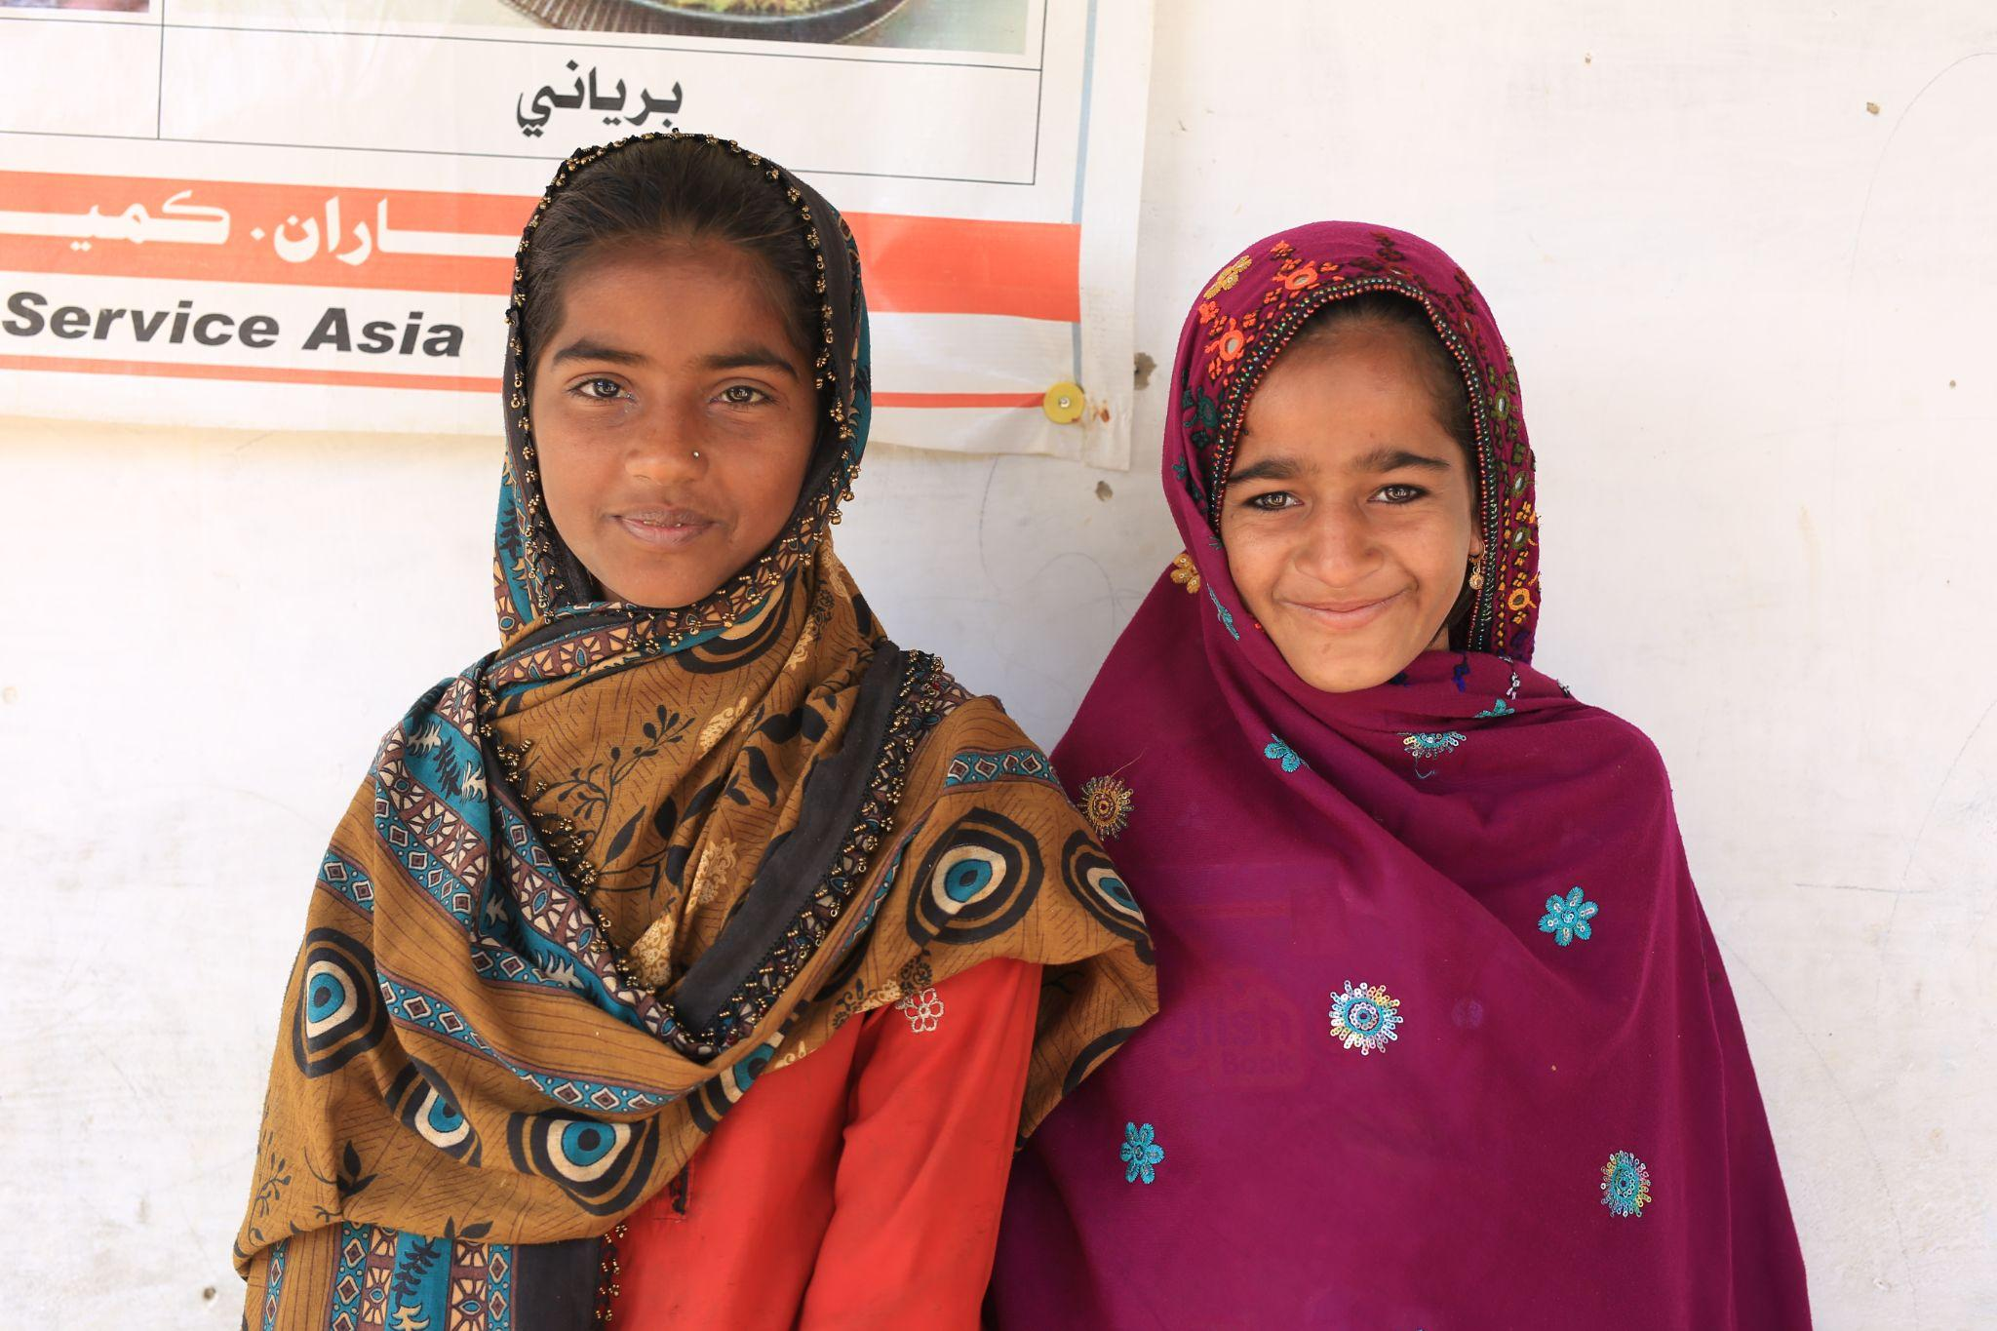
Responding through local partners
to situations of poverty, hunger, injustice and disaster, we work
to help families to achieve stability for today and hope for the future.

Slide 4
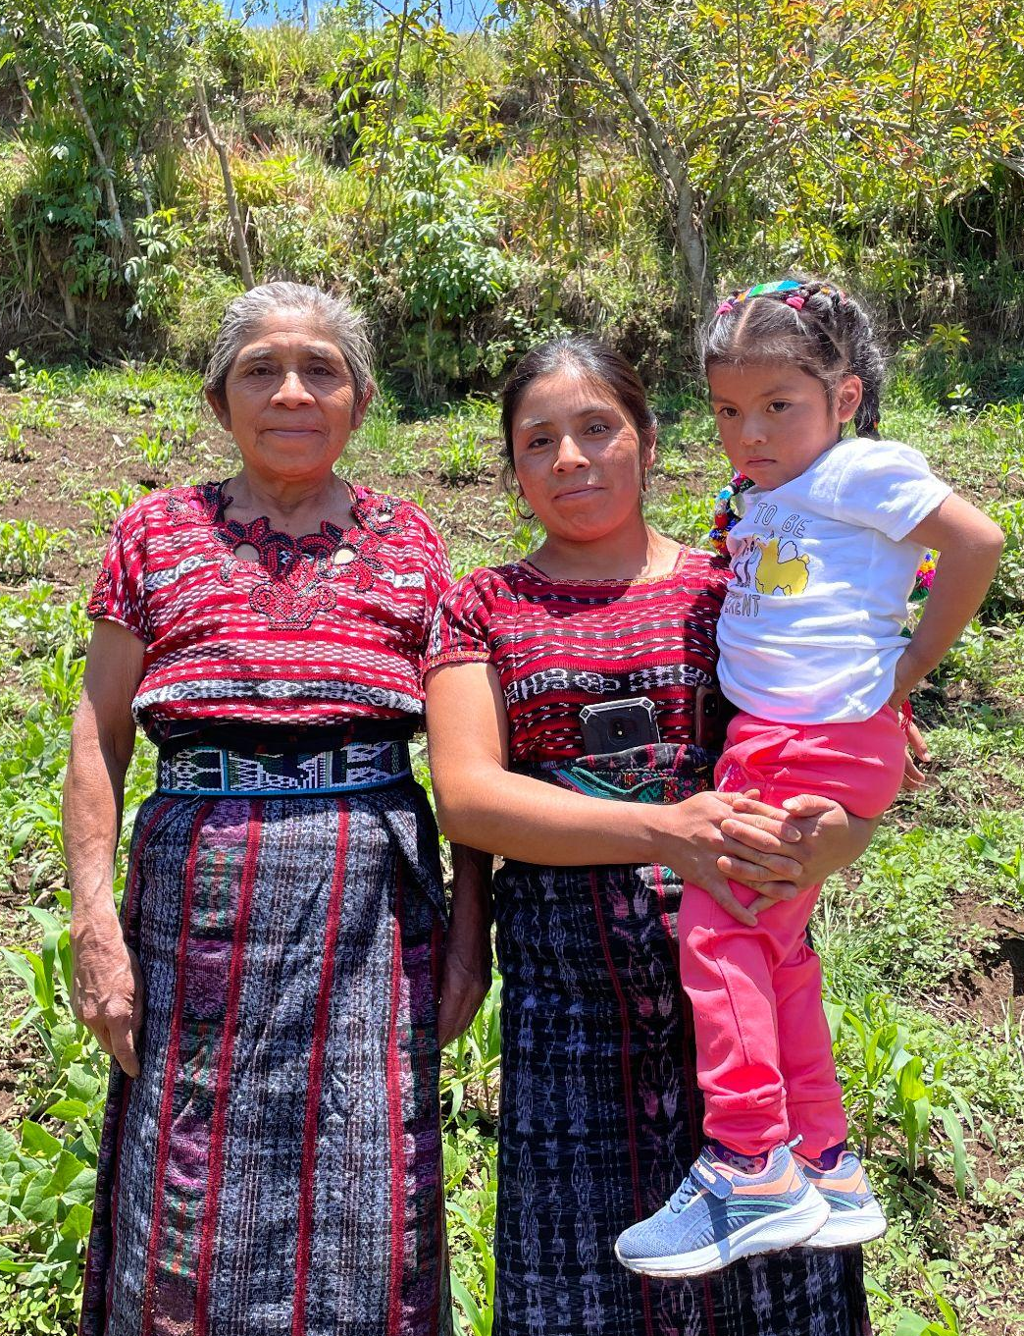
Investing in climate-smart agriculture techniques, education for boys and girls, and enabling access to health care and food are just a few of the ways your generosity will help make an impact for future generations.

Slide 5

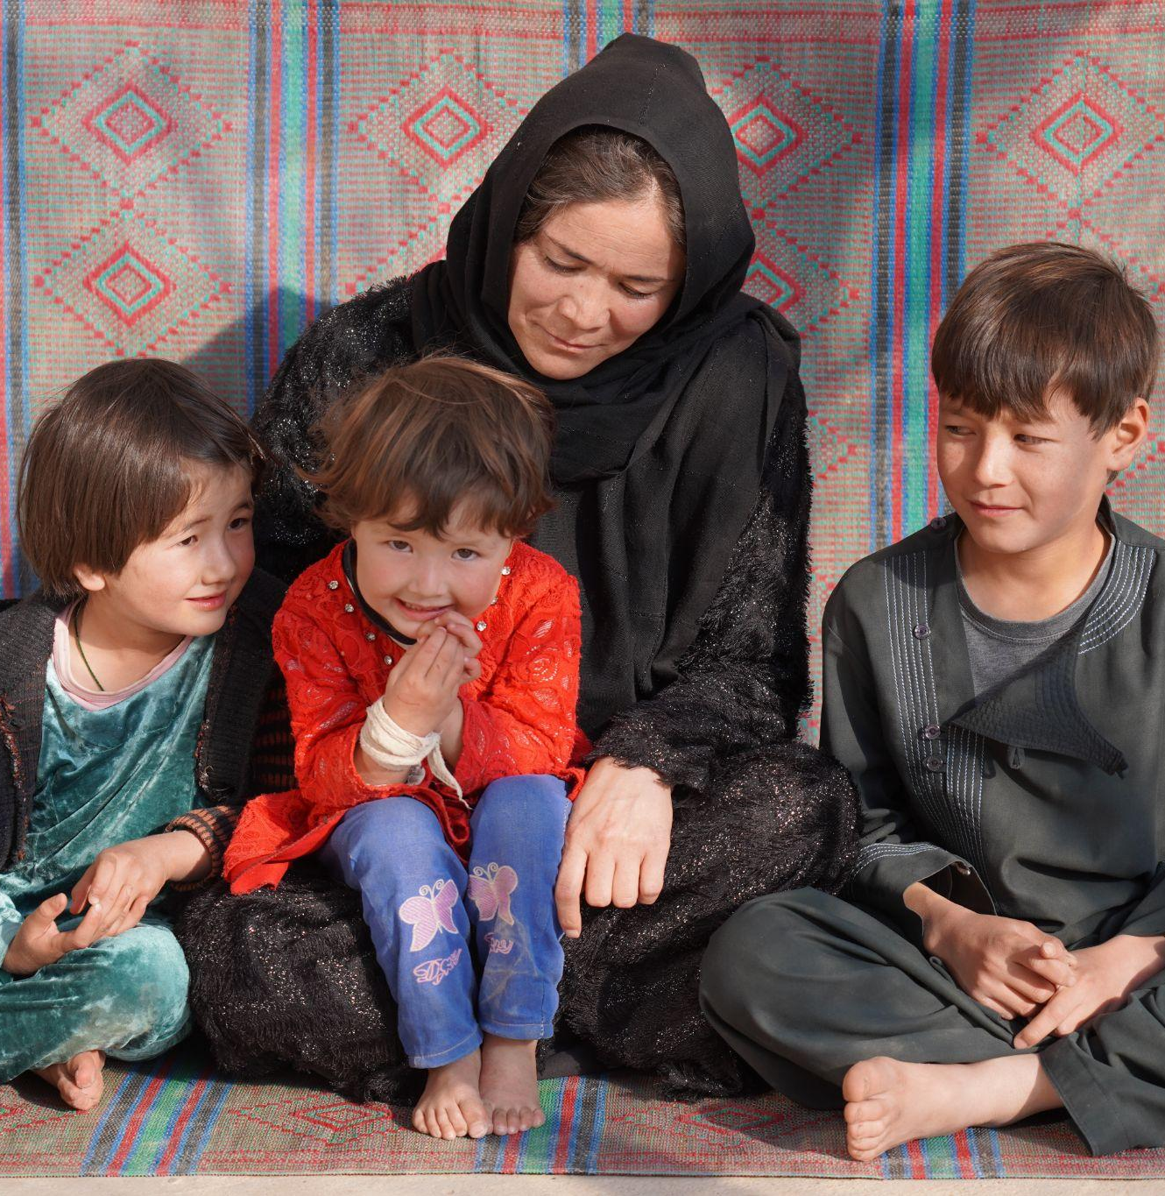
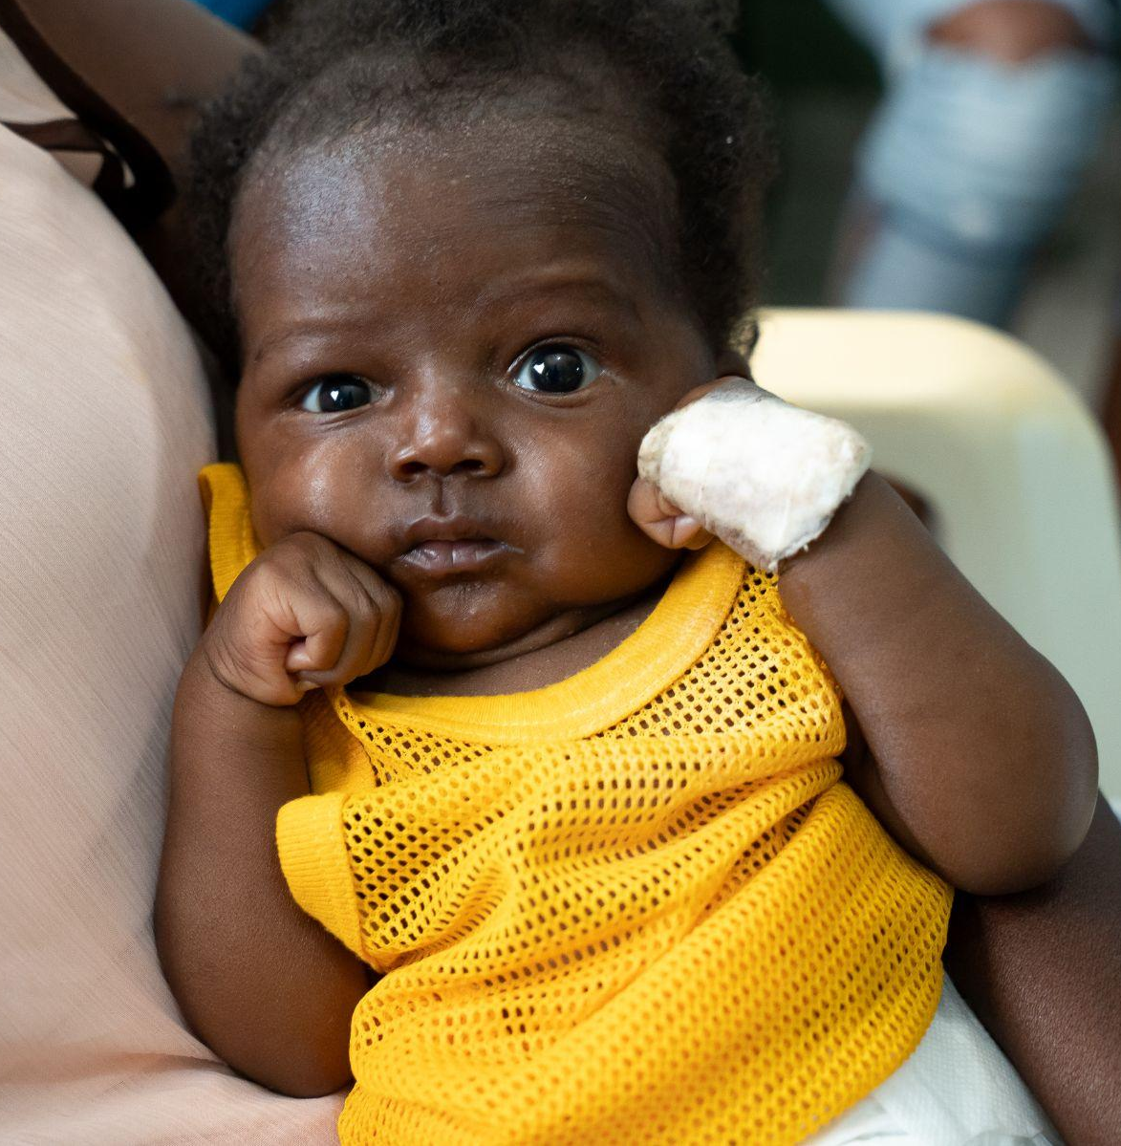
The faithful support of Presbyterians from across Canada continues
to enable life-sustaining relief
and development projectsin countless countries.

Slide 6
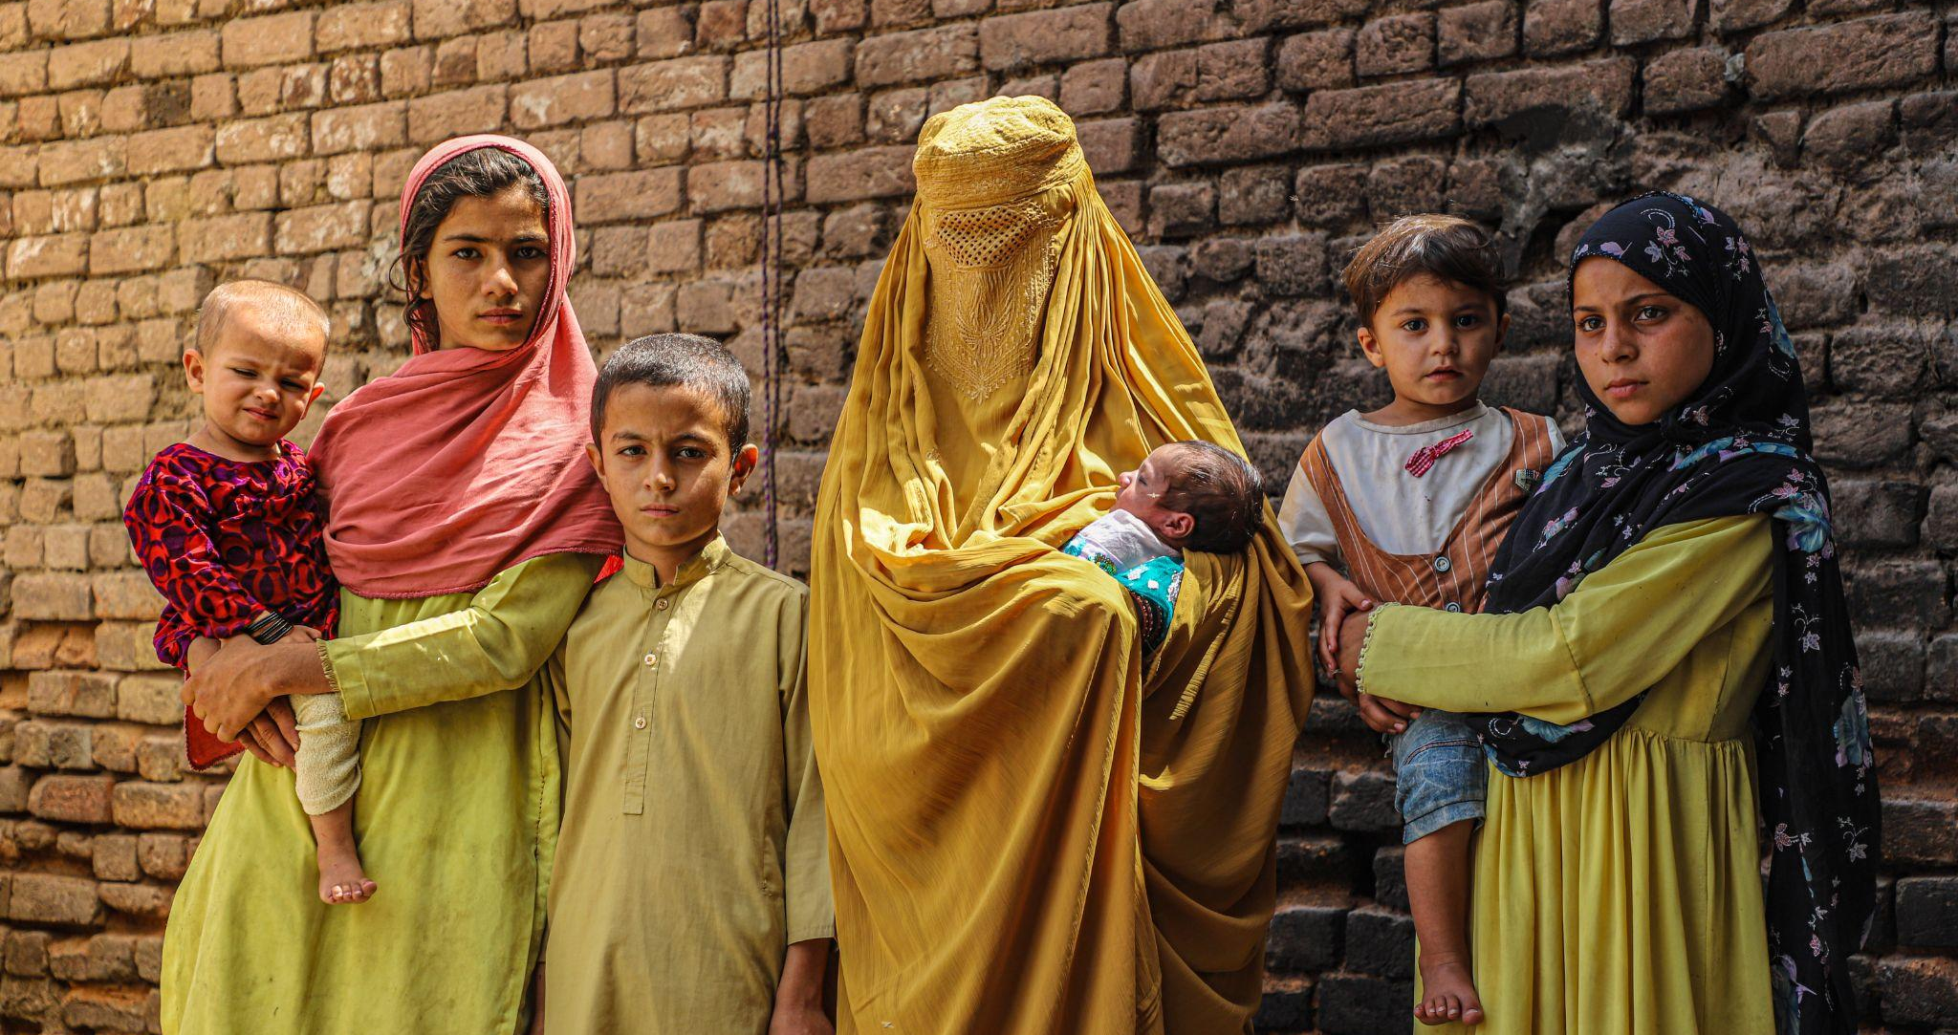

Together, we can make an impact for future generations.

Slide 7


