Slide 1
26
Pray alongside International Nepal Fellowship, a PWS&D partner in Nepal:
Dear Lord, we thank you for the remarkable growth and expansion of INF Nepal’s initiatives. We are deeply grateful for the increasing number of dedicated staff who serve with compassion and commitment. May you strengthen and guide them as they continue their work.
We lift up in prayer all those tirelessly working in the field, providing humanitarian aid and support to those in need. Bless them with wisdom, resilience and protection as they serve.
1/2

Slide 2
26
Lord, we ask for your hand over all project implementation efforts. May they be carried out with excellence, efficiency and a deep impact, reaching those who need them most. We also pray for food security programs and agricultural development projects —may they continue to grow, ensuring sustainability and nourishment for communities in need.
In your grace, may these efforts flourish and bring hope and transformation.
Amen.
Written and translated from Nepali by International Nepal Fellowship.
2/2

Slide 4
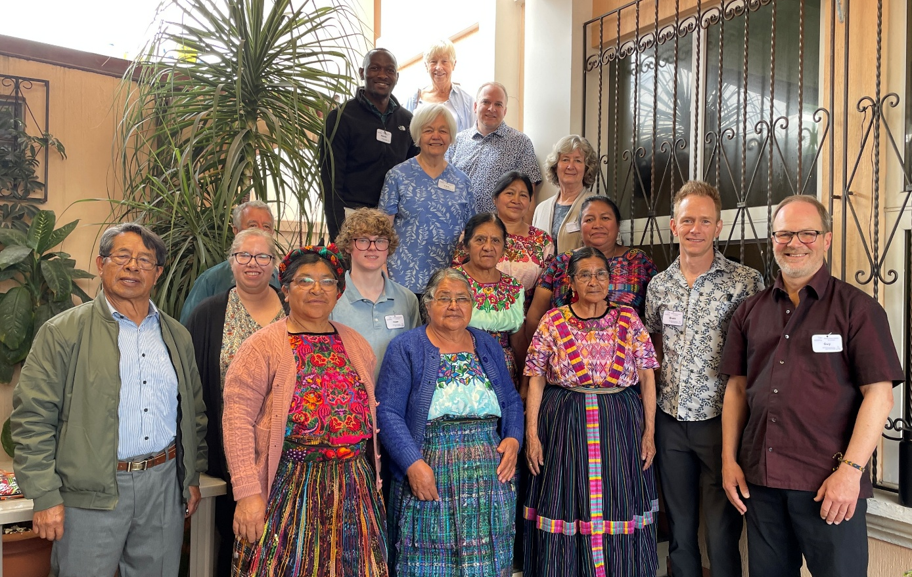
27
Pray alongside Fraternidad de Presbiteriales Mayas,
a PWS&D partner in Guatemala:
Lord Jesus, on this day we
approach you, thanking you
for the life of the PWS&D team.
Grant them wisdom in their
work. We place them in your
hands.
Written by Fraternidad de Presbiteriales Mayas.

Slide 6
28
God be in my head and in my understanding;
God be in my eyes and in my looking;
God be in my mouth and in my speaking;
God be in my heart and in my thinking;
God be at my end and at my departing.
Amen.
Written by R. Pynson. From The Book of Praise. Public Domain.

Slide 8
29
Pray alongside Garu Community Based Rehabilitation Centre, a PWS&D partner in Ghana:
Almighty God, we approach your throne of grace,
lifting up our supplications for all Canadian Presbyterian congregations who generously contribute resources to support the work of PWS&D in Ghana and many parts of the world.
1/2

Slide 9
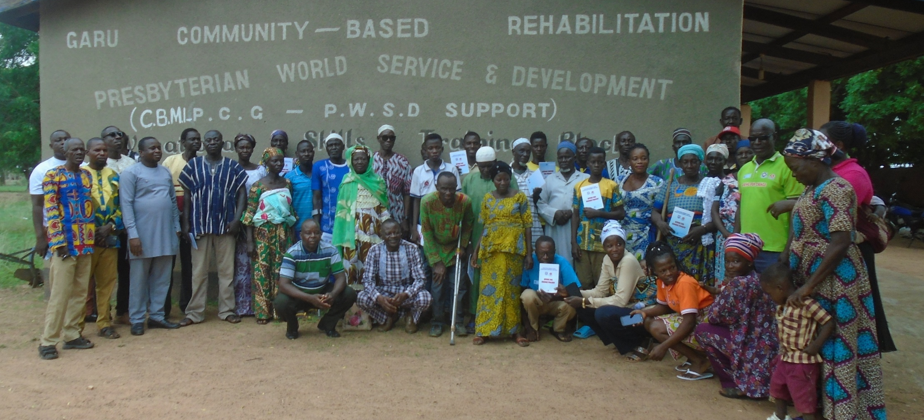
29
We pray for blessings for the leadership and members of these congregations as they continue to support the humanitarian services of PWS&D across the world. Amen.
Written by Garu Community Based Rehabilitation Centre of the Presbyterian Church of Ghana.
2/2

Slide 11
30
Pray alongside Mulanje Mission Hospital,
a PWS&D partner in Malawi:
Dear Lord, we thank you for providing us with the necessary resources for successful projects under PWS&D.
In Jesus’ name,
Amen.
Written and translated from Chichewa by Mulanje Mission Hospital.

Slide 13
31
Loving God, we give thanks for the work of your champions— for those sharing your love and mercy around the world. Thank you for all of your blessings, and for those who are doing the work of your kingdom here on Earth.
Amen.
Written by Thomas Hillier and Victoria Banfield, PWS&D Champions at St. Andrew’s Presbyterian Church in Markham, Ont.
2/2

Slide 15
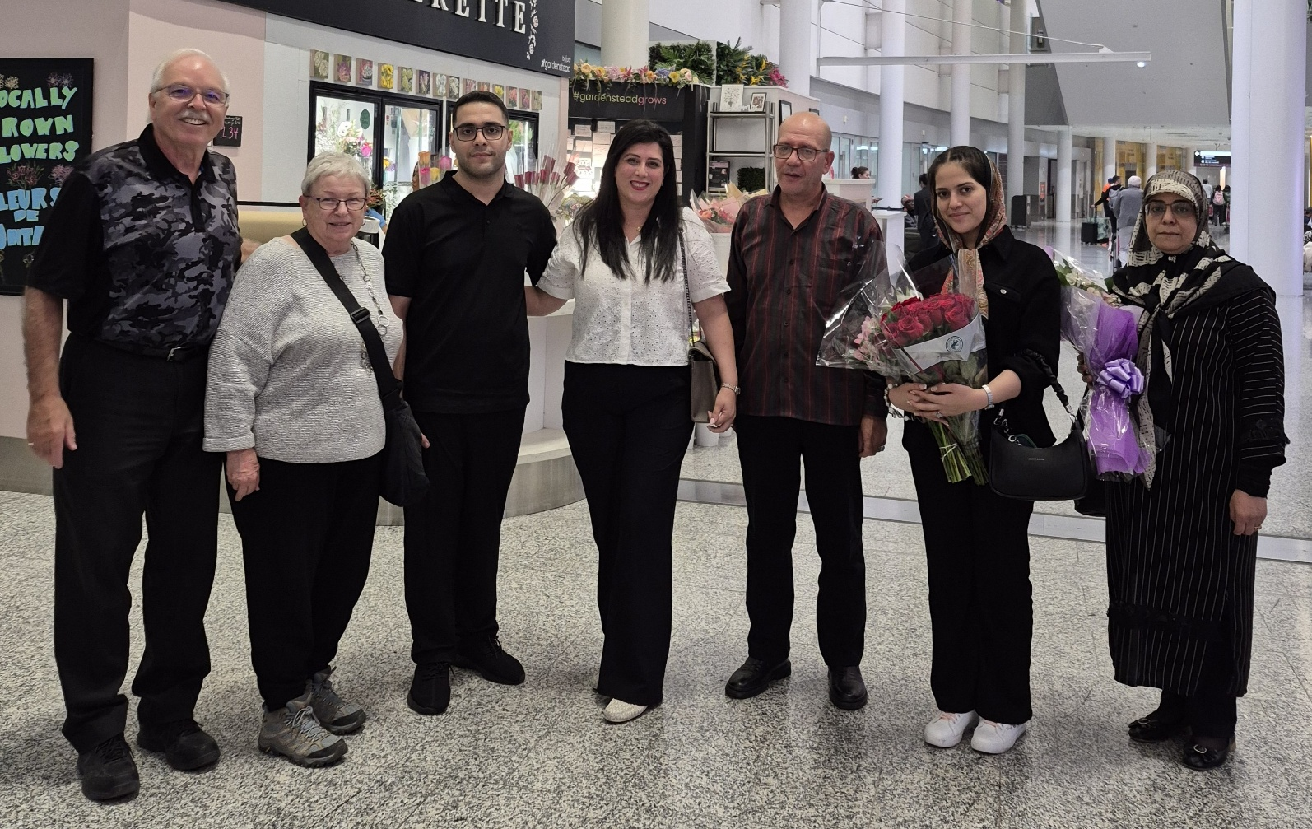
32
We pray for PWS&D’s refugee sponsorship program. All-knowing God, help congregations, presbyteries and groups welcome to Canada those escaping conflict, poverty and persecution. May those who have been displaced feel your love. Amen.

Slide 17
33
Pray alongside PWS&D’s partner in Pakistan:
We humbly pray to you, O God, for a world filled with peace, safety and prosperity. May every underprivileged and impoverished community across the globe gain access to their fundamental rights with dignity and respect. We seek blessings for all organizations dedicated to human welfare and progress, especially Presbyterian World Service & Development, which is empowering us through education.

Slide 18
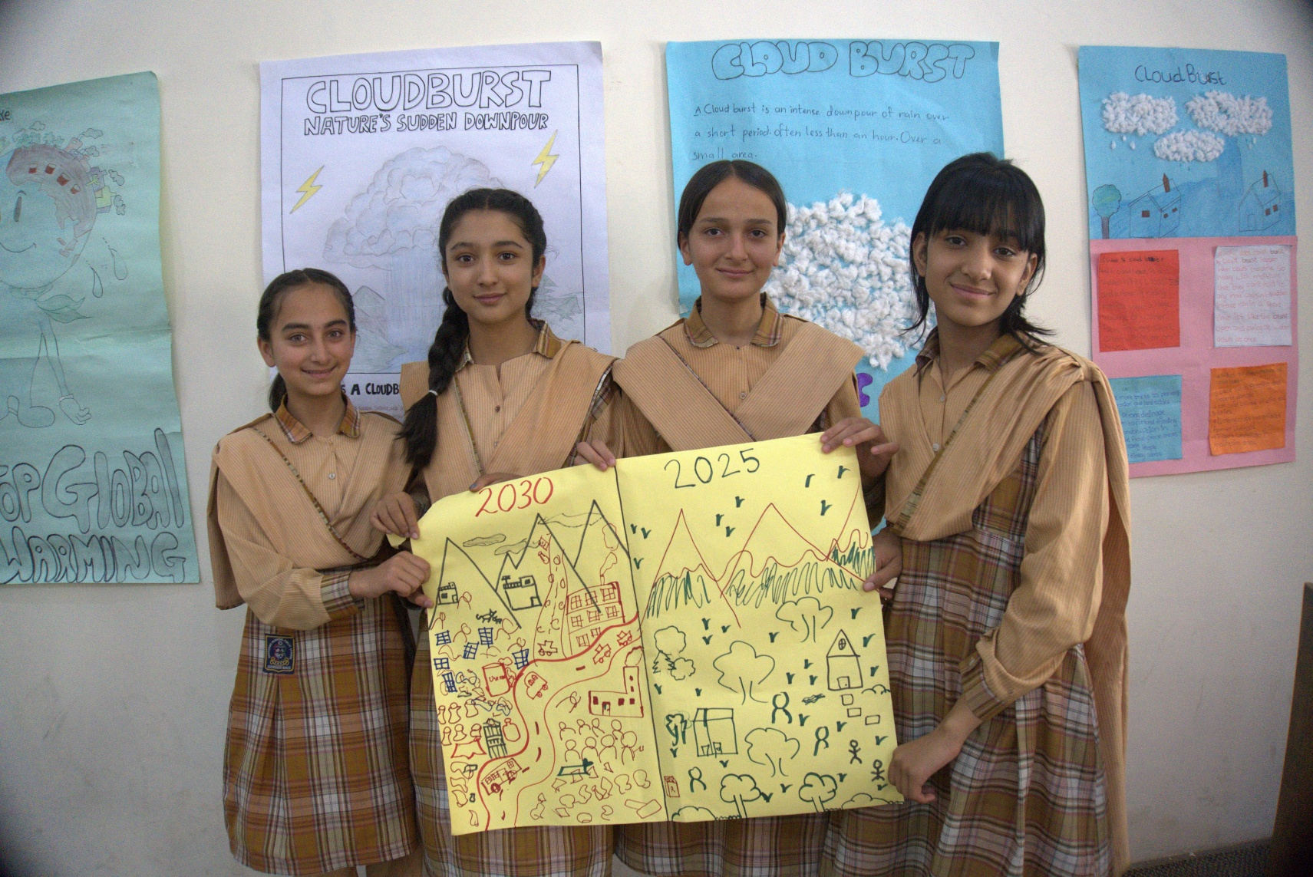
33
May they continue to grow and flourish, always extending their support to those in need. May their efforts foster development, equality and lasting peace across the world. Amen.
Written and translated from Sindhi by staff members of PWS&D’s partner in Pakistan.

Slide 20
34
God,
empty me of all that stands between
you and me
that I might be filled with
your imagination, desire, love and will.
Help me to be an effective instrument
of all that you intend.
Amen.
Written by Kerry A. Robinson. From Imagining Abundance. Reprinted with permission.

Slide 22
35
Eternal God, the whole world is full of your glory.
We bear witness to the anguish of creation
in this time of the climate crisis.
In your grace, grant us the opportunity to do good.
Lord have mercy.
Christ have mercy.
1/3

Slide 23
35
Jesus Christ, you have walked the Earth and lived in our midst.
Make us sensitive to the suffering of humankind
and the entire creation.
Strengthen us in our endeavors to create a life of dignity,
in justice, and solidarity with those who live and will live.
Lord have mercy.
Christ have mercy.
2/3

Slide 24
35
Holy Spirit, power of courage and self-control,
you speak to our consciences.
Comfort us when we suffer and are plagued by anxiety.
Make us worry when we are numb in the calmness of complacency.
Re-create us to become what we are:
one humanity under the same sky.
Lord have mercy.
Christ have mercy.
From the Season of Creation Celebration Guide 2024.
3/3

Slide 26
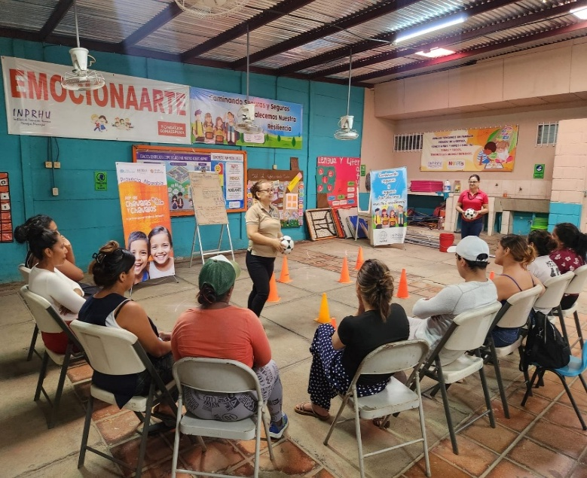
36
We pray for people in Nicaragua who, with PWS&D’s support, are learning how to prevent and address gender-based violence. Bless and guide the staff of PWS&D’s partner INPRHU as they carry out this work. Amen.

Slide 28
37
Pray alongside SOLDEV, a PWS&D partner in Malawi:
Our gracious heavenly Father, thank you for our lives, and the many blessings you have given us. We commit into your hands the PWS&D project in Malawi that is working to address the root causes of poverty and hunger—and especially the many lives this project is touching.
1/2

Slide 29
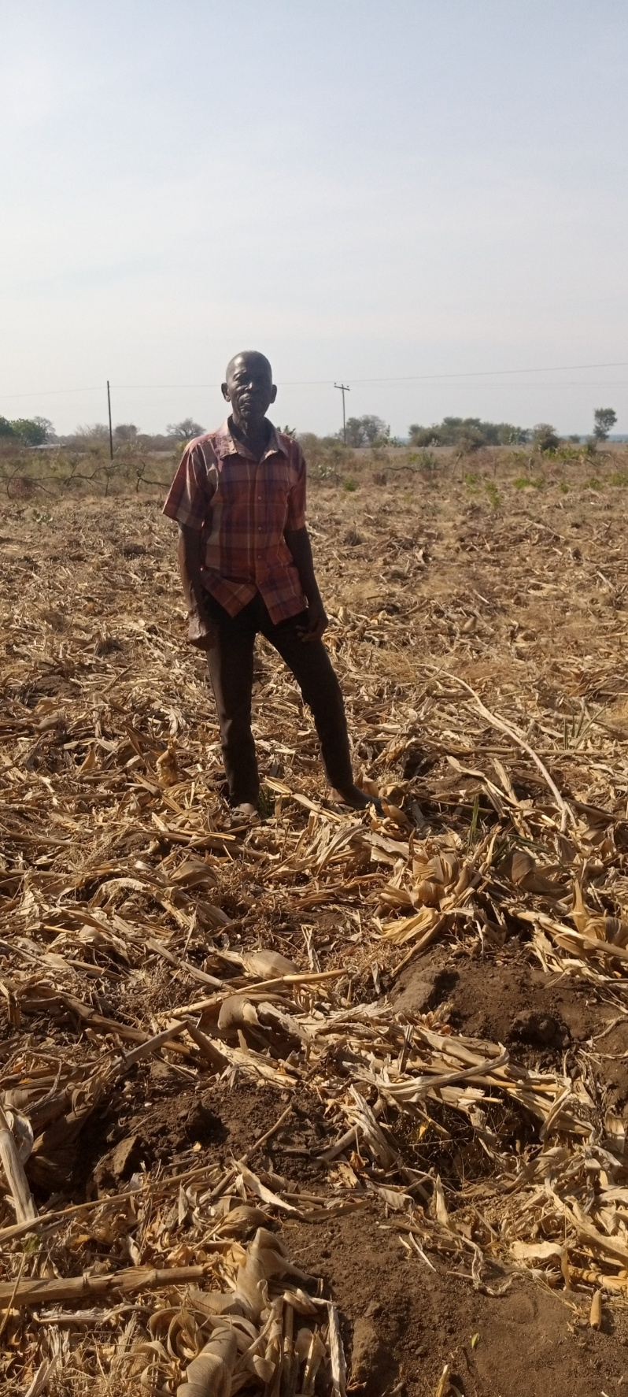
37
Your Word says to give thanks in every situation.
We thank you, Lord.
In Jesus’ name,
Amen.
Written by SOLDEV.
2/2

Slide 31
38
O God, loving Source of all that is, we worship and adore you, by the grace of the Holy Spirit among us. We confess that we have not always thought of the needs of others, especially those far away from us geographically, although their needs may far exceed our own. We ask your forgiveness for our selfishness and thank you for loving us in spite of it.

Slide 32
38
We thank you for the means to help others, especially those who are in great need. We think of those in areas of conflict and where natural disasters have upended people’s lives. We thank you for PWS&D and its work throughout the world, and we pray for our partners in these places of special need.
We pray all these things in the name of Jesus. Amen.
Written by Nora Martin, PWS&D Champion at Knox Presbyterian Church in Woodstock, Ont.

Slide 34
39
Pray alongside Mulanje Mission Hospital, a PWS&D partner in Malawi:
Heavenly Father, we thank you for a wonderful partnership between Mulanje Mission Hospital (MMH) and PWS&D. God, we appreciate the support that PWS&D is giving to orphans and vulnerable children in the catchment area of MMH to improve lives of these children. Heavenly Father, continue blessing the PWS&D team for such a wonderful giving hand towards orphans and vulnerable children.
In Jesus’ name, we pray. Amen.

Slide 36
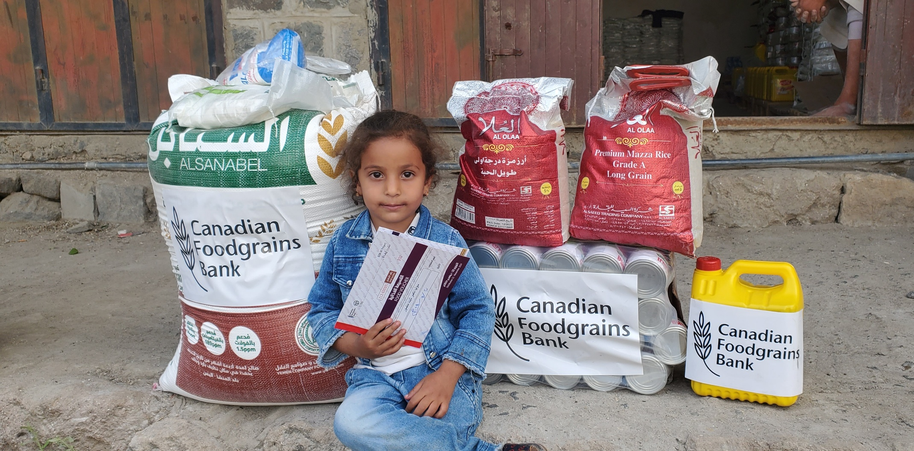
40
God of grace, we pray for PWS&D partners as they work to provide assistance and emotional counselling to people around the world who have lost their homes, family members and livelihoods due to disaster or conflict.
Amen.

Slide 38
41
Loving God, even the sparrow has found a home, and the swallow a nest for herself, where she places her young near your altar. You are attentive to all you have made.
God, who listens to every living thing,
Help us listen as you do.
Loving God, help us provide refuge to every animal and plant with whom we live. Help us be attentive to all you have made.
God, in whom all creation subsists,
Help us listen as you do.
1/4

Slide 39
41
Loving God, when Jesus cried out and gave up his Spirit,
the earth shook and the rocks split.
You are known by the whole of creation that listens to you.
God, to whom all creation responds,
Help us respond to you.
Loving God, help us hear and know you
just as the earth and rocks do.
Help us to learn from the way in which we see creation recognize your glorious beauty.
God, to whom all creation responds,
Help us respond to you.
2/4

Slide 40
41
Loving God, you are present in your creation and seek to heal her wounds. You can be found walking in the garden. Open our eyes to see you, the gardener.
God, who is present with your creation,
Help us be present too.
Loving God, we often abandon your creation and cause its wounds. Help us to follow in your footsteps and learn to walk in the garden like you.
God, who is present with your creation,
Help us be present too.
3/4

Slide 41
41
Loving God, who hears every voice, knows each cry of injustice, and is attentive to the suffering of the earth: teach us to listen. Bring healing to our lives, that we may protect the world and not prey on it, that we may listen to the world you have created and not close ourselves off from it. Reveal to us the ways in which we have failed to hear your voice in how we treat the earth.
God, who listens to every living thing,
Help us listen as you do.
Amen.
From the Season of Creation Celebration Guide 2022.
4/4

Slide 43
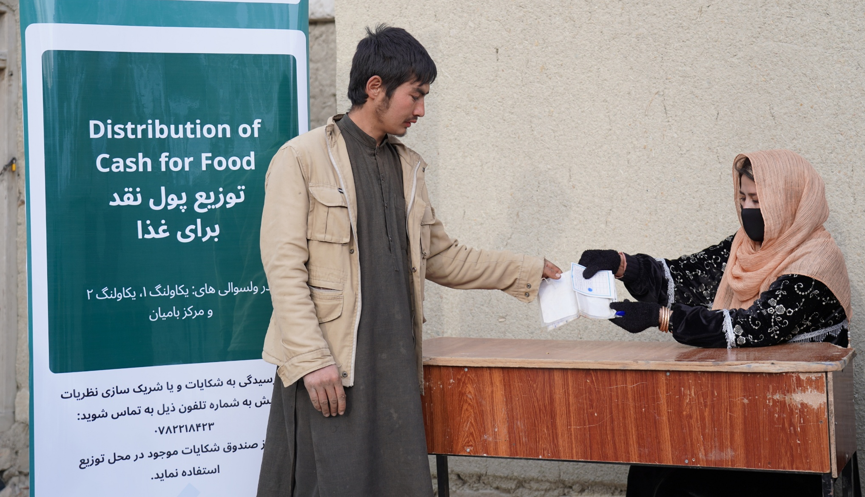
42
O God, we lift Afghanistan in our prayers as millions face severe food insecurity. May PWS&D’s food assistance project provide vital support to those most affected. Amen.

Slide 45
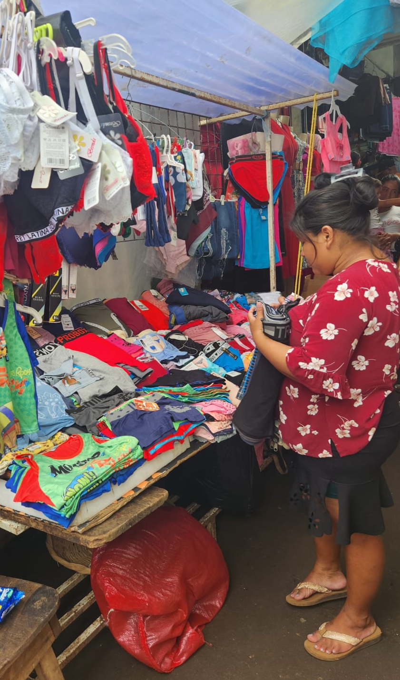
43
Great provider, thank you for the hope felt by people who are receiving education, skills training and small business opportunities through PWS&D’s livelihoods programs. We entrust the continued financial stability of program participants into your hands, as they work to grow their livelihoods and become more resilient against cycles of poverty.
Amen.

Slide 47
44
Pray alongside Church of North India-Synodical Board of Social Services, a PWS&D partner in India:
Dear Lord,
We pray for blessing upon young people who work alongside the CNI SBSS team. We pray that you will nurture them. May they be motivated to serve for the good of the community.
We pray that you would provide opportunities for young people to develop their skills and live up to their full potential.
1/2

Slide 48
44
We pray that you will raise up good leaders from among them, who will lead with wisdom, courage and integrity. May their voices be heard and valued, as they advocate for justice, peace and progress.
In your mercy,
hear our prayers. Amen.
Written by Church of North India-Synodical Board of Social Services.
2/2

Slide 50
45
Gracious God,
The harvest is plentiful but the workers are few.
Thank you for sending your people to plant seeds and that you continue to grow them.
We pray for students across the world. Whichever season they are in, we pray that you may still their hearts and minds to pursue wisdom and knowledge for the glory of your kingdom. We pray that you equip students to be the next generation of leaders and that they know that you are a loving God.
1/2

Slide 51
45
Gracious God, you are great and you are good. You are loving and almighty. We pray that you bless students and work in them in the days to come. Honour, power and glory all belong to you. In the mighty and matchless name of Jesus, we pray.
Amen.
Written by Joseph Ragbir, PWS&D Champion at Montreal School of Theology.
2/2

Slide 53
46
Pray alongside the Duncan Hospital, a PWS&D partner in India:
Gracious and Faithful God,
We thank you for your abundant blessings
and for the hands you have joined together in service.
With grateful hearts, we lift up PWS&D and all our partners
who walk alongside the Duncan Hospital,
enabling us to serve the poor, the sick
and the marginalized in Bihar.
1/3

Slide 54
46
Lord, through their generosity and support,
we are strengthened to bring healing to the suffering,
empowerment to the vulnerable,
and hope to those in despair.
May every act of care, every word of kindness,
and every touch of compassion reflect your love and grace.
As we labour together,
let our service be a testimony to your goodness.
2/3

Slide 55
46
May all we do glorify your name,
so that through us, many may see your light
and know your unfailing love.
Unite us in purpose, sustain us in our mission
and bless this partnership for the flourishing of your people.
In Jesus’ name, we pray.
Amen.
Written by The Duncan Hospital.
3/3

Slide 57
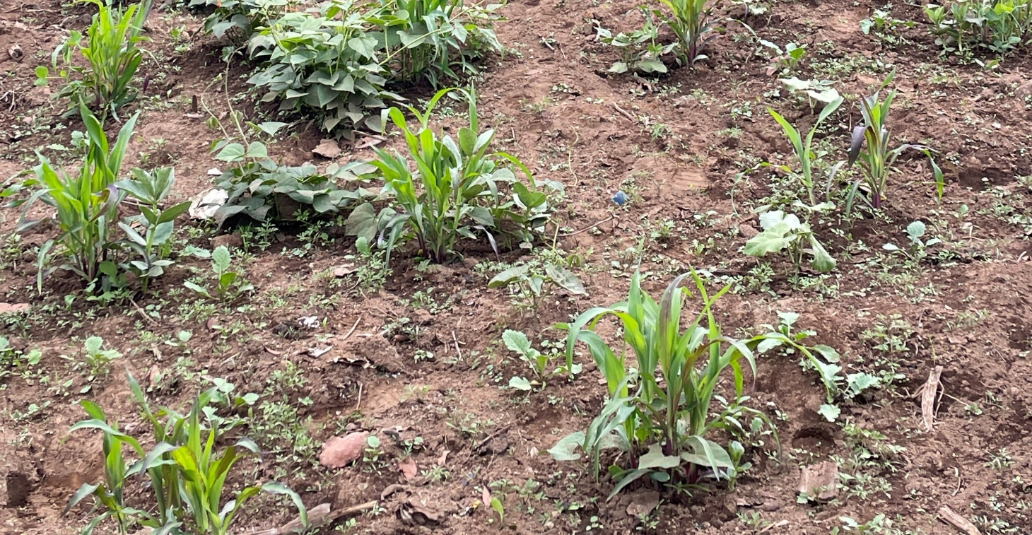
47
God of creation, we give thanks for PWS&D partners teaching conservation agriculture, which is helping farmers protect and revitalize life-giving soil and cultivate plentiful harvests.
Bless their yields to help break the cycle of poverty.
Amen.

Slide 59
48
O God of love, true source of peace,
make wars throughout the world to cease;
the wrath of sinful hearts restrain:
give peace, O God, give peace again.
Remember, Lord, your works of old,
the wonders that our forebears told;
remember not our sin’s deep stain:
give peace, O God, give peace again.
1/2

Slide 60
48
Whom shall we trust but you, O God?
Where rest but on your faithful word?
None ever called on you in vain:
give peace, O God, give peace again.
Where saints and angels dwell above,
all hearts are knit in holy love;
oh bind us in that heavenly chain:
give peace, O God, give peace again.
Written by Henry Williams Baker. From The Book of Praise. Public Domain.
2/2

Slide 62
49
Loving God, we are grateful for the programs of PWS&D throughout the world, and the partners through which they are carried out.
Thank you for the support of the many congregations across the country. It is a blessing that we can come together as one and make an impact.
Amen.
Written by Barbara Waine, PWS&D Champion at St. Andrew’s Presbyterian Church in Nanaimo, BC.

Slide 64
50
Pray alongside Ekwendeni Hospital AIDS Programme, Synod of Livingstonia, a PWS&D partner in Malawi:
Gracious and loving God, we pray for a world where peace prevails, where hunger is eradicated and where the rights of all are respected. May your boundless love bring strength to all. May justice be the foundation of our societies and compassion the guiding principle of our actions.
Amen.
Written and translated from Tumbuka by Ekwendeni Hospital Aids Programme, Synod of Livingstonia.

