Slide 1



Join us in the fight against food insecurity!
September 26, 2026
WeRespond.ca/journeyforhope

Slide 2
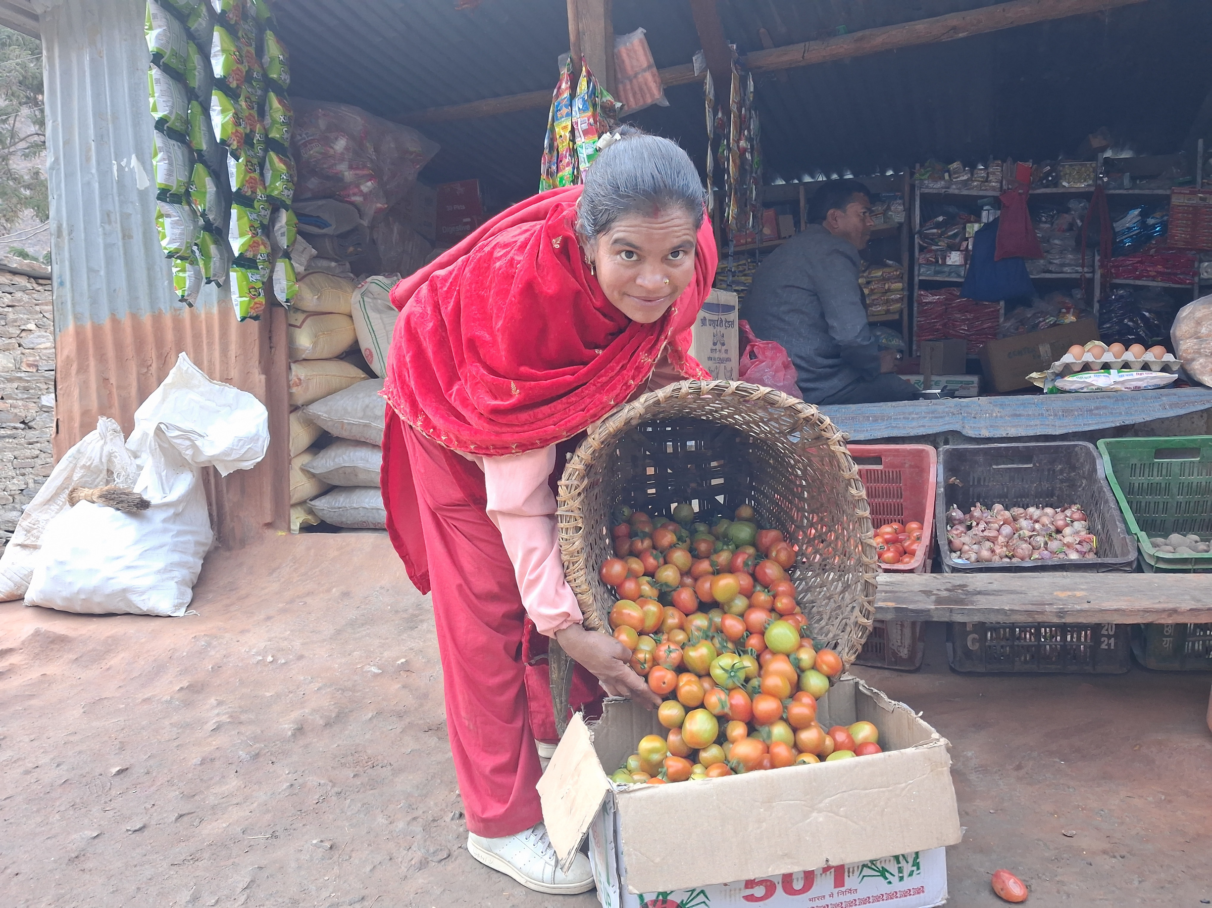

Will you join us?
September 26, 2026
WeRespond.ca/journeyforhope

Slide 3
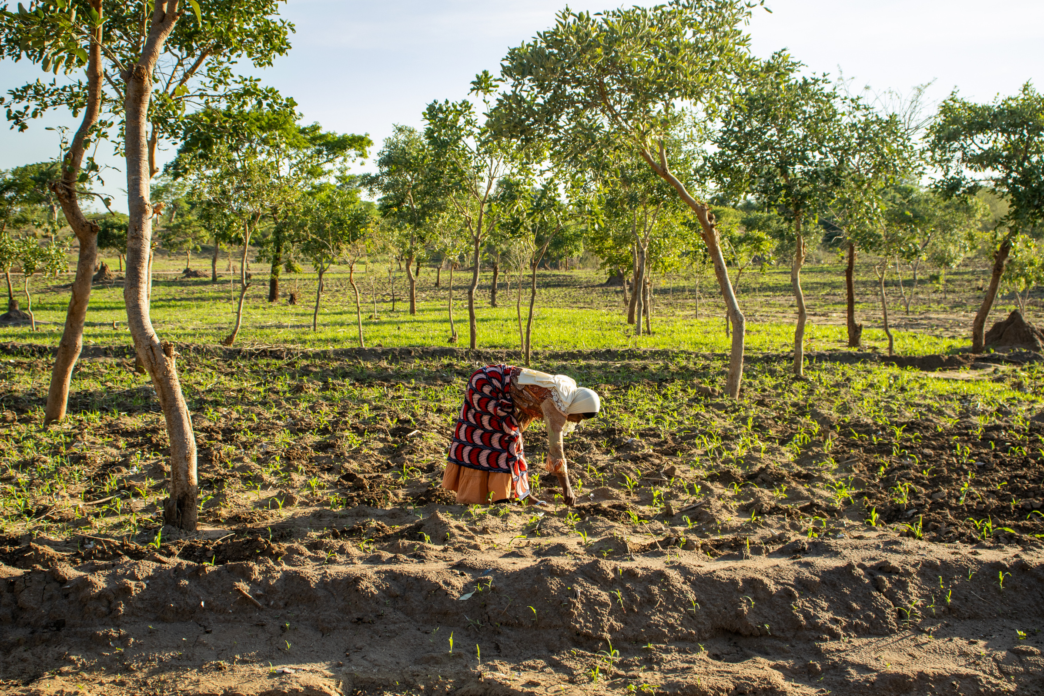
STEP UP FOR FOOD SECURITY
Join Journey for Hope!
September 26, 2026
WeRespond.ca/journeyforhope

