Slide 1
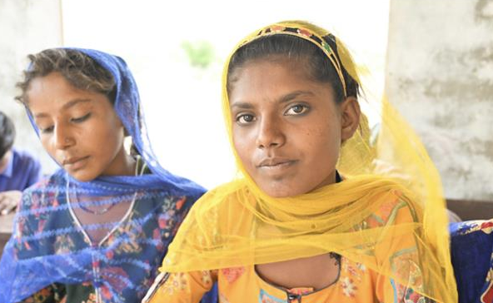
This International Women’s Day, we celebrate the theme: "For ALL women and girls: Rights. Equality. Empowerment." Every woman and girl deserves freedom to dream, thrive and lead—no exceptions. Through PWS&D programs, we are working to break barriers and build a more inclusive world.
Learn more: WeRespond.ca/International-Womens-Day-2025

