Slide 1
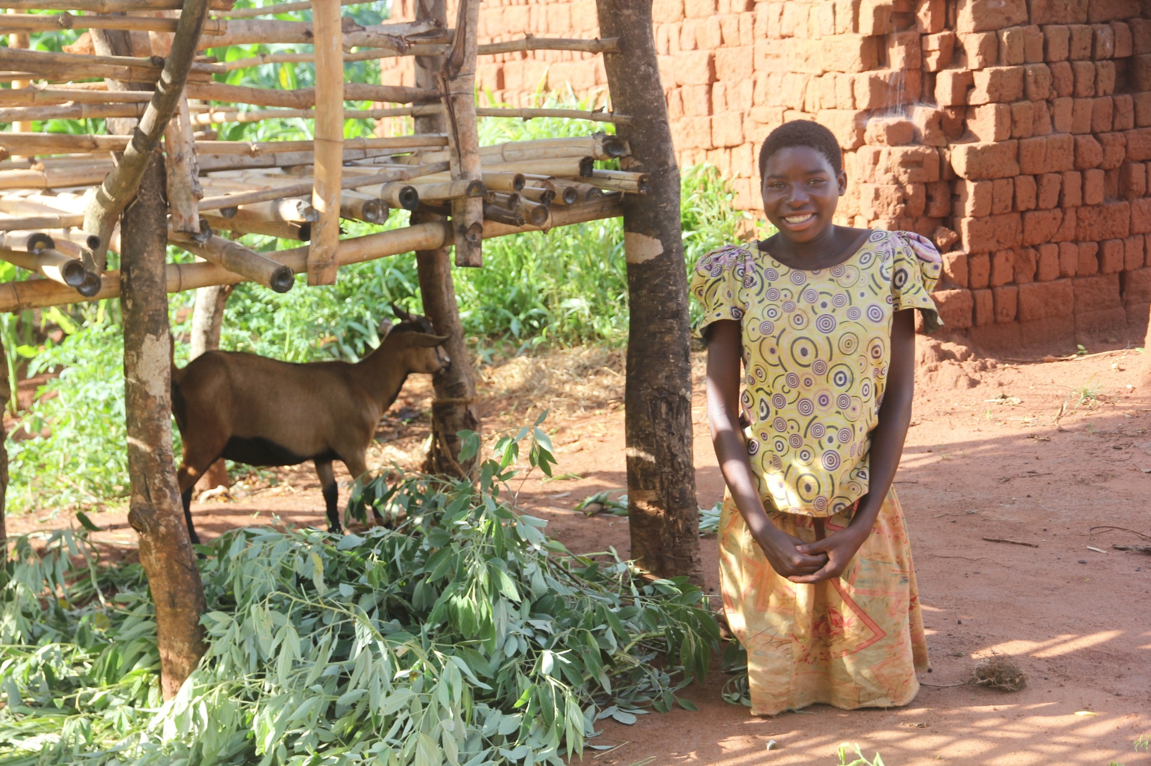
51
Loving God, we celebrate in prayer the life skills training that orphans and vulnerable children are accessing, with the support of PWS&D, so that they may achieve their dreams and goals. Lord, you are to be praised. Amen.

Slide 3
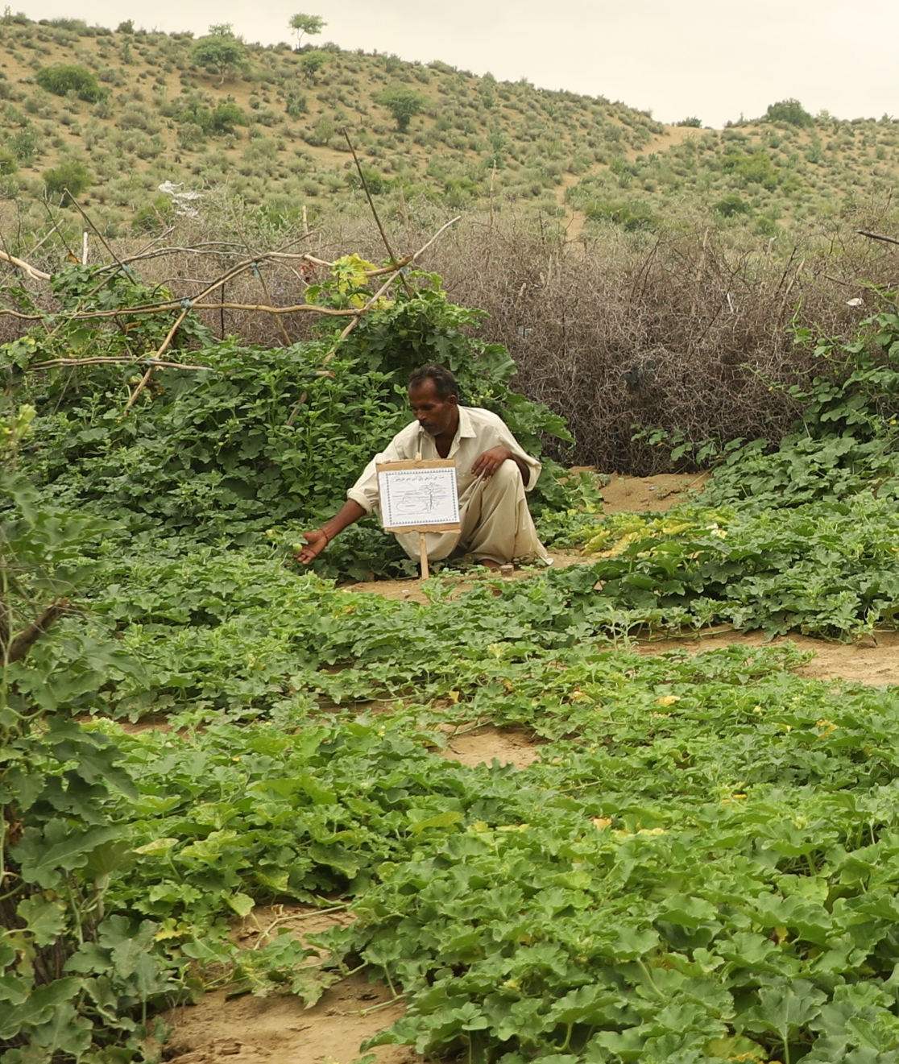
52
We pray, O God, for farmers in Pakistan who work tirelessly to replenish their land as volatile weather due to climate change continues season after season. Would you help them as they seek to provide for the needs of their families. Strengthen their communities, as well, we pray. Amen.

Slide 5
53
Pray alongside International Nepal Fellowship, a PWS&D partner in Nepal:
Dear Heavenly Father,
We come before you with grateful hearts, lifting up all the staff serving in INF Nepal. We pray for their health, strength and well-being as they dedicate themselves to this mission.
We also seek your wisdom and guidance for our leadership team and extend our prayers for our funding partners, whose unwavering support and prayers sustain this work.
1/2

Slide 6
53
Lord, may your abundant blessings be upon this mission, guiding us as we serve the people of Nepal with love, compassion and dedication.
In Jesus’ name, we pray.
Amen.
Written and translated by International Nepal Fellowship.
2/2

Slide 8
54
Come, let us worship God,
who gifted us with life and creation to sustain life.
We praise God for the wondrous creation.
Come, let us follow the Lord Jesus Christ,
who inspires us to hope and act for justice and righteousness.
We give glory to God, who restores the groaning creation and the marginalized.
1/3

Slide 9
54
Come, let us move with the Holy Spirit,
striving to establish justice and produce the first fruits of hope.
We praise God for the abundant life that is assured to all creation.
Heavenly Triune God and Creator of all,
we gather here, made in the image of the Creator,
Who created in love.
2/3

Slide 10
54
We gather in the name of the Redeemer,
our Saviour Jesus Christ,
Who reconciles all of creation.
We gather in the presence of the Life Giver, your Holy Spirit,
Who inspires new life and instills hope.
Call to Worship written by the World Council of Churches. From the Season of Creation Celebration Guide 2024.
3/3

Slide 12
55
Pray alongside the Duncan Hospital, a PWS&D partner
in India:
Righteous and compassionate God,
You created every woman and girl
with dignity, strength and purpose.
Yet many face discrimination, hardship and injustice.
We lift up to you the women
served through the Karuna Project,
that they may find hope, healing and opportunity.
Bless the hands that teach, train and uplift them.
1/2

Slide 13
55
May they be empowered with education, skills and confidence
to break barriers and build a future of equality and justice.
Be their shield in times of fear, their comfort in sorrow
and their guide toward a life of dignity and purpose.
Lord, let your light shine through this work,
bringing transformation, strength and lasting change.
May the Karuna Project continue to be a beacon of your love,
where every girl and woman knows her worth
and walks in freedom.
Amen.
Written by the Duncan Hospital
2/2

Slide 15
56
God of all creation, we praise you for the beauty and abundance of your world. Yet, we know that many in this world do not have access to material abundance. And so, we give you thanks for the response of PWS&D and their partners as they work to bring about equitable and just livelihoods for all.
We pray for those working on projects to support sustainable agriculture and build resilience to climate change.
1/2

Slide 16
56
May their efforts be blessed and bear much fruit; may communities in countries such as Malawi, Guatemala and Pakistan attain the food security that is so necessary for an abundant life.
Inspire us, we pray, to support PWS&D as they work to show God’s love in the world. Amen.
Written by Grant and Femmy Birks, PWS&D Champions at Knox Presbyterian Church in Waterloo, Ont.
2/2

Slide 18
57
Pray alongside Women for Peace and Democracy, a PWS&D partner in Nepal:
Dear Lord, we thank you for blessing us with the ability to serve and uplift women and the marginalized. Grant us the courage to continue this mission with wisdom and compassion. May your divine energy continue to guide our efforts, remove obstacles and bring light to every life we touch.
Written by Shobha Shrestha, Executive Chair of Women for Peace and Democracy.

Slide 20
58
Pray alongside C-NEW-C, a PWS&D partner in Haiti:
Heavenly Father,
We thank you for all the good things you do for us. We thank you for the opportunity to help many pregnant women and new mothers in Haiti. We ask you to bless all the efforts made in this project and make it exceed our expectations. We ask you to guide everyone involved in this project to act with wisdom, love and dedication.
1/3

Slide 21
58
Lord, we especially pray for pregnant women who are facing great challenges. We ask you to protect them throughout their pregnancies, giving them health and strength to face any difficulties that may arise. We pray that the PWS&D project would help them access the necessary medical care, nutrition education and emotional support that will help them overcome any physical, social or economic barriers.
We ask you to help the women involved in the project feel your love, which will give them courage to continue forward despite their challenges.
2/3

Slide 22
58
We also pray for you to bless their children, so that they may be born healthy and grow up in an environment full of love and care.
We are amazed by your power, Lord, and we place all that we do in this project into your hands. You are the source, and only you can bring real success. May this project surprise all those working with you in it.
In Jesus Christ’s name we pray,
Amen.
Written and translated from Haitian Creole by C-NEW-C.
3/3

Slide 24
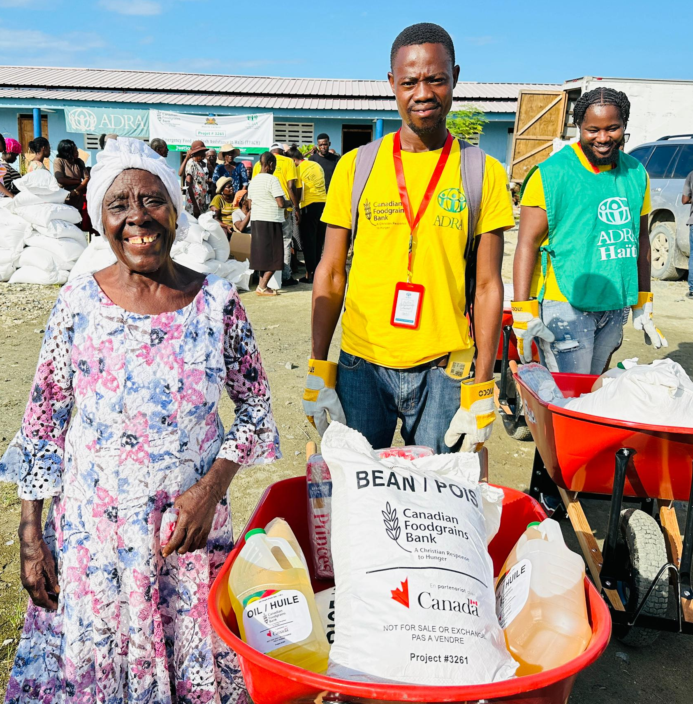
59
We pray for the millions of people facing emergency levels of hunger and for PWS&D and our partners responding to this critical situation. Amen.

Slide 26
60
God of justice and peace, we pray for our world, where governments often promote their agendas through violence, causing suffering for so many. We give thanks for organizations that work to bring comfort and aid.
We pray for safety for their workers and the success
of their programs.
Your kingdom come. Amen.
Written by Robert Griffiths, PWS&D committee member and PWS&D Champion at Hartsville Presbyterian Church in Kinkora, PE.

Slide 28
61
Teach us, good Lord,
to serve you as you deserve;
to give and not to count the cost;
to fight and not to heed the wounds;
to toil and not to seek for rest;
to labour and not to ask for any reward,
except for that of knowing that we do your will;
through Jesus Christ our Lord. Amen.
Written by Ignatius of Loyola. From The Book of Praise. Public Domain.

Slide 30
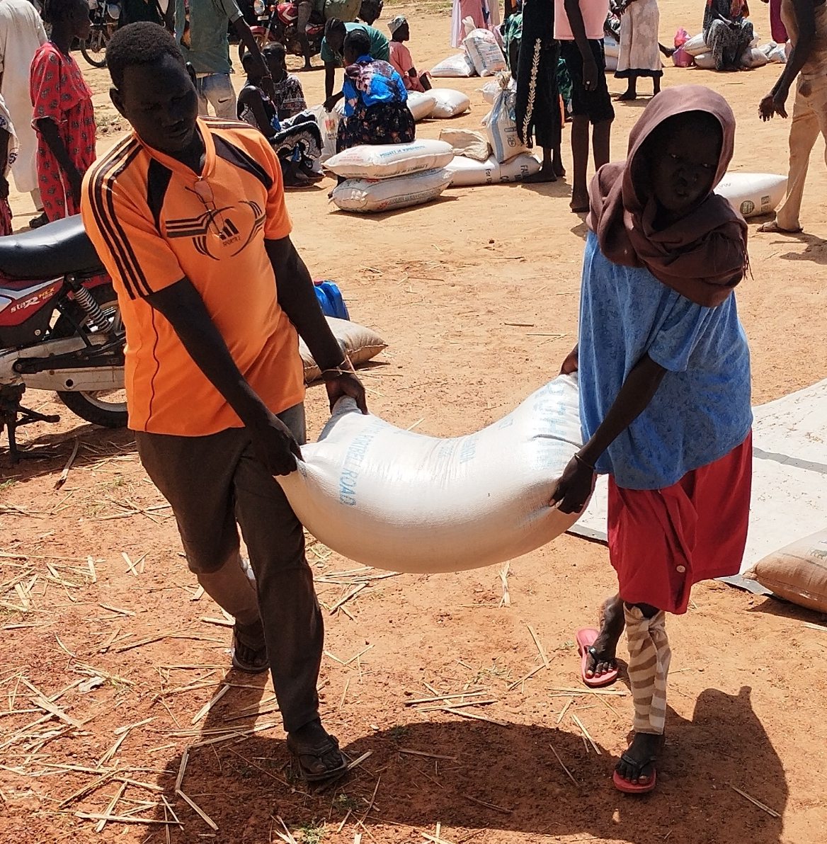
62
Dear God, we pray for internally displaced people in South Sudan, who are receiving emergency food aid to help meet their basic needs. Amen.

Slide 32
63
Pray alongside International Nepal Fellowship, a PWS&D partner in Nepal:
Heavenly Father,
We are grateful for your unwavering love and kindness. Thank you for the gift of our community and the lives of its people. We lift up the self-help groups in prayer,
asking for your blessing upon them. May they achieve economic stability and bring lasting benefits to their families and communities.
1/2

Slide 33
63
Lord, we also pray for the farmers involved in self-help groups, that they may continue to flourish. Grant them access to the resources, wisdom and support that they need to thrive. May they build strong, self-reliant communities, prepared to overcome challenges and create a future of sustainability and hope.
Amen.
Written and translated from Nepali by International Nepal Fellowship.
2/2

Slide 35
64
Loving God, we celebrate PWS&D-supported safe motherhood committees in Malawi which are teaching people about reproductive health and rights, as well as safe motherhood practices. With support from PWS&D, they help ensure women receive life-saving pre- and postnatal care. We are so grateful for the impact of these volunteers and entrust their work to you in prayer. Amen.

Slide 37
65
Pray alongside Church of North India-Synodical Board of Social Services, a PWS&D partner in India:
Dear Lord,
We come before you with hearts burdened for the many in India who are suffering from hunger and malnutrition, especially mothers and children.
You are the God who provides and sustains all life and yet so many are hungry and deprived of basic nourishment. Lord, we ask for your mercy and intervention.
1/2

Slide 38
65
We pray that you will provide for those who are hungry. Give them healthy and nutritious food and adequate care. Strengthen the mothers who sacrifice for their children and restore the health of the little ones whose bodies are fragile, for they are precious in your sight.
Bless the efforts of PWS&D and other organizations and individuals who are working tirelessly to combat hunger and improve health for marginalized communities.
In your mercy, hear our prayer. Amen.
Written by Church of North India-Synodical Board of Social Services.
2/2

Slide 40
67
Merciful God,
We give thanks for all that you have provided us. Help us to be good stewards of the earth and its resources. We pray for those who are suffering from the effects of climate change. May the work being done by PWS&D around the world bring hope and justice to those in need. Amen.
Written by Thomas Hillier and Victoria Banfield, PWS&D Champions at St. Andrew’s Presbyterian Church in Markham, Ont.

Slide 42
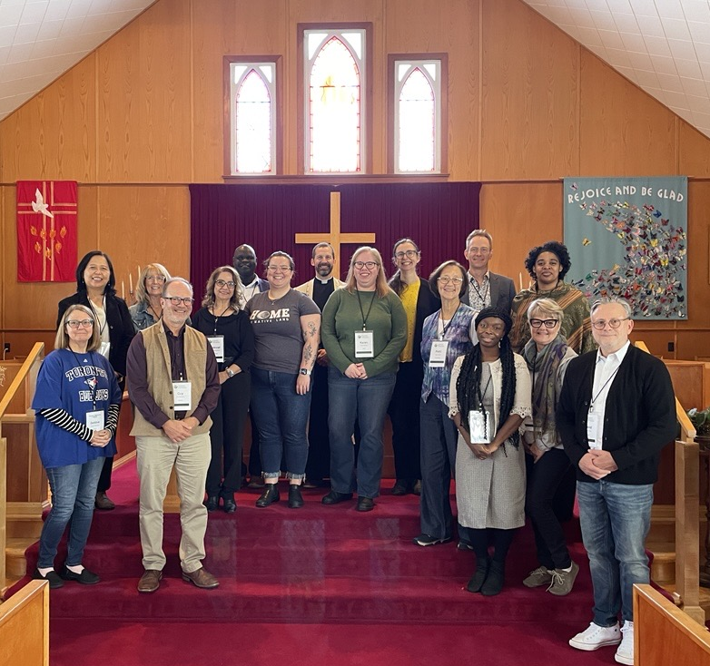
68
God of all wisdom and knowledge, we pray for your guidance of the PWS&D Committee.
Inspire its discussions and decisions,
leading to greater impact and support to those in need.
Amen.

Slide 44
69
God of the universe, we pray for all people with disabilities who are faced with the quagmire of poverty, discrimination and social exclusion across the world. We pray especially for those in Ghana who are receiving life-changing support through the Garu Community Based Rehabilitation Centre and ask that you bless and sustain them to your own glory. Amen.
Written by Garu Community Based Rehabilitation Centre of the Presbyterian Church of Ghana.

Slide 46
70
Loving God, we are thankful for the humanitarian assistance provided by PWS&D and its networks and coalitions working in Gaza. Be with the brave souls that work in mobile clinics to ease the pain and suffering, both physical and mental, of people affected by the increasingly dire conditions. Uphold the people of Gaza as they struggle simply to survive. May they feel your comforting hands. Amen.
Written by Patricia Polowick, PWS&D Champion at St. Andrew’s Presbyterian Church
in Saskatoon, Sask.
1/2

Slide 48
71
God,
You are the source of human dignity,
and it is in your image that we are created.
Pour out on us the spirit of love and compassion.
Enable us to reverence each person, to reach out to anyone in need,
to value and appreciate those who differ from us,
to share the resources of our nation,
to receive the gifts offered to us by people from other cultures.
1/2

Slide 49
71
Grant that we may always promote the justice and acceptance
that ensures lasting peace and racial harmony.
Help us to remember that we are one world and one family.
Amen.
Written by the World Council of Churches.
2/2

Slide 51
72
Source of all wisdom and knowledge,
we thank you for the tuition support that helps students at the Neno Girls Secondary School in Malawi achieve their dreams of continuing their education after primary school.
Amen.

Slide 53
73
God of all comfort, bring peace to our hearts,
guide our hands to be givers
and our feet to walk where you lead.
Open our eyes to see need close by and far away.
Sharpen our ears to hear spoken
and unspoken words of despair.
Stir our hearts to be throughways of your peace and love
to all whom our senses bring close.
Amen.
Written by Patricia Grainger, PWS&D Champion at St. Andrew’s Presbyterian Church in Kars, Ont.

Slide 55
74
O God,
We know that you hear the cause of those in need
and execute justice for the poor.
We pray for support for those who are marginalized,
and that you inspire us to work and advocate for
a more sustainable, compassionate and just world.
Amen.

Slide 57
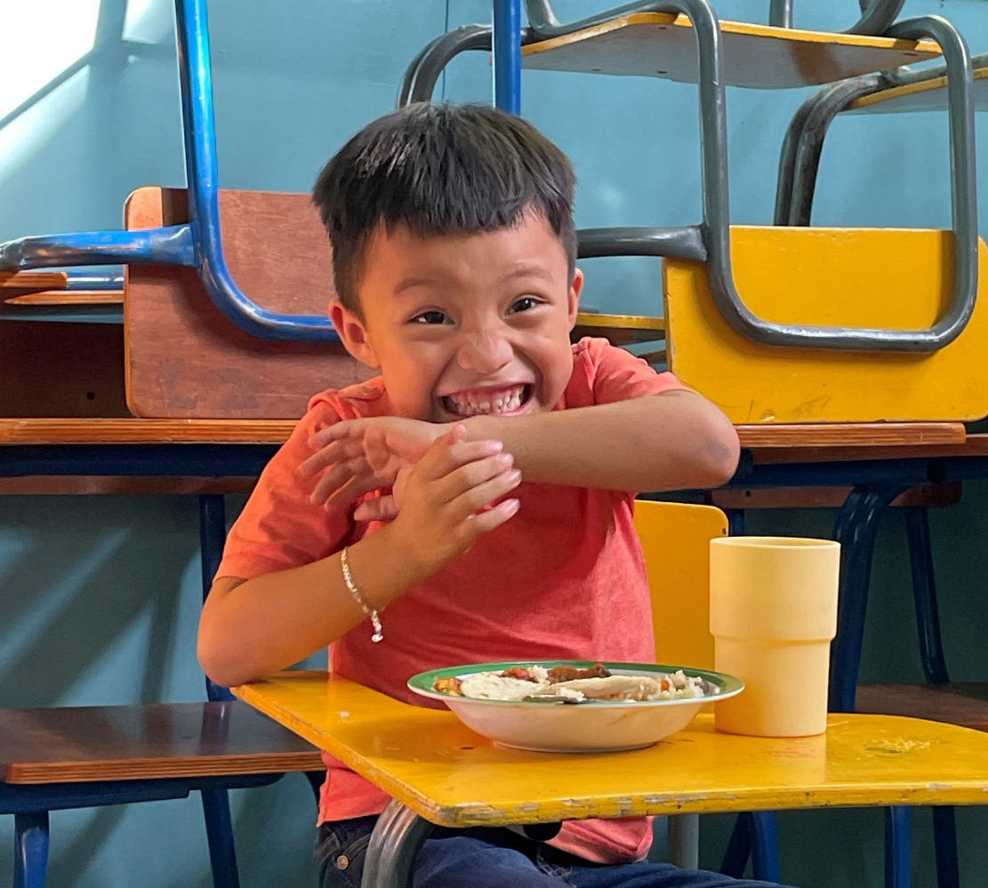
75
Your presence, Lord, is the sacred place where we find rest, strength, and instruction for our journey in this world.
May every person find a place in your house, O God, a place where they are dignified and valued with love.

Slide 58
75
May Jesus come to overturn the tables and unleash your prophetic voice so that the place of your presence may be honored.
As temples of your Spirit, purify us, O God, removing all corruption and returning us to sweet divine communion.
Amen.
Written by CEDEPCA, a PWS&D partner in Guatemala. From A Living Easter worship resource.

