Slide 1
1
Creator God,
We are thankful for all that you have given us, and for your many mercies. Make us worthy of your gifts and help us, through PWS&D and their partners and programs, to support those who need your tender loving care.
Amen.
Written by Thomas Hillier and Victoria Banfield, PWS&D Champions at St. Andrew’s Presbyterian Church in Markham, Ont.

Slide 3
2
God, when we think of your creation, we are amazed.
We can never come to the end of your wonders.
But you have entrusted us to take care of all these.
You have shown us how to sustain life.
Help us to use this knowledge for the good of the world,
To the benefit of your people and to the glory of your name.
Amen.
From the Canadian Foodgrains Bank’s 2025 World Food Day resource Until All Are Fed.

Slide 5
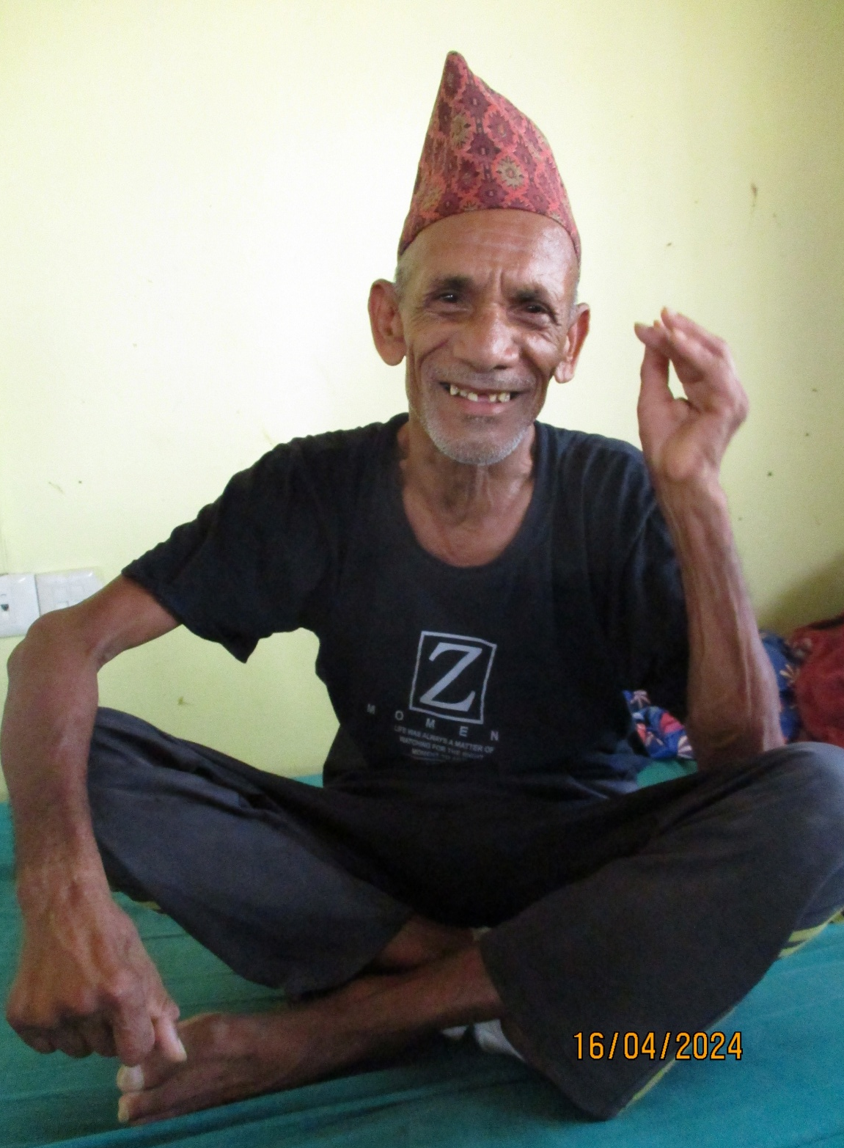
3
Healing God, hear our prayers for leprosy patients who visit PWS&D-supported clinics in Nepal. May they experience healing and feel the warmth of community, free from stigma and discrimination.
Amen.

Slide 7
4
Pray alongside AGAPE, a PWS&D partner in Nicaragua:
Lord, we come to you in gratitude for the freedom to worship that exists in our country. We pray for those we serve, that they may continue to be faithful to God in any circumstance or context.
Amen.
Written by Emily Reyes, Executive Director of AGAPE.

Slide 9
5
Compassionate God,
you see the struggles of the poor
and the burdens of the marginalized.
We lift up to you
those who are sick, suffering and in need of care.
May the Duncan Hospital be a refuge of your love,
where the broken find restoration and the weary find peace.
1/2

Slide 10
5
Bless the hands of those who serve at the hospital—
the doctors, nurses and other staff—
as they bring healing, comfort and hope to the most vulnerable.
Strengthen them to serve with humility and grace,
that through their work,
your kingdom of justice and mercy may shine.
Amen.
Written by the Duncan Hospital, a PWS&D partner in India.
2/2

Slide 12
6
We place our trust in you, O God.
We pray for faith to believe
that you rule with justice and truth
and can work your good out of this world’s evil.
We pray for faith to be calm and courageous
in the face of the darkness that surrounds.
We pray for faith to remain generous with those by our side
and to entrust into your care the many at a distance.
1/2

Slide 13
6
We pray for faith to receive the power of your love
to melt our hardened hearts and swallow up our sin.
We pray for faith to consider the purpose and end of our days,
and commit ourselves to the way of your Son, Jesus Christ.
Amen.
Written by the Rev. Dr. Andrew Johnston, former PWS&D committee member.
From the 2025 PWS&D Sunday Resource.
2/2

Slide 15
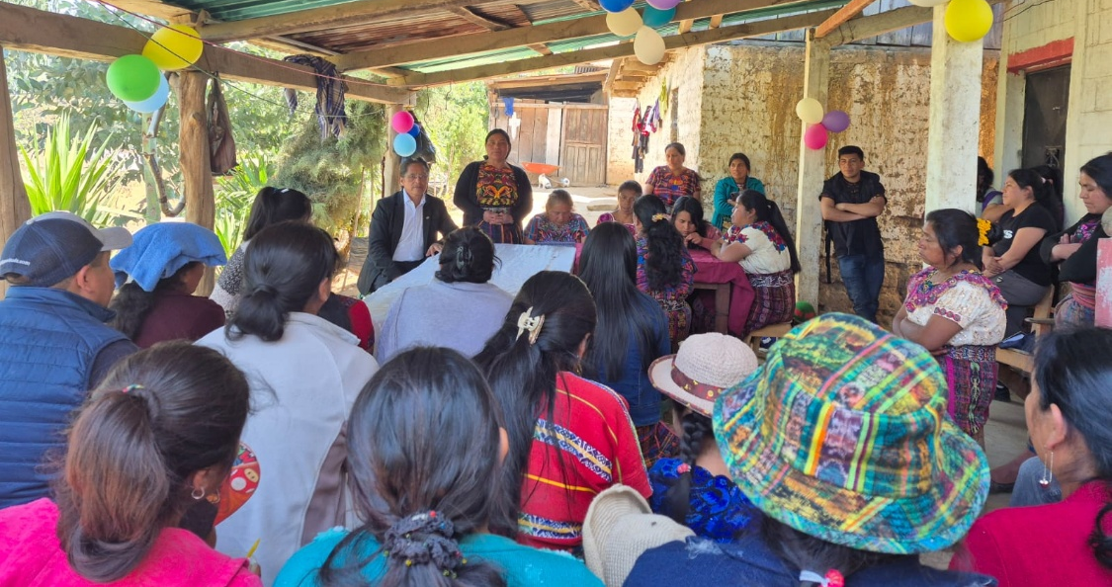
7
We give thanks to you, Loving God, that young women and men in Guatemala are learning how to stand up against gender-based violence with PWS&D’s support. Be with the program staff of AMMID (the Maya-Mam Association of Research and Development) as they do their important work.
Amen.

Slide 17
8
Heavenly Father,
We ask you to provide mental and spiritual support for pregnant women, especially for those who are in difficult situations. We pray that you give them courage during times of difficulty and pain, and help them face any challenges they encounter during their pregnancy.
1/2

Slide 18
8
We pray that you bring peace, hope and joy into their lives, so they may feel your presence and know that you are their strength at each step of their journey.
We place our trust in you and commit all these things into your hands.
In Jesus’ name, we pray.
Amen.
Written and translated from Haitian Creole by C-NEW-C, a PWS&D partner in Haiti.
2/2

Slide 20
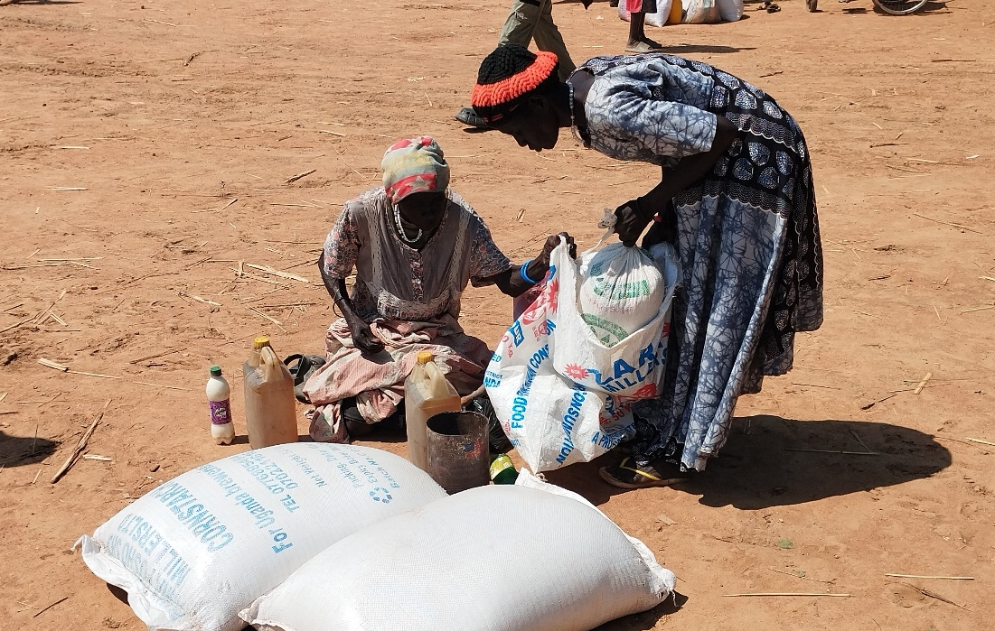
9
Peace-giving God, we pray for peace in countries facing violent conflicts. We think especially of those in Gaza, Ukraine, Yemen, Syria, South Sudan, Sudan and the Democratic Republic of the Congo. May swift and peaceful resolutions emerge, bringing an end to suffering and restoring hope. In your Holy name, we pray. Amen.

Slide 22
10
God of hope, we pray for PWS&D partners working in dangerous circumstances amid conflict. We pray for peace knowing that, beyond its impact on people’s security, war is one of the major causes of hunger around the globe. God, give us compassionate hearts, open our eyes to injustice and guide us to truth, so that in understanding, we can build a better world together.
Amen.
Written by Sharyl Eaglesham, PWS&D committee member and PWS&D at First Presbyterian Church in Winnipeg, Man.

Slide 24
11
Pray alongside Churches Action in Relief and Development, a PWS&D partner in Malawi:
Dear God, we thank you for linking us with people in Canada who have been a source of support in times of need. We pray that you will cause such relationships to flourish for the benefit of the marginalized people. We pray in Jesus’ name.
Amen.
Written by Churches Action in Relief and Development.

Slide 26
12
Dear Lord,
We come before you with hearts full of gratitude for the farmers with whom we are working in Jharkhand, India. We lift them up in prayer, asking for your divine blessings upon their hard work, their land and their harvest.
In this time of climate change, when the rains are erratic, the soil is dry and the harvest is uncertain, we ask for your divine protection and provision so that their fields may flourish, providing food for all.
1/2

Slide 27
12
We pray for women farmers with no ownership over land nor control over resources. We ask you to empower them and help them to break free from the systems of inequality.
We pray for abundance, justice and dignity—may the fruits of their labour be valued, and may they receive fair compensation and respect for their work.
In your mercy, hear our prayer.
Amen.
Written by Church of North India-Synodical Board of Social Services,
a PWS&D partner in India.
2/2

Slide 29
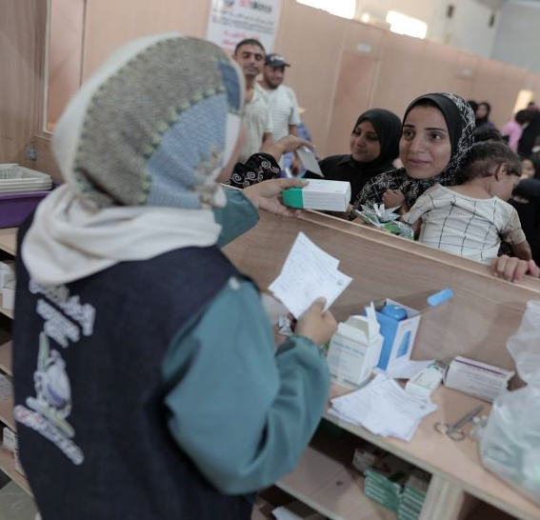
13
God, we pray for the work of partner organizations in Gaza as they serve children and families. Guide them in their important efforts to help relieve psychological and emotional stress for those affected by the Israel-Palestine conflict.
Amen.
Written by Cathy Gaddes, PWS&D Champion at Trinity Presbyterian Church in Burnaby, BC.

Slide 31
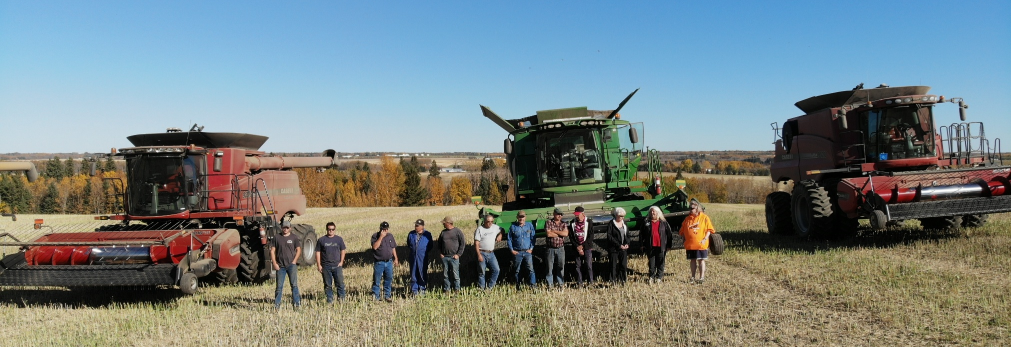
14
God, we praise you for Canadian farmers participating in growing projects through Canadian Foodgrains Bank. We pray that you bless the funds raised by these projects and used in PWS&D programs so that they will effectively combat hunger around the world.
Amen.

Slide 33
15
Pray alongside Women for Peace and Democracy,
a PWS&D partner in Nepal:
Dear Lord, with a heart full of gratitude we thank you for the strength and wisdom you have given Women for Peace and Democracy to serve women and marginalized communities. Thank you for guiding their hands and heart in this mission of empowerment. May you continue to bless their work, so that every woman finds her voice, her strength and her rightful place in society. Amen.
Written by Shobha Shrestha, Executive Chair of Women for Peace and Democracy.

Slide 35
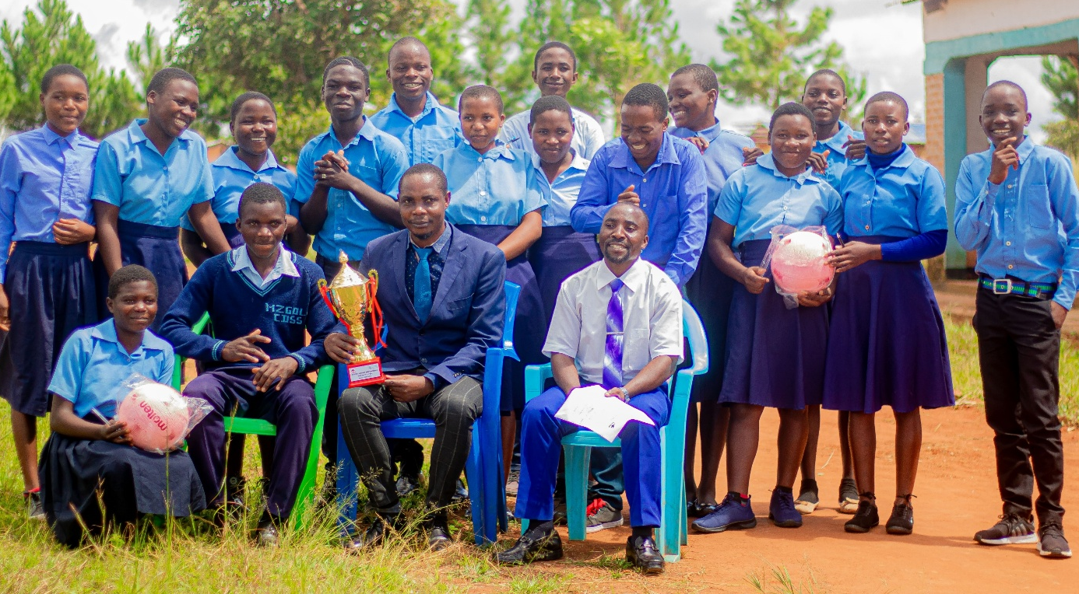
16
We give thanks, loving God, for the Every Youth Empowered Project in Malawi, which is improving awareness of sexual and reproductive health and rights for adolescents and young people. May your love be poured out as project participants learn about and advocate for their rights.
Amen.

Slide 37
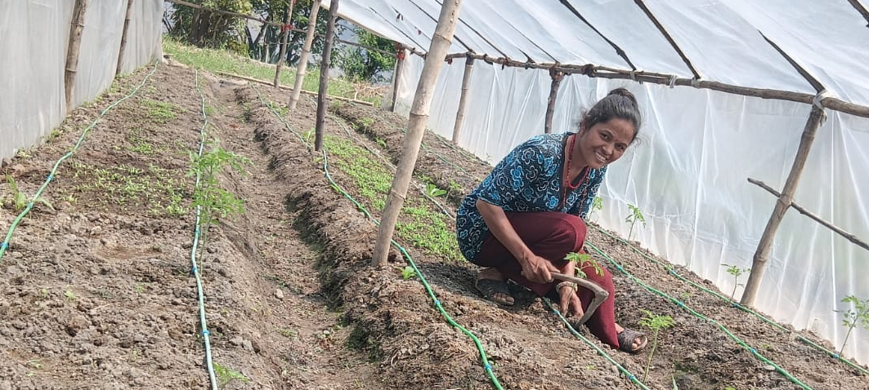
17
God, bless the earth and the ground we walk on.
Wherever we run and jump, walk and hike
make us grateful for the ground under our feet.
God, bless the earth and the dirt we dig in.
Whenever we taste something from our gardens
make us grateful for the dirt we dig in.
1/3

Slide 38
17
God, bless the earth and the wind that blows.
Wherever the wind has turned into storms,
give people strength and courage
to pick up the pieces of their lives
and rebuild their homes.
God, bless the earth and the rain that falls.
Wherever the water has turned into floods,
give people strength and courage
to clean up the mess
and rebuild their communities.
2/3

Slide 39
17
God, bless the earth and the sky above us.
Help us live wisely under the sky,
caring for the air we breathe, the water that flows,
the wind that blows and everything that grows.
Help us remember the earth and everything in it
belongs to you.
Let us treat everything as your gift.
Amen.
From the PCC’s Earth Day Intergenerational Worship Resource.
3/3

Slide 41
18
Pray alongside Women for Peace and Democracy,
a PWS&D partner in Nepal:
Dear God, thank you for allowing us to be an instrument of change. We pray that you continue to bless our journey. Open new doors and touch the hearts of those in need. May every woman we empower find dignity, hope and opportunity. Let our work be a reflection of your love and justice. Amen.
Written by Shobha Shrestha, Executive Chair of Women for Peace and Democracy.

Slide 43
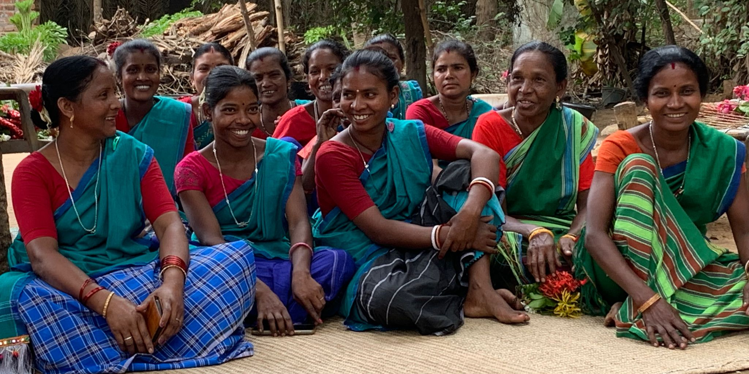
19
God, you opened a way for us. We’re reminded in your Word that we can approach you “with our hearts sprinkled clean from an evil conscience and our bodies washed with pure water” (Hebrews 10:22). We thank you for this great truth.
Amen.

Slide 45
20
God, we pray for people who are suffering due to hunger in Malawi. The fragile economy, high inflation rates as well as lack of foreign investment are making food very expensive, and many cannot afford it.
Now, cuts to international commitments for development programs are having a huge impact on people’s health and food security.
O God, would those in positions of power and influence renew their commitments to respond. Amen.
Adapted from prayer requests written by Synod of Livingstonia Health Department, a PWS&D partner in Malawi.

Slide 47
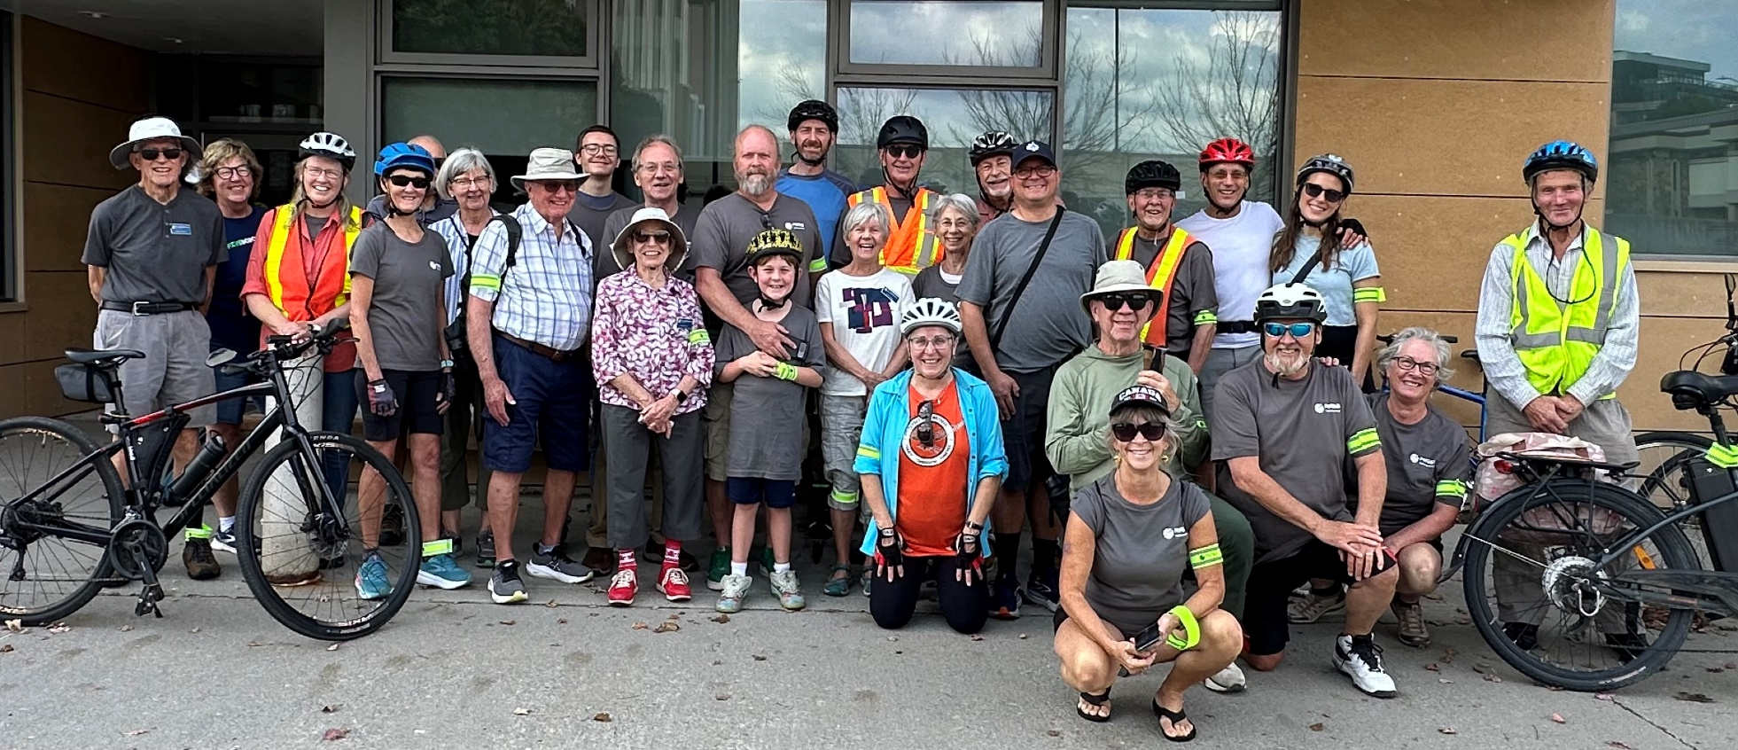
21
God, we praise you for the many ways people raise support for the work of PWS&D. We pray for safety and good weather for all who participate in the Journey for Hope each year. Would you bless them, as their hands and feet activate to bless others.
Amen.

Slide 49
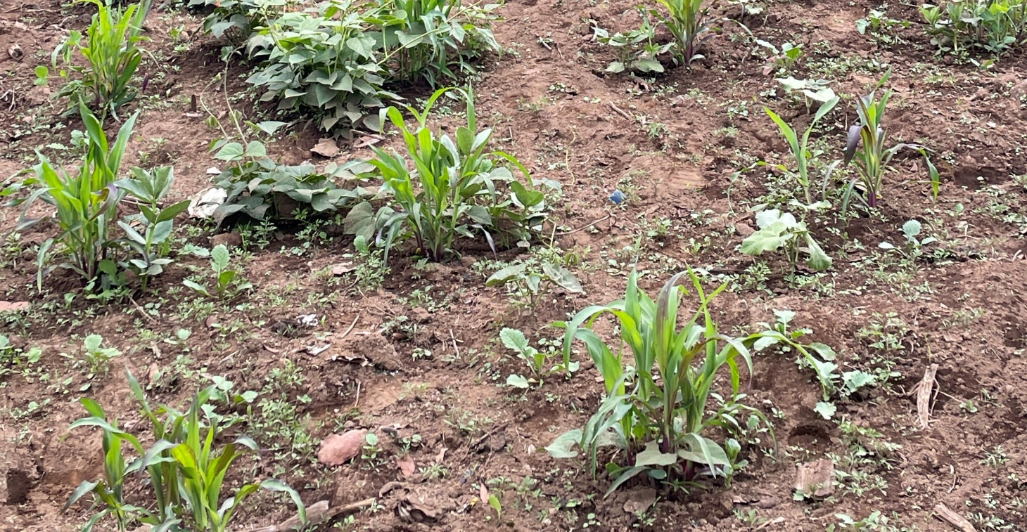
22
Holy God of amazement and wonder, you are the God of the universe made known in Jesus Christ. You are the source of life and hope, the Creator of all things. We praise you for your creative power, your endless love and your peace that passes all understanding.
You breathe life into your creatures, and we breathe every breath for you.
1/3

Slide 50
22
We marvel at the intricacies of the natural world, the human body, the cosmos—you made all of these, and you tend and care for each element of your creation with a love that is so perfect, so all-encompassing. And so, we worship you as the one who created us, who loves us and who guides us.
Generous God, you have invited us to love as you have loved. As much as we try to imitate you, we fall short. The earth suffers because we have not treated it gently or with compassion. Our neighbours are hungry and lonely, and we cannot summon the courage or the energy to help.
2/3

Slide 51
22
Despite our awe of you, we pretend that we have all the answers. Your peace eludes us, because human beings seem to prefer violence and war. Your whole earth groans in labour, waiting for you to do something new. Raise up newness within us—within ourselves and within our community, so that we might find fresh life and a renewed Spirit. In Jesus’ name, we pray.
Amen.
Written by the Rev. Dr. Sarah Travis for PWS&D Sunday.
3/3

Slide 53
23
God, we pray for those who are dealing with new realities after climate disasters. Guide those who work to create livable solutions for people and communities in places that are being devastated. Lord, provide health, comfort and community for people who have been displaced.
Amen.
Written by Christine Sands-Vizzari, PWS&D Champion at Chedoke Presbyterian Church in Hamilton, Ont.

Slide 55
24
Lord, we your children come to you in worship, remembering that your Word outlines your loving nature. You are the best parent there is.
We give thanks that mothers and pregnant moms in Haiti, with the support of PWS&D, are receiving nutritious food for both themselves and their infants. Continue to provide for their needs, we pray.
Amen.

Slide 57
25
Creator God,
the world is in crisis.
We see and acknowledge the changes around us
and we want to do what’s right but
we do not always know what that is
or agree what is best to do.
Help us to hear your Spirit calling us to advocate
for fair and just assistance
for people in the Global South
who have contributed least to the crisis,
and yet are facing more of the worst impacts.

Slide 58
25
We pray for forgiveness for when we have taken too much
or cared too little,
for hearts willing to change,
for the wisdom to know what to do and
for the will to live in ways that respect and sustain
the integrity of your creation.
These things we pray in the name of Jesus,
Amen.
Adapted from the PCC’s Climate Crisis Resource (2021).

