Slide 1
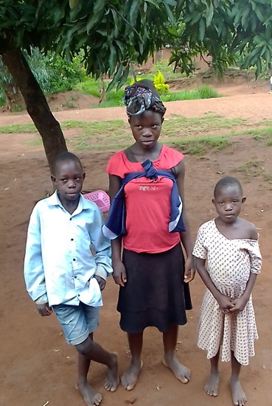


The First Sunday in Advent:
HOPE
One: As we enter the season of Advent, we remember God’s call to seek justice in the world God loves.

Slide 2
The First Sunday in Advent:
HOPE
All: We come longing for a brighter future for all.

Slide 3
The First Sunday in Advent:
HOPE
One: We light the first candle of Advent, a symbol of God’s hope,
which shines in the darkness.
(Light the candle of hope)

Slide 4
The First Sunday in Advent:
HOPE
One: May the light of this candle ignite a fire within your people, who are often afraid or hesitant to work for change.

Slide 5
The First Sunday in Advent:
HOPE
All: Holy One, strengthen us by your Spirit to commit ourselves to walking with those who are oppressed and marginalized.
Continued…

Slide 6
The First Sunday in Advent:
HOPE
All: May our actions reflect your hope, which transforms your world. In Jesus’ name we pray, Amen.

Slide 8
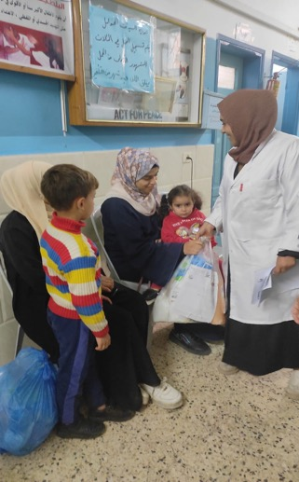
The Second Sunday in Advent:
PEACE
One: In a world too often divided, we gather to embrace the gift of peace.

Slide 9
The Second Sunday in Advent:
PEACE
All: We come with hearts open to reconciliation and understanding.

Slide 10
The Second Sunday in Advent:
PEACE
One: We light the second candle of Advent, a symbol of God’s peace in a troubled world.
(Light the candle of peace)

Slide 11
The Second Sunday in Advent:
PEACE
One: May the light of this candle guide us as we seek to fulfill our calling as peacemakers.

Slide 12
The Second Sunday in Advent:
PEACE
All: Holy One, strengthen us by your Spirit to commit ourselves to standing against injustice in our communities and the world.
Continued…
..

Slide 13
The Second Sunday in Advent:
PEACE
All: Affirm within us a dedication to foster your peace. In Jesus’ name we pray, Amen.

Slide 15
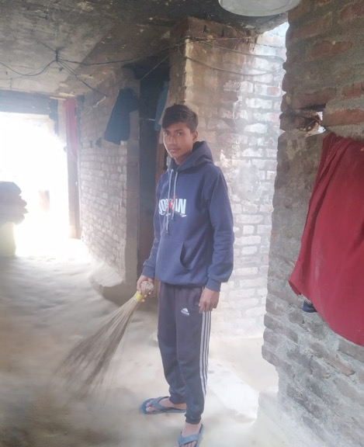
The Third Sunday in Advent:
JOY
One: As we prepare for Christ’s coming, we remember your calling to be filled with joy.

Slide 16
The Third Sunday in Advent:
JOY
All: We come knowing that our actions can help alleviate the burdens of others.

Slide 17
The Third Sunday in Advent:
JOY
One: We light the third candle of Advent, a symbol of joy that uplifts the spirit.
(Light the candle of joy)

Slide 18
The Third Sunday in Advent:
JOY
One: May the warmth and brightness of this candle encourage us to act with compassion and courage.

Slide 19
The Third Sunday in Advent:
JOY
All: Holy One, strengthen us by your Spirit to commit ourselves to being people of joy and justice.
Continued…

Slide 20
The Third Sunday in Advent:
JOY
All: Fill us with all joy and peace as we trust in you, so that we may overflow with hope. In Jesus’ name we pray, Amen.

Slide 22
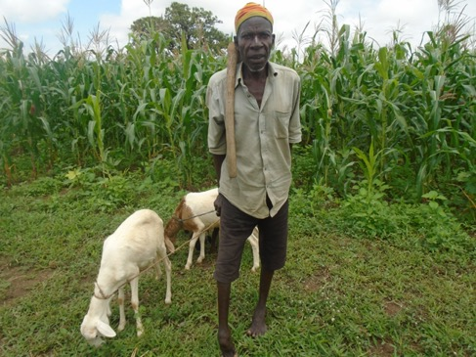
The Fourth Sunday in Advent:
LOVE
One: As we prepare for Christ’s coming, we remember that Christ modelled love by seeking justice for those on the margins.

Slide 23
The Fourth Sunday in Advent:
LOVE
All: We come with a desire to love everyone, even when it’s hard.

Slide 24
The Fourth Sunday in Advent:
LOVE
One: We light the fourth candle of Advent, a symbol of God’s love, which knows no boundaries.
(Light the candle of love)

Slide 25
The Fourth Sunday in Advent:
LOVE
One: May the light of this candle inspire us to act towards our neighbours near and far in loving and justice-seeking ways.

Slide 26
The Fourth Sunday in Advent:
LOVE
All: Holy One, we love because You first loved us. By the power of your Spirit, commit us to love in action in service of our neighbors. Continued…

Slide 27
The Fourth Sunday in Advent:
LOVE
All: Affirm within us a dedication to show your love to the world, in both word and deed. In Jesus’ name we pray, Amen.

Slide 29
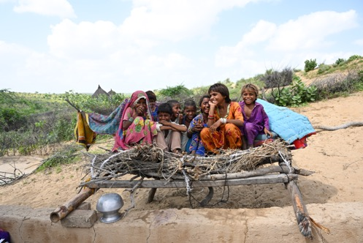
The Christ Candle
One: We gather to celebrate the birth of Christ, the Prince of Peace.

Slide 30
The Christ Candle
All: With each candle we light, we commit ourselves to seeking hope, peace, joy and love.

Slide 31
The Christ Candle
One: We light the Christ candle to shine into the world, reminding us of the new life promised through Jesus’ birth.
(Light the Christ candle)

Slide 32
The Christ Candle
One: May the warmth and light of Christ comfort all people, bringing courage to the weary and strength to the oppressed.

Slide 33
The Christ Candle
All: Holy One, by the power of your Spirit, help us to shine your light brightly to the world.
Continued…

Slide 34
The Christ Candle
All: Affirm within us the conviction to show hope, peace, joy and love throughout our lives. In Jesus’ name we pray, Amen.

