Slide 1



Join us in the fight against food insecurity!
WeRespond.ca/journeyforhope

Slide 2
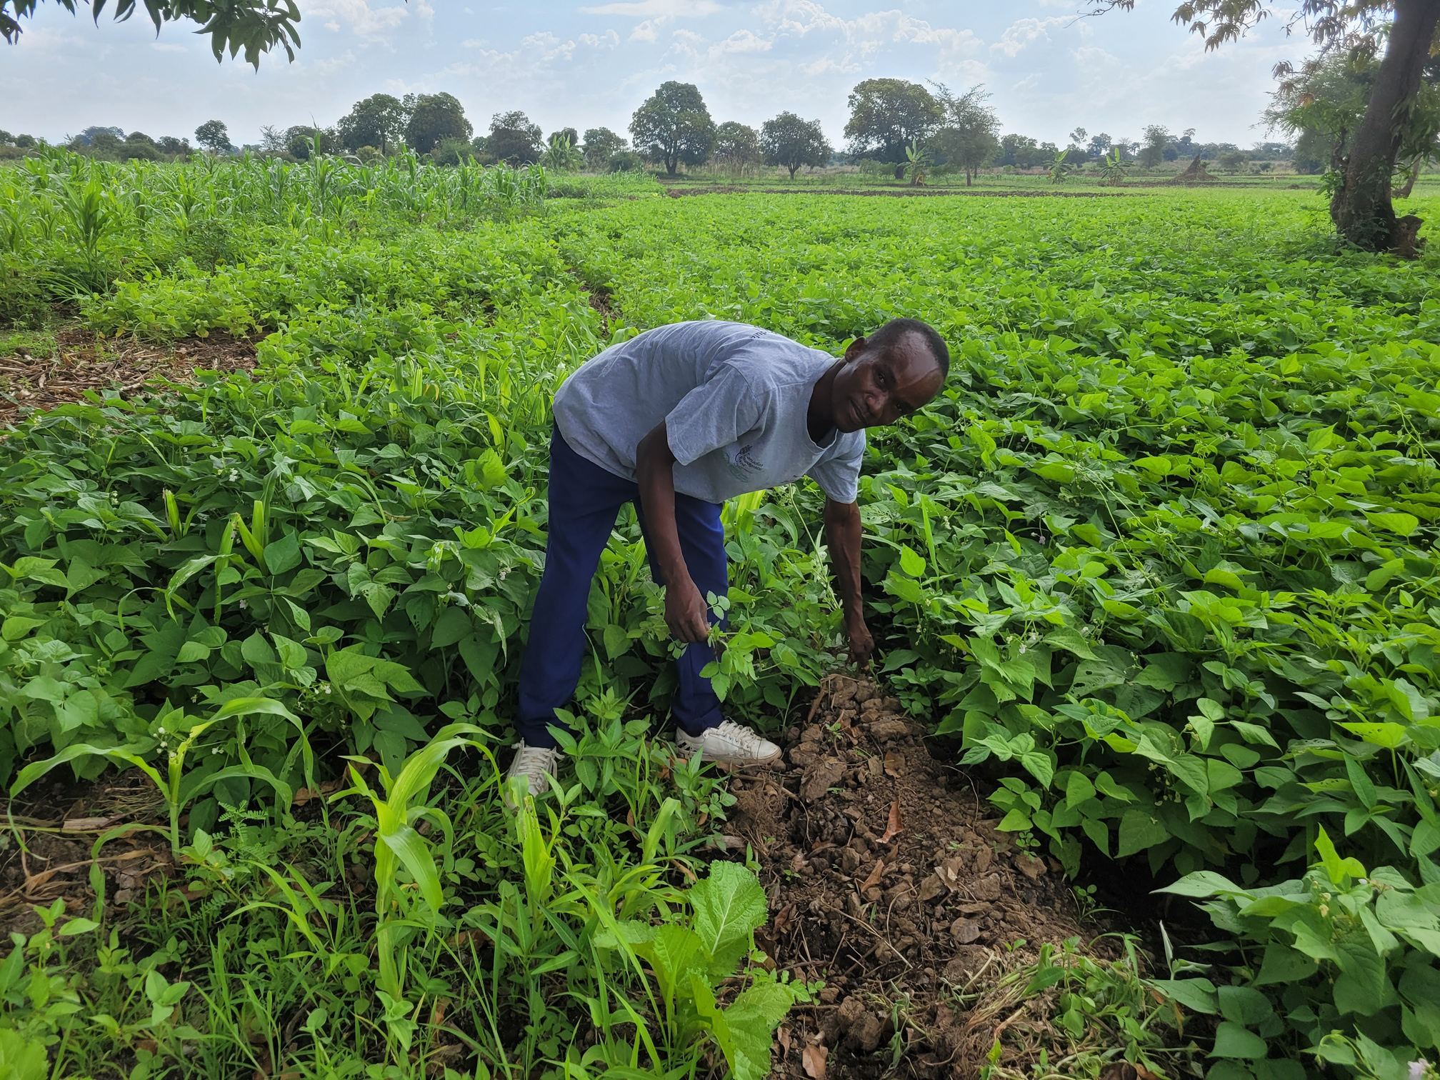

Will you join us?
September 28, 2024
WeRespond.ca/journeyforhope

Slide 3
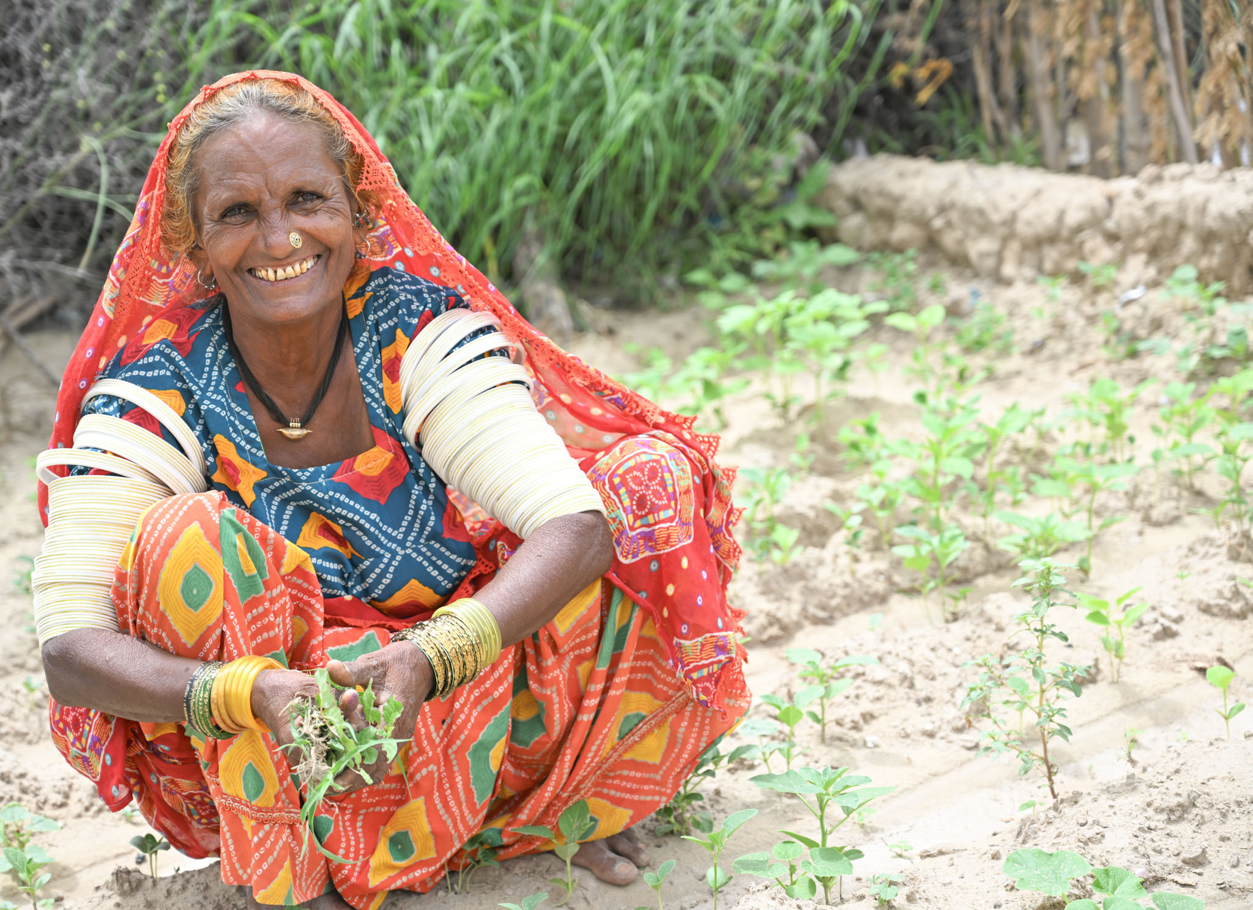
STEP UP FOR FOOD SECURITY
Join Journey for Hope!
September 28, 2024
WeRespond.ca/journeyforhope

