Slide 1
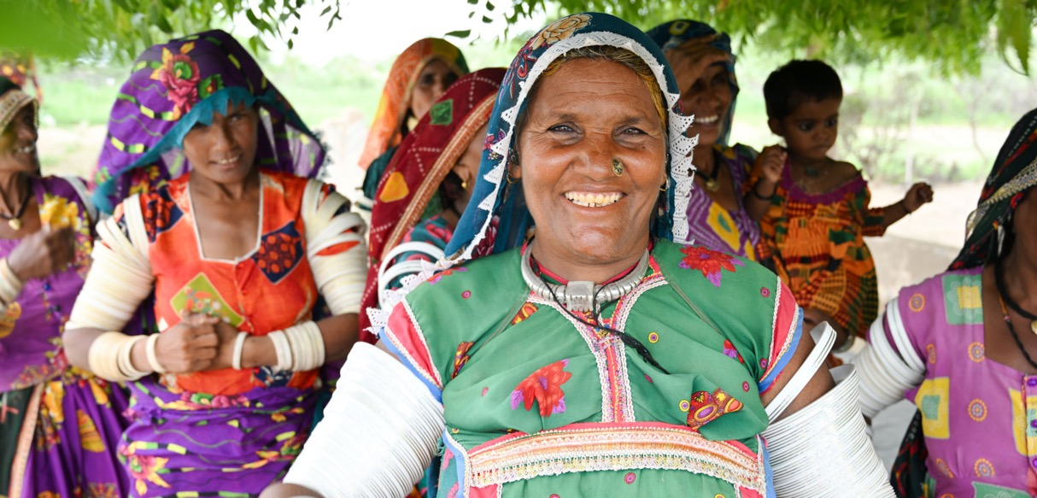
We Respond
Notes:
[Presenter to introduce self and relation to PWS&D]
Following the example set by Jesus, our church responds faithfully to the call to serve people in need. We do this through Presbyterian World Service & Development—the development and relief agency of The Presbyterian Church in Canada.
For over 75 years, our church has been actively working to serve marginalized communities through Presbyterian World Service & Development.
While the global context has evolved since PWS&D was first formed, what has not changed is a commitment to Christ’s message of love through justice, poverty reduction and support in times of disaster.
(Photo: Pakistan)

Slide 2
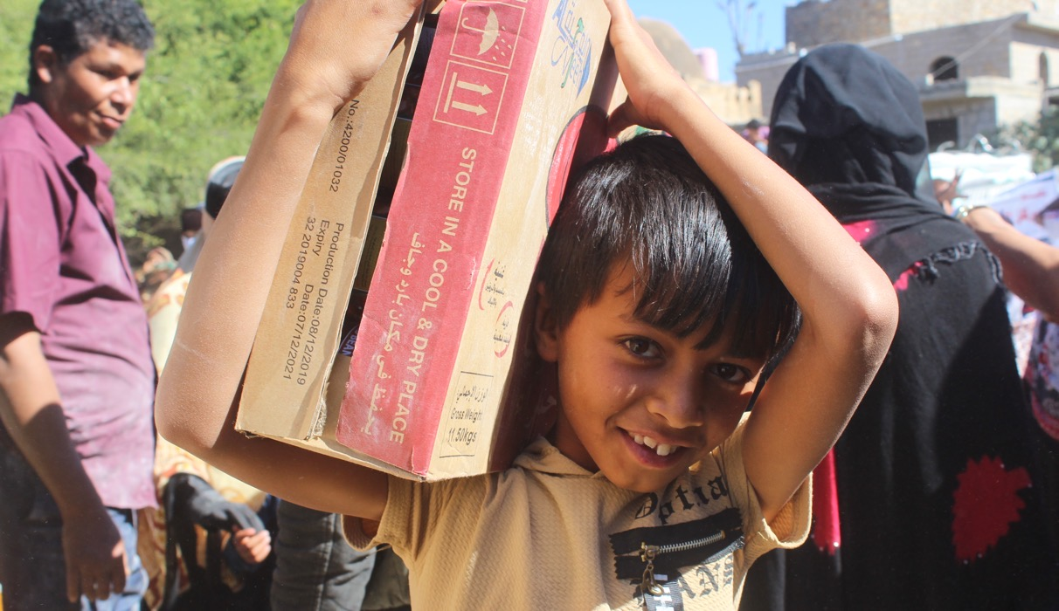
Our Vision
Inspired by God’s promise of abundant life, PWS&D envisions a sustainable, compassionate and just world.
Notes:
Rooted in the living hope of Jesus Christ and inspired by God’s promise of abundant life, PWS&D envisions a sustainable, compassionate and just world.
With support from Presbyterians across Canada, we respond to God’s call to serve the marginalized and distressed.
We respond to help communities around the world overcome poverty, recover from emergency situations and build sustainable futures.
(Photo: Yemen)

Slide 3
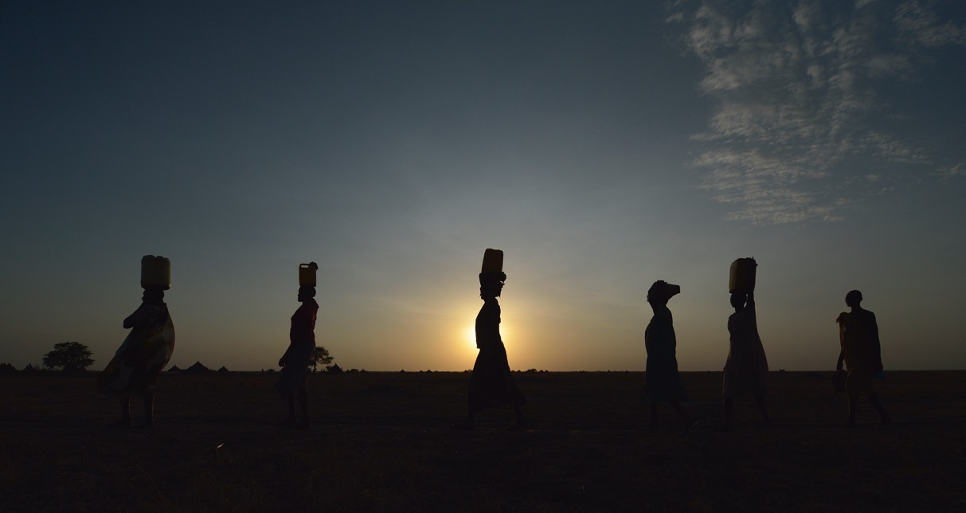
Our Values
Compassion ∙ Justice ∙ Partnership
Notes:
Working with communities around the world, PWS&D is guided by:
Compassion: PWS&D walks with distressed and marginalized people, listening carefully to their stories and responding effectively.
Justice: PWS&D works for equality, empowerment, human dignity, peace and stewardship of creation. In solidarity, we affirm that all people are entitled to know their rights, to receive equal protection, and to have access to and control over resources.
Partnership: PWS&D believes in dynamic relationships that involve mutual learning, trust, and shared vision. Healthy partnerships are accountable, ethical, equitable, flexible and respectful.
(Photo: Malawi, relief)

Slide 4


One Mission
Two Funds
Gifts to Presbyterians Sharing and PWS&D are sharing Christ’s love in Canada and around the world!
Notes:
Many people ask, “What’s the difference between PWS&D and Presbyterians Sharing?” Both funds support the overall mission and ministry of The Presbyterian Church in Canada, but they work in different ways.
Presbyterians Sharing is the fund that supports the national programs and ministries of The Presbyterian Church in Canada. Examples include the placement of mission staff overseas through International Ministries, General Assembly, Indigenous ministries, and new and renewing congregations in Canada.
PWS&D focuses on international development to tackle poverty and injustice and respond to emergencies. We raise funds directly from individuals and congregations. While PWS&D doesn’t receive funds directly from Presbyterians Sharing, we receive valuable in-kind support that helps keep administrative costs to a minimum, allowing us to maximize overseas program funding.

Slide 5
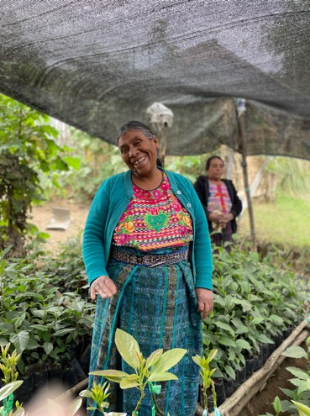



We Respond Together
Notes:
Based on our program priorities, we seek out local partners with whom we can work respectfully and collaboratively in order to create and implement programs that meet the needs of the local populations.
In addition to local partners, PWS&D collaborates with recognized internationally focused organizations, faith-based and secular, to have a greater impact and help address some of the structural issues that affect the communities where the church is working overseas. These partnerships also allow us to maximize Presbyterian donations and to respond faster in times of emergency. These organizations include the ACT Alliance, KAIROS and Canadian Foodgrains Bank.
(Photo: Guatemala)

Slide 6
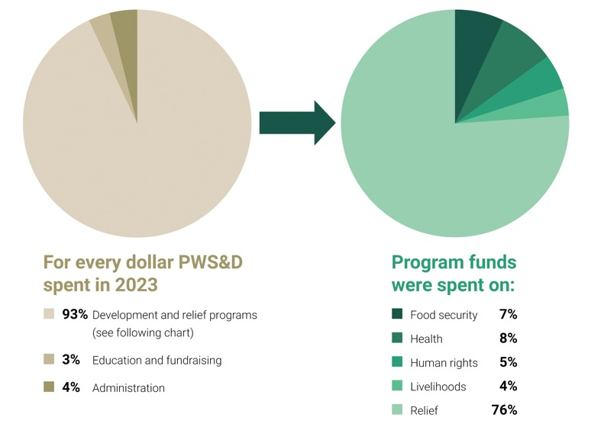
Notes:
PWS&D works to be a faithful steward of the resources entrusted to us.
*This chart represents the full value of PWS&D programming in 2023—including Government of Canada matching funds through Canadian Foodgrains Bank and KAIROS—which are not reflected in the financial statements.

Slide 7
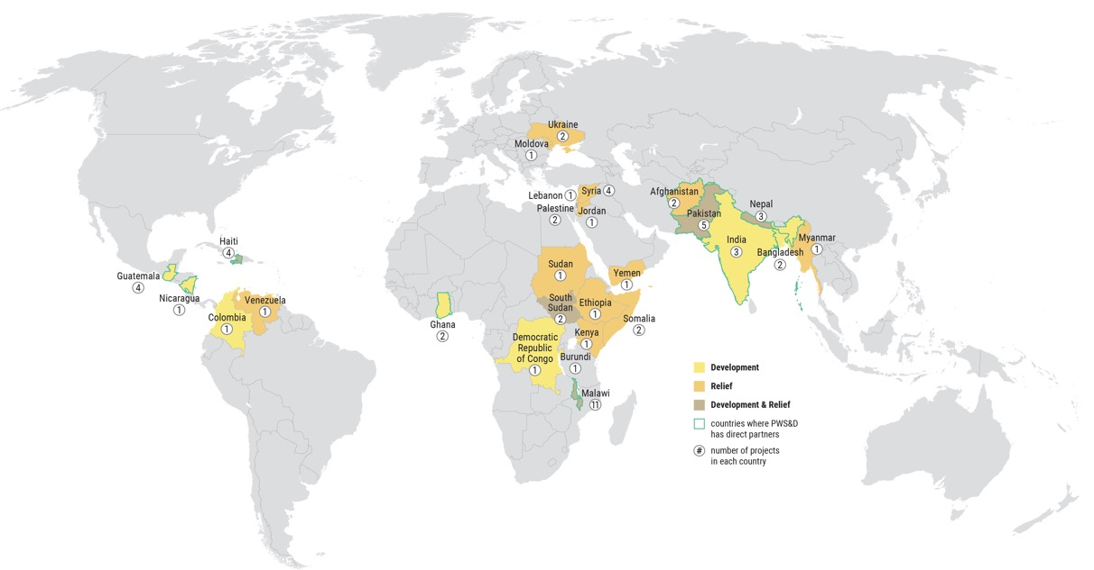
Notes:
PWS&D is committed to the well-being of marginalized people across the globe. In order to make efficient use of resources, we work in particular countries, on particular projects. These countries are chosen based on our program priorities and the presence of partners in the region.

Slide 8
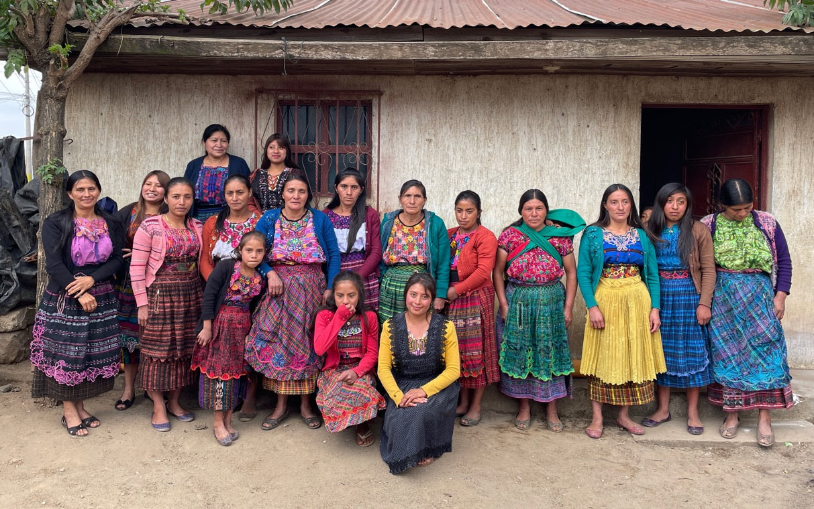
Our Priorities
Food Security ∙ Health ∙ Livelihoods ∙ Human Rights Emergency Relief ∙ Refugee Sponsorship
Notes:
The work we are doing together as a church through PWS&D can be broken into six pillars or priorities:
Food Security
Health
Economic Empowerment/Livelihoods
Human Rights
Emergency Relief
Refugee Sponsorship
The first four priorities make up our long-term development programs that work at the grassroots level to combat poverty and make lasting change. By addressing the root causes of poverty, people are empowered to take part in their own development and build sustainable futures.
(Photo: Guatemala)

Slide 9
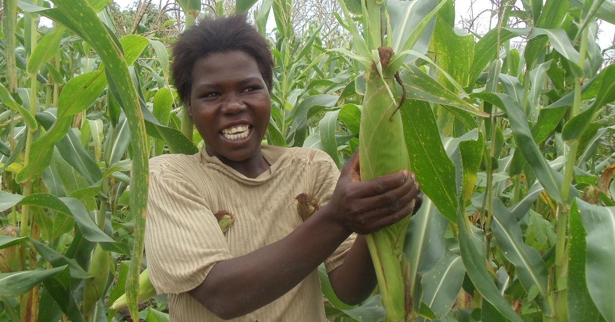
Food Security
Notes:
PWS&D’s focus on food security is helping people lead healthy and active lives by improving their access to food today and for the future. Through our food security programs PWS&D provides farmers with seeds, tools, fertilizer and training in organic, sustainable farming practices that increase crop yields and build resilience to environmental changes. PWS&D also teaches families to improve dietary diversity and prepare nutritious meals.
In 2023, PWS&D supported food security projects in Bangladesh, Burundi, Ethiopia, Ghana, Guatemala, Haiti, India, Nepal and Malawi.
(Photo: Malawi, food security)

Slide 10
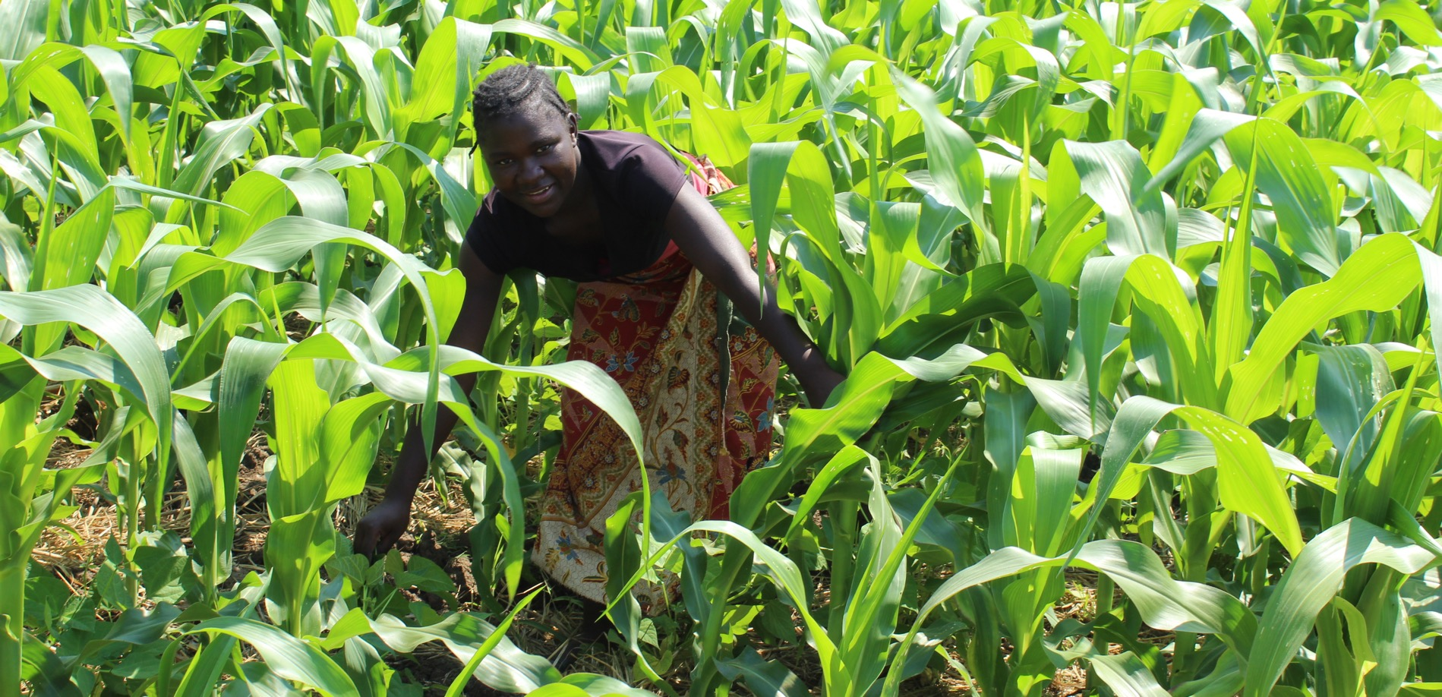
Photo: CFGB, Shaylyn McMahon
Notes:
Much of PWS&D’s work in food security and food aid is done in partnership with the Canadian Foodgrains Bank – a membership of 15 church-based agencies all working together with the common goal of ending hunger. Since 1983, the Foodgrains Bank has grown to become one of Canada’s leading food assistance organizations and the predominant Christian response to global hunger. Presbyterians are dynamic partners in this effort to help those who do not have enough to eat.
(Photo: Malawi, food security)

Slide 11
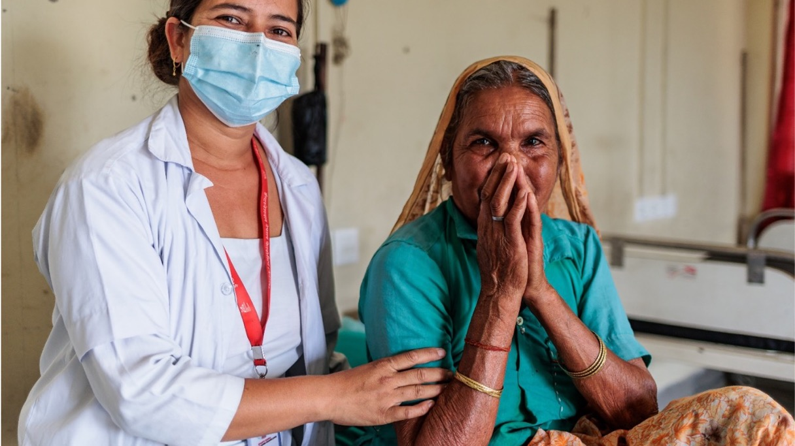
Health
Notes:
Preventable illnesses and inadequate access to health care impact many in the developing world. PWS&D’s health programs help bring medical care to remote villages, ensure mothers and children receive the care they need, tackle prevalent childhood diseases, improve access to clean water and empower communities to prevent the spread of HIV.
In 2023, PWS&D supported health projects in Ghana, Haiti, Malawi and Nepal.
(Photo: Nepal, INF)

Slide 12
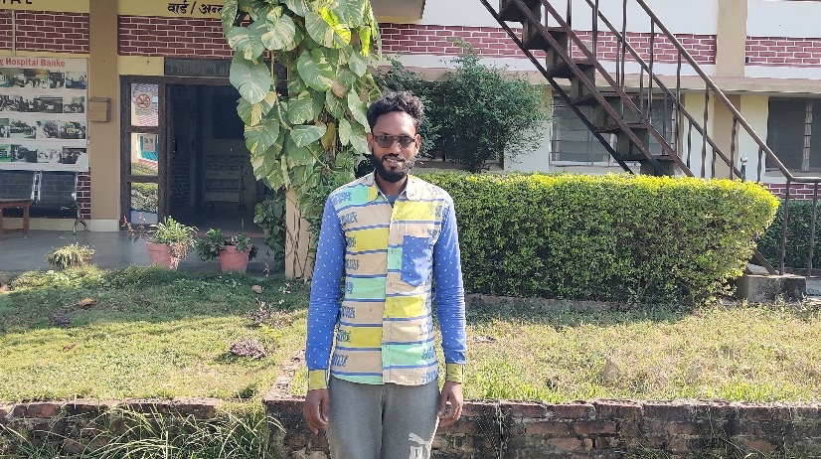
Treating Disease and Illness
Notes:
Communities are also seeing transformation through PWS&D’s work to treat disease and illness.
The Shining Hospital in Nepal, with PWS&D’s support, ensures timely diagnosis for patients living with leprosy and tuberculosis, and connects them with appropriate care.
Shining Hospital does more than just help people with their physical problems—by ensuring correct diagnoses and eliminating costs such as those for traditional healers, patients are protected financially.
Gulam Hasmad cares about people affected by leprosy. After having recovered from this disease himself, he now spends a lot of time raising awareness to help others. In his community, Gulam raises awareness about leprosy and interventions like reconstructive surgery through facilitating self-care sessions. He has formed a self-help group for those with leprosy and other disabilities, which has 20 members.
(Photo: Nepal)

Slide 13
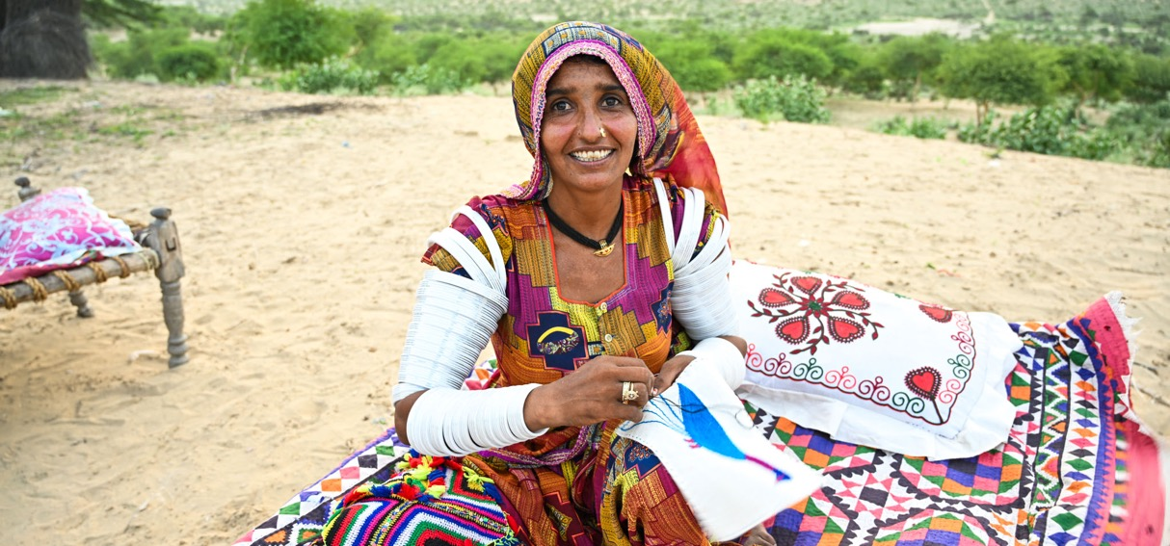
Photo: Paul Jeffrey
Livelihoods
Notes:
Having a sustainable livelihood means having food, water, shelter and clothing – the things needed in order to survive. It means being self-sufficient and able to provide for one’s family. It means having access to economic opportunities and meaningful employment.
PWS&D’s livelihood programs include education, small business development and vocational training for marginalized groups, with a special focus on girls, women and youth.
In 2023, PWS&D supported livelihoods projects in Bangladesh, Ghana, Guatemala, India, Nepal, Nicaragua, Malawi and Pakistan.
(Photo: Pakistan)

Slide 14
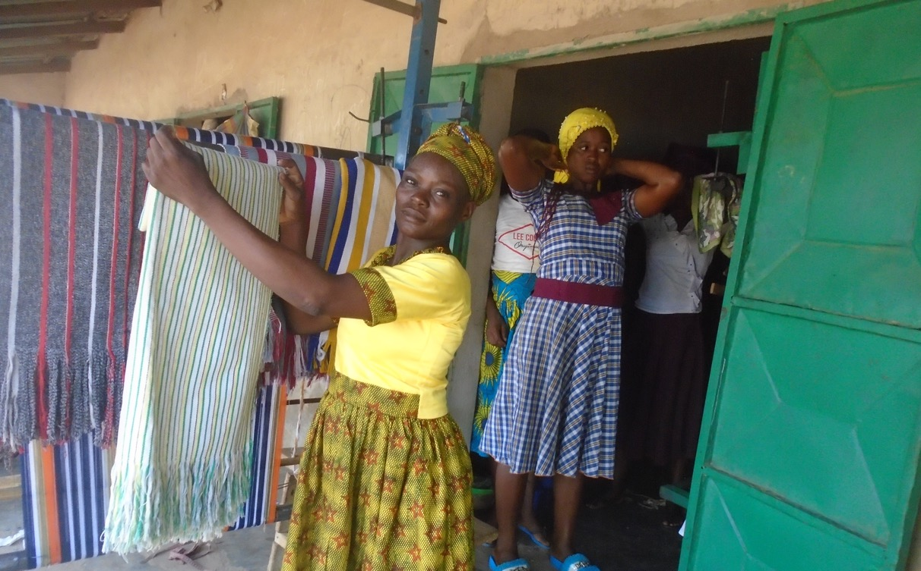
Photo: Paul Jeffrey
Human Rights
Notes:
While many regard the topic of human rights as purely political, it is difficult to deny how connected human rights and sustainable development are. Both signify a movement towards greater human dignity.
Poverty is one of the greatest obstacles to human rights. Poverty erodes people’s access to health care, adequate housing, nutritious food, education and safe water.
Without addressing issues such as inequality, disempowerment, exclusion and discrimination, the most vulnerable groups in society – the ones development programs are designed to help – become further marginalized.
PWS&D supported human rights projects in Ghana, Guatemala, India, Nicaragua and Malawi in 2023. In addition, PWS&D supported KAIROS partners in Colombia, Democratic Republic of Congo, Israel/Palestine and South Sudan.
(Photo: Ghana)

Slide 15
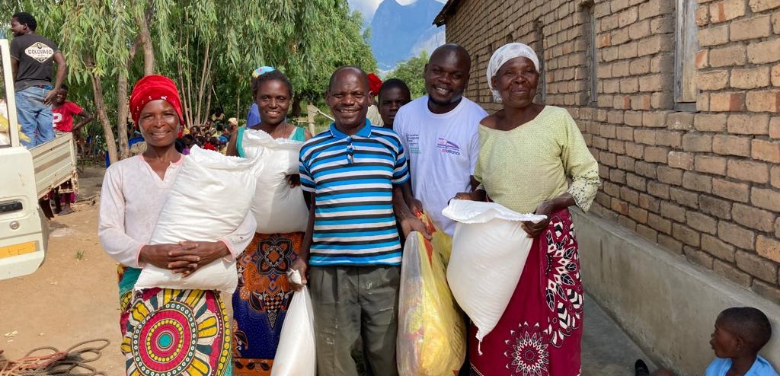
Emergency Relief
Notes:
In emergency situations, thousands or even millions of people face food shortages, displacement and disease. Children are often the most affected as they are pulled out of schools and placed in dangerous situations.
In 2023, humanitarian crises in many parts of the world brought to the forefront how marginalized so many people are. Immediate relief ensures people in need and refugees have access to food, shelter and water, and are able to recover from trauma and loss.
This year, PWS&D was involved in emergency relief in Malawi, Ukraine, and Gaza. In addition, PWS&D’s membership in Canadian Foodgrains Bank and ACT Alliance allowed us to provide necessary interventions in Afghanistan, Haiti, Jordan, Kenya, Lebanon, Malawi, Moldova, Myanmar, Nepal, Pakistan, Somalia, South Sudan, Sudan, Syria, and Ukraine.
(Photo: Malawi)

Slide 16
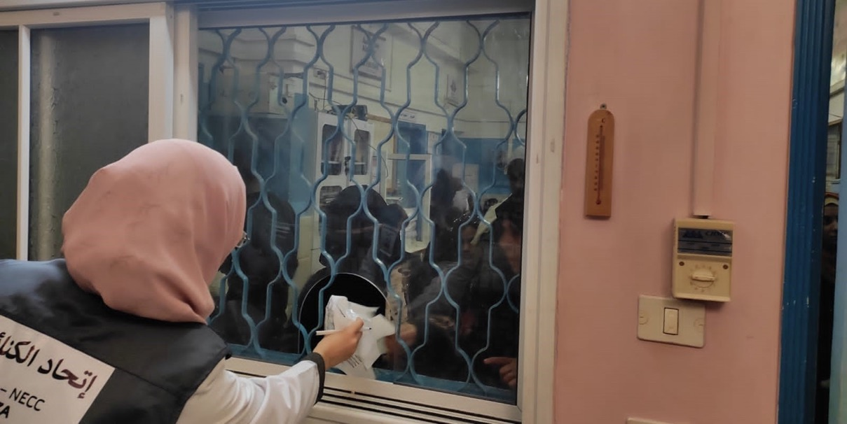
Gaza
Gaza
Notes:
Since war began in Gaza in October 2023, tens of thousands of people have been killed or injured and countless more are facing catastrophic hunger. Generous Presbyterian support has enabled PWS&D to respond, despite the challenges of getting aid into Gaza. Through partners at the ACT Alliance, cash transfers have been provided to enable families to buy water, food and other essentials. The provision of primary health and dental care has been supported, as well as psychosocial care to children and mothers to help with coping mechanisms and relieve emotional distress.
In addition, the Canadian Foodgrains Bank project through Development & Peace (with their local partner Catholic Relief Services) is supporting a 12-month food assistance project for 1,485 families (approximately 8,910 people). Families are receiving ready to eat food (date biscuits, canned tuna, dried nuts, canned beans, hummus, olive oil) and two additional rounds of either multi-purpose cash assistance or in-kind food assistance, depending on market functionality and access.
DSPR, an ACT Alliance member, provides primary health and dental care in their Rafah clinic, including pharmacy services.
DSPR = The Department of Service to Palestinian Refugees
Credit : DSPR/Mahmod Elbaragethi

Slide 17
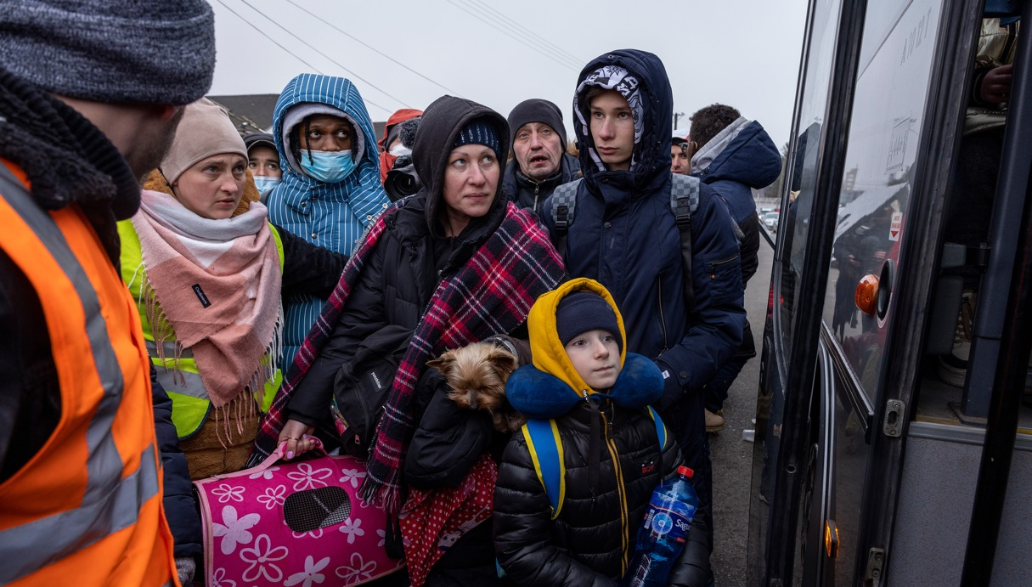
Ukraine
Notes:
The military conflict in Ukraine stretched into its second year, resulting in ongoing suffering for the civilian population.
In 2023, PWS&D continued to provide food aid through partners at Canadian Foodgrains Bank to 4,706 people in Ukraine and surrounding countries. Additionally, through the Ars Longa Foundation, support was provided to farmers in eastern Ukraine. Fifty women-headed farms were provided with fertilizer to assist them in growing food in the spring and to be able to plant in the fall.
Photo: Christoph Püschner/Diakonie Katastrophenhilfe

Slide 18
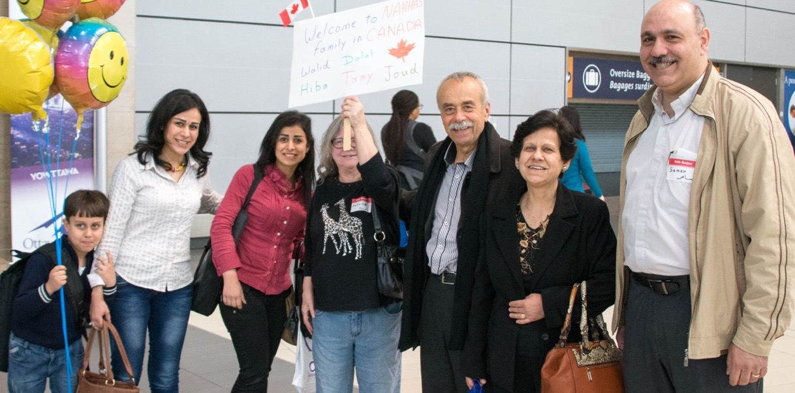
Refugee Sponsorship
Photo: Paul Jeffrey, ACT Alliance
Notes:
During the year, 99 sponsored refugees arrived in Canada originating from nine countries.
In 2023, PWS&D refugee staff helped facilitate the sponsorships of two families under the Blended Visa Office Referred (BVOR) sponsorship program. Through this program, the financial costs to sponsoring groups is reduced because the government pays 50% of the costs.
Among the highest groups of arrivals were refugees originally from Syria (31 people), Afghanistan (27 people) and the Democratic Republic of Congo (24 people). Other arrivals included individuals from Burundi, Eritrea, Ethiopia, Somalia, South Sudan and Sudan.

Slide 19
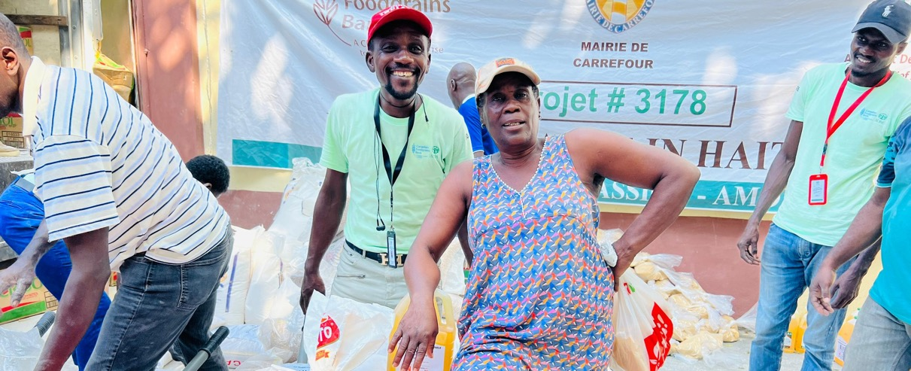
Photo: CWSA
Get Involved
Pray ∙ Donate ∙ Learn ∙ Champion
Notes:
There are a variety of ways that you can support the work of PWS&D.
Pray for those who lack the basic necessities, that they may experience abundant life
Become a donor: Ultimately, we need money and resources to support our important programs around the world. You can support PWS&D by one-time or monthly donations or by purchasing a gift from our Gifts of Change catalogue.
Make a legacy gift to PWS&D’s Loaves & Fishes Fund: Planned gifts include a bequest through your will, RRSPs, publicly traded securities, real estate, life insurance, special gifts of cash, and more.
Request a speaker for a Sunday service, group meeting or youth gathering
Use PWS&D resources to understand the challenges facing vulnerable communities
Stay Connected: You can sign up on the PWS&D website to receive our newsletters with valuable updates from our programs around the world and news about what’s happening at PWS&D. Be sure to also visit our Facebook, Instagram and Twitter pages.
(Photo: Haiti)

Slide 20
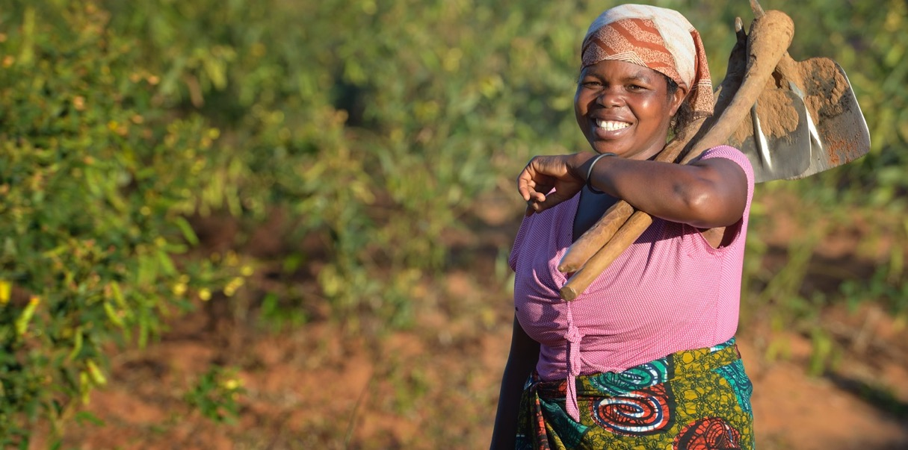

WeRespond.ca/be-a-champion
Photo: Paul Jeffrey
Notes:
One way to get more involved in PWS&D and play a vital role on the journey towards a more sustainable, compassionate and just world is to become a PWS&D Champion.
A PWS&D Champion is a volunteer who stays informed about PWS&D’s projects and partners, promotes the work of PWS&D and encourages others to get involved.
In a world with too much poverty, hunger and oppression, be a Champion for Change.
Visit WeRespond.ca/be-a-champion for more information.
(Photo: Malawi, Paul Jeffrey)

Slide 21
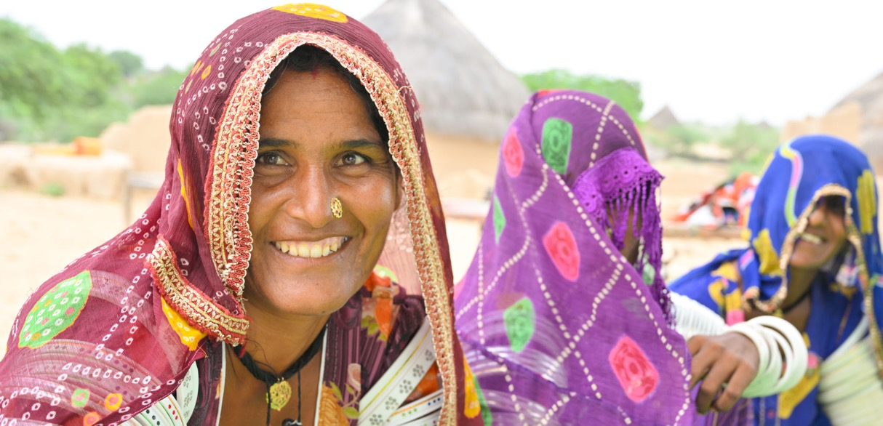
WeRespond.ca
Notes:
Visit WeRespond.ca to learn more about PWS&D and how you can get involved!
Photo: (Pakistan)

