Slide 1
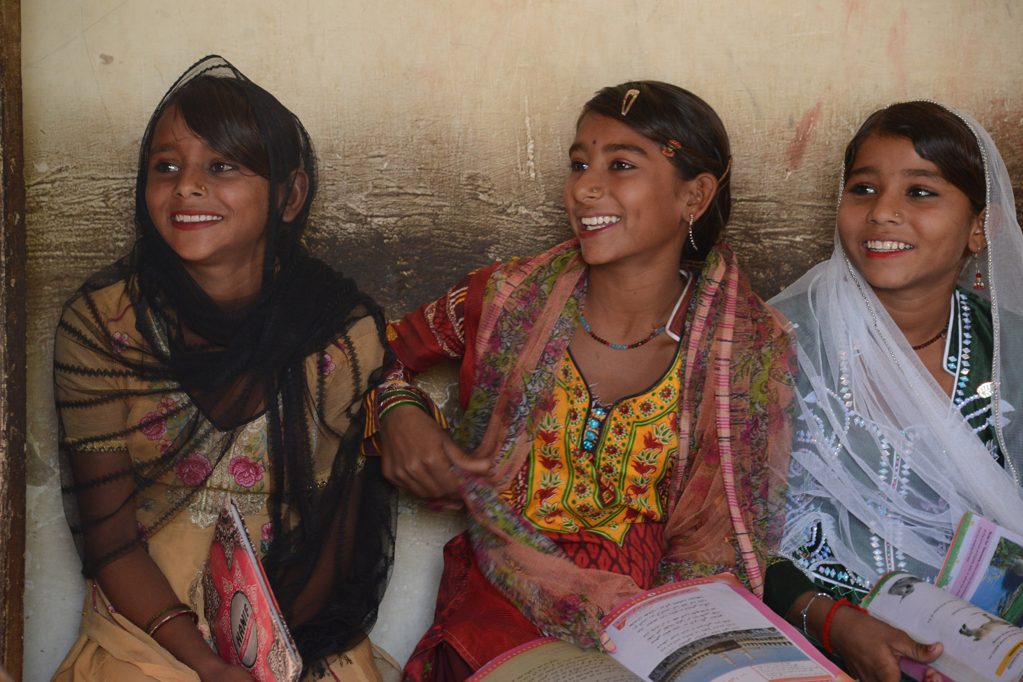
First Sunday in Lent
One: On this first Sunday of Lent, we find Jesus in the wilderness, facing temptation. And forty days in the wilderness is a long time.

Slide 2
First Sunday in Lent
All: We too experience
wilderness times of temptation,
challenge and change.

Slide 3
First Sunday in Lent
One: Yet even in the wilderness and among the wild beasts
the angels cared for Jesus.

Slide 4
First Sunday in Lent
All: As we make our way in the wilderness, we hear the good news that we are not alone –
that the reign of God has come near in Christ.

Slide 6
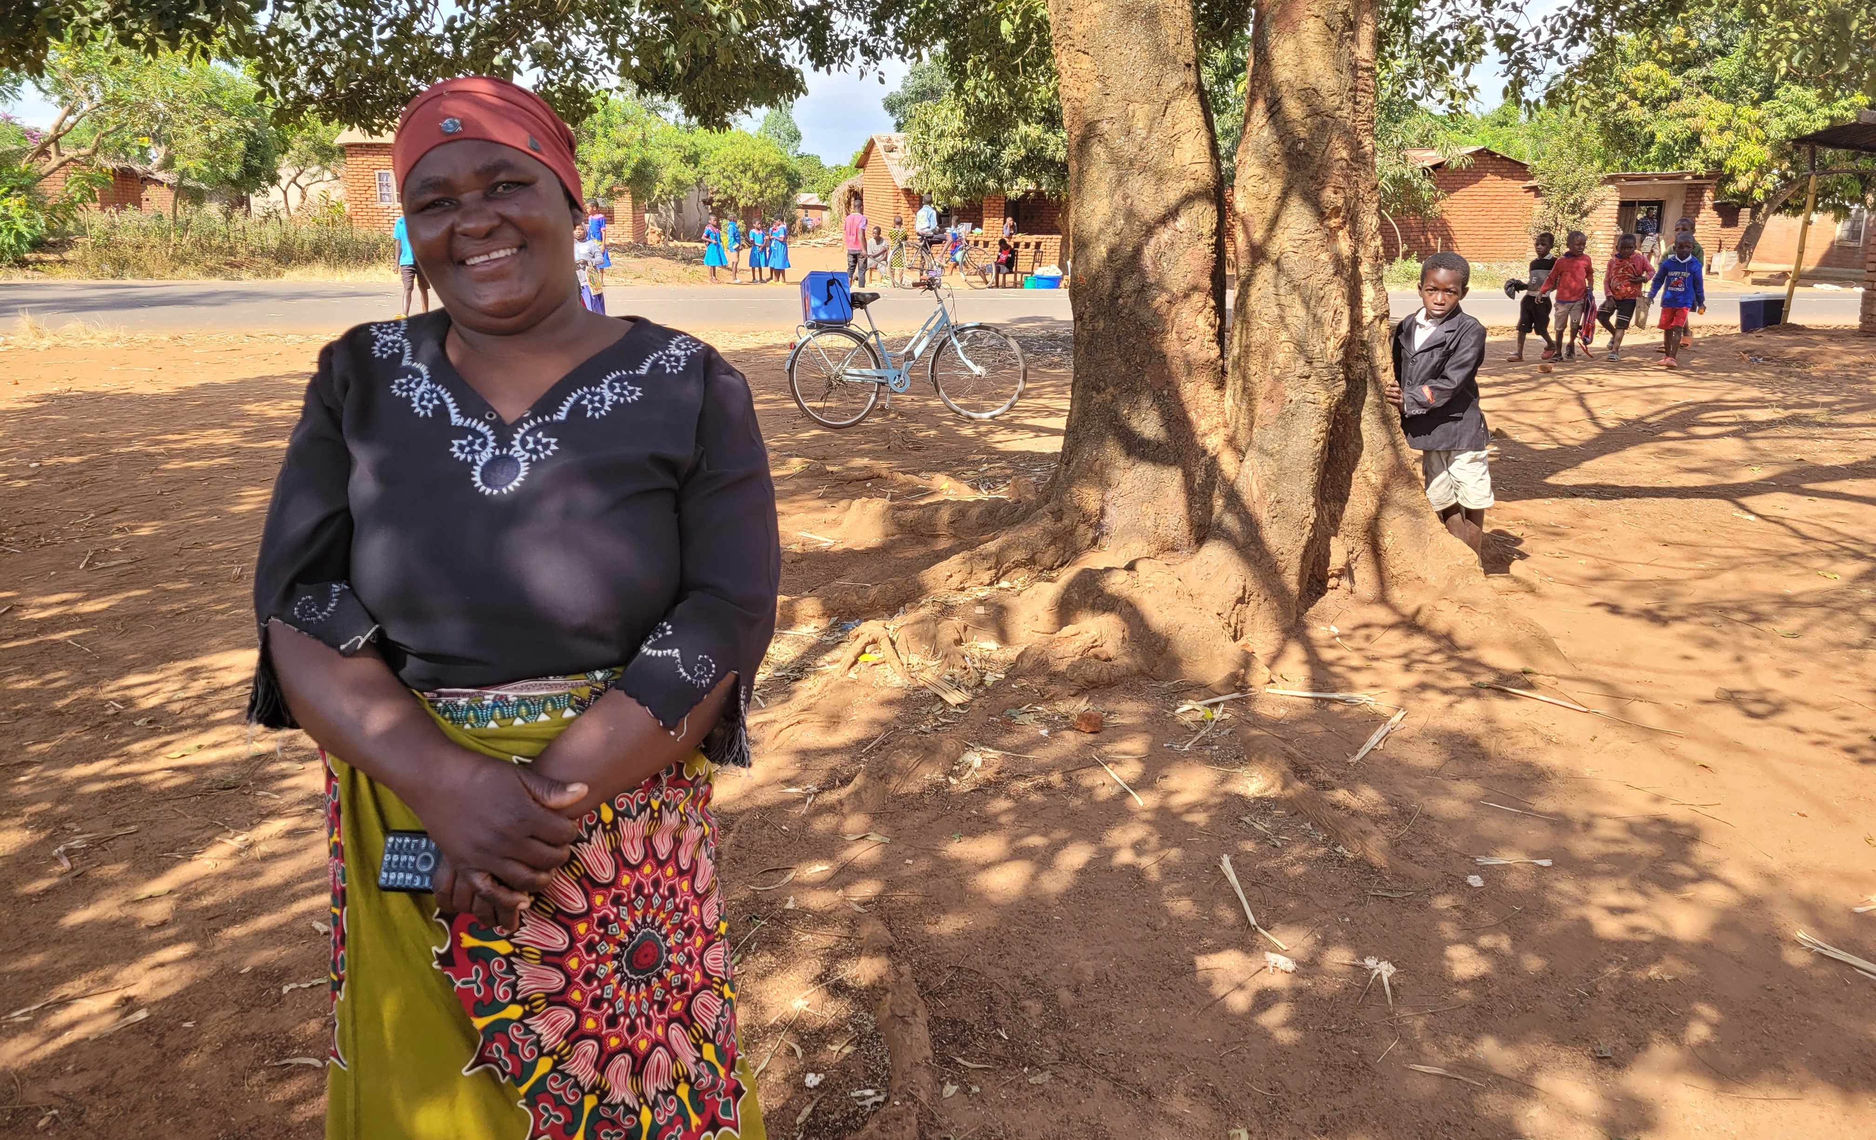
Second Sunday in Lent
One: On this second Sunday of Lent, we hear Jesus teaching about the suffering and rejection that he would endure on his way to the cross.

Slide 7
Second Sunday in Lent
The Second Sunday in Lent
All: Like Peter, we resist this teaching. We prefer an easier way without struggle and suffering.

Slide 8
Second Sunday in Lent
One: But Jesus does not hold back. He tells us that to become his followers we need to deny ourselves and take up our cross.

Slide 9
Second Sunday in Lent
All: May God help us as we learn more of what it means to be friends and followers of Jesus.

Slide 11
The Third Sunday in Lent
Third Sunday in Lent
One: On this third Sunday of Lent, we see Jesus, overturning the tables of the money changers as he drove them out of the temple.

Slide 12
Third Sunday in Lent
All: We are surprised by his actions.

Slide 13
Third Sunday in Lent
One: Yet there is much in our lives and the world that needs to be overturned and driven out.

Slide 14
The Third Sunday in Lent
Third Sunday in Lent
All: In the name of Jesus, we work to overcome oppression, poverty, and injustice in our local communities and with partners around the world.

Slide 16
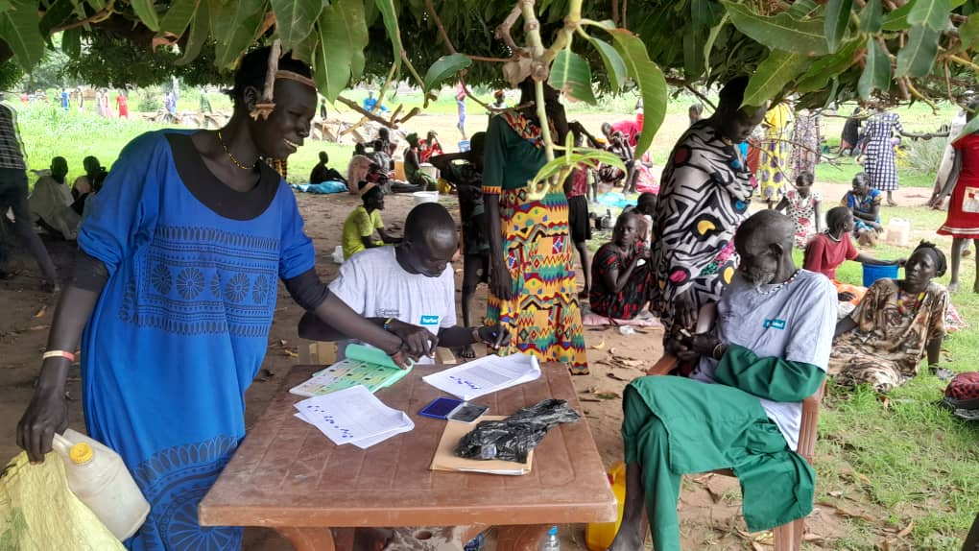
Fourth Sunday in Lent
One: On this fourth Sunday of Lent, we overhear a nighttime conversation between Jesus and a Pharisee named Nicodemus.

Slide 17
Fourth Sunday in Lent
All: Jesus says we must be born anew and born of the Spirit. With Nicodemus we ask, “How can these things be?”

Slide 18
The Fourth Sunday in Lent
Fourth Sunday in Lent
One: But maybe it’s not all about understanding these mysteries.
Maybe it’s about hearing, believing and sharing the good news with our words and our actions.

Slide 19
Fourth Sunday in Lent
All: “For God so loved the world that he gave his only Son so that everyone who believes in him may not perish but may have eternal life.”

Slide 21
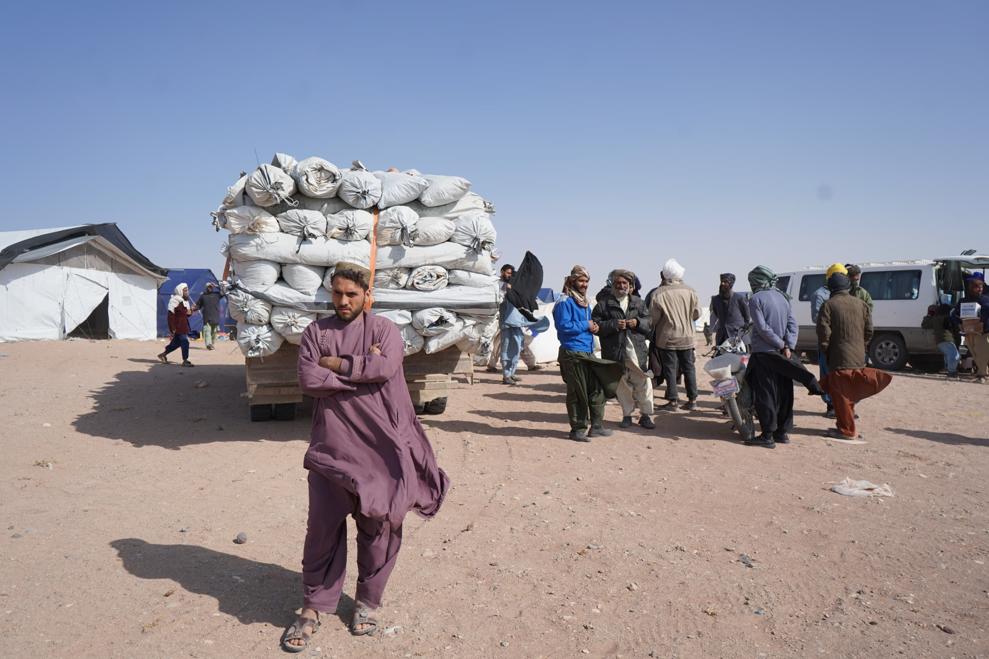
The Fifth Sunday in Lent
Fifth Sunday in Lent
One: On this fifth Sunday of Lent, we discover a troubled Jesus in prayer as he contemplates his death on the cross.

Slide 22
The Fifth Sunday in Lent
Fifth Sunday in Lent
All: We are grateful for the prayers of Jesus and for the times in the gospels when Jesus prayed.

Slide 23
Fifth Sunday in Lent
One: In the Garden of Gethsemane Jesus threw himself on the ground and prayed, “Remove this cup from me; yet, not what I want, but what you want.”

Slide 24
The Fifth Sunday in Lent
Fifth Sunday in Lent
All: And so we pray, as Jesus taught us,
“Thy kingdom come, thy will be done,
on earth as it is in heaven.”

Slide 26
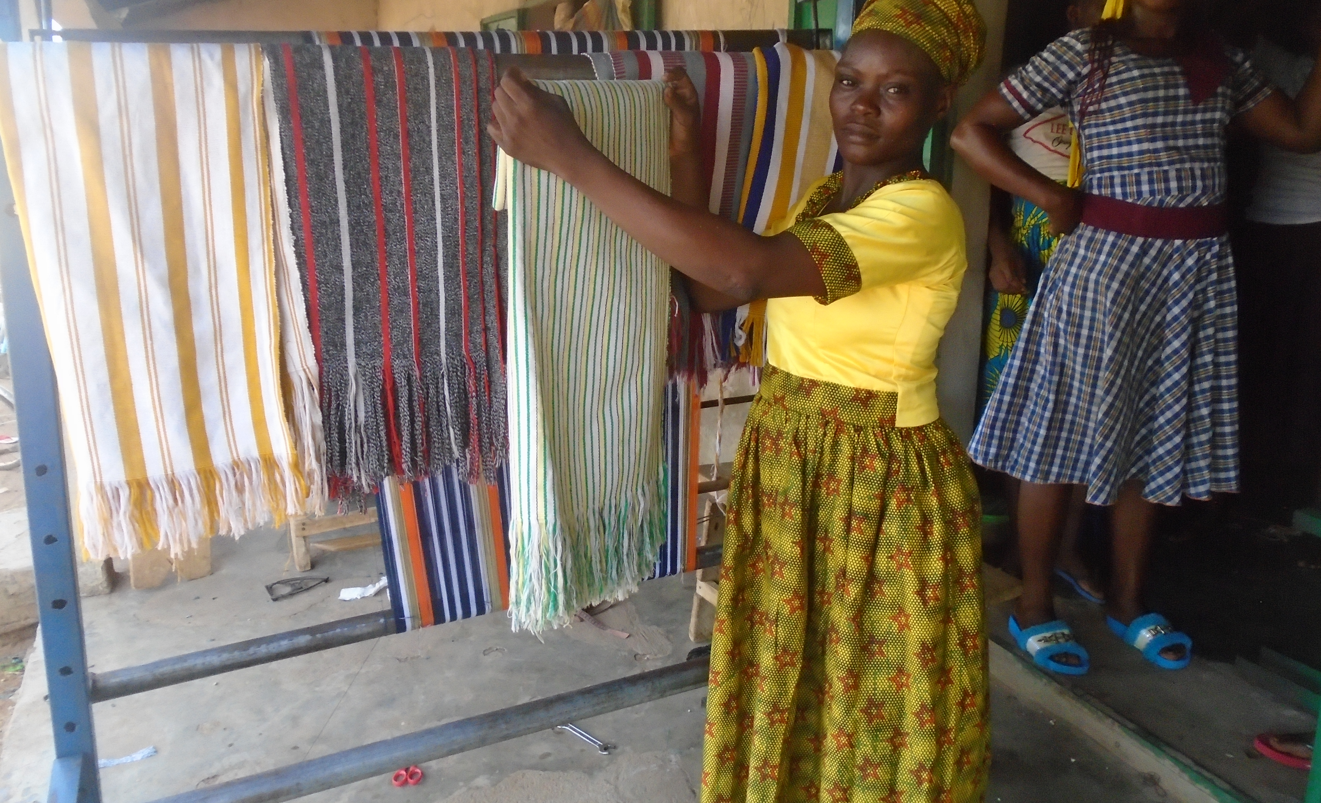
Palm/Passion Sunday
Palm/Passion Sunday
One: On this Palm Sunday, we see Jesus entering Jerusalem riding on a donkey, showing us the way of peace.

Slide 27
Palm/Passion Sunday
Palm/Passion Sunday
All: With palm branches in hand, we cry out “Hosanna,” save us now, save us from our warring madness.

Slide 28
Palm/Passion Sunday
One: “We affirm that God is at work when people are ashamed of the inhumanity of war and work for peace with justice.

Slide 29
Palm/Passion Sunday
Palm/Passion Sunday
All: We pray for peace to him who is the Prince of Peace.”
(Living Faith 8.5.3)

Slide 31
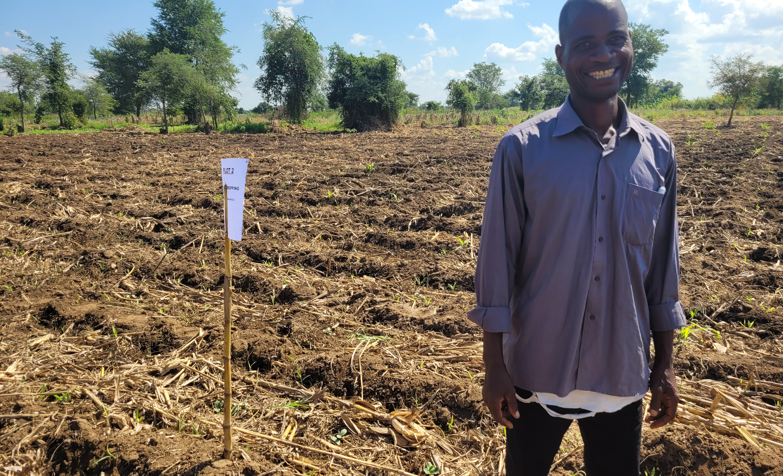
Maundy Thursday/Good Friday
Maundy Thursday/Good Friday
One: Jesus took the towel, poured water into a basin and washed the feet of his disciples.

Slide 32
Maundy Thursday/Good Friday
Maundy Thursday/Good Friday
One: Then Jesus said to them, “If I, your Lord and Teacher, have washed your feet, you also ought to wash one another’s feet.”

Slide 33
Maundy Thursday/Good Friday
Maundy Thursday/Good Friday
All: Thank you, Lord Jesus, for showing us how to love and serve on another.

Slide 34
Maundy Thursday/Good Friday
Maundy Thursday/Good Friday
One: “But God proves his love for us that while we still were sinners Christ died for us.”
(Romans 5:8)

Slide 35
Maundy Thursday/Good Friday
Maundy Thursday/Good Friday
All: Thank you, Lord Jesus, for suffering and dying on the cross for us and our salvation.

Slide 37
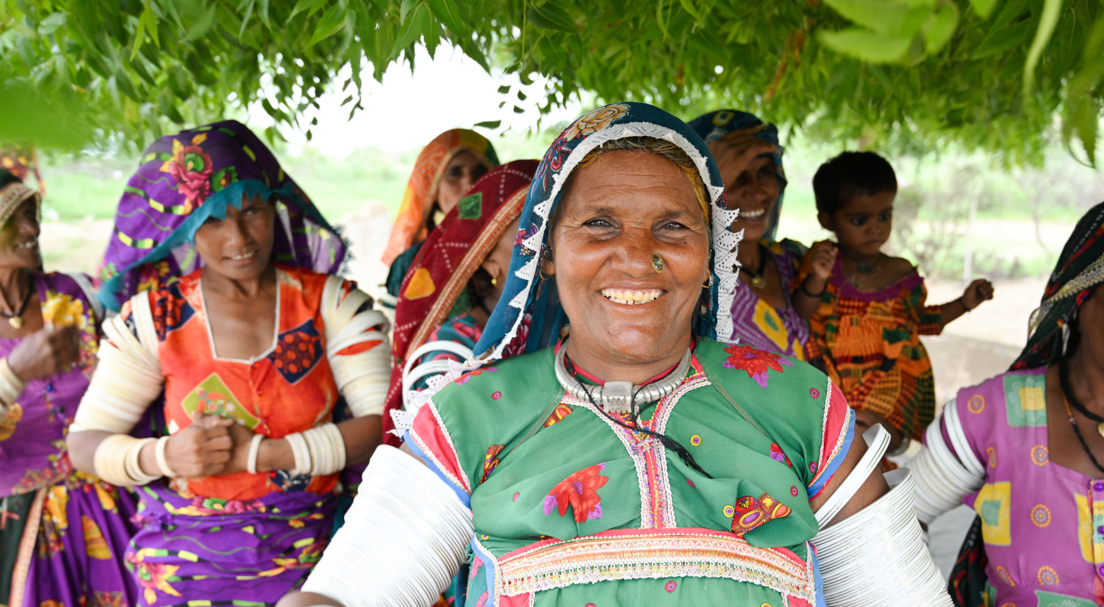
Easter Sunday
One: Christ is risen!
All: He is risen indeed!
Hallelujah!

Slide 38
Easter Sunday
One: The stone had been rolled back and the tomb was empty. The angel told the faithful women, “He has been raised. He is not here.”

Slide 39
Easter Sunday
All: And so we have hope – a living hope through the resurrection of Jesus Christ.
“May the God of hope go with us every day.”

