Slide 1

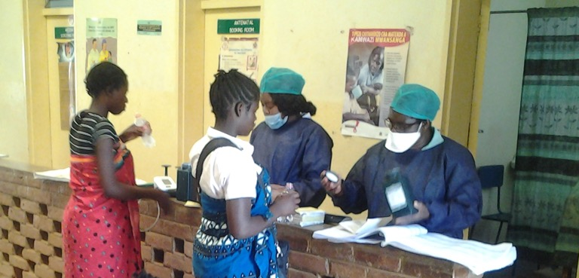

Slide 2
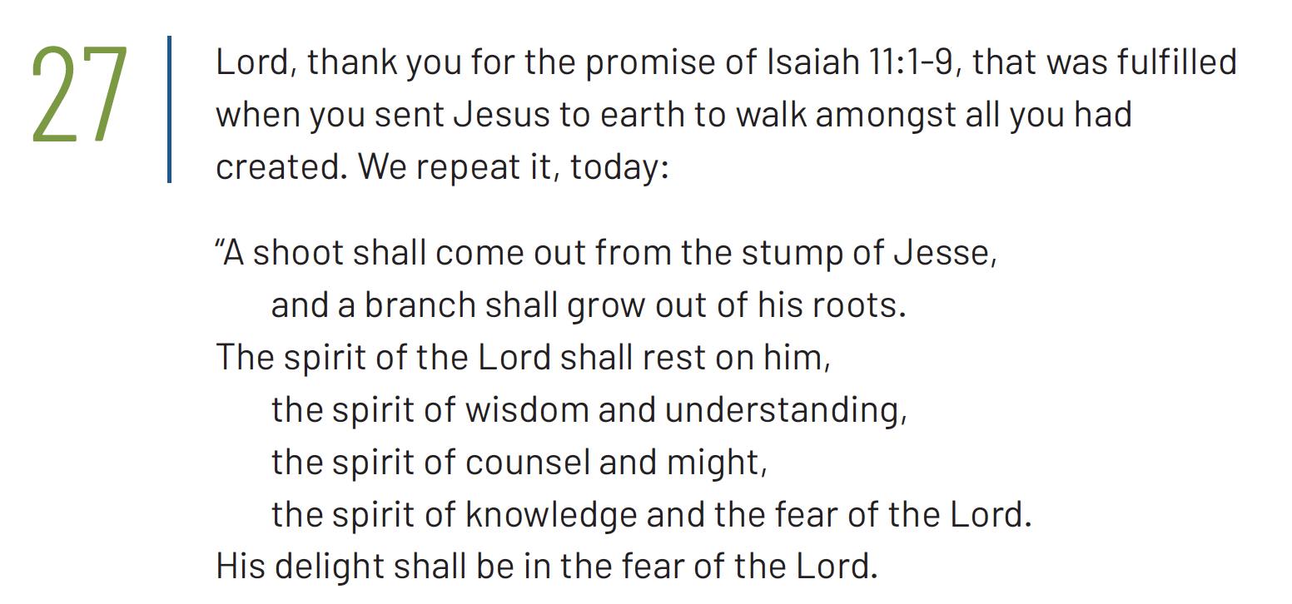
1/3

Slide 3
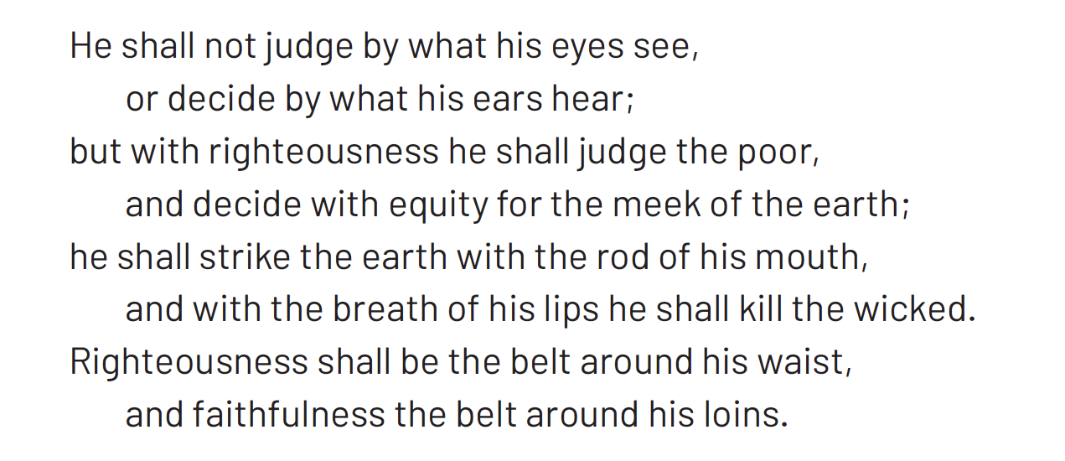
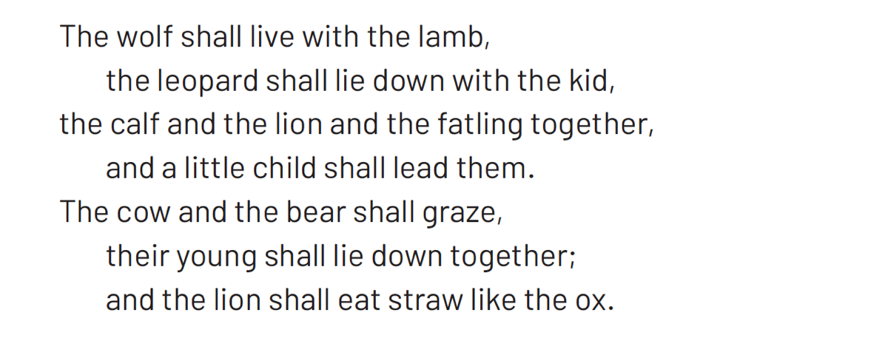
2/3

Slide 4

3/3

Slide 5


Slide 6
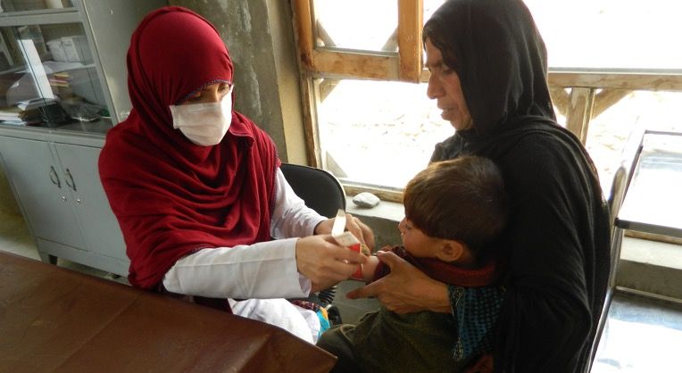


Slide 7


Slide 8
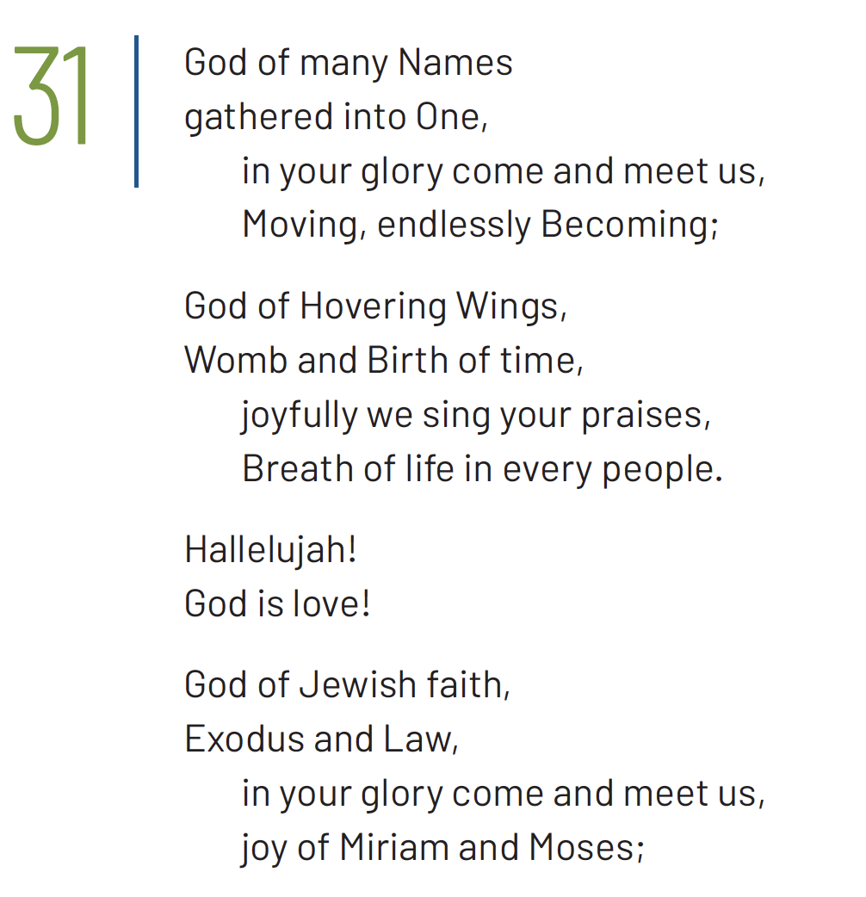
1/3

Slide 9
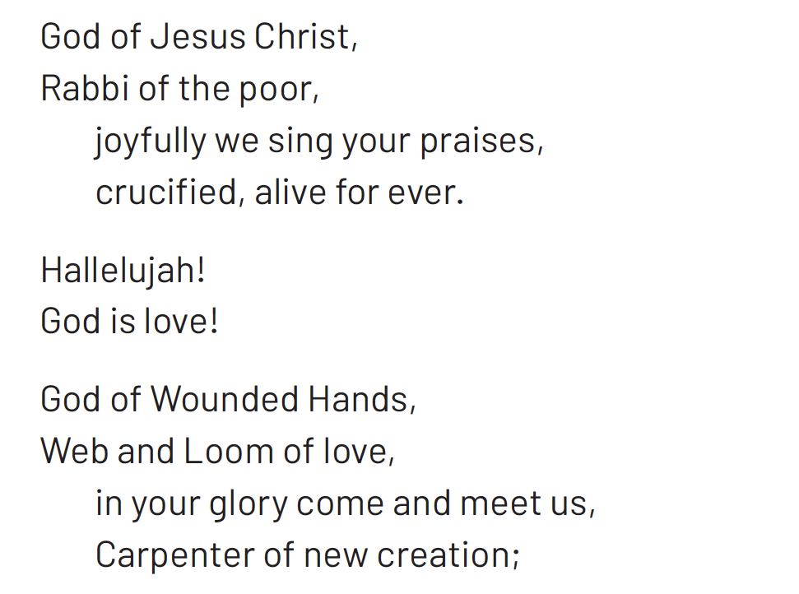
2/3

Slide 10
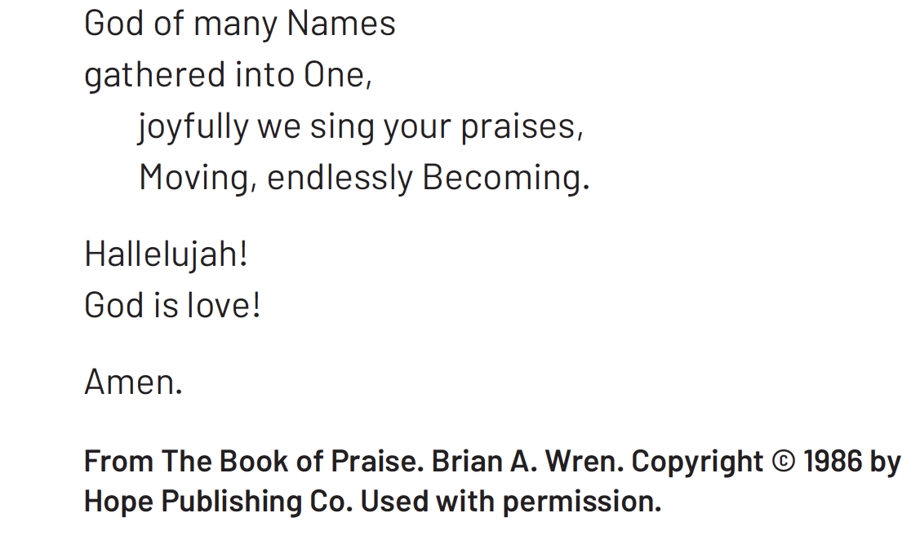
3/3

Slide 11


Slide 12


Slide 13
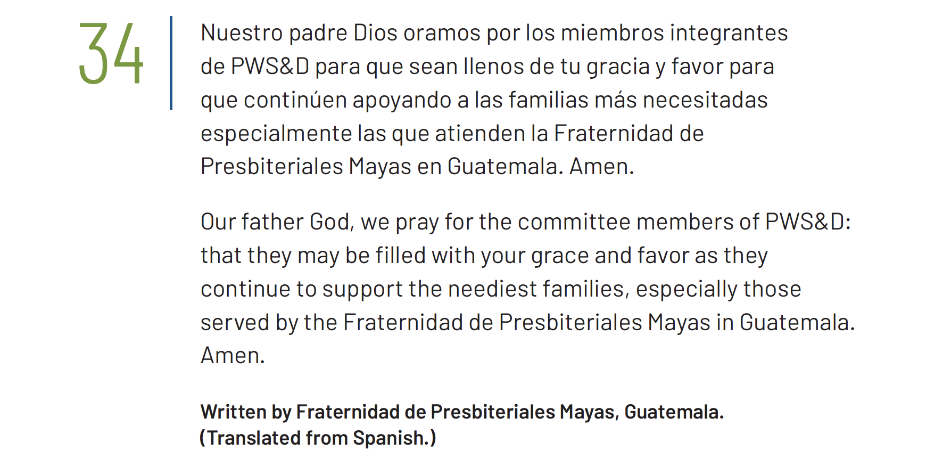
Notes:
This prayer is also available as a video read by PWS&D’s partner Fraternidad de Presbiteriales Mayas. Visit WeRespond.ca/Overflowing to download.

Slide 14


Slide 15
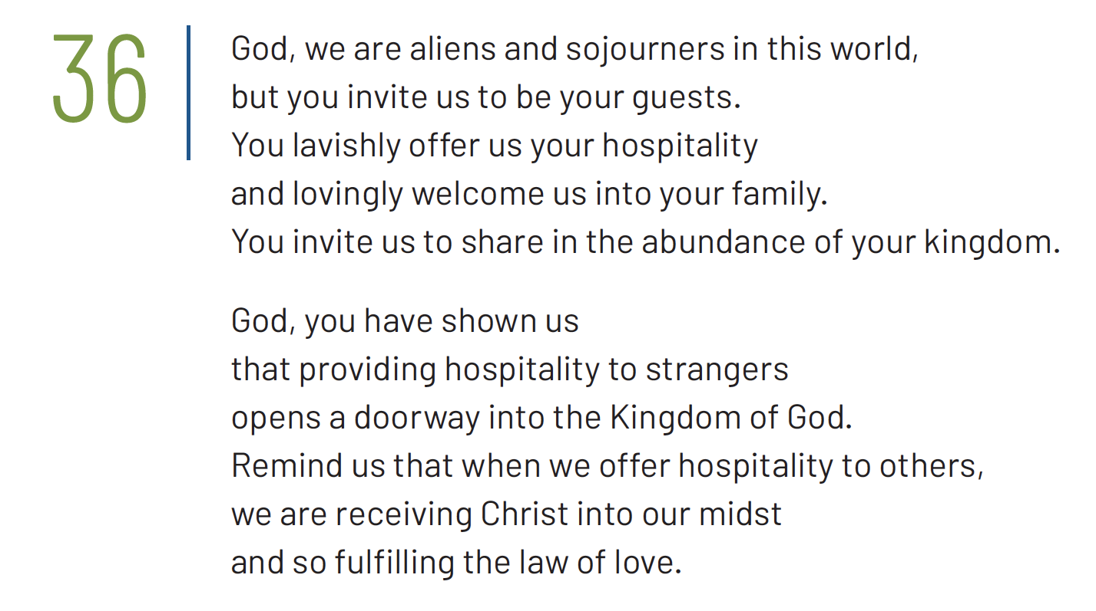
1/2

Slide 16

2/2

Slide 17



Slide 18
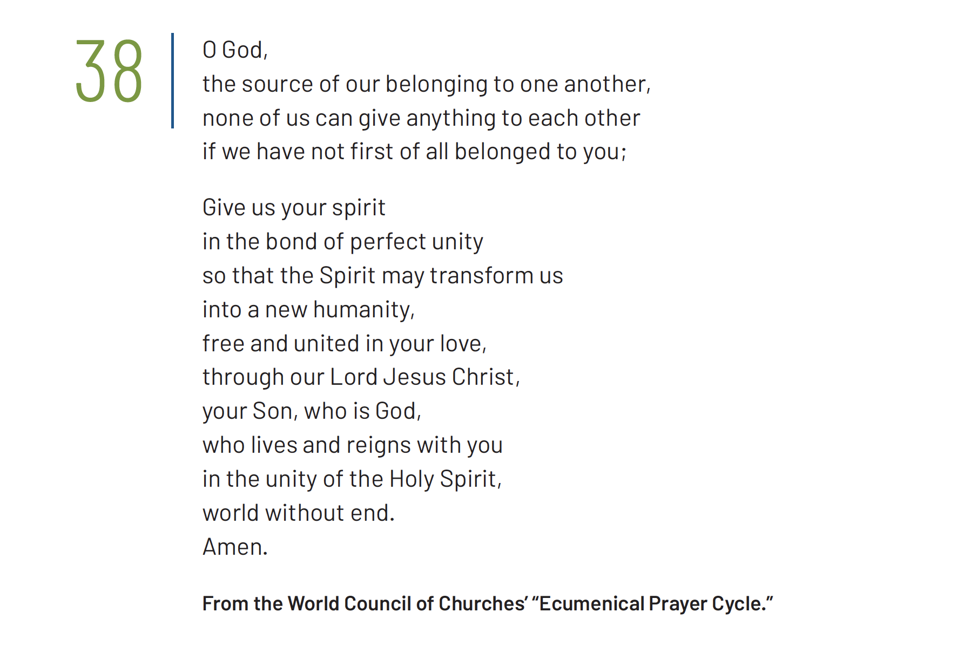

Slide 19
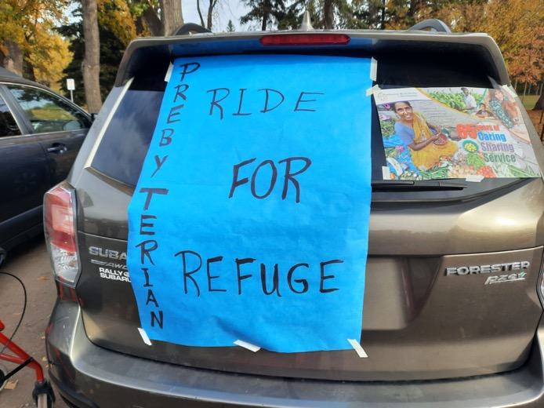


Slide 20


Slide 21
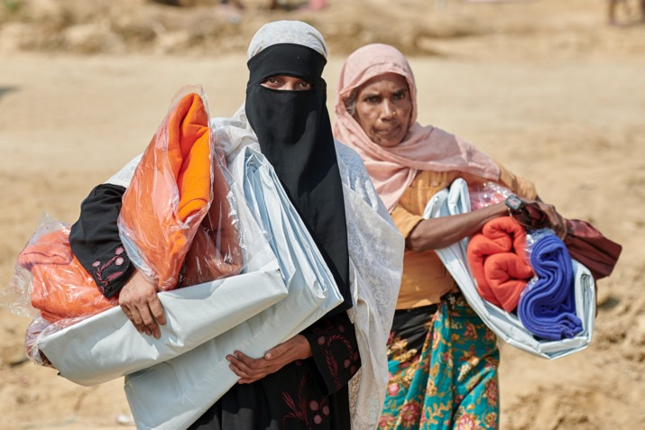


Slide 22
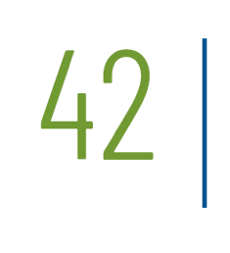

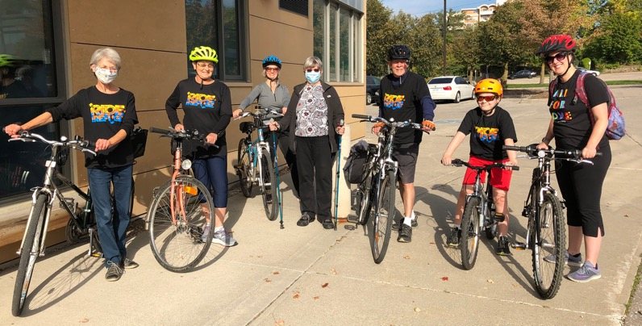

Slide 23
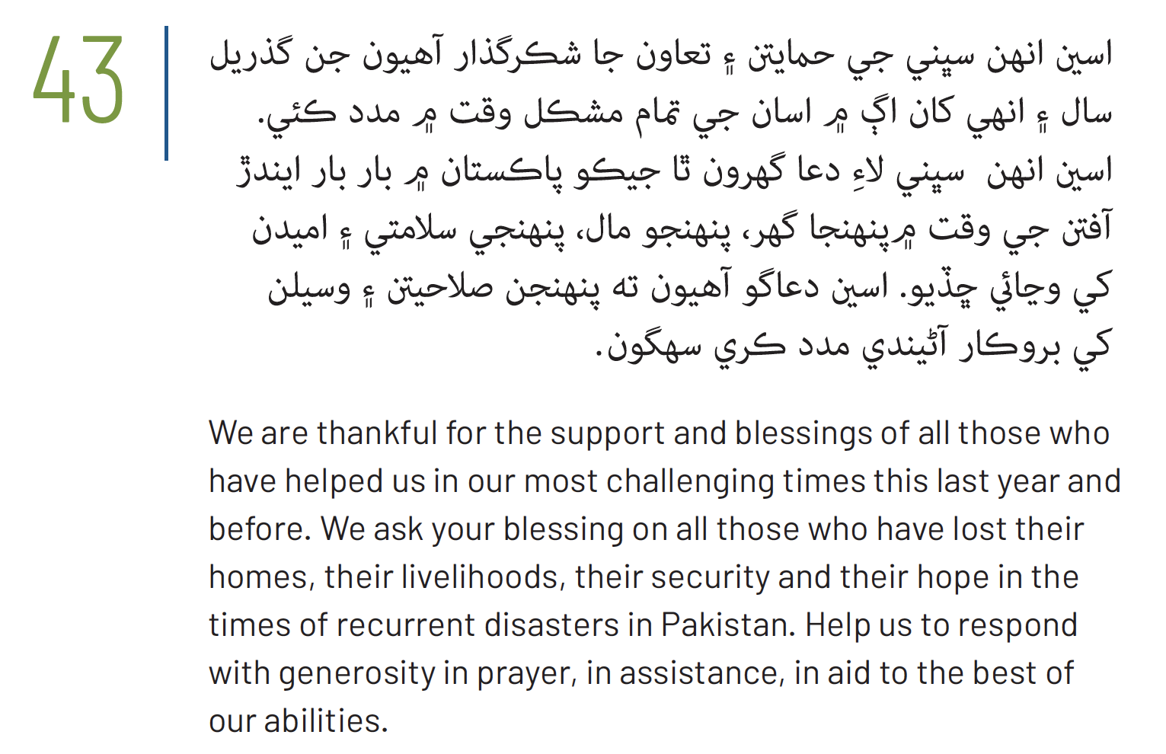


Notes:
This prayer is also available as a video read by PWS&D’s partner CWSA. Visit WeRespond.ca/Overflowing to download.

Slide 24
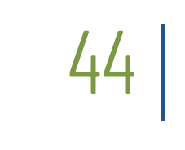

Notes:
In situations of conflict and post-conflict women are victimized many times over. Women and women’s organizations are integral actors in the defense of human rights and in processes for peace, justice and reparations. Through the Women of Courage project, the ecumenical organization KAIROS works with partners to end gender-based violence in militarized conflict and to increase the participation of women in peacebuilding processes.

Slide 25
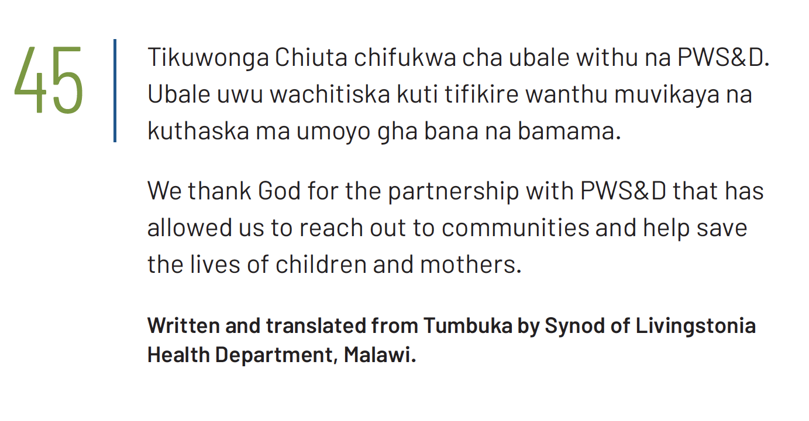

Slide 26


Slide 27


Slide 28


Slide 29
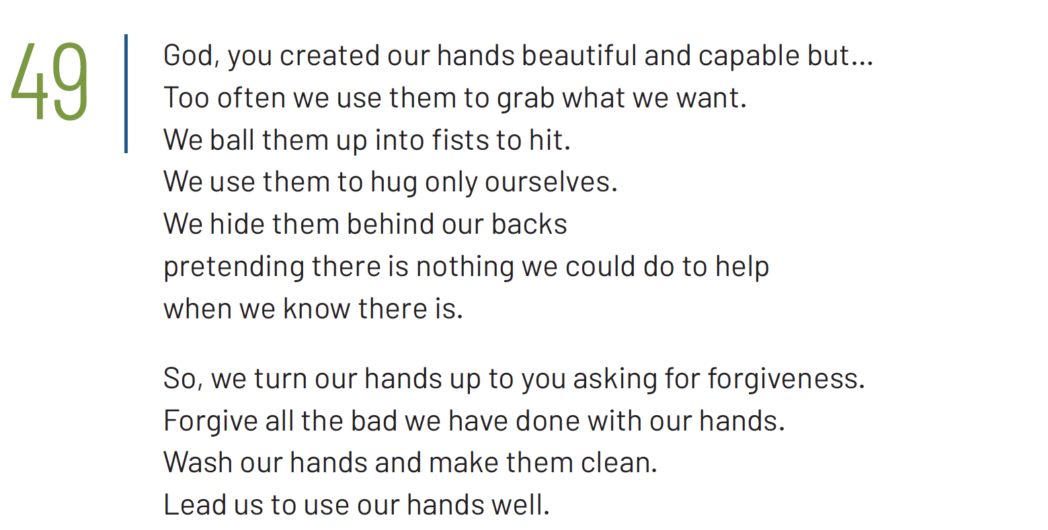
1/2

Slide 30
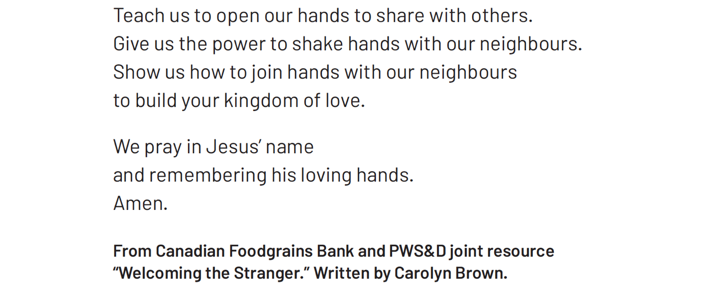
2/2

Slide 31
