Slide 1
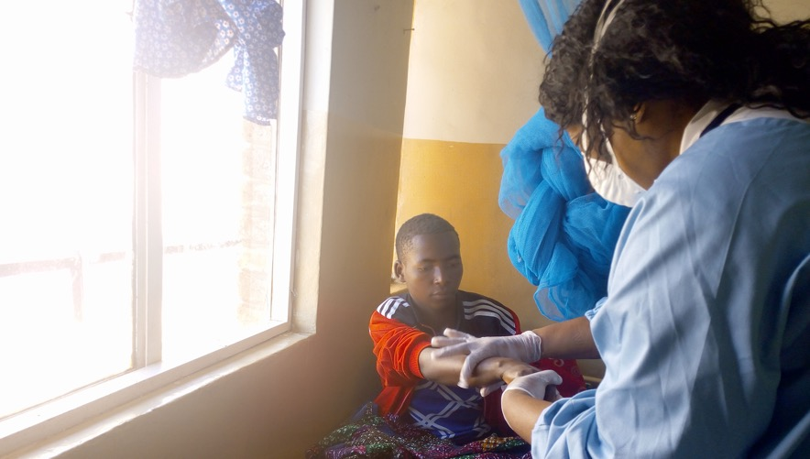
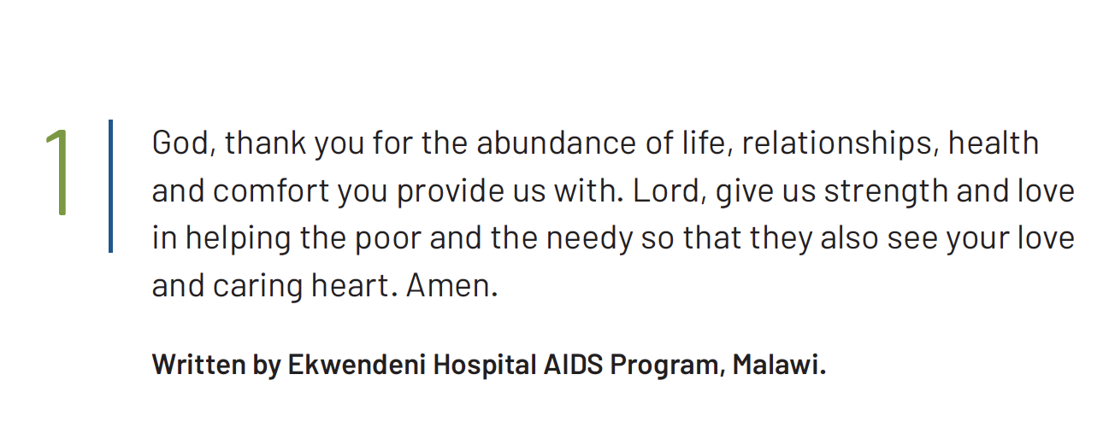
Notes:
This prayer is also available as a video read by PWS&D’s partner EHAP. Visit WeRespond.ca/Overflowing to download.

Slide 2
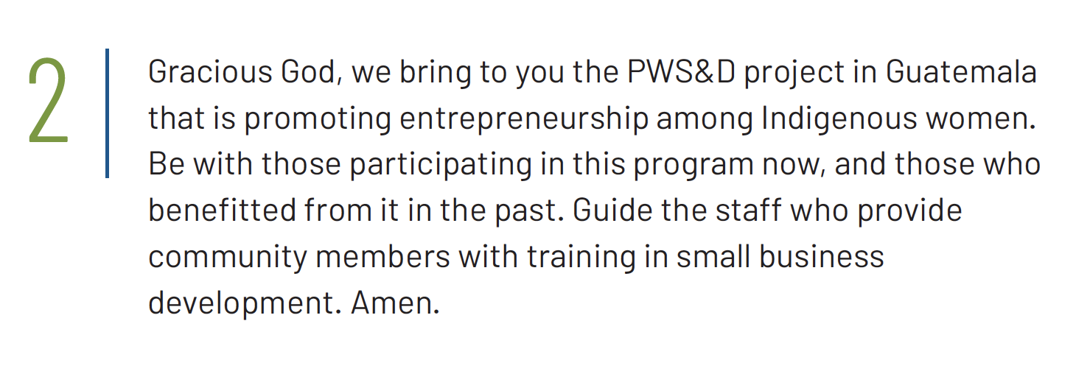

Slide 3


Slide 4
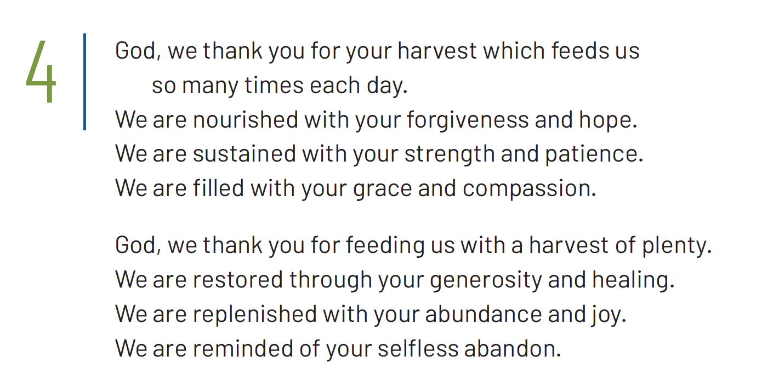
1/2

Slide 5
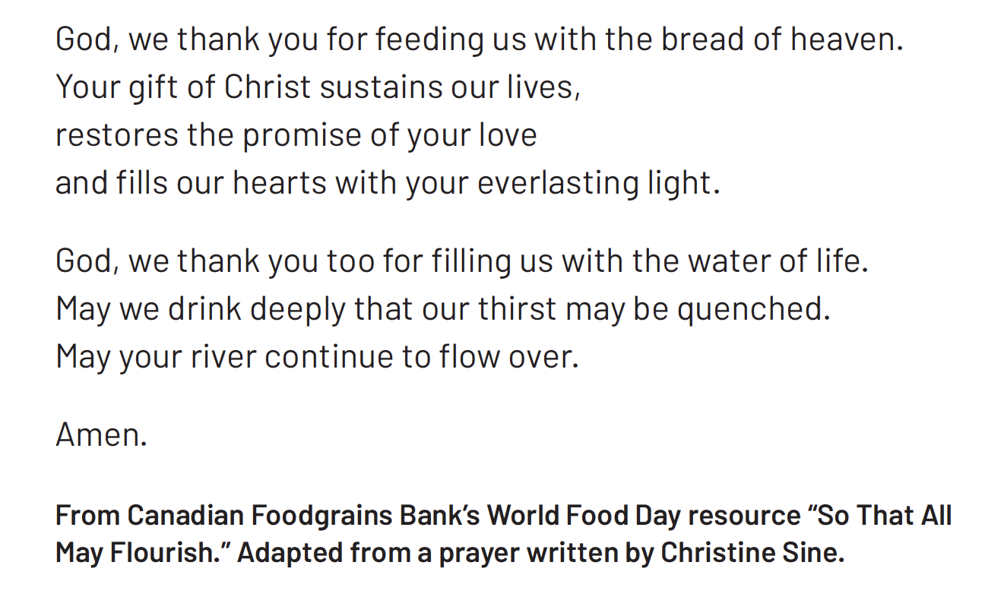
2/2

Slide 6
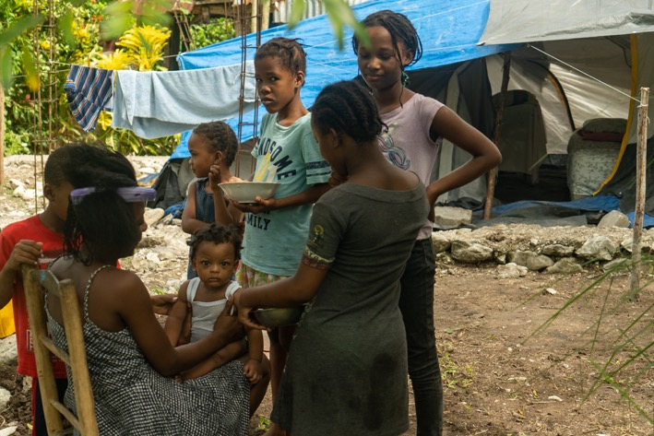


Slide 7


Slide 8
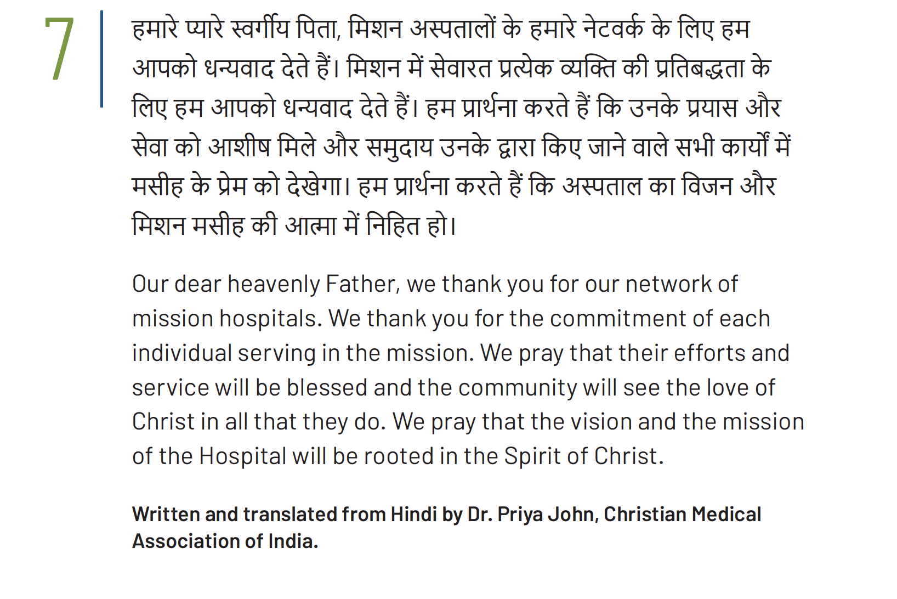
Notes:
This prayer is also available as a video read by PWS&D’s partner CMAI. Visit WeRespond.ca/Overflowing to download.

Slide 9



Slide 10
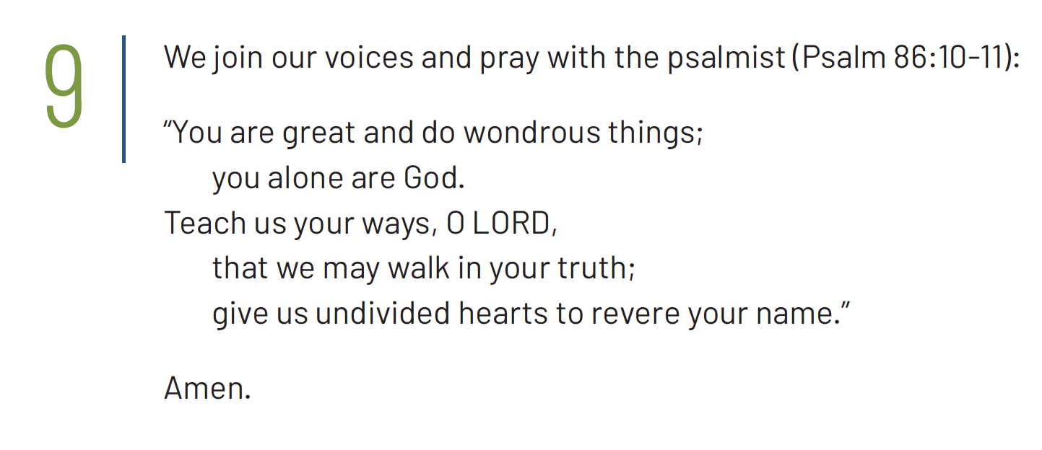

Slide 11



Slide 12
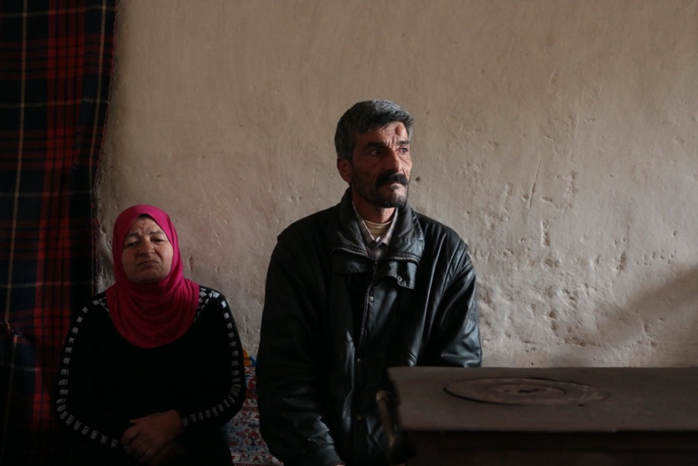


Slide 13


Slide 14
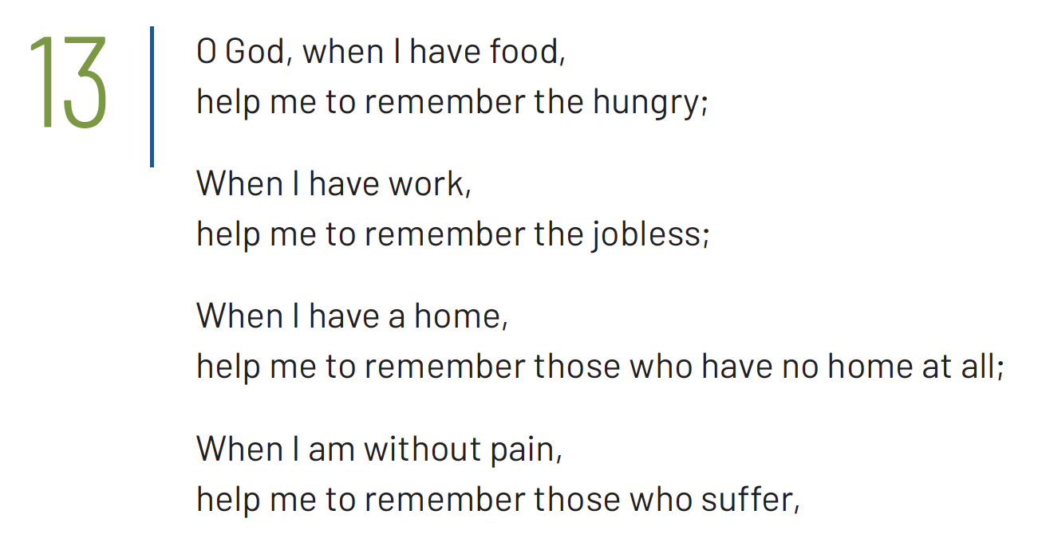
1/2

Slide 15
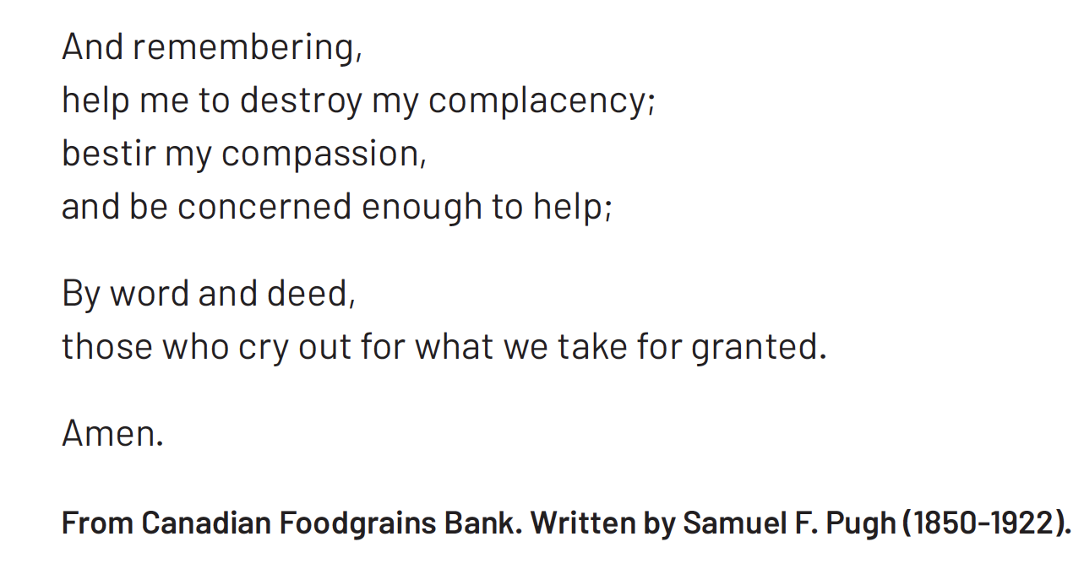
2/2

Slide 16
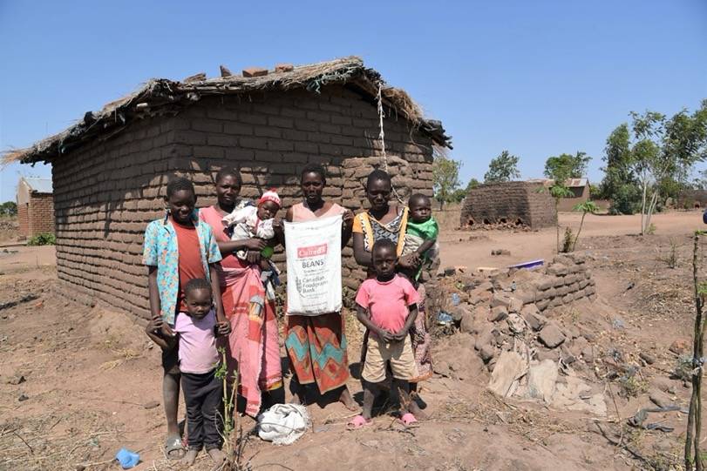


Slide 17


Slide 18
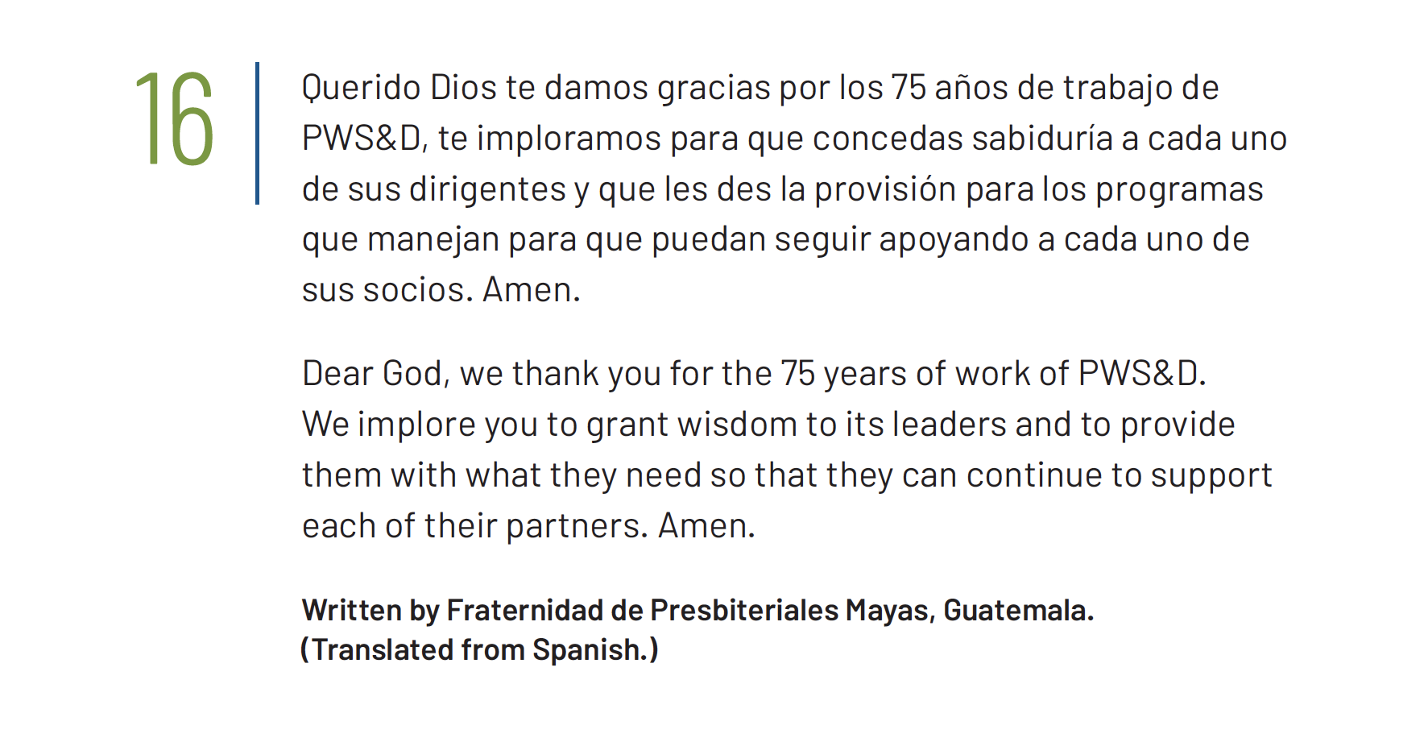
Notes:
This prayer is also available as a video read by PWS&D’s partner Fraternidad de Presbiteriales Mayas. Visit WeRespond.ca/Overflowing to download.

Slide 19


Slide 20
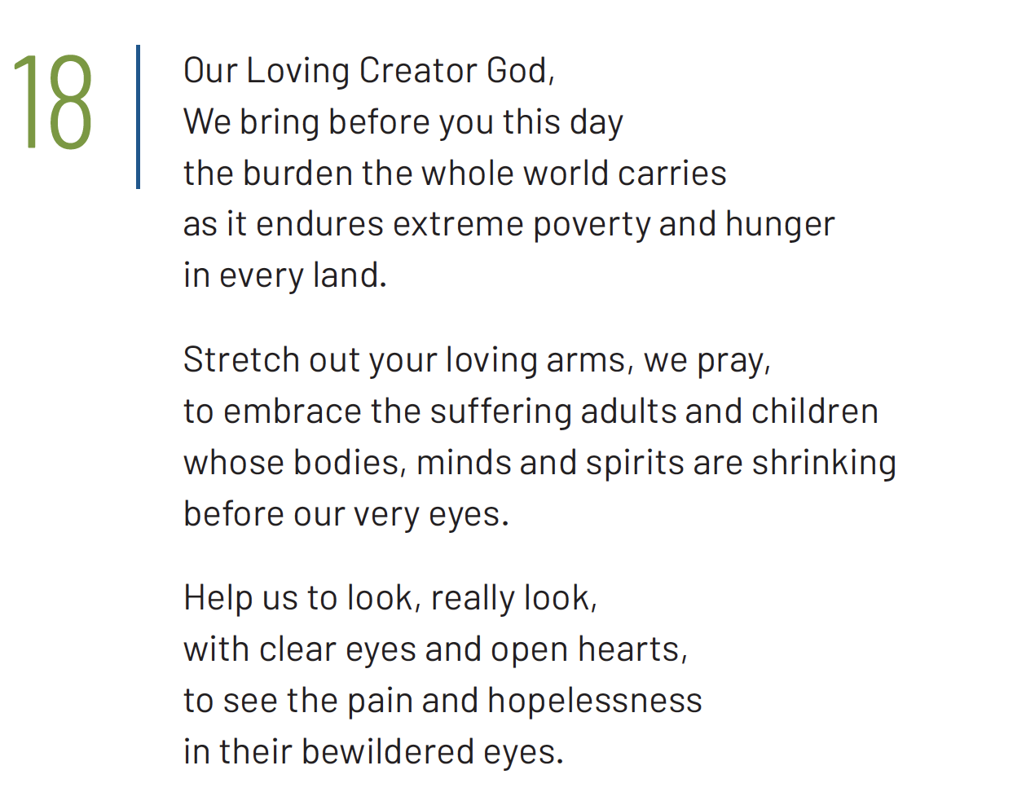
1/2

Slide 21
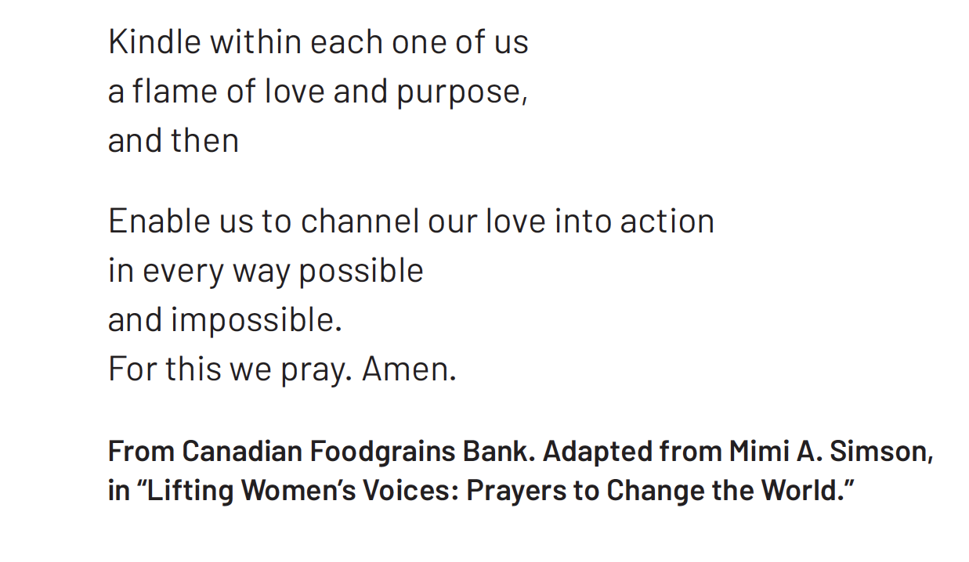
2/2

Slide 22
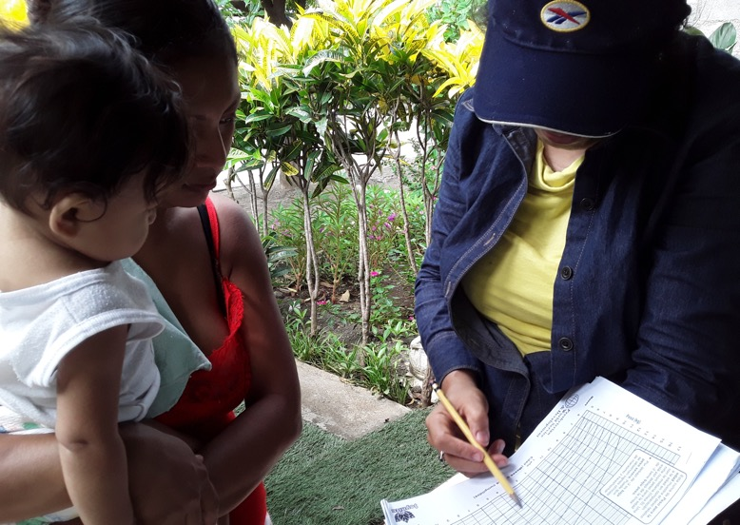


Slide 23


Slide 24
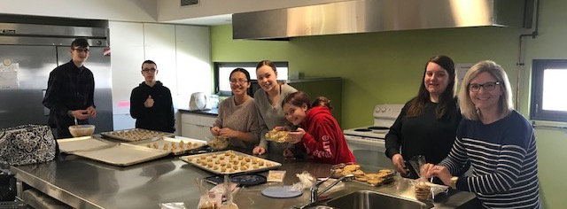


Slide 25
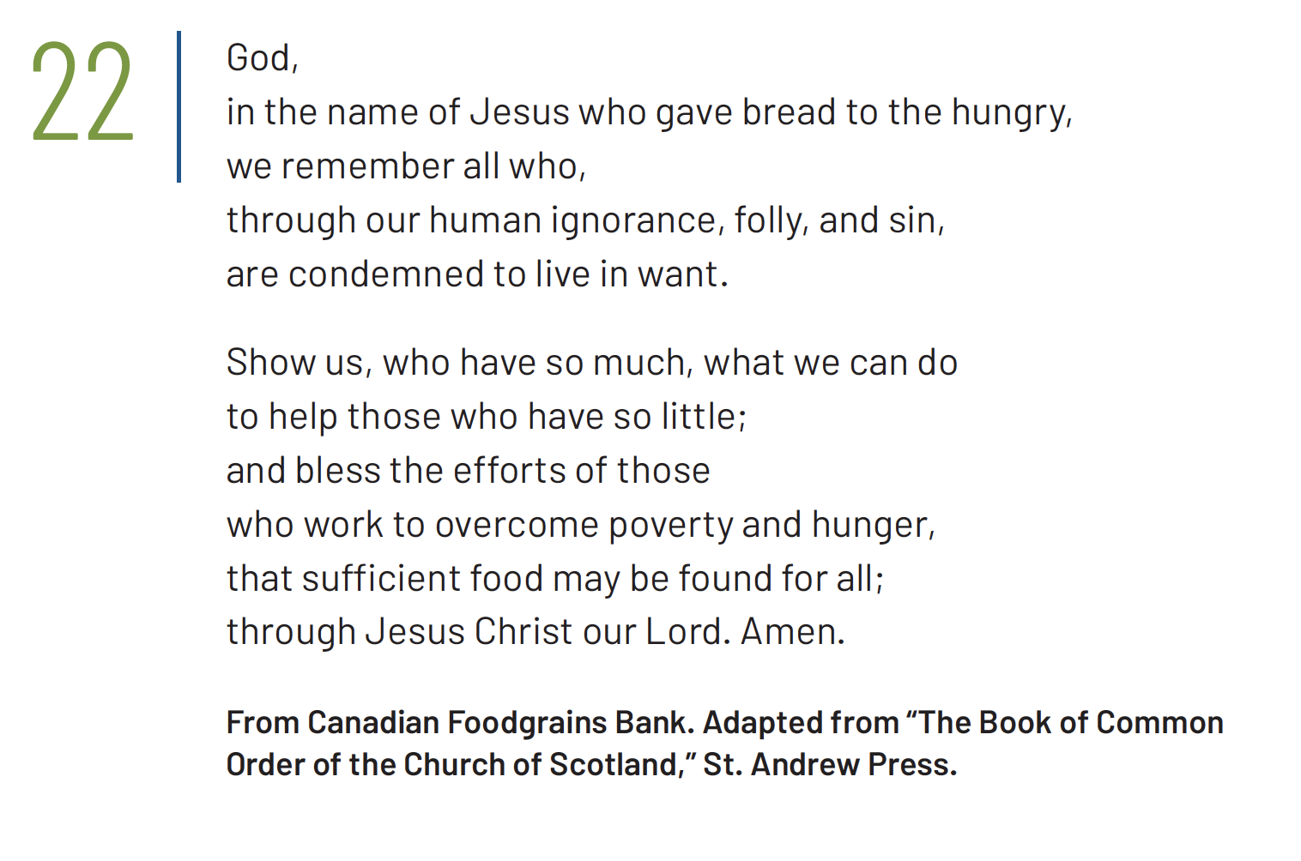

Slide 26



Slide 27
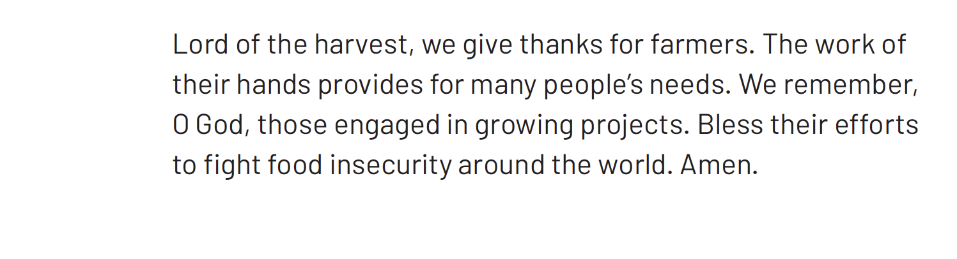
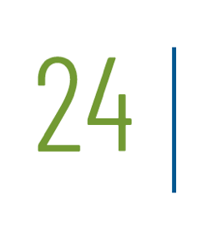

Slide 28
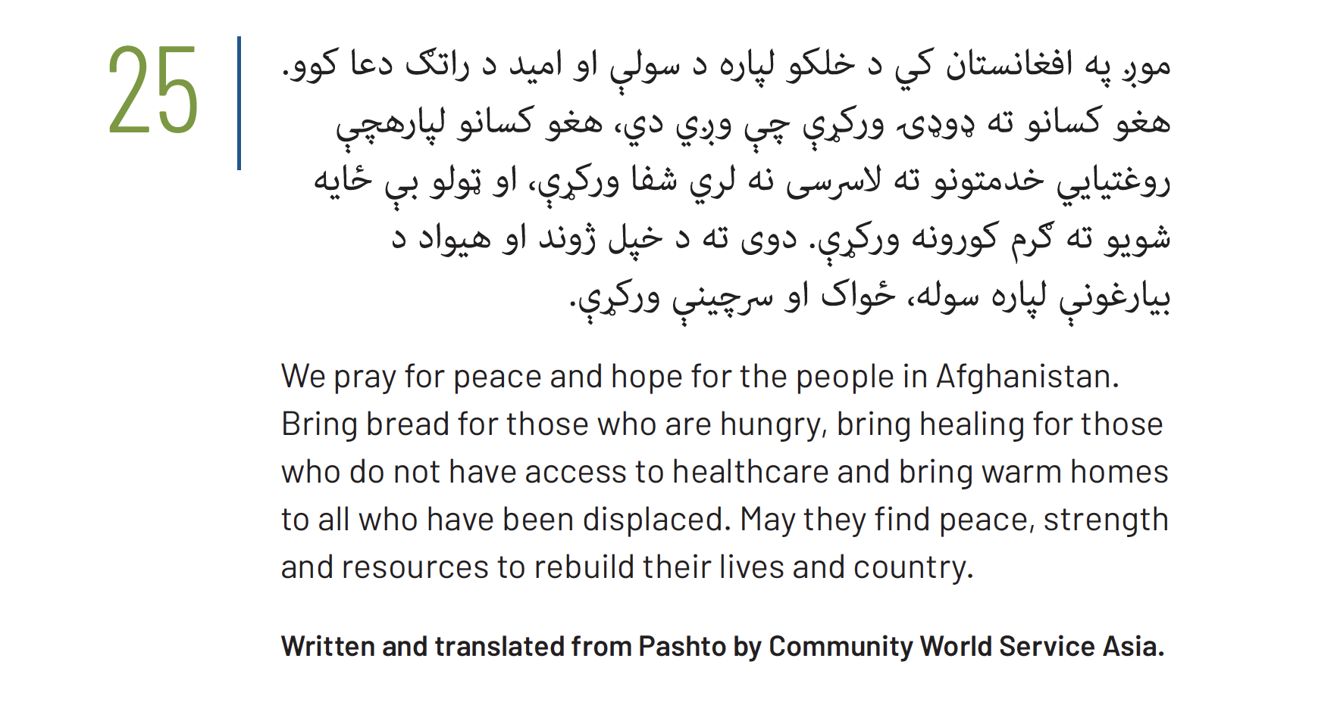
Notes:
This prayer is also available as a video read by PWS&D’s partner CWSA. Visit WeRespond.ca/Overflowing to download.

