Slide 1
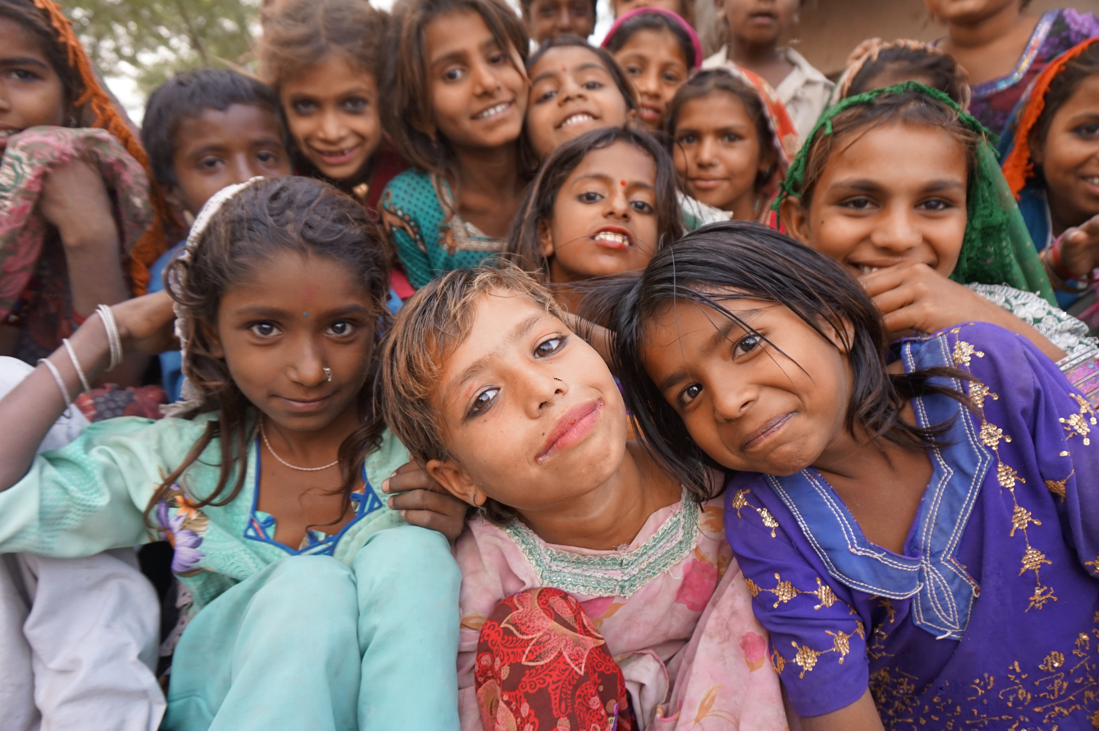
We Respond
Notes:
[Presenter to introduce self and relation to PWS&D]
Following the example set by Jesus, our church responds faithfully to the call to serve people in need. We do this through Presbyterian World Service & Development—the development and relief agency of The Presbyterian Church in Canada.
For almost 75 years, our church has been actively working to serve marginalized and vulnerable people through Presbyterian World Service & Development.
While the global context has evolved since PWS&D was first formed, what has not changed is a commitment to Christ’s message of love through justice, poverty reduction and support in times of disaster.
(Photo: India)

Slide 2
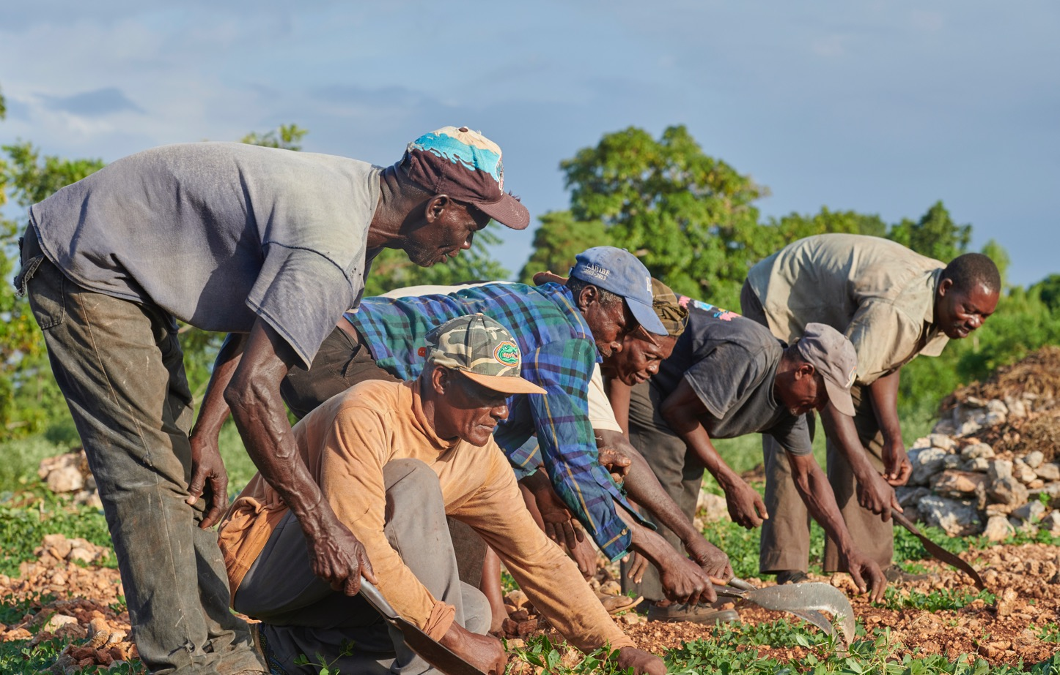
Photo: ACT/Paul Jeffrey
Our Vision
Inspired by God’s promise of abundant life, PWS&D envisions a sustainable, compassionate and just world.
Notes:
Rooted in the living hope of Jesus Christ and inspired by God’s promise of abundant life, PWS&D envisions a sustainable, compassionate and just world.
With support from Presbyterians across Canada, we respond to God’s call to serve the marginalized and distressed.
We respond to help communities around the world overcome poverty, recover from emergency situations and build sustainable futures.
(Photo: Haiti, agriculture, ACT Alliance/Paul Jeffrey)

Slide 3
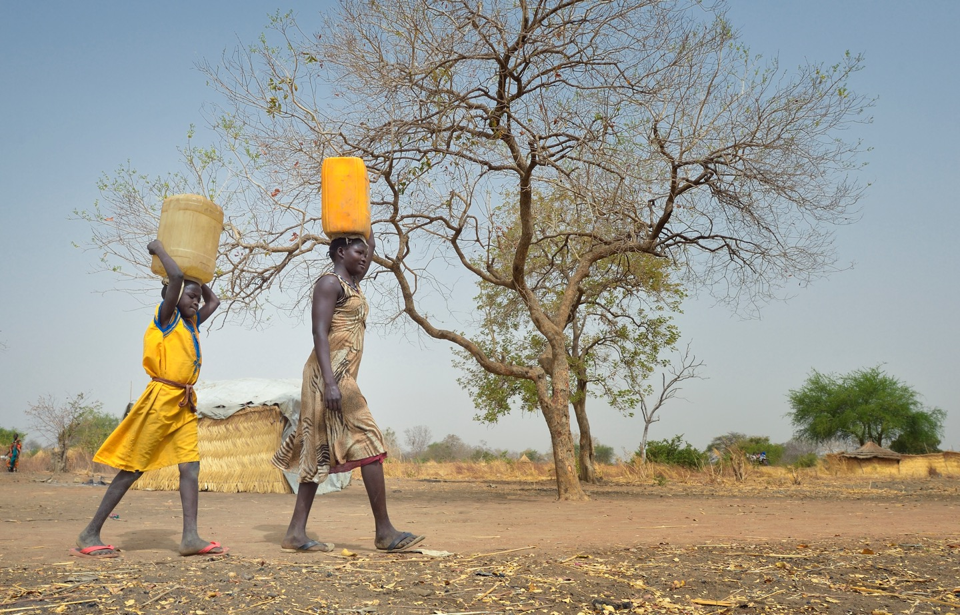
Photo: ACT/Paul Jeffrey
Our Values
Compassion ∙ Justice ∙ Partnership
Notes:
Working with communities around the world, PWS&D is guided by:
Compassion: PWS&D walks with distressed and marginalized people, listening carefully to their stories and responding effectively.
Justice: PWS&D works for equality, empowerment, human dignity, peace and stewardship of creation. In solidarity, we affirm that all people are entitled to know their rights, to receive equal protection, and to have access to and control over resources.
Partnership: PWS&D believes in dynamic relationships that involve mutual learning, trust, and shared vision. Healthy partnerships are accountable, ethical, equitable, flexible and respectful.
(Photo: South Sudan, relief)

Slide 4

One Mission
Two Funds
Gifts to Presbyterians Sharing and PWS&D are sharing Christ’s love in Canada and around the world!
Notes:
Many people ask, “What’s the difference between PWS&D and Presbyterians Sharing?” Both funds support the overall mission and ministry of The Presbyterian Church in Canada, but they work in different ways.
Presbyterians Sharing is the fund that supports the national programs and ministries of The Presbyterian Church in Canada. Examples include the placement of mission staff overseas through International Ministries, General Assembly, Indigenous ministries, and new and renewing congregations in Canada.
PWS&D focuses on international development to tackle poverty and injustice and respond to emergencies. We raise funds directly from individuals and congregations. PWS&D also receives support from the Canadian government. While PWS&D doesn’t receive funds directly from Presbyterians Sharing, we receive valuable in-kind support that helps keep administrative costs to a minimum, allowing us to maximize overseas program funding.

Slide 5
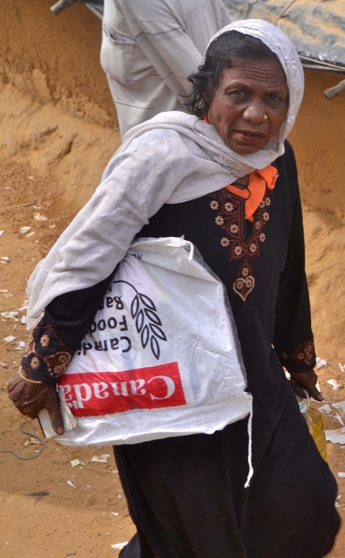


We Respond Together
Photo: CFGB
Notes:
Based on our program priorities, we seek out local partners with whom we can work respectfully and collaboratively in order to create and implement programs that meet the needs of the local populations.
In addition to local partners, PWS&D collaborates with recognized internationally focused organizations, faith-based and secular, to have a greater impact and help address some of the structural issues that affect the communities where the church is working overseas. These partnerships also allow us to maximize Presbyterian donations and to respond faster in times of emergency. These organizations include the ACT Alliance, KAIROS and Canadian Foodgrains Bank.
(Photo: Bangladesh)

Slide 6
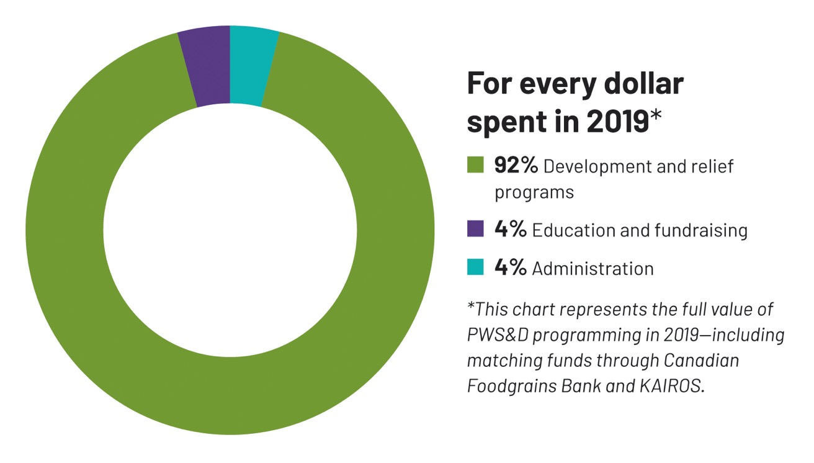
Notes:
PWS&D works to be faithful stewards of the resources generously entrusted to us.
Together we support life-changing development and relief work around the world, ensuring that men, women and children are able to achieve bright, more sustainable futures.

Slide 7
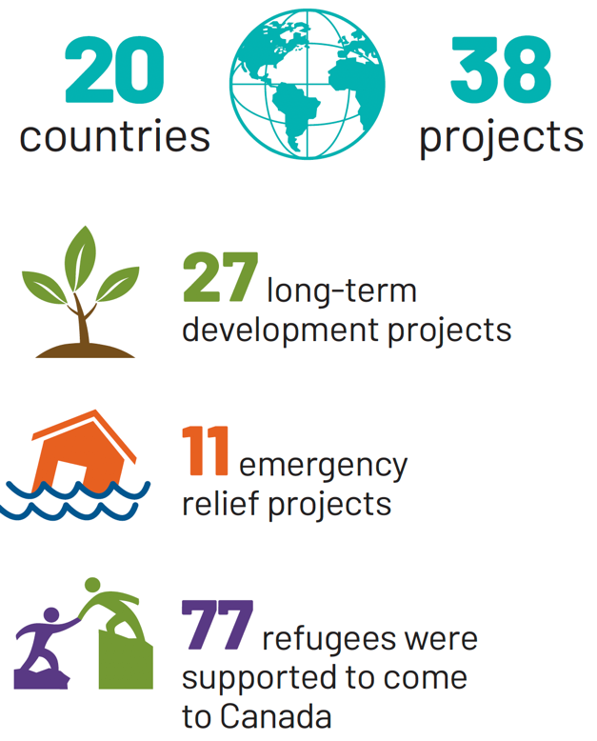
What we do
Notes:
In 2019, PWS&D supported 38 projects in 20 countries that are helping communities overcome poverty, recover from emergency situations and embrace new hope for the future.

Slide 8
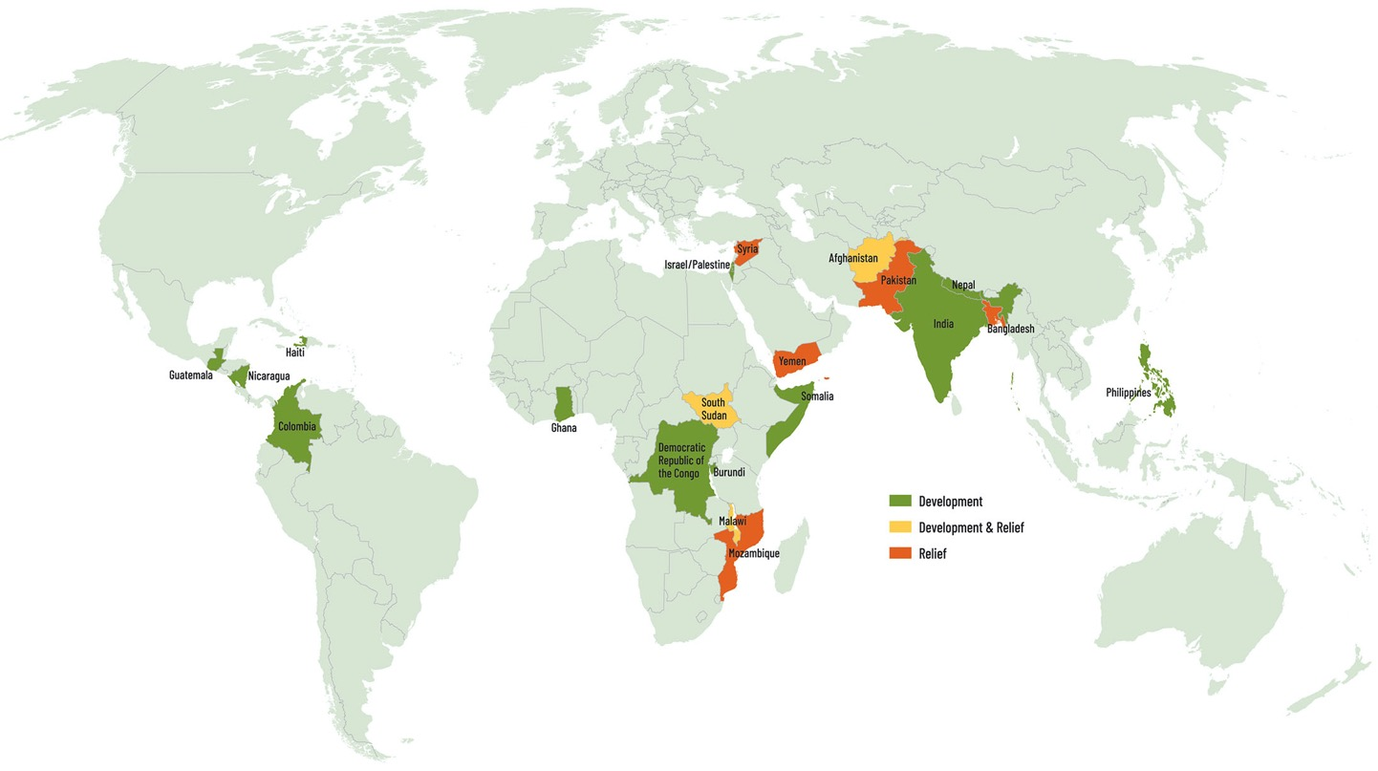
Where we work
We Respond
Notes:
PWS&D is committed to the well-being of vulnerable people across the globe. In order to make efficient use of resources, we work in particular countries, on particular projects. These countries are chosen based on our program priorities and the availability of partners in the region.
On this map, the green highlights countries where PWS&D is currently working with international partners to carry out long-term community development programs. The orange shows countries where PWS&D is responding to help provide immediate assistance in situations of conflict or natural or human-made disasters. The yellow shows countries where both are occurring.

Slide 9
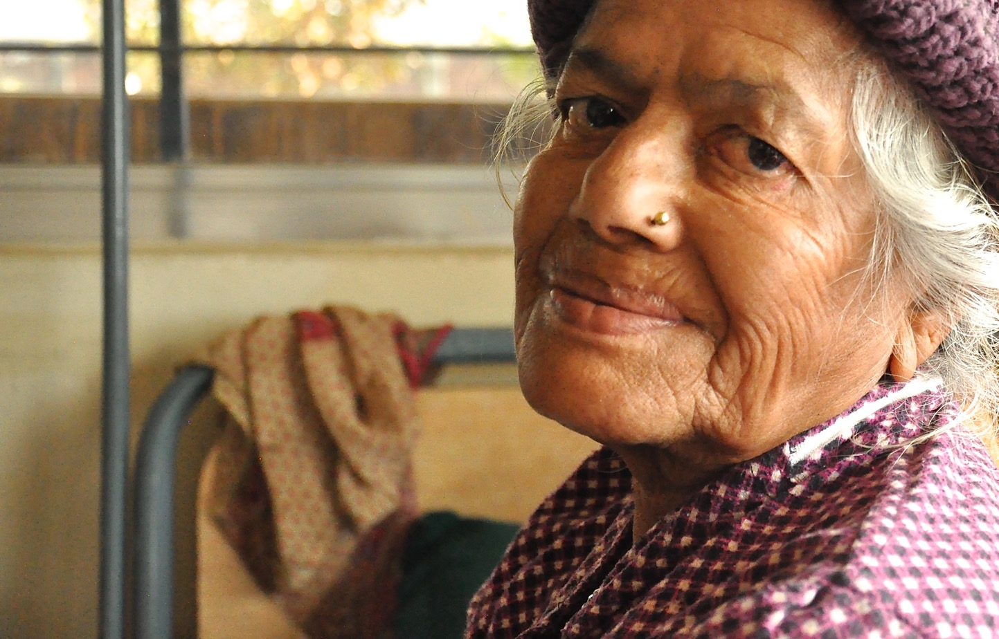
Our Priorities
Food Security ∙ Health ∙ Livelihoods ∙ Human Rights Emergency Relief ∙ Refugee Sponsorship
Notes:
The work we are doing together as a church through PWS&D can be broken into six pillars or priorities:
Food Security
Health
Economic Empowerment/Livelihoods
Human Rights
Emergency Relief
Refugee Sponsorship
The first four priorities make up our long-term development programs that work at the grassroots level to combat poverty and make lasting change. By addressing the root causes of poverty, people are empowered to take part in their own development and build sustainable futures.
(Photo: Nepal)

Slide 10
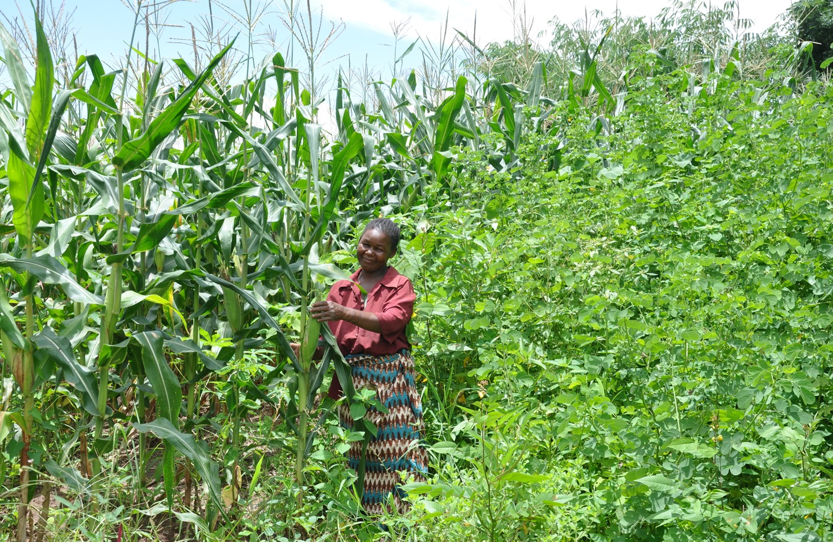
Food Security
Notes:
PWS&D’s focus on food security is helping people lead healthy and active lives by improving their access to food today and for the future. Through our food security programs PWS&D provides farmers with seeds, tools, fertilizer and training in organic, sustainable farming practices that increase crop yields and build resilience to environmental changes. PWS&D also teaches families to improve dietary diversity and prepare nutritious meals.
In 2019, PWS&D supported food security projects in Burundi, Democratic Republic of Congo, Ghana, Guatemala, Haiti, Kenya, Malawi and Nicaragua.
(Photo: Malawi, food security)

Slide 11
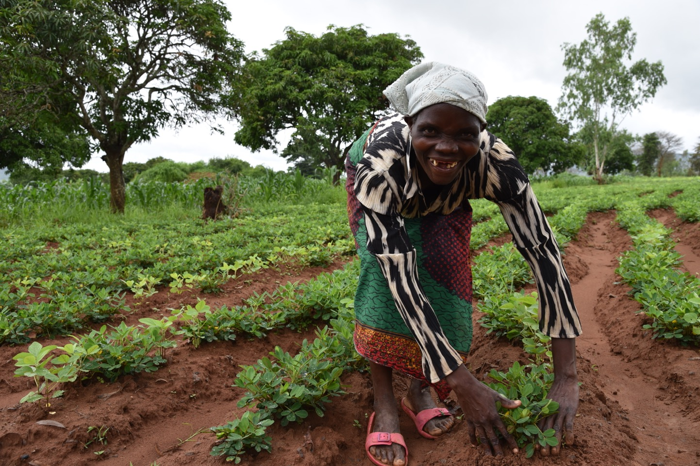
Photo: CFGB, Shaylyn McMahon
Notes:
Much of PWS&D’s work in food security and food aid is done in partnership with the Canadian Foodgrains Bank – a membership of 15 church-based agencies all working together with the common goal of ending hunger. Since 1983, the Foodgrains Bank has grown to become one of Canada’s leading food assistance organizations and the predominant Christian response to global hunger. Presbyterians are dynamic partners in this effort to help those who do not have enough to eat.
(Photo: Malawi, food security, CFGB/Shaylyn McMahon)

Slide 12
Notes:
In Haiti, Lucsius wondered if he’d ever harvest a good crop again. His farm’s soil had eroded and degraded due to climate change and the destruction of Hurricane Matthew in 2016. PWS&D provided support to a farm cooperative that changed Lucsius’ outlook for the future.
With over 2,000 other farmers in the region, Lucsius learned organic farming techniques—using mulch and planting trees—to restore the soil’s fertility and grow enough food, despite the changing climate he and other farmers are dealing with. An emphasis on nutritionally diverse crops has also improved the diets and health of participants. After using these techniques for the past seven years, Lucsius now produces enough food to feed and sustain his family.
(Photo: Haiti, food security)

Slide 13
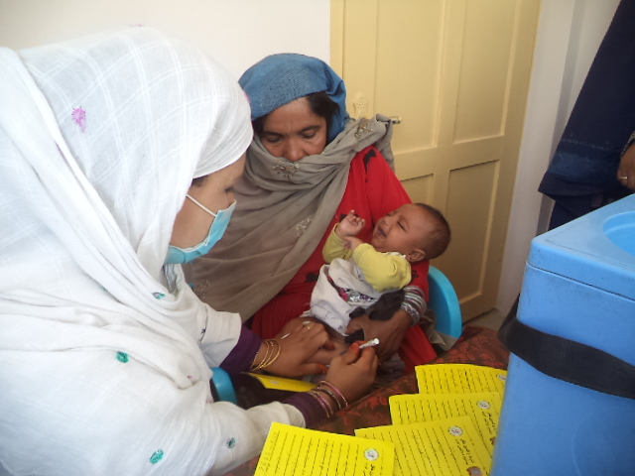
Photo: CWSA
Health
Notes:
Preventable illnesses and inadequate access to health care impact many in the developing world. PWS&D’s health programs help bring medical care to remote villages, ensure mothers and children receive the care they need, tackle prevalent childhood diseases, improve access to clean water and empower communities to prevent the spread of HIV.
In 2019, PWS&D supported health projects in Afghanistan, Ghana, India, Malawi, Nepal and Nicaragua.
(Photo: Afghanistan, MNCH)

Slide 14
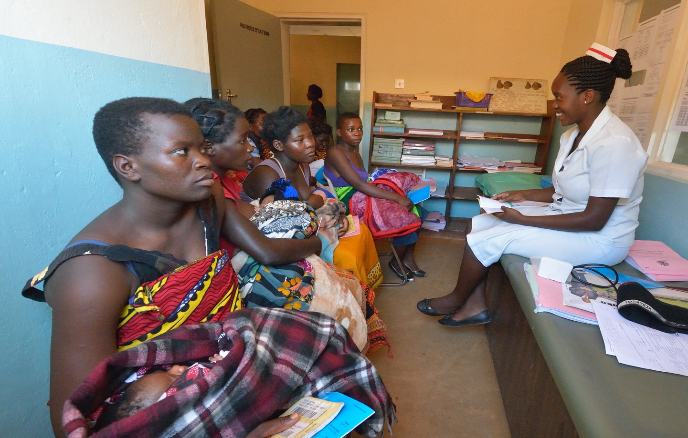
Photo: Paul Jeffrey
Maternal and Child Health
Notes:
In 2019, PWS&D’s maternal and child health project in Malawi and Afghanistan entered its final year.
With generous support from the Government of Canada over the four-year life of the project, almost 175,000 women, men, girls and boys in Afghanistan and Malawi were impacted.
(Photo: Malawi, MNCH)

Slide 15
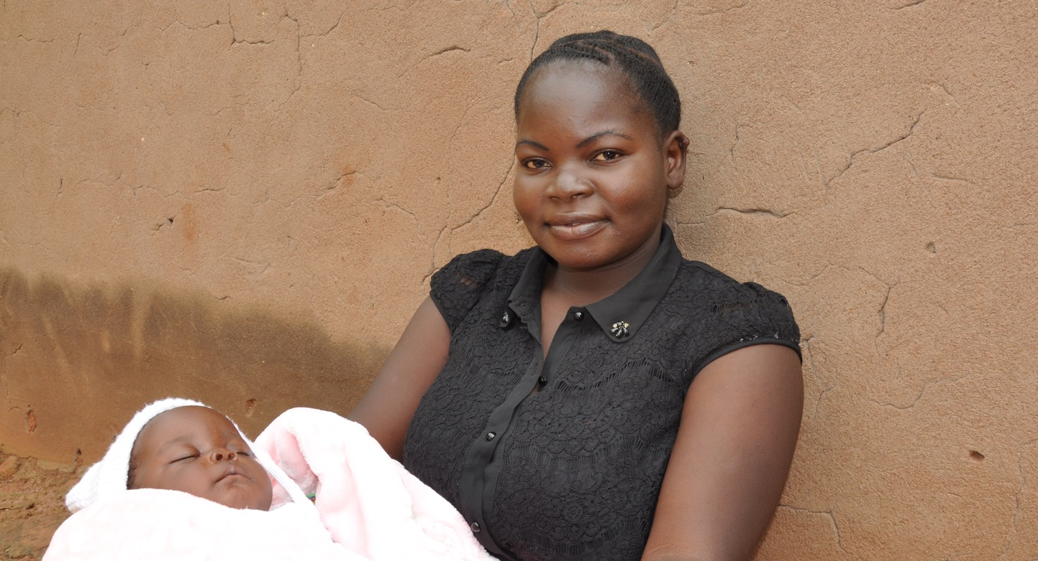
Maternal and Child Health
Notes:
In Malawi, Mary Justin is one of the women whose life has changed due to PWS&D’s maternal and child health project. The 22-year-old mother’s experiences were very different during her two pregnancies.
“My first pregnancy was a problem because there was little access. I don’t have to travel now to receive health services and am receiving much better care in my community— the same level I would get at a hospital,” she shares.
Improved care, training for health staff and volunteers, and access to vaccinations and nutrition screening for children have lowered rates of maternal and neonatal death and improved future health outcomes in the communities served.
(Malawi, MNCH)

Slide 16
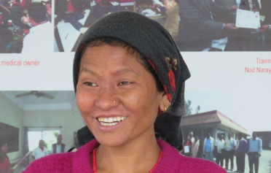
Treating Disease and Illness
Notes:
Communities are also seeing transformation through PWS&D’s work to treat disease and illness.
The Shining Hospital in Nepal, with PWS&D’s support, ensures timely diagnosis for patients living with leprosy and tuberculosis, and connects them with appropriate care.
Shining Hospital does more than just help people with their physical problems—by ensuring correct diagnoses and eliminating costs such as those for traditional healers, patients are protected financially.
In Nepal's Rukum district, Devika sought answers about her worsening leg from doctors and traditional healers with no luck. As her symptoms continued to worsen, the answer seemed impossible to find, until a friend referred her to the Shining Hospital. The staff helped Devika understand she had leprosy and provided her with the medicine she needed to get better.
(Photo: Nepal)

Slide 17
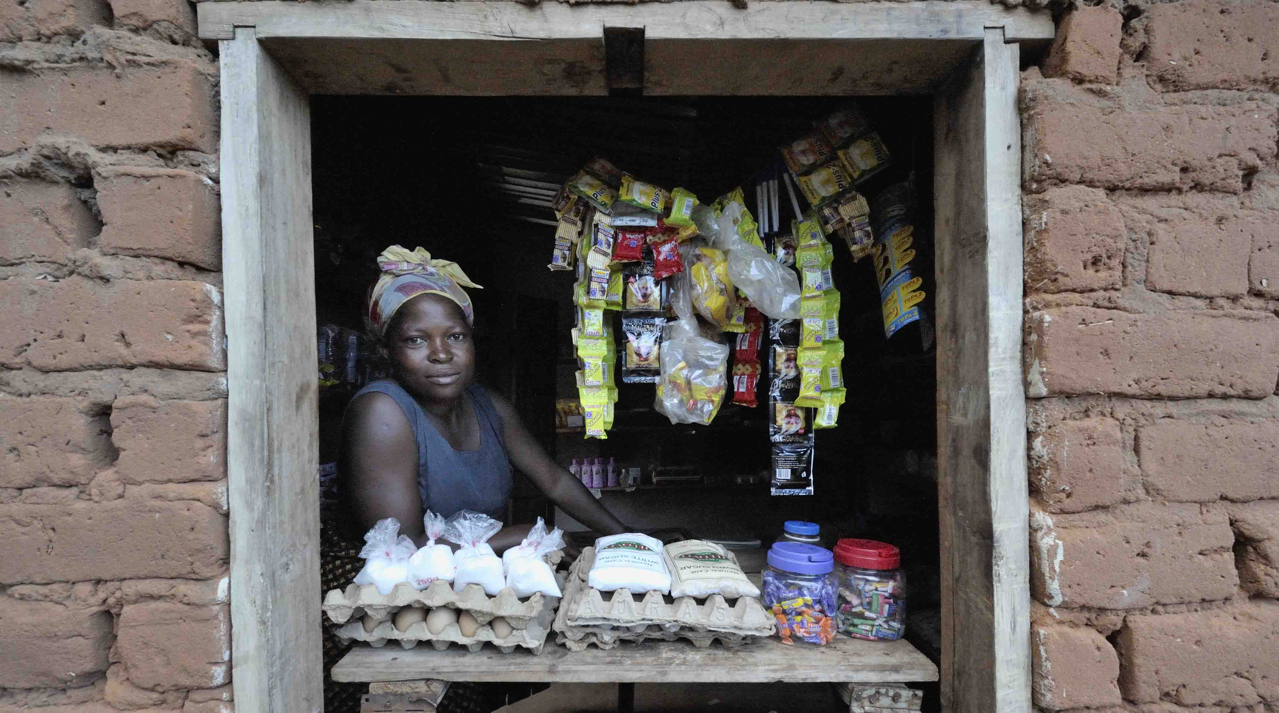
Photo: Paul Jeffrey
Livelihoods
Notes:
Having a sustainable livelihood means having food, water, shelter and clothing – the things needed in order to survive. It means being self-sufficient and able to provide for one’s family. It means having access to economic opportunities and meaningful employment.
PWS&D’s livelihood programs include education, small business development and vocational training for vulnerable groups, with a special focus on girls, women and youth.
In 2019, PWS&D supported livelihoods projects in Afghanistan, Ghana, Guatemala, India, Malawi and Nepal.
(Photo: Malawi)

Slide 18
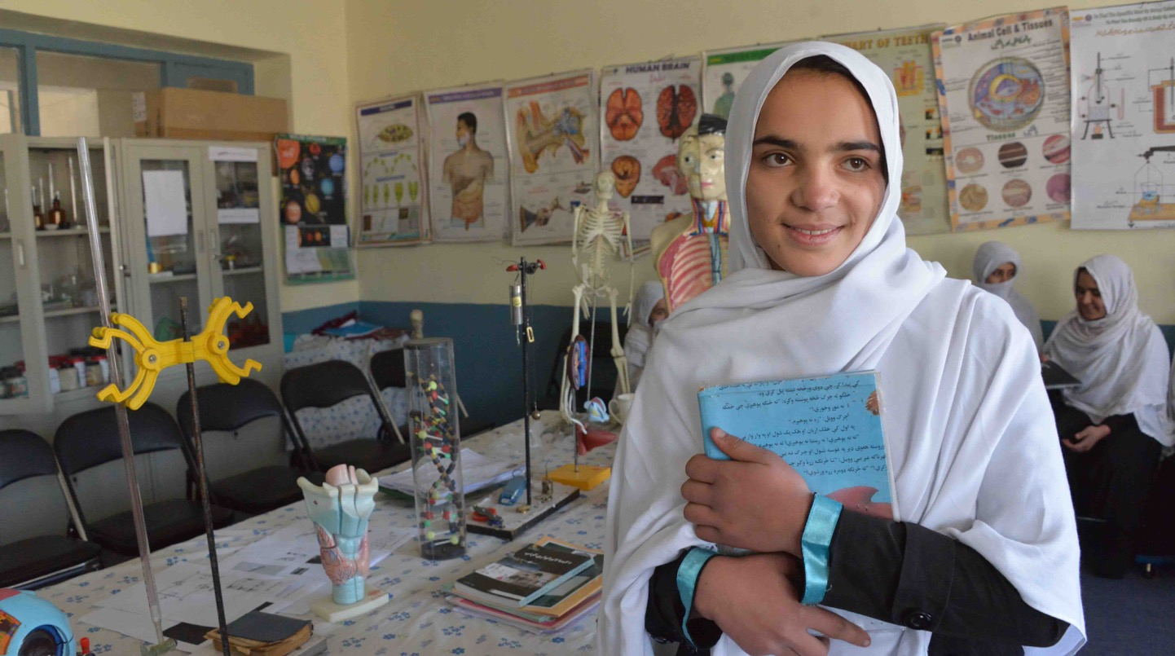
Education
Notes:
Working with partners in Afghanistan, Guatemala and Malawi, PWS&D is helping vulnerable children and marginalized adults access the education they need to have new opportunities for the future.
In Afghanistan, cultural barriers and the lack of female teachers contribute to lower enrolment of girls than boys, placing roadblocks in front of girls' opportunities to earn a future living.
PWS&D's local partner works to remove barriers to school attendance for girls. Teacher training ensures that education is not only available but of excellent quality, offering the hope of a brighter future for students and the country.
When one person becomes self-reliant, they can shape their future and lift up others.
(Photo: Afghanistan, girls' education)

Slide 19
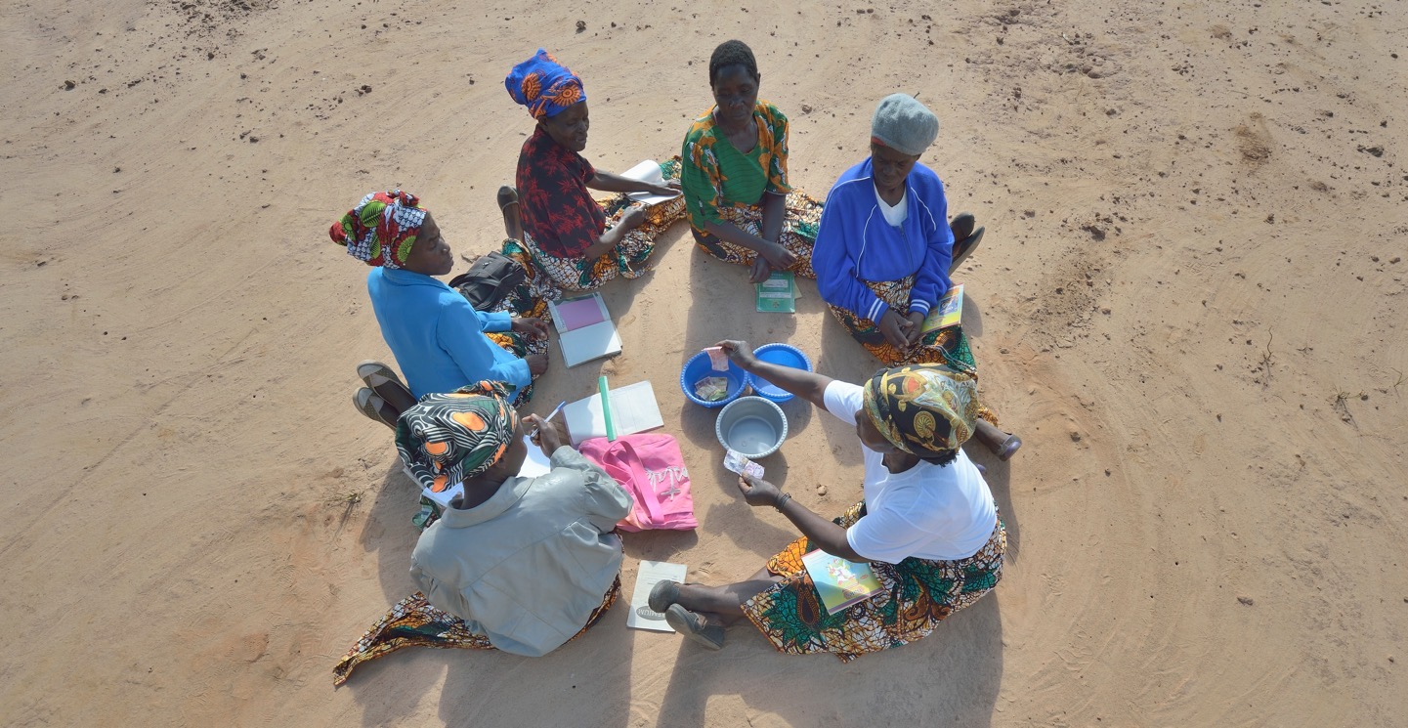
Photo: Paul Jeffrey
Self Help Groups
Notes:
Two others ways that PWS&D supports people around the world to develop sustainable livelihoods are self-help groups and vocational skills training.
Members of self help groups meet periodically to save money, distribute loans and support each other. These loans help women buy clothes, food and other items for their families. They also help women start small businesses.
(Photo: Malawi, self help groups)

Slide 20
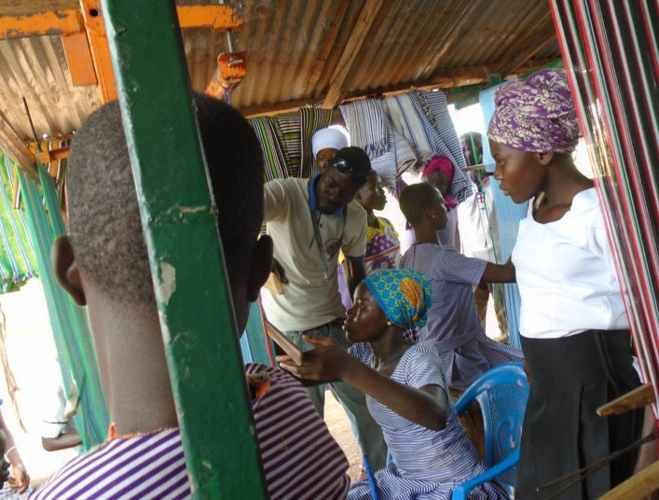
Vocational Skills Training
Notes:
When Halidu was just 13 years old, his right leg was amputated after a chronic sore he developed didn't heal.
While recovering, Halidu enrolled in PWS&D supported workshops that provided him with vocational skill training and instruction in weaving, tailoring and dressmaking.
After graduating, Halidu started his own business, teaching other students. So far, he has helped train 44 apprentices.
Halidu gives a testimony of how thankful he is for the Garu Community Based Rehabilitation program's impact on his life. "I owe the CBR program and all their partners, especially PWS&D in Canada, a great deal of gratitude for contributing positively to my life. I am who I am today because of your generous work and love. God bless you."
(Ghana)

Slide 21
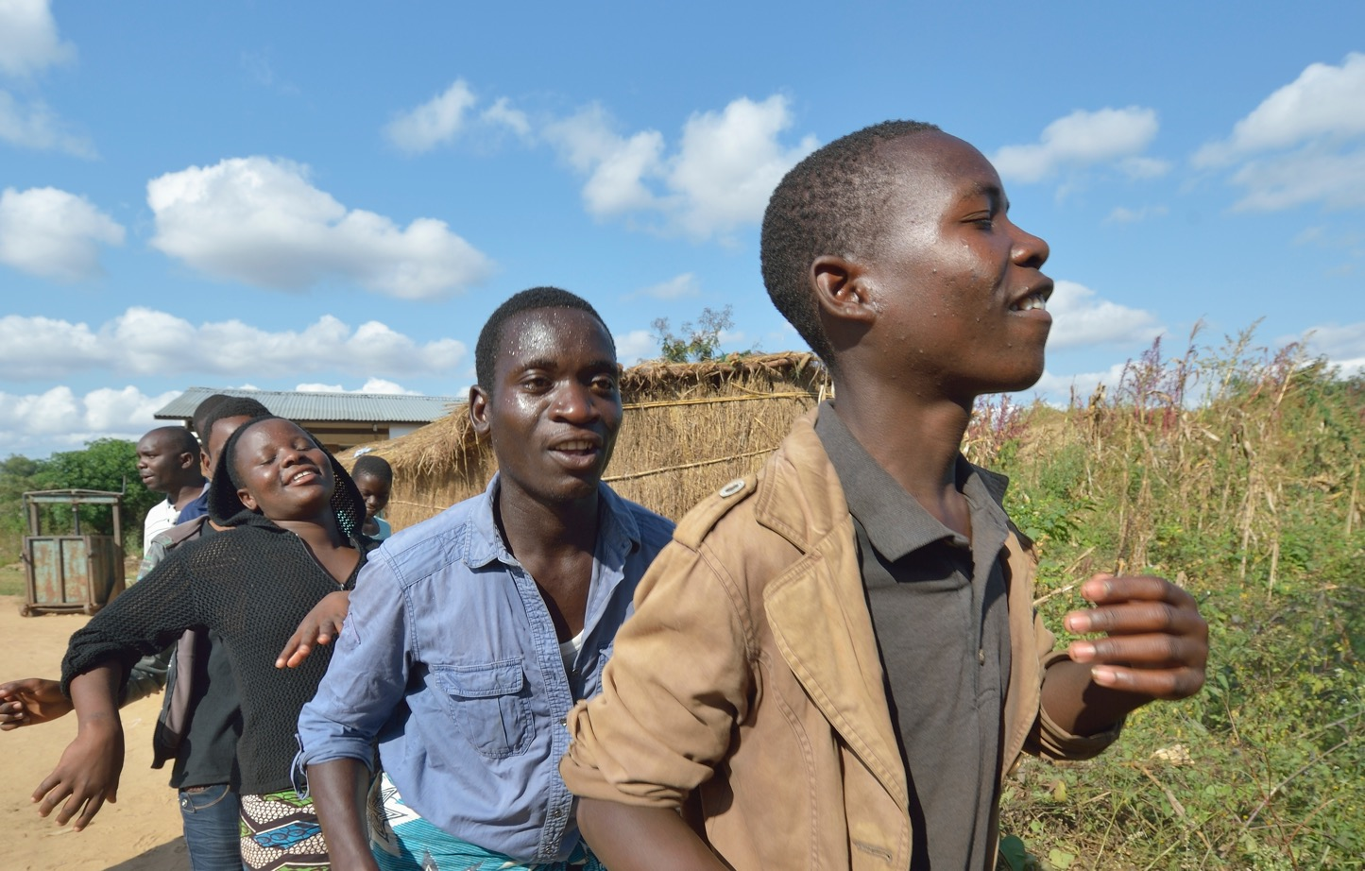
Photo: Paul Jeffrey
Human Rights
Notes:
While many regard the topic of human rights as purely political, it is difficult to deny how connected human rights and sustainable development are. Both signify a movement towards greater human dignity.
Poverty is one of the greatest obstacles to human rights. Poverty erodes people’s access to health care, adequate housing, nutritious food, education and safe water.
Without addressing issues such as inequality, disempowerment, exclusion and discrimination, the most vulnerable groups in society – the ones development programs are designed to help – become further marginalized.
PWS&D supported human rights projects in Afghanistan, Ghana, Guatemala, India, Malawi and Nepal in 2019. In addition, PWS&D supported KAIROS partners in Colombia, Democratic Republic of Congo, Israel/Palestine and South Sudan.
(Photo: Malawi)

Slide 22
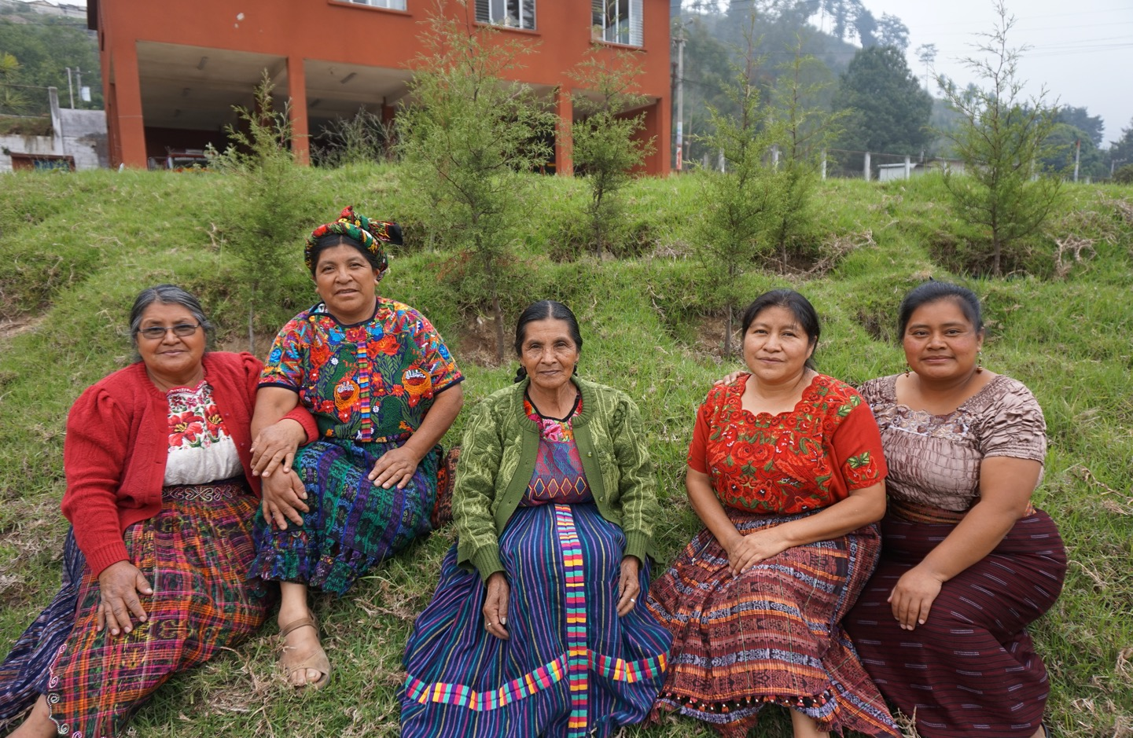
Photo:: Paul Jeffery
Notes:
Working with partners around the world, Presbyterian World Service & Development is responding to situations where women, youth and other marginalized groups are too often treated like second-class citizens.
This includes indigenous people in Guatemala who experience oppression and extreme poverty;
women in Ghana accused of witchcraft and banished from their homes;
people living with disabilities or HIV and AIDS who face persistent stigma and discrimination;
women and girls in India who are excluded from making decisions for their own health and well-being;
And girls who are prevented from receiving an education in Afghanistan.
(Photo: Guatemala)

Slide 23
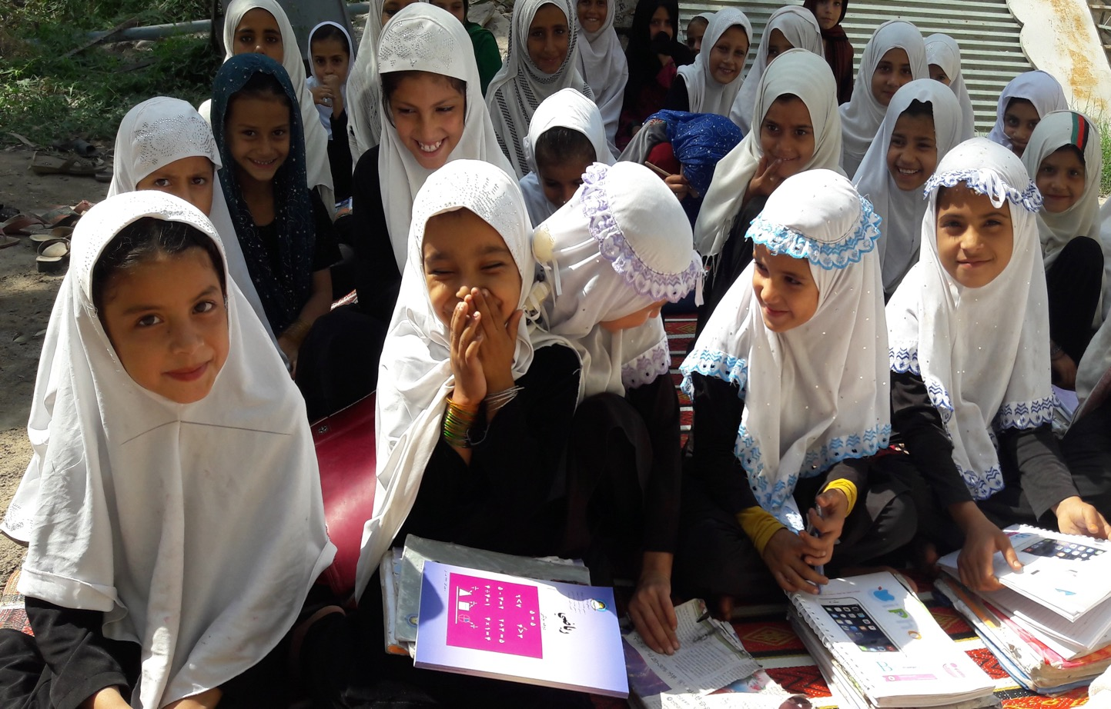
Notes:
Zarmina felt frustrated by her community's deeply-held belief that there is little need to educate women and girls. "Our community firmly believes that girls were born to stay within their home," she explains.
In Afghanistan, economic constraints and long distances to schools are just a few of the other factors keeping girls at home and away from the classroom.
Wanting to create change for her daughters and the other young women and girls of the community, Zarmina participated in workshops led by PWS&D partners on peace, gender and human rights. Now, she helps her community prosper by advocating for equal access to education for both girls and boys.
"We will continue working for this cause," says Zarmina. "We hope that one day there will be no child out of school, not only in our community, but in the entire country.”
(Photo: Afghanistan, girls' education)

Slide 24
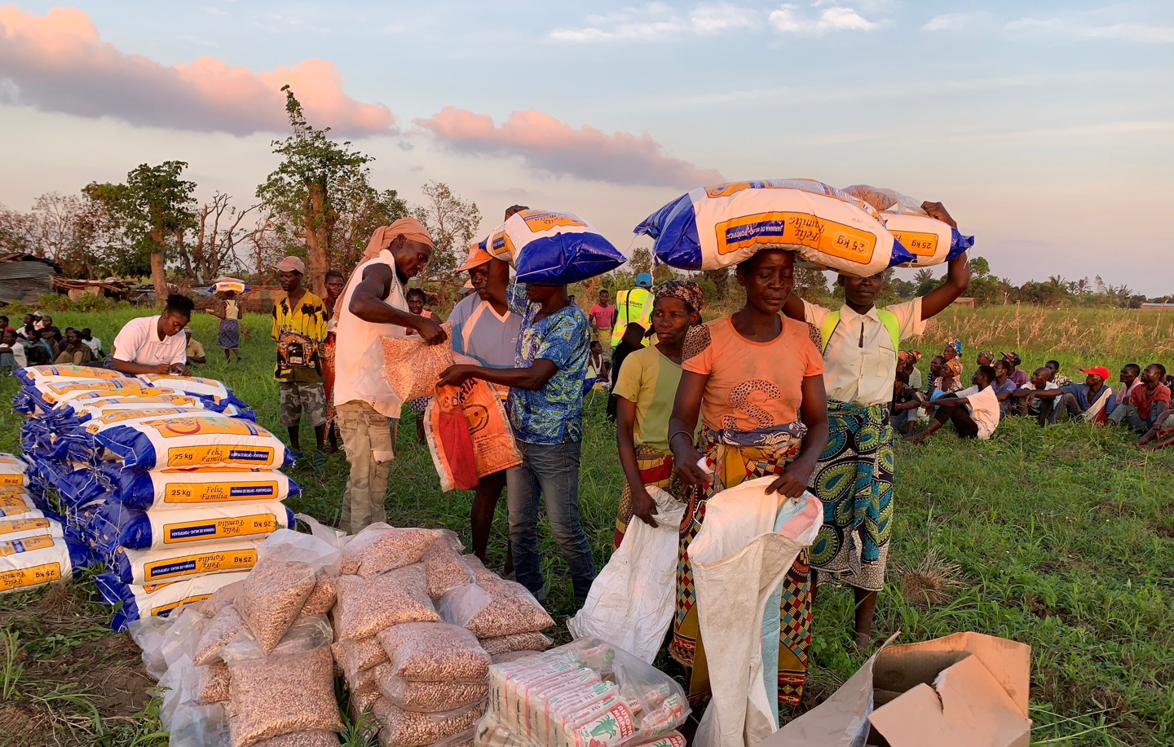
Photo: ACT Alliance
Emergency Relief
Notes:
In emergency situations, thousands or even millions of people face food shortages, displacement and disease. Children are often the most affected as they are pulled out of schools and placed in dangerous situations.
In 2019, humanitarian crises in many parts of the world brought to the forefront how vulnerable so many people are. Immediate relief ensures vulnerable people and refugees have access to food, shelter and water, and are able to recover from trauma and loss.
This year, PWS&D was involved in emergency relief in Malawi, Mozambique, Yemen, Pakistan, Afghanistan, Bangladesh, South Sudan and Syria. .
(Photo: Mozambique, Cyclone Idai)

Slide 25
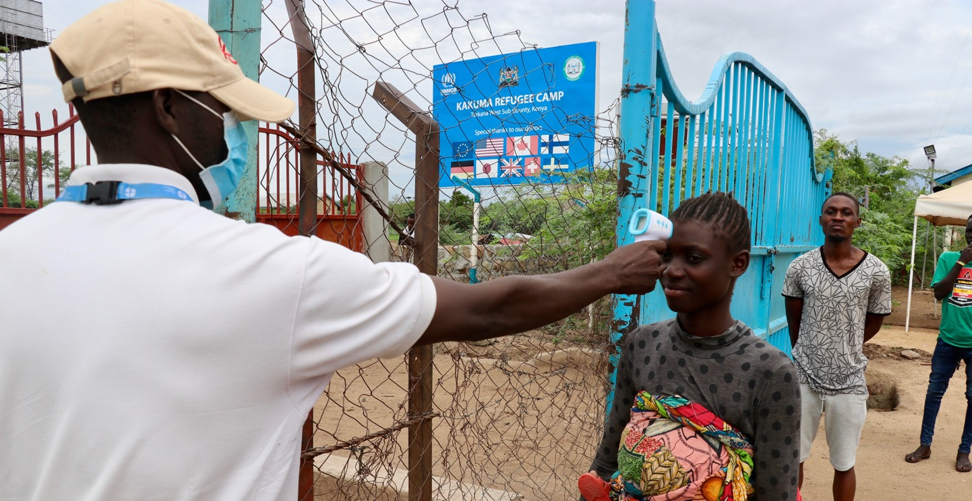
Photo: CFGB
COVID-19 Crisis
Notes:
The COVID-19 pandemic has swept over the world, leaving no country untouched and causing worsened inequalities.
Many households have seen their livelihoods and employment either severely limited or completely lost. Families are worried about meeting their most pressing needs, especially for food.
Since the start of the pandemic, PWS&D has been responding. Through the ACT Alliance, PWS&D supported short-term relief projects in 14 countries that are helping affected people access food, sanitation and hygiene, protective equipment and psychosocial support, focusing on gender justice and the protection of highly vulnerable populations.
Additionally, through ACT Alliance PWS&D is supporting longer-term relief projects in Bangladesh, Somalia, South Sudan and Palestine. These projects are ensuring families have access to food, water, sanitation services and psychosocial support.
(Photo: Kenya, COVID-19)

Slide 26
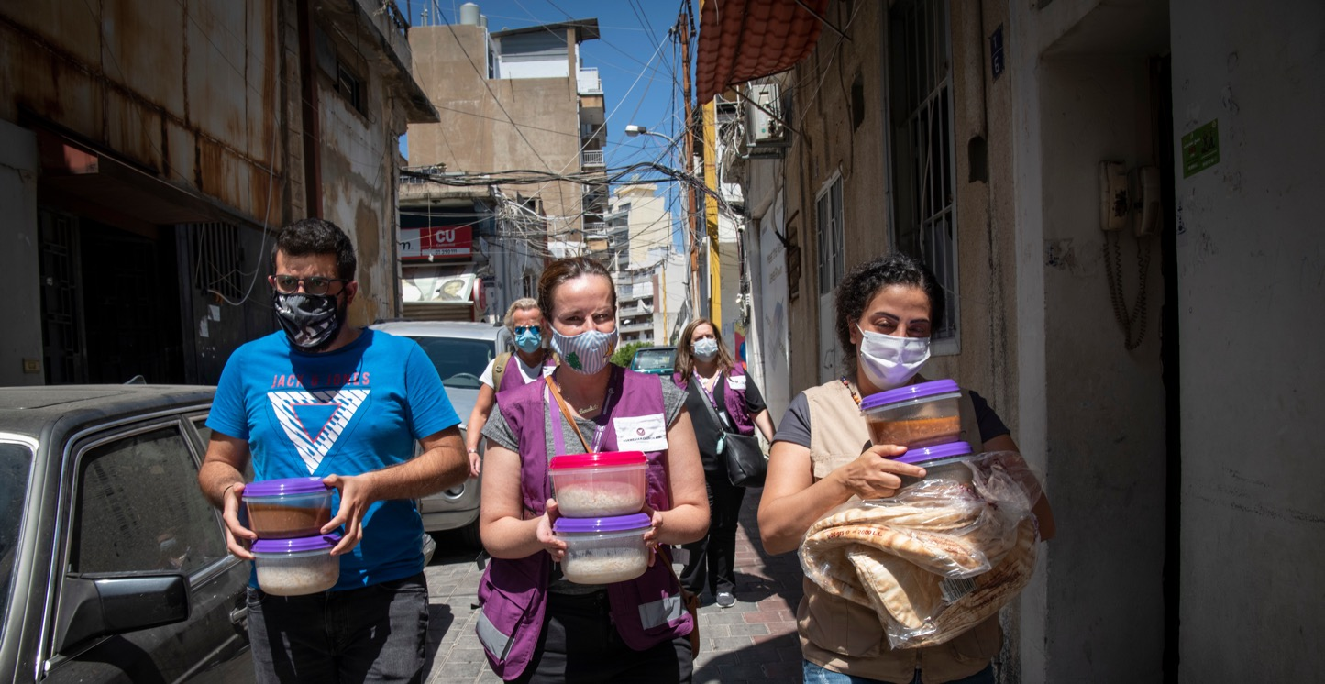
Photo: Håvard Bjelland/ Norwegian Church Aid
Photo: CFGB
Beirut Explosions
Notes:
In August of 2020, multiple explosions ripped through Beirut, Lebanon's capital, causing 300,000 people to become homeless and injuring 5000 others.
Lebanon was already facing an economic crisis, and the effects of COVID-19, meaning the ability to access food and health care, only worsened with the blasts.
Following these devastating explosions and recognizing the enormous need, the Government of Canada committed to matching donations until late August. Through PWS&D's membership in the Canadian Foodgrains Bank, all donation made to PWS&D was eligible to be matched.
Through the matched funds, food vouchers will be distributed over several months, with a priority placed on the most vulnerable, including female or child-headed households, Syrian refugees or those who were displaced or injured by the explosion. Vouchers allow families to purchase the food they need while also supporting the local economy.
(Photo: Lebanon, Beirut blast)

Slide 27
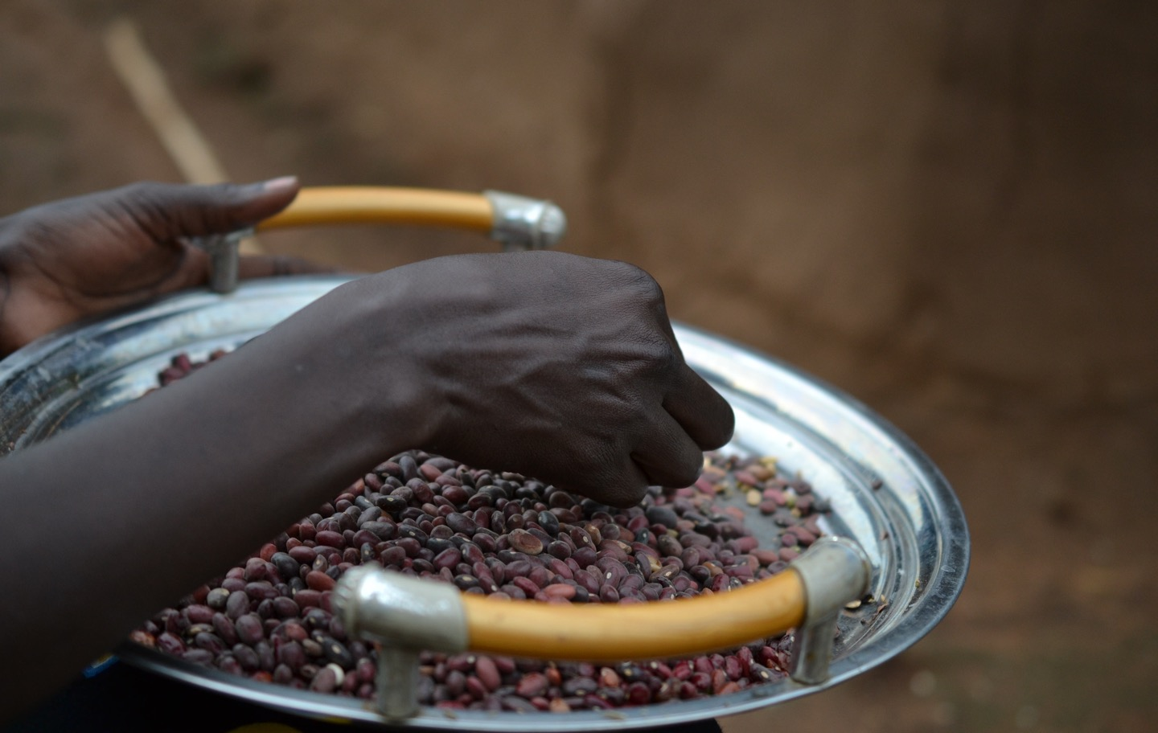
Photo: CFGB/Amanda Thornsteinsson
Notes:
Malnutrition and hunger, exacerbated by ongoing conflict and climate change, continue to affect populations throughout Africa, Asia, the Middle East and Latin America.
Through long-standing partnerships with Canadian Foodgrains Bank and ACT Alliance, and because of the generosity of Presbyterians from across Canada, PWS&D is able to provide necessary immediate interventions.

Slide 28
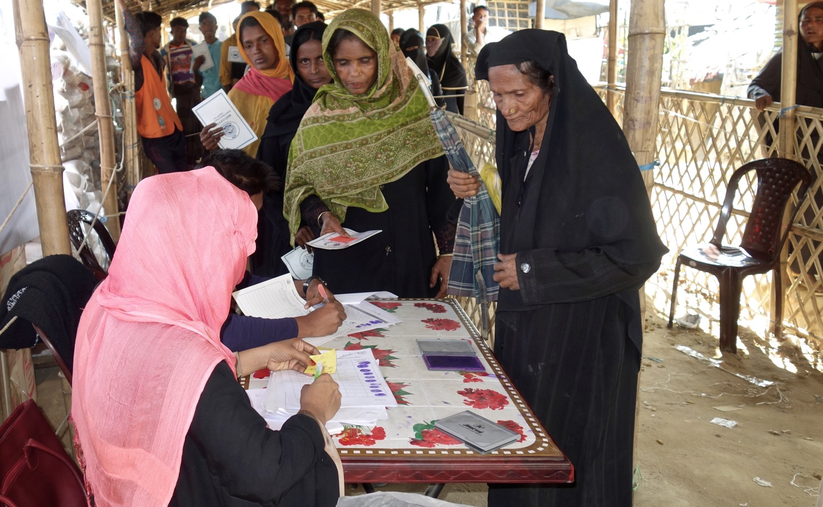
Photo: CFGB
Rohingya Crisis
Notes:
In 2017, escalating brutality forced over 700,000 Rohingya people to flee their country and seek shelter in desperate conditions with little access to food, medical care and sanitation services.
In the immediate aftermath of the violence, through the work of PWS&D and our partners, thousands of families received life-saving food distributions after fleeing. Shelter support, essential non-food items, hygiene kits, water and sanitation, and psychosocial support were also provided to many families.
Still today, the Rohingya can’t return home. Many continue to struggle to live healthy, productive lives in Bangladesh. Recognizing the complex and extensive food and livelihood needs of those living in the Cox’s Bazar refugee camps, PWS&D continues to respond in partnership with Canadian Foodgrains Bank and partners at the ACT Alliance.
Receiving food vouchers means families are able to make food choices and spend according to their preferences at local markets. Their income can then be spent on other essential needs rather than food. Local vendors whose incomes are improved by this program also receive training in efficient business practices.
(Photo: Myanmar, Rohingya crisis, CFGB)

Slide 29
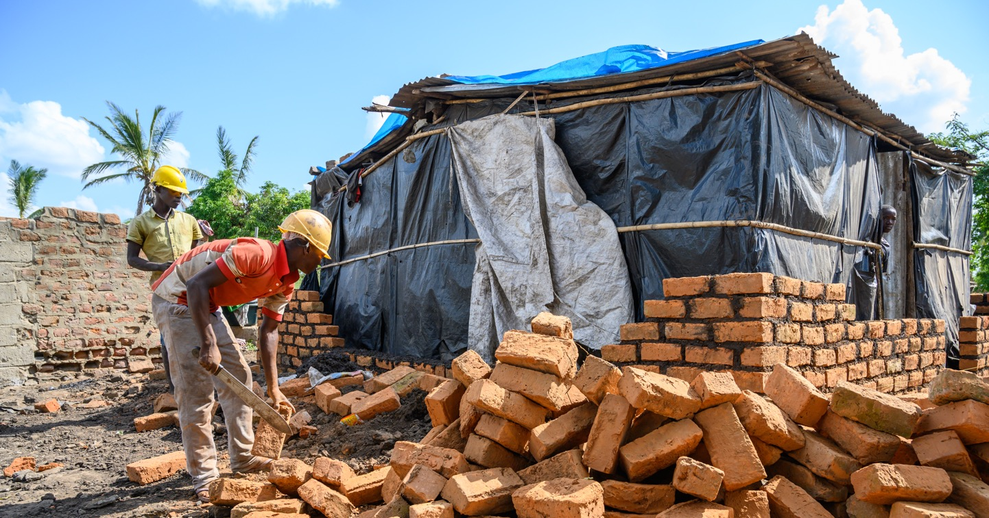
Photo: ACT Alliance
Cyclone Idai
Photo: CFGB/Amanda Thornsteinsson
Notes:
In early 2019, Cyclone Idai made its deadly landfall in Malawi, Mozambique, and Zimbabwe, leaving a destructive path. Roads were submerged, houses demolished, and crops and livelihoods were destroyed. The cyclone caused over 1,000 deaths and left over 146,000 people without a home.
Recognizing the enormous needs, PWS&D responded in partnership with Canadian Foodgrains Bank and with support from the Humanitarian Coalition, as well as with partners at the ACT Alliance.
In Malawi, 2,000 families were provided with food baskets and cash transfers to help cope with food insecurity. Additionally, 525 latrines were rebuilt.
In Mozambique, over 5000 households were provided with food and non-food items. Another 10,000 households were also presented with livelihood support and seeds and tools for farming.
(Photo: Mozambique, Cyclone Idai)

Slide 30
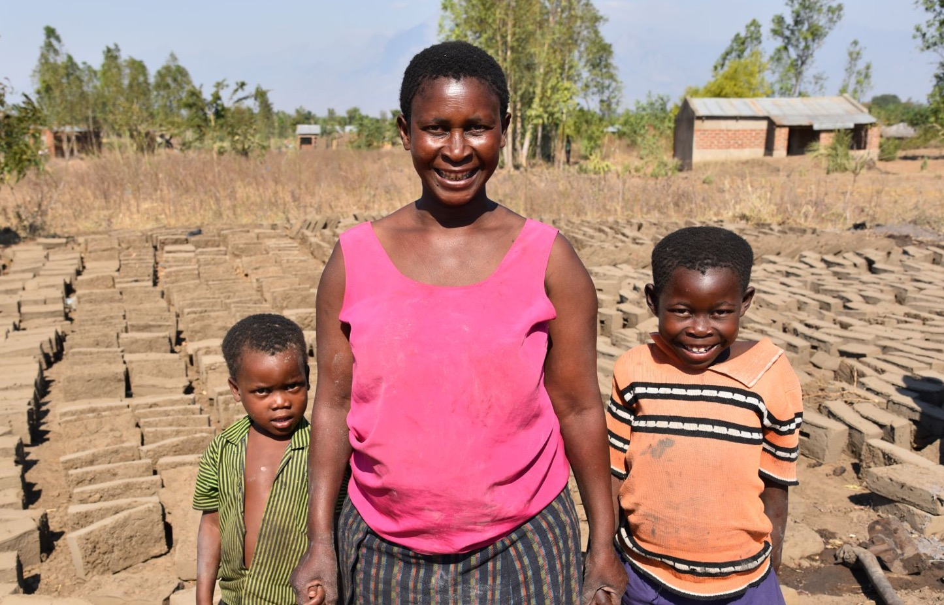

Photo: CFGB
Notes:
Katherine was one of 840,000 Malawians stuck when Cyclone Idai unleashed torrential rain and winds that led to devastating flooding across Malawi, Mozambique and Zimbabwe.
The devastating flood ruined more than Katherine’s home—it battered her plot of farmland and washed away most of the maize she’d grown.
Without maize to sell, Katherine had a new set of challenges to cope with. Her biggest concern was getting food for her children.
Because of generous contributions towards Cyclone Idai relief efforts, Katherine and 10,000 others in Malawi did not have to worry where their food would come from.
Through a PWS&D-supported project with Canadian Foodgrains Bank, Katherine received flour, beans, and cooking oil packages. Life-saving nourishment that gave her the strength and courage to bounce back.
“The kids are very happy to eat the food,” smiles Katherine.
(Photo: Malawi, Cyclone Idai relief)

Slide 31
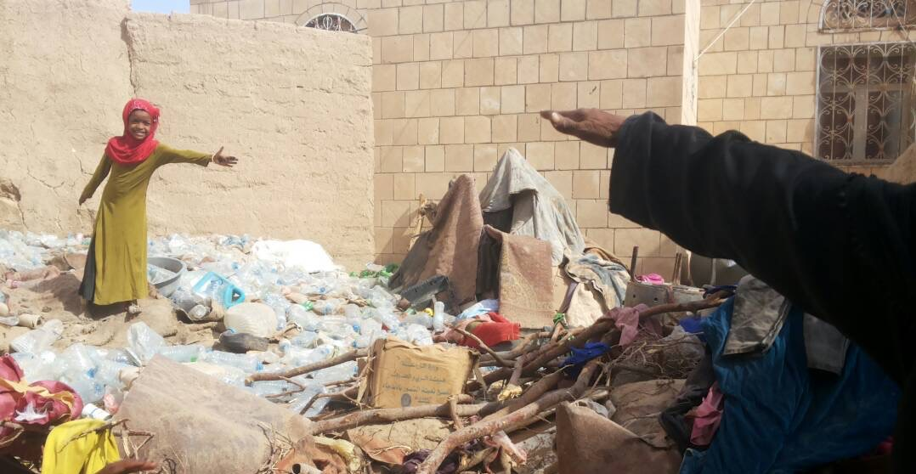
Photo: Paul Jeffrey, ACT Alliance
Yemen Crisis
Notes:
Yemen: Airstrikes and fighting in Yemen continue to take the lives of thousands of people, in addition to reducing access to food, clean water and the other essential services that millions of residents need to survive.
PWS&D is supporting members of Canadian Foodgrains Bank to provide 1,100 vulnerable families with packages of flour, beans, oil, sugar and salt. In addition, PWS&D led an ecumenical and interfaith response with Islamic Relief Canada to restore safe drinking water to over 850 households.
(Photo: Yemen, ACT: Paul Jeffrey)

Slide 32
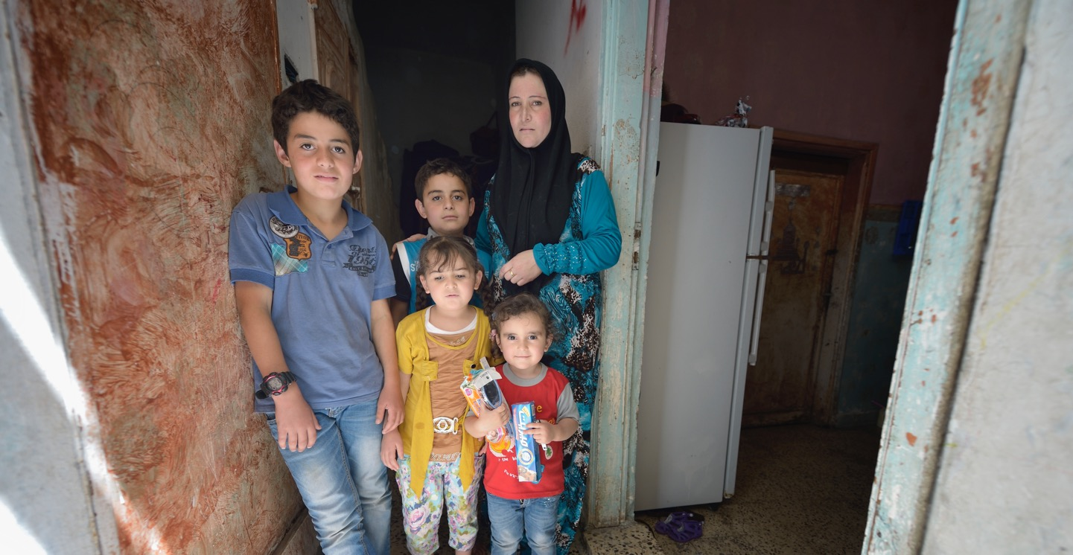
Photo: Paul Jeffrey
Syria Crisis
Notes:
Syria: As 2019 marked the eighth year of civil war in Syria, tragically the need for assistance remained high. Responding through the ACT Alliance, PWS&D provided support for housing, education, livelihoods and trauma counselling to refugees who fled to Jordan and Lebanon. In Syria—now the site of the world’s largest internally displaced population—7,400 families who are either displaced within or have returned to Syria received monthly food baskets of rice, oil and pulses through the Foodgrains Bank.
Additionally, working with Christian churches and leaders in underserved areas, monthly rations were distributed to 12,250 people in poor and primarily rural locations.
(Photo: Syria)

Slide 33
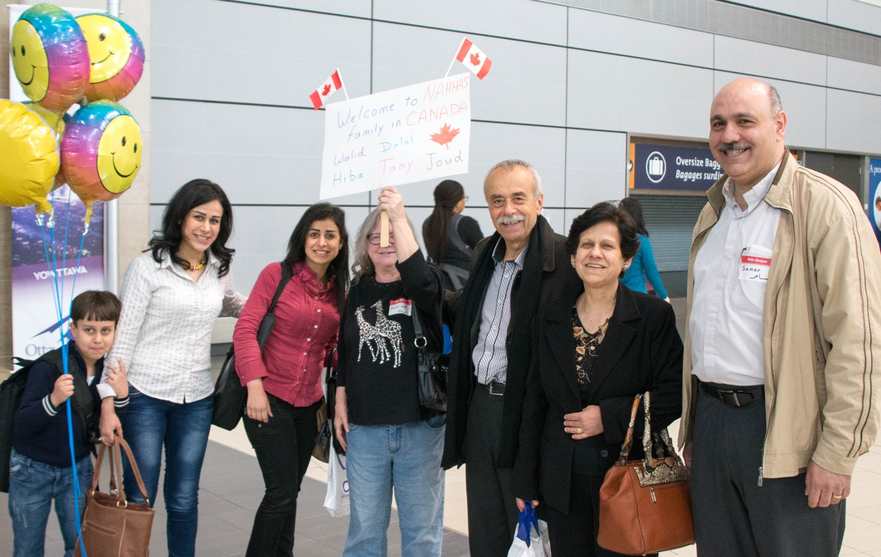
Refugee Sponsorship
Photo: Paul Jeffrey, ACT Alliance
Notes:
PWS&D’s refugee sponsorship ministry is a response to Christ’s call to serve and defend the vulnerable and persecuted.
Refugee sponsorship numbers continue to increase. In 2019, 25 new applications to sponsor 81 people were filed. During the year, 77 sponsored people arrived in Canada.
For the first time since 2015, the highest number of sponsorship requests was not for Syrian refugees, but rather for refugees from the Democratic Republic of the Congo. PWS&D also provided accompaniment to congregations undertaking sponsorships from Afghanistan, Burundi, Egypt, Ethiopia, Iran, Myanmar, Pakistan, Somalia, South Sudan, Syria and Uganda.

Slide 34
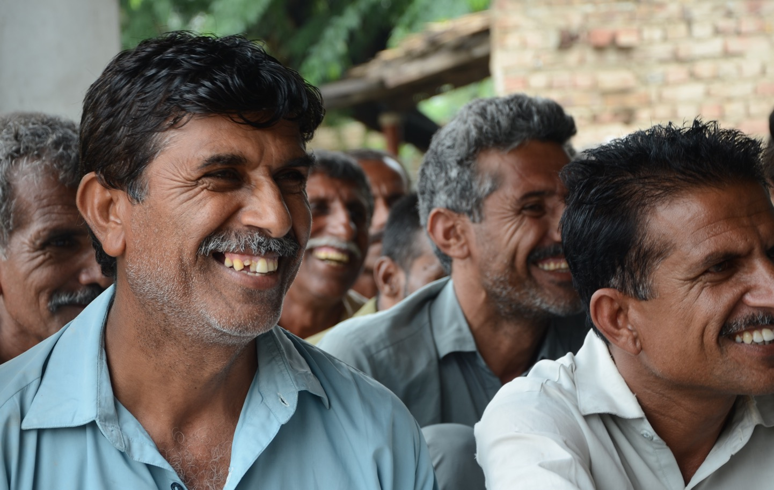
Photo: CWSA
Get Involved
Pray ∙ Donate ∙ Learn ∙ Champion
Notes:
Does any of this lead you to want to get involved?
There are a variety of ways that you can support the work of PWS&D.
Pray for those who lack the basic necessities, that they may experience abundant life
Become a donor: Ultimately, we need money and resources to support our important programs around the world. You can support PWS&D by one-time or monthly donations or by purchasing a gift from our Gifts of Change catalogue.
Make a legacy gift to PWS&D’s Loaves & Fishes Fund: Planned gifts include a bequest through your will, RRSPs, publicly traded securities, real estate, life insurance, special gifts of cash, and more.
Request a speaker for a Sunday service, group meeting or youth gathering
Use PWS&D resources to understand the challenges facing vulnerable communities
Stay Connected: You can sign up on the PWS&D website to receive our newsletters with valuable updates from our programs around the world and news about what’s happening at PWS&D. Be sure to also visit our Facebook, Instagram and Twitter pages.
(Photo: Pakistan, agriculture, CWSA)

Slide 35
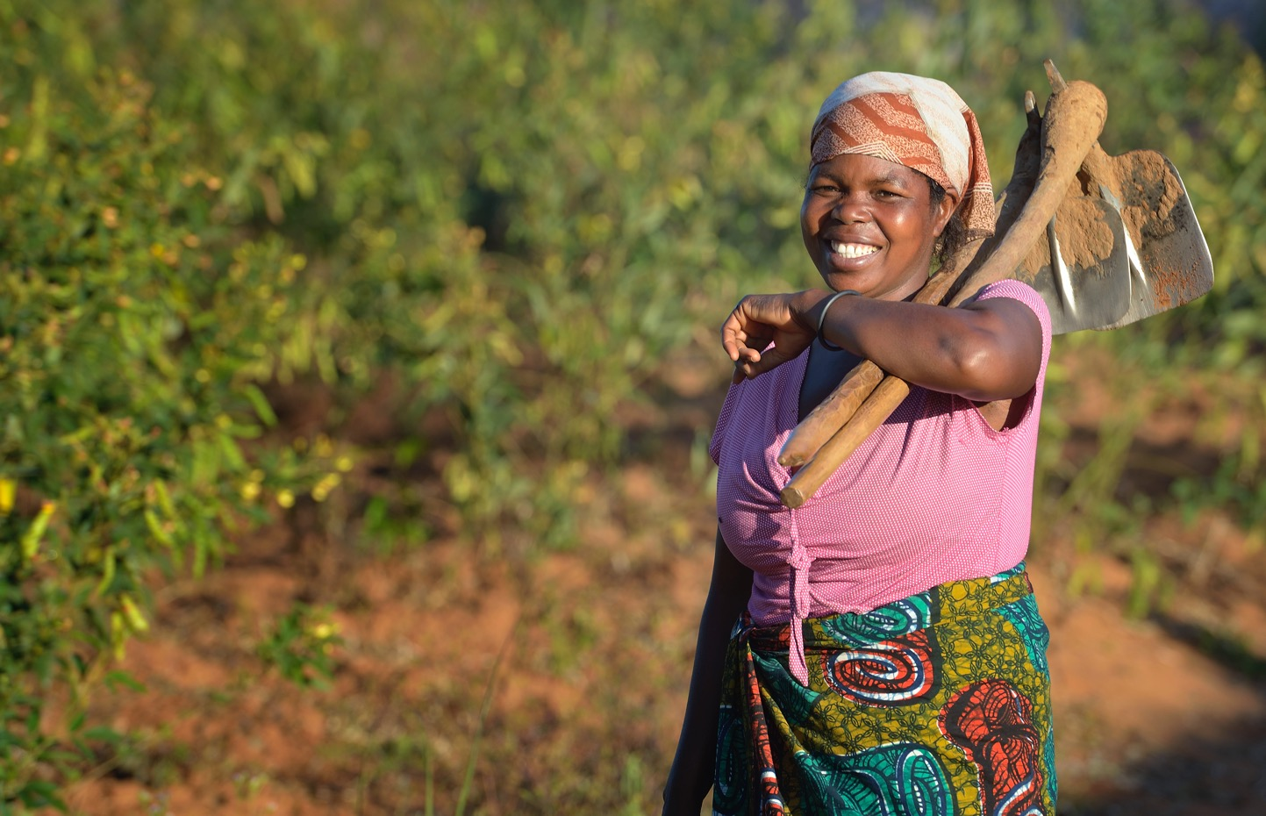
WeRespond.ca/be-a-champion
Photo: Paul Jeffrey
Notes:
One way to get more involved in PWS&D and play a vital role on the journey towards a more sustainable, compassionate and just world is to become a PWS&D Champion.
A PWS&D Champion is a volunteer who stays informed about PWS&D’s projects and partners, promotes the work of PWS&D and encourages others to get involved.
In a world with too much poverty, hunger and oppression, be a Champion for Change.
Visit WeRespond.ca/be-a-champion for more information.
(Photo: Malawi, Paul Jeffrey)

Slide 36

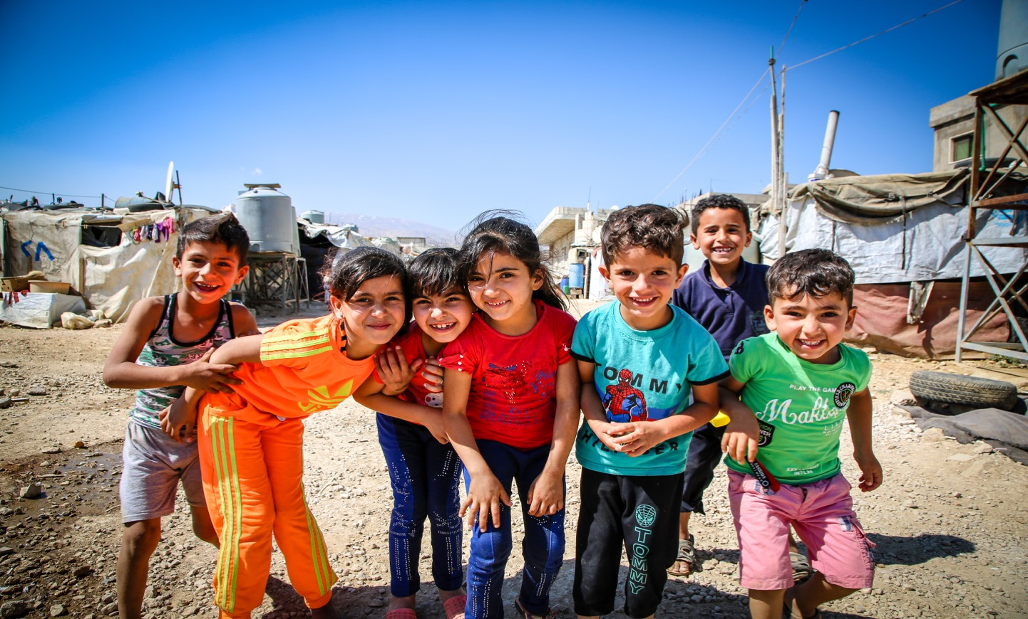
Photo: Paul Jeffrey
Notes:
Visit WeRespond.ca to learn more about PWS&D and how you can get involved!
(Photo: Lebanon)

