Slide 1
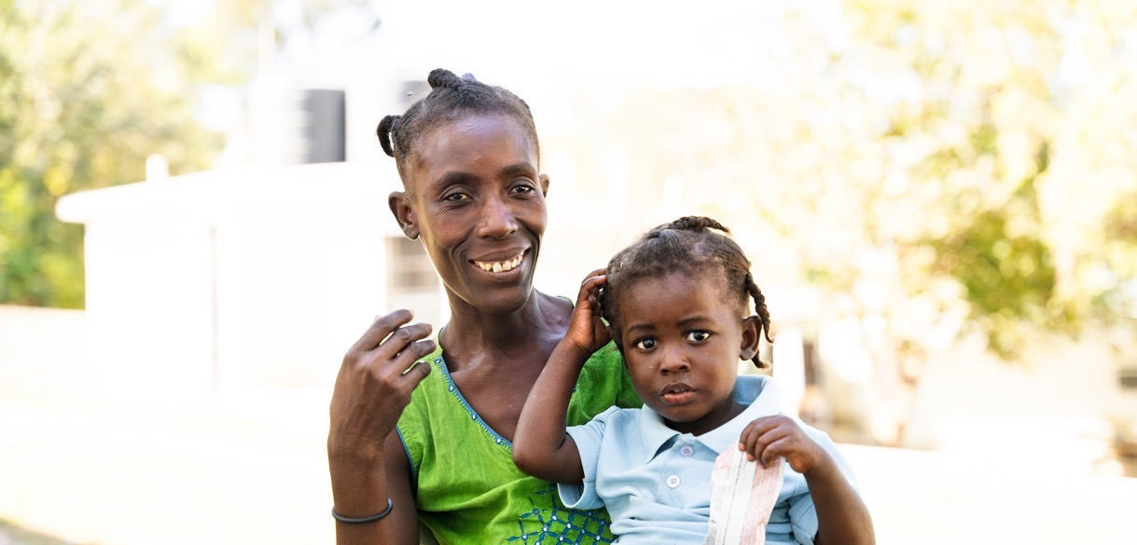
We Respond
Notes:
[Presenter to introduce self and relationship to PWS&D]
Following the example set by Jesus, our church responds faithfully to the call to serve people in need. We do this through Presbyterian World Service & Development—the development and relief agency of The Presbyterian Church in Canada.
For almost 80 years, our church has been actively working to serve marginalized communities through Presbyterian World Service & Development.
The global context has changed a lot since PWS&D was first formed, and it feels like it continues to change on a daily base. What has not changed, though, is the church’s commitment to Christ’s message of love expressed through PWS&D’s work.
(Photo: Haiti)

Slide 2
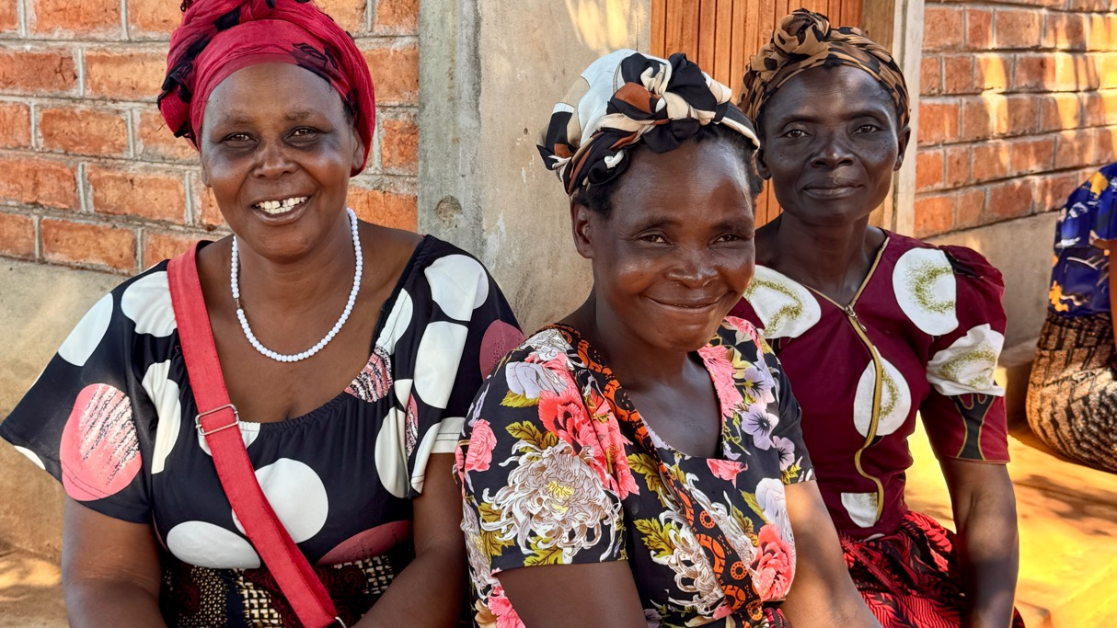
Our Vision
Inspired by God’s promise of abundant life, PWS&D envisions a sustainable, compassionate and just world.
Notes:
Rooted in the living hope of Jesus Christ and inspired by God’s promise of abundant life, PWS&D envisions a sustainable, compassionate and just world.
With support from Presbyterians across Canada, we respond to God’s call to serve the marginalized and distressed.
We respond to help communities around the world overcome poverty, recover from emergency situations and build sustainable futures.
(Photo: Malawi)

Slide 3
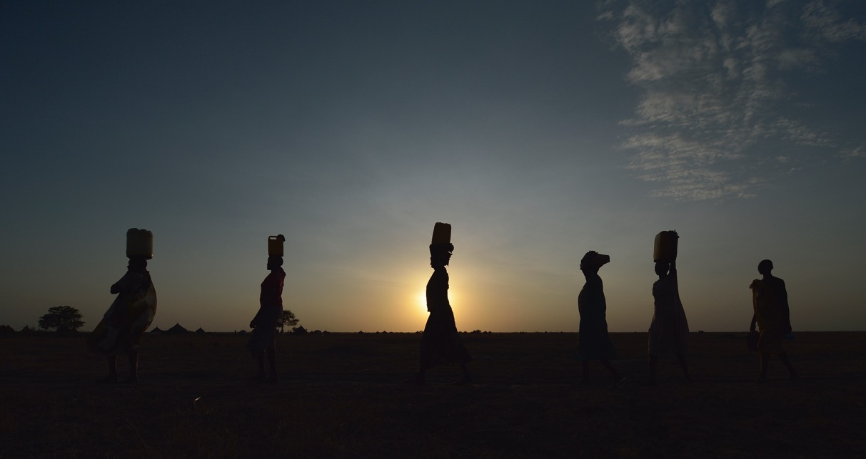
Our Values
Compassion ∙ Justice ∙ Partnership
Notes:
Working with communities around the world, PWS&D is guided by:
Compassion: PWS&D walks with distressed and marginalized people, listening carefully to their stories and responding effectively.
Justice: PWS&D works for equality, empowerment, human dignity, peace and stewardship of creation. In solidarity, we affirm that all people are entitled to know their rights, to receive equal protection, and to have access to and control over resources.
Partnership: PWS&D believes in dynamic relationships that involve mutual learning, trust, and shared vision. Healthy partnerships are accountable, ethical, equitable, flexible and respectful.
(Photo: Malawi)

Slide 4


One Mission
Two Funds
Gifts to Presbyterians Sharing and PWS&D are sharing Christ’s love in Canada and around the world!
Notes:
Many people ask, “What’s the difference between PWS&D and Presbyterians Sharing?” Both funds support the overall mission and ministry of The Presbyterian Church in Canada, but they work in different ways.
PWS&D focuses on international development to address global poverty and injustice, and responds to emergencies, whether natural or human-made. We raise funds directly from individuals and congregations. While PWS&D doesn’t receive funds directly from Presbyterians Sharing, we receive valuable in-kind support that helps keep administrative costs to a minimum, allowing us to maximize overseas program funding.
Presbyterians Sharing is the fund that supports the national programs and ministries of The Presbyterian Church in Canada. Examples include the placement of mission staff overseas through International Ministries, General Assembly, Indigenous ministries, and new and renewing congregations in Canada.

Slide 5
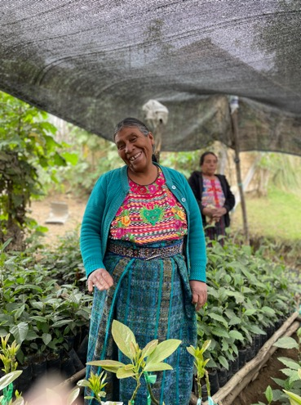



We Respond Together
Notes:
PWS&D prioritizes working with local partners in the countries where we work. Recognizing that local people know best about what is needed in their communities, we work respectfully and collaboratively to create and implement programs that meet these needs.
In addition to local partners, PWS&D collaborates with other internationally focused organizations, faith-based and secular, to have a greater impact and help address some of the structural issues that affect the communities where the church is working overseas.
These partnerships also allow us to maximize Presbyterian donations and to respond faster in times of emergency. These organizations include the ACT Alliance, Canadian Foodgrains Bank and KAIROS.
(Photo: Guatemala)

Slide 6
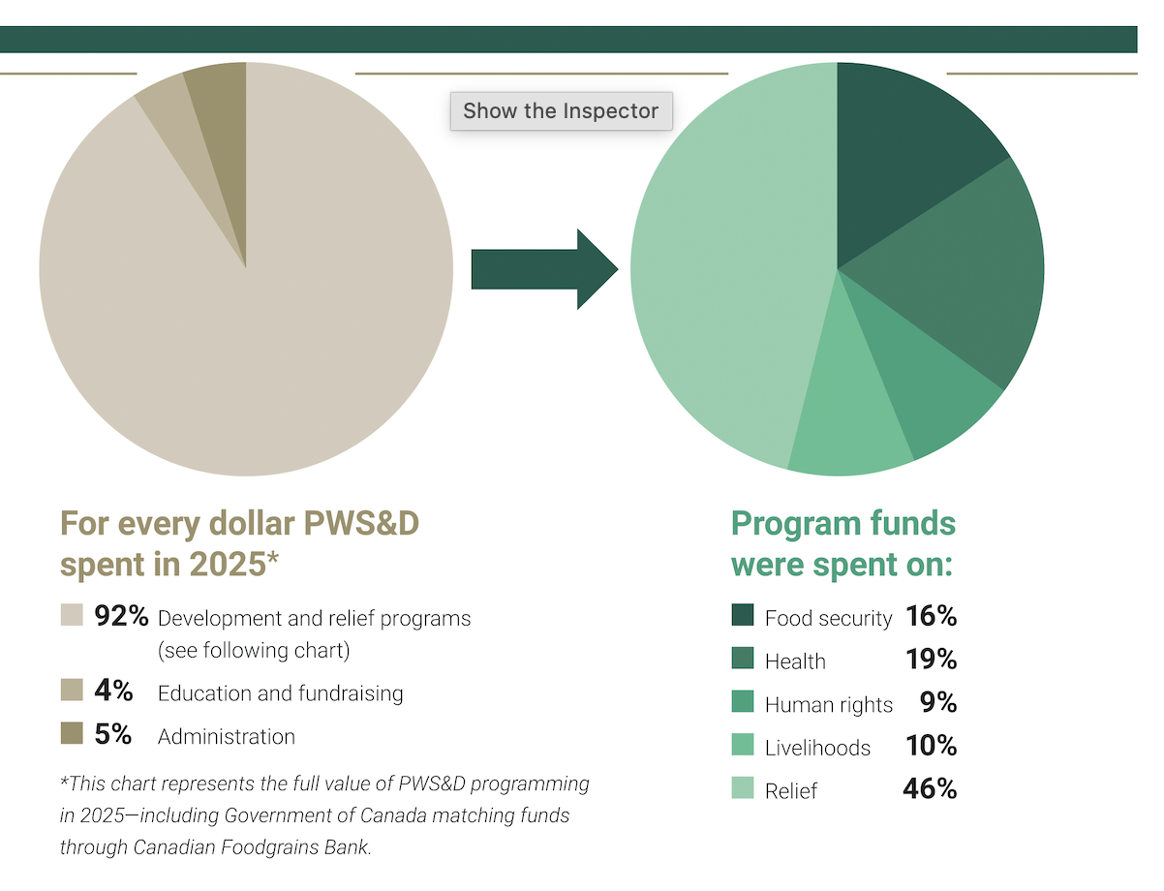
Notes:
PWS&D works to be a faithful steward of the resources entrusted to us.
*This chart represents the full value of PWS&D programming in 2025—including Government of Canada matching funds through Canadian Foodgrains Bank.

Slide 7
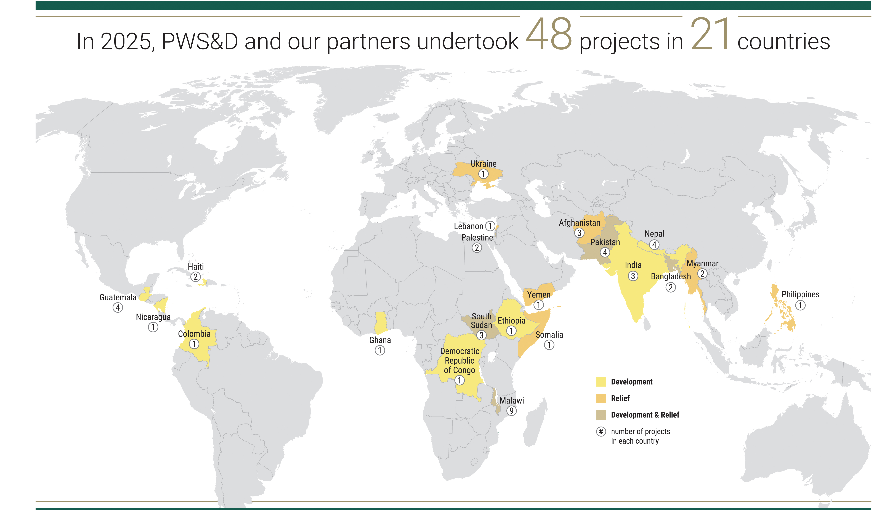
Notes:
PWS&D is committed to the well-being of marginalized people across the globe. In order to make efficient use of resources, we work in particular countries, on particular projects. These countries are chosen based on our program priorities and the presence of partners in the region.

Slide 8
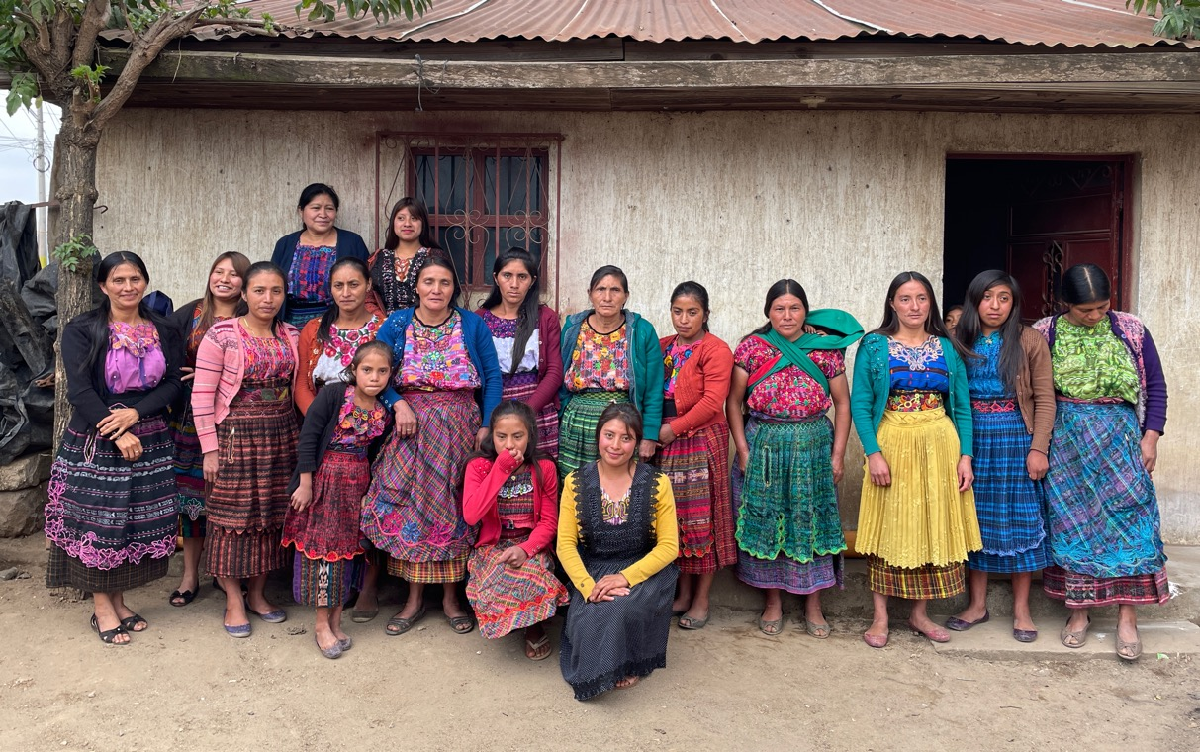
Our Priorities
Food Security ∙ Health ∙ Livelihoods ∙ Human Rights Emergency Relief ∙ Refugee Sponsorship
Notes:
The work we are doing together as a church through PWS&D can be broken into six pillars or priorities:
Food Security
Health
Economic Empowerment/Livelihoods
Human Rights
Emergency Relief
Refugee Sponsorship
The first four priorities make up our long-term development programs that work at the grassroots level to combat poverty and make lasting change. By addressing the root causes of poverty, people are both better able to build sustainable futures.
(Photo: Guatemala)

Slide 9
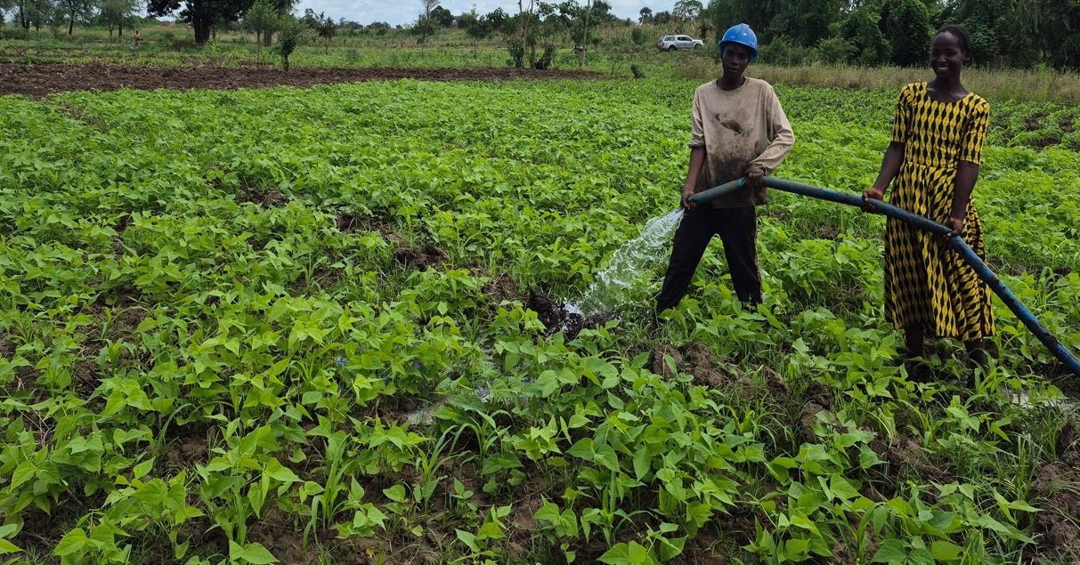
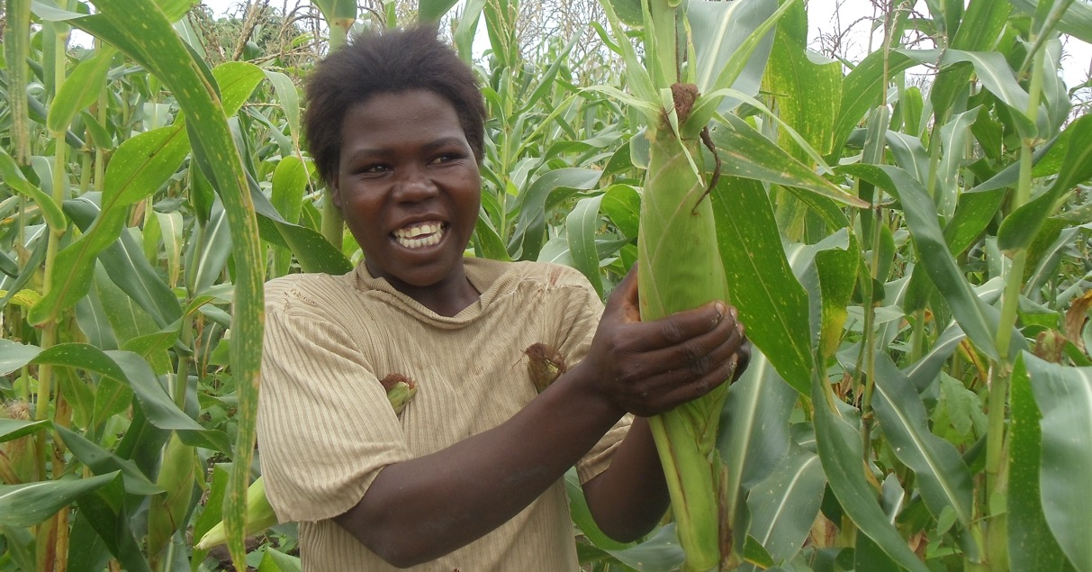
Food Security
Notes:
PWS&D’s focus on food security is helping people lead healthy and active lives by improving their access to food today and for the future. PWS&D also teaches families to improve dietary diversity and prepare nutritious meals.
In the past year, PWS&D has supported food security projects in Bangladesh, Ethiopia, Ghana, Guatemala, India, Nepal, Malawi, South Sudan and Pakistan.
(Photo: Malawi, food security)

Slide 10
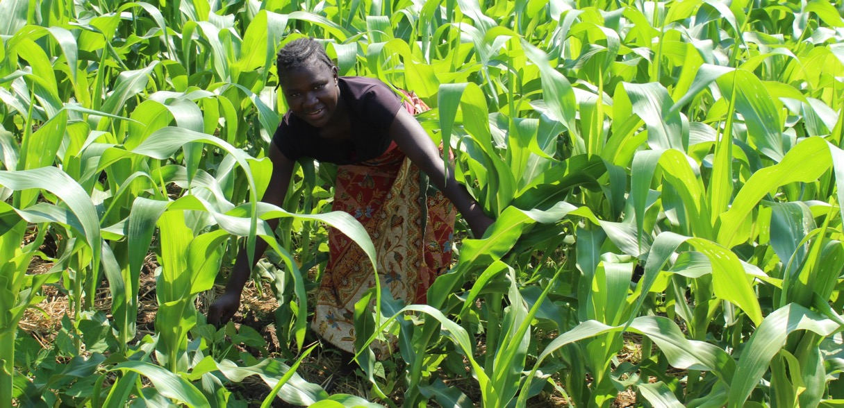
Photo: CFGB, Shaylyn McMahon
Notes:
Much of PWS&D’s work in food security and food aid is done in partnership with Canadian Foodgrains Bank – a membership of 15 church-based agencies all working together with the common goal of ending hunger. Since 1983, the Foodgrains Bank has grown to become one of Canada’s leading food assistance organizations and the predominant Christian response to global hunger. Presbyterians are dynamic partners in this effort to help those who do not have enough to eat.
(Photo: Malawi, food security)

Slide 11
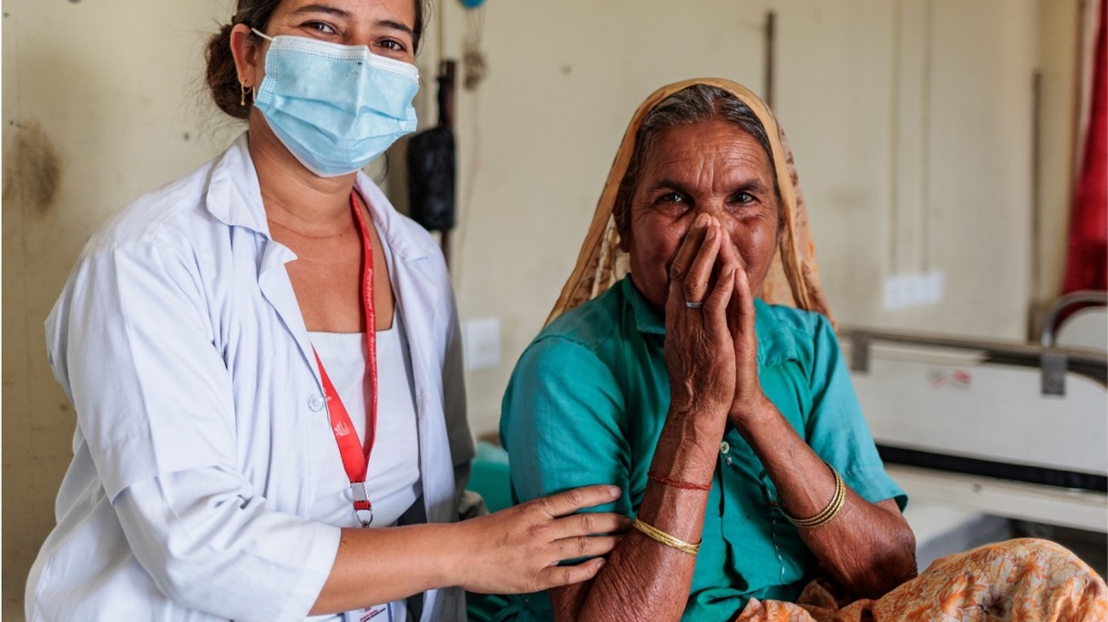
Health
Notes:
The second theme is health. PWS&D’s health programs help bring medical care to remote villages, ensure mothers and children receive the care they need, tackle prevalent childhood diseases, improve access to clean water, and empower communities to prevent the spread of HIV.
This photo is from Nepal, where we provide support particularly related to the elimination of leprosy and tuberculosis.
PWS&D has supported health projects in Bangladesh, Ghana, Haiti, India, Malawi and Nepal.
(Photo: Nepal, INF)

Slide 12
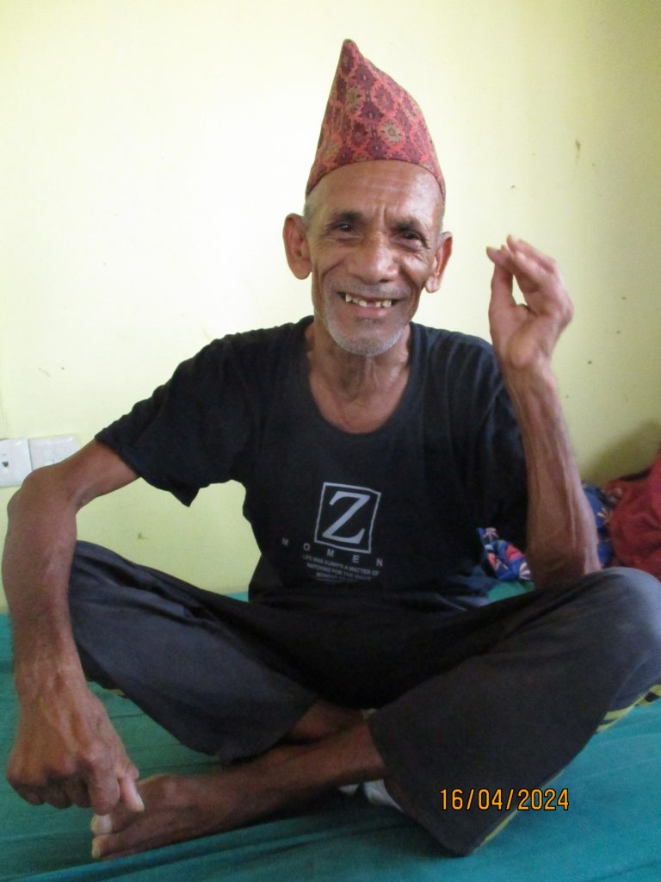
Treating Disease and Illness
Notes:
Communities are also seeing transformation through PWS&D’s work to treat disease and illness.
The Shining Hospital in Nepal, with PWS&D’s support, ensures timely diagnosis for patients living with leprosy and tuberculosis, and connects them with appropriate care.
Shining Hospital does more than just help people with their physical problems—by ensuring correct diagnoses and eliminating costs such as those for traditional healers, patients are protected financially.
Dhane BK, an elderly man from Nepal, completed treatment for leprosy seven years ago but recently developed a serious foot ulcer. He was admitted to Shining Hospital for specialized care supported by PWS&D. With strong support from his family and dedicated medical staff, Dhane showed resilience and followed his treatment plan closely, including daily ulcer care and learning self‑care practices. His condition has steadily improved, and his story highlights the power of determination, family support, and access to quality health care in overcoming difficult health challenges.

Slide 13
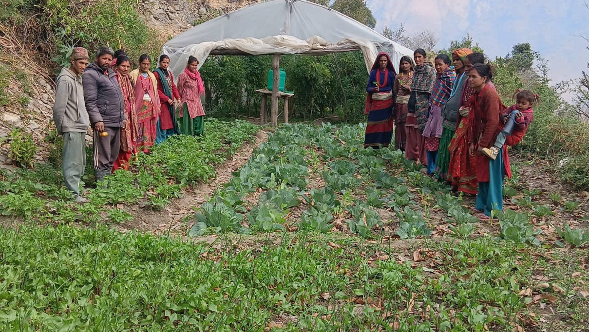
Livelihoods
Notes:
Having a sustainable livelihood means having food, water, shelter and clothing – the things needed in order to survive. It means being self-sufficient and able to provide for one’s family. It means having access to economic opportunities and meaningful employment.
PWS&D’s livelihood programs include education, small business development and vocational training for marginalized groups, with a special focus on girls, women and youth.
PWS&D has supported livelihoods projects in Bangladesh, Ethiopia, Ghana, Guatemala, India, Nepal, Malawi, South Sudan and Pakistan.
(Photo: Nepal)

Slide 14
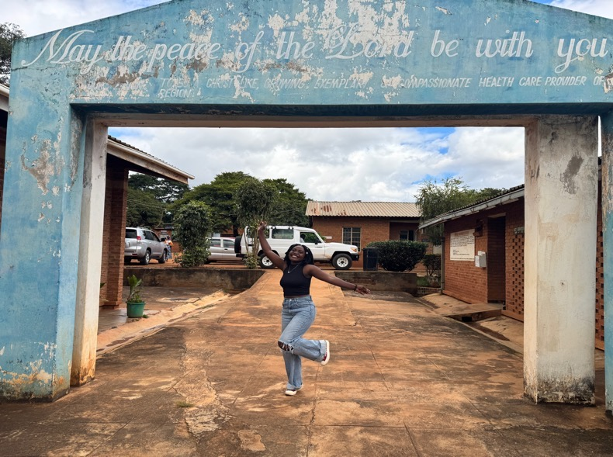

“You never knew I existed, but you still had a heart to give.”
Notes:
Debora Nguloube grew up in rural Malawi, facing profound loss at a young age. Abandoned by her mother at just four years old and later losing her father, she was raised by her grandparents. Despite these hardships, Debora held tightly to a dream: to continue her education.
When she was accepted into secondary school but couldn’t afford the fees, that dream seemed to slip away.
For a moment, it felt as though her life had come to a standstill.
Everything changed when she received support through the Ekwendeni Hospital AIDS Program’s Orphans and Vulnerable Children project. With their help, Debora was able to stay in school and eventually pursue a university degree in banking and finance.
“I saw life becoming easier, and I could envision a future for myself, not just for me, but for my family and the community,” she shared.
Reflecting on the kindness that made her journey possible, Debora said, “What I’ve learned is to be kind, not just to people so close to you… You never knew I existed, but you still had a heart to give.”
Her words echo the message of Matthew 25:37–40, where Jesus teaches that acts of compassion, especially toward those we may never meet—are acts done for Him. Even when we don’t know who we are helping, God sees a heart that chooses love.
Today, Debora’s story is inspiring change in her village. Her journey is opening doors not only for herself, but for others.
“When they look at me, they get inspired,” she said. “They say, ‘I think we should have gone back to school.’ And some are even going back to school.”

Slide 15
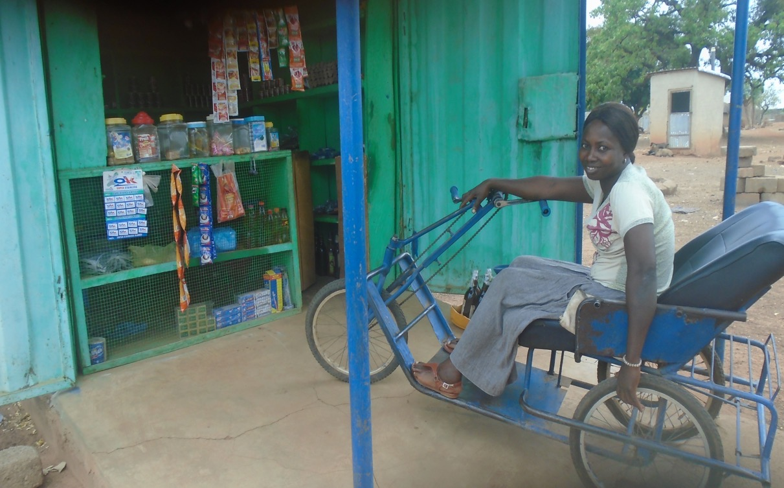
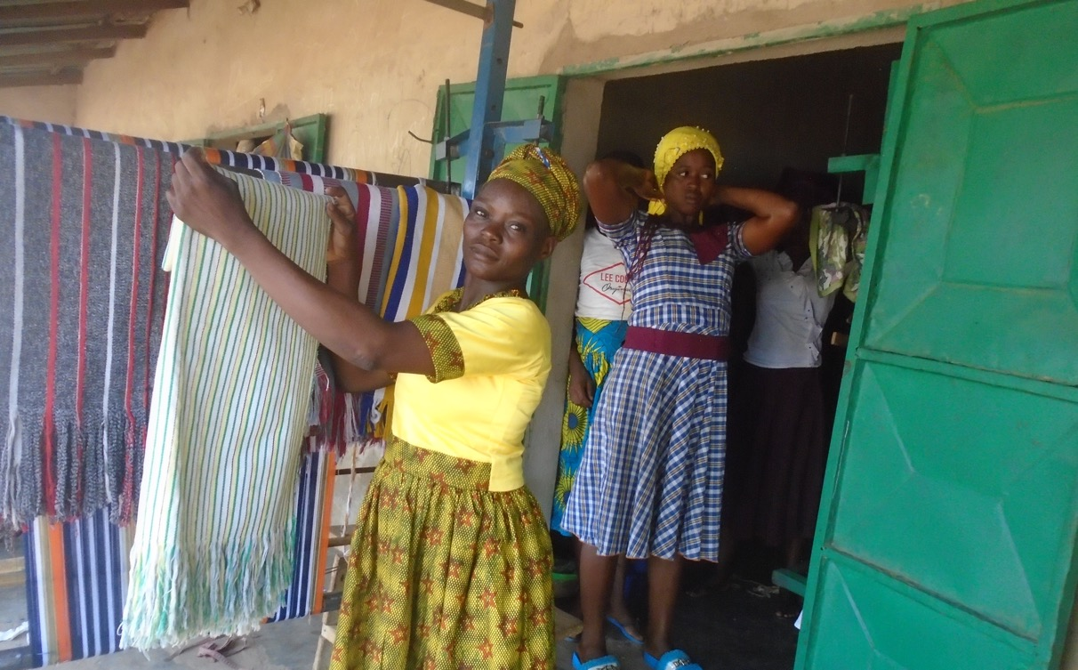
Photo: Paul Jeffrey
Human Rights
Notes:
While many regard the topic of human rights as purely political, it is difficult to deny how connected human rights and sustainable development are. Both signify a movement towards greater human dignity.
Poverty is one of the greatest obstacles to human rights. Poverty erodes people’s access to health care, adequate housing, nutritious food, education and safe water.
PWS&D human rights projects aim to address issues such as inequality, disempowerment, exclusion, and discrimination, to help ensure that the most marginalized groups in society do not become further marginalized.
PWS&D has supported human rights projects in Ghana, Guatemala, India, Malawi, Nicaragua and Nepal. In addition, PWS&D supports KAIROS partners in Colombia, Democratic Republic of Congo, Palestine and South Sudan.
(Photo: Ghana)

Slide 16
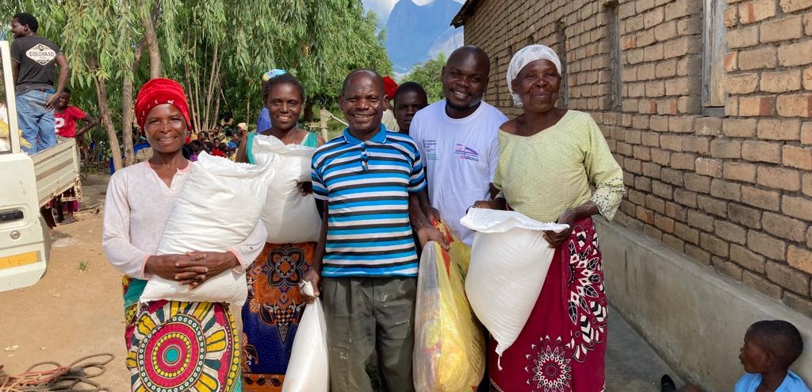
Emergency Relief
Notes:
In emergency situations, thousands or even millions of people can face food shortages, displacement and disease. Children are often the most affected as they are pulled out of schools and placed in dangerous situations.
Humanitarian crises in many parts of the world brought to the forefront how marginalized so many people are. Immediate relief ensures that people in need and refugees have access to food, shelter, and water, and can recover from trauma and loss.
In the past couple of years, PWS&D was involved in emergency relief with direct partners and through ecumenical networks such as ACT Alliance and the Canadian Foodgrains Bank.
PWS&D has responded to emergency situations in Afghanistan, Gaza, Haiti, Jordan, Kenya, Lebanon, Malawi, Moldova, Myanmar, Nepal, Pakistan, Somalia, South Sudan, Sudan, Syria, and Ukraine.
(Photo: Malawi)

Slide 17
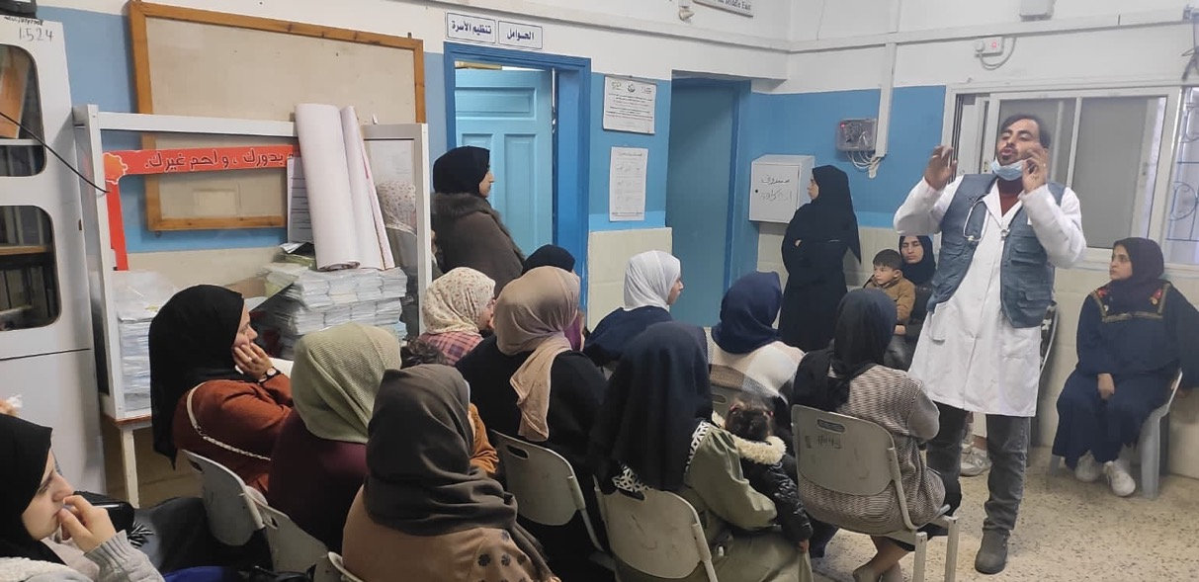
Gaza
Gaza
Notes:
Since the war began in Gaza in October 2023, over 75,000 people have been killed or injured, millions have been displaced multiple times, and extensive damage to health facilities and other civilian infrastructure has left almost the entire population of Gaza without access to clean drinking water or adequate nutrition.
Blockades and difficulties in accessing Gaza create barriers to assistance, but despite the challenges, we remain committed to providing as much assistance as possible through available channels.
Since the start of the conflict, at various times, PWS&D has provided cash assistance to enable families to buy water, food and other essentials. Primary health and dental care have been supported, as well as psychosocial care for children and mothers to help with coping mechanisms and relieve emotional distress.
Additionally, we’ve supported food assistance through distributions of both cooking supplies and ready-to-eat food .

Slide 18
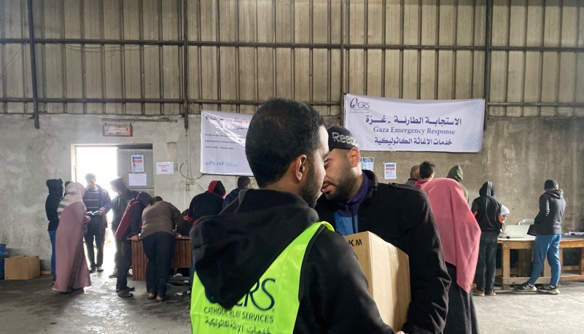
“This parcel will alleviate his suffering and provide my child with the necessary food.”
Gaza
Gaza
Notes:
Ibrahim Atallah is a father in Gaza whose life has been profoundly affected by the conflict that escalated after October 2023. He cares for his three‑year‑old son, who has a disability and depends on a very limited diet of biscuits and milk—foods that have become scarce and unaffordable due to shortages and rising prices.
Struggling to meet his son’s basic needs, Ibrahim faced increasing stress as access to food and other essentials declined.
In response, PWS&D supported a Canadian Foodgrains Bank project that provided ready-to-eat food parcels to displaced, conflict-affected families across Gaza City and North Gaza, helping those without access to kitchens, fuel, or stable incomes.
The assistance eased his financial burden and improved his son’s well-being, with familiar foods providing comfort and stability during an otherwise uncertain time.
“This parcel will alleviate his suffering and provide my child with the necessary food,” Ibrahim shared, adding that receiving support in a respectful and dignified way made him feel valued and gave him hope.

Slide 19
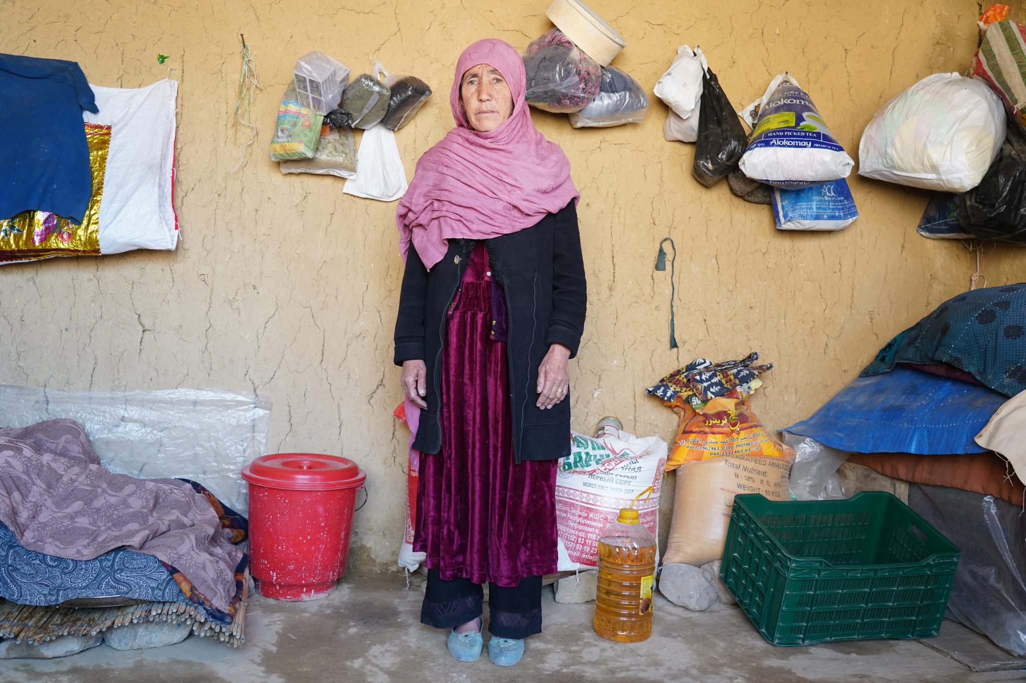
Afghanistan
Notes:
Since the Taliban took control of Afghanistan again in 2021, humanitarian conditions have only worsened. Now largely out of the news, millions of people in Afghanistan do not have enough food to eat.
PWS&D has supported work in Afghanistan since 2001 and continues to partner with a local organization to provide assistance where we can. For a second year, we have implemented a project to aid over 3,000 families with cash to buy food over the harsh winter months.
This support is making a real difference. I want to share some words of gratitude from Zahra, a project participant, after the first of five food-aid distributions.
“Now we can eat, stay warm, and I can care for my children without borrowing and falling deeper into debt. Your support goes far beyond food. It has restored hope and dignity to our lives. It reminds me that we are not forgotten, that someone still cares about families like ours. With continued support, I believe my children can have a brighter future than the hardships we face today."

Slide 20
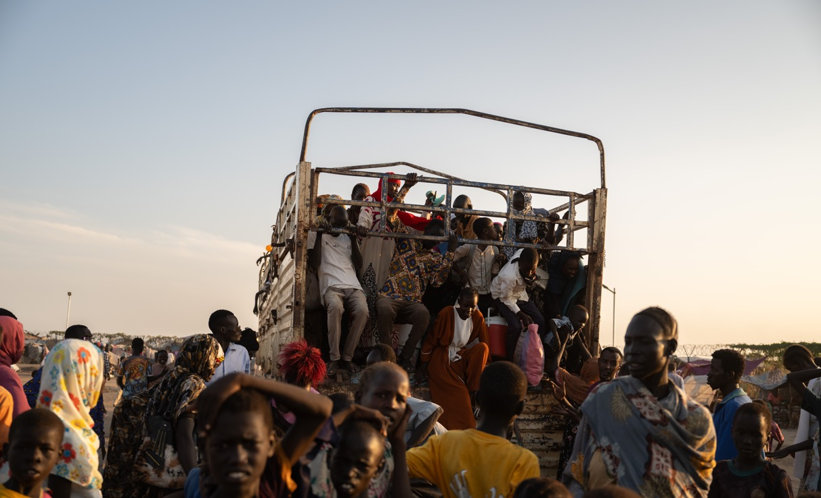
Sudan
Notes:
Sudan is currently facing the severe humanitarian crisis, with 24.8 million people in need of urgent aid, including 14 million children. The country has experienced significant population displacement, with millions of people—mainly children and women—forced to leave their homes and scatter across various regions; many of them have been displaced multiple times.
PWS&D, in partnership with the Canadian Foodgrains Bank, Development and Peace, and local partner Trócaire Sudan, is supporting an emergency nutrition project in South Kordofan. Given the enormous impact the crisis is having on children, the program is focusing on providing emergency malnutrition treatment for children and pregnant/lactating mothers.

Slide 21
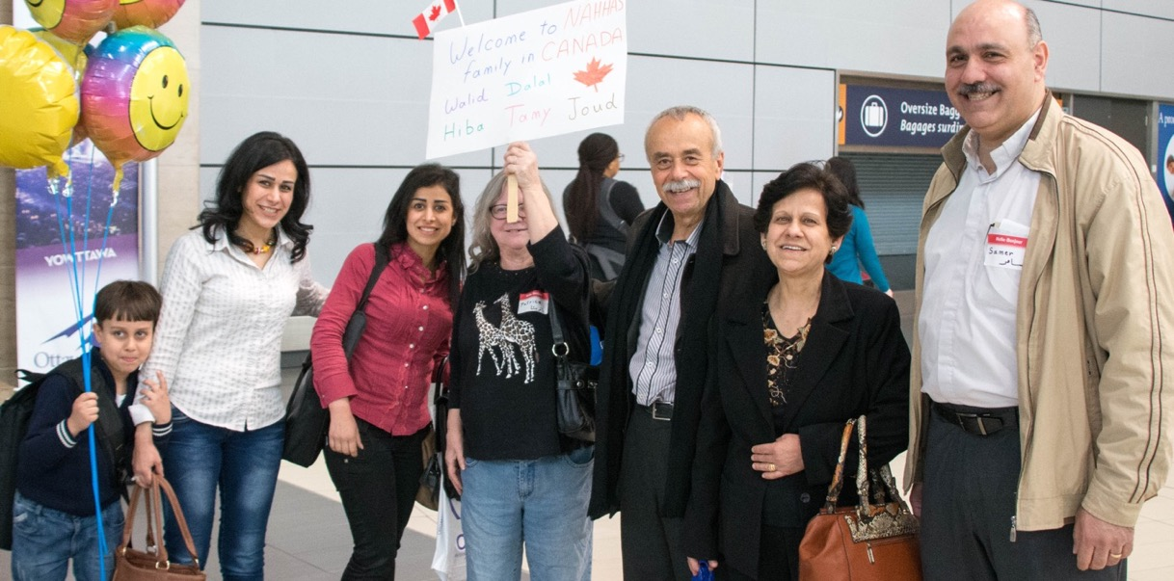
Refugee Sponsorship
Photo: Paul Jeffrey, ACT Alliance
Notes:
PWS&D’s refugee ministry is based on the belief that no one is a refugee by choice.
On behalf of the Presbyterian Church in Canada, PWS&D implements the refugee sponsorship agreement the church holds with the Government of Canada. PWS&D staff provide assistance and accompaniment to congregations and presbyteries who are hoping to sponsor refugees to come to Canada.
PWS&D and the PCC are increasingly concerned about changes to Canada’s immigration policy, which have made significant cuts to the number of refugees who are able to be sponsored to Canada. We continue to advocate for Canada to keep its doors open to refugees and work to address the causes that force people to seek refuge away from their home countries.
Since 2024, there has been a 70% reduction in the number of spaces allocated to the PCC for sponsorship.
In 2025, PWS&D’s refugee sponsorship work has provided accompaniment to 13 congregations and six presbyteries, sponsoring 55 refugees.
Please reach out if you’re interested in more information about how your congregation can become involved with sponsorship.

Slide 22
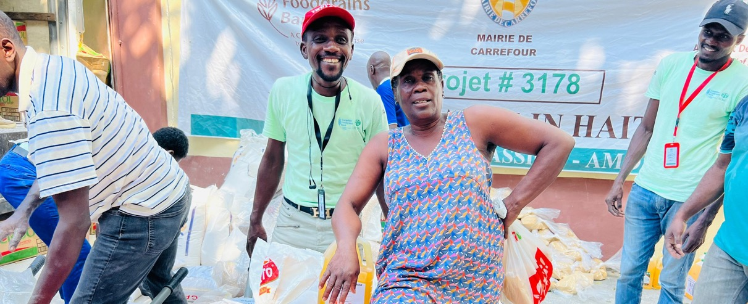
Get Involved
Pray ∙ Donate ∙ Learn ∙ Champion
Notes:
There are a variety of ways that you can support the work of PWS&D.
Pray for those who lack the basic necessities, that they may experience abundant life
Become a donor: Ultimately, we need money and resources to support our important programs around the world. You can support PWS&D by one-time or monthly donations or by purchasing a gift from our Gifts of Change catalogue.
Make a legacy gift to PWS&D’s Loaves & Fishes Fund: Planned gifts include a bequest through your will, RRSPs, publicly traded securities, real estate, life insurance, special gifts of cash, and more.
Request a speaker for a Sunday service, group meeting or youth gathering
Use PWS&D resources to understand the challenges facing vulnerable communities
Stay Connected: You can sign up on the PWS&D website to receive our newsletters with valuable updates from our programs around the world and news about what’s happening at PWS&D. Be sure to also visit our Facebook, Instagram and Twitter pages.
(Photo: Haiti)

Slide 23
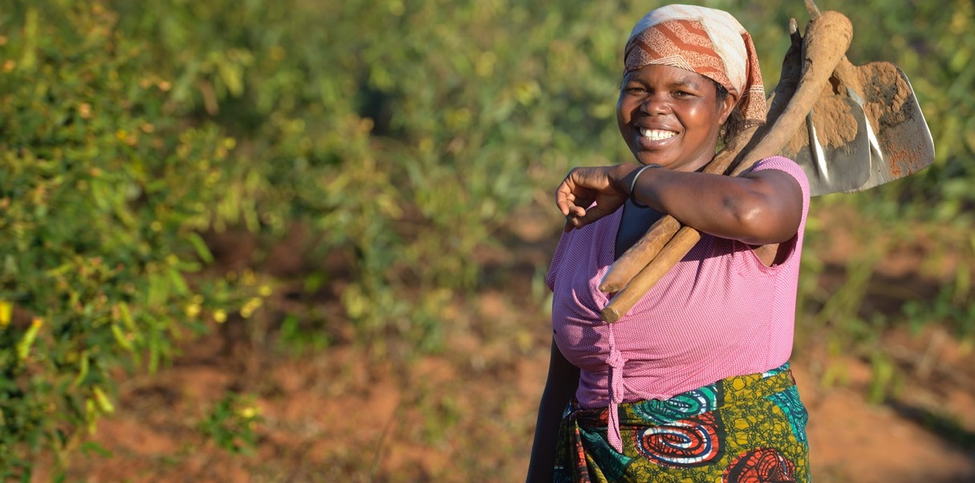

WeRespond.ca/be-a-champion
Photo: Paul Jeffrey
Notes:
One way to get more involved in PWS&D and play a vital role in the journey towards a more sustainable, compassionate and just world is to become a PWS&D Champion.
A PWS&D Champion is a volunteer who stays informed about PWS&D’s projects and partners, promotes the work of PWS&D and encourages others to get involved.
In a world with too much poverty, hunger and oppression, be a Champion for Change.
Visit WeRespond.ca/be-a-champion for more information.
(Photo: Malawi, Paul Jeffrey)

Slide 24
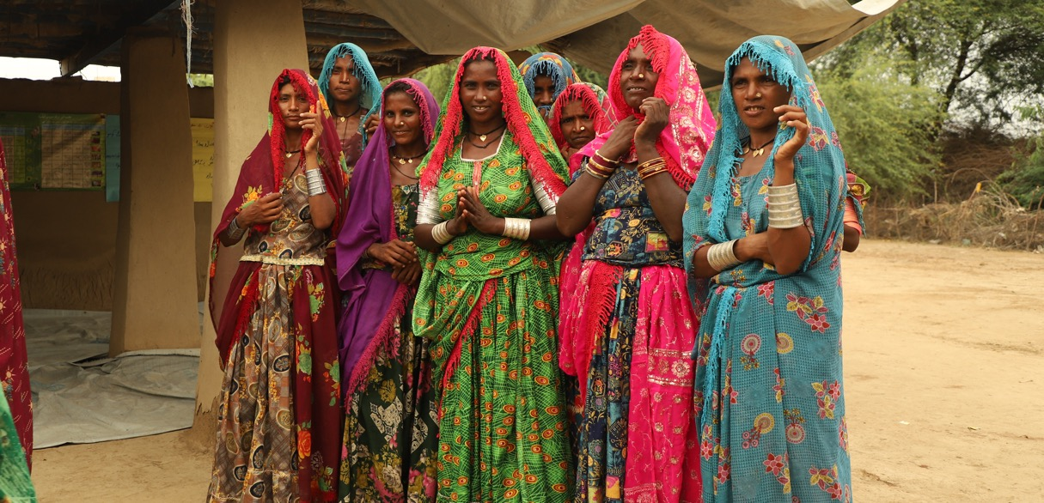
WeRespond.ca
Notes:
Visit WeRespond.ca to learn more about PWS&D and how you can get involved!
Photo: (Pakistan)

