Slide 1
Prayer Partnership
Daily Prayers for July – Sept 2024

Slide 2
July 2024

Slide 3
MONDAY
JULY 1

Slide 4
TUESDAY JULY 2

Slide 5
WEDNESDAY JULY 3

Slide 6
THURSDAY JULY 4

Slide 7
FRIDAY JULY 5

Slide 8
SATURDAY JULY 6

Slide 9
SUNDAY JULY 7

Slide 10
MONDAY JULY 8

Slide 11
TUESDAY JULY 9

Slide 12
WEDNESDAY JULY 10

Slide 13
THURSDAY JULY 11

Slide 14
FRIDAY JULY 12

Slide 15
SATURDAY JULY 13

Slide 16
SUNDAY JULY 14

Slide 17
MONDAY JULY 15

Slide 18
TUESDAY JULY 16

Slide 19
WEDNESDAY JULY 17

Slide 20
THURSDAY JULY 18

Slide 21
FRIDAY JULY 19

Slide 22
SATURDAY JULY 20

Slide 23
SUNDAY JULY 21

Slide 24
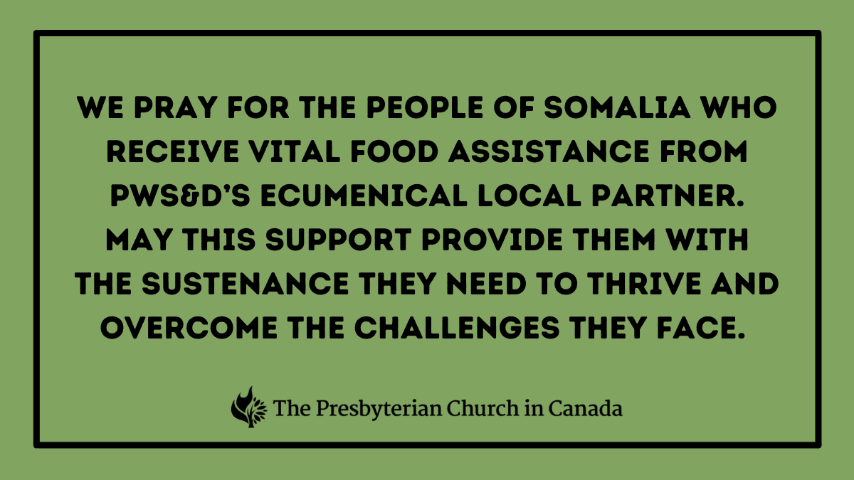
MONDAY JULY 22

Slide 25
TUESDAY JULY 23

Slide 26
WEDNESDAY JULY 24

Slide 27
THURSDAY JULY 25

Slide 28
FRIDAY JULY 26

Slide 29
SATURDAY JULY 27

Slide 30
SUNDAY JULY 28

Slide 31
MONDAY JULY 29

Slide 32
TUESDAY JULY 30

Slide 33
WEDNESDAY JULY 31

Slide 34
August 2024

Slide 35
THURSDAY AUG. 1

Slide 36
FRIDAY AUG. 2

Slide 37
SATURDAY AUG. 3

Slide 38
SUNDAY AUG. 4

Slide 39
MONDAY AUG. 5

Slide 40
TUESDAY AUG. 6

Slide 41
WEDNESDAY AUG. 7

Slide 42
THURSDAY AUG. 8

Slide 43
FRIDAY AUG. 9

Slide 44
SATURDAY AUG. 10

Slide 45
SUNDAY AUG. 11

Slide 46
MONDAY AUG. 12

Slide 47
TUESDAY AUG. 13

Slide 48
WEDNESDAY AUG. 14

Slide 49
THURSDAY AUG. 15

Slide 50
FRIDAY AUG. 16

Slide 51
SATURDAY AUG. 17

Slide 52
SUNDAY AUG. 18

Slide 53
MONDAY AUG. 19

Slide 54
TUESDAY AUG. 20

Slide 55
WEDNESDAY AUG. 21

Slide 56
THURSDAY AUG. 22

Slide 57
FRIDAY AUG. 23

Slide 58
SATURDAY AUG. 24

Slide 59
SUNDAY AUG. 25

Slide 60
MONDAY AUG. 26

Slide 61
TUESDAY
AUG. 27

Slide 62
WEDNESDAY AUG. 28

Slide 63
THURSDAY AUG. 29

Slide 64
FRIDAY AUG. 30

Slide 65
SATURDAY AUG. 31

Slide 66
September 2024

Slide 67
SUNDAY SEPT. 1

Slide 68
MONDAY SEPT. 2

Slide 69
TUESDAY SEPT. 3

Slide 70
WEDNESDAY SEPT. 4

Slide 71
THURSDAY SEPT. 5

Slide 72
FRIDAY SEPT. 6

Slide 73
SATURDAY SEPT. 7

Slide 74
SUNDAY SEPT. 8

Slide 75
MONDAY SEPT. 9

Slide 76
TUESDAY SEPT. 10

Slide 77
WEDNESDAY SEPT. 11

Slide 78
THURSDAY SEPT. 12

Slide 79
FRIDAY SEPT. 13

Slide 80
SATURDAY SEPT. 14

Slide 81
SUNDAY SEPT. 15

Slide 82
MONDAY SEPT. 16

Slide 83
TUESDAY SEPT. 17

Slide 84
WEDNESDAY SEPT. 18

Slide 85
THURSDAY SEPT. 19

Slide 86
FRIDAY SEPT. 20

Slide 87
SATURDAY SEPT. 21

Slide 88
SUNDAY SEPT. 22

Slide 89
MONDAY SEPT. 23

Slide 90
TUESDAY SEPT. 24

Slide 91
WEDNESDAY SEPT. 25

Slide 92
THURSDAY SEPT. 26

Slide 93
FRIDAY SEPT. 27

Slide 94
SATURDAY SEPT. 28

Slide 95
SUNDAY SEPT. 29

Slide 96
MONDAY SEPT. 30

