Slide 1
Prayer Partnership
Mission Moments for July – Sept 2024
We want you to read the whole story!
The new Mission Moments PowerPoint slides are now laid out in sets of 3 —allowing your congregation to read the entire Mission Moment rather than an edited version, with text now large enough to be read from the back of the church.

Slide 4
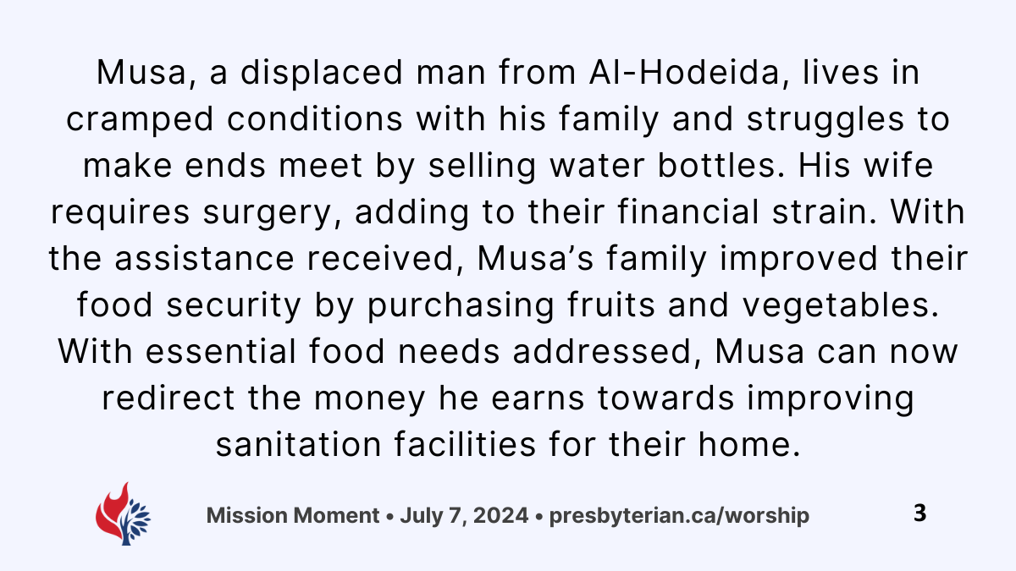

Slide 7
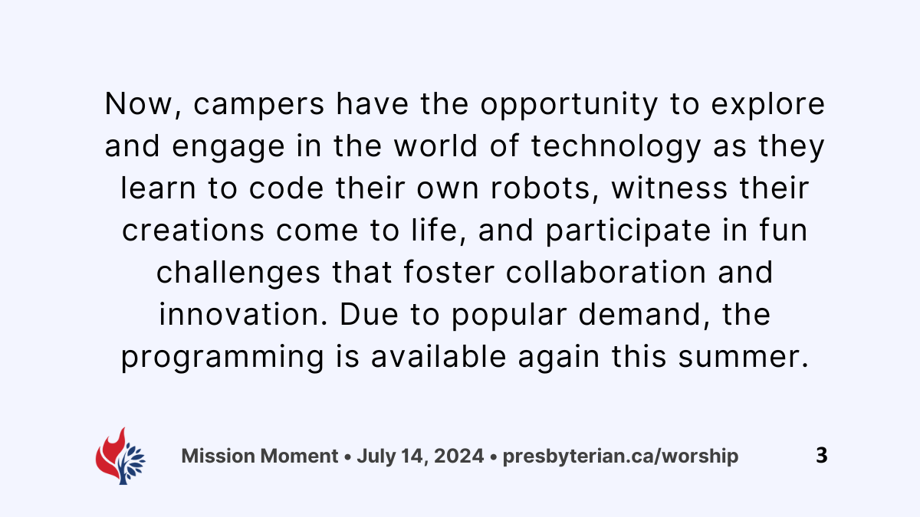

Slide 9
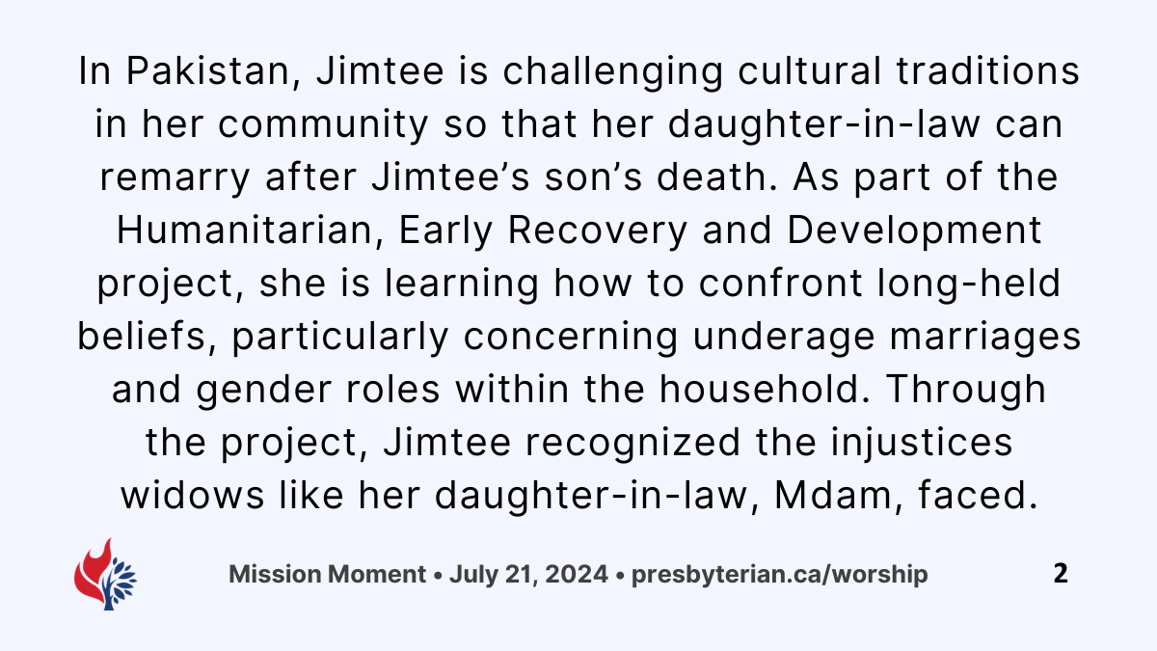

Slide 10
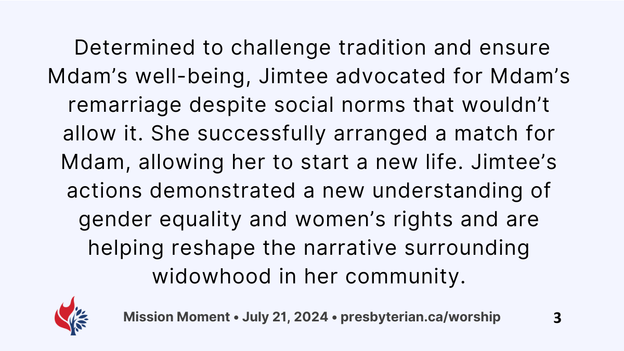

Slide 22
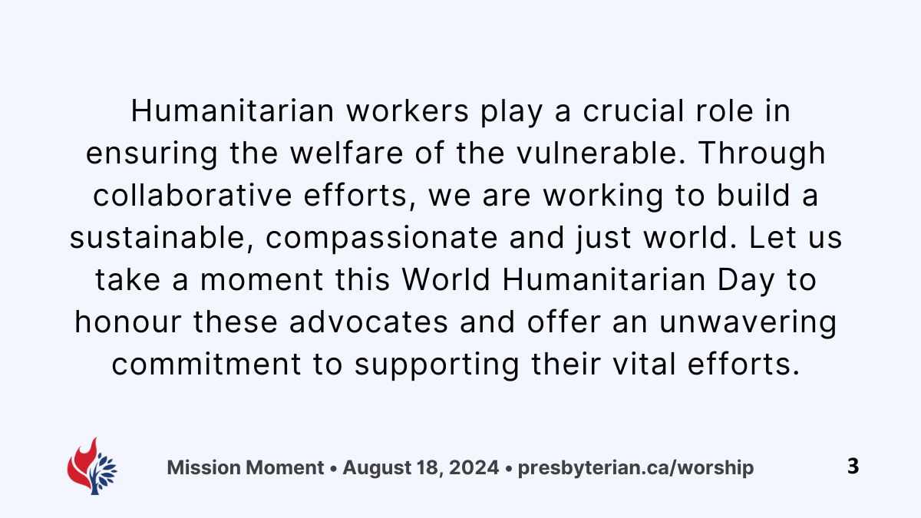

Slide 24
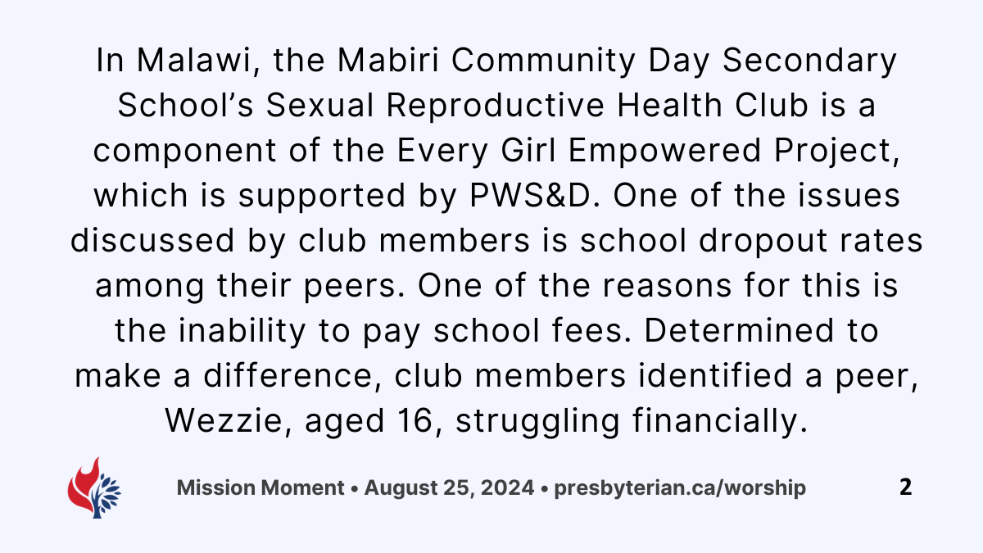

Slide 25
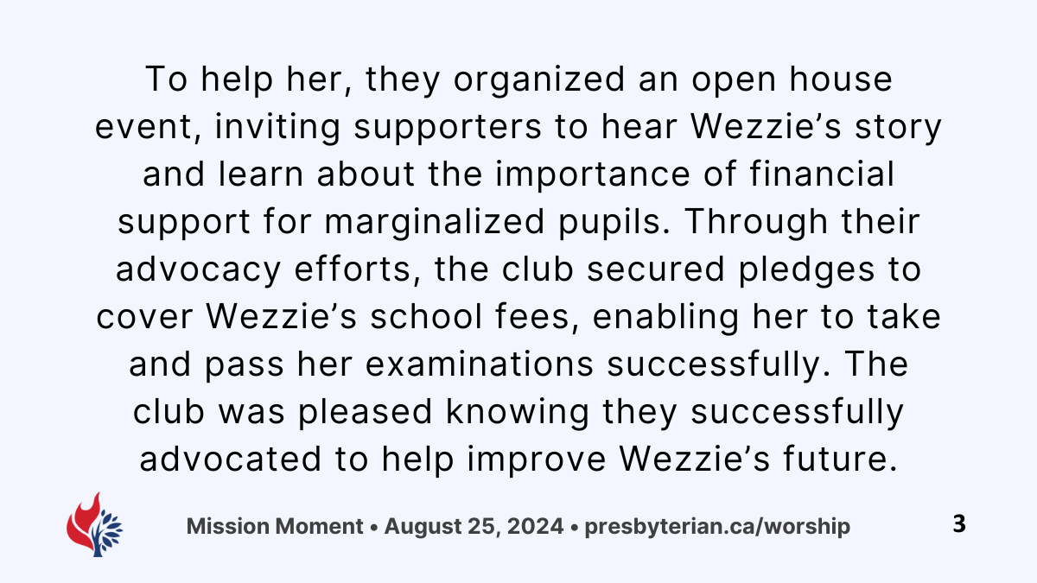

Slide 29
