Slide 1
PCC Building Survey & Congregation Risk Assessment
Will be recorded.
April 24, 2024
Notes:
So let us begin to explore different ways we report and communicate finances.

Slide 2
Presenters
Karen Plater, Stewardship & Planned Giving
Maggie Leung, Stewardship & Planned Giving
Mike Wood Daly, Special Guest, Sphaera Research
Notes:
One of the benefits of a webinar is that you can pull in multiple people to present. This really is a collaborative effort.

Slide 3
Notes:
Together we are helping congregations like Knox Presbyterian Church in Weyburn, Saskatchewan experiment with new ministry initiatives. They have started bringing their community together through an exciting music ministry called PALM: Peace, Art, Love and Music. Under the PALM banner, Knox Weyburn has hosted a variety of music and art-related events for all ages.

Slide 4
Land Acknowledgement
We acknowledge that congregations across Canada are on the traditional territories of various Indigenous peoples.
The Presbyterian Church in Canada national offices are on the traditional territory of the Huron-Wendat, Petun, Seneca and, most recently, the Mississaugas of the Credit Indigenous Peoples.
We are on a journey of healing and reconciliation between Indigenous and non-Indigenous Peoples.
Notes:
s we gather, we acknowledge our failings and apologize, and we reaffirm our commitment to healing and reconciliation with Indigenous people—First Nations, Inuit, and Metis.

Slide 5
Ask Questions
Stay muted during presentation
Use Q&A to ask questions
Use Chat for comments
We will unmute for questions and comments at the end. Raise Hand to show you want to speak

Slide 6
Spread the word
Recording, slides & notes will be posted at
presbyterian.ca/leadership-webinars
Notes:
Recordings will also be posted at https://presbyterian.ca/leadership-webinars/ for people to find and use in the future.

Slide 7
Why are we looking at church buildings & property?
Karen Plater
Notes:
So let us begin to explore different ways we report and communicate finances.

Slide 8
Karen Plater
Associate Secretary for Stewardship & Planned Giving 2007-present
Communications, PWS&D 1996-2007
What do numbers tell us?

Slide 9
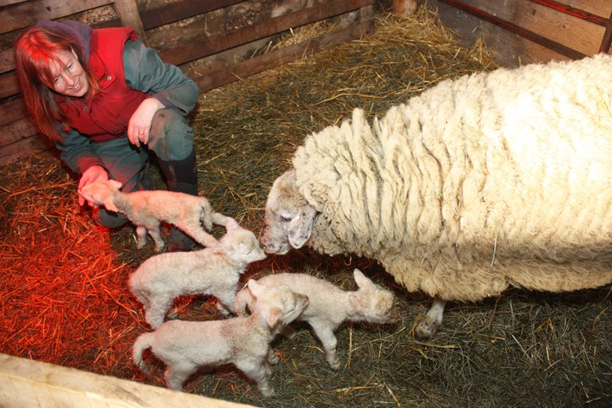
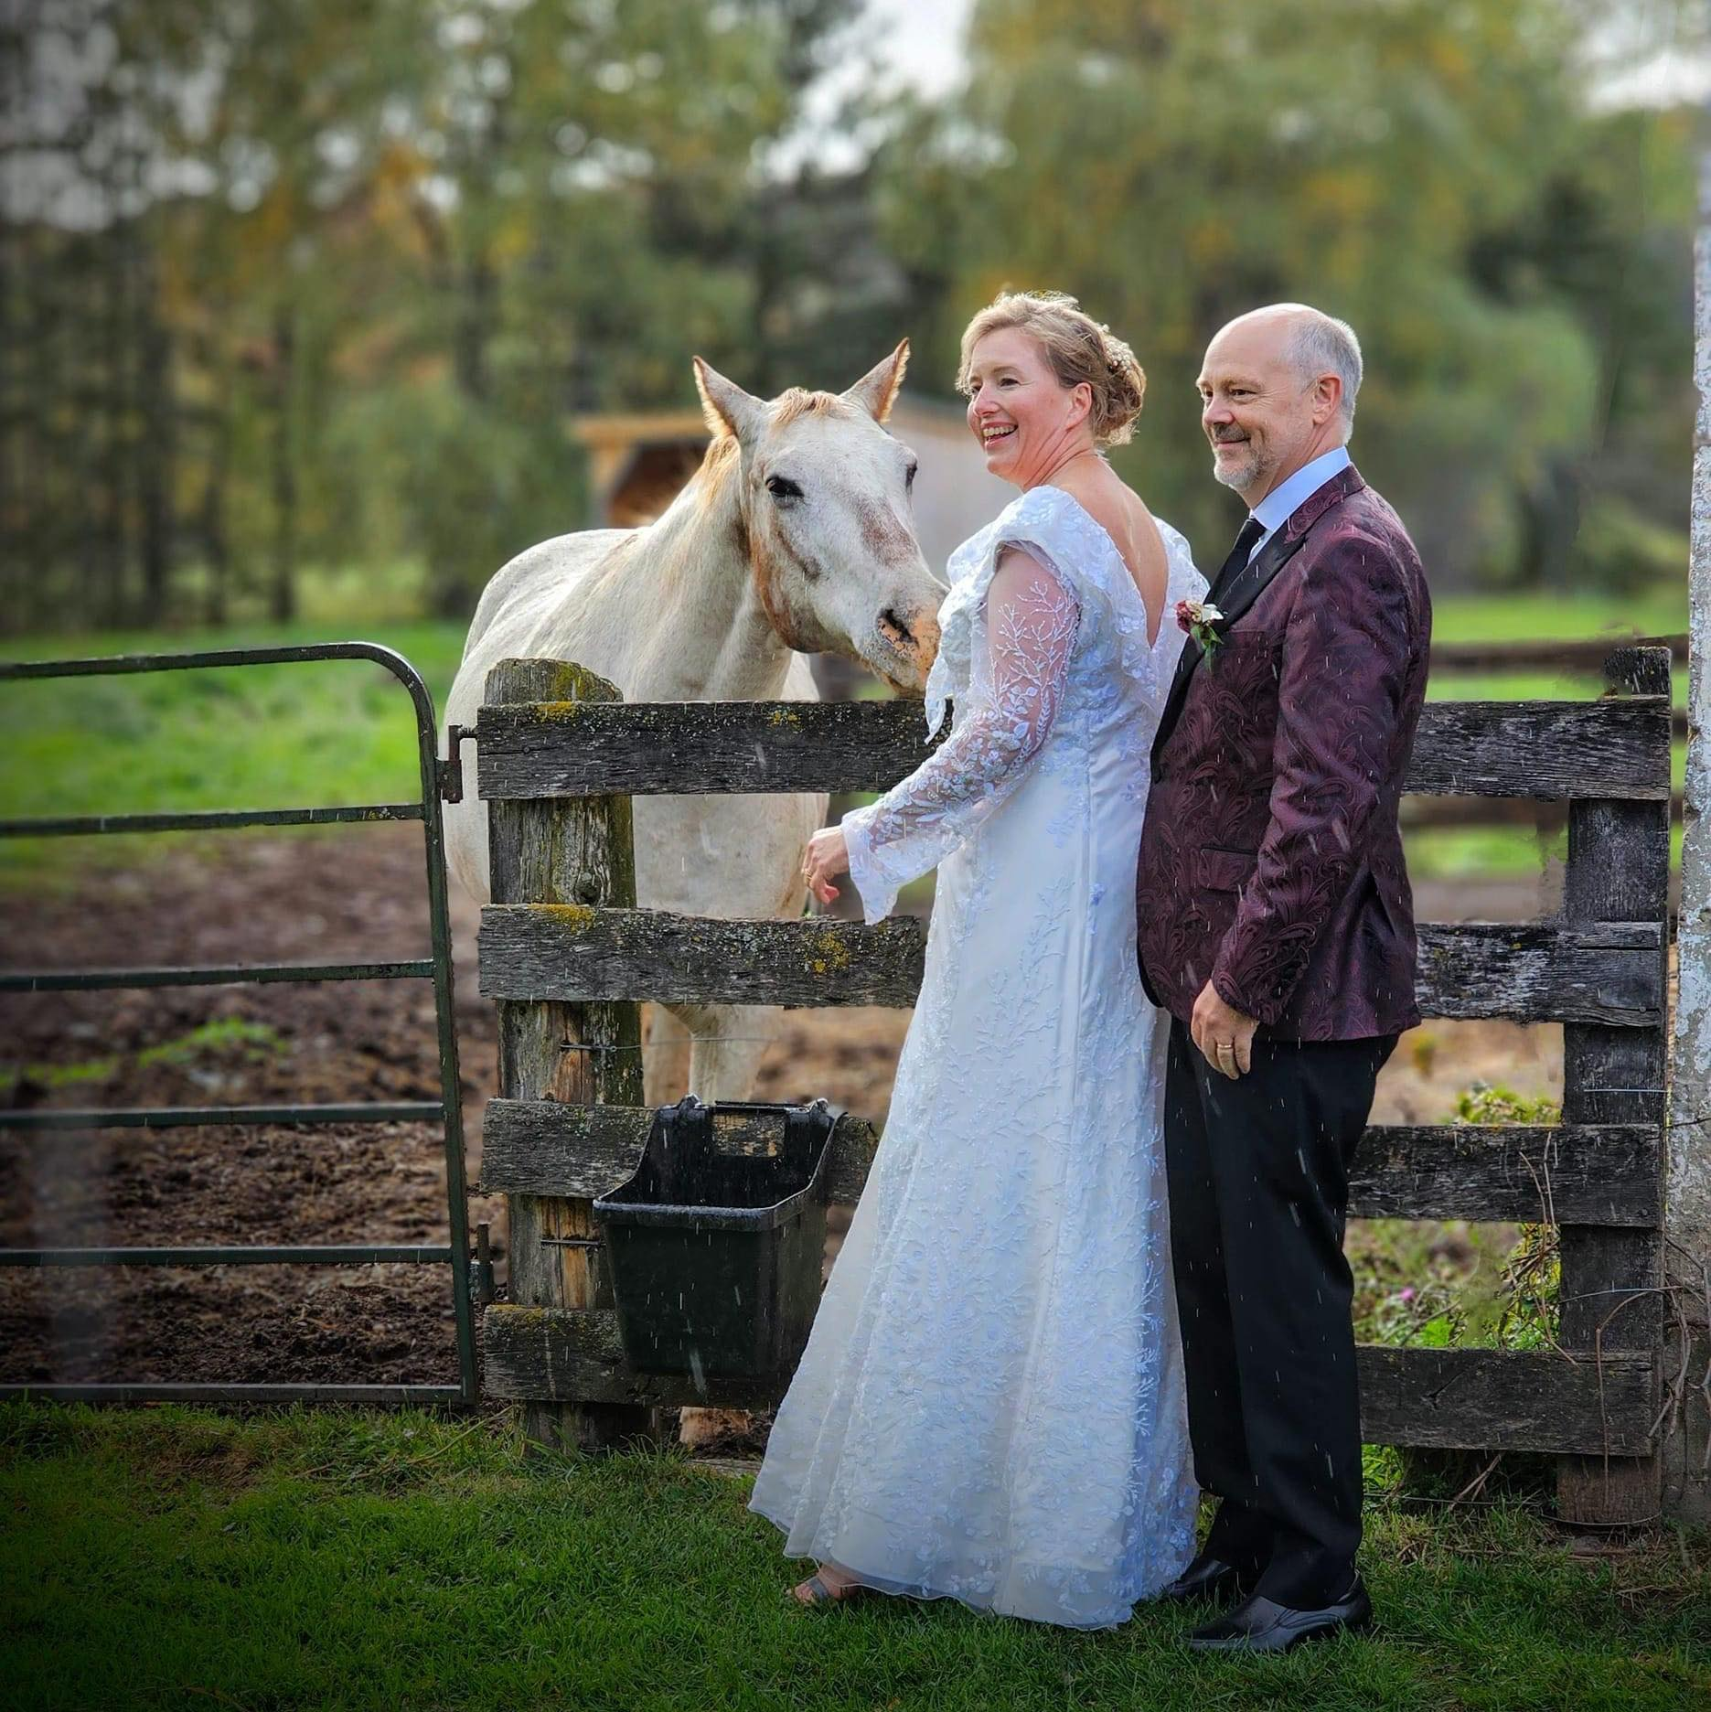
Notes:
And when I’m not at work, you’ll find me on my farm where I apply the lessons I’ve learned raising sheep – and now goats – to life and church!
And married this past Thanksgiving – 10 years after loosing my first husband John. Both spouses like travelling with me to congregations – particularly for the Presbyterian hospitality!

Slide 10
Why look at buildings
Stewardship of an important resource
Roles of congregation, presbytery, denomination
2. Legacy from past generations.
3. Once they are gone, they are difficult to get back
4. Role they have played in colonial history
5. Role they play in mission & ministry
Notes:
At the General Assembly – heard that fourteen Presbyterian congregations closed in 2023. Beginnings and endings have long been a part of the history of the
church. There is always something sad when a congregation’s ministry ends. Our church history, however, is steeped in the tradition of being reformed and always
reforming. Several reports at that same General Assembly highlighted congregational ministries that have adapted to their context while adopting fresh ways to share the
good news by meeting community needs in changing times. God’s church is alive – dynamic and changing. In the past 10 years over 4,500 congregations
across all denominations have closed in Canada. We have seen church properties sold to private individuals, businesses and developers, turned into private
homes, condos, pubs, stores, cafés, galleries and theatres.
We have also seen an affordable-housing crisis across Canada and a loss of affordable spaces for community gatherings and programs serving acute and
chronic social needs. We are also increasingly aware of the critical role played by land and churches in our colonial history.
We know not all congregations own buildings – some are worshipping in rented facilities – but many do and often those using other spaces at times, think about whether a building will be helpful for mission and ministry. . . . And that a building flavours the mission and ministry of the congregation.

Slide 11
Role of Buildings in Ministry
A space to worship, grow, learn together, which tell of God
& the character of faith
Milestones happen there: baptisms, weddings, funerals
Contain memories & stories & history
Serve the broader community
A space for community events & gathering
Affordable spaces for non-profits/small businesses
A place of sanctuary
Notes:
We want to value all of the things that these buildings give and have given to the church – and honour the gift that we have been given to steward and stewards responsibly.

Slide 12
Challenges of Buildings
Expensive (time & money) to run and maintain
May be difficult to adapt to different needs
May not be accessible to everyone in the community
Can also contain stories of hurt & pain
Role be in the journey of healing & reconciliation between Indigenous and non-Indigenous people
Notes:
We will keep these all in mind – as we talk about church buildings and property and the roles that they play in God’s mission.

Slide 13
Previous webinar
Notes:
We will keep these all in mind – as we talk about church buildings and property and the roles that they play in God’s mission.

Slide 14
Connection Stories
Fall 2023
Notes:
We will keep these all in mind – as we talk about church buildings and property and the roles that they play in God’s mission.

Slide 15
PCC Building Survey
Notes:
So let us begin to explore different ways we report and communicate finances.

Slide 16
Notes:
Again a good news story today – similar to now and growing are positives. Considering amalgamation or new configuration of ministry – is not necessarily a bad thing - again, an opportunity to share lessons/best practices.
Dissolution or closed – ministry still continues and the funds are re-invested in the future – but may continue in a different way.

Slide 17
Notes:
66% of property is under-used to moderately used – could invest/support congregations to help them see how it might be better used.
2% maxed out – may be looking at other property expansion, solutions for their buildings.
32% efficiently used – doing really well.
I think it’s important to have both the good news stories – KEEP going!!

Slide 18
Notes:
With 15-17% interested – we know that there is some interest and worth investing resources to support those interested – this is hard to navigate, lots of lessons which can be shared etc.
However, we also know that not all of our time will go into this – good balance.
Also – some possibilities may emerge as we move forward, case studies etc.

Slide 19
Congregation Risk Assessment
Mike Wood Daly
Notes:
So let us begin to explore different ways we report and communicate finances.

Slide 20
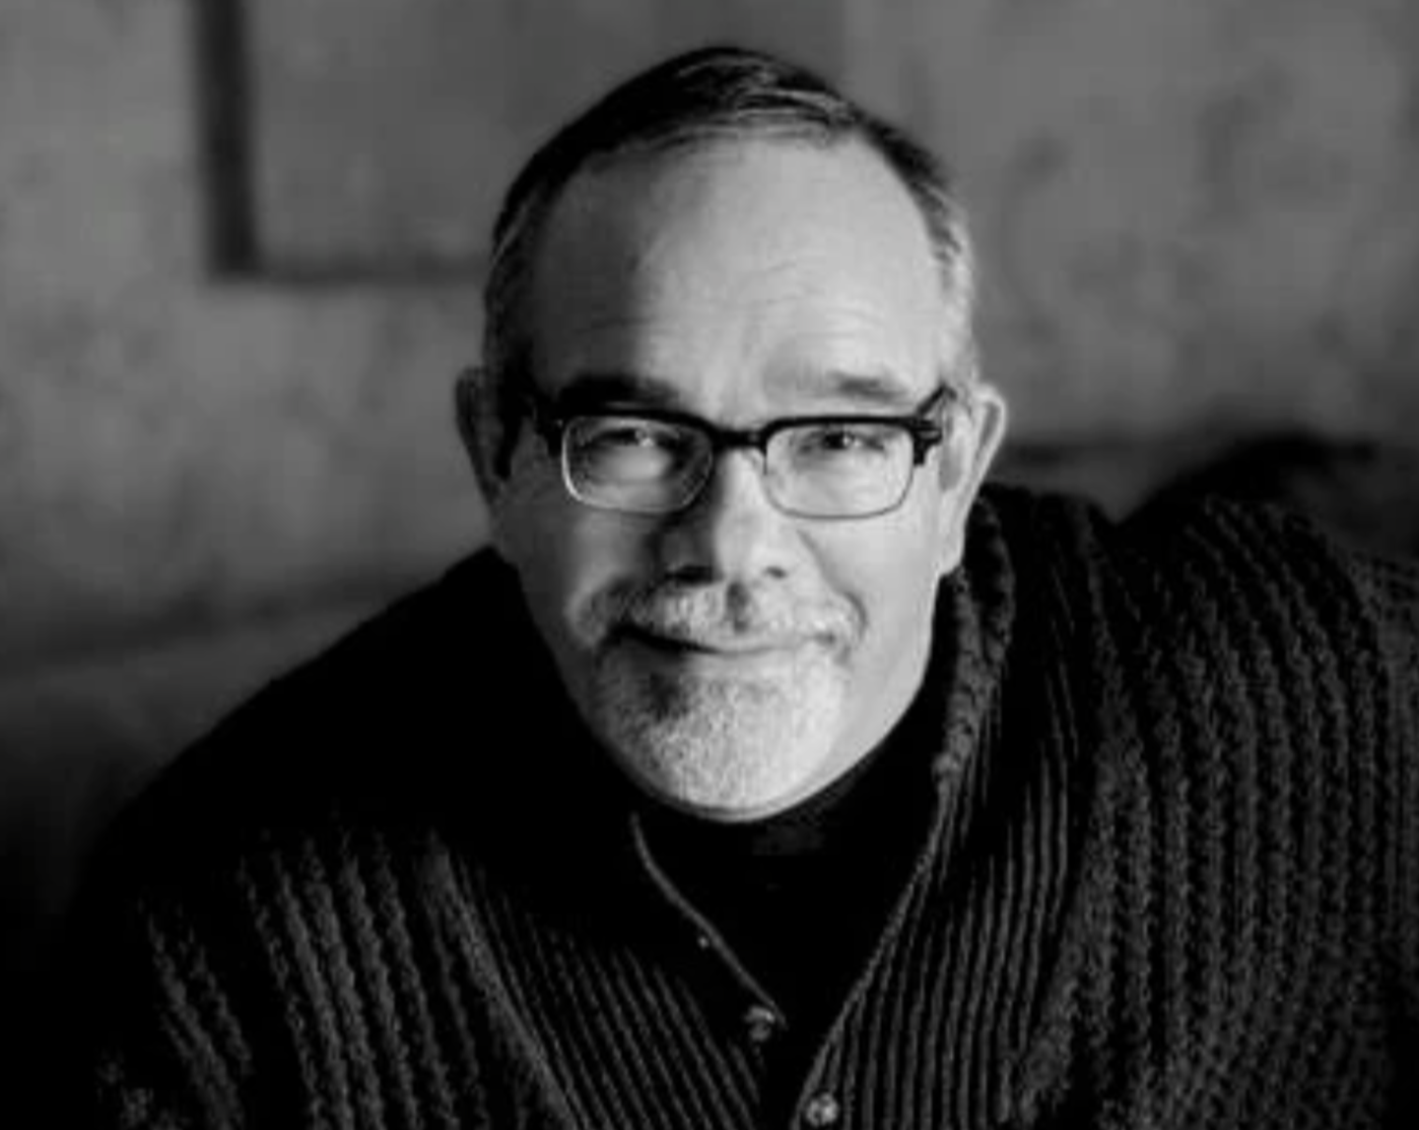
Dr. Mike Wood Daly
Information Fuels Imagination
Halo Canada Project
Sphaera Research
Trinity Centres Foundation
Notes:
One of the benefits of a webinar is that you can pull in multiple people to present. This really is a collaborative effort.

Slide 21
Risk of Closure – Indicators
Studied 4300 Canadian churches that closed between 2009 and 2018. Examined the T3010 records over 5 years and observed the following common characteristics:
An annual deficit for three or more years consecutively
Annual expenses running 30% higher than revenue
Cash and Long-term investments equaling less than three times the annual deficit
Occupancy costs totaling 30% or more of annual expenses
Staffing costs greater than 60% of total expense

Slide 22
Risk of Closure – Important Factors
Financial factors are not the only reason a church closes.
Not all factors were observed in every congregation that closed
But any of these factors can indicate some risk of potential closure.
The presence of three or more of these factors suggests a high risk of closure within the next 3 to 5 years.

Slide 23
PCC Assessment of Risk
Requested the T3010 financial records for PCC congregations for the years between 2016-2020. 769 congregation’s records were examined
The categories examined included:

Slide 24
Results of Risk Assessment – 2016 to 2019

Slide 25
National Risk Results Highlights – 2016 to 2019
REVENUE
Relative to many other mainline denominations, PCC congregations showed a relatively stable to positive financial picture overall
Cash and short-term investments rose by 51%
Long-term investments increased by 20%
The average overall revenue per congregation remained about the same at $206K, more than $22K above annual expenditures.
While performing well overall
21% of congregations (158) saw cash and short-term investments decline by more than 30%
9% saw the value of charitable receipts decline by more than 30%
11% saw total assets decline by more than 30%
10% saw total revenues decline by more than 30%

Slide 26
National Risk Highlights – 2016 to 2019
EXPENSE
54% of PCC churches saw occupancy costs increase by more than 30%
60% saw management and administration costs rise more than 30%
15% saw compensation costs increase every year
12% saw their total expenses increase every year
19% saw their total expenses increase by more than 30%
COVID Year One
27% saw cash and short-term investments decline
70% saw a decline in receipted charitable donations
18% saw their occupancy costs increase (despite decreased revenue)
68% saw a decline in total revenue
21% saw an increase in total expenses

Slide 27
National Risk Highlights
High Risk 4%
Moderate
15%

Slide 28
National Risk Highlights

Slide 29
Congregation Risk Assessment with Building Survey Data
Mike Wood Daly & Karen Plater
Notes:
So let us begin to explore different ways we report and communicate finances.

Slide 30
PHASE TWO
Adds information on attendance, capacity, building condition and use, degree of interest in, and readiness for property development.
632 responses to building survey; 611 matches in previous survey
Findings: (based on T3010, stat report & survey): 20 congregations at high risk of closure, 89 moderate risk, 190 low risk and another 312 not at risk

Slide 31
PHASE TWO FINDINGS
Findings based on T3010, PCC stat report & building survey:
20 congregations at high risk of closure
89 moderate risk
190 low risk
312 not at risk
Notes:
Do you like the good news first, then bad news? Or bad news, then good?

Slide 32
Overview
 | NO RISK 312 CHURCHES |  | LOW RISK 190 CHURCHES |  | MEDIUM RISK 89 CHURCHES |  | HIGH RISK 20 CHURCHES |  | ALL 611 CHURCHES
Avg. Assets | $1,298,348 |  | $1,250,885 |  | $878,356 |  | $646,688 |  | $1,206,300
Avg. Liabilities | $183,602 |  | $144,072 |  | $144,293 |  | $17,155 |  | $163,627
Avg. Revenue | $240,896 |  | $205,149 |  | $118,479 |  | $44,512 |  | $205,563
Avg. Expenses | $215,541 |  | $197,296 |  | $125,060 |  | $67,688 |  | $191,848
Avg Surplus/Deficit | $30,056 |  | $7,853 |  | -$6,581 |  | -$23,176 |  | $13,478
# Rural Congregations | 103 | 33% | 56 | 29% | 39 | 44% | 8 | 40% | 250 | 41%
# Urban Congregations | 207 | 66% | 134 | 71% | 49 | 55% | 11 | 55% | 393 | 64%
Total # Congregations | 310 | 99% | 190 | 100% | 89 | 100% | 19 | 95% | 589 | 96%
Avg. Rural Halo Value | $601,386 |  | $463,387 |  | $333,417 |  | $214,590 |  | $453,946
Avg. Urban Halo Value | $891,652 |  | $760,188 |  | $591,364 |  | $319,368 |  | $833,972
Avg. Halo Value (All) | $774,878 |  | $672,210 |  | $473,012 |  | $275,251 |  | $703,039

Slide 33
Congregational Futures
 |  | NO RISK 312 CHURCHES |  | LOW RISK 190 CHURCHES |  | MEDIUM RISK 89 CHURCHES |  | HIGH RISK 20 CHURCHES |  | ALL 611 SURVEY CHURCHES
Next 3-7 years? | Similiar to now | 124 | 40% | 78 | 41% | 35 | 39% | 9 | 45% | 246 | 40%
 | Growing | 95 | 30% | 51 | 27% | 21 | 24% | 4 | 20% | 171 | 28%
 | Considering amalgamation or new config. | 40 | 13% | 28 | 15% | 10 | 11% | 1 | 5% | 81 | 13%
 | Considering dissolution or already closed | 8 | 3% | 4 | 2% | 8 | 9% | 1 | 5% | 21 | 3%
 | Don't Know | 45 | 14% | 29 | 15% | 15 | 17% | 3 | 15% | 92 | 15%
Focus Presbytery/Denomination attention on medium to high-risk congregations that are growing (have internal capacity), considering amalgamation and or closing (making property available for sale and investment of assets or redevelopment for social impact).

Slide 34
Site Location
 |  | NO RISK 312 CHURCHES |  | LOW RISK 190 CHURCHES |  | MEDIUM RISK 89 CHURCHES |  | HIGH RISK 20 CHURCHES |  | ALL 611 CHURCHES
Community your congregation is serving: | Rural | 128 | 41% | 70 | 37% | 45 | 51% | 9 | 45% | 252 | 41%
 | Rural Suburban | 18 | 6% | 9 | 5% | 4 | 4% | 3 | 15% | 31 | 5%
 | Rural Suburban City | 4 | 1% | 2 | 1% | 2 | 2% |  |  | 7 | 1%
 | Suburban | 39 | 13% | 32 | 17% | 11 | 12% | 2 | 10% | 105 | 17%
 | Suburban City | 9 | 3% | 15 | 8% | 4 | 4% | 3 | 15% | 38 | 6%
 | City | 78 | 25% | 59 | 31% | 22 | 25% | 4 | 20% | 164 | 27%
Rural sites are likely to have lower property values limiting their development capacity
Property values of urban and suburban sites are more likely to enable greater density, higher value yields, inclusion of community services, and higher social impacts.

Slide 35
Attendance and Seating Capacity
 | NO RISK 312 CHURCHES | LOW RISK 190 CHURCHES | MEDIUM RISK 89 CHURCHES | HIGH RISK 20 CHURCHES | ALL 611 CHURCHES
Average Seating | 220 | 224 | 203 | 200 | 218
Max Seating | 1200 | 800 | 1100 | 700 | 1200
Min Seating | 35 | 45 | 40 | 35 | 35
Avg Attend | 52 | 45 | 29 | 17 | 45
Max Attend | 1150 | 759 | 272 | 80 | 1150
Min Attend | 0 | 0 | 0 | 0 | 0
Avg attend as % of capacity | 29% | 23% | 17% | 12% | 22%
Congregations with average attendances less than 20% of capacity are far more likely to be at high or medium risk of closure.

Slide 36
Heritage, Parking and Development Potential
 | NO RISK 312 CHURCHES |  | LOW RISK 190 CHURCHES |  | MEDIUM RISK 89 CHURCHES |  | HIGH RISK 20 CHURCHES |  | ALL 611 CHURCHES
30+ Parking spaces | 138 | 44% | 83 | 44% | 27 | 30% | 6 | 30% | 254 | 42%
Developr Enquiries | 39 | 13% | 32 | 17% | 16 | 18% | 2 | 10% | 89 | 15%
Barriers: Heritage/Zoning | 77 | 25% | 51 | 27% | 20 | 22% | 2 | 10% | 151 | 25%
Congregations with more than 30 parking spaces could have enough property to support development
Previous enquiries by developers may suggest significant development capacity
Heritage and/or zoning restrictions may limit development capacity but do not always present insurmountable development challenges.

Slide 37
Building Condition and Use
 |  | NO RISK 312 CHURCHES |  | LOW RISK 190 CHURCHES |  | MEDIUM RISK 89 CHURCHES |  | HIGH RISK 20 CHURCHES |  | ALL 611 SURVEY CHURCHES
Building Cond’n | Good condition, normal maintenance expenses | 221 | 71% | 136 | 72% | 55 | 62% | 9 | 45% | 421 | 69%
 | Medium condition, needs renovations | 83 | 27% | 48 | 25% | 31 | 35% | 10 | 50% | 172 | 28%
 | Poor condition, needs extensive renovations | 6 | 2% | 5 | 3% | 3 | 3% | 1 | 5% | 15 | 2%
Current Use | Efficiently used: used well to serve ministry and community. | 65 | 21% | 63 | 33% | 24 | 27% | 3 | 15% | 193 | 32%
 | Moderately used: could be better used to serve ministry and community. | 61 | 20% | 71 | 37% | 24 | 27% | 6 | 30% | 209 | 34%
 | Under-used: used only for Sunday services and a few special events. | 59 | 19% | 45 | 24% | 39 | 44% | 1 | 5% | 187 | 31%

Slide 38
Excess Property
 | NO RISK 312 CHURCHES |  | LOW RISK 190 CHURCHES |  | MEDIUM RISK 89 CHURCHES |  | HIGH RISK 20 CHURCHES |  | ALL 611 CHURCHES
We have property which could be sold to support ministry. | 51 | 16% | 28 | 15% | 9 | 10% | 2 | 10% | 50 | 8%
Under-used buildings in poor condition could be building candidates for re-imagining or redevelopment.
Buildings that are well-used and in good condition may also represent good candidates, since good use and appropriate maintenance may suggest the congregation has capacity to manage a project.
Excess property which could be sold, also likely represent congregations that could be good candidates for a re-imagined development of their property.

Slide 39
Existing and Projects Underway
 |  | NO RISK 312 CHURCHES |  |  | LOW RISK 190 CHURCHES |  | MEDIUM RISK 89 CHURCHES |  | HIGH RISK 20 CHURCHES |  | ALL 611 CHURCHES
Have a completed project: | Yes | 12 | 4% | 4% | 10 | 5% | 1 | 1% | 2 | 10% | 25 | 4%
 | In Progress | 17 | 5% | 5% | 11 | 6% | 3 | 3% | 1 | 5% | 32 | 5%
Project includes: | Housing | 6 | 2% | 2% | 3 | 2% |  |  |  |  | 9 | 1%
 | Commercial |  |  |  |  |  |  |  | 2 | 10% | 2 | 0%
 | Space for non- profits |  |  |  |  |  | 1 | 1% |  |  | 1 | 0%
Market rent #units |  | 200 |  |  | 172 |  |  |  |  |  | 372
Subsidized rent # units |  | 60 |  |  |  |  |  |  |  |  | 60
Group home # units |  | 1 |  |  | 39 |  |  |  |  |  | 40
Ownership # units

Slide 40
Congregational Interest in Development
 |  | NO RISK 312 CHURCHES |  | LOW RISK 190 CHURCHES |  | MEDIUM RISK 89 CHURCHES |  | HIGH RISK 19 CHURCHES |  | ALL SURVEY CHURCHES
Are you interested in pursuing a develop’t project in the future? | Interested in possibilities | 45 | 14% | 25 | 13% | 9 | 10% | 5 | 25% | 84 | 14%
 | Already part of our plans, 5-10 years in future. | 18 | 6% | 12 | 6% | 6 | 7% | 1 | 5% | 37 | 6%
 | Not interested | 189 | 61% | 113 | 59% | 55 | 62% | 10 | 50% | 367 | 60%
 | Too exhausted/ don't have resources to pursue | 37 | 12% | 25 | 13% | 14 | 16% | 4 | 20% | 80 | 13%
 | Started, got stuck, and need help in moving forward. | 1 | 0% | 5 | 3% | 1 | 1% |  |  | 7 | 1%

Slide 41
Congregational Interest in Development
Churches that are expressing interest will always represent a better development opportunity
Note the correlation: churches with less risk are also more likely to express interest in development
There are at least 8 congregations who have tried and are asking for help to re-engage

Slide 42
Congregational Readiness for Development
 |  | NO RISK 312 CHURCHES |  | LOW RISK 190 CHURCHES |  | MEDIUM RISK 89 CHURCHES |  | HIGH RISK 19 CHURCHES |  | ALL SURVEY CHURCHES
How ready is your congregation to begin? (Select all that apply.) | There is expressed interest to do something new | 19 | 6% | 8 | 4% | 6 | 7% | 3 | 15% | 35 | 6%
 | We have a strong mission and vision that a project would compliment | 8 | 3% | 6 | 3% | 4 | 4% | 2 | 10% | 19 | 3%
 | Our ministry is struggling, and we think a project could help turn things around. | 14 | 4% | 7 | 4% | 1 | 1% | 2 | 10% | 23 | 4%
Congregations that express interest are not the same as congregations that are ready
A strong sense of shared mission is critical to development success
Caution should be exercised in working with congregations who are exploring development out of desperation

Slide 43
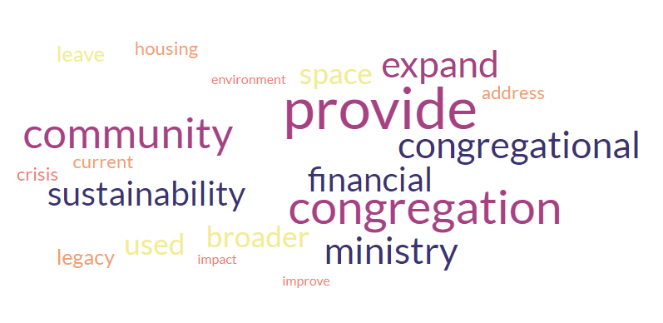
Reasons for Exploring Development

Slide 44
Reasons for Exploring Development
Occurrence | Word | Occurrence | Word
151 | provide | 69 | used
120 | congregation | 45 | leave
107 | community | 45 | legacy
91 | congregational | 38 | address
91 | expand | 38 | crisis
91 | ministry | 38 | current
82 | financial | 38 | housing
82 | sustainability | 23 | environment
69 | broader | 23 | impact
69 | space | 23 | improve

Slide 45
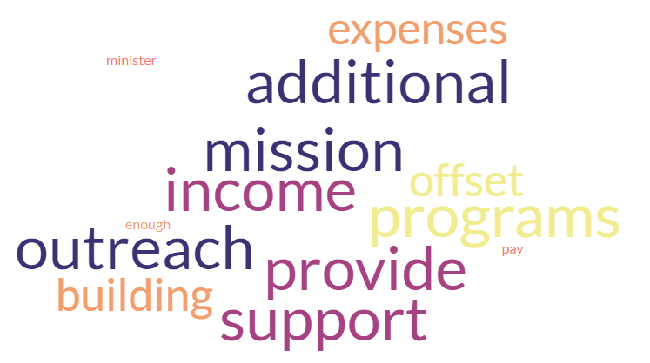
What would your Church like to do with the Revenue?

Slide 46
What would your Church like to do with the Revenue?
Occurrence | Word | Occurrence | Word
101 | provide | 86 | offset
101 | income | 86 | building
101 | support | 86 | expenses
101 | additional | 57 | enough
101 | mission | 57 | pay
101 | outreach | 57 | minister
101 | programs

Slide 47
Development Profile
Based on the data and development survey, the typical profile of a congregation that could consider development to preserve their property asset when at risk is:
Expenses exceed revenue by 30%
Cash and long-term reserves total less than 3 times deficit
Deficit three-years in a row
Compensation costs exceed 60% of total revenue
Occupancy costs greater than 30% of total revenue
Attendance < 17% of seating capacity
Enquiries have already been made by developer
The building is in poor condition
The building is under-used
The congregation has extra property that could be sold
The congregation has expressed interest

Slide 48
Conclusions and Recommendations
Focus on Medium to High-Risk Congregations: From a denominational/presbytery perspective, prioritize churches that are medium to high-risk, yet have internal capacity and are experiencing growth, considering options such as amalgamation or closure for property availability and investment.
Consider Property Values in Rural vs. Urban/Suburban Sites: Rural sites may have lower property values, limiting their development capacity, while urban and suburban sites are more likely to support higher density, yield greater value, and have potential for community service inclusion and social impact.
Attendance Capacity and Risk of Closure: Congregations with average attendances below 20% of capacity are more likely to be at high or medium risk of closure.
Parking Space as an Indicator: Congregations with more than 30 parking spaces may indicate a property large enough to support development.

Slide 49
Conclusions and Recommendations
Previous Developer Inquiries: Past inquiries by developers may suggest significant development capacity and potential.
Consider Heritage and Zoning Restrictions: While heritage and zoning restrictions may limit development capacity, they don't always present insurmountable challenges.
Evaluate Building Condition: Under-used buildings in poor condition are likely candidates for redevelopment, but well-used and well-maintained buildings may also be suitable, indicating capacity to manage a development project.
Excess Property and Expressions of Interest: Churches with excess property available for sale, expressing interest in development, or actively seeking help for re-engagement are strong candidates. However, caution is needed when dealing with congregations exploring development out of desperation.

Slide 50
Conclusions and Recommendations
We would encourage the denomination/presbytery to consider a number of competing factors when discerning if or how much to invest in assisting congregations in the development process.
Medium to high-risk congregations
Potential financial yields
Current or potential degree of social impact
Neighbourhood demographic shifts
Expressed interest in development
Capacity and readiness to move forward with a development plan.

Slide 51
Next Steps
Providing data to Presbyteries & Congregations
Gathering & Disseminating More Information
Identifying Funding
Sharing Case Studies
Supporting Conversations
May 2025 – Ecumenical Event in Ontario (Re-imagining Church Properties)

Slide 52
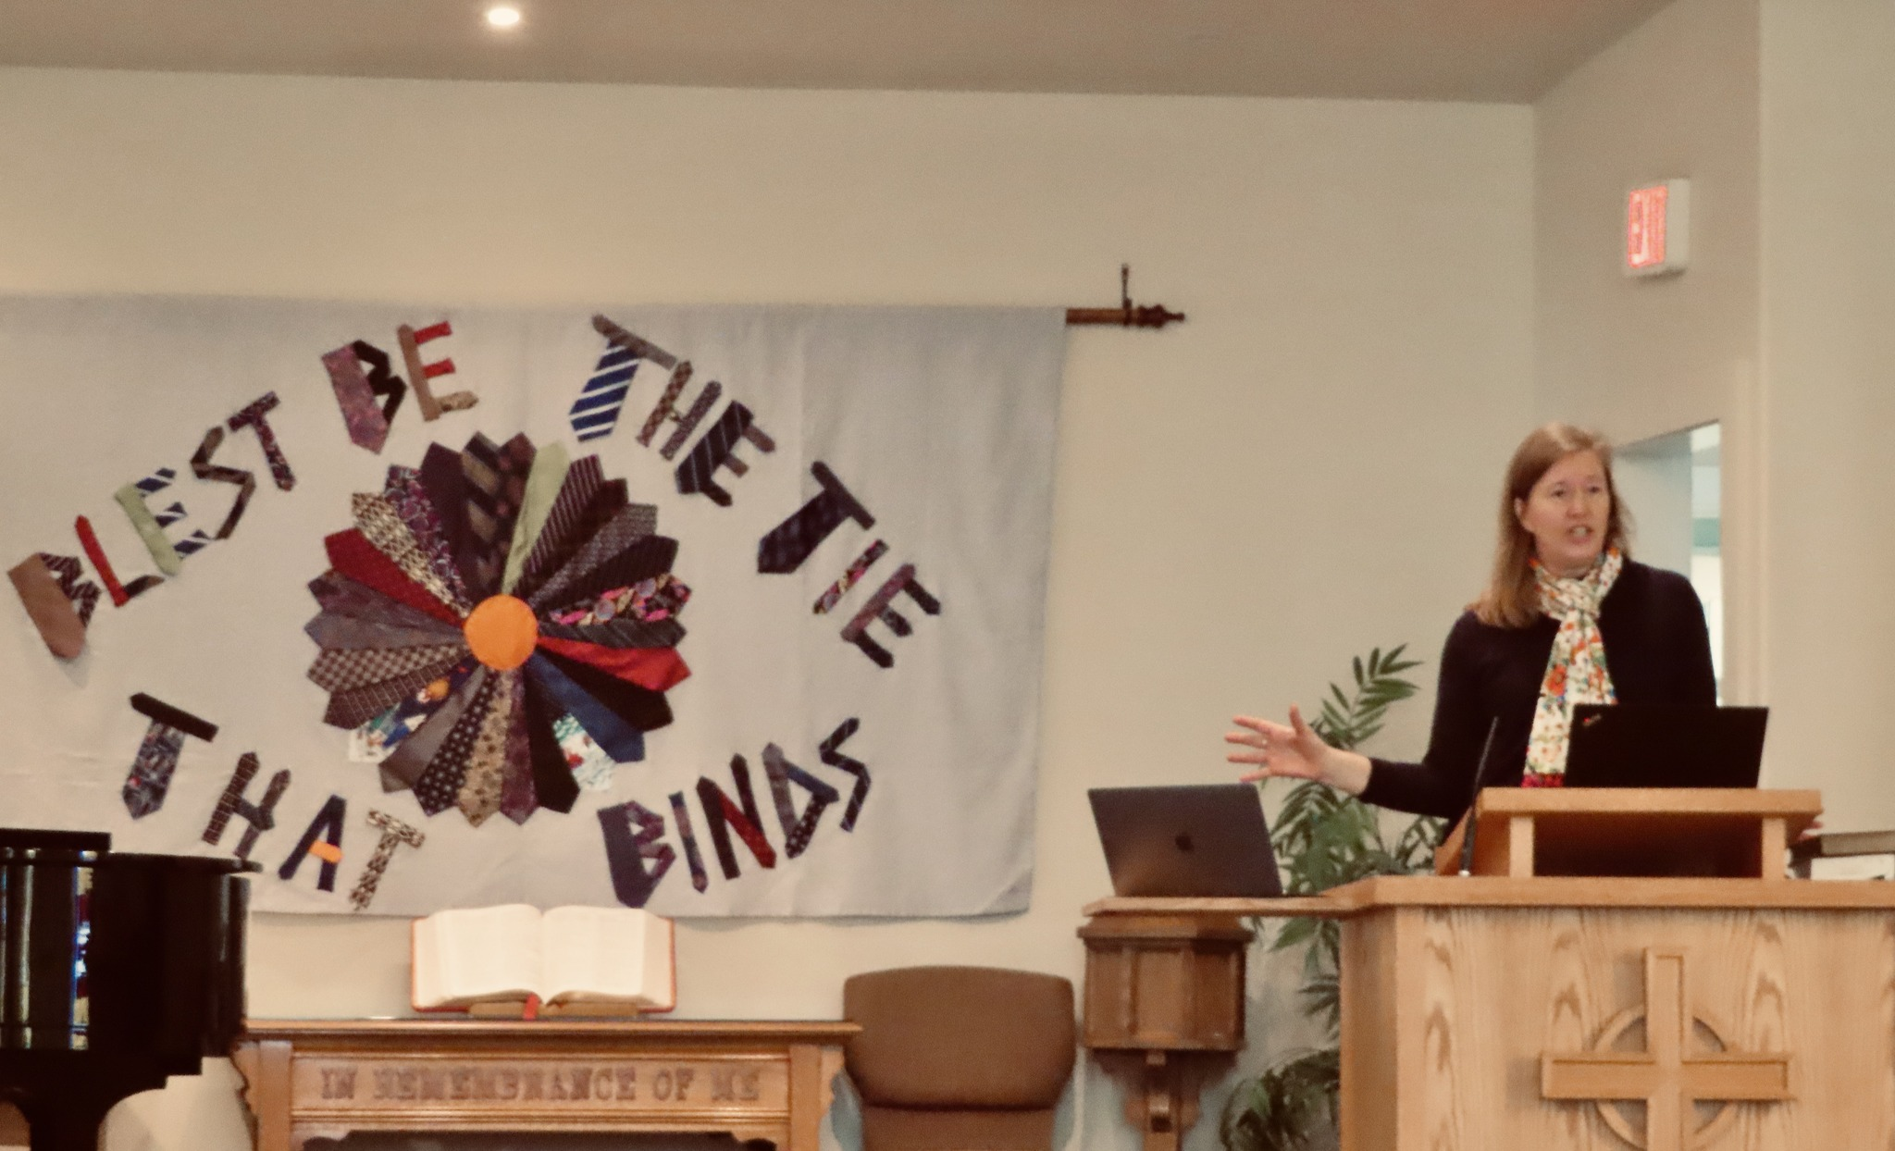
Contact Info
Karen Plater
Associate Secretary
Stewardship & Planned Giving
The Presbyterian Church in Canada
50 Wynford Dr.
Toronto, ON M3C 1J7
Phone: 416-441-1111 x272 or 1-800-619-7301 x272
Fax: 416-441-2825
kplater@presbyterian.ca
Notes:
We are always happy to help. Contact us if you have questions!

Slide 53
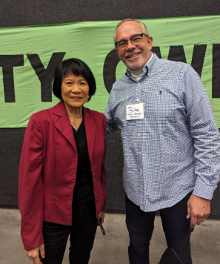
Contact Info
Dr. Mike Wood Daly
Sphaera Research / Halo Canada
sphaera.research@gmail.com
halocanadaproject@gmail.com
647-529-8370
Notes:
We are always happy to help. Contact us if you have questions!

Slide 54
Recording
presbyterian.ca/leadership-webinars
Notes:
Recordings will also be posted at https://presbyterian.ca/leadership-webinars/ for people to find and use in the future.

Slide 55
Time for Q & A
Use the Q&A for questions.
Raise hand to speak.
Unmute when called.
We’ll check chat at the end.
Notes:
.

Slide 56
Thank you!
presbyterian.ca
Notes:
.

