Slide 1
Prayer Partnership
Daily Prayers for April – June 2024

Slide 2
April 2024

Slide 3
MONDAY APR. 1

Slide 4
TUESDAY APR. 2

Slide 5
WEDNESDAY APR. 3

Slide 6
THURSDAY APR. 4

Slide 7
FRIDAY APR. 5

Slide 8
SATURDAY APR. 6

Slide 9
SUNDAY APR. 7

Slide 10
MONDAY APR. 8

Slide 11
TUESDAY APR. 9

Slide 12
WEDNESDAY APR. 10

Slide 13
THURSDAY APR. 11

Slide 14
FRIDAY APR. 12

Slide 15
SATURDAY APR. 13

Slide 16
SUNDAY APR. 14

Slide 17
MONDAY APR. 15

Slide 18
TUESDAY APR. 16

Slide 19
WEDNESDAY APR. 17

Slide 20
THURSDAY APR. 18

Slide 21
FRIDAY APR. 19

Slide 22
SATURDAY APR. 20

Slide 23
SUNDAY APR. 21

Slide 24
MONDAY APR. 22

Slide 25
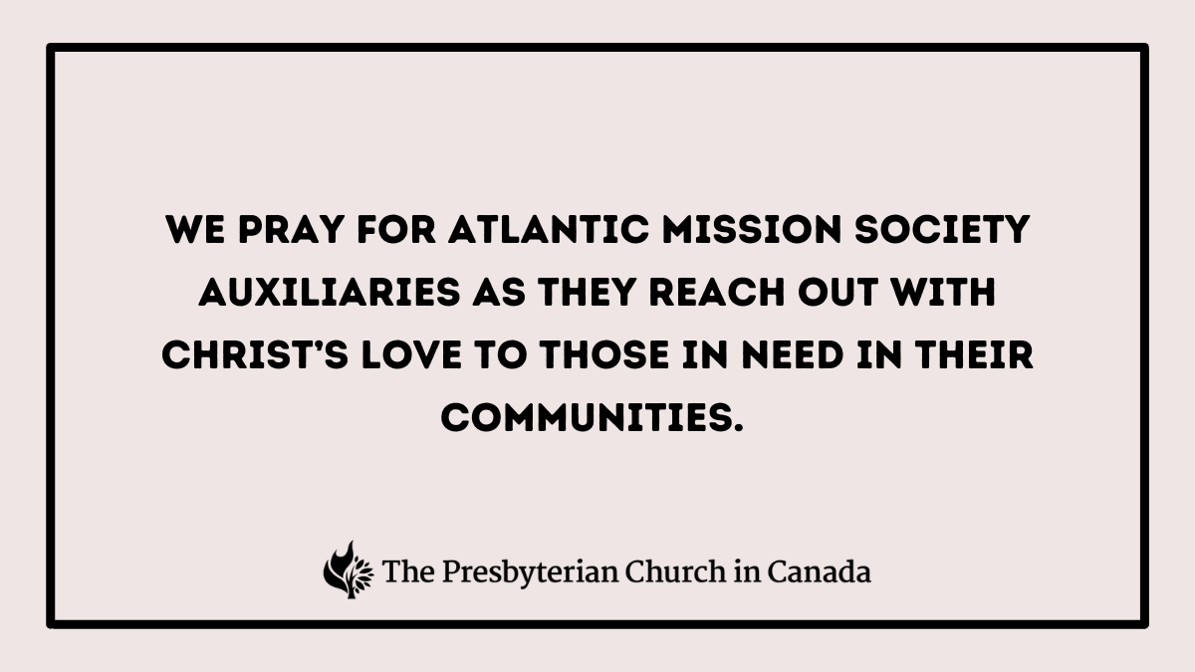
TUESDAY APR. 23

Slide 26
WEDNESDAY APR. 24

Slide 27
THURSDAY APR. 25

Slide 28
FRIDAY APR. 26

Slide 29
SATURDAY APR. 27

Slide 30
SUNDAY APR. 28

Slide 31
MONDAY APR. 29

Slide 32
TUESDAY APR. 30

Slide 33
May 2024

Slide 34
WEDNESDAY MAY 1

Slide 35
THURSDAY MAY 2

Slide 36
FRIDAY MAY 3

Slide 37
SATURDAY MAY 4

Slide 38
SUNDAY MAY 5

Slide 39
MONDAY MAY 6

Slide 40
TUESDAY MAY 7

Slide 41
WEDNESDAY MAY 8

Slide 42
THURSDAY MAY 9

Slide 43
FRIDAY MAY 10

Slide 44
SATURDAY MAY 11

Slide 45
SUNDAY MAY 12

Slide 46
MONDAY MAY 13

Slide 47
TUESDAY MAY 14

Slide 48
WEDNESDAY MAY 15

Slide 49
THURSDAY MAY 16

Slide 50
FRIDAY MAY 17

Slide 51
SATURDAY MAY 18

Slide 52
SUNDAY MAY 19

Slide 53
MONDAY MAY 20

Slide 54
TUESDAY MAY 21

Slide 55
WEDNESDAY MAY 22

Slide 56
THURSDAY MAY 23

Slide 57
FRIDAY MAY 24

Slide 58
SATURDAY MAY 25

Slide 59
SUNDAY MAY 26

Slide 60
MONDAY MAY 27

Slide 61
TUESDAY
MAY 28

Slide 62
WEDNESDAY MAY 29

Slide 63
THURSDAY MAY 30

Slide 64
FRIDAY MAY 31

Slide 65
June 2024

Slide 66
SATURDAY JUNE 1

Slide 67
SUNDAY JUNE 2

Slide 68
MONDAY JUNE 3

Slide 69
TUESDAY JUNE 4

Slide 70
WEDNESDAY JUNE 5

Slide 71
THURSDAY JUNE 6

Slide 72
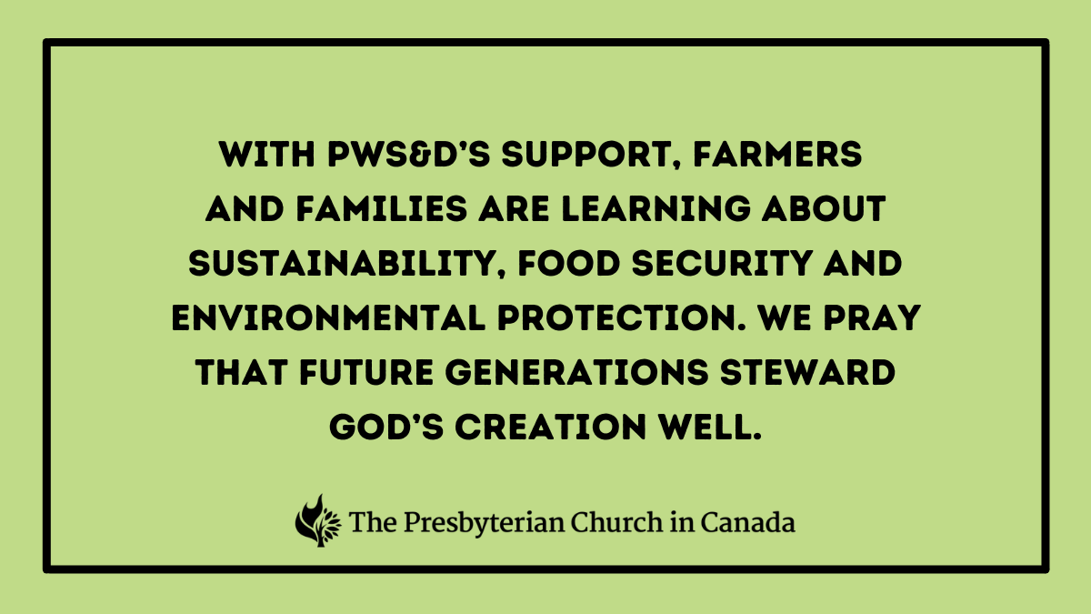
FRIDAY JUNE 7

Slide 73
SATURDAY JUNE 8

Slide 74
SUNDAY JUNE 9

Slide 75
MONDAY JUNE 10

Slide 76
TUESDAY JUNE 11

Slide 77
WEDNESDAY JUNE 12

Slide 78
THURSDAY JUNE 13

Slide 79
FRIDAY JUNE 14

Slide 80
SATURDAY JUNE 15

Slide 81
SUNDAY JUNE 16

Slide 82
MONDAY JUNE 17

Slide 83
TUESDAY JUNE 18

Slide 84
WEDNESDAY JUNE 19

Slide 85
THURSDAY JUNE 20

Slide 86
FRIDAY JUNE 21

Slide 87
SATURDAY JUNE 22

Slide 88
SUNDAY JUNE 23

Slide 89
MONDAY JUNE 24

Slide 90
TUESDAY JUNE 25

Slide 91
WEDNESDAY JUNE 26

Slide 92
THURSDAY JUNE 27

Slide 93
FRIDAY JUNE 28

Slide 94
SATURDAY JUNE 29

Slide 95
SUNDAY JUNE 30

