Slide 1
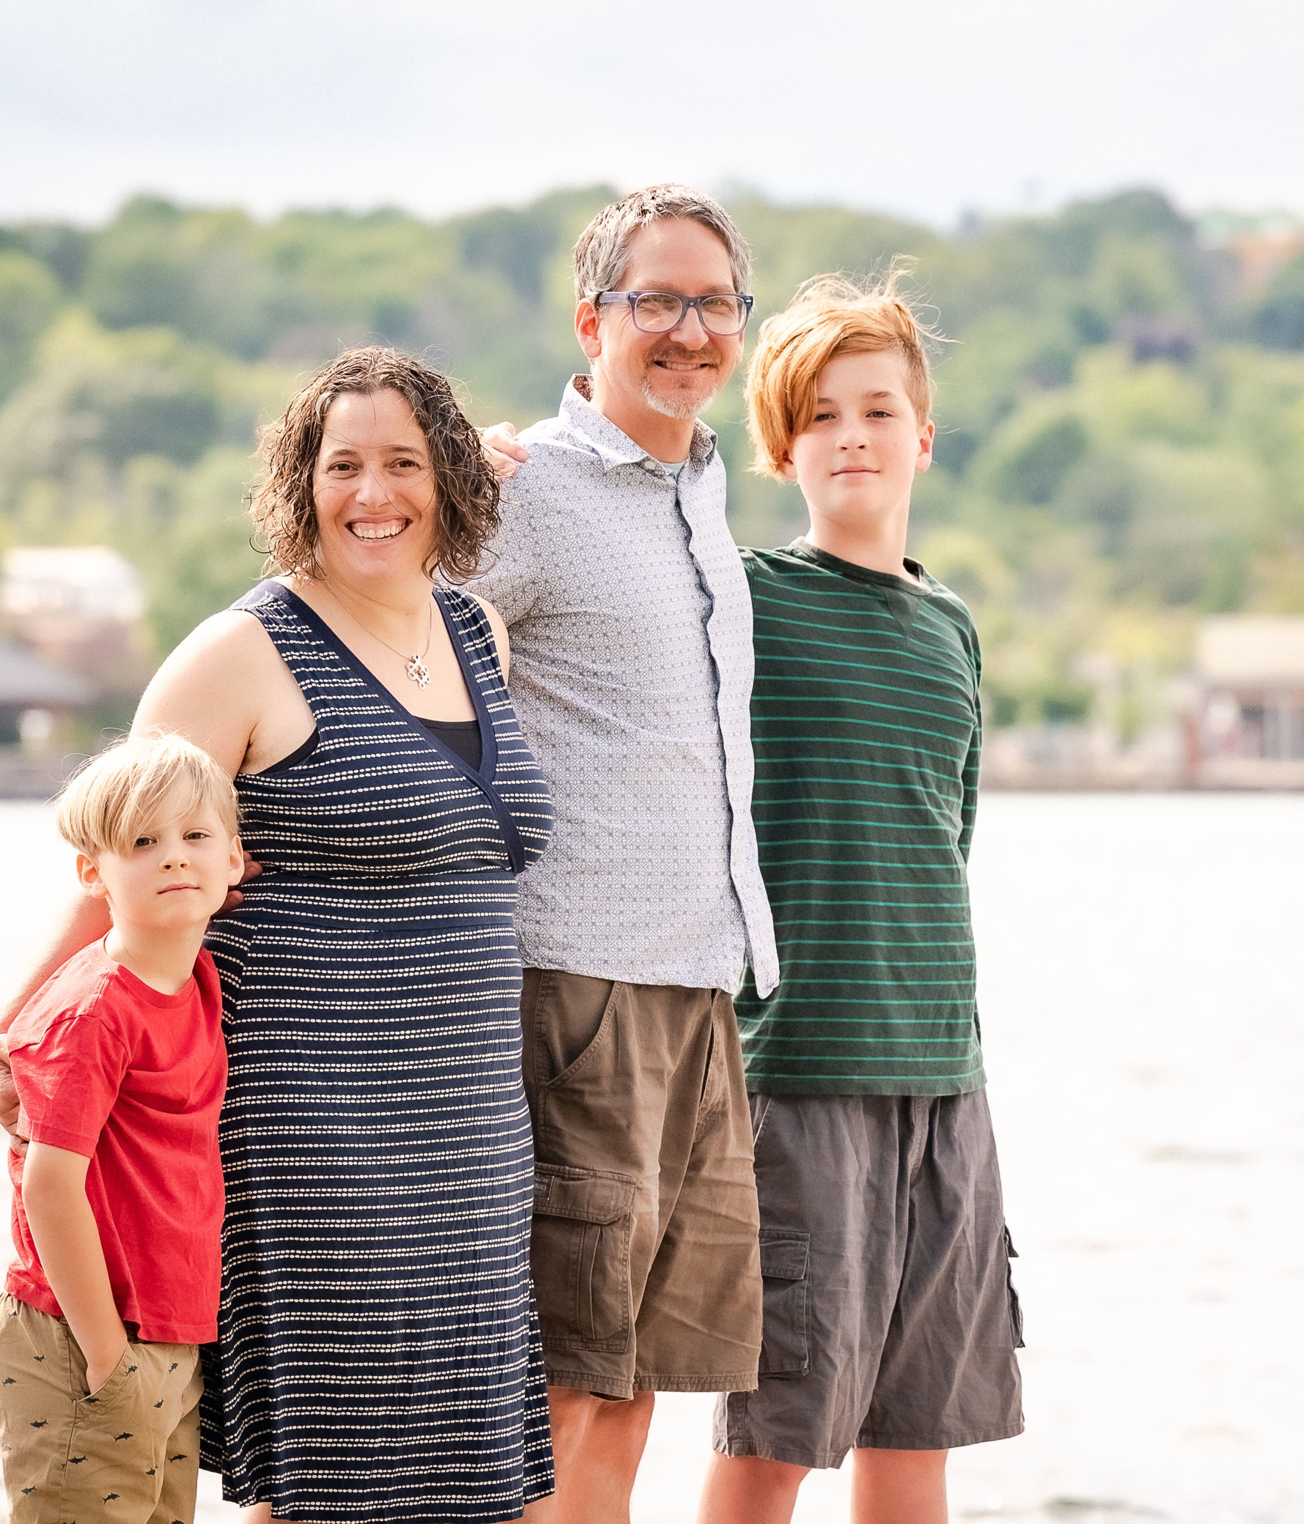
﻿Sunday, January 7
When the Rev. Lora Nafziger visited her sister in Nepal in 2022, she never imagined that she would return as Staff Care and Counselling Advisor with United Mission to Nepal (UMN). A faith-based international NGO, UMN strives to help all Nepalis achieve a fuller life through medical and community development programs. Responding to God’s call, Lora departed for Kathmandu in early January 2024 with her spouse Mitch Rhodes and their two youngest children. Lora, who is also a clinical social worker, will provide spiritual and emotional support to expatriate UMN staff and Nepali staff. She is jointly supported by the PCC through gifts to Presbyterians Sharing and Mennonite Mission Network.

Slide 2
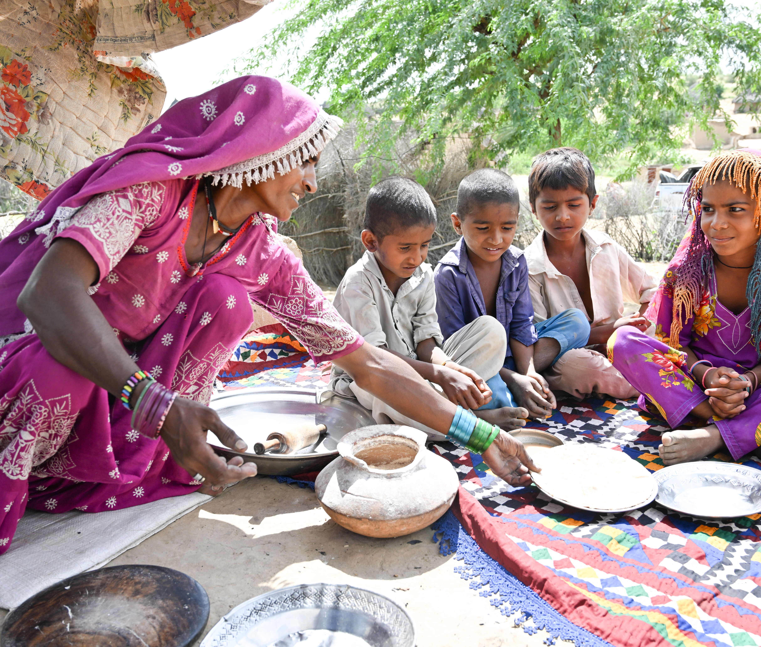

﻿Sunday, January 14
Sohdi became the sole provider for her family when her husband died a decade ago. A farmer in Pakistan, she plants various crops, but droughts and floods have disrupted food production for three years. In 2021, Sohdi received aid through the Humanitarian, Early Recovery and Development project, supported by PWS&D, which provided food aid to households in need. This assistance enabled her family to eat properly even during times of failed harvests. The project also provided support for women artisans to improve their skills and market their goods, making them more resilient for the future. Sohdi is grateful for this support that allowed her to stay out of debt. Now, she dreams of her son’s wedding as well as sending her other children to school.

Slide 3
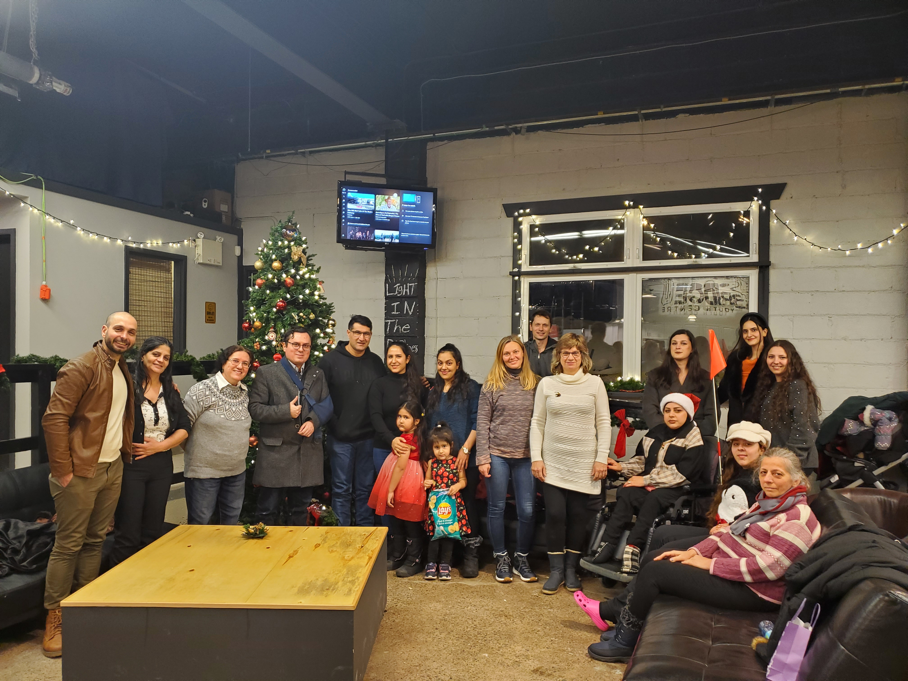
﻿Sunday, January 21
We are God’s people, called to serve God with our many gifts. We belong to a denomination that is connected by faith, governance, history and mission. Presbyterians Sharing is one of the ways that Presbyterians across Canada work together to proclaim the good news of Jesus Christ, sharing God’s love and hope in our communities, in Canada and around the world. Gifts to Presbyterians Sharing help build strong congregations, serve vulnerable people, walk with Indigenous people, seek justice and share God’s love. When we work together, we can accomplish so much more than we ever could on our own.

Slide 4
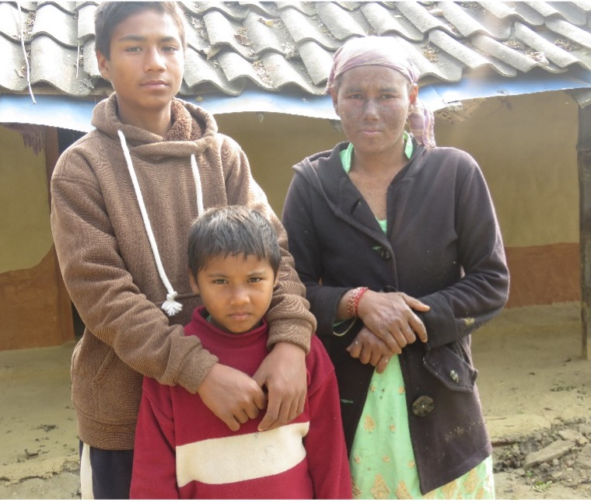
﻿Sunday, ﻿January 28
In Nepal, Nirba struggled with an undiagnosed skin condition that kept her inside. In addition to her health struggles, Nirba grappled with financial instability. Because she couldn’t afford medical assistance, Nirba borrowed money from friends and relatives. Thanks to a clinic set up by the International Nepal Fellowship (a PWS&D partner), Nirba was able to meet with a dermatologist, receive a diagnosis of leprosy and begin treatment. The clinic’s support also provided financial aid for Nirba’s child’s education. Nirba expressed profound gratitude for this assistance as it not only helped her son but her own health situation as well.

Slide 5
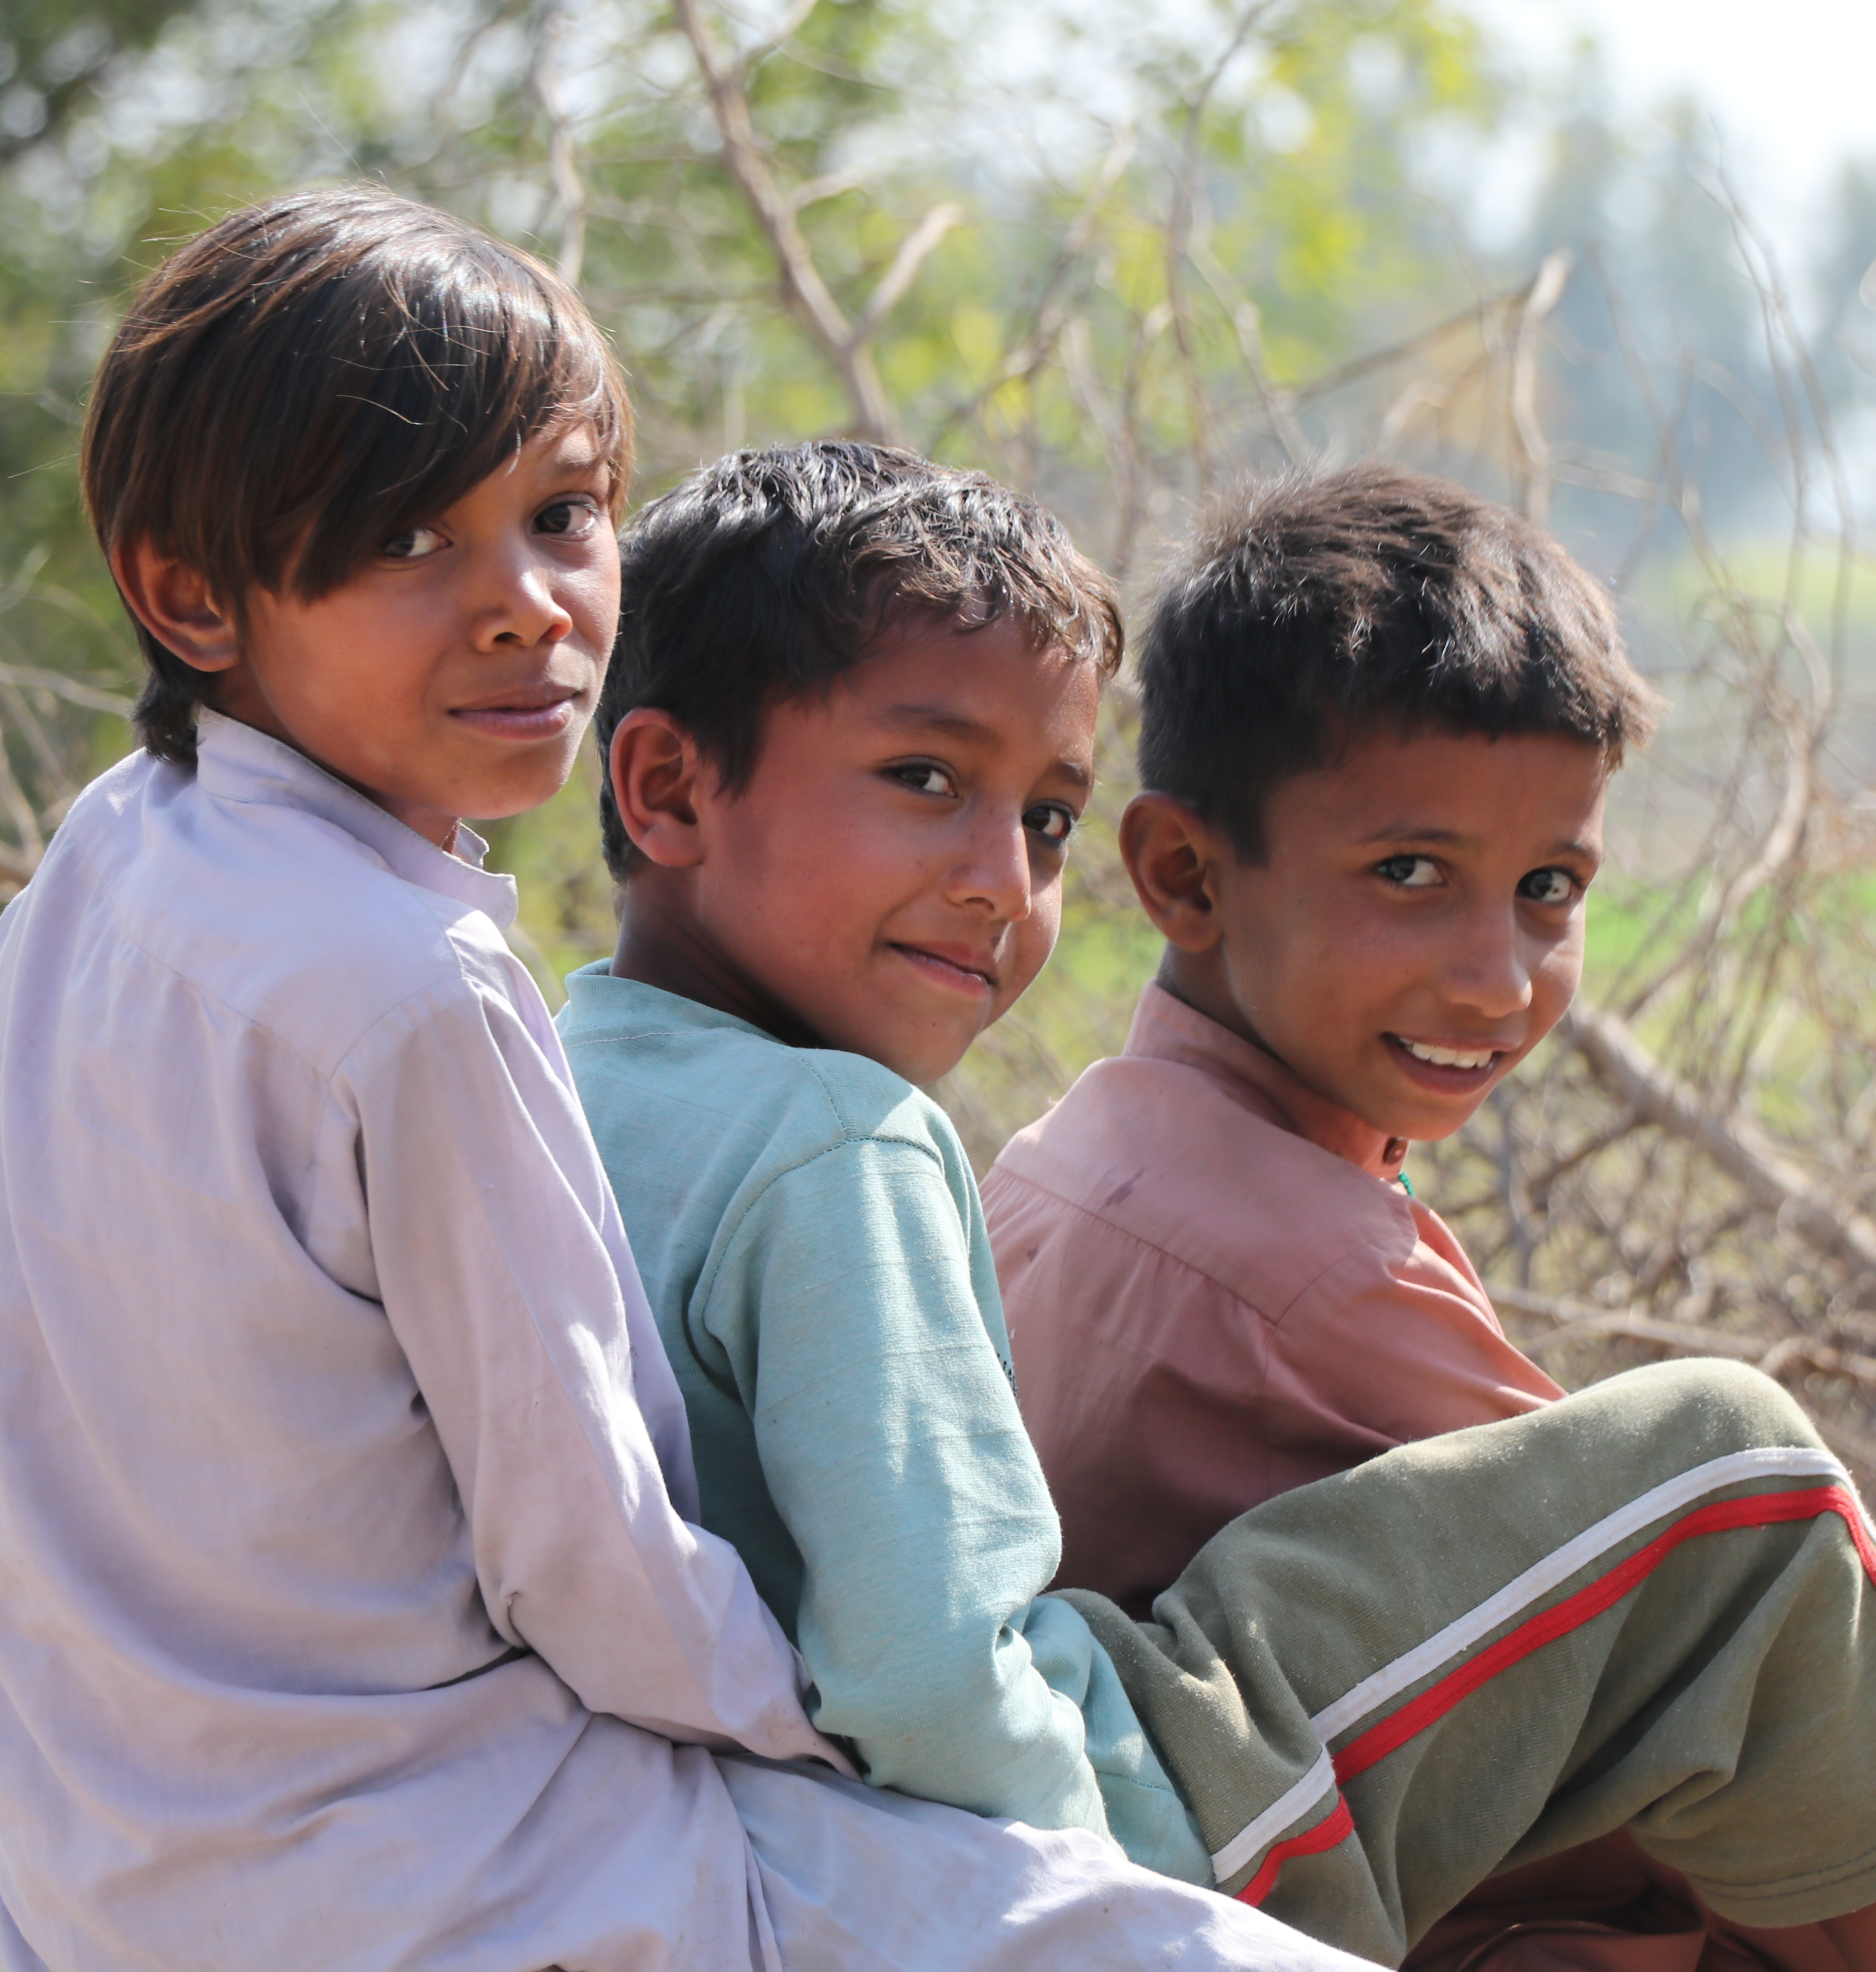
﻿Sunday, February 4
For decades, Presbyterian World Service & Development has faithfully dedicated itself to serving those in need across the globe. In collaboration with our valued partners, PWS&D is actively contributing to positive transformation within our global community. From responding to emergencies to helping families and communities access nutritious food, clean water, adequate health care and quality education, PWS&D is helping people thrive. As people of faith, we respond to Christ’s call to walk with the distressed and marginalized, work towards equality, the restoration of human dignity, peace, and care for God’s creation. Together, we are working towards a sustainable, compassionate and just world.

Slide 6
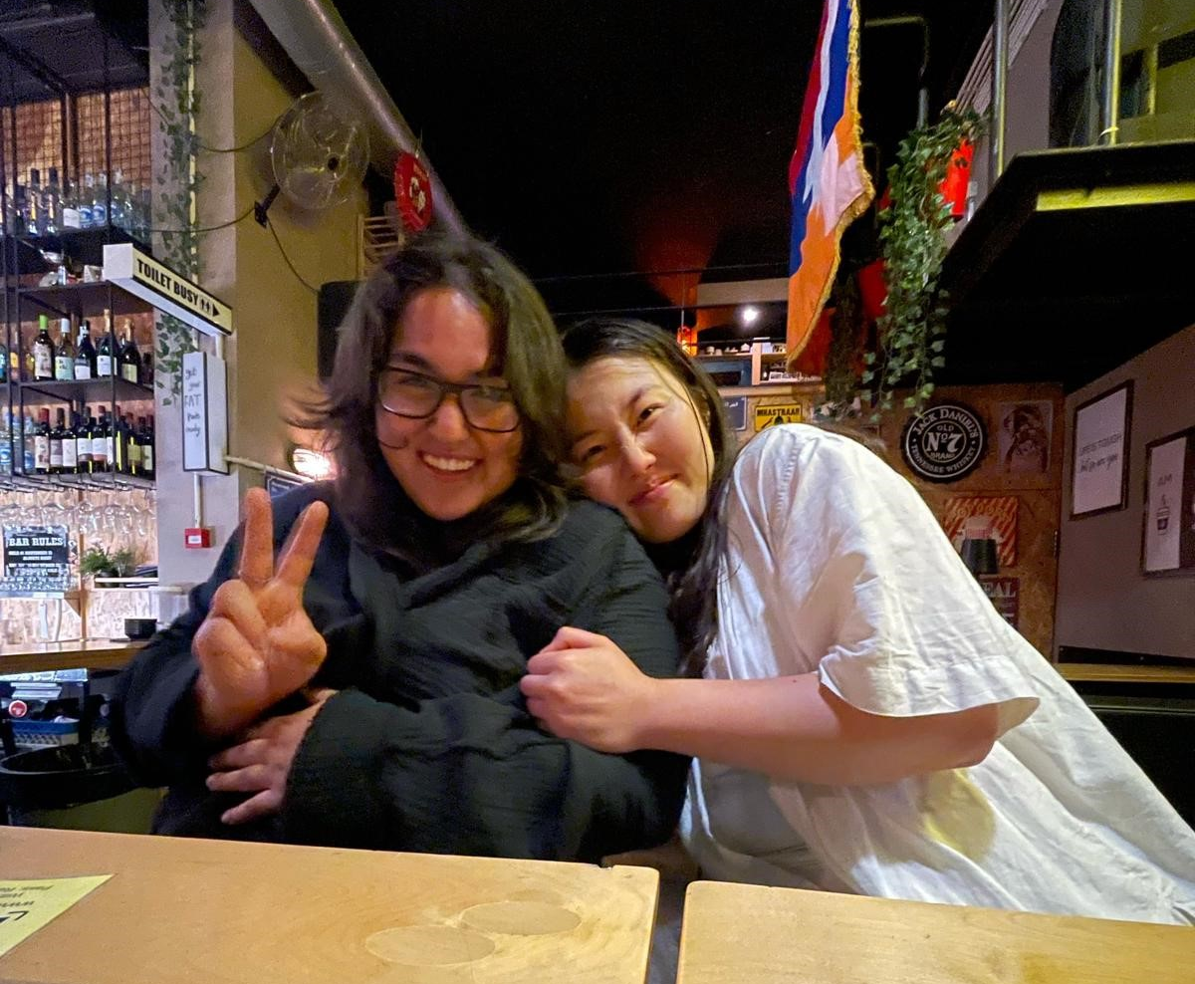
﻿Sunday, February 11
In response to an invitation from Palestinian Christians, the PCC (through Presbyterians Sharing) sent Robyn Ahn (St. Andrew’s, Barrie) and Urwah Rasool (Unionville PC, ON) to Palestine/Israel through the Journey for Justice program hosted by the PCC’s partner, Joint Advocacy Initiative of the East Jerusalem YMCA/YWCA. With 23 other young people, they experienced the daily life of Palestinian youth, listening to their stories and seeing first-hand how occupying measures impacted them. It was an unforgettable, eye-opening experience for Robyn and Urwah.

Slide 7
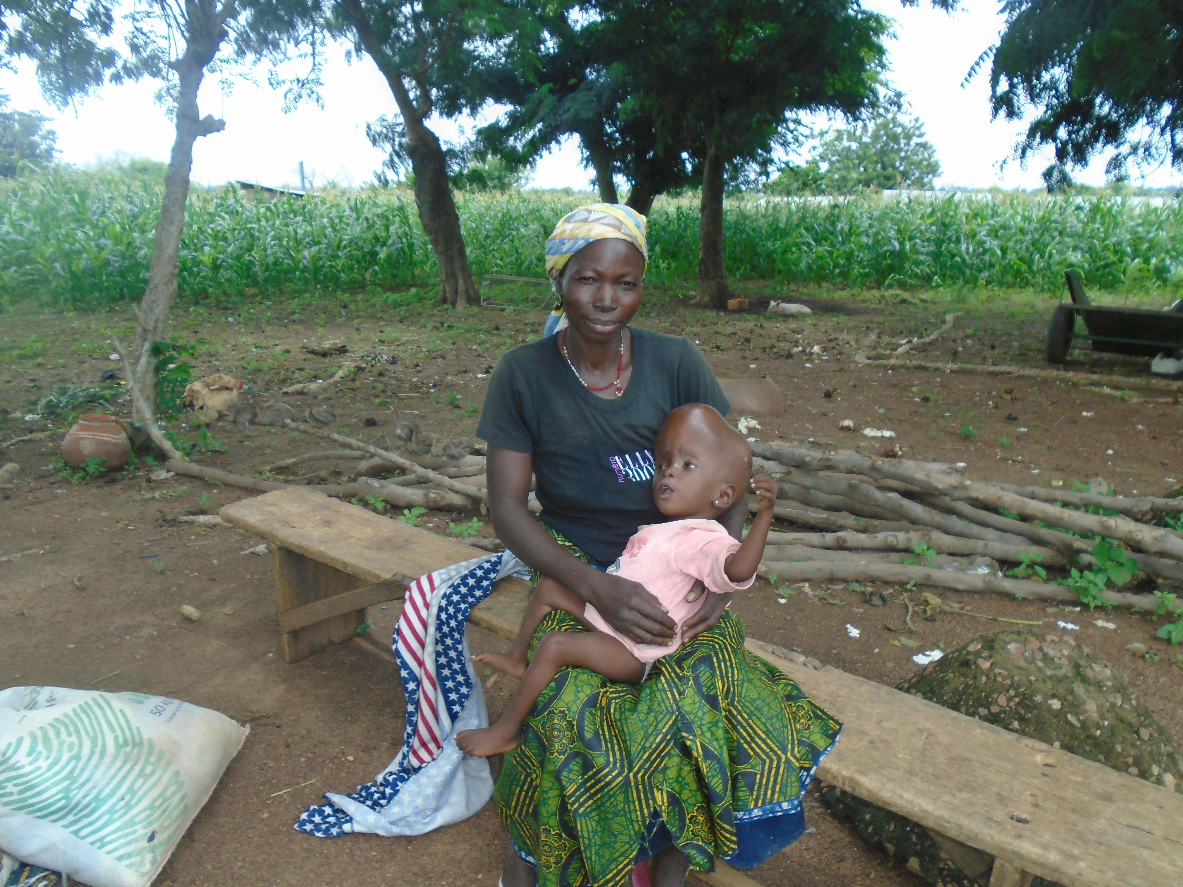
﻿Sunday, February 18
Two-year-old Moriama Safianu has a congenital deformity linked to hydrocephalus. Born into a poor family in northern Ghana, Moriama faced the heavy burden of social stigma, prompting her parents to keep her indoors to shield her from the community’s hurtful judgments. Things changed when she was identified for support during a community survey conducted by a community rehabilitation program. The dedicated staff referred her to the Garu Presbyterian Health Centre for specialized care. The staff at Garu also worked with Moriama’s community to address the stigma she had been facing. Moriama’s mother expressed her profound gratitude: “I am immensely thankful to the CBR program and PWS&D for coming to our aid. Thanks to your intervention, Moriama is no longer subjected to stigma from the community members.”

Slide 8
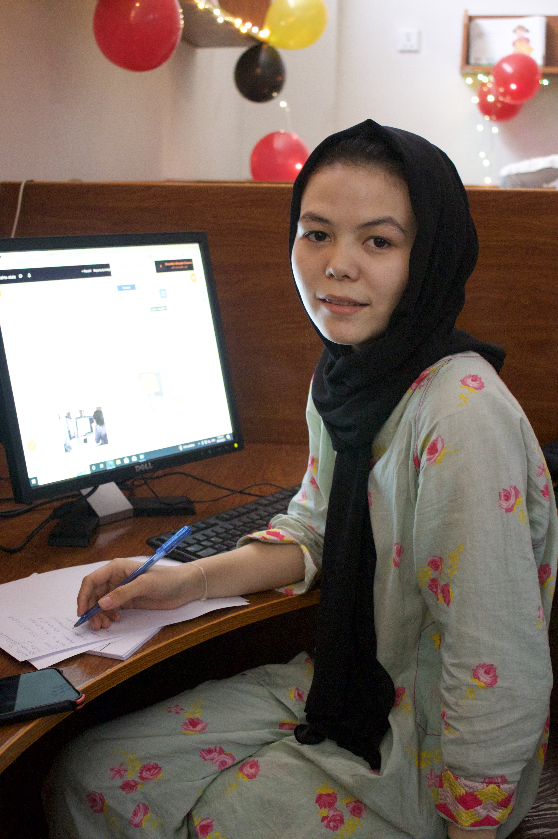
﻿Sunday, February 25
“We really appreciate the program, as we are in dire need to keep the education going for our kids,” shared a grateful parent. For Afghan children who sought refuge in Pakistan, education is often out of reach because they are not nationals. PWS&D supports the Digital Learning Center in Peshawar, which provides out-of-school children and adults with basic digital literacy classes, high school courses and tutoring sessions that aim to help a total of 520 students. Students and their family members are benefiting from the Darakht-e Danesh Library, which provides free and open educational resources on such topics as math, language, business and the sciences. Students access classes both in English and Dari/Farsi, equipping them with essential skills and providing hope for those who have lost so much, broadening their opportunities for the future.

Slide 9
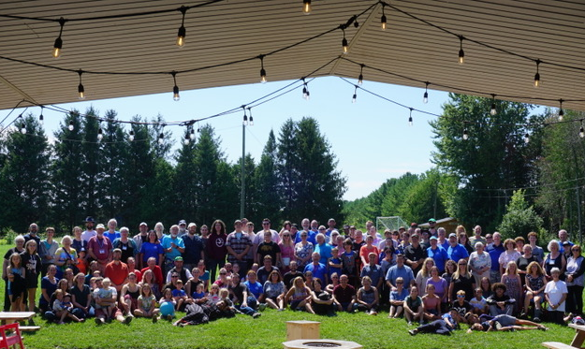
﻿Sunday, March 3
As part of a Caring Community Initiative, the Presbyterian Music Camp piloted a Mental Health Workshop program during the summer of 2023. The program included mental health support and workshops run by a qualified health professional on the topics of anxiety, depression, ADHD, self-harm, suicide and other mental health topics. The opportunity for attendees to express themselves in a caring and safe environment with professional leadership took safety to the next level for the camp, and provided an opportunity for individuals to explore some of their struggles with support. The program continues to grow by providing Mental Health First Aid training to staff and volunteers as well as exploring ways that art and music therapy can be offered in a camp setting.

Slide 10
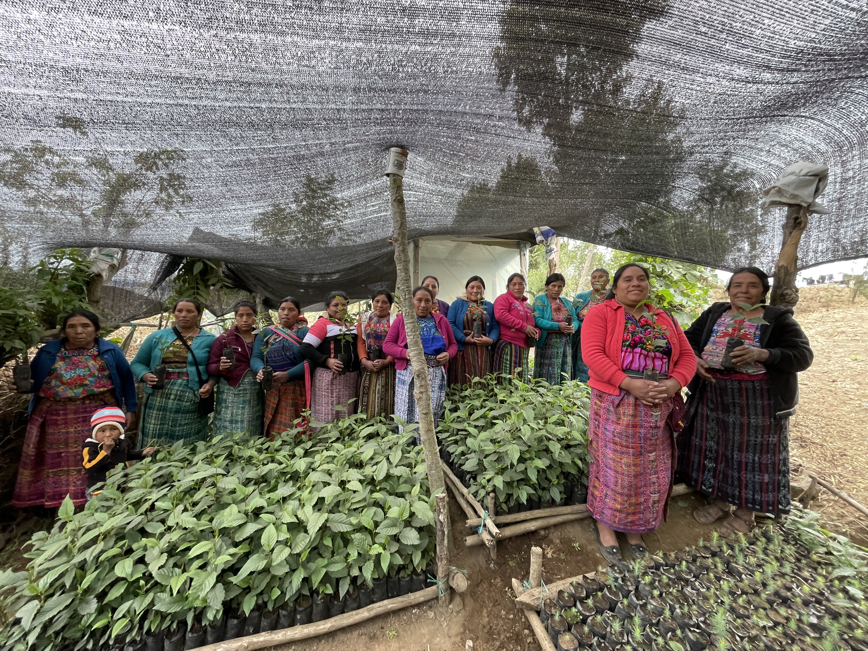
﻿Sunday, ﻿March 10
“We are brave and strong because we learned important information about rights, feelings and participation.” PWS&D supports a human rights program in Guatemala that not only empowers women by ensuring they know their rights but also equips them with essential skills and knowledge about food security and nutrition. Through education on when and how to plant vegetables, grow tree seedlings and how to care for livestock, women have more stable incomes and improve their family’s access to nutritious meals. “We are happy for our project. We sell the trees in the town and use the money to buy food,” shares one of the participants. This program provides women with the resources and skills they need to lift themselves out of poverty and create a more equitable society.

Slide 11
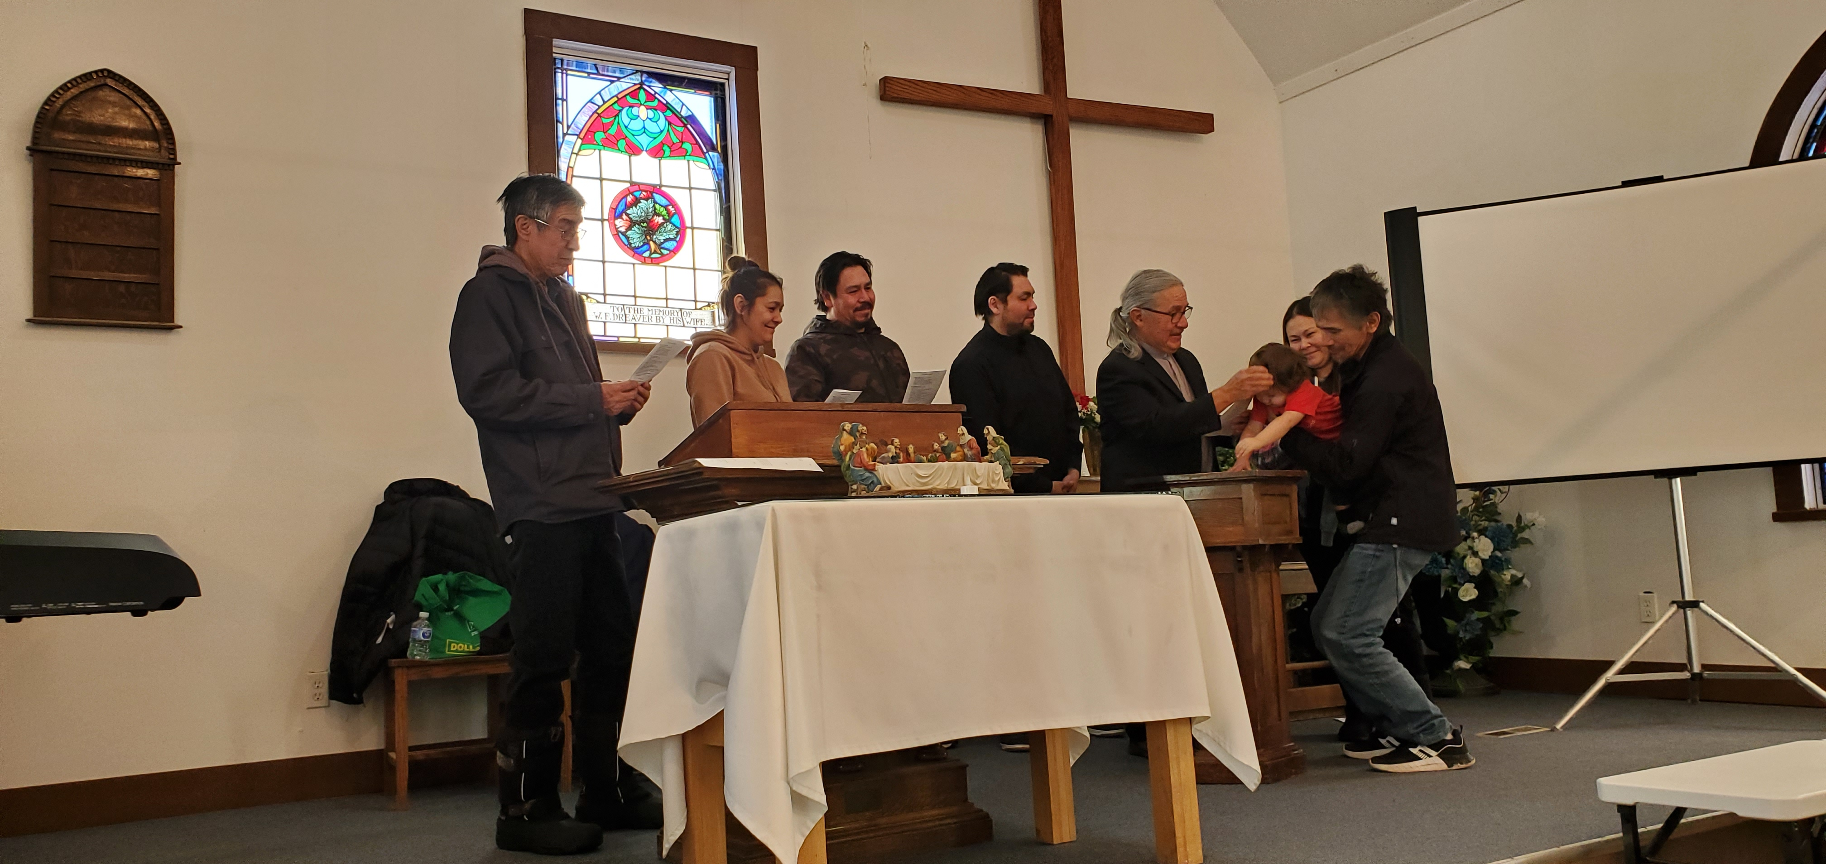
﻿Sunday, March 17
For hundreds of years, roads have been providing important networks of connection and community. Not only in a physical sense, but by creating equal access to vital places like schools, churches and hospitals, and fostering a sense of community. With support from Presbyterians Sharing, the Life and Mission Agency and the Band Council on Mistawasis Plains Cree Reserve in Northern Saskatchewan are working together to create a road system through the reserve that will connect Mistawasis Memorial Presbyterian Church with the rest of the community. In turn, it will open up the possibilities of new ministry opportunities by bringing together the community and creating a sense of hope and connectedness.

Slide 12
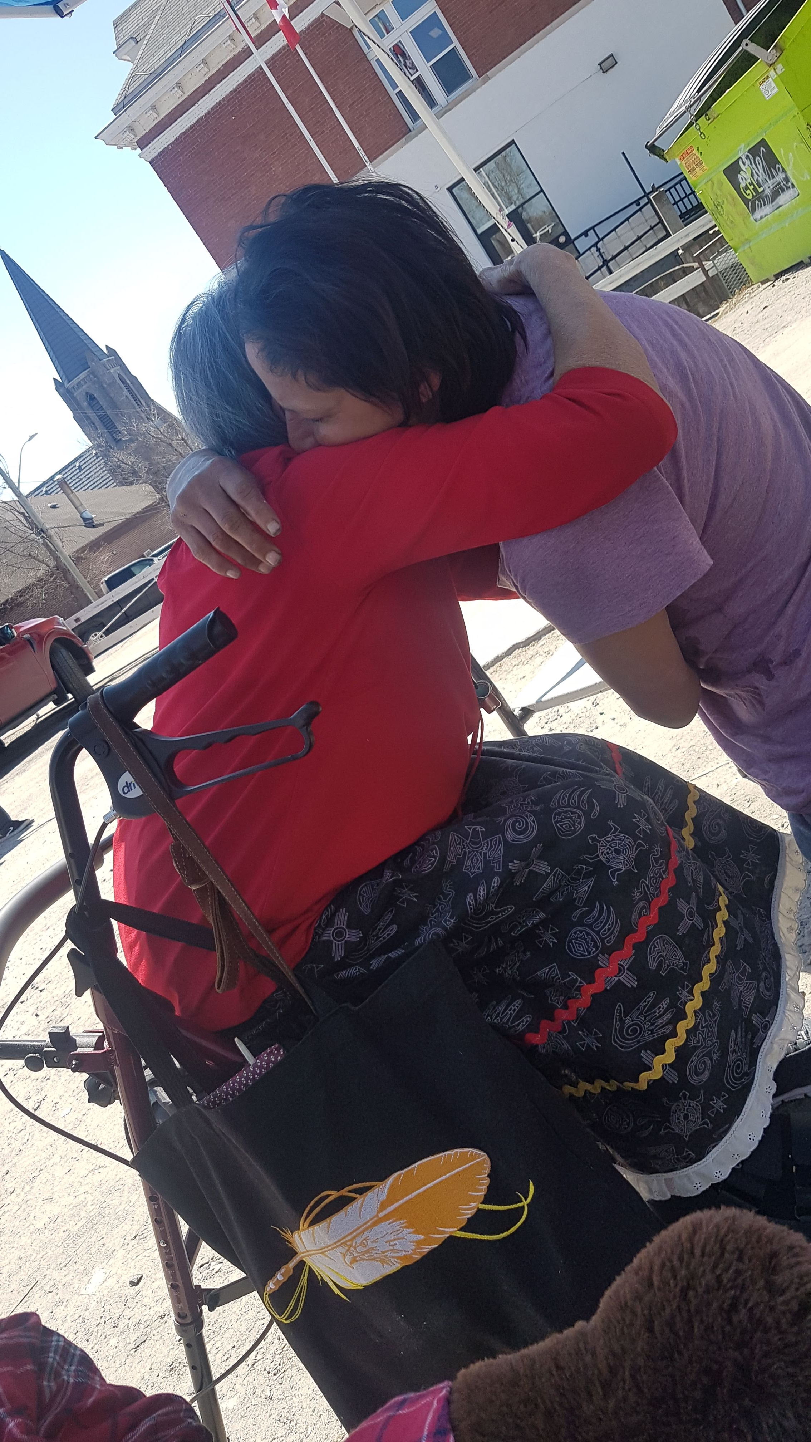
﻿Sunday, March 24
Following Christ’s example to care for the broken-hearted and those crushed in spirit, Anamiewigummig Kenora Fellowship Centre provides care and support for people who have endured intergenerational trauma and profound loss and grief in their lives. The centre promotes healthy grieving practices that include sharing circles and memorial fires, creating a safe space for a time of prayer, sharing sorrow and mourning the loss of loved ones. The community has come to value the importance of the sacred fire teachings and the warmth and comfort it offers, welcoming all to come just as they are.

Slide 13
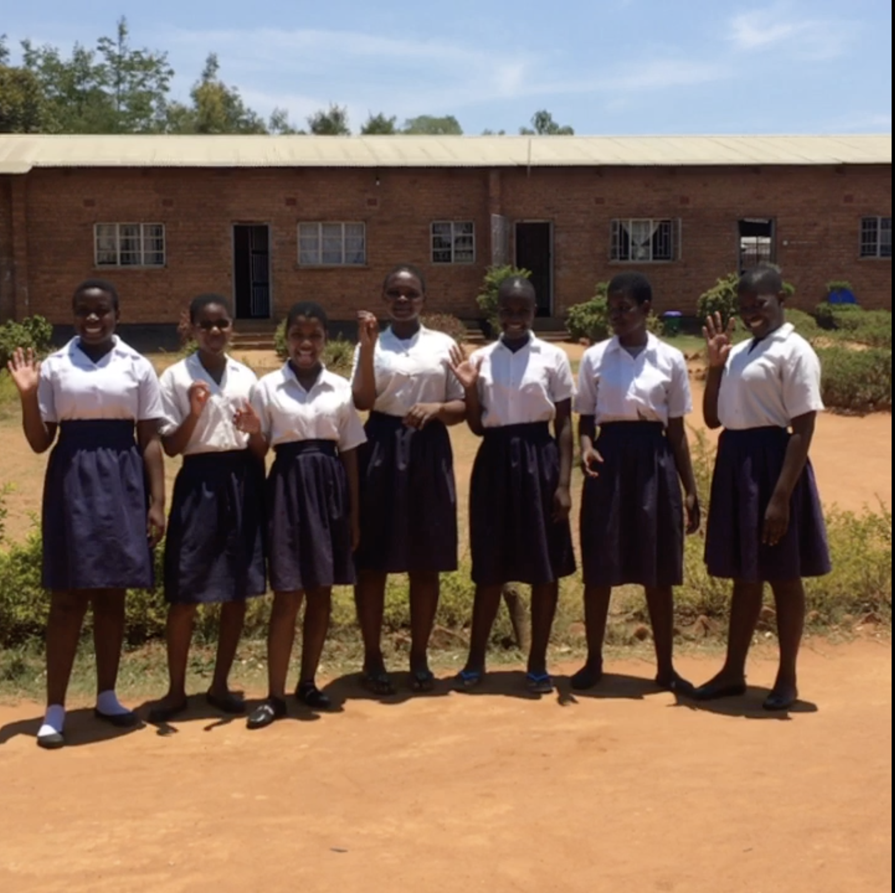
﻿Sunday, March 31
In Malawi, Madalitso Mphamba, a determined 16-year-old, once doubted she would ever have the chance to attend secondary school. When Madalitso’s mother fell seriously ill and had to give up her job, they moved in with family for support. At first, Madalitso’s grandma’s beer brewing venture was thriving and played a crucial role in supporting her primary school education. However, Madalitso’s grandmother eventually had to stop this business, and the family could no longer afford to send Madalitso to school. With help from PWS&D, the Blantyre Synod Education Department’s Neno scholarship program allowed Madalitso to re-enroll, enabling her to dream of a brighter future.

