Slide 1
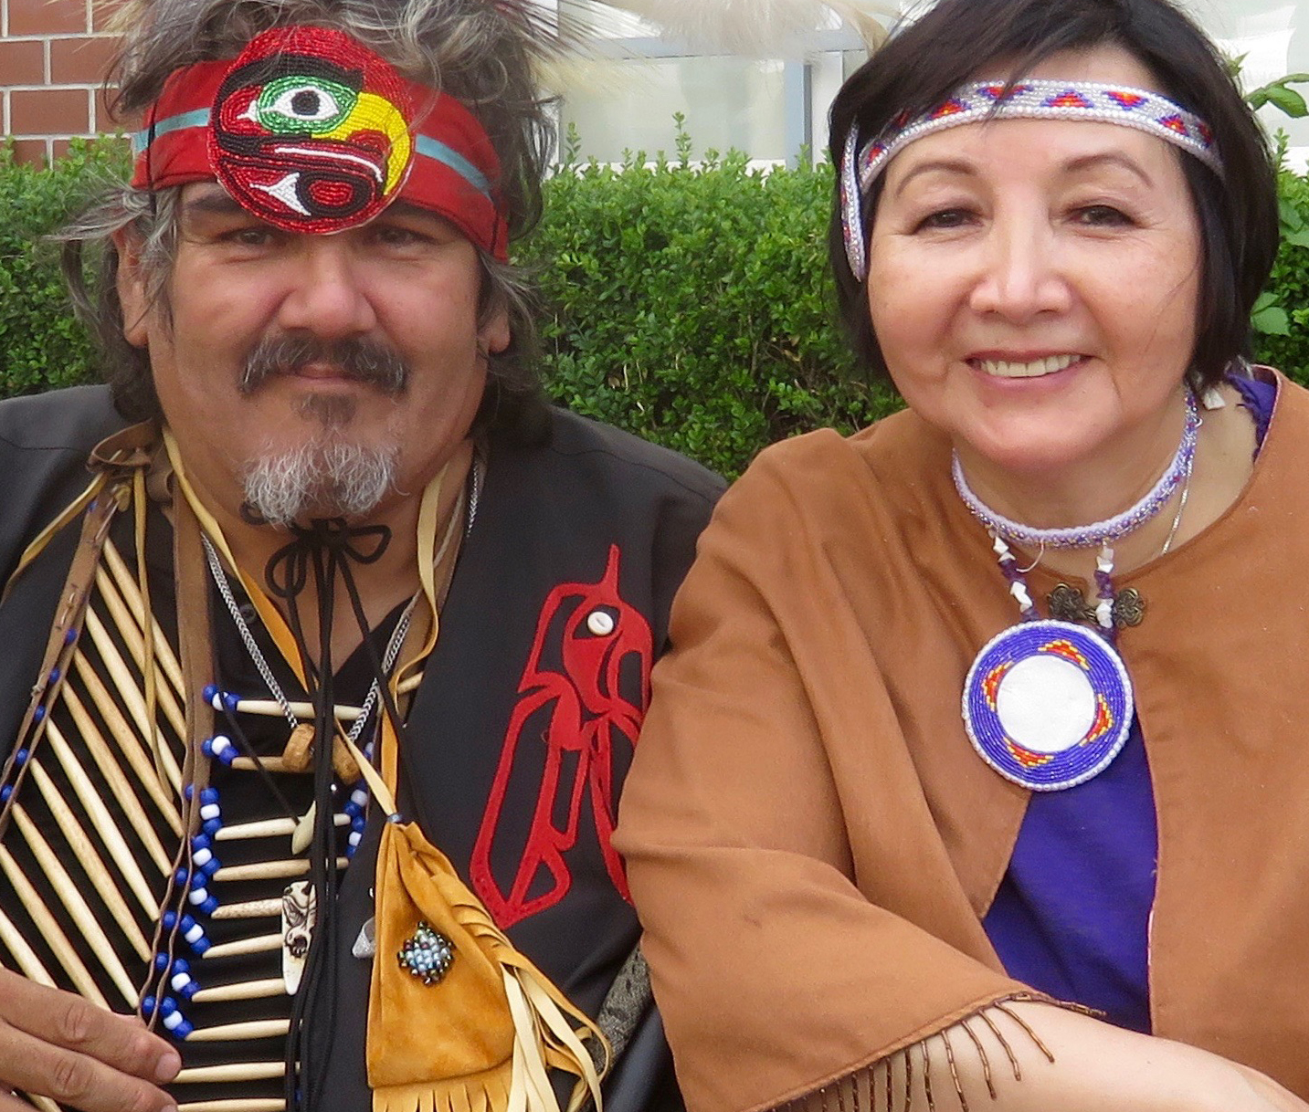
﻿Sunday, October 1
Hummingbird Ministries, one of the Indigenous ministries supported by gifts to Presbyterians Sharing, is committed to bringing peace and healing to Indigenous families living in BC’s lower mainland. Led by The Rev. Mary Fontaine, Moderator of the 2023 General Assembly, the ministry helps to restore hope by offering regular healing circles, working with the community in art and celebration, and providing educational and healing workshops, Bible studies, children’s art and music programs. The ministry has also recently embarked on a journey to gather the wisdom and teachings of Indigenous elders through a series of interviews, reviving and preserving their treasured stories for generations to come.

Slide 2
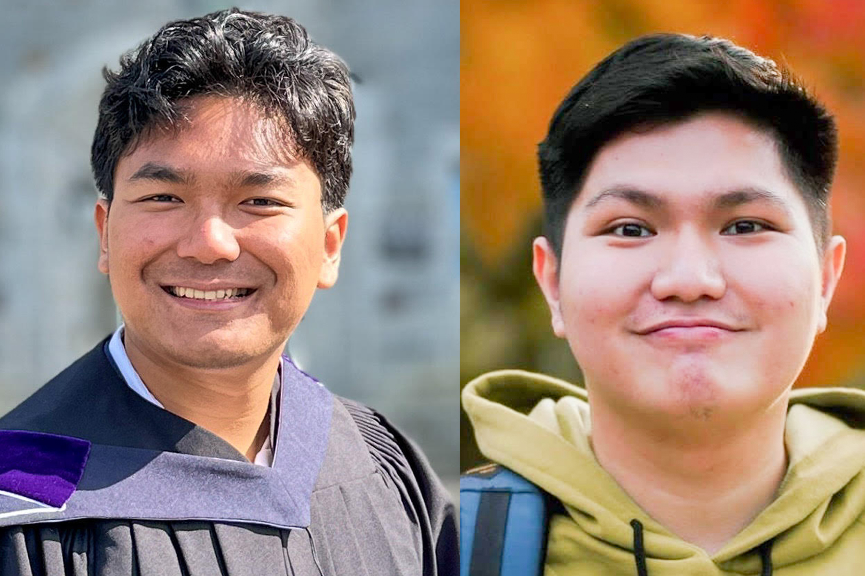
﻿Sunday, October 8
In the book of Acts, the disciples traveled far and wide to share the good news of Christ. The Rural and Remote Ministry Fund offers seminary students the opportunity to gain practical ministry experience in rural communities across the country. This summer, Nehemia Neuhisa and Howard Tuwaidan, both seminary students, served as student ministers for the Synod of Saskatchewan. Through the experience, Nehemia and Howard were able to lead worship at 10 different congregations, support Vacation Bible School programs, serve as chaplains at Camp Christopher, and volunteer at Saskatoon Native Circle Ministry. Like the early disciples, their commitment to mission and outreach was a blessing to many.

Slide 3
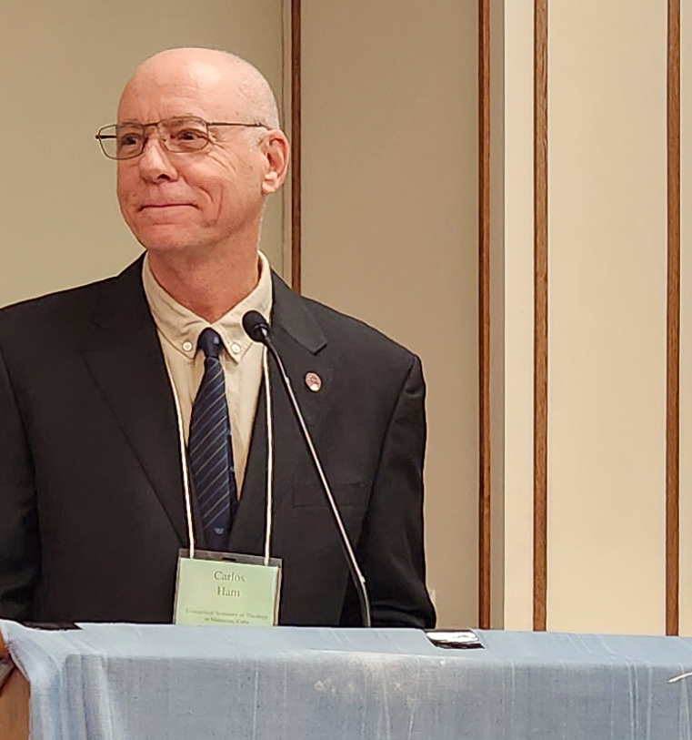
﻿Sunday, October 15
The hardening of the US sanctions and the global financial crisis are contributing to a shortage of food, fuel, clean water and medicine in Cuba. With partners’ support, the Evangelical Seminary of Theology in Matanzas carries on, providing high quality, diversified theological education, and serving the community through diaconal projects. In 2022, the PCC helped improve the infrastructure for hybrid teaching and assisted with the renovation to the library and the Historical Archive. The Rev. Dr. Carlos Ham, Rector, shared at the 2023 General Assembly: “We appreciate the ways in which you accompany our work, not only providing much-needed financial support, but also through prayers.”

Slide 4
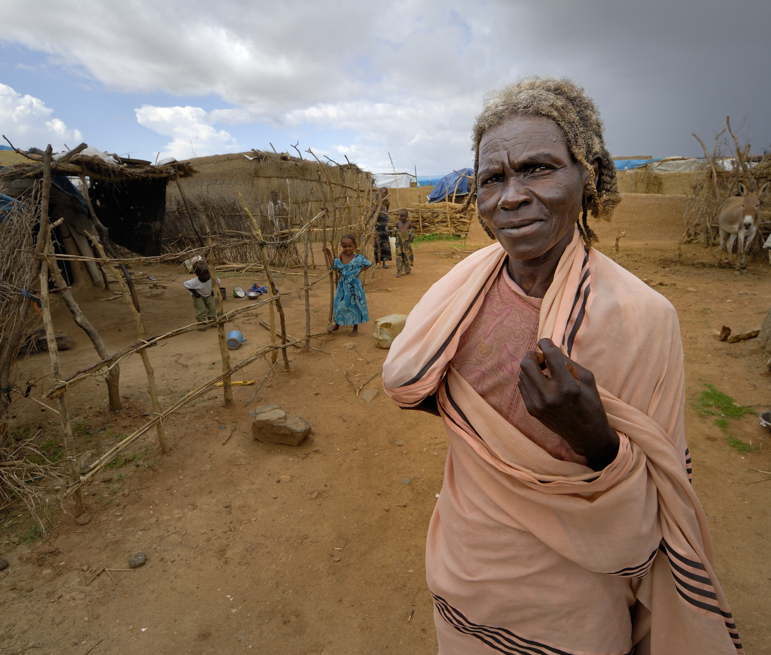

﻿Sunday, ﻿October 22
World hunger is a more pressing global challenge than ever. An increasing number of people around the world suffer from worsening and chronic food insecurity and malnutrition. Climate change, conflict, and poverty exacerbated by global inflation are key factors worsening this crisis. Hunger threatens physical and mental well-being and hinders social and economic development. Through its partners, PWS&D is responding to the hunger crisis in East Africa, where millions of people are suffering from increased food insecurity. Conflicts, such as those in Sudan and the Democratic Republic of Congo, are forcing hundreds of thousands of families from their homes. Furthermore, extreme climate weather events across the Horn of Africa have created high hunger levels. Through PWS&D, we are helping to provide emergency support to people affected by the food crisis.

Slide 5
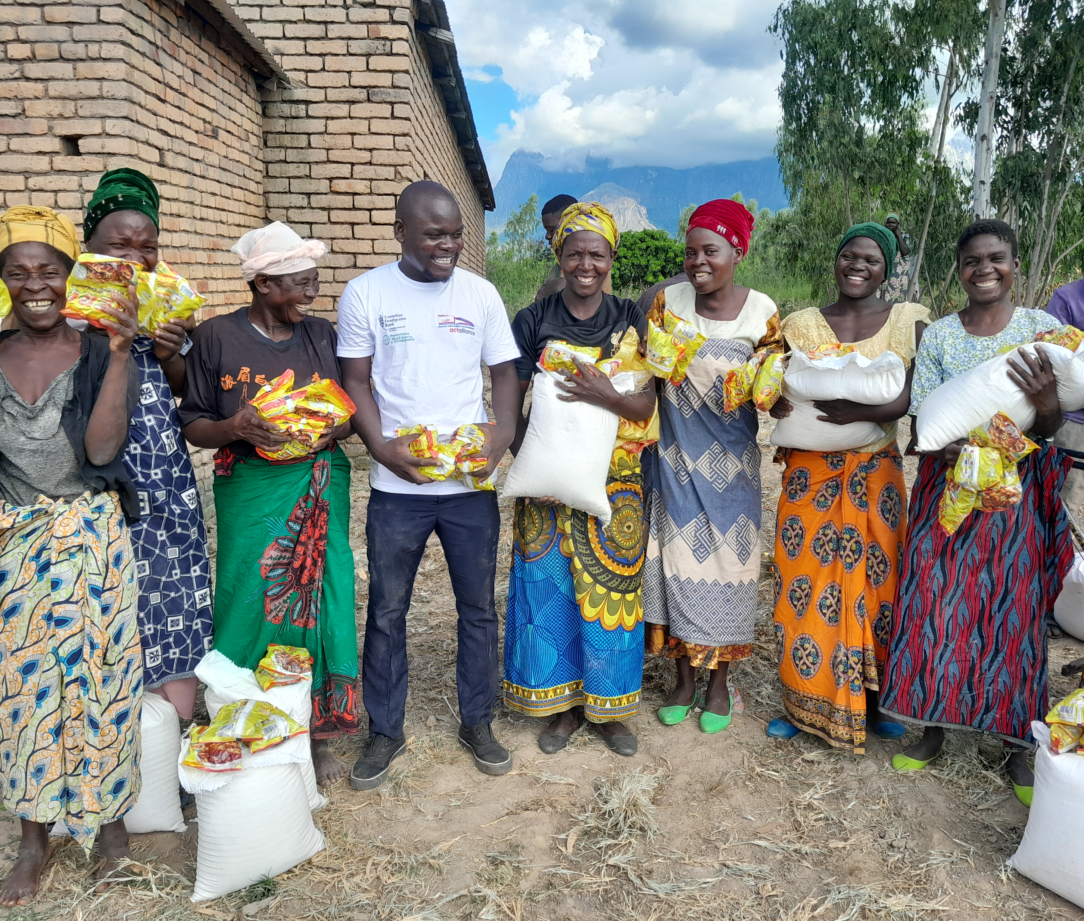
﻿Sunday, October 29
Cyclone Freddy—one of the most powerful storms ever recorded in the southern hemisphere—made landfall in Malawi in March 2023. Thousands in Malawi were left homeless, and with severe crop losses, over 345,000 people were affected by the heavy rains, floods and landslides. Through its partners, PWS&D responded to this devastating disaster by providing maize flour and soya to enable families to meet their immediate food requirements. Additionally, because of critical food insecurity due to droughts and floods in the area, PWS&D implemented a three-month food assistance project for 2,500 households. This project provided food assistance in the form of cash transfers, as well as seeds to produce high-value crops.

Slide 6
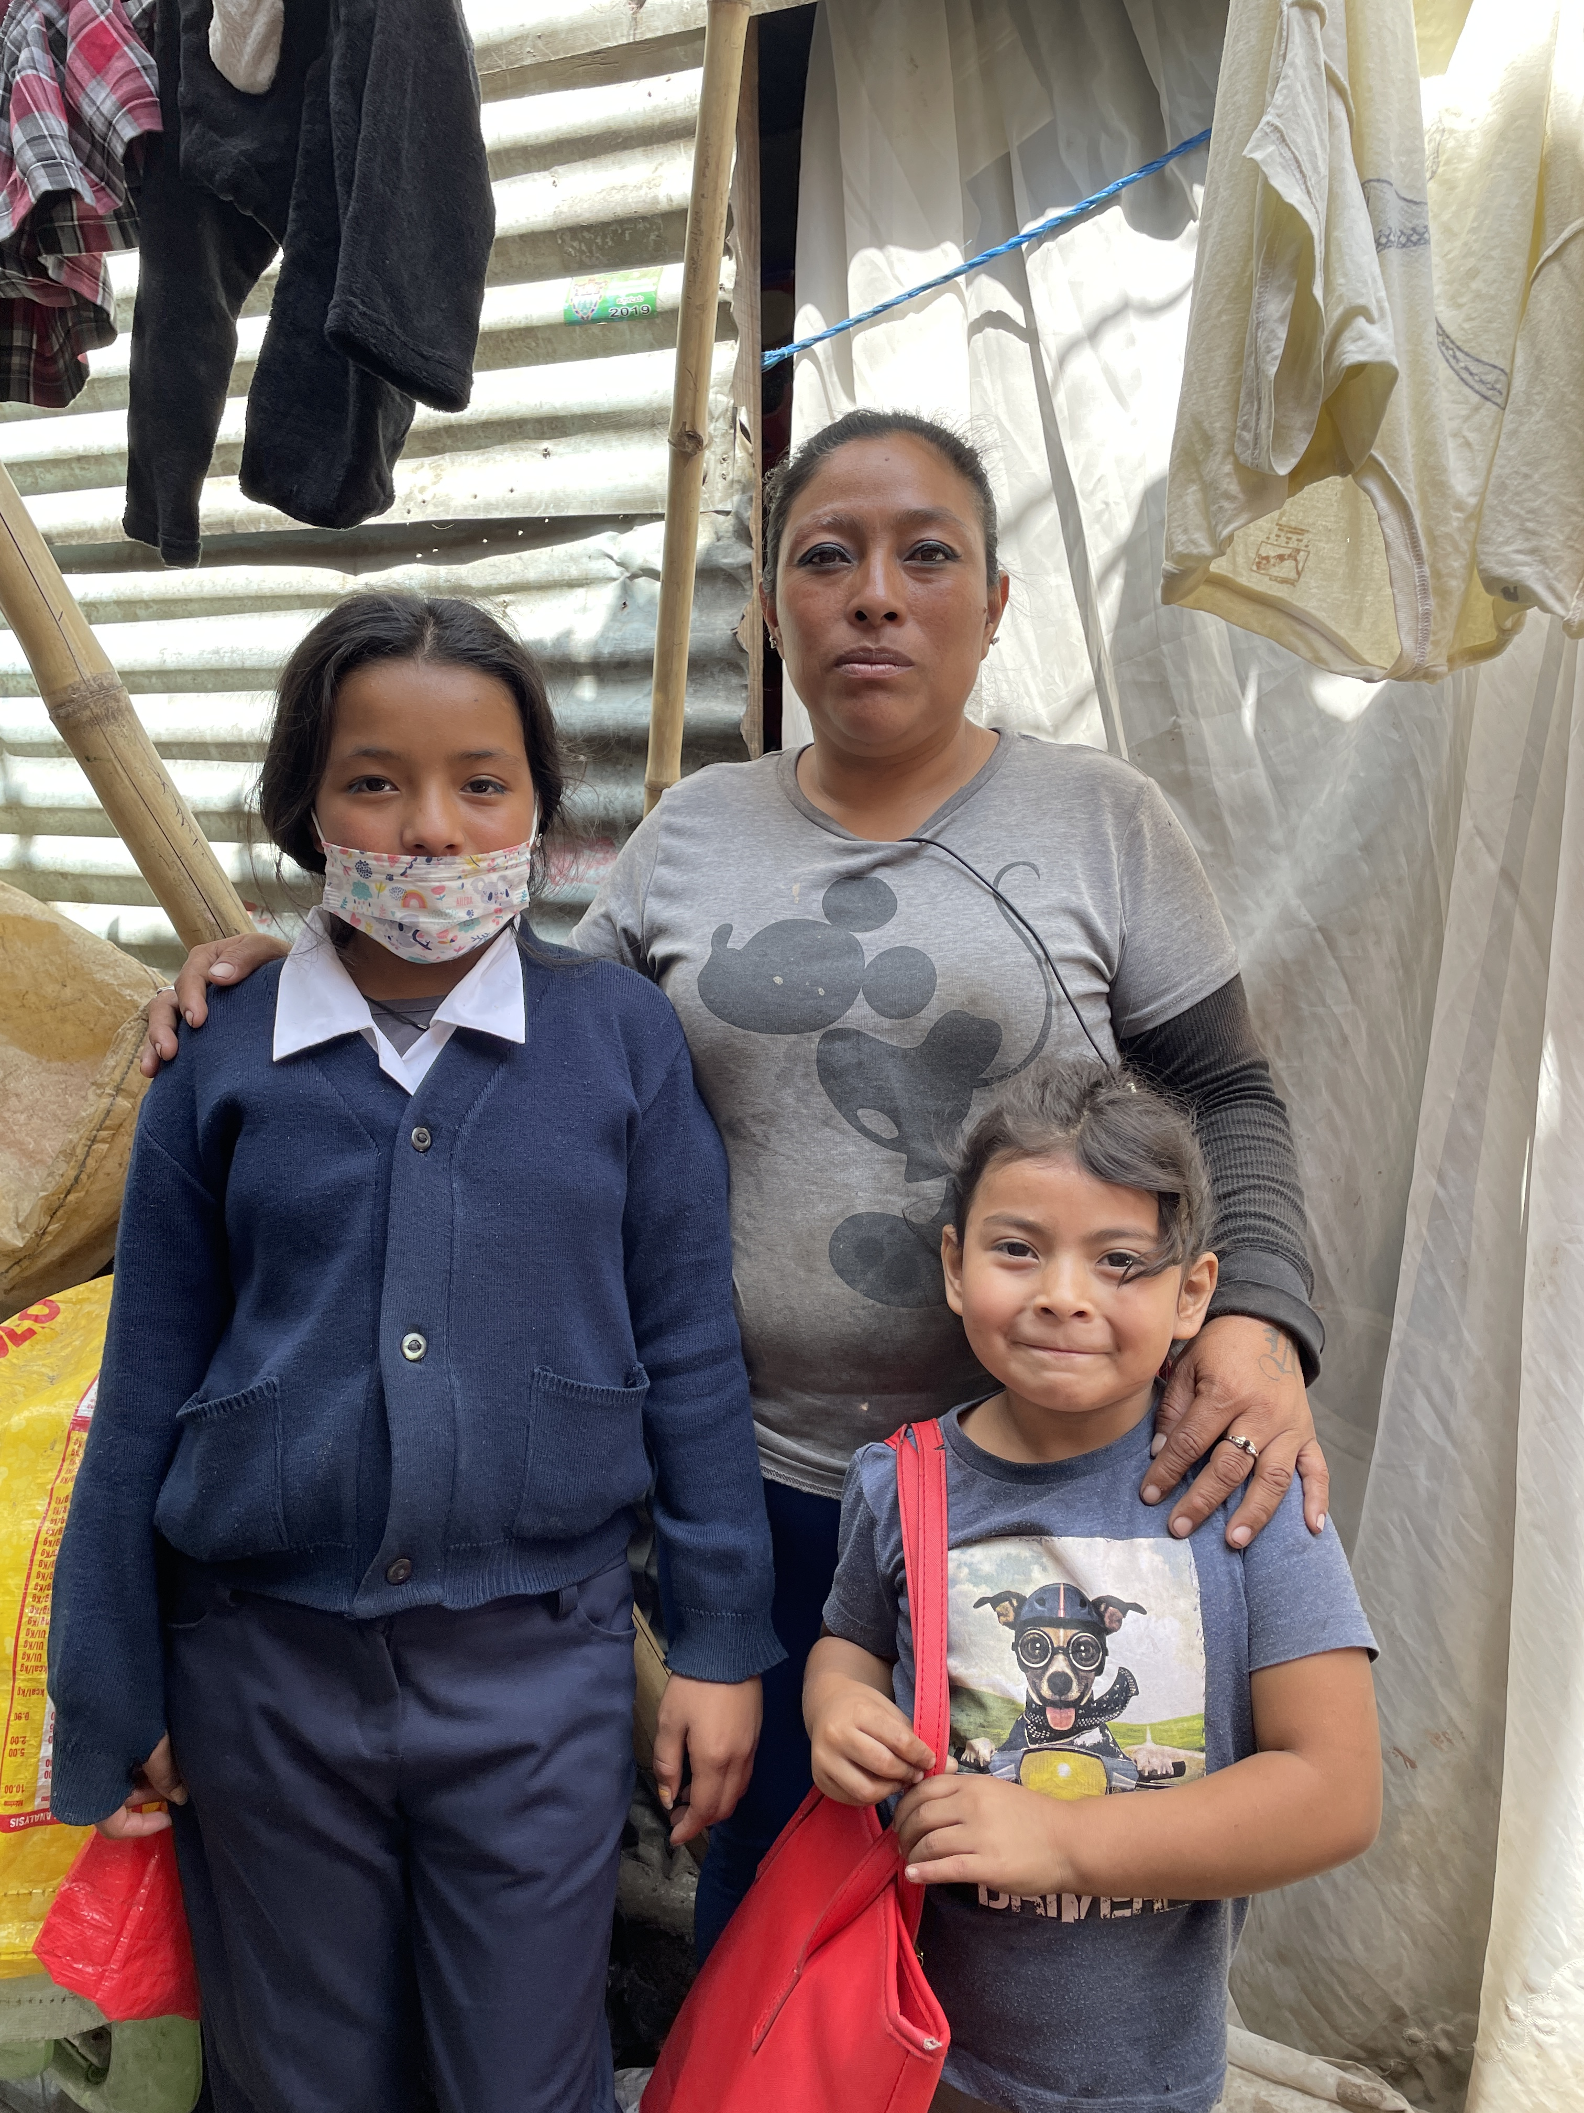
﻿Sunday, November 5
In Guatemala, Leslie—a mother to four—takes great pride in the small home, built atop a former landfill site, she has owned for 15 years. To make ends meet, she sorts plastic bottles from the landfill, with her five-year-old daughter Kaitlin often accompanying her. Leslie’s other daughter, Naomi, attends the PWS&D-supported Francisco Coll School. At this school, she has developed essential reading and writing skills. Leslie also participates in parenting classes, noting, “[It’s] very helpful because I’ve changed the way I parent. I shout less. I used to come home from work and start shouting at the kids, but I’ve learned differently. The classes are very beneficial.”

Slide 7
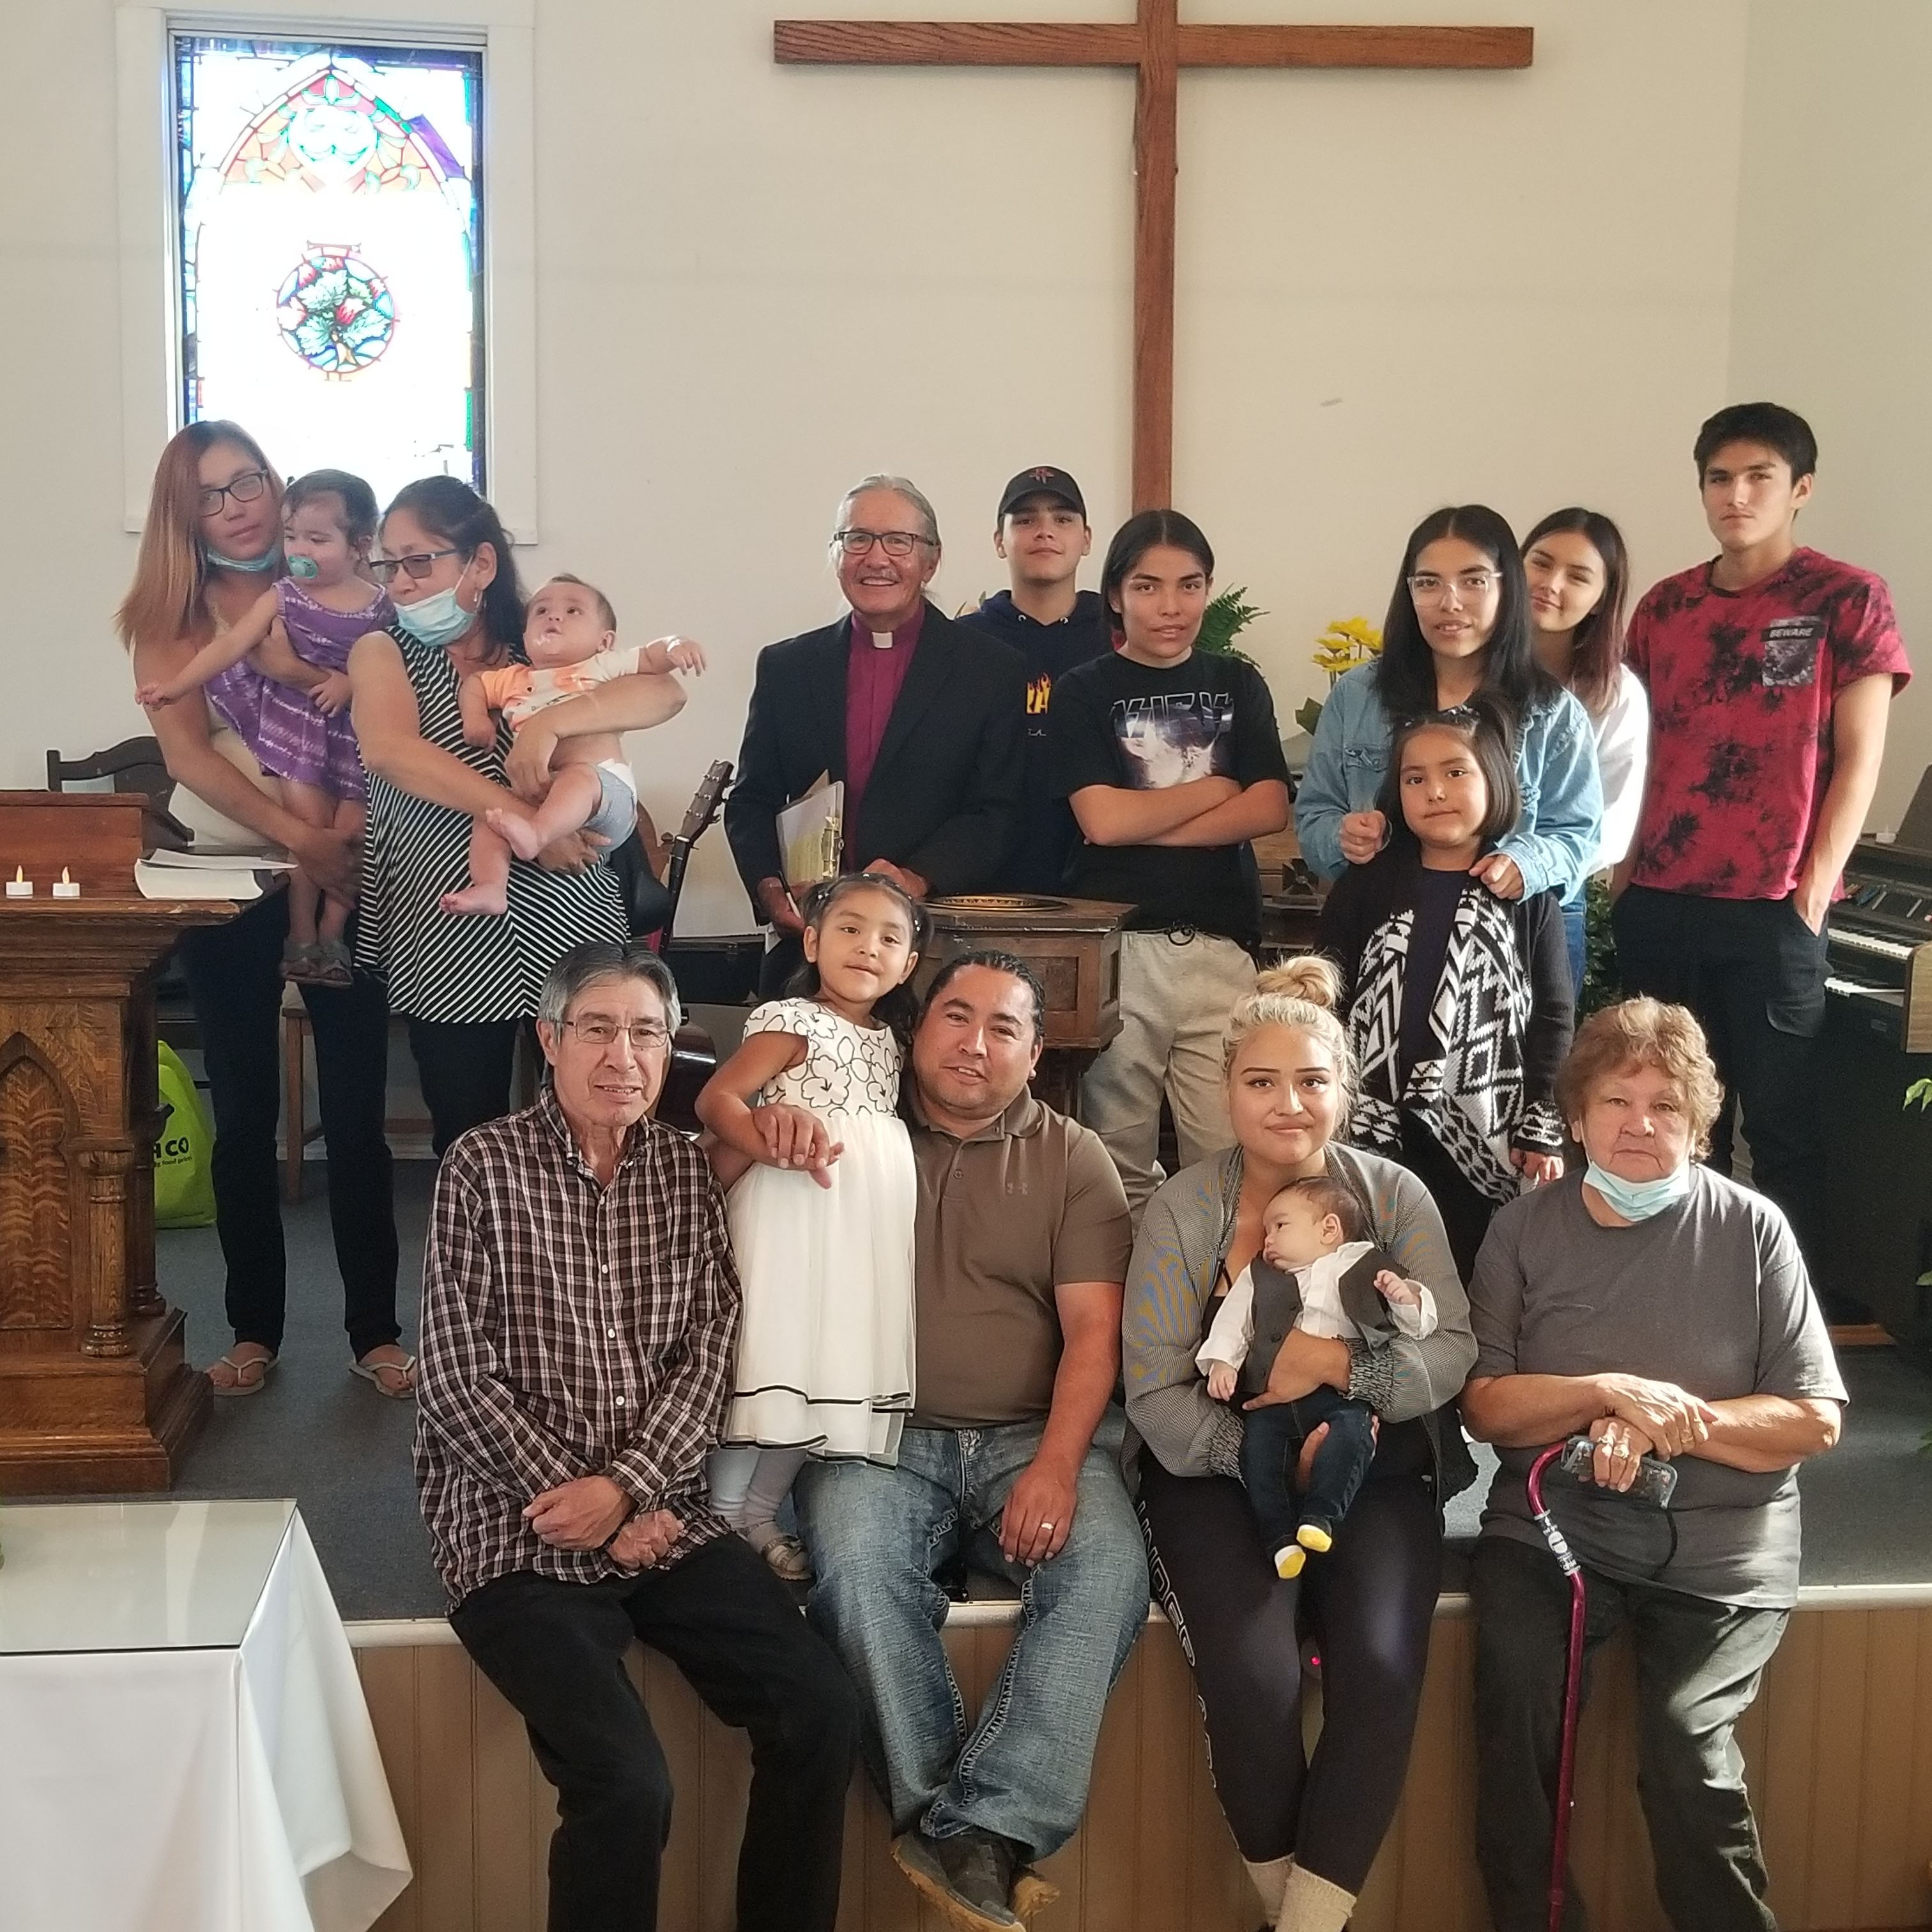
﻿Sunday, November 12
We are a vibrant denomination, working together to put our faith into action. When we give to Presbyterians Sharing, we share in God’s mission and proclaim God’s love. We participate in mission and ministry in Canada, build strong congregations, support theological colleges and provide resources and educational opportunities. We serve vulnerable people, seek justice and work toward healing and reconciliation with Indigenous people. We share Christ’s love around the world, sending grants and staff to encourage, equip and accompany PCC partners in their ministry. Through Presbyterians Sharing, we make mission and ministry happen. None of this would be possible without your generous gifts.

Slide 8
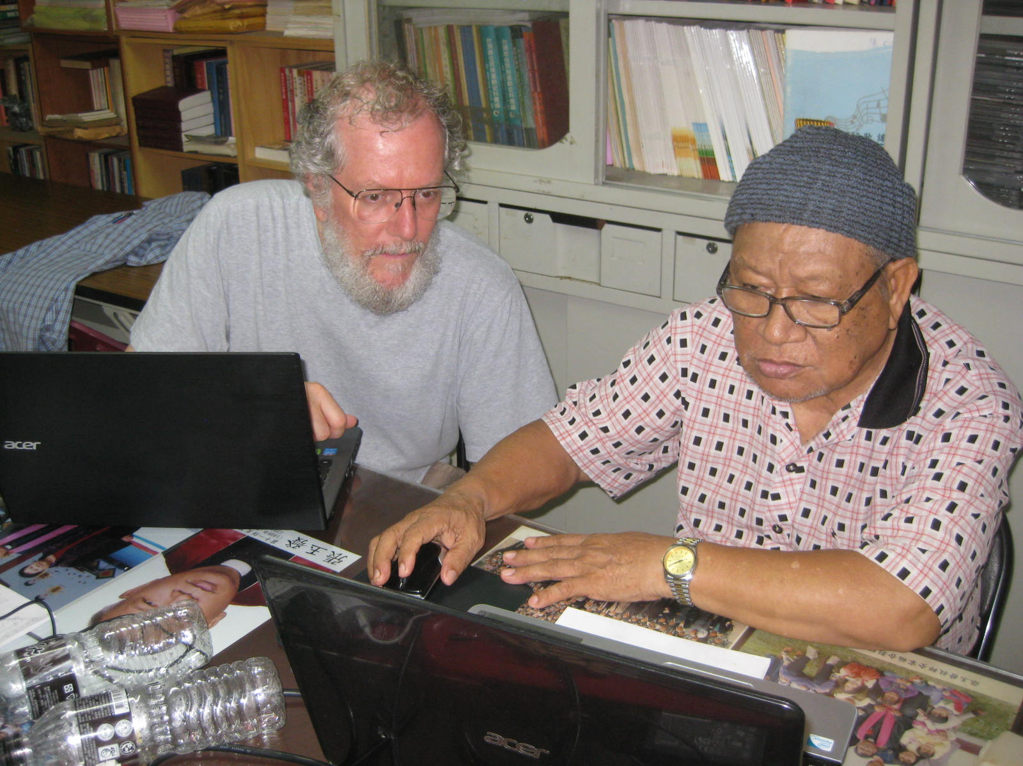
﻿Sunday, ﻿November 19
The friendship between the Rev. Dr. Paul McLean and the Rev. Manias Chang Yu-fa began in 2012 when they first started working together on the Bunun Bible translation project, one of the Indigenous languages in Taiwan. In March 2023, they had just finished finalizing the entire translation when Manias was hospitalized. He passed away three months later. Although Manias did not live to see the complete Bunun Bible, his family and friends find comfort in knowing that he knew that his translation work of many years was completed before he passed away. We give thanks for faithful servants. Paul receives support from Presbyterians Sharing for his work in Bible Translation

Slide 9
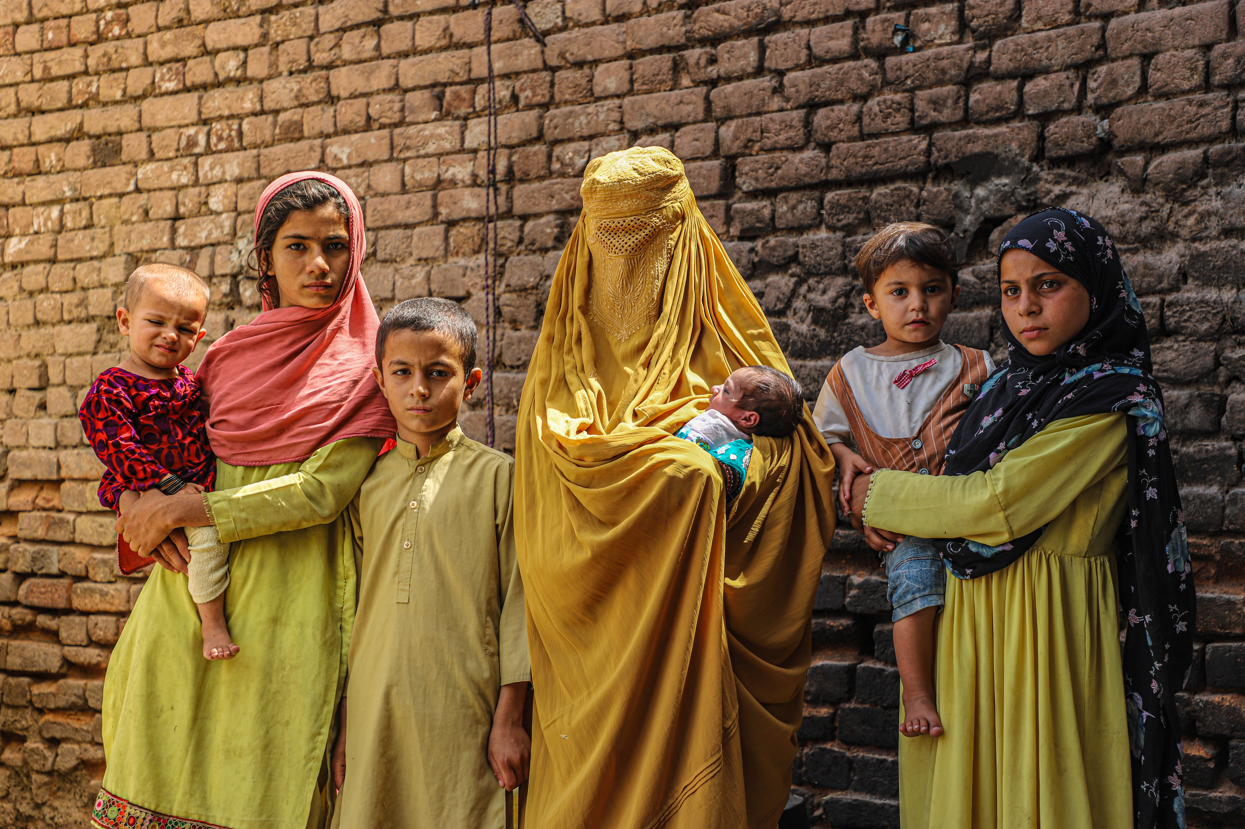
﻿Sunday, November 26
Over the past two years, Canadian aid organizations advocated to remove legal barriers to much-needed aid in Afghanistan. The barriers prevented aid organizations, including PWS&D, from providing urgent humanitarian assistance since the Taliban took control in August 2021. The recent parliamentary adoption of Bill C-41 now enables Canadian aid organizations to provide crucial aid in Afghanistan safely and effectively. Bill C-41 is vital to improving access to health care, ensuring access to food, water and sanitation, education, and protecting human dignity. As winter approaches, the needs are even greater. PWS&D will now support work in Afghanistan once again—an important step in coping with political, economic and climate adversity for many in the country.

Slide 10
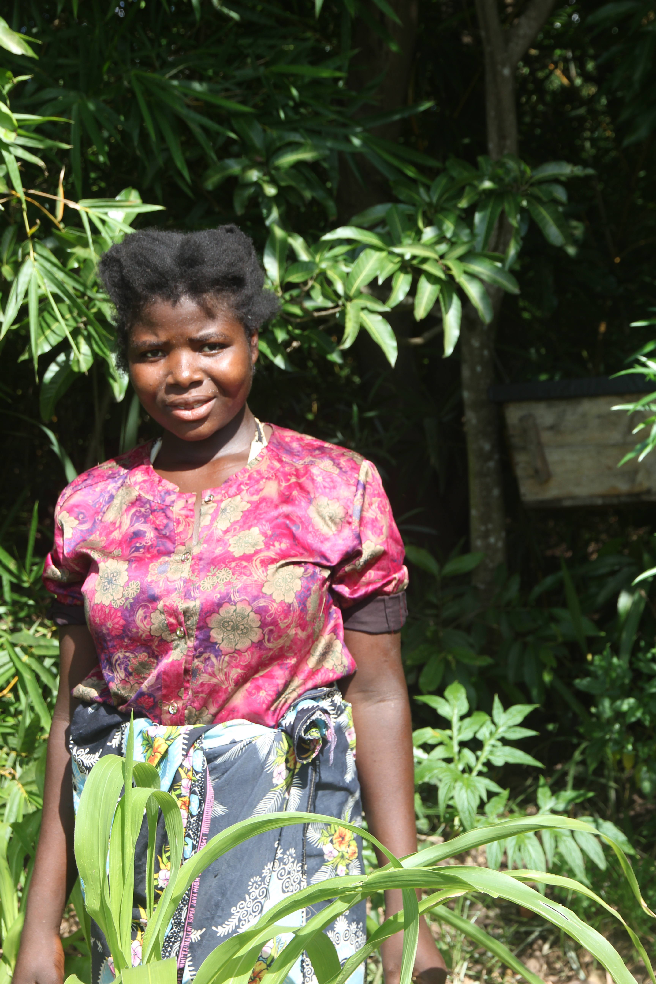
﻿Sunday, December 3
On World Humanitarian Day, we honour countless individuals who have dedicated themselves to making a difference in the lives of others. Humanitarian work is often challenging, and those undertaking it face many risks, yet they continue to work tirelessly, motivated to help others and improve the world. From PWS&D partners who deliver food, water, and other essential supplies to those who work without respite to rebuild communities after disasters, humanitarian workers play a crucial role in ensuring the well-being of those in need. We also recognize the need for sustained support and investment in humanitarian efforts to address the root causes of human-made crises and provide lasting solutions for those in need. On World Humanitarian Day, let us recognize humanitarian workers and renew our commitment to supporting their vital work.

Slide 11
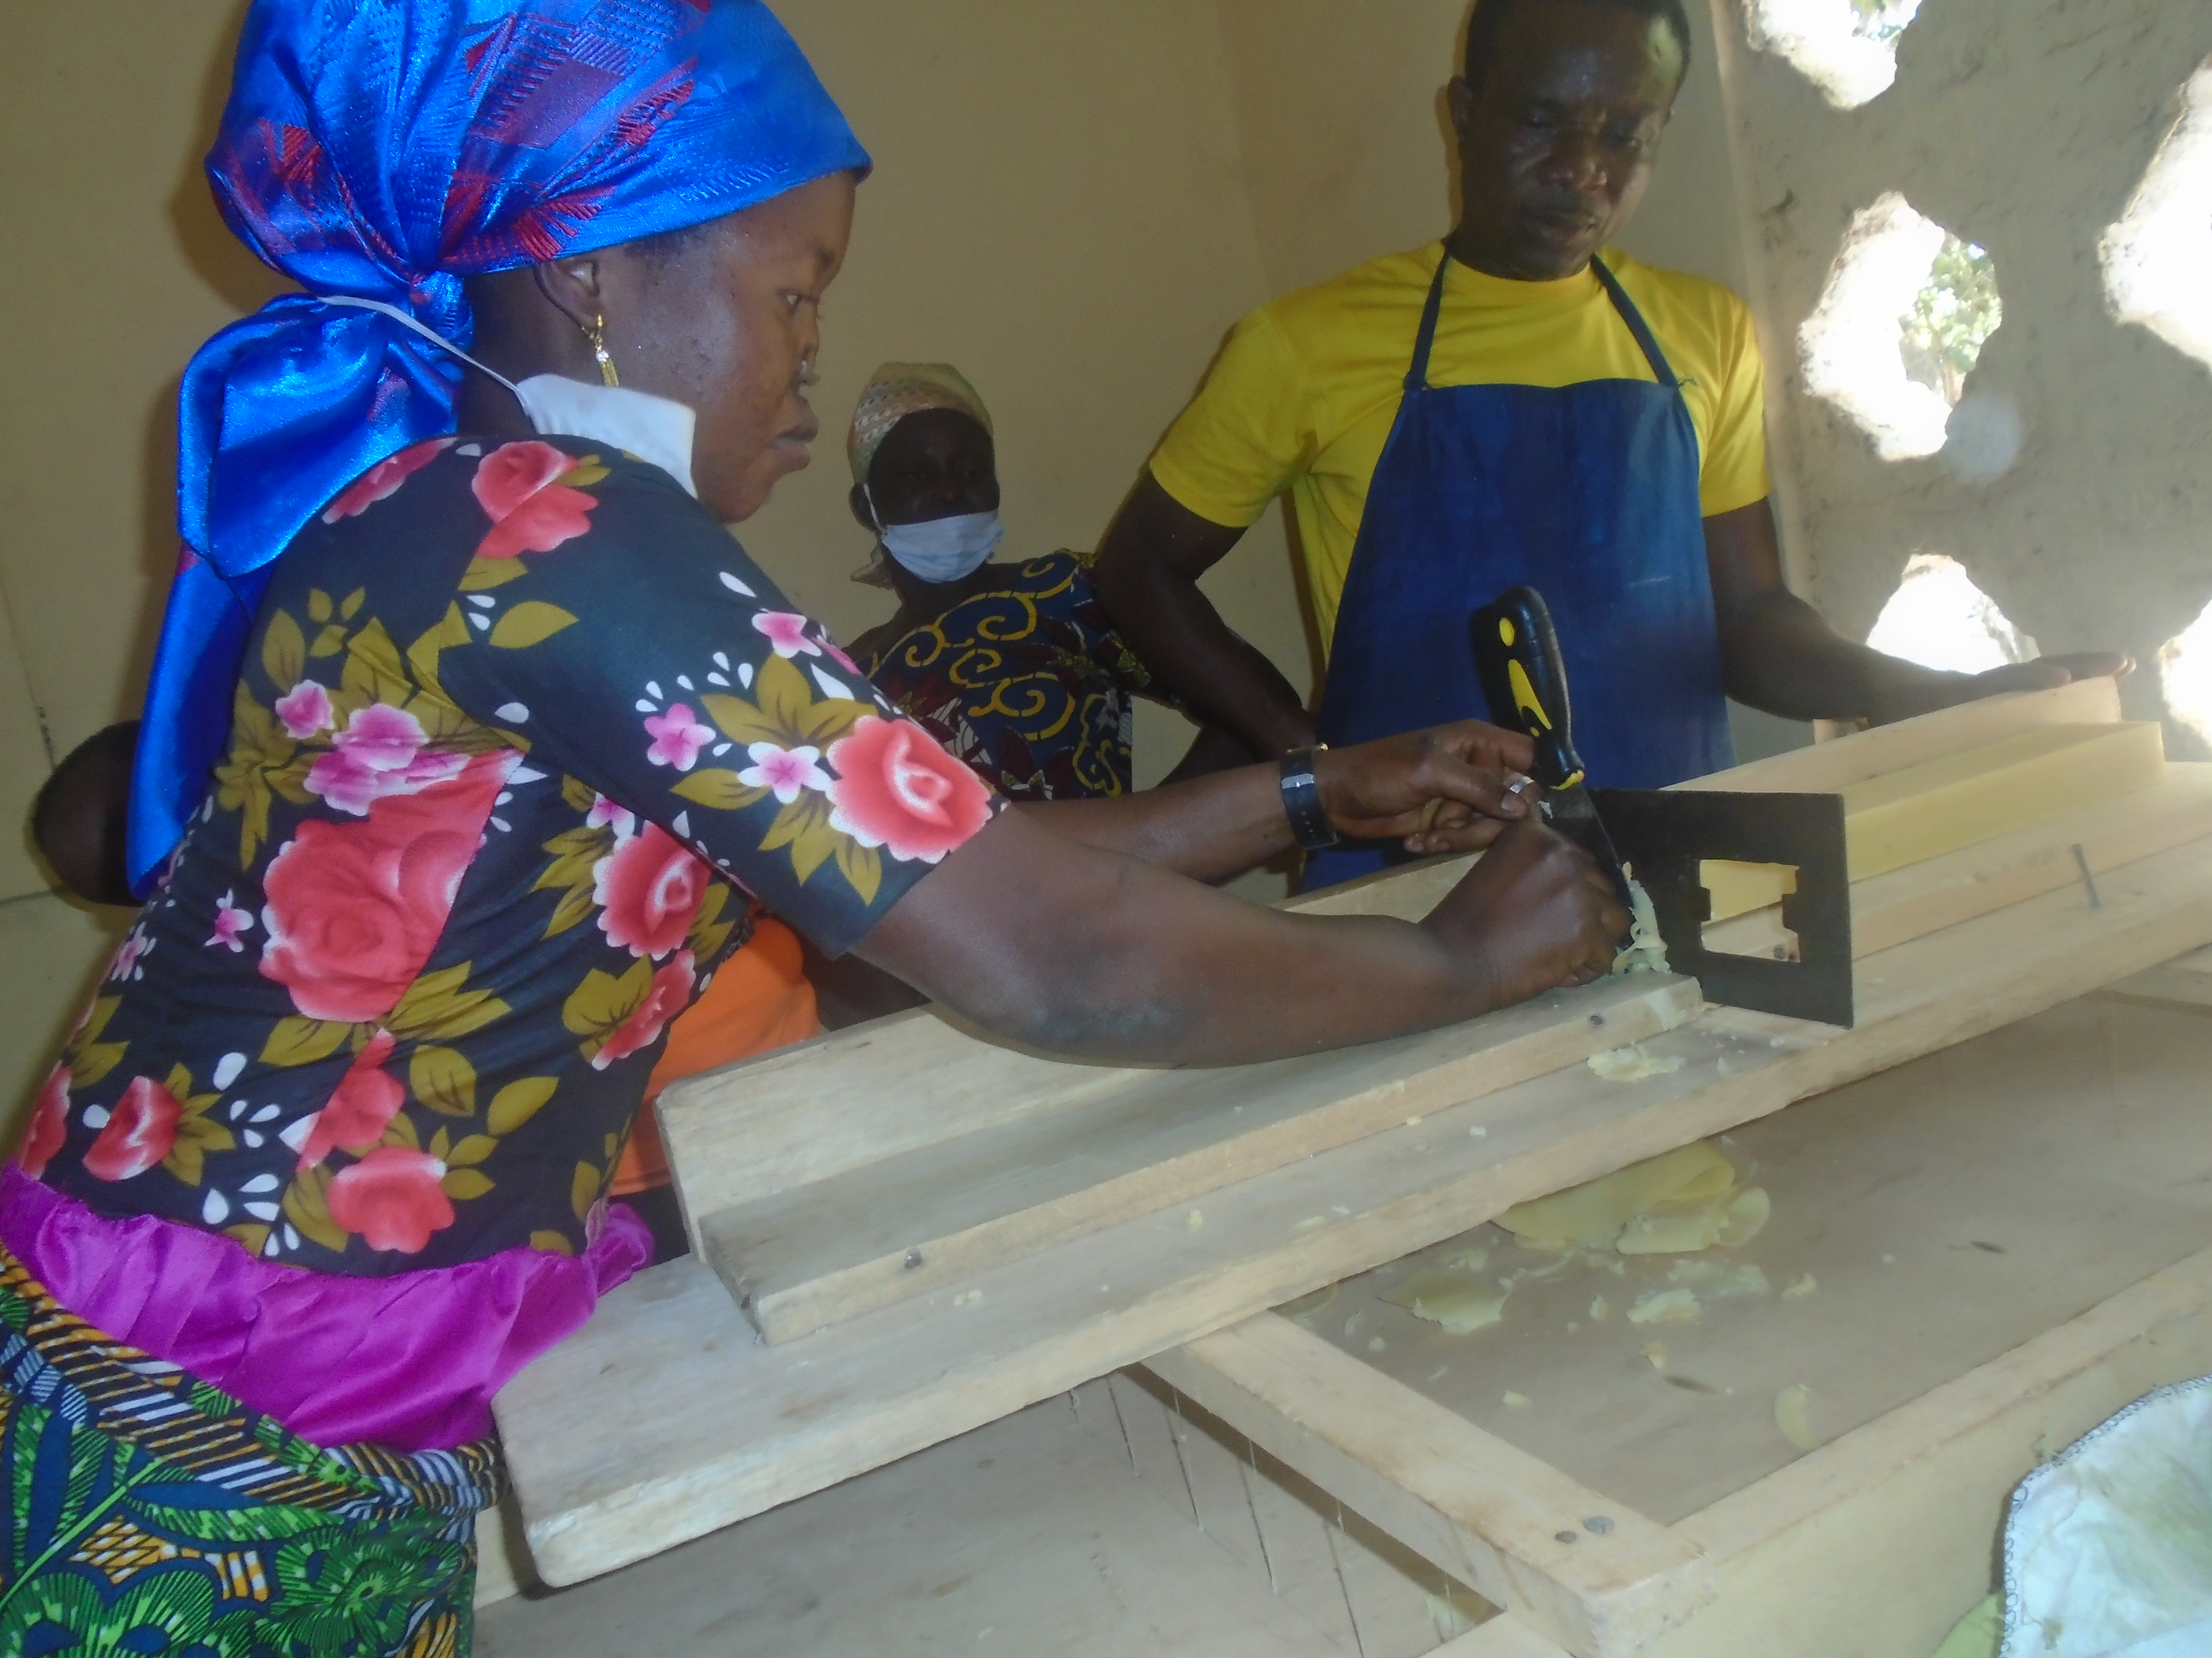
﻿Sunday, ﻿December 10
In northern Ghana, people living with disabilities face a range of issues, such as widespread poverty, limited access to livelihood opportunities and health care, and social barriers to full inclusion. Political, environmental, and economic challenges work together to create those difficult conditions. PWS&D works with the Presbyterian Church of Ghana in a Community-Based Rehabilitation (CBR) program to address these challenges through vocational skills training programs such as soap and pomade making. Ateni Lois, a participant in the soap-making class, expresses her gratitude, stating, “We are so grateful to the CBR program and PWS&D for equipping us with the skills to be able to produce soap and pomade for money. Very soon, we will be in good business and will be out of poverty in our respective communities.”

Slide 12
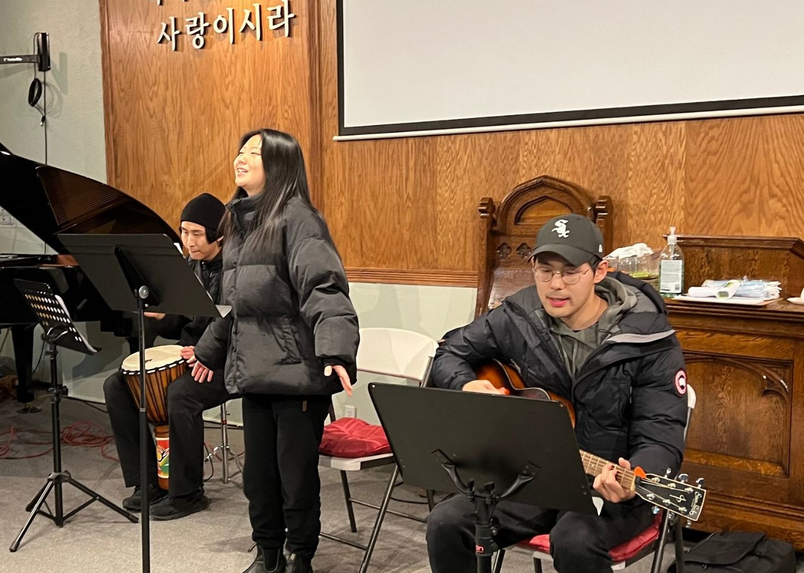
﻿Sunday, December 17
With support from Presbyterians Sharing, The Well Church (Mississauga) provides a welcoming space for those who identify as a third culture community; that is, one that is neither the culture of mostly immigrant parents nor the dominant culture of Canadian society. In a post-pandemic world, the ministry has decided to re-set their focus around spiritual formation, in everything from small groups to children’s ministry, retreats and conferences. They are also training leaders to be elders with spiritual formation at the centre. By focusing on spiritual formation and becoming more Christ-like, the congregation has not only grown closer as a community, but they also feel better equipped to share their personal stories of hope and transformation with friends and neighbours.

Slide 13
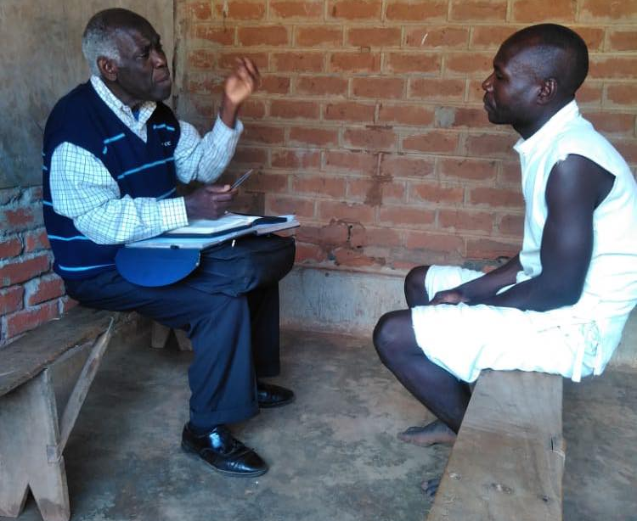
﻿Sunday, December 24
Through Presbyterians Sharing we shine Christ’s light in Canada and around the world. We are there when a prisoner in Malawi discovers Christ’s love through Bible study, and when an Indigenous woman in Taiwan reads the Bible in her own language for the first time. We are there when a congregation adapts to meet community needs in new ways and when a theological student in Canada, Malawi, Nigeria, Ghana or Beirut graduates, ready to serve God. We are there when a child receives a healthy snack and after-school support from an inner-city ministry, and when a refugee claimant needs a friend. We are also there for one another as we pray, serve and share the gifts God has given us. When we put our gifts in God’s hands, God does remarkable things!

Slide 14
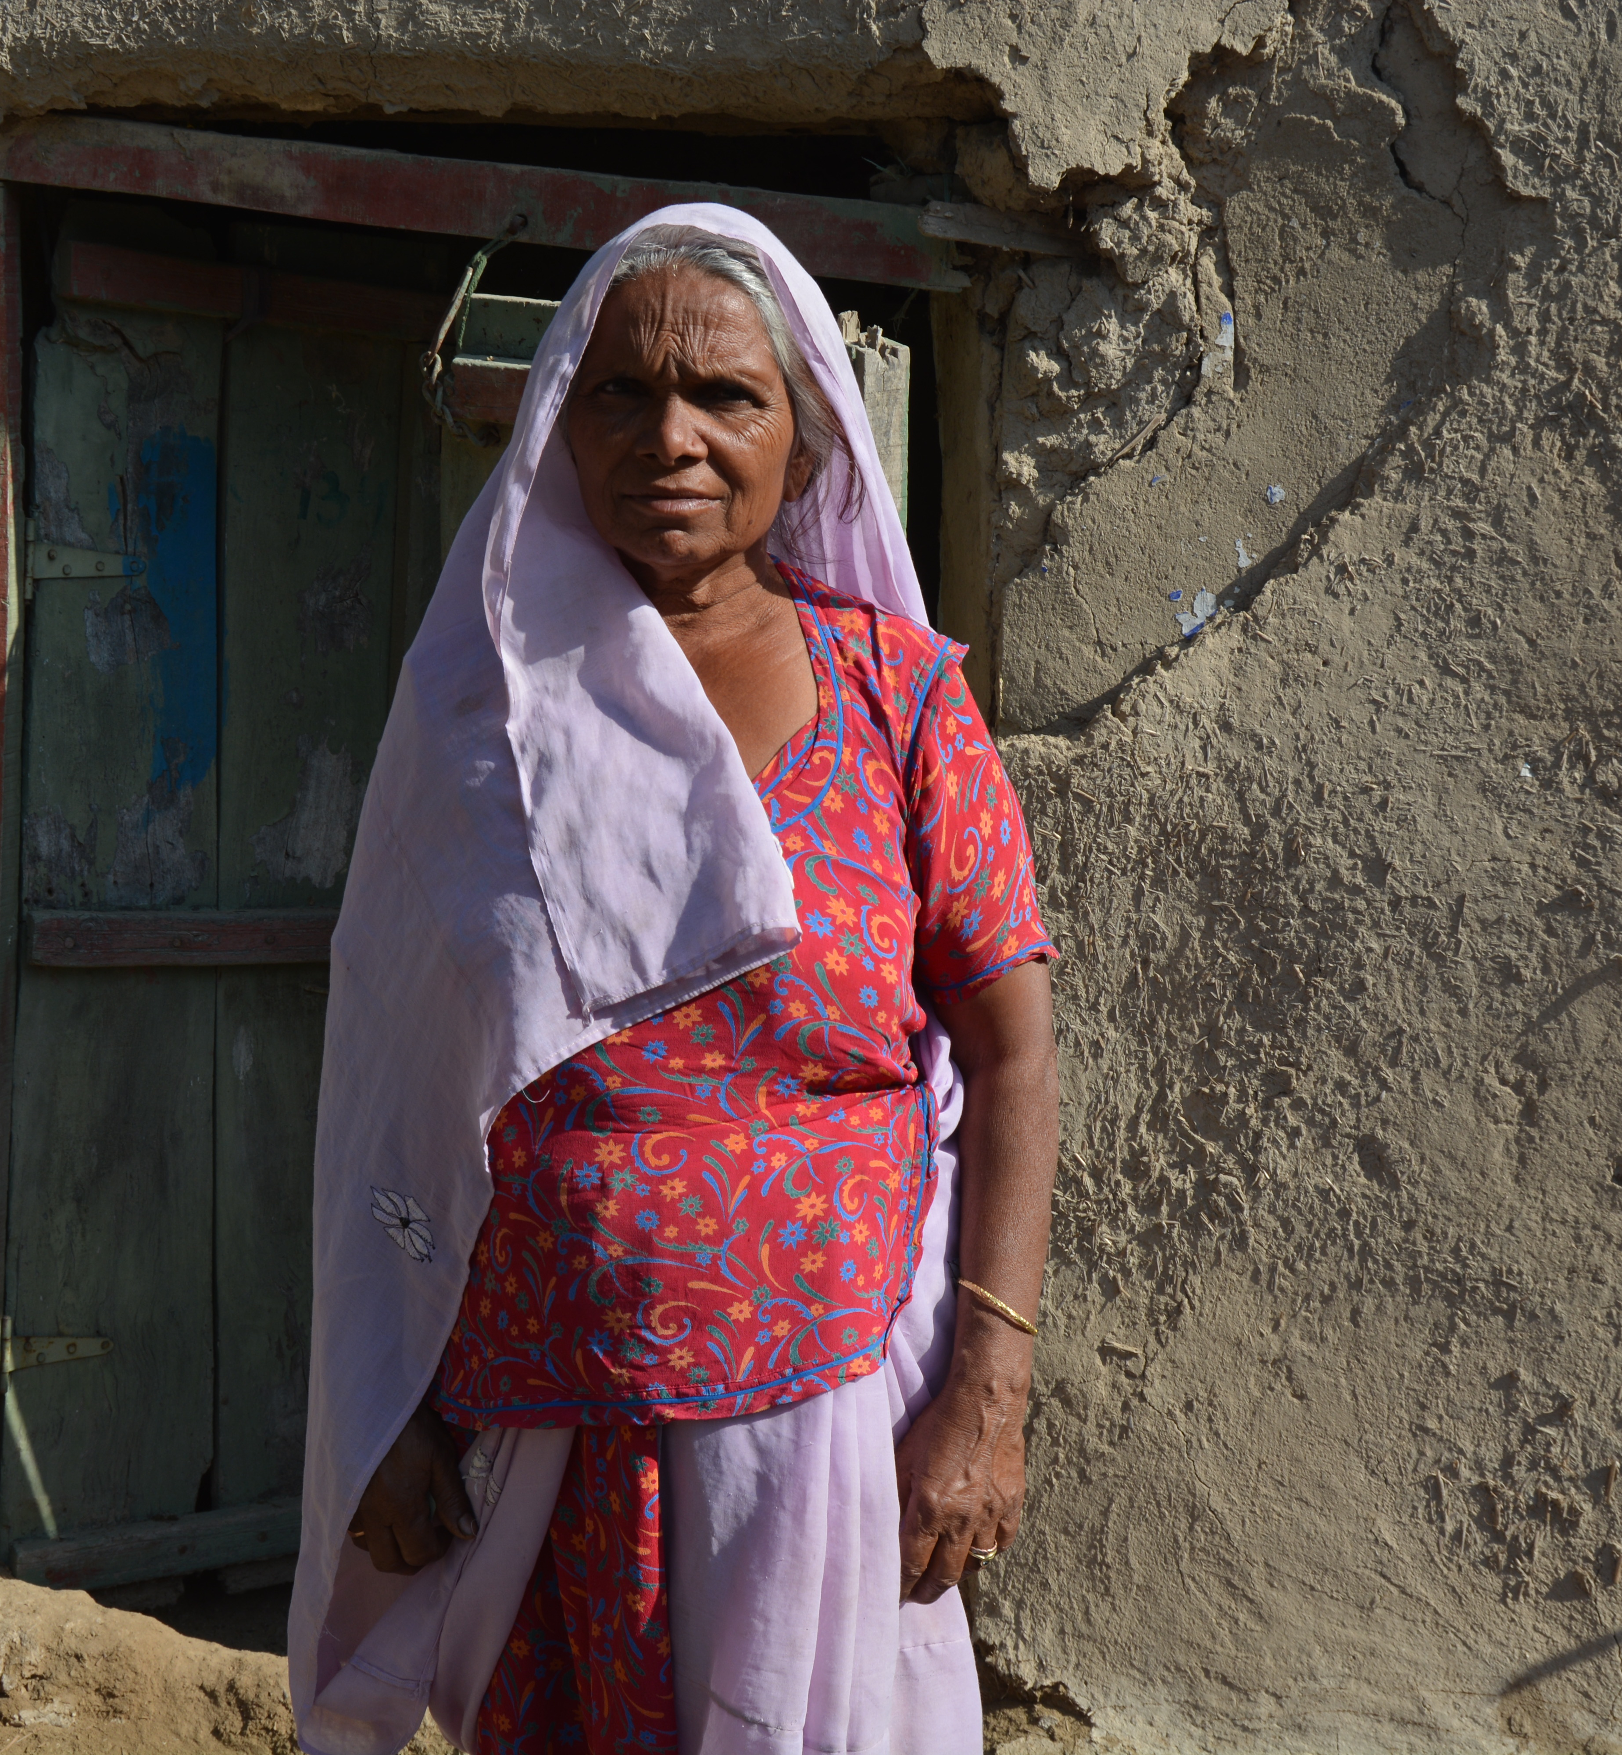
﻿Sunday, December 31
Dhai, a woman in her early forties from Pakistan, has faced hardships throughout her life. She cared for her husband, who was disabled, until his death. She later became the sole provider for her family, working as a cook for a local landowner, which allowed her to support her family. Heavy rains in Pakistan in 2022 caused her house to collapse, leaving her family without a home. Through all this Dhai remained hopeful as she explained, “If the aid comes, it will be good.” Fortunately, Dhai and her family found solace and assistance through the PWS&D-supported Humanitarian, Early Recovery and Development project, which provided them with essential food aid as well as better resilience to future disasters.

