Slide 1
Help! We Have a Deficit!
The Presbyterian Church in Canada
presents
Strategies to help you move from deficit to new possibilities
Karen Plater & Lori Guenther Reesor
May 9, 2023

Slide 2
The Presbyterian Church in Canada
Made possible by your gifts to
Notes:
This stewardship webinar is made possible by your gifts to Presbyterians Sharing.

Slide 3
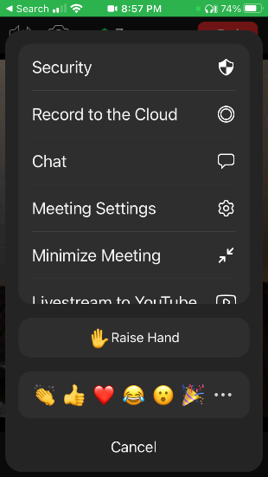
Mobile
Stay muted and use chat to ask anything
Chat will be monitored and questions asked as we go along or at the end
You can unmute at the end
PC

Slide 4
Get ready to take a poll (see link in chat)
https://pollev.com/lorireesor507

Slide 5
Karen Plater
Associate Secretary for Stewardship & Planned Giving
Farmer
Writer

Slide 6
Lori Guenther Reesor
B.Math, MTS, DMin
Christian giving researcher
Author, speaker, fundraising consultant
www.lgreesor.com

Slide 7
What’s a deficit?
Budget: anticipated income is less than the planned expenses
Financial statements: Annual income is less than operating expenses, may be covered by savings or funds
Planned vs. Unexpected
Notes:
KAREN: I hear from congregations all the time that they are in a deficit – or have a deficit budget. What’s a deficit?
Planned vs. unexpected – if it’s planned because covered by funds/savings sometimes reflected in the balance sheet – you will want to differentiate between income from funds or # of years that you could have that deficit before you run out of funds - important thing here is transparency, clarity, reliability – because that’s what will encourage people to feel confident their gifts to you will be well used. Q. “Should I give my tithe to the church?”
WHY are you in a deficit?! – is a key question to getting out of it.
While we are going to suggest some ideas, there aren’t quick and easy solutions – each of you needs to look at the situation in your congregation and determine what we will – what we want to give you are some suggestions and ideas – if you are trying all of these, maybe it will be time to look at alternatives like amalgamation with another congregation, or it might just be time to try something new in STEWARDSHIP

Slide 9
What’s the story a deficit tells?
There isn’t enough
We need to do something:
Raise Income
Cut Costs
Notes:
KAREN: I hear from congregations all the time that they are in a deficit – or have a deficit budget. What’s a deficit?
WHY are you in a deficit?! – is a key question to getting out of it.
While we are going to suggest some ideas, there aren’t quick and easy solutions – each of you needs to look at the situation in your congregation and determine what we will – what we want to give you are some suggestions and ideas – if you are trying all of these, maybe it will be time to look at alternatives like amalgamation with another congregation, or it might just be time to try something new in STEWARDSHIP

Slide 10
MYTH: Everyone is giving all they can
Notes:
LORI will debunk this myth.

Slide 11
What I hear about giving
people in church say ‘we tithe’
What they actually mean: this conversation is done
$20 a week is $1000/year
If this is a tithe, then what is annual income?

Slide 12
Notes:
Redo this with a bigger font, add a slide with Cardus % of people who attend weekly

Slide 13
Notes:
For more : Sarah Wilkins-Laflamme

Slide 14
Two common strategies

Slide 15
This Photo by Unknown Author is licensed under CC BY
Notes:
Silence is often linked to fear. Fear of talking about money. Fear of closure. Fear of failure. Silence is not praise and thanksgiving. Do we pay attention to whether people give or not?

Slide 16
Denial
This Photo by Unknown Author is licensed under CC BY
Notes:
De Nile – not just a river in Egypt. It’s time to take risks – to step forward – to talk about money in your congregation.

Slide 17
Don’t be afraid
Notes:
Generosity as a grateful response to our generous and unchanging God

Slide 18
TRUTH: We serve a grace-filled God who provides enough to share
Notes:
How do we see and live out that in our faith? One of the challenges, when we are in deficit, is that our narrative suddenly changes from God will provide to We don’t have enough – we need to cut. How do we accept our realities, while still living out the reality of our faith.

Slide 19
Circle of Grace
From Lori’s book
Growing a Generous Church: A Year in the Life of Peach Blossom Church
Notes:
We can go back to the basics. There is an illustration I like to use when I think of God’s grace and our response.
Circle of Grace – 2 Cor 8 & 9, inspired by James Dunn
Most fully developed in Growing a Generous Church: A Year in the Life of Peach Blossom Church
Big Hearts Breakfast Club they talk about it’s all God’s stuff

Slide 20
Notes:
Steadfast love of the Lord never ceases, his mercies never come to an end. Beginning of Lent.
Salvation, every good gift comes from God.

Slide 21
Notes:
Humans are prone to forgetting all about God. My stuff, I earned it! Mine!
give us this day our daily bread approach

Slide 22
Notes:
Flip side of self-sufficiency is despair.

Slide 23
Notes:
Do we proclaim in church “I thank God for your generosity”
Do we send thank you letters?
Can’t acknowledge what we have received from God, then we certainly don’t thank God

Slide 24
Notes:
We don’t tell stories and make connections with where our giving goes. Money follows our prayers. “Head office”

Slide 25
Notes:
Not neighbours. Leaving God and neighbours out of circle, it’s just us and the budget
The host does not ask “what can you give me?” He asks for three loaves of bread. Not one, not two but three.

Slide 26
Notes:
Should I explain it again using soteriology, anthropology, ecclesiology?
What are you thankful for?
What gifts do you have to share?
What you need?

Slide 27
Creating a Culture of Generosity
Notes:
So we want to explore how we can create cultures of generosity in our congregations. Lori will share just a little about her experiences with doing Generosity Assessments with congregations.

Slide 28
Scarcity
Deficit = Scarcity language
Scarcity assumes everyone is already giving what they can
Scarcity feels only thing to do is to make cuts, particularly on ministry outside your congregation
Notes:
We will desconstruct some of these myths . . .

Slide 29
Abundance in Bible
5000 are fed with a few fish and loaves
Water is changed into wine
Parables of the mustard seed & yeast
Notes:
The gospel is a story of abundance. Our God is an abundant God. We’ve been given enough. But so often, in times of declining attendance, budgets, volunteers, we can become scared and think there isn’t enough.
That’s not to say we never have to cut programs, or live within what we have been given – but it changes the way we look at what we have been given. Prayerful discernment is an important part of that. Maybe we need to redirect our energies so we are living the theology of abundance, instead of always being scared there isn’t enough. A little bit is faith that God will provide, but a lot is seeing how God is providing.

Slide 30
Abundance
“I believe that abundance is a mindset and not a condition of wealth. Abundance is recognizing that the One who provides us with everything and recognizing that it is not only enough, but enough to share.”
Michael R. Ward, Abundance: Creating a Culture of Generosity, Fortress Press, 2020
Notes:
LORI will

Slide 31
Generosity
“The generous are the ones who have learned the joy of material wealth is the ability to share it with others for the common good with no expectation of receiving anything in return.”
Michael R. Ward, Abundance: Creating a Culture of Generosity, Fortress Press, 2020
Notes:
Not sure this one is helpful LGR

Slide 32
TRUTH: Giving is a joyful endeavor
Notes:
LORI will debunk this myth.

Slide 33
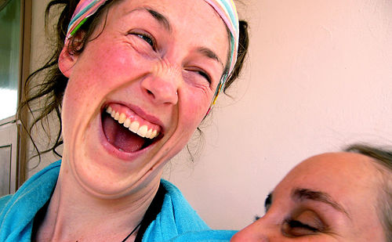
II Corinthians 9:7
Notes:
Each of you must give as you have made up your mind, not reluctantly or under compulsion for God loves a cheerful giver.
John McMullen, in his book Stewardship Unlimited, notes that when you ask people to give until it hurts, you quickly discover how low their pain threshold is!
In reflecting on McMullen’s statement, Al Winn, a Presbyterian minister in the States, suggested that we shouldn’t ask people to give until it hurts; instead, we should ask them to give until it feels good. Well, that is exactly what Paul was asking the first century Corinthians. “Don’t give reluctantly or under compulsion,” he wrote, “for God loves a cheerful giver.” In other words, Paul was urging the Corinthians to give until it felt good, because God loves a cheerful giver.
The Greek word translated as “cheerful” his hilarus, from which we get the English word, “hilarious.” Paul is saying that God loves hilarious givers – those who enjoy giving so much that they gleefully exclaim, “Yippee! Let me do it again!”

Slide 34
TRUTH: Giving is a spiritual practice

Slide 35
For if the eagerness is there, the gift is acceptable according to what one has – not according to what one does not have.
II Corinthians 8:12
Notes:
According to Paul, we are all rich, “rich enough to be generous.”
Sadly, we often look at ourselves on the basis of what we don’t have. We tend to compare ourselves to others and then put ourselves down: “I don’t have a big house or a prestigious job. I don’t have good looks or loads of talent or a 150 IQ.” And in the process we convince ourselves that we have nothing worth giving. But Paul tells us that that is the wrong way to look at ourselves. We need to look at ourselves the way God himself looks at us. And God looks at us on the basis of what we have to give, not on the basis of what we don’t have.
When we begin to look at ourselves on the basis of what we have to give rather than what we don’t have, our inner dialogue begins to change from negative putdown to positive affirmation: “I may not have a big house, but I do have the ability to fix up my house or apartment so it looks and feels like home for me and my family. And I can welcome guests with warm hospitality so that they feel like they are at home when they come for a visit.”
“I don’t have many friends, and I may not be the most popular person around; but I know how it feels to be left out, and I can reach out to others when they feel rejected and lonely.”
“I don’t have oodles of talents, but I can fix things around the house. Why, I can even fix my neighbor’s lawn mower when it breaks down!” I’ll never forget a funeral at which I officiated. The chapel was packed with friends and neighbors of the deceased as they remembered the man fondly known as “Mr. Fix-It” in his neighborhood.

Slide 36
What’s our story?
Nostalgia is the thief of hope. It tricks people into believing that
their best days are behind them.
Dr. Gordon Livingston, as quoted by Diana Butler Bass in A People’s History of Christianity

Slide 40
Can we increase giving?
Notes:
Start with an honest assessment of resources. 2 loaves, 5 fishes. “I have nothing” is a prayer

Slide 41
Generosity Assessment
A grateful examination of where your church is at!
https://presbyterian.ca/stewardship/generosity-assessment/
Notes:
This can help you see where there might be opportunities for growth using the numbers in your congregation. Have you ever looked at them?
Lori – share some of what she has seen.

Slide 42
Suppose one of you has a friend
This Photo by Unknown Author is licensed under CC BY-NC
Notes:
And He said to them, “Suppose one of you has a friend, and goes to him at midnight and says to him, ‘Friend, lend me three loaves,
because a friend of mine has come to me from a journey and I have nothing to serve him’;
and from inside he answers and says, ‘Do not bother me; the door has already been shut and my children and I are in bed; I cannot get up and give you anything.’
“I tell you, even if he will not get up and give him anything just because he is his friend, yet because of his shamelessness he will get up and give him as much as he needs.

Slide 43
Notes:
We don’t tell stories and make connections with where our giving goes. Money follows our prayers. “Head office”

Slide 44
Set a goal
Every member growing in generosity this year.

Slide 45
Bethel Church, NS
Lots of kids, no money!
Shared Vision
Educated congregation
Raised $100,000 in three months ($70,000 from three gifts of stock)
Launched a mid-week program for children in community
Additional bequests brought total to $150,000
Notes:
Lots of kids, no money!
Only had $5,000 endowment for CE – at 5% interest - $250 YEAR for CE
Educated congregation about gifts of assets (especially gifts of stock)
Got kids involved in campaign
Raised $100,000 in 3 months ($70,000 from 3 gifts of stock)
Launched a mid-week program for children in community
Additional bequests brought total to $150,000
Good example: Had a VISION for what they wanted to do -

Slide 46
Lessons
People give to people
Money follows mission (Use a narrative budget!)
Teach how they can give
Notes:
A well thought out policy provides guidance for how undesignated planned gifts will be channeled while still retaining the flexibility to respond to changing circumstances.
Your policies should fit the ethos and specific needs of your congregation.
Many congregations state that planned gifts will not be used for the annual operating budget. This can help avoid providing an excuse for current members to reduce their annual gifts “because we have so much money in the bank.” It also assures potential donors that their life savings are being invested into the future vision of the church.
Some congregations with older facilities, choose to channel a significant portion of undesignated planned gifts into their building fund. This can help relieve some of the added pressure that buildings can place on the annual budget, while honouring the legacy of past generations who built the building.
The purpose of legacy giving policies and endowment funds is not to tie us up in red tape, but to set us free to share the gospel for generations to come.

Slide 47
First Church, Brandon, MB
Endowment was known as “slush fund”
Now called “partner in ministry” fund
Income matches current gifts to expand or launch ministries
During “Foundation Month” they tell the stories of people who made gifts
Notes:
Slush or rainy day fund = we are waiting for things to go bad. Partner in Ministry – we are moving forward.

Slide 48
Lessons
Be grateful
Say thank you
Share stories

Slide 49
St. Andrew’s, Kingston, ON
Endowment Fund covers the maintenance and upkeep of building, so that all gifts through the offering plate go to support the ministry

Slide 50
Lessons
Tailor funds to allow you to do ministry
Use endowments to support future ministry

Slide 51
TRUTH: We need to do ministry.
TRUTH: Ministry costs.
Cutting expenses can create a negative spiral.
Use gifts for maximum impact.
Notes:
LORI will debunk this myth.

Slide 52
Church Buildings
How are they being used?
Who else might use them & what for?
What builds our ministry
What serves our community
Rent vs. by donation
Upcoming webinar in June 2023

Slide 53
Church personnel
How are they contributing to ministry?
How do their skills complement each other?
How effectively do they work as a team?

Slide 54
Church Programs
Who are they serving?
What might we do different?
What does our community need?

Slide 55
Use gifts for maximum impact
Don’t do just because it’s always been done
Invest in programs that proclaim the good news in word & action
Choose programs that serve community needs
Use volunteers wisely
Use skills & assets of your congregation
Have FUN

Slide 56
By the power at work within us God can accomplish abundantly more than all we can ask for or imagine. Ephesians 3:20
Notes:
If you are doing all this – and it’s still not enough – time to look at amalgamations and dissolution – but we hope this has been a message of hope.

Slide 57
RESOURCES that may help!

Slide 58
Talk to us!
Lori Guenther Reesor
Delighted to be a guest speaker at your church, charity or theological school
Fundraising consultant and data geek (Stats major)
Board meetings
www.lgreesor.com

Slide 59
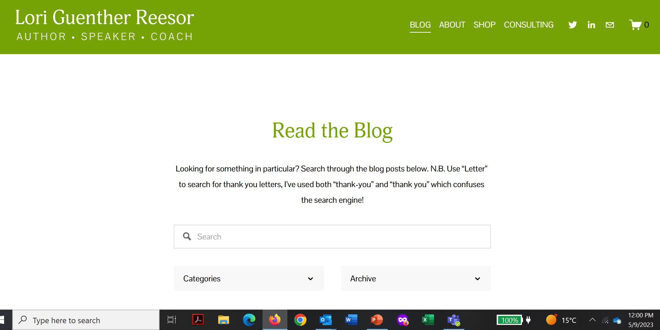
Sign up for Lori’s blog
www.lgreesor.com
Three emails a month:
generosity
the spiritual discipline of giving
Canadian giving trends
Legacy giving

Slide 60
Growing a Generous Church: A Year in the Life of Peach Blossom Church
www.lgreesor.com
Commonword.ca
Amazon
Notes:
Ships to USA

Slide 61
Talk to us
Zoom or in person consultations with session
Sunday preaching & workshops
Email questions
Karen Plater, Associate Secretary kplater@presbyterian.ca
Maggie Leung, Gifts and Database Administrator mleung@presbyterian.ca
Jim MacDonald, Development Manager jmacdonald@presbyterian.ca

Slide 62
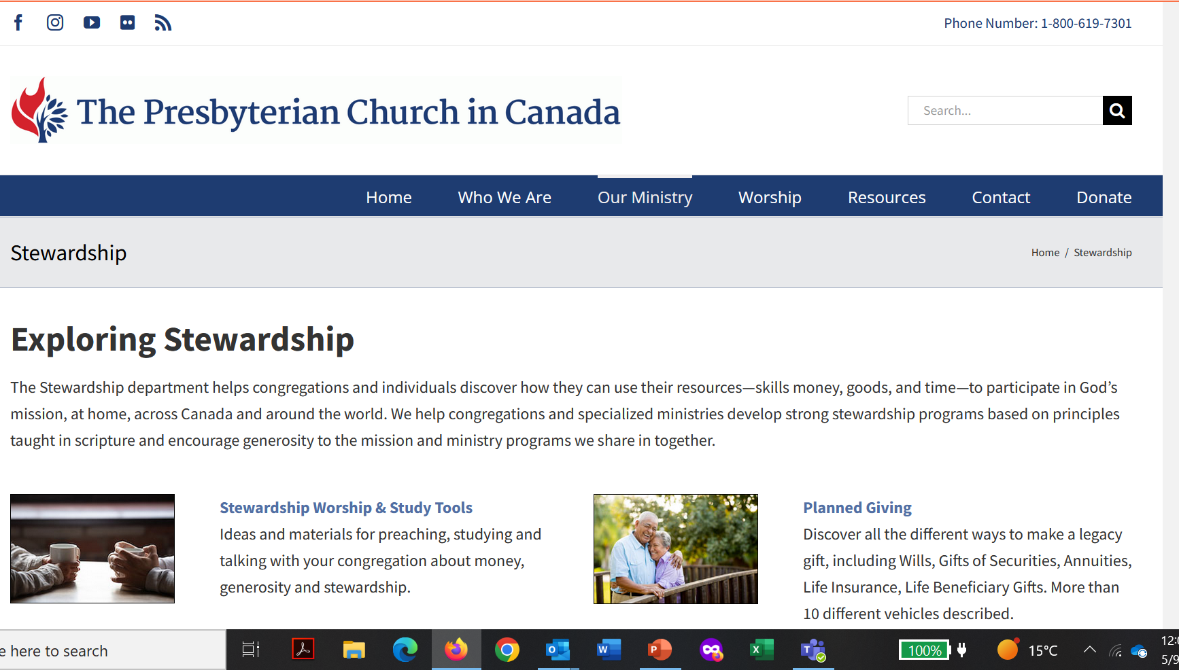
PCC Digital Resources
presbyterian.ca/stewardship
Stewardship e-news
Website

Slide 63
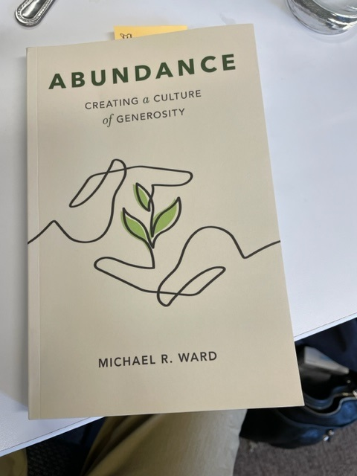
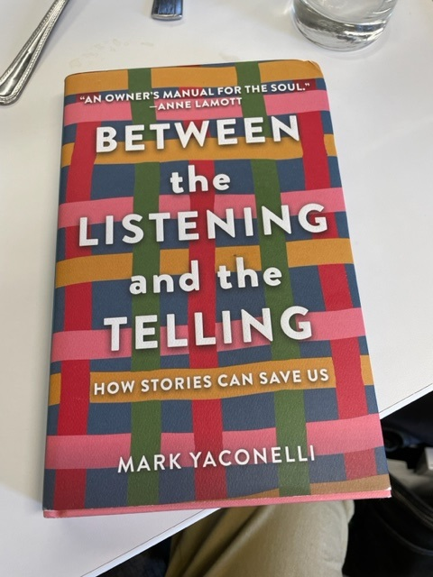
Other books to explore

Slide 64
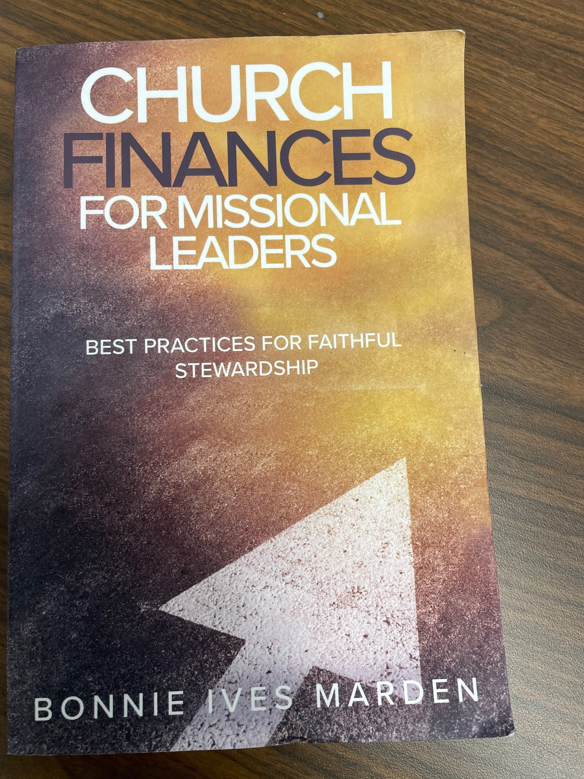
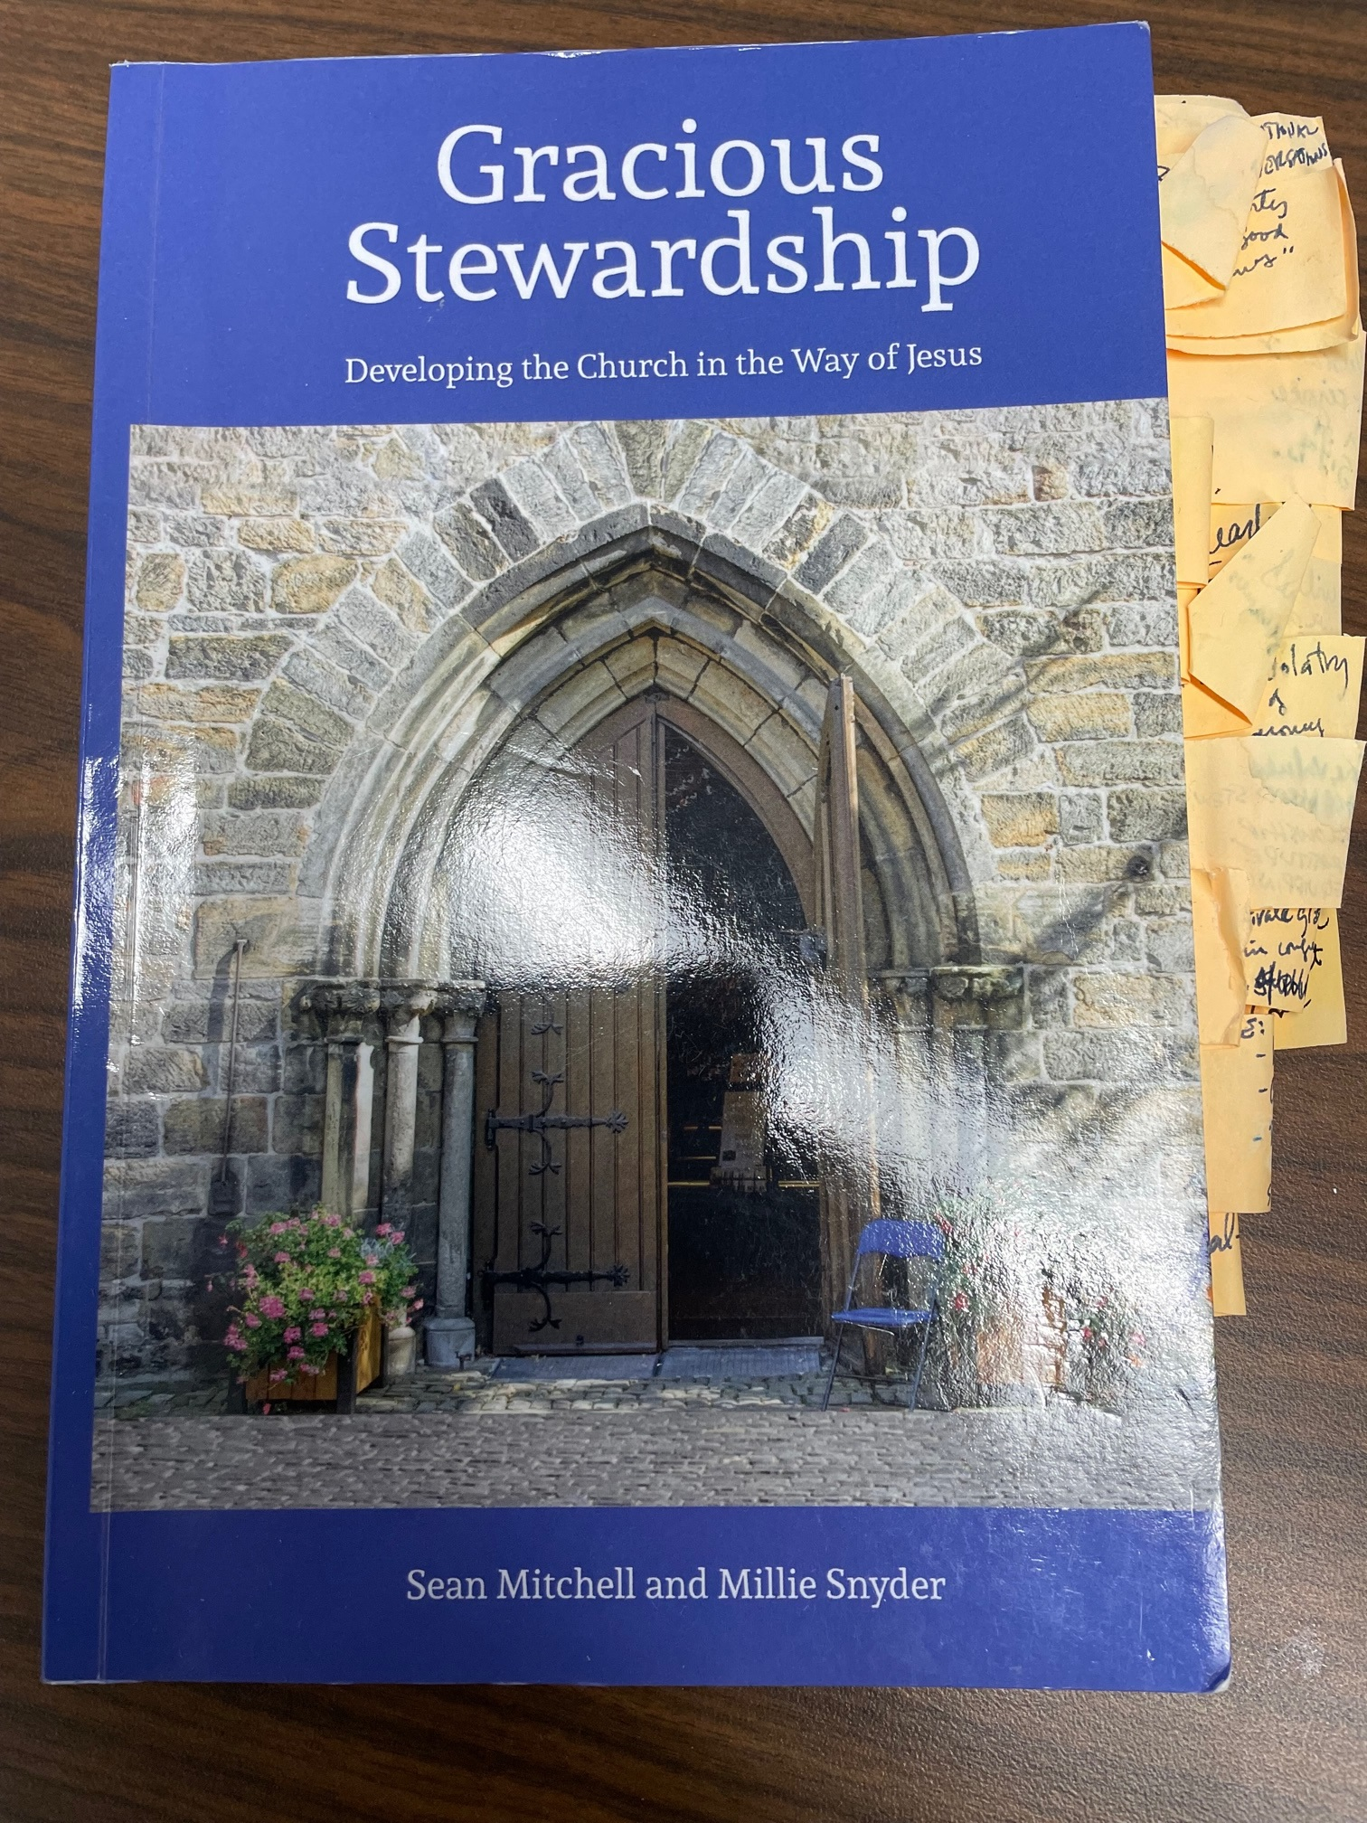

Slide 65
Discuss!

Slide 66
Thank you!
Notes:
This is for the Presbyterian Church in Canada and brought you with support from gifts to Presbyterians Sharing.

