Slide 1
PCC Statistical & Financial Report
March 18, 2024
Notes:
So let us begin to explore different ways we report and communicate finances.

Slide 2
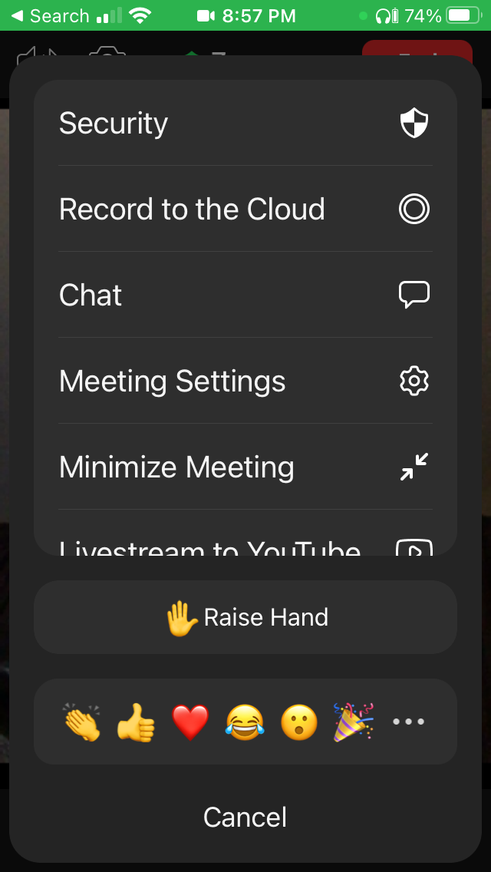
Protocol
Mobile
Stay muted and use chat to ask questions or comment
Questions and comments may be reviewed at the end so include a clue/reference to what your question is referring to
We will unmute at the end for verbal questions
PC

Slide 3
Spread the word
Recording, slides & notes will be posted at
presbyterian.ca/
leadership-webinars
Share them!
Notes:
Recordings will also be posted at https://presbyterian.ca/leadership-webinars/ for people to find and use in the future.

Slide 4
Presenters
Karen Plater, Stewardship & Planned Giving
Maggie Leung, Stewardship & Planned Giving
Terrie-Lee Hamilton, General Assembly Office
Shana Kay Shirley, Financial Services
Notes:
One of the benefits of a webinar is that you can pull in multiple people to present. This really is a collaborative effort.

Slide 5
Expressing Connectedness
Official record
Story about denomination
Produced in Act & Proceedings (A&P)
Health of a congregation
Used by Presbyteries
Shared stewardship
Calculation of the dollar base used for Pension Assessment (4.5%); Presbyterians Sharing Allocation (10%) & some presbytery & synod Assessments
Notes:
As Presbyterians we are connected with each other in God’s mission.
Completing the statistical report is one way we express our connectedness.
The report becomes an official record of your congregation and tells an important story about our denomination. The numbers are recorded annually in The Acts and Proceedings of General Assembly and distributed to PCC congregations and partner churches throughout the world.
Presbyteries may look at them when they are looking at the health of the congregation
And they are also a way in which we express our shared stewardship – both in supporting mission and ministry at national and regions levels, and in supporting pensions of ministers and professional church workers.
A congregation’s dollar base provides a fair way to determine a congregation’s recommended allocation for Presbyterians Sharing (10% of dollar base) and pension assessment (5% of dollar base).
Some synods and presbyteries also use the dollar base to determine their assessments.
It is important to note that pension contributions are a legal requirement set out in the constitution of the Pension Plan, so it is essential that all congregations are treated equally in the calculation. The 5% figure was based on the needs of the pension fund.
Presbyterians Sharing is a recommended allocation which allows congregations to participate as fully as they are able in the spirit of joining in common mission and ministry. The 10% figure was chosen to mirror the tithe, which teaches proportional, intentional, faithful giving off the top of one’s income. Congregations are encouraged to meet or exceed the recommended allocation. The levels of these contributions were accepted by congregations through General Assembly.
Filling out the form to determine these amounts can make some people feel like they are paying a tax. But what it is really doing is helping to establish amounts which allow congregations to faithfully participate in the mission and ministry of our denomination. By adhering to a common system of calculation, we ensure equity for all.

Slide 6
Land Acknowledgement
We acknowledge that congregations across Canada are on the traditional territories of various Indigenous peoples
The Presbyterian Church in Canada is on the traditional territory of the Huron-Wendat, Petun, Seneca and, most recently, the Mississaugas of the Credit Indigenous Peoples.
Notes:
s we gather, we acknowledge our failings and apologize, and we reaffirm our commitment to healing and reconciliation with Indigenous people—First Nations, Inuit, and Metis.

Slide 7
Stat Report Guide & Worksheet
Find the forms and guide at
presbyterian.ca/finance
Notes:
All of the information in our presentation will be found in the PCC statistical guide – so this is the stat report bible! If you can’t find the answer in it, contact us for clarity. It helps us update it in the future. We almost have the 2021 ready to go – but our prep meeting on Monday and questions we’ve already been asked, mean we have held off, as we can update it after this webinar based on your input.

Slide 8
Access Guide & Forms
presbyterian.ca/resources/finance
Worksheet and guide
Online form
208
Notes:
You can download the PDF guide and form and also access the online form from presbyterian.ca/resources/finance.

Slide 9
Guide & Worksheet
Notes:
All of the information in our presentation will be found in the PCC statistical guide – so this is the stat report bible! If you can’t find the answer in it, contact us for clarity. It helps us update it in the future. We almost have the 2021 ready to go – but our prep meeting on Monday and questions we’ve already been asked, mean we have held off, as we can update it after this webinar based on your input.

Slide 10
Word Document so you can add your numbers. If you have problems with it, ask us for a pdf.
Updated every year.
Notes:
The PDF form comes with a guide that contains detailed instructions on how to complete each line. We’ll cover the changes for this year during this webinar, and you can also double check the updated guide to make sure that the question being asked isn’t different this year.

Slide 11
Submitting Electronically
Lowers cost of entering data
Enter email 2x – needs to be same
Save/Next Buttons
Notes:
A few years ago, congregations began to fill out the statistical report electronically. This helps us to keep costs of entering the data needed for the Acts & Proceedings low.
For importing data, the most effective form is the online form as there have been numerous challenges with the auto-calculations on the pdf forms depending on the type of computer or browser used. Sometimes the calculation codes can be overwritten, or the data doesn’t import well, which can lead to errors. If possible, please submit via the online form, otherwise follow the pdf instructions very carefully to minimize errors.
To use the online form
Gather your information using the pdf form and then enter the data at presbyterian.ca/stat-report.
Begin by entering your name and email address
Then click “Create my online stat form”

Slide 12
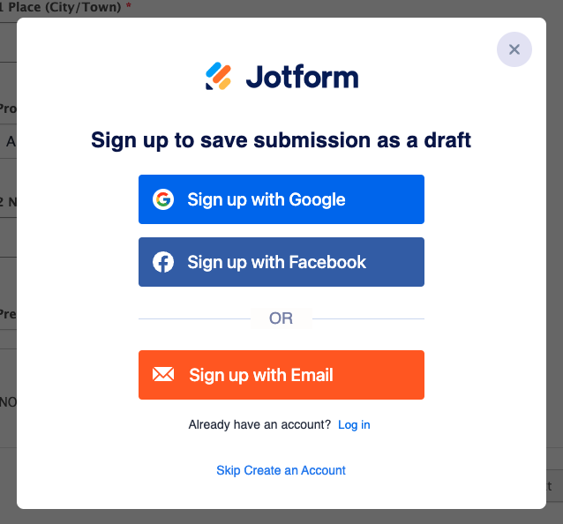
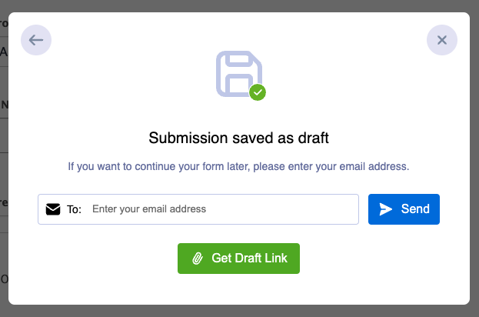
Saving work
Use “Skip Create an Account” to fill in the form later
Share link with collaborator
Send questions to statistics@presbyterian.ca
Notes:
You’ll know it’s submitted when you see the confirmation page.
On that page, you will see a link.
Save this link because it allows you to save the information and return to continue to fill in the form at a later date and/or share the link with another person.

Slide 13
Saving work
Notes:
You’ll know it’s submitted when you see the confirmation page.
On that page, you will see a link.
Save this link because it allows you to save the information and return to continue to fill in the form at a later date and/or share the link with another person.

Slide 14
Email with Link to Draft Form
No email?
Check spam folder
Email statistics@presbyterian.ca
Forward to collaborator
Notes:
You will also receive a confirmation email, which contains that same link. Save this link because it allows you to return to continue to fill in the form at a later date, to save the information and share the link with another person.

Slide 15
Congregational STATISTICS
Notes:
Any history about the report?
How long the stats have been collected?
Changes over the years?

Slide 16
4-6. Stats
4. Elders
a) # of elders
b) term service
5. Children (0-18)
6. Households
(One or more members)
Notes:
LINE 4
(a) Asks for the number of Ruling Elders on your Session.
(b) Please indicate whether or not the session uses term service for elders.
LINE 5 asks for the total number of children between 0 -18 who participate in the life of the congregation, whether attending church school or otherwise.
LINE 6 asks for the Total Number of Households with one or more professing members or adherents. A professing member is defined as: “those who have been admitted into the fellowship of the Lord’s Table and who, on profession of their faith in Christ and obedience to him, have been received by the Session”. Book of Forms, 140.1. Adherents are others who are associated with and support the life of the church.
LINE 7
Baptisms: Please list the number of baptisms that took place during 2020 in each age group. The total will be shown automatically in the third box.

Slide 17
7. Baptisms
Notes:
LINE 7
Baptisms: Please list the number of baptisms that took place in each age group. The total will be shown automatically in the third box.

Slide 18
8. Professing Membership
Begin with last year’s number
Additions
8b Profession of Faith
8c Special Act of Session
Notes:
LINE 8 covers Professing Membership:
This begins with the official membership number that appeared in the 2020 Acts and Proceedings from last year’s Statistical Report.
Do not change this figure. Your new membership figure will be calculated by reporting the people who have been added and removed using the various sections.
For instance, section B) asks for those added by profession of faith
C) asks for those added by certificate of transfer
D) Adds those additions up
And E) provides a subtotal

Slide 19
8. & 9. Members & Adherentsb
Removals
8f by certificate
8g because of death
8h revision of the roll
8i auto-calculates
8j Professing membership
8 j auto-calculates
9. Adherents under pastoral care (adults only)
Notes:
LINE 8 Professing Membership: This begins with the official membership number that appeared in the 2020 Acts and Proceedings from last year’s Statistical Report. Do not change this figure. Your new membership figure will be calculated by reporting the people who have been added and removed using the various sections.
LINE 9 Adherents under Pastoral Care: This includes adults associated with the congregation.

Slide 20
10. Weekly Worship Attendance
It’s subjective!
Notes:
LINE 10 Estimated Weekly Worship Attendance: We know 2020 was a year that changed the definition of worship attendance for many. In this section, as best you can, estimate your normal weekly attendance for Sunday worship over this past year. Consider both online (live- streaming, Zoom, YouTube, Facebook Live, pre-recorded services, etc.) and in-person participation. Think about whether attendance went up or down overall, compared to previous years.
To estimate the number of online participants, use your knowledge of your congregation, the number of people who would participate in worship when the building was open, unique views/opens of recordings over a one-week period and any feedback you have had. For example, based on your knowledge and feedback, you might calculate your online views like this: one Sunday, you know that there were 54 unique views of the service. You polled the congregation and 96 people said they participated online. There were four families with four participants each (16 people, 4 views) +, 30 couples (60 people, 30 views) + 20 singles (20 people, 20 views. 96 people /54 unique views = 1.7 participants per unique view. You would then use this multiplier to interpret the number of people participating from the number of unique views. If people used their own devices (like for a Zoom service), the number of participants will be closer 1 participant per unique view. While the multipliers are will be subjective, they can give us a rough idea of participants. Use the same multiplier for (b), (c) and (d).

Slide 21
FINANCES For Stat purpose
Notes:
PART II FINANCES
Now we get to the finances section. These statistics are divided into two sections because often the finances and stats sections are filled out by different people.
This is for financial statistics – but also to help us determined the congregational dollar base.

Slide 22
Minister Accommodation
Notes:
LINE 11 Accommodation: This area relates to accommodation and accommodation allowance paid to the minister.
On Line 11(d), enter the total accommodation allowance paid to other Professional Church Workers
(defined at Line 22 in this guide) and include that amount in the figure on Line 23 of the report.

Slide 23
If new CRA Number email statistics@presbyterian.ca
13. CRA Registration
Notes:
LINE 13 Canada Revenue Agency filing date:
Each year, a charity must complete and file, with CRA, an annual information return (T3010), within six months of its year-end date i.e. normally by June 30th of the year following.
Enter the date in 2022 on which your 2021 return was filed.
You’ll notice there’s a note here: if your congregation’s T3010 has not been filed with CRA, or if your CRA number has changed, inform both National offices and your Presbytery Clerk.
Your CRA number is unlikely to change, except in a few rare circumstances.

Slide 24
FINANCIAL FIGURES Revenue
Notes:
PART II FINANCES
Now we get to the finances section. These statistics are divided into two sections because often the finances and stats sections are filled out by different people.
This is for financial statistics – but also to help us determined the congregational dollar base.

Slide 25
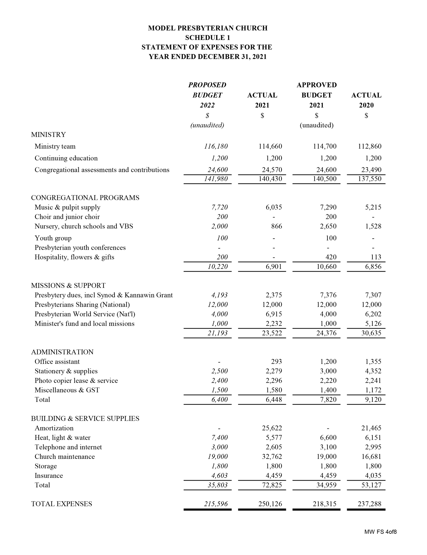
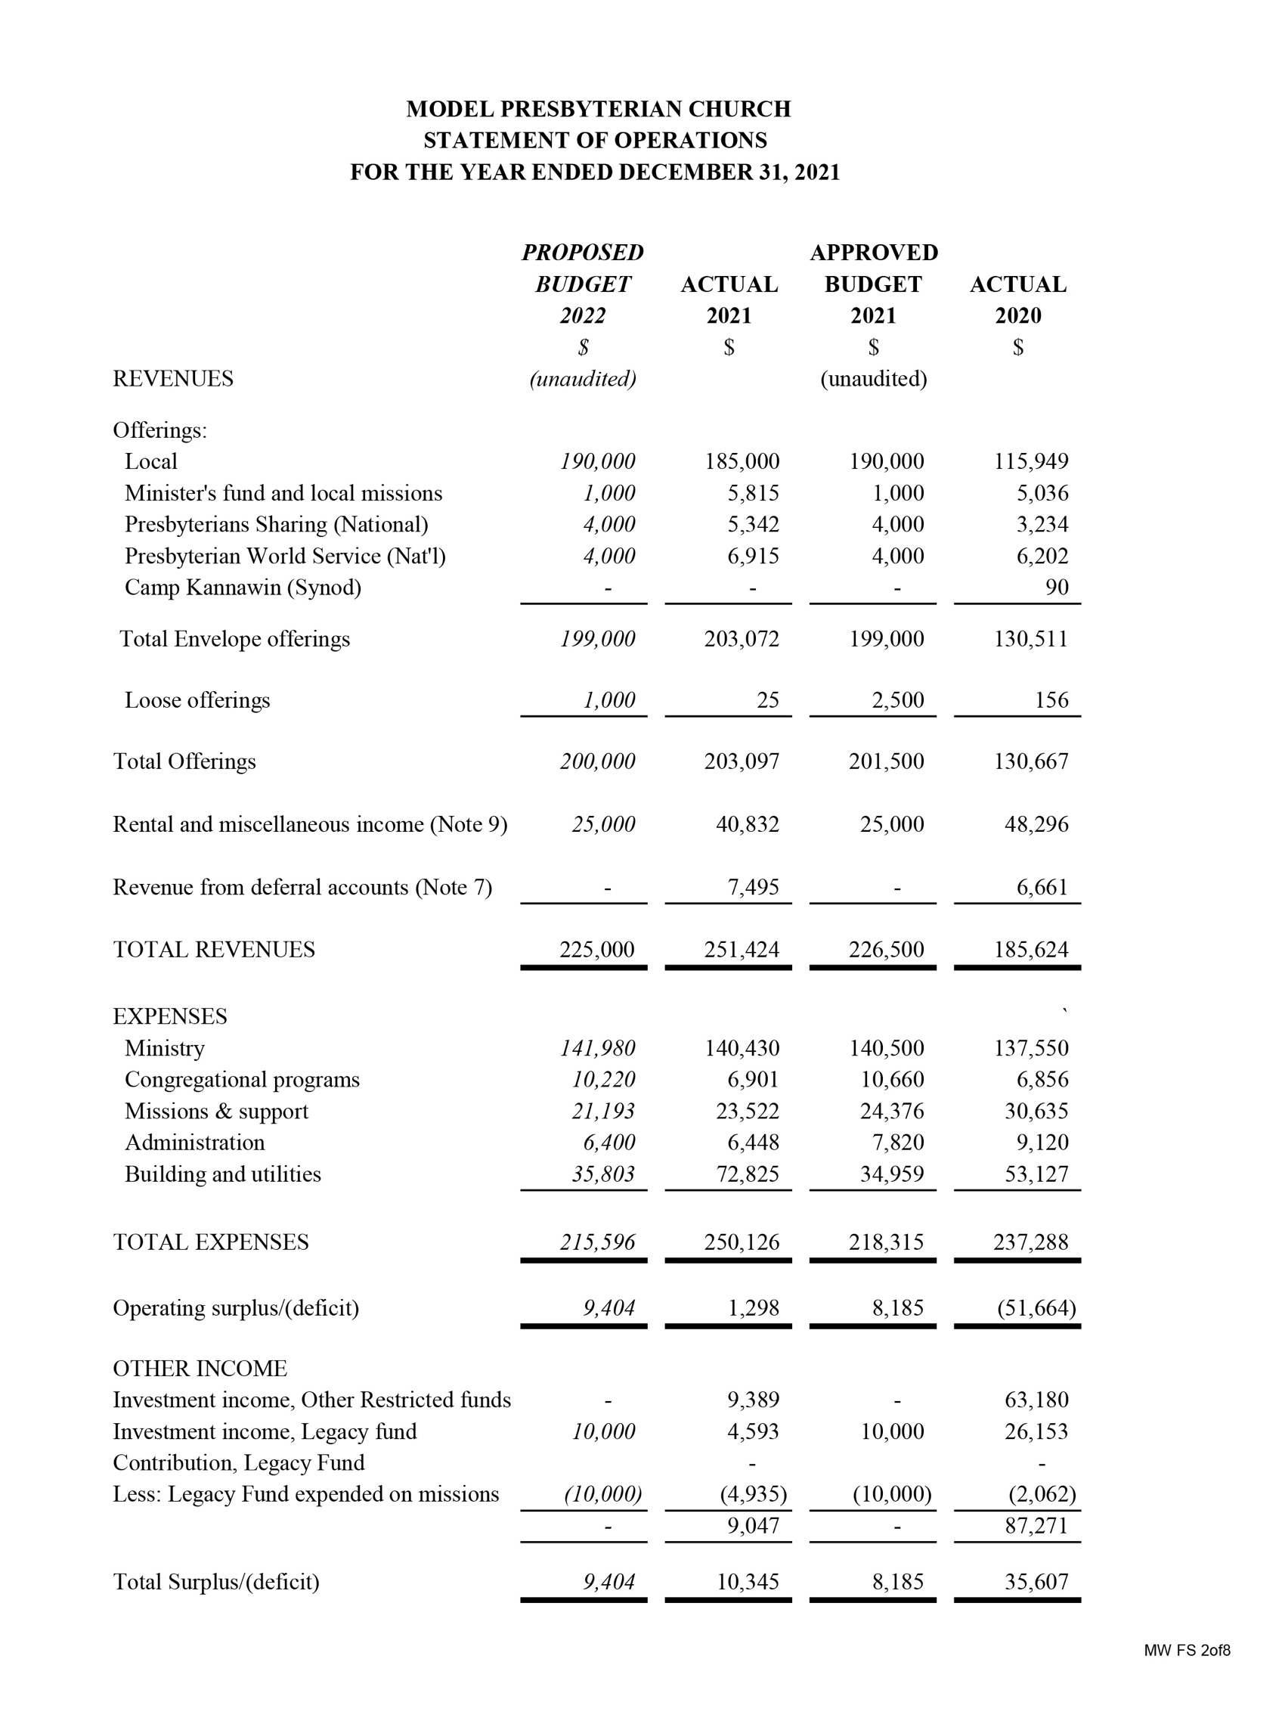
Where the numbers come from
Consolidated
Financial statements
Operating and Fund(s)
Should reconcile
Notes:
Here is a mock-up two-part Statement of Operations for an example church.
The Schedule 1 section totals tie into the expenditure sections on the statement of operations.

Slide 26
Your congregation’s dollar base is calculated as follows.
Total money received by congregation from all sources for use in a given year: $__________
(Line 14)
subtract
All money remitted for mission: – $__________
(Line 26)
subtract
Debt repayment (principal + interest): – $__________
(Line 24)
Dollar base = $__________
(Line 31)
Dollar Base Calculation
Notes:
To calculate your congregation’s recommended allocation for a given year, you need the dollar base from two years previous. The dollar base is congregational revenue* in a given year minus expenditures for Presbyterians Sharing, PWS&D and other mission and debt repayment. (See Statistical Report Information Guide to find out what is included in congregational revenue.) The dollar base for each congregation can be found in the final column on the far right side of the page in the Statistical and Financial Reports of the Acts and Proceedings or you can use a calculator and plug in the lines from the statistical report and use the formula below to see how the dollar base was calculated for your congregation.

Slide 27
14. Revenue
2022 FORM
Include
Envelope, PAR, Online donations, Loose offerings
Rental Income
Mission Gifts PS & PWSD, etc.
Bequests/legacies for use in current year
Interest & Capital for use in current year
Funds from sale of property used for current purposes
Presbytery & other grants (except Canadian Ministries)
Other funds Used for current purposes
No HST/GST
Notes:
LINE 14 Total $ received by congregation for church operations for current purposes (Current purposes covers expenses reported in lines 21-27.)
Include the following items:
Envelope, PAR, online donations, and loose offerings
Rental income (gross amount) and donations for use of the manse or church facilities (day-care centers, banquets, weddings etc.)
Amount raised for mission purposes (Presbyterians Sharing, PWS&D, and other PCC mission funds, other Canadian registered charitable mission organizations, and refugee sponsorship etc.)
Amounts received from organizations within the congregation for current purposes (Session, church school, women's groups, men's groups and youth groups, etc.)
Bequests and legacies used for current purposes
Interest and capital from endowment, restricted or other funds used for current purposes
Funds from the sale of property used for current purposes.
The Canada Emergency Wage Subsidy (CEWS) grants and other support from the government (Federal, Provincial, Municipal), church grants or other sources to help congregations with their expenses related to COVID-19.
Other funds from any source which were used to pay for current purposes.
Do not include:
Funds raised by Women's Missionary Society/Atlantic Mission Society which are sent to the WMS and AMS. (These are reported on line 29.)
The share paid by other points to support the minister in multi-point congregations (This is reflected on each point’s statistical report.)
Bequest and legacies which will be used in future years through endowment or special funds. (This is reported in Line 16.)
Grants from Canadian Ministries (reported in Line 17.)
Note:
GST/HST should be credited against operating expenses and not be included on any revenue line.
CEWS and other funds provided for financial relief during COVID-19 should be reported as revenue in Line 14 and not credited against operating expenses.

Slide 28
20. Revenue
Notes:
LINE 14 Total $ received by congregation for church operations for current purposes (Current purposes covers expenses reported in lines 21-27.)
Include the following items:
Envelope, PAR, online donations, and loose offerings
Rental income (gross amount) and donations for use of the manse or church facilities (day-care centers, banquets, weddings etc.)
Amount raised for mission purposes (Presbyterians Sharing, PWS&D, and other PCC mission funds, other Canadian registered charitable mission organizations, and refugee sponsorship etc.)
Amounts received from organizations within the congregation for current purposes (Session, church school, women's groups, men's groups and youth groups, etc.)
Bequests and legacies used for current purposes
Interest and capital from endowment, restricted or other funds used for current purposes
Funds from the sale of property used for current purposes.
The Canada Emergency Wage Subsidy (CEWS) grants and other support from the government (Federal, Provincial, Municipal), church grants or other sources to help congregations with their expenses related to COVID-19.
Other funds from any source which were used to pay for current purposes.
Do not include:
Funds raised by Women's Missionary Society/Atlantic Mission Society which are sent to the WMS and AMS. (These are reported on line 29.)
The share paid by other points to support the minister in multi-point congregations (This is reflected on each point’s statistical report.)
Bequest and legacies which will be used in future years through endowment or special funds. (This is reported in Line 16.)
Grants from Canadian Ministries (reported in Line 17.)
Note:
GST/HST should be credited against operating expenses and not be included on any revenue line.
CEWS and other funds provided for financial relief during COVID-19 should be reported as revenue in Line 14 and not credited against operating expenses.

Slide 29
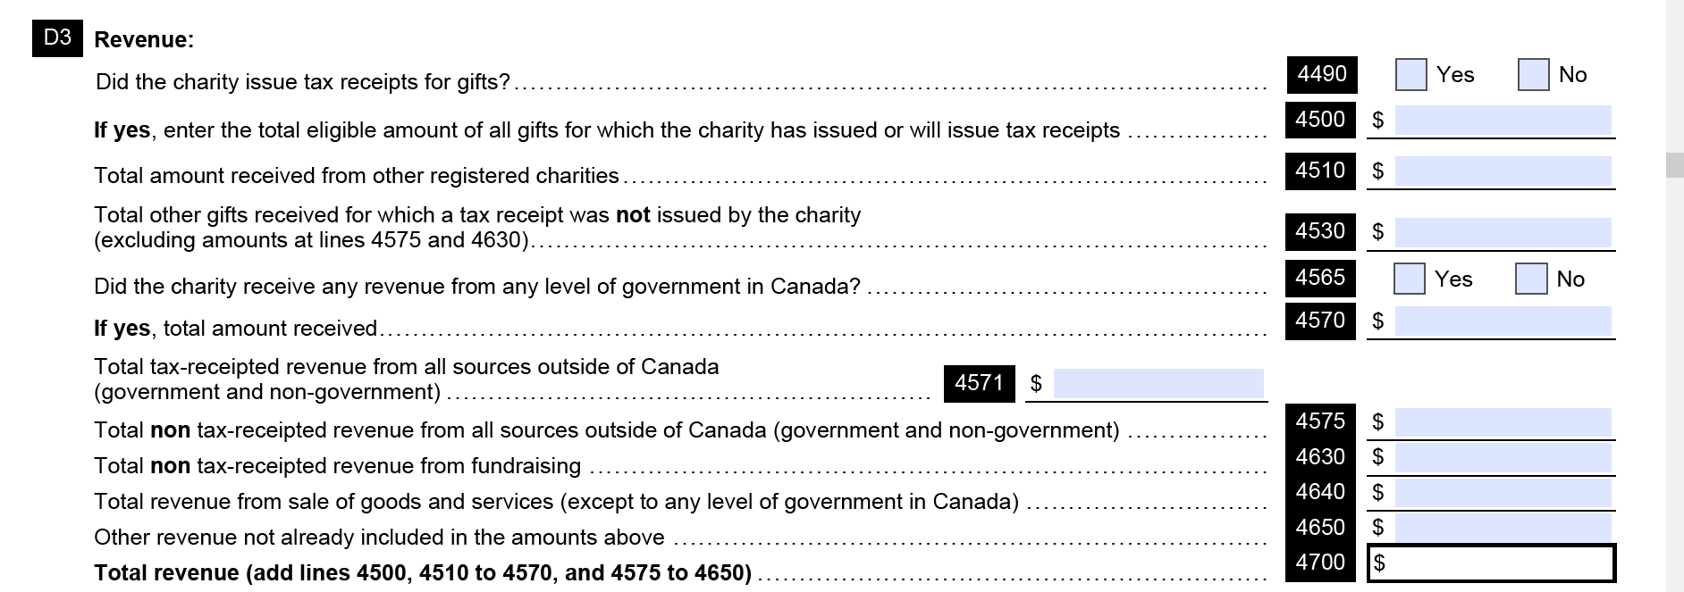
All Revenue (Line 20 on T3010)
Notes:
Just to clarify, some of the lines in the receipts section refer to receipts received for current use and a few refer to receipts for future use…

Slide 30
Line 14 Revenue from all sources for use in a given year
Current Use
14.Offering/Net Rent/ Transfers/Special Gifts/Grants
Unavailable for Operating
14a. Deduction from Gross Rent
17. Designated Grants
18. Raised for Repairs
19. Extraordinary funds
Future Use
15. Sale of Property
16. Endowments & Bequests, Special Funds
Notes:
Just to clarify, some of the lines in the receipts section refer to receipts received for current use and a few refer to receipts for future use…

Slide 31
14a. Net Rental Income
Notes:
Lines 14a and 14b are for statistical purposes only.
LINE 14a Gross Rental Income for use of manse or church facilities. This is the total of all receipts for using the church facilities. This is the amount you have included in Line 14.
Line 14b Net Rental Income for use of manse or church facilities. Deduct the following expenses related to rentals to determine the net income:
Pro-rated utilities – pro-rate according to the days of the week the facility is used and the area of the facilities which are used.
Staff hired only for rental purposes (cost of extra cleaning staff for special events or to host the event) or pro-rated staff who have a significant portion of their job due to rental purposes.
Repairs to facilities used by renters – pro-rate according to the days of the week the facility is used and the area of the facilities which are used.
Amortization of buildings and equipment – pro-rate according to the days of the week the facility is used and the area of the facilities which are used.

Slide 32
15.-16. For USE IN FUTURE years
Net of:
any mortgage/loans
any legal costs
For use in the future
Notes:
LINE 15 Sale of Property: The amount recorded should be the sale price less any mortgages or loans on the property, and any legal costs.
(Net dollars recovered by the congregation during this year.)

Slide 33
17. Revenue from past years
(previously excluded)

Slide 34
18. Revenue for building/capital
(included in Line 20)

Slide 35
19. Restricted Revenue (in Line 20)

Slide 36
KP
14. Revenue
2023 FORM
Notes:
LINE 14 Total $ received by congregation for church operations for current purposes (Current purposes covers expenses reported in lines 21-27.)
Include the following items:
Envelope, PAR, online donations, and loose offerings
Rental income (gross amount) and donations for use of the manse or church facilities (day-care centers, banquets, weddings etc.)
Amount raised for mission purposes (Presbyterians Sharing, PWS&D, and other PCC mission funds, other Canadian registered charitable mission organizations, and refugee sponsorship etc.)
Amounts received from organizations within the congregation for current purposes (Session, church school, women's groups, men's groups and youth groups, etc.)
Bequests and legacies used for current purposes
Interest and capital from endowment, restricted or other funds used for current purposes
Funds from the sale of property used for current purposes.
The Canada Emergency Wage Subsidy (CEWS) grants and other support from the government (Federal, Provincial, Municipal), church grants or other sources to help congregations with their expenses related to COVID-19.
Other funds from any source which were used to pay for current purposes.
Do not include:
Funds raised by Women's Missionary Society/Atlantic Mission Society which are sent to the WMS and AMS. (These are reported on line 29.)
The share paid by other points to support the minister in multi-point congregations (This is reflected on each point’s statistical report.)
Bequest and legacies which will be used in future years through endowment or special funds. (This is reported in Line 16.)
Grants from Canadian Ministries (reported in Line 17.)
Note:
GST/HST should be credited against operating expenses and not be included on any revenue line.
CEWS and other funds provided for financial relief during COVID-19 should be reported as revenue in Line 14 and not credited against operating expenses.

Slide 37
FINANCES Section EXPENSEs

Slide 38
Stipend
Constituent Roll Ministers
Multipoint? Only your church $
Pro-rated if partial year
Notes:
LINE 21 Stipend of Principal Minister:
This does not include the amount paid to an interim moderator, interim minister, or supply minister no matter what length of time they are with the congregation.
(Note: change may be coming in 2022 – currently only principal minister, in future will be all ministers because of study on pay equity.)
Apart from utilities, do not include any amount paid to the principal minister in respect to accommodation. If an accommodation allowance is paid in lieu of a manse, this amount should be entered in Line 11(c) and also included as part of "All other operating expenses", Line 23.
If the Cost of Utilities is paid as part of a lump sum accommodation allowance, before entering the accommodation allowance in Line 11(c) and 23, please subtract an approximate amount for utilities and enter this amount on the appropriate line under stipend of principal minister.
Other Monies Provided by Congregation may be defined as any sum provided by the congregation to a minister whether on a regular or irregular basis, which has not been provided for in one of the other lines above.
For a multi-point charge, the amount actually paid by the congregation filling in this form should be reported, not the total stipend paid to the minister from all points.
LINE 22 Total Stipend of Other Professional Church Workers: In this instance, the term Other Professional Church Workers is understood to mean full-time or part-time workers such as ministers other than the principal minister, members of the Order of Diaconal Ministries, Youth Workers, Christian Educators. It does not include church secretary, organist, etc. whose salaries are included in the figure at Line 23.

Slide 39
Other Minister Stipend
Notes:
LINE 21 Stipend of Principal Minister:
This does not include the amount paid to an interim moderator, interim minister, or supply minister no matter what length of time they are with the congregation.
(Note: change may be coming in 2022 – currently only principal minister, in future will be all ministers because of study on pay equity.)
Apart from utilities, do not include any amount paid to the principal minister in respect to accommodation. If an accommodation allowance is paid in lieu of a manse, this amount should be entered in Line 11(c) and also included as part of "All other operating expenses", Line 23.
If the Cost of Utilities is paid as part of a lump sum accommodation allowance, before entering the accommodation allowance in Line 11(c) and 23, please subtract an approximate amount for utilities and enter this amount on the appropriate line under stipend of principal minister.
Other Monies Provided by Congregation may be defined as any sum provided by the congregation to a minister whether on a regular or irregular basis, which has not been provided for in one of the other lines above.
For a multi-point charge, the amount actually paid by the congregation filling in this form should be reported, not the total stipend paid to the minister from all points.
LINE 22 Total Stipend of Other Professional Church Workers: In this instance, the term Other Professional Church Workers is understood to mean full-time or part-time workers such as ministers other than the principal minister, members of the Order of Diaconal Ministries, Youth Workers, Christian Educators. It does not include church secretary, organist, etc. whose salaries are included in the figure at Line 23.

Slide 40
12. Debt Repayment
Notes:
LINE 12 Total Debt: Please fill in the total long-term debt owed by the congregation

Slide 41
26. Mission 2022
a) Presbyterians Sharing
b) Remitted to PCC
PWS&D, Gifts of Change, International Ministries, Canadian Ministries etc.
c) Refugees
d) Other Mission
Notes:
LINE 26 (a) Amount Remitted to Presbyterians Sharing: Report the amount remitted to Presbyterians Sharing for 2020 and received by the PCC for 2020. You may find this amount on your final congregational remittance report (report period ended Dec 31, 2020). This amount must have been remitted before the PCC books closed on January 18, 2021 or it will be included as a 2021 gift. It may include funds remitted directly to the PCC from individuals who asked that they be credited to your congregation’s allocation. When you receive your year-end congregational remittance reports, be sure they are correct.
LINE 26 (b) Amounts remitted for PCC mission projects; official refugee sponsorships; and other external registered charitable organizations. The related income for these donations must be reported on Line 14, and remittances need to be supported by an official charitable registration number. This should not include Presbytery or Synod allocations.
26b1) This is for gifts given to The Presbyterian Church in Canada for PWS&D and other special mission projects. You will find this amount on your final 2020 congregational remittance report (report period ended Dec 31, 2020).

Slide 42
26. Mission 2023
Gifts– not expenses
Presbytery and Synod Dues are invoiced to congregations
Notes:
LINE 26 (a) Amount Remitted to Presbyterians Sharing: Report the amount remitted to Presbyterians Sharing for 2020 and received by the PCC for 2020. You may find this amount on your final congregational remittance report (report period ended Dec 31, 2020). This amount must have been remitted before the PCC books closed on January 18, 2021 or it will be included as a 2021 gift. It may include funds remitted directly to the PCC from individuals who asked that they be credited to your congregation’s allocation. When you receive your year-end congregational remittance reports, be sure they are correct.
LINE 26 (b) Amounts remitted for PCC mission projects; official refugee sponsorships; and other external registered charitable organizations. The related income for these donations must be reported on Line 14, and remittances need to be supported by an official charitable registration number. This should not include Presbytery or Synod allocations.
26b1) This is for gifts given to The Presbyterian Church in Canada for PWS&D and other special mission projects. You will find this amount on your final 2020 congregational remittance report (report period ended Dec 31, 2020).

Slide 43
27.-29. Expenses
Large surplus means you should report more income on Line 16 – for use in the future.
Small deficits may be covered by previous year surpluses
Large deficit – means some income is missing (loan, grant, investment cashed)
Notes:
LINE 27* Total Expenditures: Add Lines 25 and 26.
LINE 28* Congregational Surplus (Deficit): This is the result of Line 20 minus Line 27. It will either be a produce a surplus or a deficit (shown as a negative figure.) If there is a large deficit (greater than $10,000) please attach an explanation where the money is coming from to deal with this deficit. (savings/GIC, bank balance, loans etc.)

Slide 44
Upload your financials
Notes:
When you get to the final page of the report, consider whether or not you have filled in all the information. Remember, you don’t need to click on the “submit statistical report” button to save your data. As long as you clicked the ”next” button on each page as you went along, you’ve saved your data.
When you do click on the “submit statistical report” button your submission will be sent.

Slide 45
31. Dollar Base Calculation
Auto-calculates online
Can’t be negative
Double check
Compare with figures in 2023 Acts & Proceedings
Large, unexplained difference? statistics@presbyterian.ca
Complete this calculation if submitting paper report
Notes:
LINE 31* Calculation of $ Base: Please complete this calculation if filling in by hand. On the electronic forms, the calculation will fill in automatically. We recommend that that you check this amount with the figures you have filled in to be sure the automatic calculations are working properly. Also compare the figures with what is published at the back of the 2020 Acts & Proceedings. If the figure is vastly different, without a reason of which you are already aware, you may have made an error in calculations.
Contact Jackie Czegledi, ext. 320, or Oliver Ng, ext. 316, for assistance.
* All fields in these lines are auto-calculated with the data from previous lines.

Slide 46
Session Annual Statistics
https://form.jotform.com/12345678912345?session=youremailaddress@your.email
CONTACT INFORMATION
Contact Person for Part 1 – Statistics
Name:
Position in
Congregation:
Phone Number:
Email:
Contact Person for Part 2 – Finances
Name:
Position in
Congregation:
Phone Number:
Email:
Contact Info
First Name
Last Name
Area Code
Phone Number
Part I Statistics
Part II Finances
example@example.com
First Name
Last Name
Area Code
Phone Number
example@example.com
Notes:
This is the contact info for people filling out the sections and who we will contact if we have questions about these specific reports.

Slide 47
Contacts
Clerk & Treasurer
Send updates throughout the year to GAO and Finance
Notes:
This is to build our database and keep informed of information important to the treasurer and clerk throughout the year. You can send updates throughout the year, particularly when we are doing emails, so this is primarily for congregations who fill-in once a year, and might not have a treasurer on email.
Please list them, even if they are the same as the finance contact (ASK MAGGIE)

Slide 48
Before you
click submit
Do not click “Submit” button until all fields completed
You cannot edit a submitted form
Changes after submission? Email statistics@presbyterian.ca
Notes:
When you get to the final page of the report, consider whether or not you have filled in all the information. Remember, you don’t need to click on the “submit statistical report” button to save your data. As long as you clicked the ”next” button on each page as you went along, you’ve saved your data.
When you do click on the “submit statistical report” button your submission will be sent.

Slide 49
After you click Submit
You will receive a copy of your final form data via email
Forward email to your Presbytery Clerk
Check spam folder if email does not arrive
DEADLINE for national office: April 15, 2024 (Presbytery may differ)
Notes:
When you get to the final page of the report, consider whether or not you have filled in all the information. Remember, you don’t need to click on the “submit statistical report” button to save your data. As long as you clicked the ”next” button on each page as you went along, you’ve saved your data.
When you do click on the “submit statistical report” button your submission will be sent.

Slide 50
Confirmation Email (to original email at beginning of form)
Check spam folder if email does not arrive
Forward to your Presbytery Clerk and/or representative
Send updates/changes to statistics@presbyterian.ca
DO NOT fill out a newform
Notes:
The final confirmation email includes the information you submitted in the form. This acts as a record of what you submitted. The email reminds you to forward a copy of the email to your Presbytery Clerk by April 15th.

Slide 51
Extracting Data for Reports
Data comes from all your financial statements
Notes:
Financial Responsibilities and Reporting
Bear in mind that the financial statements will primarily be used by the treasurer for three different reporting purposes, and thus when the data is being extracted, it should serve to “feed” all the reporting requests
Annual report to the congregation
Canada Revenue Agency (CRA) Public Information return (T3010)
PCC annual statistical return

Slide 54
Recording
Recording & Slides will be available at
presbyterian.ca/
leadership-webinars
Share it around!
Notes:
Recordings will also be posted at https://presbyterian.ca/leadership-webinars/ for people to find and use in the future.

Slide 55
Contact Info
www.presbyterian.ca/finance/
statistics@presbyterian.ca
Canada Revenue Agency - www.canada.ca/en/services/taxes/charities
Notes:
We are always happy to help. Contact us if you have questions!

Slide 56
Share it!
presbyterian.ca/leadership-webinars

Slide 57
Time for Q & A
Use the chat to ask a question.
Raise hand to speak.
Notes:
.

Slide 58
Thank you!
presbyterian.ca
Notes:
.

