Slide 1

from
BREAD AND CUP to
FAITH AND GIVING
The Presbyterian Church in Canada
presents
Rev. Bruce Barkhauer
March 30, 2022

Slide 2

The Presbyterian Church in Canada
Today’s stewardship webinar
Resources for talking about stewardship in your congregation.
Made possible by your gifts to
Notes:
We are always happy to help. Contact us if you have questions!

Slide 3
The Presbyterian Church in Canada
Stewardship and Planned Giving Staff
416-441-1111 or 1-800-619-7301 www.presbyterian.ca
Karen Plater, Associate Secretary, ext. 272
kplater@presbyterian.ca
Maggie Leung, Gifts and Database Administrator, ext. 239
mleung@presbyterian.ca
Jim MacDonald, Development Manager, ext. 257
jmacdonald@presbyterian.ca
Heather Chappell, Education Program Coordinator, ext. 267
hchappell@presbyterian.ca
Notes:
We are always happy to help. Contact us if you have questions!

Slide 4
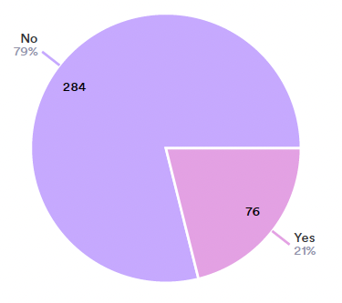
PCC Stewardship
Survey
Does your congregation have an intentional program to encourage generous giving?
(A stewardship campaign)
360 churches responding
Is stewardship a sermon topic at your church? (357)
  61% said Yes
How often does your congregation talk about topics related to money? (362)
  58% = Several times a year
  40% = Once a year
  3% = Never
How often do you run a stewardship campaign? (75)
  17% of PCC churches run an annual 3 - 5 week program
  49% integrate stewardship throughout the year

Slide 5
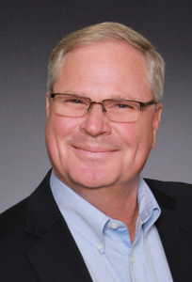

Rev. Bruce Barkhauer
Minister for Faith and Giving
centerforfaithandgiving.org
Notes:
I’d like to introduce a friend of the PCC stewardship department with whom we’ve shared webinars in the past: Rev. Bruce Barkhauer. Bruce teaches generosity for a living. A noted speaker, educator, consultant, and writer, Barkhauer brings creativity, energy, fresh, and sometimes humorous thought into conversations about stewardship as a practice of faith and spiritual discipline and we’re grateful to have him with us today.
Bruce served as a parish pastor for 25 years before accepting a call to serve as the first Minister for Faith and Giving for the Christian Church in the Disciples of Christ. He is married to Laura, and they share three children and three grandchildren. Welcome Bruce…

Slide 6

Notes:
Your new intentional program for stewardship is called From Bread and Cup to Faith and Giving. Tell us a little about the them of this program… (next slide)

Slide 7
Theme
Bread and Cup → Faith and Giving
Table
Common receipt of God’s grace
Encounter the divine
We respond = Stewardship
Having received grace / give grace
Agent for transformation in world

Slide 8
Adaptable Three Ways
Traditional campaign
  3 or 4 weeks
  Ask/Invite
Year-long campaign
  Over many months
  Culminate to an ask
  More time to reflect
  Opportunity to talk more
Hybrid
Over more time
3 or 4 week intensive at end
More intentionality
Sprint vs. Marathon
Notes:
Speaks to how 49% of PCC churches integrate stewardship throughout the year while 17% run a 3-5 week program.

Slide 9
Running an Effective Stewardship Campaign
Modeled on “consecration day” strategy
Leading up to a special day of intentionality and ask/invite
Consider effectiveness of church’s mission
In community, gathers (models on First Testament)
Special culminating event
Unfamiliar?
  Adaptable to your church size / context
  Essential pieces consistent
  Benefit of preaching/study etc.
  Offers real strategy

Slide 10
Calendar for Consecration Day Method
6 Weeks Prior to Consecration Day
» Outside guest leader meets with Consecration Day leaders
4 Weeks Prior to Consecration Day
» Give first stewardship sermon
» Begin stewardship education for all ages
» Mail letter to congregation announcing financial stewardship plans and activities
3 Weeks Prior to Consecration Day
» Begin presentations on stewardship at church school and worship
» Begin taking reservations for both Consecration Day Victory Dinner
» Give second stewardship sermon
» Recruit officers to phone persons who have not made reservations
» Continue publicity in newsletter
2 Weeks Prior to Consecration Day
» Continue stewardship presentations
» Continue accepting reservations for dinner
» Hold training meeting for callers
1 Week Prior to Consecration Day
» Conclude stewardship presentations
» Call persons without reservations
» Confirm that worship and dinner plans are on schedule
CONSECRATION DAY
» Guest speaker preaches
» Commitment cards are distributed at close of worship and then consecrated
» Tabulate results
» Victory Dinner
» Enjoy fellowship and fun
» Announce results of campaign
1st Week
After Consecration Day
» Send letter to everyone who has not made a commitment
Source: Presbyterian Foundation Stewardship Manual
https://www.presbyterianfoundation.org/wp-content/uploads/2018/01/Stewardship-Manual-FINAL.pdf

Slide 11
Focus: Mission Impact
Need not talk about money
How is God calling you to invest in the Missio Dei?
What transformational work are we doing?
It’s not about the budget, it’s about the mission

Slide 12
Purpose
Help congregation explore
  stewardship as a spiritual practice
  Biblical and theological education
Tell the story of what you do
  Why it matters
  What is our impact?
  Bearing witness
Reflect on support
  Prayerful and powerful choice
Notes:
The purpose of this focused time has three major points.
1) Help the congregation explore and understand the faithful practice of stewardship
as a spiritual practice. This is a time to do biblical and theological education.
2) Allow the congregation to see the benefit of their mission and ministry. It is a time
to tell the story of what you do and why it matters. How does the church move your
mission from the page to the pavement? What is our impact? How are we bearing
witness to the reality of the Realm of God set loose in the world?
3) Give people the opportunity to intentionally reflect on how they want to support the
life changing and transformative efforts of their congregation. We want to make
space for a prayerful and powerful individual choice to move personal resources to
community efforts to change the world.

Slide 13

Folder One
Getting Started (What’s included?)
Getting the Full Benefit of the Resources
(Understanding how the resources work: By design!)
Small Church Adaptation (Is all this really necessary for us?)
Leadership (Who you need to lead and their job descriptions.)
Witnesses (Finding the right people to help you tell your story.)
Outside Help
(Do we need a consultant to help us succeed and who do we call?)
Introduction to the Theme
The Importance of Mission Clarity
(Can you say what you do and why you do it?

Slide 14
Calendar
Calendar Sub-folder
(To help you schedule and plan your invitation.)
Files:
Year-round Schedule (Ideas for making the stewardship conversation into a marathon rather than a three-week sprint)
Short Spring/hybrid Schedule (for those who work with a fiscal year that begins in the summer)
Short Fall/hybrid Schedule (traditional)

Slide 15
Bonus
Bonus Materials Sub-folder
Files:
Ideas for Pentecost (Inspire giving!)
Seeking Grants (Finding additional income streams.)
How to do a Philanthropic Autobiography (A great exercise for leadership.)

Slide 16
Folder Two
Considering the Text
Exegesis and sermon starter materials for the preacher
for each of eight suggested texts:
  The last supper
  Feeding the 5,000
  From east and west and north and south
  Eating Jesus’ flesh and drinking Jesus’ blood
  Breaking of bread in the early church
  The cup and the bread: a sharing in the body of Christ
  Feasting and feeding
  Jesus knocks at the door and comes in to eat
Notes:
The philosophy of the program.

Slide 17
Folder Three
Worship Elements
Liturgical Resources for each of the eight texts
Language and intentionality of stewardship / finances
Theologically rich resources
Modify for your context
Worship elements include
  Call to Worship
  Invocation
  Prayer of Confession
  Invitation to Communion
  Invitation to Offering
  Prayer for the Offering
  Benediction
  Suggested Hymns, activities and ideas
Notes:
- When I was a parish pastor, what did I wish I had?
We know that many pastors and lay people struggle with the language and intentionality of stewardship, particularly as it relates to finances. Our goal is to provide theologically rich resources that make this invitation easier. You should, of course, feel free to modify these elements for what will best fit your context and personal style.
The worship elements that follow should be a jumping off point for you and your worship team. Worship is of course enriched when references to specific things happening within the life of your congregation are woven in. In each section of the worship resource you will find:

Slide 18
Folder Four
A Journey into the Spiritual Practice of Generosity
Around the Table of Jesus
A Study for Small Groups
Curriculum for each of the eight suggested texts
Ideal for small groups or Sunday School classes
How communion prepares us to be better stewards
Can be taught on Zoom / video conference
Notes:
In this small-group study, we’ll explore eight scriptures that bring us to the Lord’s Table and consider how the act of communion prepares us to be better stewards. Through prayer, reflection, discussion, and action, we will learn to embrace the lessons Jesus Christ offers us as we share the Bread and Cup.

Slide 19
Folder Five
Children’s Resources
Children’s sermons and curriculum
One lesson for each of the eight texts
More coming
  Additional materials will be provided
  Monthly updates

Slide 20
Folder Six
More to Come
Communication Packets
Effective Social Media Bulletin Inserts
Communications Packet #1
Communications Packet #2
Communications Packet #3
Communications Packet #4
Communications Packet #5 Generational Giving

Slide 21
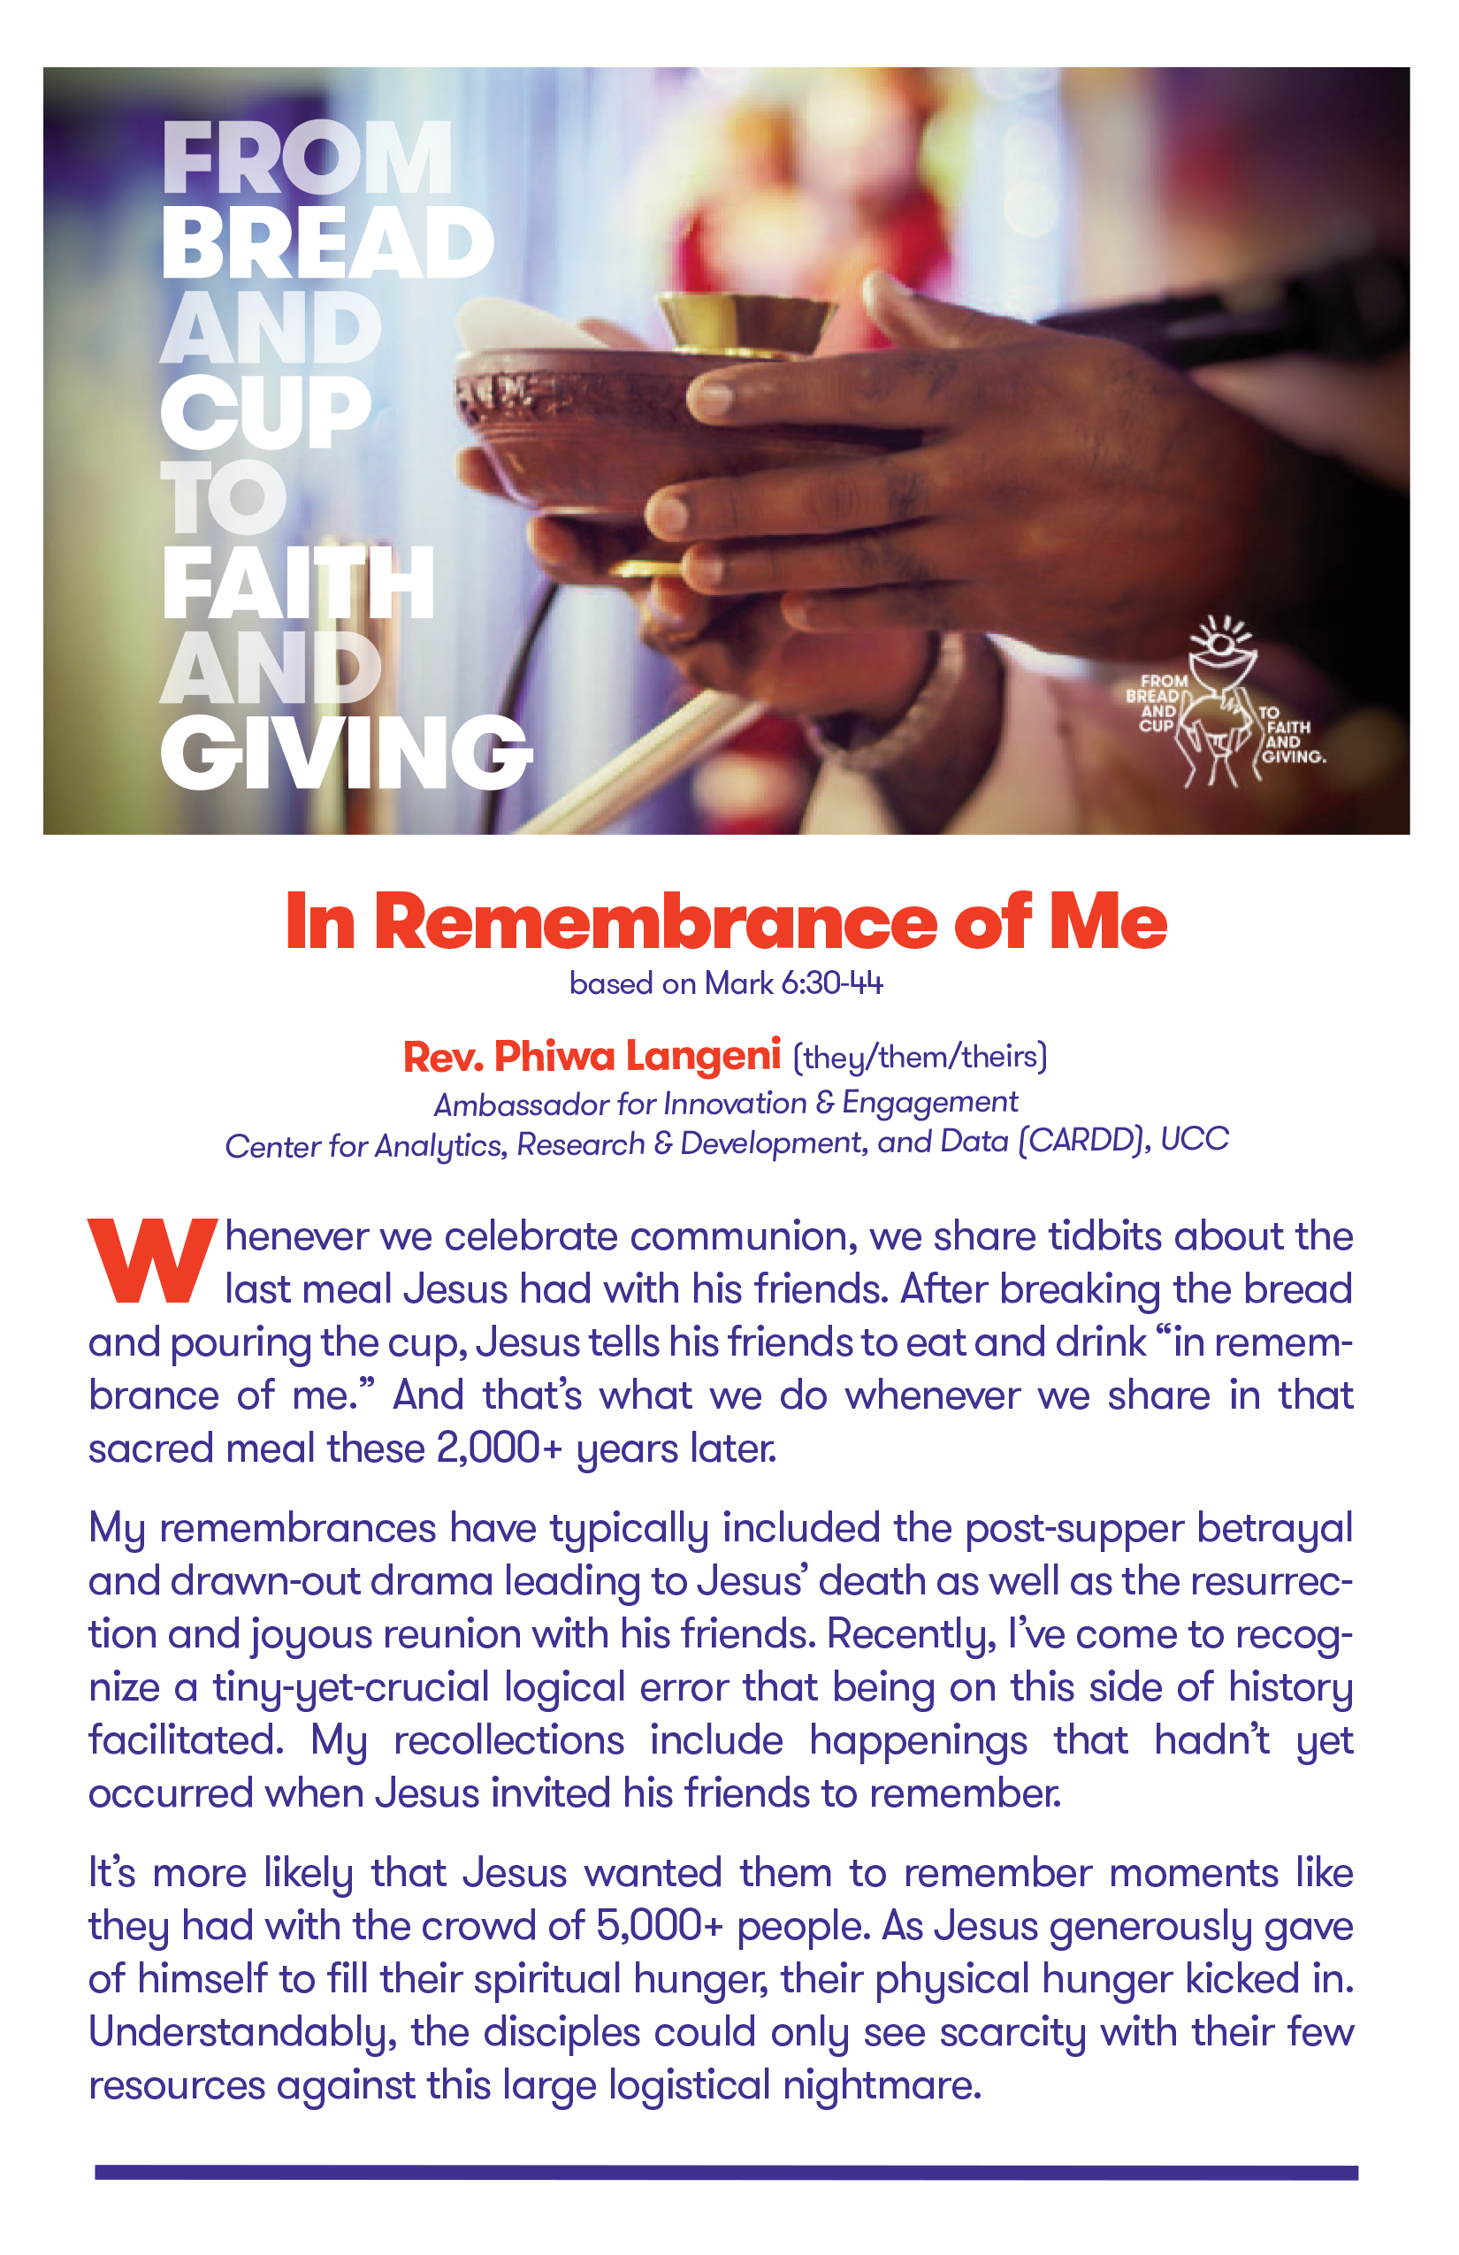
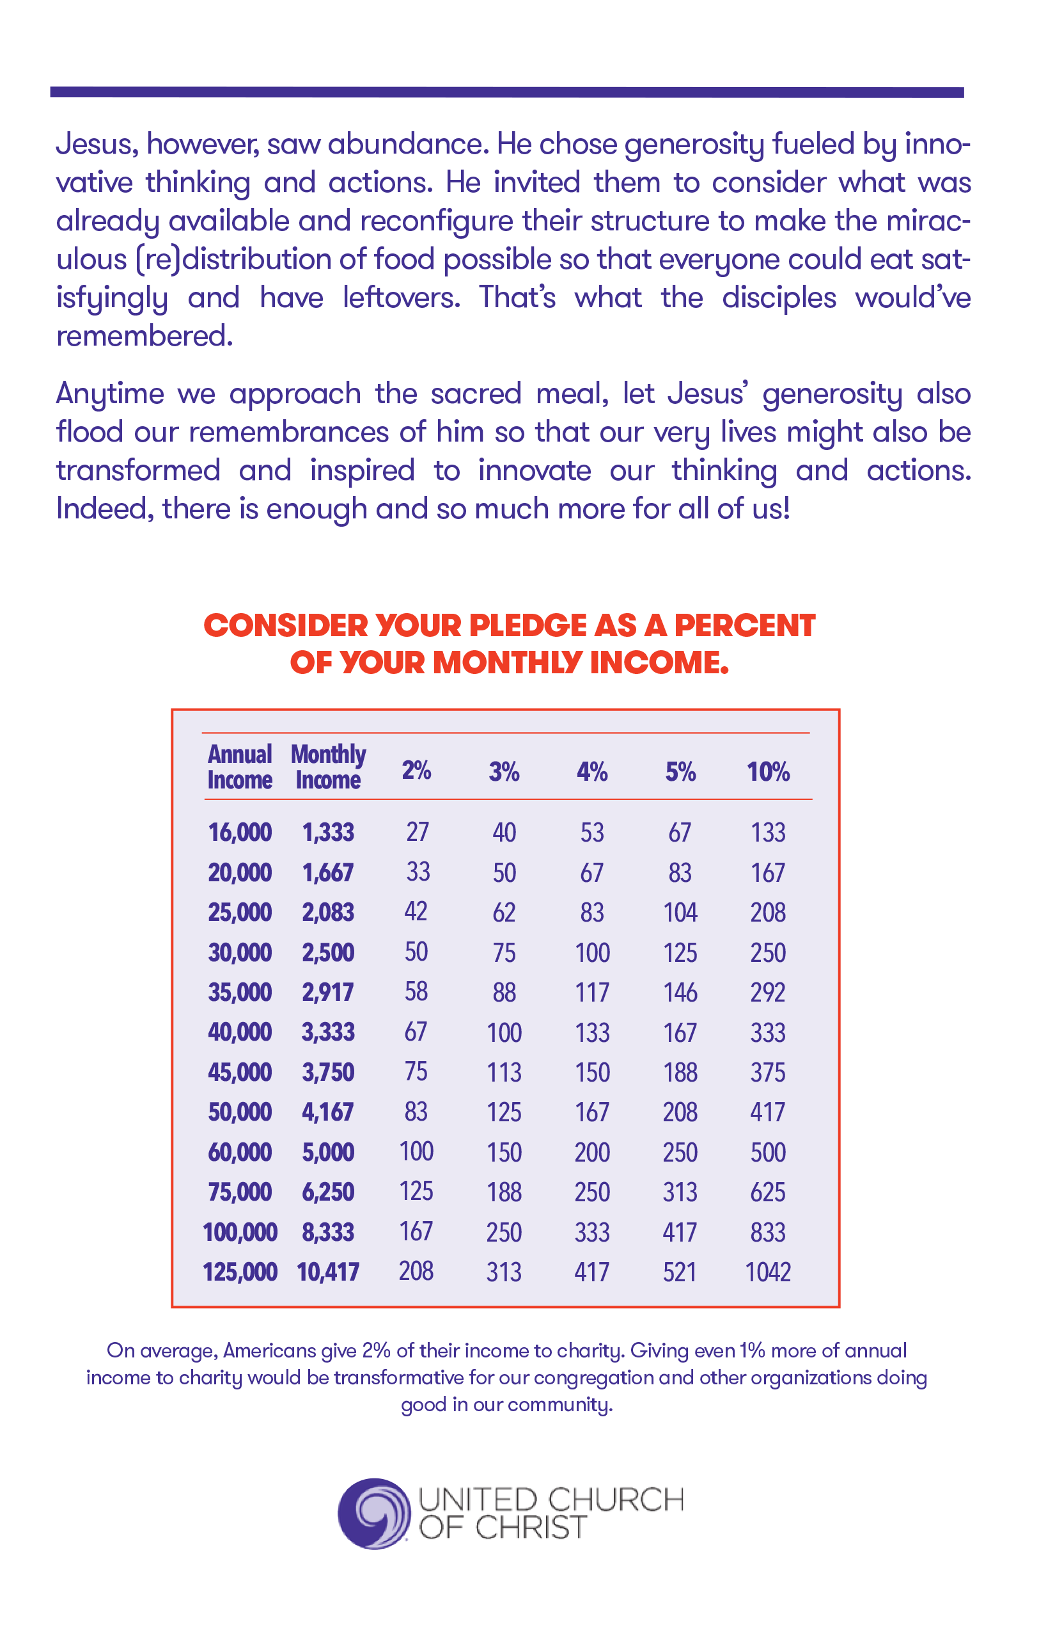
Bulletin
Insert

Slide 22
Folder Seven
Tools
Files:
Images (Logos for the theme)
Poster (Promotion for Commitment Sunday/theme interpretation)
Pledge Cards
Percentage of Giving Table
Letterhead/Envelope Graphics
Electronic Giving
Worship Bulletins
Legacy Giving

Slide 23
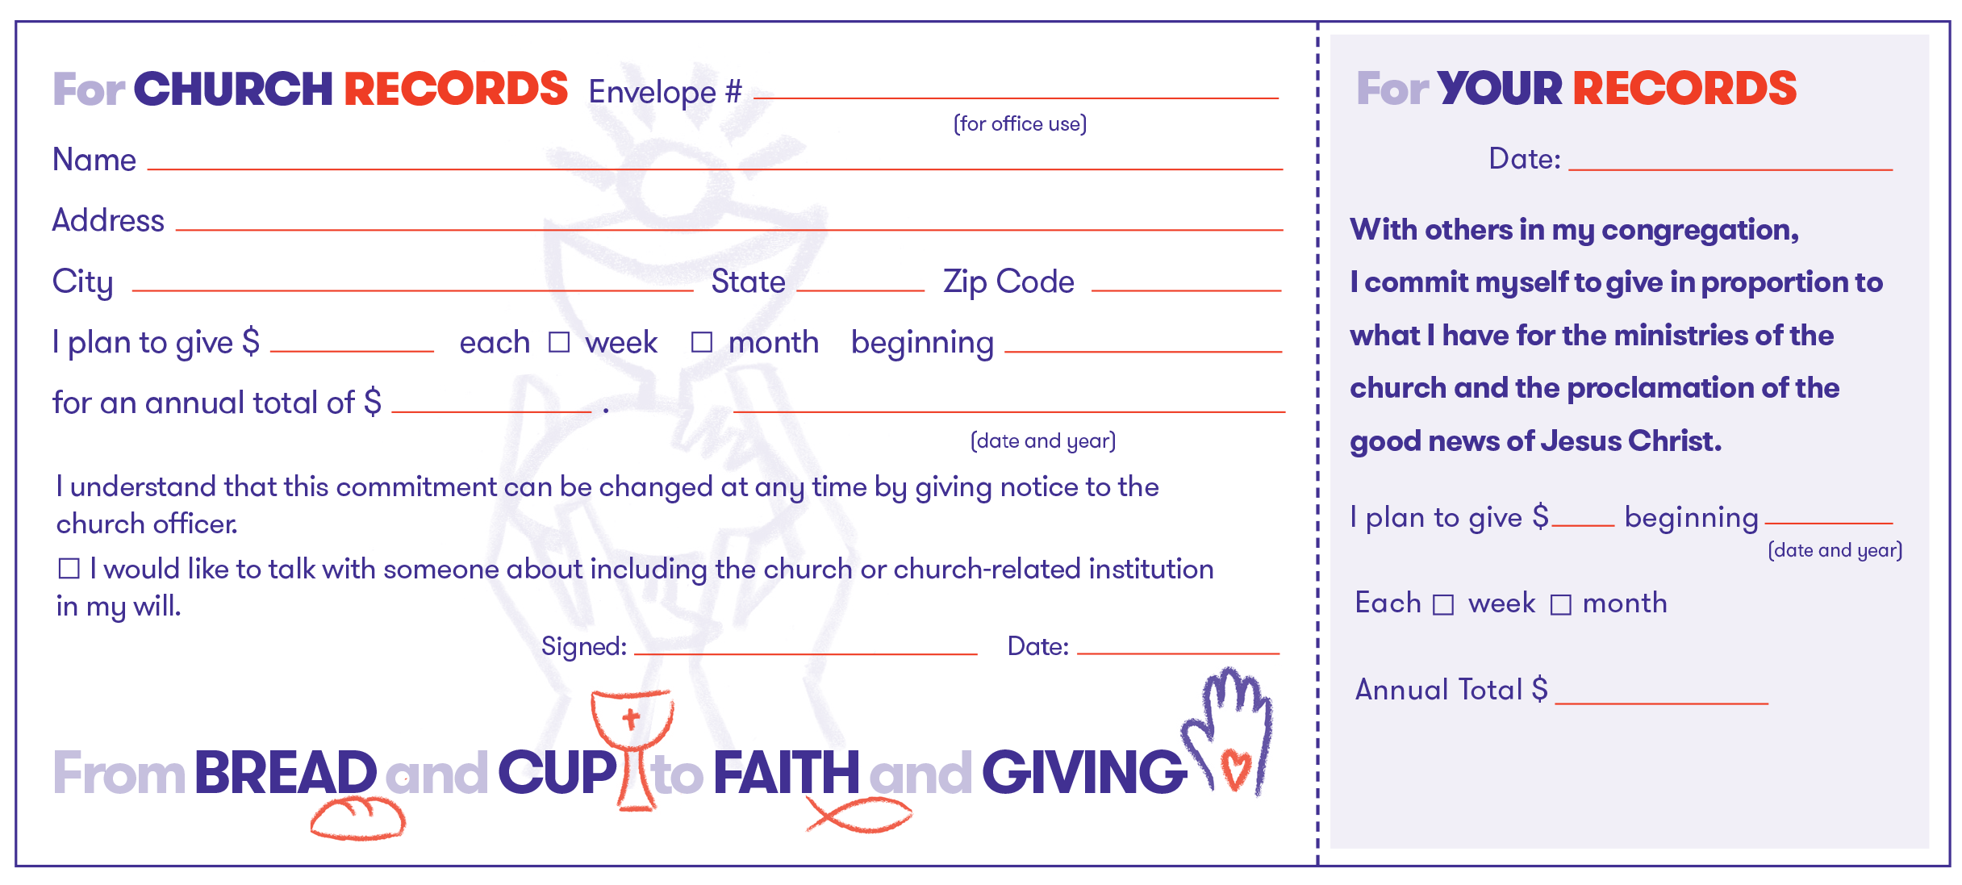
SAMPLE

Slide 24
Folder Eight
Materials organized by text
(Exegesis, Worship, Small Group, Children’s)
Pastors and worship planners may find this file helpful to access the materials.

Slide 25
Office Hours
Available for help and discussion
Monthly communiques re: added materials

Slide 26
Stewardship Resources
Designed to help you fund mission and ministry
Dynamic resource
Supplementary resources added
  After Easter
Resources aggregated in folders
Notes:
Summary:
Stewardship resources designed to help you fund the mission and ministry your church has been called by God to do!
This is a dynamic resource which means that we will be adding
materials throughout 2022. Be sure we have your correct e-mail so that
you will receive notifications when supplementary resources are added.
If your email changes, let us know!
We will continue to add new materials to this resource. Planned updates include:
By February 25: Small Group Resources
By March 31: Children’s Resources, Communication Packet folders, Bulletin Inserts,
Worship Bulletin Cover, Letterhead and Envelopes.
Expect additions to occur regularly after Easter, some which will relate to the current reality of the
pandemic and appropriate strategies. (There are things we just don’t know now but will know later!)
What follows is an index of the materials to help you find what you are looking for. The resources are
aggregated in folders containing files.

Slide 27

Thank You

Slide 28
The Presbyterian Church in Canada
A Practical Guide to Joyful Generosity
  A link to the recording of today’s presentation and slides will be emailed to all participants next week. You may share it with anyone interested.
Thank you!
The Stewardship
& Planned Giving Team

