Slide 1
The Ministry of Managing Money
Congregational Finances and Stewardship for Treasurers
Notes:
The Ministry of Managing Money
Congregational Finances and & Stewardship
Webinars presented by The Presbyterian Church in Canada
with the support of Presbyterians Sharing

Slide 2
Table of Contents
Notes:
Table of Contents
Telling the Story: Reporting & Communicating Finances
Session, Congregation & Donors
Periodic Updates
Annual General Meeting
Narrative Budget
Canada Revenue Agency

Slide 3
Webinar Series
Today Telling the Story Reporting & Communicating Finances
Notes:
Today, we are going to cover tips to help you report & communicate finances to members, session, donors, the government, Presbytery and national office. We’ll cover the T3010, the PCC statistical report and what you should report to the congregation at your AGM and throughout the year.
Our webinar series is supported by gifts to Presbyterians Sharing.

Slide 4
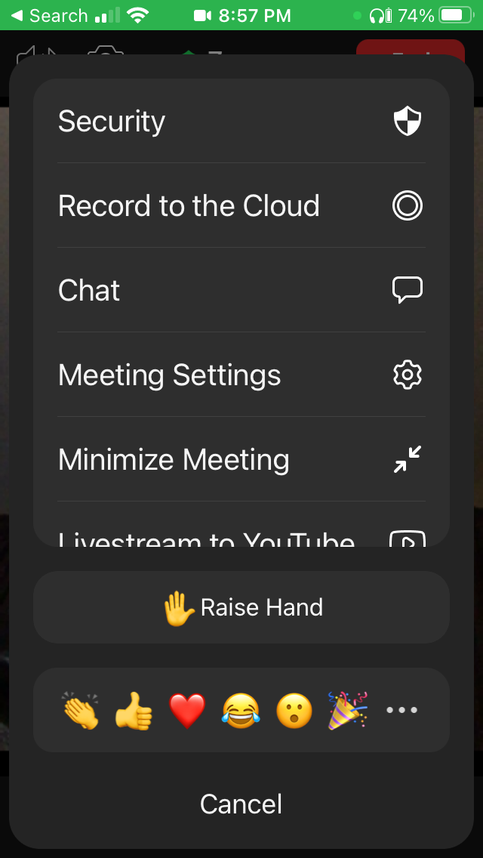
Protocol
Mobile
Stay muted and use chat to ask anything
Chat will be monitored and questions asked as we go along or at the end
There may be an opportunity to unmute at the end
PC

Slide 5
Spread the word
Recording & Slides & Notes will be available at
presbyterian.ca/
leadership-webinars
Share it around!
Notes:
Recordings will also be posted at https://presbyterian.ca/leadership-webinars/ for people to find and use in the future.

Slide 6
Presenters
Karen Plater, Stewardship & Planned Giving
Maurice Mawhinney, Presbytery of West Toronto & PCC Finance Committee
Jim MacDonald, Stewardship & Planned Giving
Oliver Ng, CFO, PCC
Larry Eastwood, Congregational Treasurer, BC
Bill Paterson, Congregational Treasurer, AB
Notes:
One of the benefits of a webinar is that you can pull in multiple people to present. This really is a collaborative effort. We’re honoured with the participation of congregational treasurers – Larry Eastwood in BC and Bill Paterson in AB. Both were active answering questions on chat, so we thought we’d recruit them to present!

Slide 7
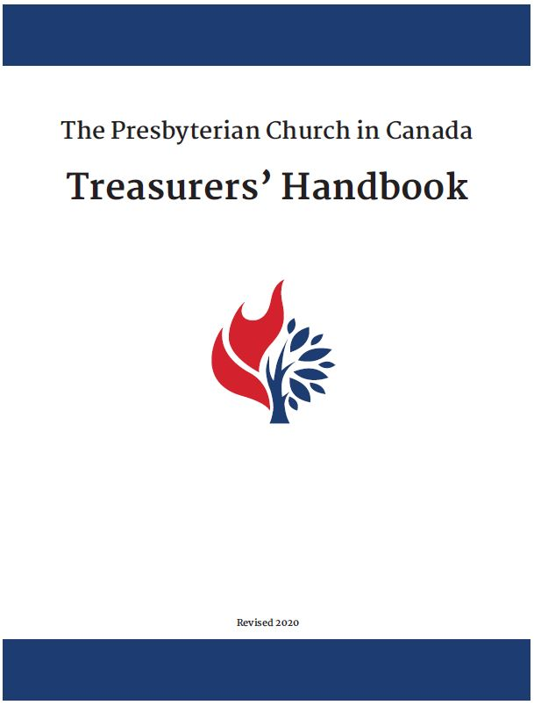
Treasurer’s Handbook
Download presbyterian.ca/resources/finance/
Notes:
Most of the information will be found in the Treasurer’s Handbook.

Slide 8
Best Practices
“Budget building and management work is sacred and will directly impact the morale and confidence of the whole community.”– Bonnie Ives Marden
Available on Amazon.ca
Notes:
Bonnie Ives Marden’s book Church Finances for Mission Leaders does an excellent job of integrating both stewardship and money management and biblical principles.

Slide 9
Telling the Story: Reporting & Communicating Finances
January 13, 2022
Notes:
So let us begin to explore different ways we report and communicate finances.

Slide 10
Produce Reports
KP
The Session
The Congregation
Donors
Presbytery, Synod & National Office (Statistical Report)
Canada Revenue Agency
Banks, Insurance, Foundations & Grant makers
Notes:
The Job Of The Treasurer
One role is to produce reports. It’s important to know there will be different reports for different audiences. We’re going to look at the first five bullets – but the info you use for them is probably what Banks, Insurance and Foundations or other grant makers want.

Slide 11
Report Characteristics
KP
Financial Statements & Budgets should be
Understandable
Relevant
Reliable
Consistent
Comparable
Accurate/Reconciled
Notes:
Financial Statements
Financial statements should possess the following characteristics to be useful
Understandable – describe the financial information in a meaningful way
Relevant – providing timely information and context
Reliable – information is supported, accurate, and if estimated, conservative
Comparable – consistent application of accounting methods

Slide 12
Session, Congregation & Donors
Notes:
And onto the CRA.

Slide 13
Session
KP
Details for operating budget & special funds
See the big picture
Monthly updates
Notes:
Responsible for the finance & stewardship of all the congregation – so they want to see both the details and the big picture.
Monthly updates – anticipate questions. Is there a line which is different from the previous year? What might stand out.
Obviously, members, adherents and other donors want to know how their donations are being used
Donations to General fund, special “designated” fund(s), e.g. building, new organ, etc.
Donations to Presbyterians Sharing…, PWS&D
Stipends and salaries
Church programs and ministries, facilities upkeep and operations

Slide 14
Congregation
KP
Present operating budget & special funds
More big picture, but want to be transparent and accountable
Updated at AGM
Periodic updates on budget income
Notes:
Obviously, members, adherents and other donors want to know how their donations are being used
Donations to General fund, special “designated” fund(s), e.g. building, new organ, etc.
Donations to Presbyterians Sharing…, PWS&D
Stipends and salaries
Church programs and ministries, facilities upkeep and operations

Slide 15
Donors
KP
Impact of Donations
Stories of Lives Changed

Slide 16
Periodic Updates
KP

Slide 17
people give the way they receive
KP
agriculture harvest
salary weekly, bi-weekly, monthly
self-employed seasonal
Copyright 2017 © Stewardship Possibilities
Dr. Kennon L. Callahan, Ph. D.
All Rights Reserved. Used with permission Use
Notes:
Copyright 2017 © Stewardship Possibilities
Dr. Kennon L. Callahan, Ph. D.
All Rights Reserved. Used with permission.
Items appear over multiple clicks

Slide 18
KP
J F M A M J J A S O N D
Copyright 2017 © Stewardship Possibilities
Dr. Kennon L. Callahan, Ph. D.
All Rights Reserved. Used with permission Use
Giving Pattern in Budget
Notes:
Our budgets tend to treat income as if it comes in regularly, the same amount.
Items appear over multiple clicks

Slide 19
KP
J F M A M J J A S O N D calendar
Copyright 2017 © Stewardship Possibilities
Dr. Kennon L. Callahan, Ph. D.
All Rights Reserved. Used with permission Use
Giving Pattern
Notes:
We really know that it fluctuates.
Items appear over multiple clicks

Slide 20
KP
J F M A M J J A S O N D
Jan 2019 6%
Jan 2020 5%
Jan 2021 7%
3YA 6%
2022 budget: 100,000
Budget 1/12 8.33%
Needed $8,333
Received $6,110
Short $2,223
Copyright 2017 © Stewardship Possibilities
Dr. Kennon L. Callahan, Ph. D.
All Rights Reserved. Used with permission Use
Notes:
Items appear over multiple clicks

Slide 21
KP
J F M A M J J A S O N D
Jan 2019 6%
Jan 2020 5%
Jan 2021 7%
3YA 6%
2022 budget: 100,000
Giving Goal of 6%
Jan $6,000
Given $6,100
Thank You!
Copyright 2017 © Stewardship Possibilities
Dr. Kennon L. Callahan, Ph. D.
All Rights Reserved. Used with permission Use
Notes:
Items appear over multiple clicks

Slide 22
KP
J F M A M J J A S O N D
Jan 2019 6%
Jan 2020 5%
Jan 2021 7%
3YA 6%
2022 budget: 100,000
Giving Goal of 6%
Jan $6,000
Given $5,500
Thank You!
Copyright 2017 © Stewardship Possibilities
Dr. Kennon L. Callahan, Ph. D.
All Rights Reserved. Used with permission Use
Notes:
Items appear over multiple clicks

Slide 23
KP
J F M A M J J A S O N D
Jan 2019 6%
Jan 2020 5%
Jan 2021 7%
3YA 6%
2022 budget: 100,000
Giving Goal of 6%
Jan $6,000
Given $8,000
Thank You – we’re going to do some more!
Copyright 2017 © Stewardship Possibilities
Dr. Kennon L. Callahan, Ph. D.
All Rights Reserved. Used with permission Use
Notes:
Items appear over multiple clicks

Slide 24
Time for Q & A
HC
Use the chat to ask a question about presenting monthly updates

Slide 25
Annual General Meeting
KP

Slide 26
Annual Meeting
KP
Report and celebrate accomplishments
Cast vision for the future
Receive the financial statement, (including audit/financial review), and approve a budget for the coming year
Notes:
Annual Church Report
As treasurer, you are responsible for monthly reports and the annual report to the congregation.
The goals of the Annual meetings are:
To report and celebrate what has been accomplished (session/pastor)
To cast vision for the future (session/pastor)
To receive the financial statement, (including audit/financial review), and approve a budget for the coming year (treasurer/finance committee)

Slide 27
Present the Audited Financial Statements
LE
Audited = examined by someone, other than the Treasurer (see Session One)

Slide 28
Prepping for the AGM
LE
Anticipate questions and build them into your presentation
Show 3 years of actuals, last year’s budget, next year’s budget

Slide 29
Prepping for the AGM
LE
Congregation needs it in their hands 2 weeks before meeting
If invested in consolidated portfolio, info doesn’t come out until end of Q1
Leave time for auditors to complete audit
Leave time for publication (photocopying, layout, etc.)

Slide 30
Time for Q & A
KP
Use the chat to ask a question about presenting line-item statements and budgets

Slide 31
Narrative Budget
JM

Slide 32
Top 3 reasons people give
JM
Belief in Mission & Vision
Confidence in Leadership
Accountability & Transparency
Barna Foundation Survey
Notes:
A Barna Foundation survey shows the top 3 reasons people give
People want to be part of something that impacts others. They believe in the Mission and Vision – of the non-profit they are giving to. For congregations, this means that they want to see how they are participating in God’s mission – that they are not just paying the bills to keep the building open.
People are looking for trust & authenticity in the places and people to which they give. They want to have Confidence in Church Leadership.
AND
People need to see evidence of responsible management (accountability) with consistent regular communication of results (transparency). They want to be assured you achieving what you communicate that you are doing.
Let’s keep these in mind as we look at the different budget options you are going to present.

Slide 33
Present the budget
JM
Line-Item Budget is an accounting tool
Narrative Budget is an educational and visioning tool
We can be intentional in how we use both
Notes:
(reveal bullet points)
Click:
The church’s line-Item Budget, which is an accounting and management tool. It’s what is going to help answer reasons 2 and 3 of why people give: confidence in leadership and accountability and transparency.
Click:
A Narrative Budget however, is an educational and visioning tool which you can use to help capture people’s hearts – speaking to the mission and vision of the congregation.
Click:
And we can be intentional in how we use both.

Slide 34
Narrative Budget
JM
Connects income and expenses to mission and vision
Tells story of the line-item budget
Notes:
So your line-item budget keeps track of church income and expenses. It does not easily connect church spending with church vision and tell the story of how you are achieving that vision. And yet that’s the main reason people give.
For instance, people don’t give to the Cancer Society so they can pay the staff, rent and heating bills at the administrative office. They give because, first of all, it supports people with cancer and secondly, funds research toward a cure and then, finally, it supports caregivers. However, there won’t be any supports or research without the infrastructure to support it.
By linking dollars to mission, a narrative budget inspires and informs donors about the importance and impact of their gifts. It allows you to share your budget in a way that gives a fresh perspective on the ministry your church is doing at home and in the world.

Slide 35
How to tell the story in a different way
Re-sort and summarize church’s line-item budget into missional categories
Add visuals and pictures to tell the story
Notes:
To create a narrative budget, you must start with good data – a good fiscal line-item budget – one that is sustainable, connected to the vision , and is achievable for your church.
Once you have a good budget in place, you need to transform the data to tell your congregation’s story. To do that, you are going to re-sort and summarize the church’s line-time budget into missional categories and then add visuals (graphs and pictures so that people can see what their gifts are accomplishing.)
To make your narrative budget you need to assign the different lines from your line ministry budget to key areas of ministry. It’s not an accounting exercise – and it’s quite subjective – but the idea is to build a reasonable snapshot of how resources – time, talent and treasure - are used in the church. While allocating figures to ministry areas can be challenging at first, with each subsequent year the process will become easier. Let’s look at how we can create and assign missional categories.

Slide 36
Determining Categories & Distribution Whose job?
JM
Determining the mission categories and creating the percentages may not be the treasurer’s job – it could/should be taken on by the session and/or brainstormed by congregation
The more help you have creating the budget (narrative and line-item), the more ownership you will have for the budget overall and the more people will be willing to support it.
Notes:
Determining the mission categories and creating the percentages may not be the treasurer’s job – it could/should be taken on by the session.
The more help you have creating the narrative budget, the more ownership you will have for the budget overall, the more people will be willing to support it. So it’s worth the time to build participation into your budget building!

Slide 37
Determining Categories & Distribution Tips & Ideas
JM
Use the figures from the clergy tax form to assign the minister’s time
Get input from committee chairs
Ask church staff (ministers, youth workers, administrators) for their input
Notes:
You can use the figures collected by the minister for tax purposes to help you determine how to distribute the minister’s time across the narrative budget categories. (It can be a good discussion with the minister about how they are using their time!)
Talk to committee chairs, who might consult their committees
Get input from other church staff (ministers, youth workers, administrators etc) about how they use their time and how they support the different narrative categories

Slide 38
Based on line items
from accounts
How line-item expenses will be distributed across missional categories
Notes:
After we agree on our narrative budget categories, which you can see here highlighted in yellow, we estimate the percentage of each budget summary category that should be applied to each narrative category.
You’ll notice that in column one, we’ve listed summary lines that come your line-item budget.
For instance, we add up the amount spent on facilities and grounds. We then work out how much of that cost, as a percentage, applies to the mission-based categories of a narrative budget.
Let’s look at your congregation’s facilities and grounds. The expenses in this category might be utilities (heat, hydro, water) landscapers, cleaners, minor repairs and renovations. In a line-item budget, these would each get their own lines. But we know the grounds and facilities are used for A LOT of different things, the sanctuary is used for worship and community concerts and youth movie nights, the Sunday school rooms are used for learning and to host Alcoholics Anonymous, and the youth group, and WMS groups and more! (And sometimes they might be used to make an income.) This chart shows that this congregation has decided facilities and grounds are used 35% of the time for Worship, 25 percent to Learning and the balance to other categories because the facilities and grounds are needed for most church activities.
You’ll find that expenses will fit in a variety of narrative categories. The nice thing is, it’s not an accounting process -- it’s a communications tool – and the more involvement you have in helping create the categories, the less chance there will be debate about them at your AGM!

Slide 39
Estimate the percentage of each budget summary category that should be applied to each narrative category.
Distribute the budget summary subtotals across the Narrative Budget Categories and then total to make up the data for the pie chart.
Data for pie chart
Notes:
We then take the actual numbers from the line-item budget and multiply them by the percentages we’ve determined, which distributes the budget summary subtotals across the Narrative Budget Categories.
For instance, we take Human Resources as a line-item subtotal for this example, which is calculated to be $300,000 and, using the percentages in the blue table above, we distribute that expense across the narrative budget categories, with the 35% indicated under Worshipping in the blue table above multiplying out to $105,000 in the yellow table below. We do this for all the percentages for each narrative budget category and then add each narrative budget category up at the bottom. Those narrative budget totals are used to create a pie chart. (I used a fairly large congregation example, just to help you see the differences in the numbers.)

Slide 40
JM
Notes:
And this is the pie chart. You can see here how our congregation’s expenses now tell the story of what we achieve together as a congregation. To some extent, how we spend our resources, shares what’s important to us as a congregation, and this helps us see it clearly. In this sense, it can also be a planning tool, because we can see how our gifts are put to work, and decide if we want to shift that for future years.

Slide 41
When you give $100
JM
$14 supports evangelism and mission programs
$18 supports education of children, youth and adults
$12 allows for pastoral care
$6 covers the costs of administration
$32 goes to meaningful and vibrant worship
$18 helps us connect each other and the community
Notes:
Now a lot of treasurers like pie charts, because we’re numbers people. But they might not mean a lot to others - Another way to say the same thing is to break down a gift of $100 into the categories you’ve chosen. For people who are concerned that their money may be getting burned up in administrivia, it’s nice to see just how each dollar is spent.

Slide 42
When you give $100
JM
$30 goes to meaningful and vibrant worship
$15 supports care for people in our community
$10 encourages and equips our children
$7 supports evangelism program
$12 allows pastoral care
$8 supports our youth
$8 supports mission programs
$10 is for Administration
Notes:
Here is an example of expenses categorized in a slightly different way. You’ll notice that they assume more for administration, and they further separate mission from evangelism, youth from children, etc. It’s totally up to you how you want to break out your narrative categories. It should be tied into your annual reports!

Slide 43
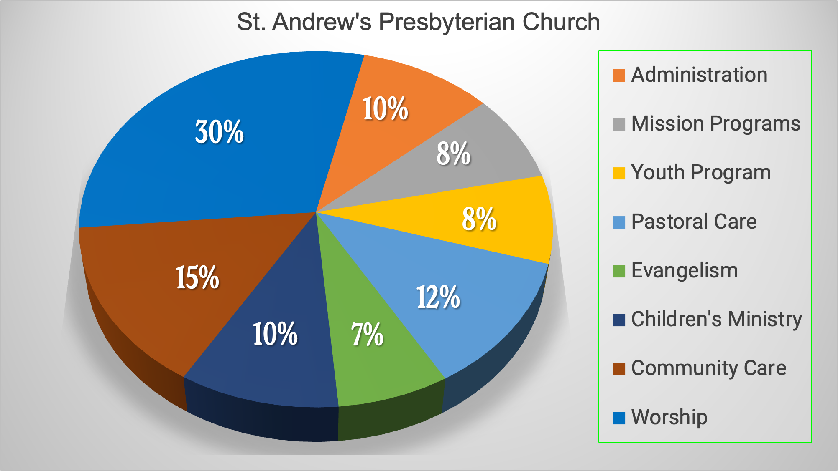
JM
Notes:
And here’s the pie chart from that example. The pie chart comes straight out of Microsoft Excel directly into PowerPoint, ready to present at your annual congregational meeting.

Slide 44
Missional Categories Find sample at presbyterian.ca/ stewardship/ narrative-budgets/
Notes:
Once you have your missional categories and pie chart, you can decide how to present them to the congregation.
This is an example of a narrative budget presented in a simple four-page bulletin insert.
Page one has the pie chart on it, and a simple statement about the congregation’s mission and vision.

Slide 45
Missional Categories Find sample at presbyterian.ca/ stewardship/ narrative-budgets/
Notes:
Page two says a little bit more about the six missional categories. Each category has a deeper description which was drawn from the story the congregation is simultaneously telling in its annual report.
Budget amounts are categorized into six missional categories. The categories are based on the story the congregation is simultaneously telling in its annual report.
Our example keeps it simple, but there are other components you might consider to incorporating into a longer document (statistics, case histories, quotes, infographics, photos of your church in action, etc.)
As you can see here, a narrative approach to communicating your budget allows you to better communicate the vision of the church.
This sample is available on the PCC website by searching “narrative budgets”

Slide 46
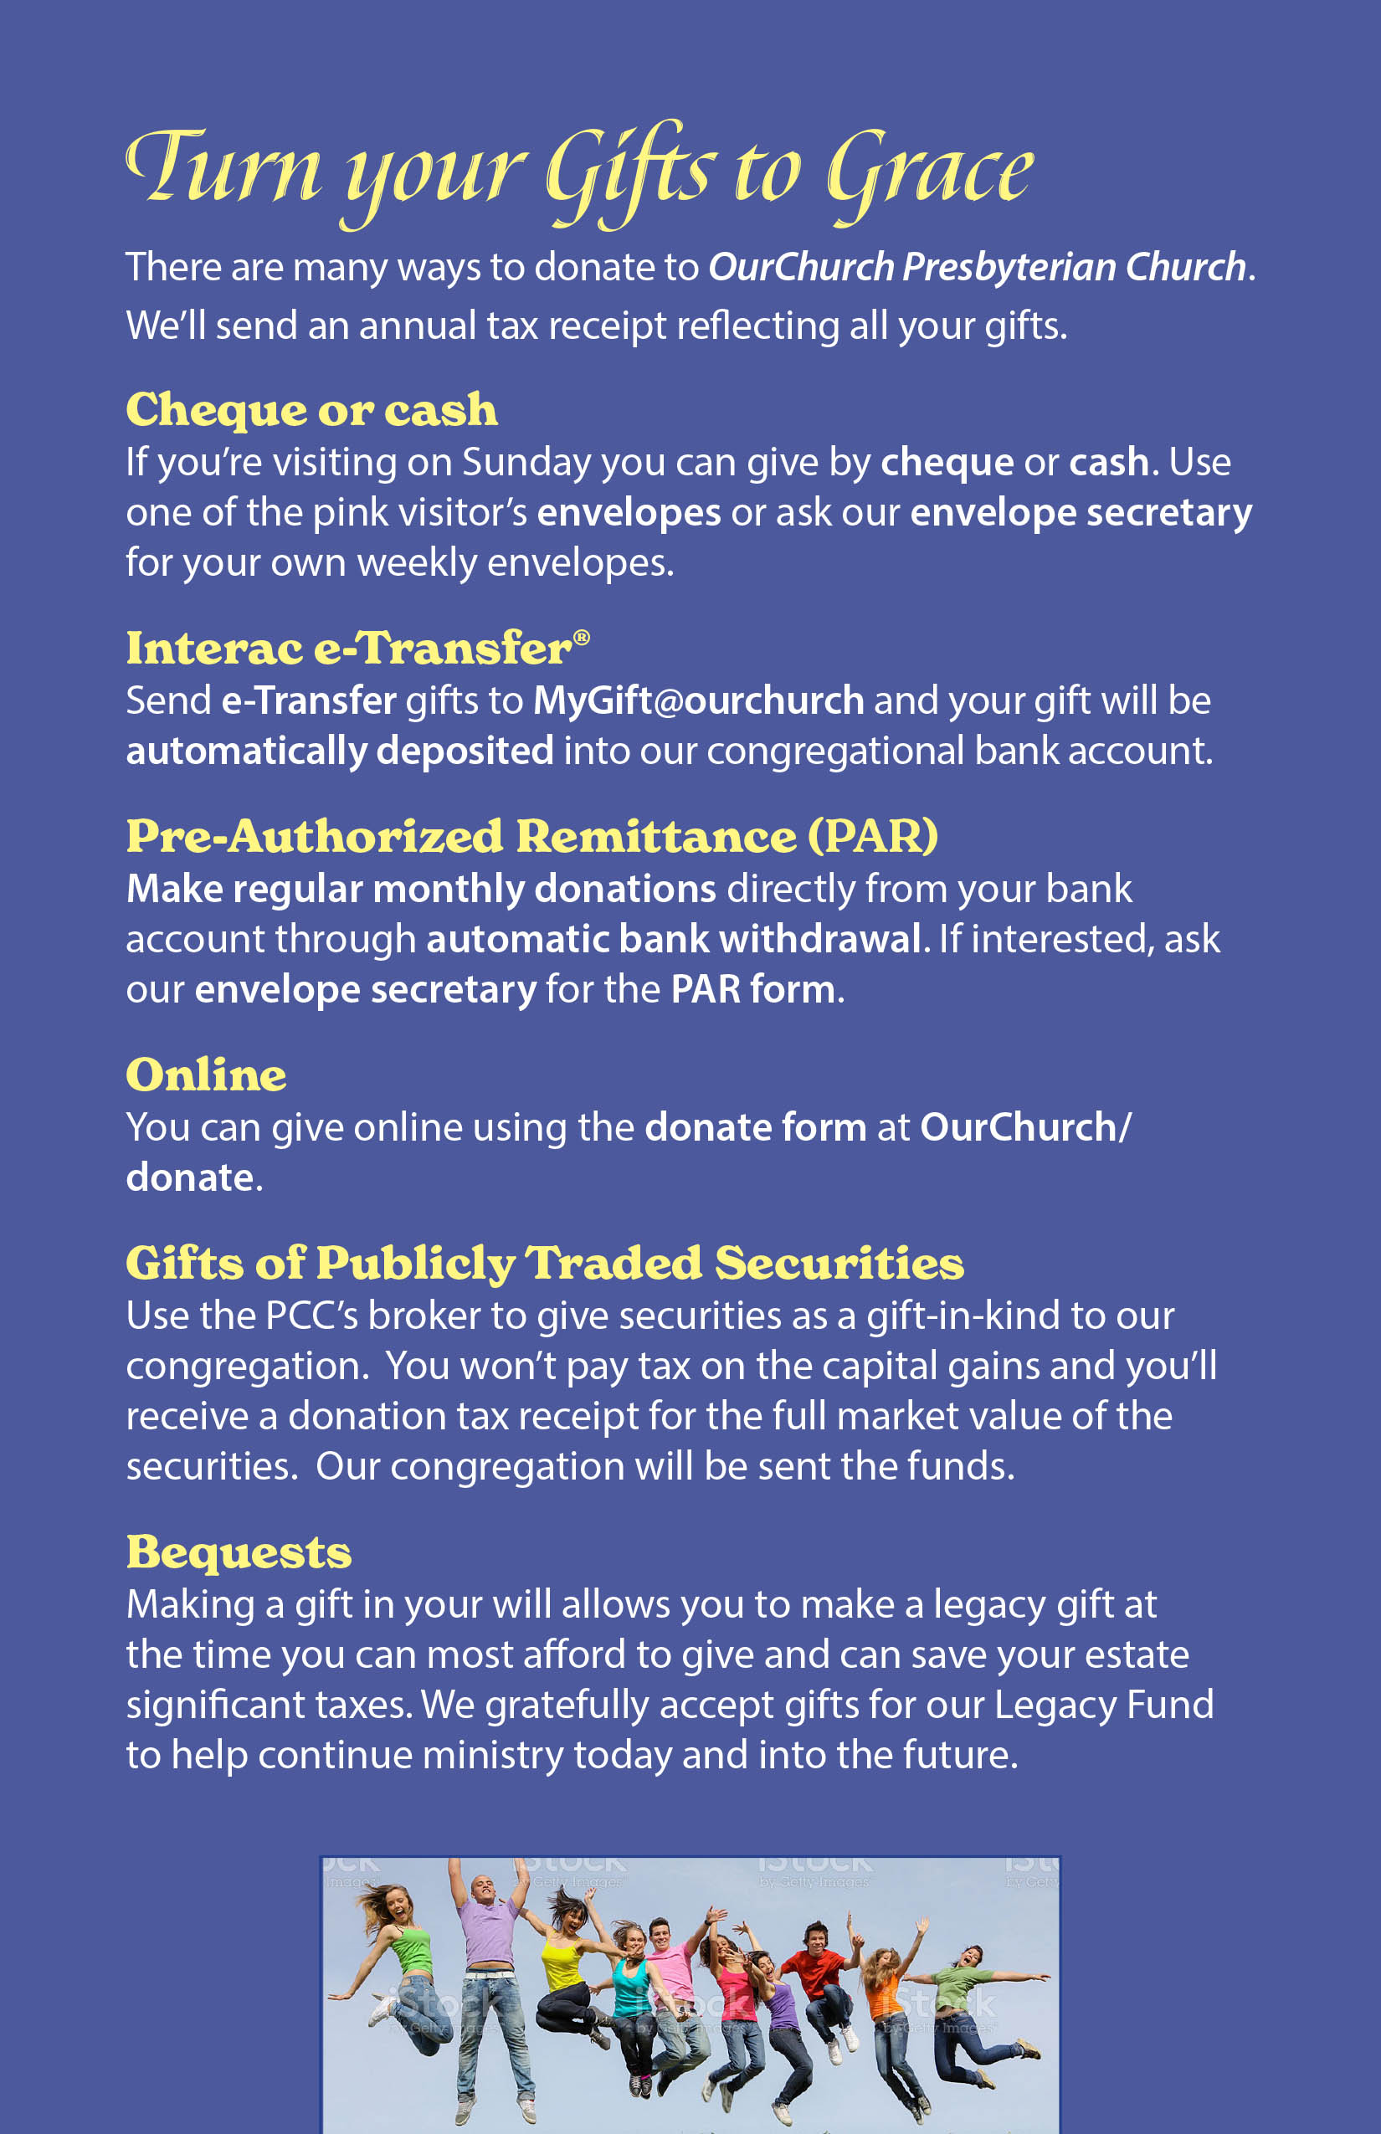
Missional Categories Find sample at presbyterian.ca/ stewardship/ narrative-budgets/
Notes:
And the final page shows how a person can give to support this exciting mission!
This bulletin insert keeps everything simple, but you could also have a longer document, or a PowerPoint presentation which includes statistics, case histories, quotes, infographics, photos of your church in action, etc.
As you can see here, a narrative budget allows you to share how gifts connect to the vision of the church.
This sample is available on the PCC website by searching “narrative budgets”. Feel free to use it!
There is also a previous webinar with real life examples presented by Mark Trembly on how XXX congregation in Calgary built their narrative budget.

Slide 47
The power of numbers
JM
$70 provides Christian Education for our children each week
$15 provides a hot meal for one person through Out of the Cold
$3000 will repaint our Sunday School
$700 will send a youth to Canada Youth
Notes:
The narrative budget tells the story of UNDESIGNATED GIFTS to your general fund. It helps them know what their offering envelopes and PAR achieve.
But we also know people like to give designated gifts. You can use a narrative budget to help you determine numbers like these. Because you don’t just use the actual cost, but can add a % for administration, because you know what the REAL administration percent is.

Slide 48
Beyond money
JM
# of people attending/reached
# of hours invested
Notes:
Remember to include other statistics in your narrative budget, to help show what the congregation is doing, beyond gifts of money.

Slide 49
Communicate Vision
JM
Visually inviting, and energizing
Write about positive impacts
Art and text from youth / Sunday school or creative volunteer
Feature testimonials or stories
Notes:
Finally, remember that the narrative budget is a communication piece.
Make your Narrative Budget attractive, inviting, and energizing
Think about the value of cartoons, drawings/photos, charts, personalized invitations, questions-and-answers, emotional honesty, high-quality design and layout, and drama. Include art from youth and children.
Use surprising, delightful, or inviting words focussed on impact.
Feature testimonials or stories
A creative volunteer might even make a simple video about the narrative budget.
If you need any help with setting up a narrative budget, please contact me in the Planned Giving and Stewardship Department for advice and assistance.

Slide 50
Time for Q & A
HC
Use the chat to ask a question
Notes:
.

Slide 51
Canada Revenue Agency
Notes:
And onto the CRA.

Slide 52
Canada Revenue Agency (CRA)
BP
Annual Public Information Return (T3010)
Monthly / quarterly payroll deductions and reporting of any scholarships paid
Harmonized Sales Tax / Goods and Services Tax (HST/GST) rebates
Notes:
Canada Revenue Agency
Annual Public Information Return – T3010
Monthly / quarterly payroll deductions and reporting of any scholarships paid
Harmonized Sales Tax / Goods and Services Tax (HST/GST) refunds/rebates
Today – we’re going to focus on the T3010

Slide 53
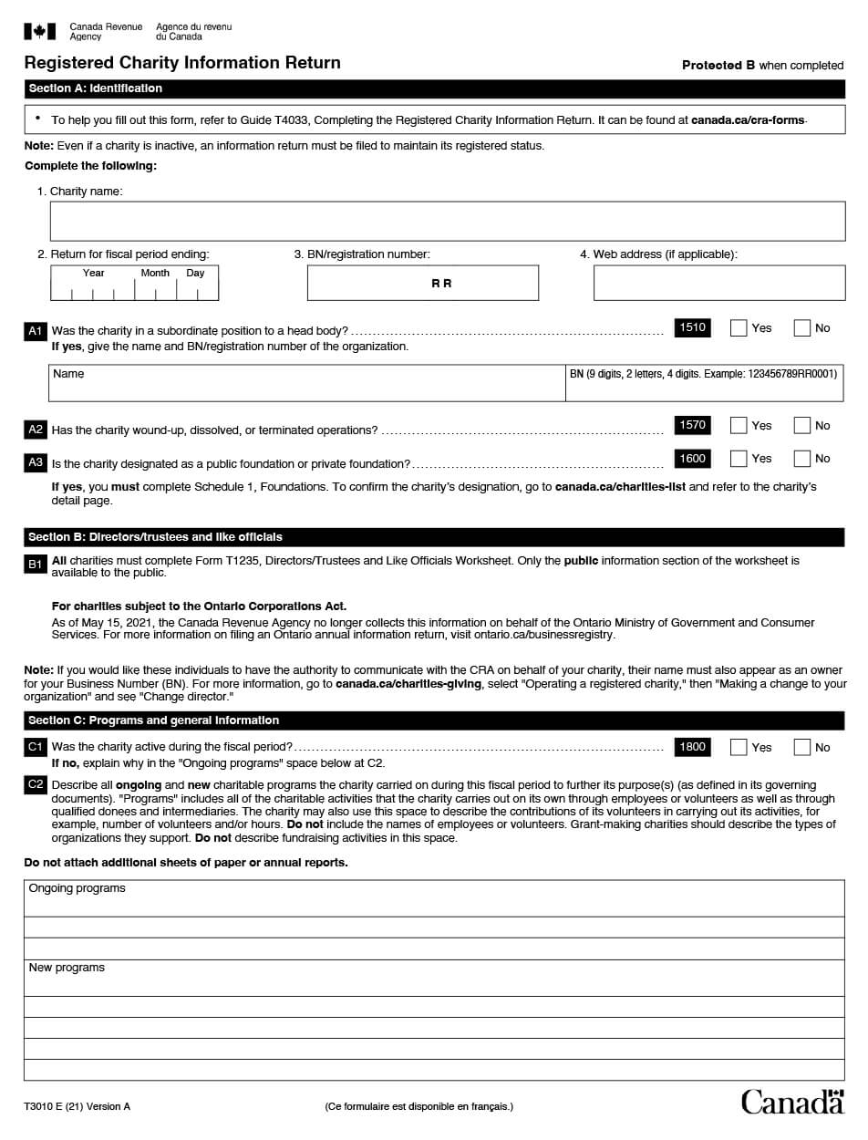
What is the T3010?
BP
Annual Charity Return
Filed with CRA Charities Directorate
Provides Accountability and Transparency
Due within 6 months of end of church’s fiscal period
Notes:
SECTION 15.0 COMPLETING THE T3010 – ANNUAL CHARITY RETURN
What is it?
An annual return which is filed with the CRA Charities Directorate to confirm compliance with the provisions contained in the Federal Income Tax Act. It provides accountability and transparency to the public since the information is made available through the CRA website. It is due within six months of the end of the church’s fiscal period.

Slide 54
T3010: Forget to file?
BP
Charitable status revoked
Unable to issue tax receipts
$500 penalty
Late filers published on CRA site
Notes:
What happens if we don’t file?
Failure to file the T3010 on a timely basis is cause for the congregation to have its charitable status revoked. It would then not be able to issue tax receipts for donations. Further, it could be subject to a $500 penalty (to be administered as a re-registration fee). The T3010 is used to confirm compliance with the provisions contained in the ITA (ITA). Names of late filers are published on the CRA website.
It can be a full-year process to get back your charitable status and CRA will hold back any refunds the congregation is entitled to it.
NOTE: The return is due the end of June, in the meantime, you’ve issued your tax receipts and been used by donors, they could look at all the donors who have given and re-assess their taxes! This is a headache you don’t want.
We need to be sure that the Session and Board of Managers are aware of this – it’s why the Presbytery asks, the national office asks, and it’s often a question your auditors will ask – on what date was the T3010 filed?

Slide 55
T3010: What’s needed?
BP
(1 of 2)
Financial statements & accounting records
Financial records from other groups within the church
WMS (unless filed separately)
Sunday School
Choir,
Camps
Blank Form T3010 Return downloaded from www.cra-arc.gc.ca
Notes:
What do I need to get started? (Slide 1 of 2)
Financial statements & accounting records
Financial records from other groups within the church (i.e. WMS unless filed separately, Sunday School, Choir, etc.)*
A blank Form T3010 Return
(mailed to congregations by CRA)
and a Registered Charity Basic Information (Form TF725) See next slide
Look on CRA’s website if you need any of the forms or the guide. www.cra-arc.gc.ca
*Per bullet #2: Maurice mentioned that congregations may have multiple funds and related bank accounts which must be reconciled for the T3010.

Slide 56
Guides and Worksheets available at: canada.ca/en/revenue-agency/services/forms-publications/forms.html
BP
Guide T4033 – Completing the Registered Charity Information Return
Called the Guide
Can be found at canada.ca/cra-forms
T1235 – Directors/Trustees Worksheet
T1236 – Qualified Donees Worksheet
Schedules 1 to 6 (May not need but included in download)
Notes:
What do I need to get started?
Guides and Worksheets:
T4033 – Completing the Registered Charity Information Return (called the Guide)
T1235 – All charities must complete Form T1235, Directors/Trustees and Like Officials Worksheet. Only the public information section of the worksheet is available to the public.
Note: Does not update Directors/Trustees list for provincial registration (esp. Ontario)
Decide if the Minister will or won’t be listed, it can be helpful for them to be listed for smaller congregations. . . Be consistent!
T1236 – Qualified Donees Worksheet is used by a registered charity to identify the gifts it made to qualified donees and other organizations during a fiscal year. If you answered “yes” to question C3, “Did the charity make gifts or transfer funds to qualified donees or other organization?” then you must fill out the T1236.
Is Presbytery a qualified done or not? IF they don’t have their CRA registration (some do and some don’t, it’s not a transfer, but an expense. Presbytery should provide an invoice or letter saying what the assessment is and what is covered under it.
Schedules 1 to 6. (Note: you may not have to complete all these schedules, but they are included in the Form T3010 package)
Look on CRA’s website if you need any of the forms or the guide. www.cra-arc.gc.ca

Slide 57
LE
✓
The Presbyterian Church in Canada
10785 6619 RR 0001
Notes:
2019 T3010 (Cont’d.)
A1 – Was the charity in a subordinate position to a parent organization?
Check Yes
Presbyterian churches are “linked” to The Presbyterian Church in Canada
Enter: The Presbyterian Church in Canada
Enter: 10785 6619 RR 0001

Slide 58
LE
✘
Notes:
C6 – Treasurer may have to put the odd checkmark on C6
Select all applicable fundraising methods used by the charity during the fiscal period.

Slide 59
LE
✘
Notes:
2019 T3010 (Cont’d.)
C7 – Did the charity pay external fundraisers?
Check No
A third-party fundraiser is a company or individual, not employed by the charity, that solicits funds for the charity.

Slide 60
Poll
LE
✘
Larger churches can be “Yes”
Be consistent
Notes:
2019 T3010 (Cont’d.)
C8 – Line 3200 – The charity may have made a payment to one or more of its directors/trustees or like officials, or persons not at arm’s length, which was not a reimbursement or an allowance, and was for an amount spent to carry on their duties (for example, an out-of-town director’s accommodation and travel expenses while attending a board meeting). If so, select yes.
The term not at arm’s length means persons acting jointly without separate interests or who are related.
C8 – Minister shouldn’t be included in T1235 – Directors/Trustees Worksheet, so C8 not applicable to Minister
Smaller churches versus larger churches
Larger churches likely select [ ] yes
Be consistent
Poll: Which do you do?

Slide 61
LE
✘
Notes:
2019 T3010 (Cont’d.)
C13 - Did the charity allow a donor to use any of the charity’s property during the fiscal period
Check No

Slide 62
LE
✘
Notes:
2019 T3010 (Cont’d.)
Schedule 2 - Line 210 – Programs outside of Canada
This doesn’t apply to PWS&D & International Ministries

Slide 63
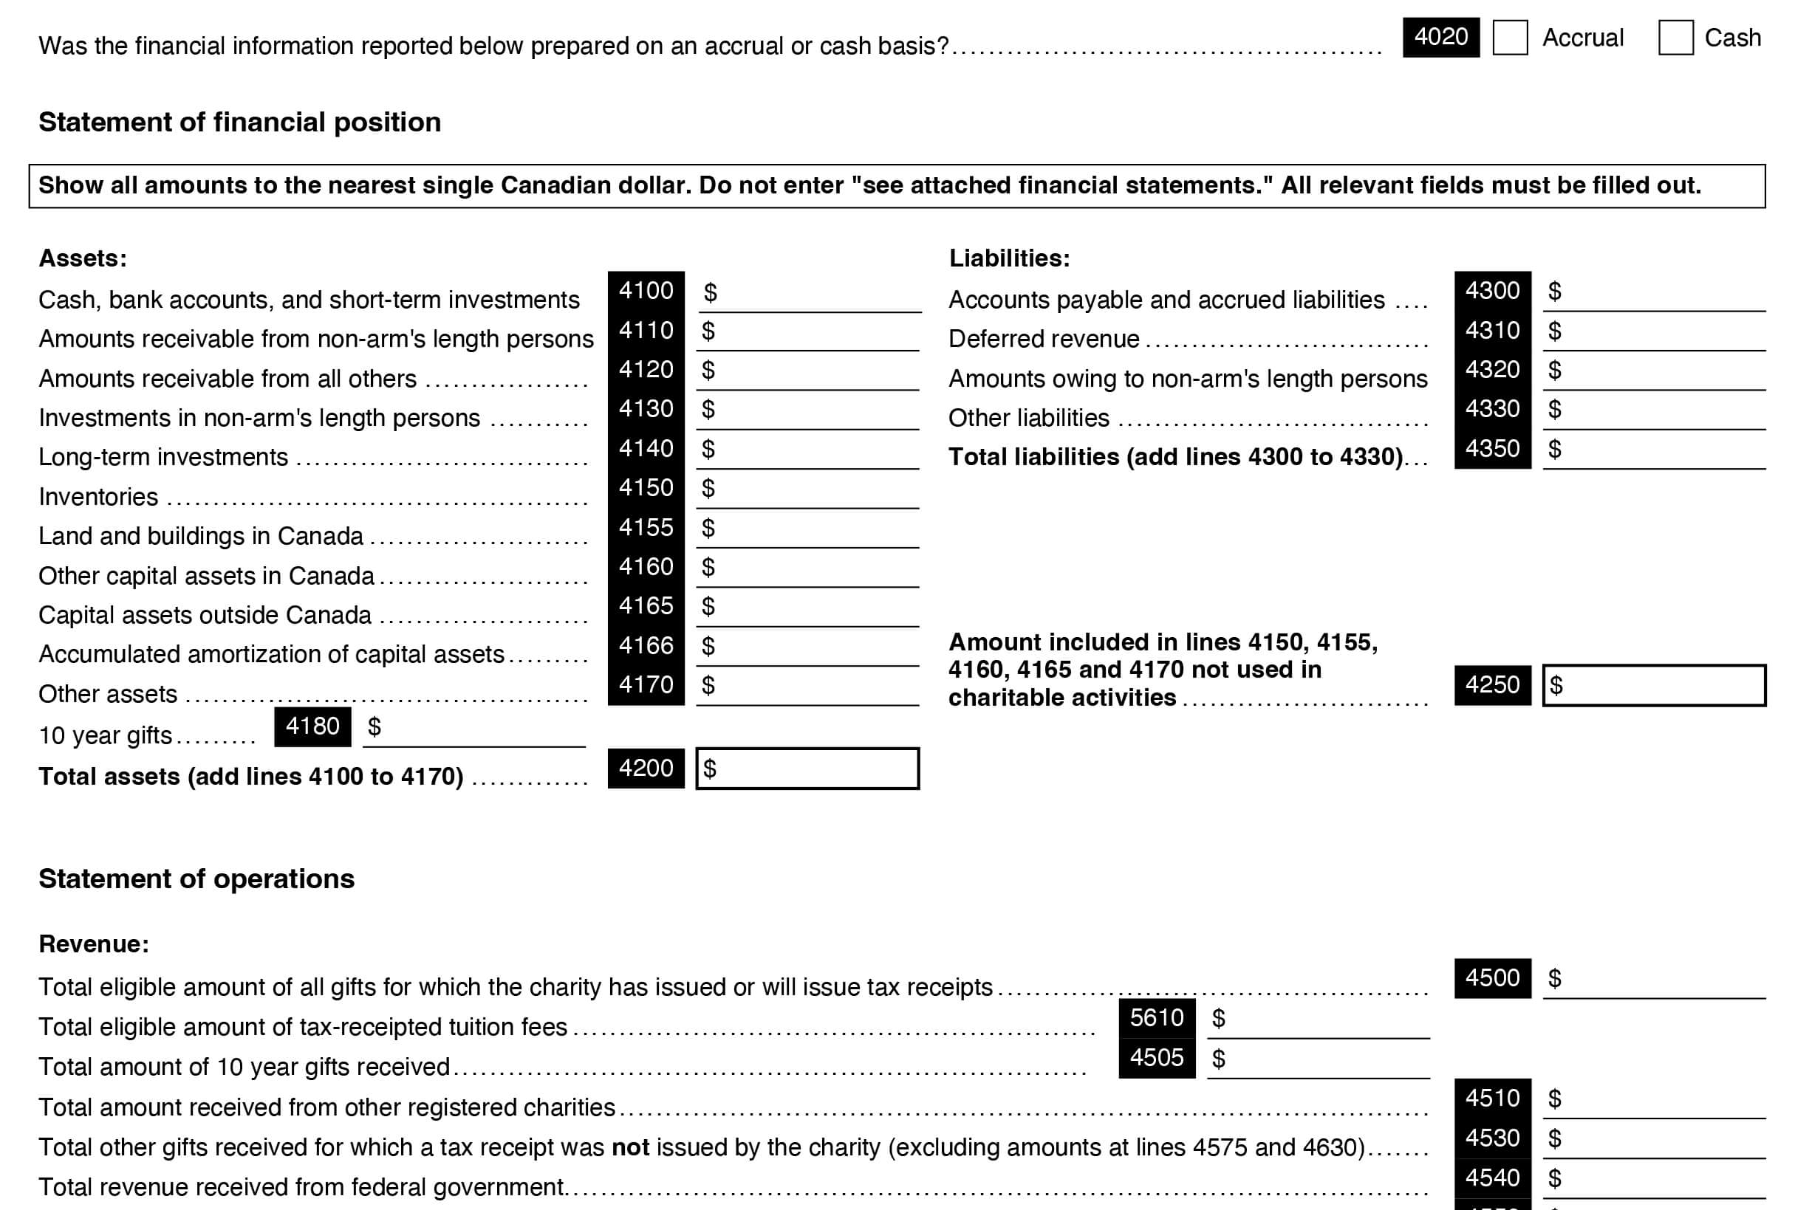
LE
Notes:
2019 T3010 (Cont’d.)
If you are completing Schedule 6: Detailed Financial Information:
Line 4155 - Land and Buildings in Canada
Line 4165 - Capital assets OUTSIDE Canada
Line 4166 - Accumulated amortization of capital assets
this refers to an accounting term that means how an asset depreciates over time
i.e. a computer depreciates over time
some congregations will set up the computer as an asset and then depreciate it over 5 years or 20% of the value each year
Line 4510 - Total amount received from other registered charities

Slide 64
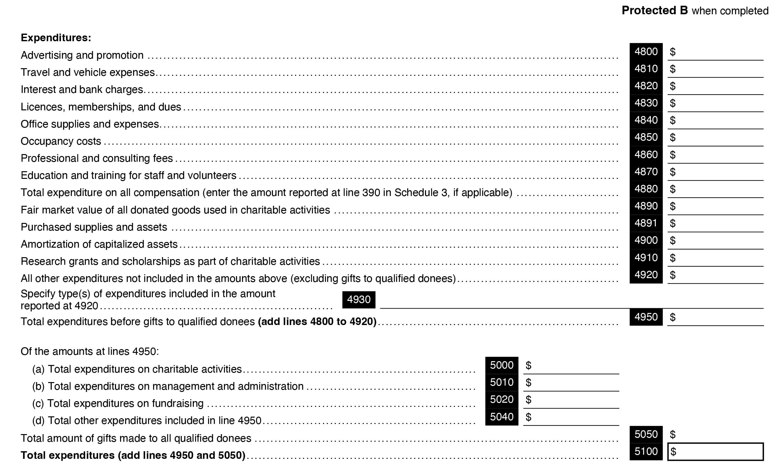
LE
Notes:
Line 5050 - Total amount of gifts made to all qualified donees
Line 5100 - Total expenditures (add amount from line 4950 and 5050)
Pulpit supply should be treated as an expense and not included in Line 4880

Slide 65
LE
Notes:
Line 4880 – must be the same as the amount reported on Line 390 of Schedule 3

Slide 66
LE
Line 5000: Total expenditures on charitable activities Majority of expenditures reported on this line
All resources in the pursuit of its charitable purposes.
Expenditures divided between line 5000 and 5010
Notes:
Line 5000
We recommend that the majority of expenditures be reported as charitable program expenditures on this line
By law, the church is required to use substantially all of its resources in the pursuit of its charitable purposes.
Expenditures can be divided between line 5000 and 5010
examples: Bank charges, accounting/legal fees, office supplies (part or all), insurance premiums, printing (part or all), postage, support staff salaries (part or all), church bulletin, meeting expenses

Slide 67
Complete based your congregation’s circumstances
Pay special attention to line 5900 and 5910
Properties not used in charitable activities – if you have any pay attention to the disbursement quota
LE
Notes:
Other financial information
Complete this section based on the situation of your congregation. Pay special attention to line 5900 and 5910. You should not have any properties not used in charitable activities. If you do, make sure you comply with the disbursement quota.

Slide 68
<$100K vs. >$100K Churches
LE
Notes:
Under 100K can skip 2 pages of detailed analysis
Smaller churches can complete section D
Larger churches must complete Schedule 6

Slide 69
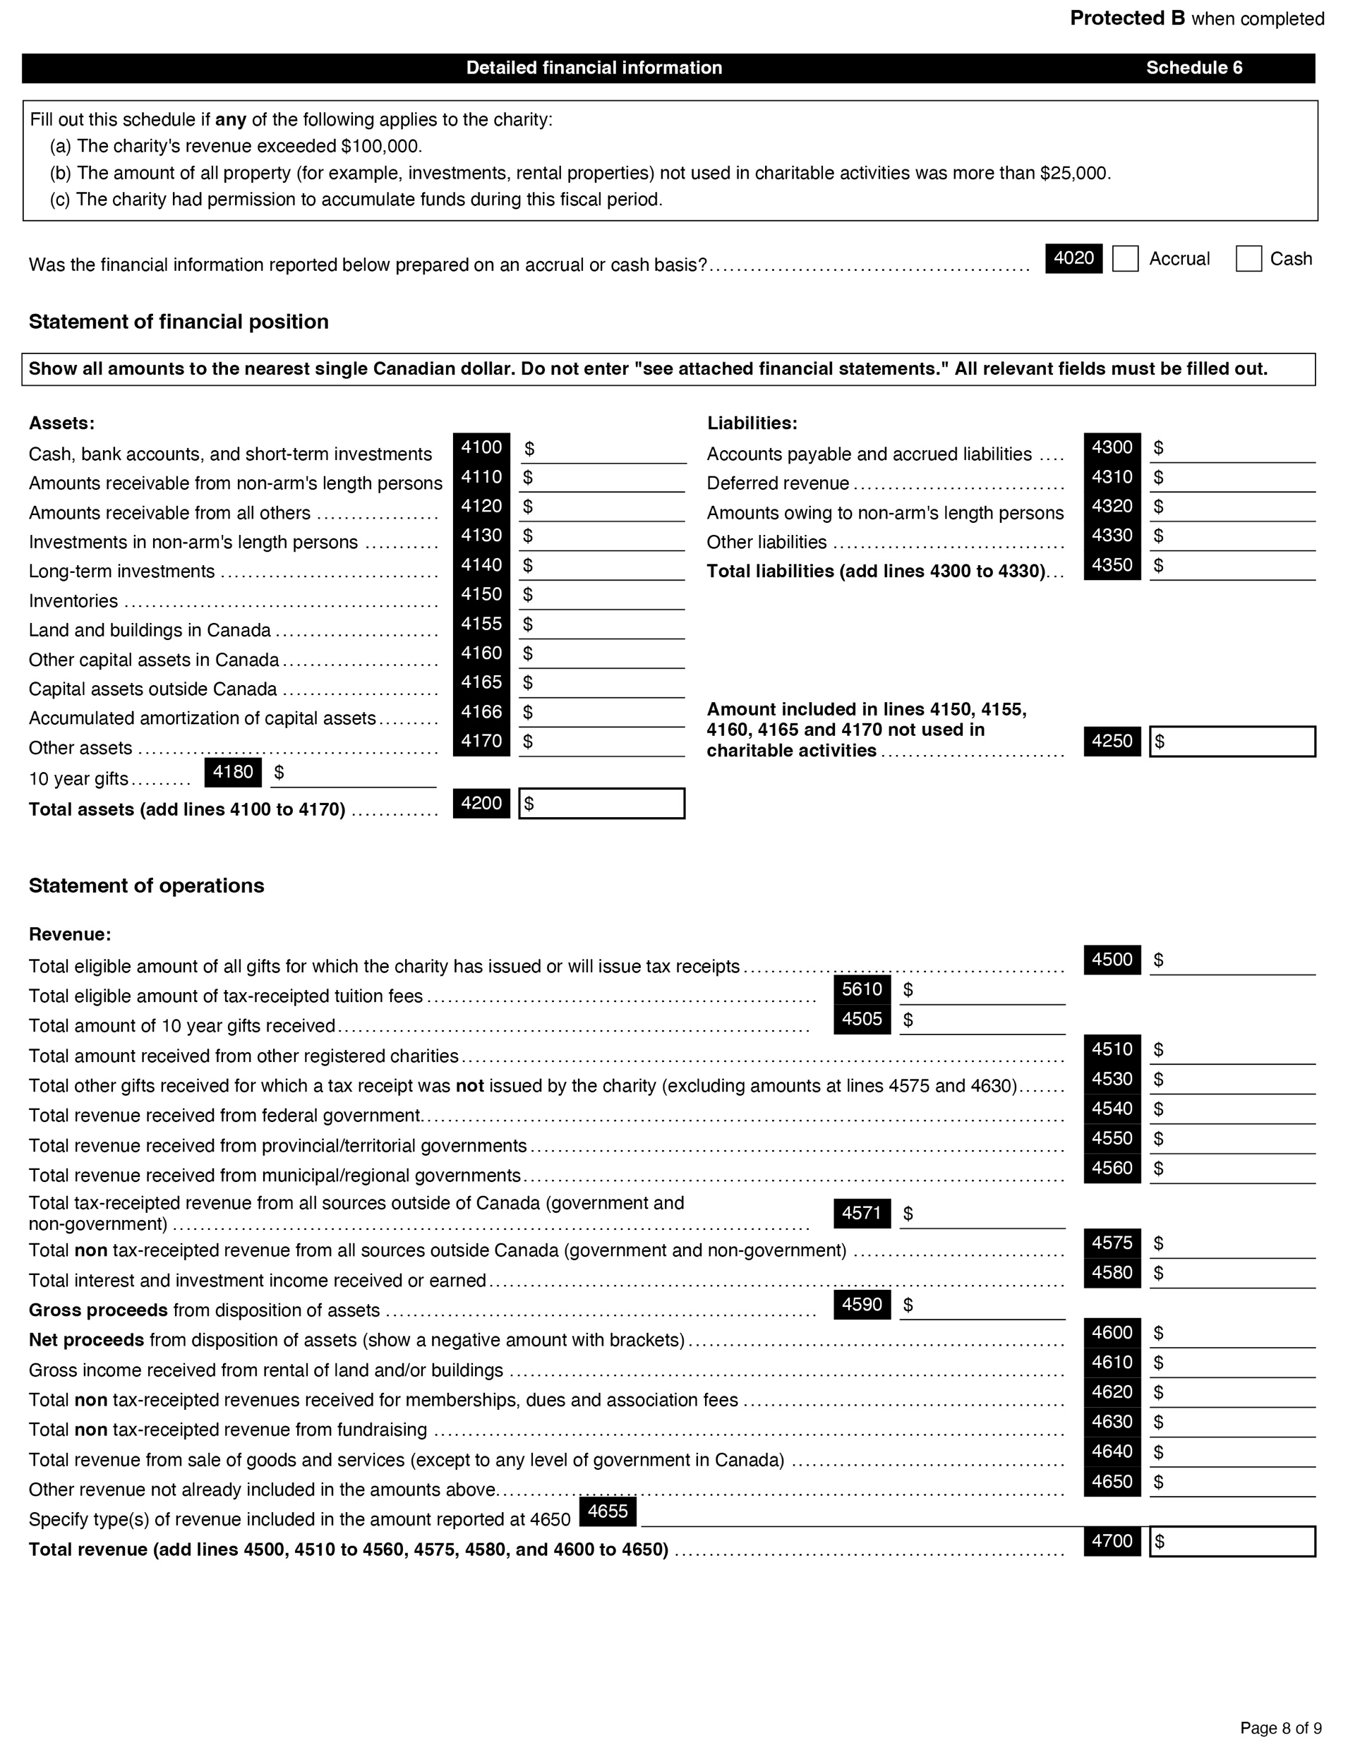
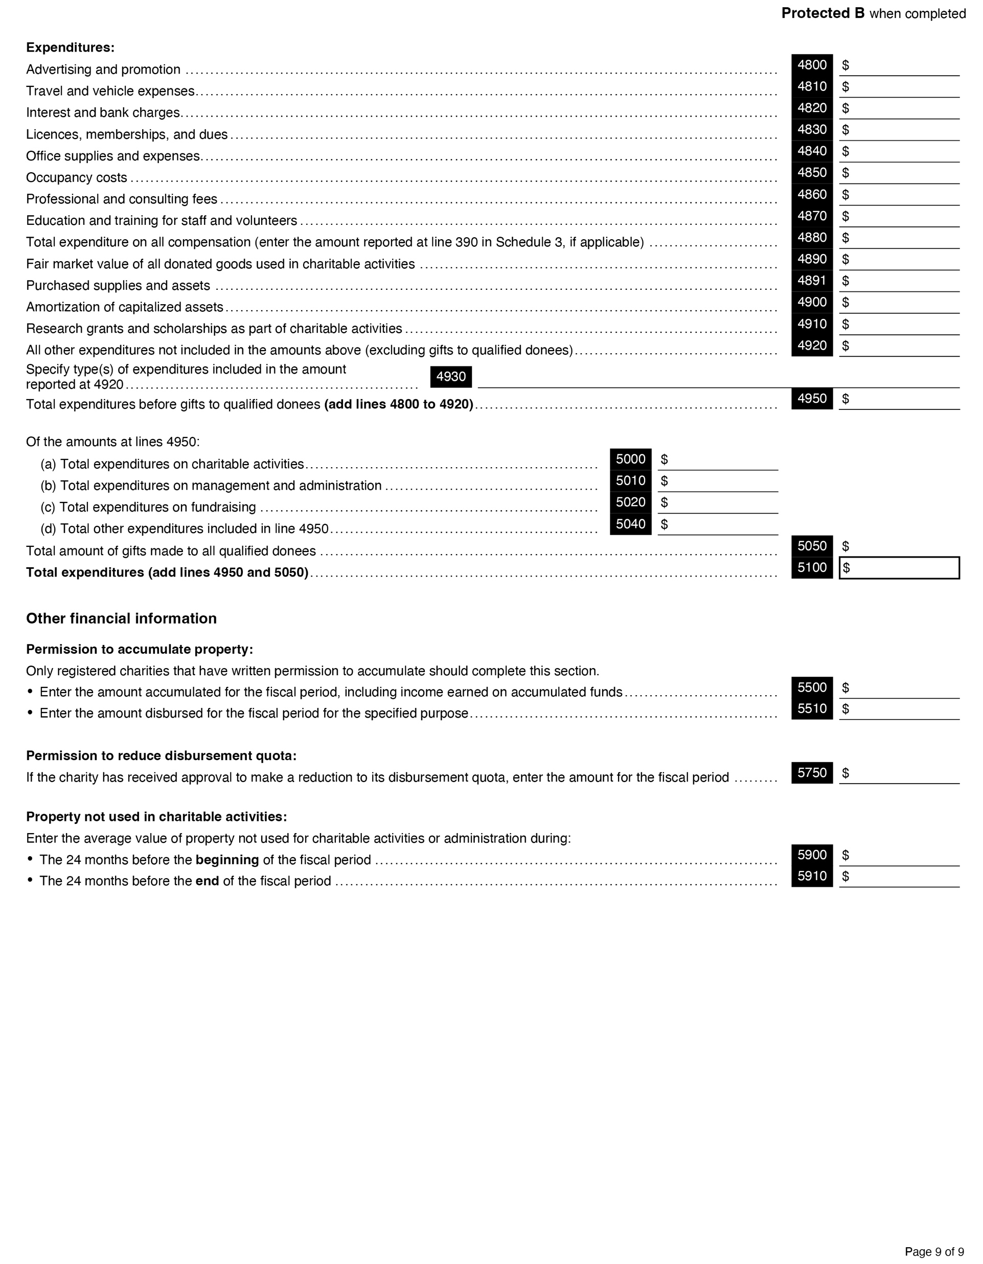
<$100K vs. >$100K Churches
LE
Section D
Schedule 6
Notes:
Under 100K can skip 2 pages of detailed analysis
Smaller churches can skip Schedule 6
Larger churches must complete Schedule 6

Slide 70
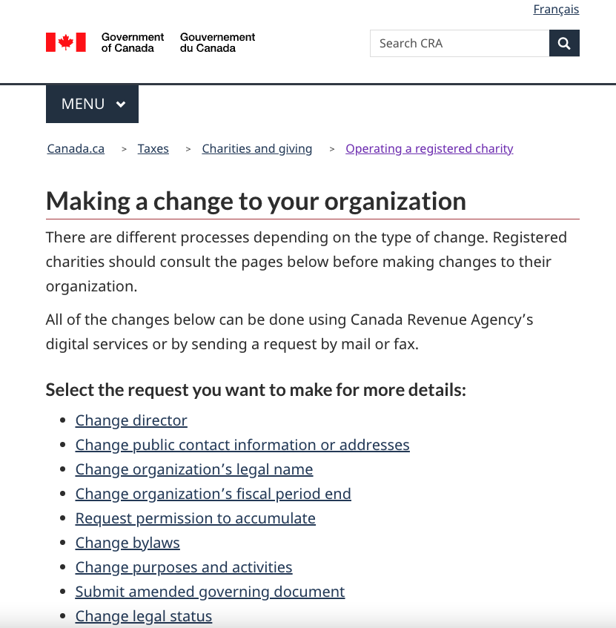
Authority to communicate with CRA
LE
Name must appear as owner for Business Number (BN)
Go to:
canada.ca/charities-giving
"Operating a registered charity"
"Making a change to your organization”
"Change director”
Record “minute” re changes
Notes:
NOTE: This is the most difficult task with the CRA! Be persistent.
Often the responsible members of session at a church change and the church doesn’t inform the CRA, which may make it difficult to communicate with the CRA when the need arises.
There are two systems 1) the T3010 charity registration and 2) the GST/HST/payroll issues – these don’t seem to communicate with each other.
If you would like a new individual to have the authority to communicate with the CRA on behalf of your charity, their name must also appear as an owner for your Business Number (BN).
For more information, go to canada.ca/charities-giving, select "Operating a registered charity," then "Making a change to your organization" and see "Change director."
Session needs to add a minute to record the names that will be submitted to the CRA.

Slide 71
Extracting Data for Reports
BP
Data from financial statements primarily used for
Annual report to the congregation
CRA Public Information return (T3010)
PCC annual statistical return
Use grouping and headers
allow easy extraction of data
Or flow to the other reports
Use account “segments” in your accounting software
Key to setting up your Chart of Accounts.

Slide 72
BP
Total of $ numbers being put into T3010 L4500 should agree to total receipted by Envelope Steward/Secretary.

Slide 73
BP

Slide 74
Contact Info
KP
The Presbyterian Church in Canada 50 Wynford Drive, Toronto ON M3C 1J7
Tel: 416-441-1111 or 1-800-619-7301, Fax: 416-441-2825
www.presbyterian.ca
Oliver Ng, CFO & Treasurer, ext 316, ong@presbyterian.ca
Diana Kellington, Accountant, ext 312, dkellington@presbyterian.ca
Karen Plater, Stewardship & Planned Giving Associate Secretary ext. 272 kplater@presbyterian.ca
Jackie Czegledi, Senior Administrator, Finance, ext. xxx jczegledi@presbyterian.ca
Maggie Leung, Gifts Administrator ext. xxx mleung@presbyterian.ca
Canada Revenue Agency - www.canada.ca/en/services/taxes/charities
Notes:
We are always happy to help. Contact us if you have questions!

Slide 75
Thank You
KP
Recording & Slides will be available at
presbyterian.ca/
leadership-webinars
Share it around!
Notes:
Recordings will also be posted at https://presbyterian.ca/leadership-webinars/ for people to find and use in the future.

Slide 76
Q & A
KP
What more do you want to know?
Use the chat

Slide 77
Coming Webinars
KP
What would you like?

Slide 78
Thank You
presbyterian.ca/
leadership-webinars
Share it around!

