Slide 1
The Ministry of Managing Money
Congregational Finances & Stewardship
Session 3: Sharing God’s Gifts: Examining Expenditures
Notes:
Hi everyone
Today is part three in our webinar series and we're going to be talking about Sharing God’s Gifts, Examining Congregational Expenditures.
We’re all glad you’ve joined us today. We’ve had a number of people who can’t attend live, but say that they're looking forward to watching the recording. All webinars are recorded and posted on the PCC website under leadership webinars . We’ll send you the link so it’s easy for you to find or forward to someone else, but it will be up there for everyone to use (until we re-do them.)

Slide 2
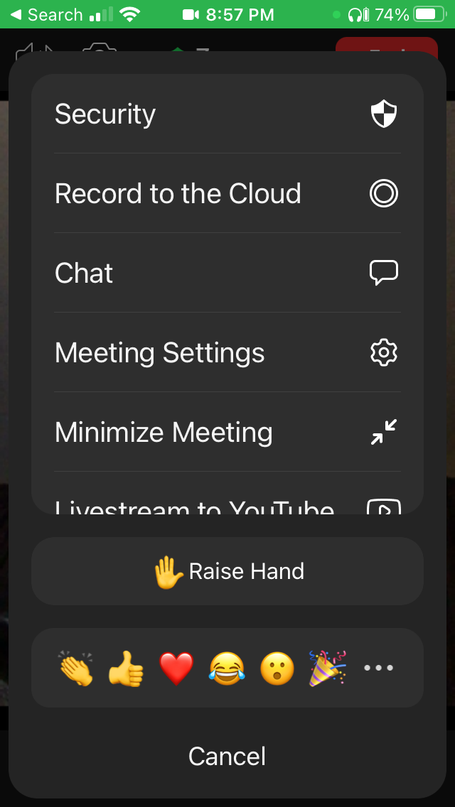
Protocol
JM
Mobile
Stay muted and use chat to ask anything
Chat will be monitored and questions asked as we go along or at the end
There may be an opportunity to unmute at the end
PC
Notes:
A little bit of protocol for today's meeting. Viewers are going to be stay muted; our host has already muted everybody, so if you have any comments, please type them in using the chat function. Hopefully, you can find the chat setting on your mobile or on your computer.
The chat will be monitored, and questions will either be asked as we go along, or at the end.
At the end, there may be an opportunity to unmute to ask questions… but we do have a lot of people registered so that may be a bit of a juggling act… we’ll see.
So, please do ask your questions in chat and we’ll make every effort to answer them.

Slide 3
Webinar Series
JM
Today Sharing God’s Gifts Examining Congregational Expenditures
Thurs., Jan. 13 Telling the Story Reporting & Communicating Finances
Notes:
Today, this webinar is all about spending the gifts we have been blessed to steward.
A reminder that this series of webinars is supported by gifts to Presbyterians Sharing.
On January the 13th, we’ll cover
What the session and congregation need to know and what to present at your AGM
reporting finances throughout the year
and filling out the CRA T3010
and the PCC statistical report.

Slide 4
Spread the word
JM
Recording & Slides & Notes will be available at
presbyterian.ca/
leadership-webinars
Share it around!
Notes:
Just a reminder to spread the word. Recordings of this series of webinars will be posted at https://presbyterian.ca/leadership-webinars/ for people to find and use in the future. We’ve also been posting the ppt slides and the notes – which you are free to copy and adapt for your context – and share with your session, committees, board of managers or anyone else who might be interested.
(I’d recommend you only present little bits and perhaps don’t go into as much detail as we did – not everyone is as fascinated about the details as we tend to be!)
Okay, let’s begin.

Slide 5
Sharing God’s Gifts: Examining Congregational Expenditures
JM
December 9, 2021
Notes:
So as we look at sharing God’s gift’s we’re going to dive in-depth to some of the details of congregational expenditures that congregations struggle with including payroll related matters (deductions, housing allowance, insurance, pension and benefits, pulpit supply) and property management. We’ll also look at synod and presbytery assessments, Presbyterians Sharing allocations and how to remit to the national office. Finally, we’ll touch on mission and ministry! Mission and ministry are the biggest parts of our mission – and why we are doing this work – so these issues aren’t in the order of importance, but it’s important to remember that our property and staff are big parts of the ways we carry out mission and ministry – so it’s good to have a handle on them. ☺

Slide 6
Presenters
JM
Karen Plater, Associate Secretary, Stewardship & Planned Giving
Maurice Mawhinney, Presbytery of West Toronto & PCC Finance Committee
Jim MacDonald, Development Manager, Stewardship & Planned Giving
Nicole Jeffrey, Director, Pension & Benefits
Liane Maki, Pension & Benefits Clerk & Health & Dental Specialist
Carol Nugent, Payroll Administrator, PCC Finances
Oliver Ng, CFO, PCC
Rebecca Weber, Accounts Receivable Clerk, PCC Finances
Notes:
One of the benefits of a webinar is that you can pull in multiple people to present. This really is a collaborative effort. We have with us:
Karen Plater, Associate Secretary Stewardship & Planned Giving
Maurice Mawhinney, Presbytery of West Toronto Treasurer & Finance Committee (and helped with the handbook)
Jim MacDonald, Development Manager, Stewardship & Planned Giving
Nicole Jeffrey, Director, Pension & Benefits
Liane Maki, Pension & Benefits Clerk & Health & Dental Specialist
Carol Nugent, Payroll Administrator, PCC Finances
Oliver Ng, CFO, PCC
Rebecca Weber, Accounts Receivable, PCC Finances

Slide 7
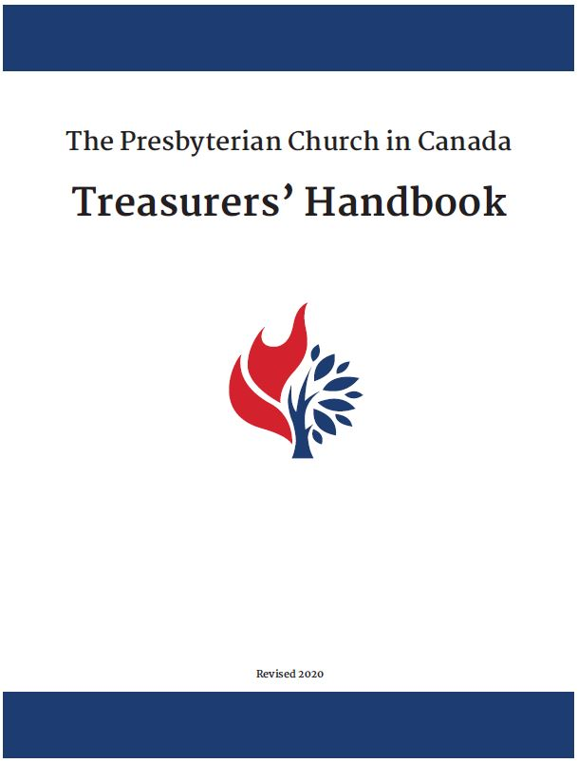
Treasurer’s Handbook
JM
Download presbyterian.ca/resources/finance/
Notes:
And just a reminder, most of the information we are presenting can be found in the Treasurer’s Handbook which is available for download.

Slide 8
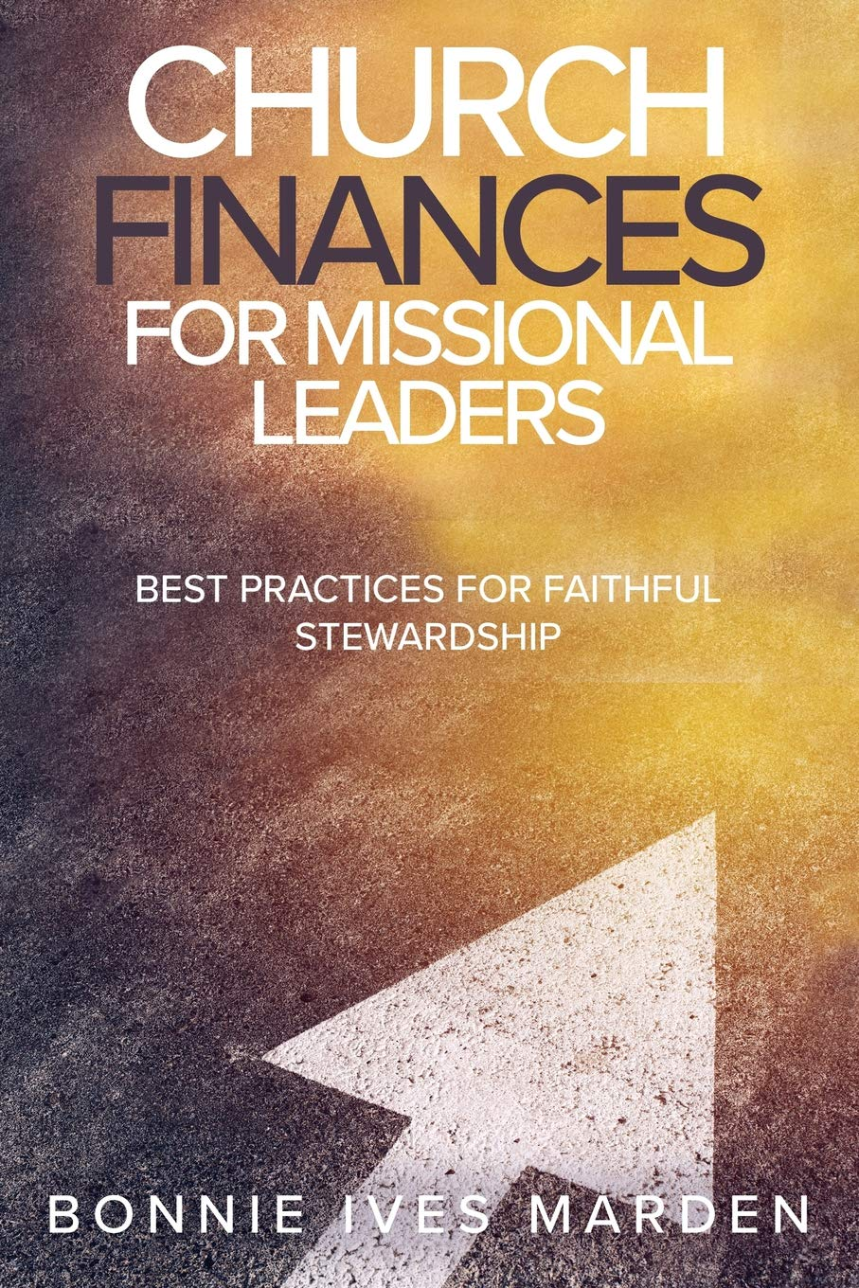
Best Practices
JM
“Budget building and management work is sacred and will directly impact the morale and confidence of the whole community.”– Bonnie Ives Marden
Available on Amazon.ca
Notes:
We’ve also taken a number of ideas from Bonnie Ives Marden’s book Church Finances for Mission Leaders. She does an excellent job of integrating both stewardship and money management and biblical principals – and really complements what is found in the treasurer’s handbook – so we highly recommend it.
And now I’ll hand it over to the Associate Secretary for Stewardship and Planned Giving, Karen Plater…

Slide 9
Treasurer Role: Disburse Money
KP
Operating Budget
Payroll
Utilities
Worship
Maintenance
Programs
Mission & Outreach
Special Funds
Capital
Mission & Designated
Benevolence
Endowment/Legacy
Notes:
This is a reminder that when it comes to expenditures the treasurer is responsible to oversee how the church disburses money.
Operating Budget
Payroll
Utilities
Worship
Maintenance
Programs
Mission & Outreach
Special Funds
Capital
Mission & Designated
Benevolence
Endowment/Legacy

Slide 10
Treasurer Role Expenditures
KP
The Session is entrusted with responsibility to manage the affairs of the church, including the financial resources (money), so the treasurer does not control expenditures
Treasurer ensures:
budget is created
tracking funds and maintaining records/books
church decisions carried out by volunteers/staff/outside help
bank reconciliation completed monthly
Notes:
The Session is entrusted with responsibility to manage the affairs of the church, including the financial resources (money). So the treasurer does not control the finances but is the person primarily responsible to ensure that the details of financial decisions are carried out.
The treasurer does this by helping ensure the budget is created to support the mission and ministry the congregation dreams of doing in the year.
They also help ensure the revenue the church receives (gifts, grants, rent) and what it spends (expenditures) are tracked and recorded so that the session and committees can know where you are at throughout the year, compare with previous years and make adjustments if needed. The tracking and maintaining of books can be done by the treasurer, church staff, outside hired accountant/bookkeeper, or a volunteer.
Tracking and maintaining good records help make completing annual government forms (like the T3010), GST/HST rebates and the PCC statistical forms and to be ready for any audit or financial review.
A bank reconciliation should be completed monthly. In simple terms, this is reconciling or balancing the church accounting records to the bank statement or records. Getting into a routine helps keep your books up to date. If you treat each month like a ‘year-end’, then the year-end report is simply another month-end report.
Barbara Fullerton, a colleague who used to be in stewardship with the UCC, studied stewardship best practices – being open and transparent with finances was key to better revenues. It’s not WHY people give to the church, but it helps them see how God is using the gifts that have been given – and is a model for their lives. So how we handle expenditures and what they are spent on – should reflect God’s mission. We want our budgets to read with grace, abundance, compassion. We’ll look at that more in Session 4.
Now I’ll turn it over to Maurice to talk about the treasurer details!

Slide 11
Calculating your congregation’s dollar base presbyterian.ca/sharing/presbyterians-sharing-suggested-allocation-calculator/
KP
Your congregation’s dollar base is calculated from your stat report as follows.
Total money received by congregation from all sources for use in a given year: $__________ (Line 14)
subtract
Gifts for Presbyterians Sharing, PWS&D, other PCC mission; Refugee sponsorship, contributions to other Qualified Donee mission organizations : $__________ (Line 26)
subtract
Debt repayment (principal + interest): – $__________ (Line 24)
= $__________ Dollar Base (Line 31)
* Not included is revenue raised for i) net sale of property (Line 15) ii) endowments, bequests/legacies, special funds (Line 16) iii) Canadian Ministries grants (Line 17) iv) funds raised for major repairs, renovations or new construction (Line 18).
Notes:
Just a short word on what the dollar base is because it’s going to come up when we talk about Pension Assessment, Presbyterians Sharing Allocation and Presbytery and Synod Assessments. While we will look at the statistical reports in more detail on January 13, 2022, you may find it helpful to know how it’s calculated.

Slide 12
Cash Flow
MM
Goal is that expenses do not exceed incoming finances (and reserves) so that ministry can thrive
What to do if you run into problems
Overdraft, borrow from restricted funds, emergency loans from PCC
Notes:
Monthly budgets take the annual budget and divide by 12. However, this does not take into account seasonal income dips in giving (like over summer months) or highs (like year end giving at Christmas) or the number of weeks (Sundays) in a month. These highs and lows effect the church’s cash flow – how much and when funds are available for ministry spending.
To determine historic cash flows, take the monthly giving and expenses reports over the course of a year. In your currently monthly reports, add a column that compares the current month to the same period last year. At the monthly board meetings, church leadership can ensure that spending is in line with expected fluctuations in cash flow. Their goal is that expenses (outflows) do not exceed incoming finances (and reserves) so that ministry can thrive in your church. Stipends and salaries generally tend to be consistent month over month, except for the normal quarterly payments (e.g. H&D, or maximizing out on EI / CPP,) but the like of utilities will vary generally with “summer lows” and “winter highs”.
If it’s an issue: borrow from Restricted fund, overdraft protection from bank, borrow from PCC – not something you want to happen often. Or can be serious problems.
Good to have one bank account – rather than a lot of different accounts – with different bank accounts – you can have one bank account and keep track of them. Some want to keep them in a separate account, but not required if you have a system of tracking.

Slide 13
Cash vs. Accrual Basis and Generally Accepted Accounting Principles (GAAP)
MM
Cash
Revenues are recorded when they are received, which may be before or after they are earned
Expenses are recorded when they are paid, which may be before or after they are incurred
Financial statements reflect revenues and expenses based on when transactions were entered rather than when revenues were earned or expenses incurred.
No receivables are recorded
No payables are recorded.
No method of tracking partial payments is available.
Accrual
Revenues are recorded when they are earned, which may be before or after they are received.
Expenses are recorded when they are incurred, which may be before or after they are paid.
Financial statements match revenues to the expenses incurred in earning them, and more accurately reflect the results of operations.
Payables are recorded when payment is not made at the time of purchase.
Revenues and expenses are recorded in full, even though partial payments may be made over extended time periods.
Notes:
In order to comply with the Book of Forms the Treasurer must keep track of the receipts (credits) and disbursements (debits). Another way to think of this is what comes in (cash) and what goes out (cash). Many congregations maintain their books on a “cash” basis.
Other congregations keep their books on an accrual basis. A simple way to think of accrual accounting is it keeps track of what is “owed” to the congregation and what the congregation owes to others at a point in time like December 31st, 2021.
Appendix A in the treasurer’s handbook gives us this comparison of Cash vs. Accrual accounting.
If a congregation does not use the accrual method but chooses to use the “cash” basis, then the financial statements do not comply with GAAP (Generally Accepted Accounting Principles). This means, if an external auditor (non-congregational member) carried out an audit or a review engagement, his/her report would have to “qualify” the financial statements because they don’t comply with GAAP. From my review of the FS accompanying the annual statistical reports, most congregations use the “cash basis”.
So should you panic or be worried? No. But for larger congregations with significant assets and a larger amount of revenue and costs, the congregation may require an external audit, and in this case, they will want to comply with GAAP. And, with greater reporting requirements from government and donors and others, it’s probably a good idea for most congregations to move to GAAP.

Slide 14
Accounts
MM
Accounts comprise:
Assets and Liabilities – Balance sheet
Income and Expenses – Statement of Operations
Notes:
Accounts are required to produce the financial statements -
Basically, there are two statements required
Balance sheet – assets and liabilities
Statement of operations
There may be other statements required to be produced to account for activity in funds – restricted or unrestricted, e.g. mission fund, manse fund, accounting for investments, etc.
The assets would include cash / bank accounts, fixed assets – land, buildings, fixtures and fittings, less accumulated depreciation (where appropriate), investments, miscellaneous accounts receivables and possibly prepaids
Liabilities would include “current liabilities”- accounts payable (amounts due to creditors, e.g. CRA, PCC,) accrued liabilities (unpaid invoices for goods, services and supplies, current portion of mortgage payments. Long term liabilities would include mortgage balance over one year, In addition, the liabilities would include the “equity of any restricted funds” and the accumulated surplus / (deficit).
We’ll look at this more in-depth in January.

Slide 15
Account Categories Expenditures
MM
Each major item has a separate GL account
Goal is to have enough categories to properly allocate items, easily generate reports, and make comparisons, but not in so many as to be onerous.
Notes:
Slide 95
Expenses categories
From page 28 PCC Treasurers Handbook
“Chart of Accounts: Before the chart of accounts is set up (this is a listing of accounts that have unique numbers and descriptions for the assets, liabilities, revenues and expenses), some thought should be given to the end product i.e. the financial statements. What categories, or grouping of expenses, should be reported? Would the congregation (or the Board of Managers) like to see more detail, or less detail? Basically, each major item should have a separate general ledger account.”
Additional examples can be found from the website of the Free Methodist Church in Canada (FMCIC) Bookkeeping, Records and Chart of Accounts from FM Treasurer’s Guide –https://www.fmcic.ca/treasurersguide/church-finances/bookkeeping-records-chart-of-accounts/
Where practical, it is recommended that the accounting system be computerized. This makes the financial recording, reporting and production of charitable receipts much easier. There are several simple yet inexpensive software programs that are suitable. (See the Treasures Handbook)
If a manual system is used, a ledger record with enough columns will be required to record income and expenses by categories.
See chart of accounts at https://www.fmcic.ca/wp-content/uploads/Sample-Church-Chart-of-Accounts.pdf

Slide 16
Categories of Expenses Examples Chart of Accounts
MM
Stipend – Minister’s salary.
Salaries – Organist, church administrator
Pulpit Supply
Manse Expenses
Worship Expense
Printing, Postage – Printing, stationery, postage and supplies.
Christian Education – Lesson materials and teaching aids, Vacation Bible School expenses, fellowship expenses, fees for educational expenses.
Maintenance Expense – Repairs to buildings and equipment, service, contracts, snow removal, gardening, etc.
Taxes – local improvement taxes
Children & Youth Ministry
Pension Fund – Contribution to the Pension Fund (Congregational Assessment)
Mission and Outreach – Contributions to Presbyterians Sharing, PWS&D and other mission work.
Benevolence Fund
Presbytery Assessment.
Utilities (Gas or Oil, Electricity, Water)
Insurance
Small Office Equipment Purchase (non capital)
Capital Depreciation Expense (Accrual)
Notes:
Chart of Accounts
Displayed are some of the major categories normally disclosed in the statement of operations.
Again, see chart of accounts examples on page 28 of the PCC Treasurers Handbook.

Slide 17
Internal Control
MM
Internal control requires having checks and balances to ensure that monies, property and other assets belonging to the congregation are properly received, adequately protected, accurately recorded, and effectively used.
The basic rule is that no one person should be in complete control of any one accounting transaction.
Notes:
6.1 INTERNAL CONTROL
The purpose of internal control is to protect the reputations of individuals involved with church finances and to protect the church’s assets. The church has a duty to its volunteers to protect them from unfounded accusations against which they cannot defend themselves. It is wise for the church to arrange its affairs so that volunteers are not put into a position of unwarranted temptation. Internal control usually involves dividing financial duties in a manner that creates checks and balances. A good accounting system must contain a series of checks and balances to ensure that monies and property or other assets belonging to the congregation are properly received, adequately protected, accurately recorded, and effectively used.
The basic rule is that no one person should be in complete control of any one accounting transaction:

Slide 18
Internal Control Best Practices related to expenses
MM
Cheques signed by two signing officers who are at arm’s length. Signing a cheque payable to oneself, as payee, is not the best of internal controls.
Expenses compared to budget and paid on presentation of an invoice or voucher approved by stakeholder (committee chair, for example)
No additional authorization required if within budget; authorization for expenses over budget needs to be approved by someone, probably session
All church financial activity, including that of the Women’s Missionary Society (WMS) or the Atlantic Mission Society (AMS), youth, Sunday school, church camp, food bank, benevolence fund etc., must be included in all records and reports, including the Annual Report and the annual Registered Charity Information Return, unless the group has its own registered charity number
Notes:
Cheques signed by two signing officers who are at arm’s length. In some congregations if the amount is below a certain value, say, $500 or $1,000, only one signer is required, but the best practice is to have two signers.
Expenses should be compared to budget and paid only on presentation of an approved invoice or voucher. Again, based on experience, some congregations have the primary stakeholder (committee or team lead) sign off / approve on the invoice. In other cases, the invoice(s) is / are attached to a cheque requisition which is prepared indicating amount, account(s) to be charged, signed off by the stakeholder, and then initialed by the cheque signer(s).
All church financial activity, including that of the Women’s Missionary Society (WMS) or the Atlantic Mission Society (AMS), youth, Sunday school, etc., must be included in all records and reports, including the Annual Report and the annual Registered Charity Information Return, unless the WMS/AMS has its own registered charity number

Slide 19
Payroll Issues
Notes:
Now we’ll look at the details of payroll issues. For many congregations, their largest expenses are connected to payroll in some way, so it’s an important issue to cover.

Slide 20
Church Employees
KP
There are two kinds of church employees: minister and non-minister. Each category may include staff who are employed on a full-time, part-time, casual, or contract basis.
Minister employees include ordained ministers and diaconal ministers
Non-minister employees include caretakers, secretarial/administrative staff, bookkeepers, musicians, ministers-in-training, lay missionaries and others in positions that do not fall into the minister category.
Notes:
In the church there are two kinds of church employees: minister and non-minister. Each category may include staff who are employed on a full-time, part-time, casual, or contract basis. We distinguish them because of the accountability they have (Ministers are responsible to Presbytery) and the responsibilities they hold. The PCC provides guidelines for that all congregations must adhere to for paying ministers – for example, that they follow minimum stipend.
Minister employees include ordained ministers and diaconal ministers
Non-minister employees include caretakers, secretarial/administrative staff, bookkeepers, musicians, ministers-in-training and others in positions that do not fall into the minister category.

Slide 21
Minister Staff presbyterian.ca/wp-content/uploads/2021-Minimum-Stipend-and-Allowance-Schedule.pdf
KP
General Assembly sets/defines
Minimum Stipend & Maximum Qualifying Income
Cost of Living Adjustment (COLA)
Pulpit/Sunday Supply
Health & Dental Benefits
Defines Appropriate Accommodation
Basic Travel & Multiple Point Charge Travel Amounts
Years of Service Increments
Students on Annual Appointments
Notes:
Each year, the General Assembly approves the Minimum Stipend and Allowance Schedule and sets the annual Maximum Qualifying Income (MQI). Also has guidelines for COLA . . . .
The 2008 General Assembly defined COLA to be CPI (consumers price index) as per Statistics Canada average of the year on year increases from June to May. According to the calculation, the COLA for 2021 would be 1.6%. Given the implications of the pandemic on the church, the Assembly Council approved, on an exceptional basis a COLA of 0% for 2021. Congregations may still consider adjustments to the stipend and allowances.
The 2019 GA adopted a recommendation that minimum Sunday Supply be increased by $5 annually. It’s $185 plus travel at
$0.45 per km for 2022.

Slide 22
Minimum Stipend
KP
Notes:
Presbyteries can set their own minimums provided they exceed those set by the General Assemblies.
Category I − ordained ministers, lay directors of institutions
Category II − diaconal ministers, lay missionaries with special training
Category III − lay missionaries
The 2008 General Assembly defined COLA to be CPI (consumers price index) as per Statistics Canada average of the year on year increases from June to May

Slide 23
Non-ministerial staff Employees vs. Contractors
KP
It’s important to determine whether a worker is an employee or a self-employed.
If the worker is an employee:
employer is responsible for making statutory deductions (CPP, EI, income taxes) and for remitting them and the employer’s share to CRA
If worker is self-employed:
they are considered to be operating a business, and statutory deductions are not required. They must show proof of HST/GST registration.
Notes:
Employees or Contractors?
Employment status directly affects a person's entitlement to employment insurance (EI) benefits under the Employment Insurance Act. It can also have an impact on how a worker is treated under other legislation such as the Canada Pension Plan and the Income Tax Act.
In an employer-employee relationship, the payer is considered an employer and the worker an employee. Employers are responsible for deducting Canada Pension Plan (CPP) contributions, EI premiums, and income tax from remuneration or other amounts they pay to their employees. Employers must remit these deductions along with their share of CPP contributions and EI premiums, to the Canada Revenue Agency (CRA).
An employer who fails to deduct the required CPP contributions or EI premiums has to pay both the employer's share and the employee's share of any contributions and premiums owing, plus penalties and interest. For more employer information, go to Find out if you need to make payroll deductions.
If the worker is a self-employed individual, they must operate a business and be engaged in a business relationship with the payer.

Slide 24
Non-ministerial staff Employees vs. Contractors
KP
The CRA asks the worker and the payer questions to understand the working relationship and allow us to verify whether the intent of the parties is reflected in the facts. They look at the answers separately for each element and then together.
The questions relate to the following elements:
the level of control the payer has over the worker's activities
whether the worker or payer provides the tools and equipment
whether the worker can subcontract the work or hire assistants
the degree of financial risk the worker takes
the degree of responsibility for investment and management the worker holds
the worker's opportunity for profit
any other relevant factors, such as written contracts
Notes:
Certain factors have to be considered when deciding if a worker is an employee or a self-employed individual.
(These factors differ if the contract is formed in the province of Quebec or in any other province or territory. Usually, the province or territory where the contract was formed will decide which set of factors to use.)
There is a guide on the CRA website which summarizes the questions and serves as an aid to determining worker’s employment status.
Consideration should be given to the following factors:
Control over work and performance
Ownership of tools and equipment
Subcontracting work / hiring assistants
Financial risk
Responsibility for investment and management
Worker’s opportunity for profit
Other factors like written contracts
The web goes into detail of each of these questions. We’ll look at a couple of examples.

Slide 25
Control Indicators: Employee canada.ca/en/revenue-agency/services/forms-publications/ publications/rc4110/employee-self-employed.html#mpl_slf_mpld_wrkr
KP
The relationship is one of subordination. The payer will often direct, scrutinize, and effectively control many elements of how and when the work is carried out.
The payer controls the worker with respect to both the results of the work and the method used to do the work.
The payer chooses and controls the method and amount of pay. Salary negotiations may still take place in an employer-employee relationship.
The payer decides what jobs the worker will do.
The payer chooses to listen to the worker's suggestions but has the final word.
The worker requires permission to work for other payers while working for this payer.
Where the schedule is irregular, priority on the worker's time is an indication of control over the worker.
The worker receives training or direction from the payer on how to do the work. The overall work environment between the worker and the payer is one of subordination.
Notes:
For example, the Control Indicators. Control is the ability, authority, or right of a payer to exercise control over a worker concerning the manner in which the work is done and what work will be done. So it examines things like the the degree of control held by the payer or the degree of independence held by the worker. The actual degree of control will vary with the type of work and the skills of the worker. Deciding the degree of control can be difficult when examining the employment of professionals such as engineers, doctors, and IT consultants. Because of their expertise and specialized training, they may need little or no specific direction in their daily activities.
When examining the factor of control, they look at both the payer's control over the worker's daily activities and the payer's influence over the worker.
It is the control of a payer over a worker that is relevant and not the control of a payer over the end result of a product or service purchased. It is the right of the payer to exercise control that is relevant, not whether the payer actually exercises this right.
These are some of the indicators for Employees

Slide 26
Control Indicators: Employee canada.ca/en/revenue-agency/services/forms-publications/ publications/rc4110/employee-self-employed.html#mpl_slf_mpld_wrkr
KP
A self-employed individual usually works independently.
The worker does not have anyone overseeing their activities.
The worker is usually free to work when and for whom they choose and may provide their services to different payers at the same time.
The worker can accept or refuse work from the payer.
The working relationship between the payer and the worker does not present a degree of continuity, loyalty, security, subordination, or integration, all of which are generally associated with an employer-employee relationship.
Notes:
These are some of the indicators for Self-Employed.

Slide 27
Tools & Equipment Indicators canada.ca/en/revenue-agency/services/forms-publications/ publications/rc4110/employee-self-employed.html#mpl_slf_mpld_wrkr
KP
Employee
The payer supplies most of the tools and equipment the worker needs. In addition, the payer is responsible for repair, maintenance, and insurance costs.
The payer retains the right of use over the tools and equipment provided to the worker.
The worker supplies the tools and equipment and the payer reimburses the worker for their use.
Self-employed
The worker provides the tools and equipment needed for the work. In addition, the worker is responsible for the costs of repairs, insurance, and maintenance to the tools and equipment.
The worker has made a significant investment in the tools and equipment and the worker retains the right over the use of these assets.
The worker supplies their own workspace, is responsible for the costs to maintain it, and does substantial work from that site.
Notes:
These are some of the indictors for Tools & Equipment.
The others are defined on the website – it could take a whole webinar to cover them all, but it’s important that you know where to look if you get into a grey area.
Carol will help you understand what a congregation is responsible for, for their employees.

Slide 28
Employees (full-time, part-time, casual, or contract basis)
CN
The congregation must
Withhold and remit tax and other premiums (required for permanent, optional for casual or contract)
Keep records and file tax forms
Produce a T4 for each employee on or before Feb 28 (electronic or paper)
employee gets two copies
one copy is sent to CRA with summary
one copy is kept in the office with copy of summary
Produce T4A for casual, contract, honorariums (electronic or paper)
Send summary of T4/T4A to CRA on or before Feb 28 (electronic or paper)
Notes:
Remitting less tax than is reasonable could result in officers of the congregation being liable for the minister’s taxes, and for fines or penalties.

Slide 29
T4A
CN
Produced for contract (anyone without a GST/HST#), , casual employment and honorariums for aggregate amounts over $500 or if taxes were withheld and remitted
Church must obtain name, address, and social insurance # (SIN) of the recipient
Notes:
A further note on T4As.

Slide 30
Payroll Government Deductions
CN
TD-1 forms should be completed at the start of employment and if there are any changes in status (personal circumstances)
Required government payroll deductions for all employees
Online calculator can be found at www.cra-arc.gc.ca/
Income Tax
Employment Insurance (EI)
Canada Pension Plan (CPP)
Notes:
All persons receiving a stipend/salary from the congregation should complete both federal and provincial TD-1 forms. The TD-1 forms are Personal Tax Credit Returns for federal and provincial income tax. From these forms, the claim for exemptions for federal and provincial income tax purposes is determined. The TD-1 forms are filled out at the start of employment and if there are any changes in status. They are filed on an annual basis and kept safely filed in each person’s payroll file. TD-1 forms can be downloaded from the CRA website – www.cra-arc.gc.ca.
An online payroll calculator provided by the CRA at www.cra-arc.gc.ca will tell you what the correct deductions are for CPP, EI and income tax. This will enable you to pay to the minister or staff person for the net wages and the deductions you will need to send to CRA. It will also give you the information you have to record in your general ledger.
Another resource we have provided is a spreadsheet that will allow you to track the payments through the year and make it easier to complete the T4 & T4A at year end. Contact the Financial Services department at national office to obtain a copy of this spreadsheet.
The total amount of tax (both federal and provincial portions) deducted for the month is usually remitted monthly to CRA by the scheduled due date, together with the EI/CPP/QPP premiums and contributions, using the CRA remittance form. Some congregations, due to their lower deduction amount, may be permitted by CRA to remit on a quarterly, rather than monthly basis. Remittances are due on the 15th day after month end.
Now, I’ll turn it over to Nicole to talk about the PCC Pension & Benefits program.

Slide 31
PCC Pension and Benefits
NJ
presbyterian.ca/pensionandbenefits/employers
Pension plan provides pension income for retired clergy & professional church workers
Health & Dental Benefits provides assistance for employee & family medical and dental expenses
Group life and long-term disability plan provides income protection for member and/or dependents/beneficiaries
Maternity/Parental Leave provides top-up of salary/stipend to members of the health and dental plan (95% of salary for standard leave; adjusted if extended leave)
Pulpit Supply provides top-up to congregations for Sunday supply in the event of illness or injury of your minister (maximum 17 weeks)
Notes:
Purpose of the Pension and Benefits Plans
Income for retired clergy and employees
Assistance for family medical and dental expenses
Income protection
Congregation can apply for top-up of maternity parental leave benefits, pulpit supply benefits through the Pension and Benefits office. These benefits are paid out of the health and dental fund.

Slide 32
PCC Pension and Benefits
NJ
Pension plan
a defined benefit
it’s contributory: both member and congregational (employer) contributions are required
pension adjustment calculated and reported on T4 (box 52)
Registered Pension Plan (RPP) contributions reported on T4 (box 20)
Presbytery Clerk, sessions and congregations keep the Pension & Benefits office notified of:
ordinations; transfers; retirements; terminations; transitional allowances/severances; deaths
Notes:
A defined benefit pension plan means that the minister will have a guaranteed income in retirement based on the number of years they have contributed to the plan. It’s not indexed to inflation but may be adjusted from time to time.
The minister’s ability to contribute to an RRSP is adjusted because of the pension plan. This adjustment is called the Pension Adjustment and is calculated annually and reported on the PA.
We rely on communication from Presbyteries, sessions and congregations to advise us of changes to plan members employment status

Slide 33
PCC Pension and Benefits Enrollment
LM
Ministers (compulsory)
Pension plan minimum eligibility requirement is 8 hours per week
Benefits minimum eligibility requirement is 20 hours per week
Congregational Assessment is the employer’s contribution to the pension plan.
Health & Dental (H&D) premiums and Group Life insurance premiums are paid separately
Non-ministerial (optional)
Congregations may offer pension and benefits to eligible non-ministerial employees:
Pension contributions are required from both employee and employer
Employer contributions are in addition to the pension plan congregational assessment
All eligible employees must be offered the same benefits
Notes:
All employees in the same classification are entitled to the same benefits.
Pension plan congregational assessment is required from all congregations and is based on the dollar base reported in the previous year A&P.
Employer pension contributions for non-ministerial staff is a percentage of the qualifying income. Calculation details are covered later in the presentation.
H&D premiums are paid for by the congregation/employer and invoiced quarterly by the finance department.
Group insurance premiums are paid for by the member through payroll deductions based on a percentage of their qualifying income. Calculation details covered later in the presentation.

Slide 34
Payroll Deductions for PCC Pension and Benefits
LM
The following must be deducted from the member’s payroll for all members enrolled in the plans:
Pension Plan Employee contribution
Group Life Insurance Premium
Contributions must be remitted monthly to the pension and benefits office.
Notes:
Each year in October, memo’s are sent to treasurer’s advising of the upcoming years rates for pension, group insurance and health & dental.
Member pension and group insurance rates are calculated as a percentage of the member’s qualifying income, capped at the annual maximum. Calculation details are covered later the presentation.
Calculation examples are included on the memos and worksheets are available on the pension and benefits webpage 2022-MQI-and-H-D-memo (4).pdf

Slide 35
Pension Plan Employee Contribution presbyterian.ca/pensionandbenefits/
NJ
Contributions calculated at 8% of Qualifying Income (QI) for 2022, capped at the annual Maximum Qualifying Income (MQI)
Qualifying Income (QI):
QI for ministers = basic stipend + 60% in lieu of housing and all allowances
QI for non-ministerial staff = salary + health and dental premium (if applicable)
Maximum Qualifying Income (MQI):
MQI for 2022 = $75,840
Maximum Contributions for 2022: $75,840 x .08 = $6,067.20 per year, $505.60 per month
MQI is prorated for part-time service or less than full-time service
Notes:
Rates available on the pension and benefits webpage Pension and Benefits - Treasurers - The Presbyterian Church in Canada

Slide 36
NJ
Pension Plan Congregational Assessment
presbyterian.ca/pensionandbenefits/
It’s the employer’s portion to the pension fund for all PCC ordained and diaconal ministers.
The Pension Plan Congregational Assessment notice is prepared and distributed each November.
Congregations assessed on dollar base from Annual Statistical Report. A congregation’s dollar base can be found in the Acts & Proceedings of the previous year. The dollar base used in 2022 allocations and assessments is calculated from the 2020 statistics and found in the 2021 A&P.
2019 dollar base x 5% = 2021 assessment
2020 dollar base x 4.5% = 2022 assessment
Notes:
Pension Plan Congregational Assessment: Every congregation is assessed an amount for their contribution to the pension plan, which supports ministers and professional church workers. As employers, congregations are legally required to pay their assessment. The 2021 Congregational Assessment is 5% of a congregation’s 2019 dollar base*. The 2022 Congregational Assessment is 4.5% of a congregation’s 2020 dollar base*. Payments are due monthly. The Pension Plan Congregational Assessment notice is prepared and distributed each November.
Congregations assessed on dollar base from Annual Statistical Report. A congregation’s dollar base can be found in the Acts & Proceedings of the previous year. The dollar base used in 2022 allocations and assessments is calculated from the 2020 statistics and found in the 2021 A&P. (Try saying that three times fast. )
2019 dollar base x 5% = 2021 assessment
2020 dollar base x 4.5% = 2022 assessment

Slide 37
Pension Adjustment
NJ
Pension Adjustment (PA)
A PA is an individual’s total pension credits for the year with a specific employer. A PA reflects the accumulation of benefits or level of savings in a year by, or for, a member because of their participation in one or more registered pension plans (RPP’s)
In a Defined Benefit pension plan, PA is calculated by a formula (example):
9 * (qualifying income) * .015 less $600
9 * (74,880 * .015) - $600
PA = $9,509
PA reported on T4 (box 52)
Registered Pension Plan contributions (box 20)
Notes:
Always round PA to nearest dollar.
Example shows the maximum PA.
PA memo is sent to treasurer’s every October. Information is found on the pension and benefits webpage PA-Calculator-for-2021.pdf (presbyterian.ca)

Slide 38
Health & Dental Benefits
LM
The PCC Health and Dental plan for active employees provides coverage for:
Prescription drugs
Paramedical services
Medical services and equipment
Dental benefits
Out of country emergency medical
Notes:
Plan booklets are available on the pension and benefits webpage Information for Active Members - The Presbyterian Church in Canada

Slide 39
Health & Dental Premiums
LM
Premiums:
Employer paid benefit
2022 premium is $4,684 per position, per annum plus tax if applicable (8%ON, 9%QC)
Invoiced by the finance department quarterly
Employer is required to pay the health and dental premium for 6 months after the pulpit or position becomes vacant and the employer is no longer paying stipend/salary and benefits. This helps provide funding for other benefits paid through the health and dental fund i.e. maternity/parental leave and pulpit supply top-ups
NOTE: In Quebec only, health and dental premium is a taxable benefit which goes on the T4
Notes:
Premiums can be paid through automatic withdrawal, EFT or by cheque. Must be paid quarterly.

Slide 40
Group Insurance Benefits, Eligibility & Premiums
LM
Benefits: Provides member life insurance, dependent life insurance, accidental death and dismemberment (AD&D) & long-term disability (LTD) coverage
Eligibility: All ministers working a minimum of 20 hours per week or more must be enrolled
Other employees working 20 hours a week or more may be offered enrollment (all employees who meet the eligibility criteria must be offered the same benefits)
Premiums
Employee paid benefit – to be deducted from member payroll
2022 rate is 2.2% of qualifying income capped at $1,668.48 per annum/$139.04 per month plus tax if applicable (8% ON, 9% QC, 7% MB)
Premium must be paid for by the employee in order for the benefit to remain non-taxable

Slide 41
Long-term Disability (LTD)
NJ
Upon approval by the insurance provider, LTD provides 60% of pre-disability earnings for members who are unable to perform the essential duties of their job due to illness.
Premiums are part of the group insurance deduction paid for by the member through payroll deduction
Elimination period varies between classifications (210 days for ministers and 119 days for employees/non-ministerial)
PCC sick leave policy for ministers and/or congregation’s own sick leave policy for non-ministerial staff to be used during the elimination period
Notes:
Contact the pension and benefits office if your member is on a sick-leave and it looks like the member may apply for LTD benefits.

Slide 42
Workplace Safety & Insurance Board (WSIB) (Ontario only)
NJ
provides wage-loss benefits, medical coverage and support to help people get back to work after a work-related injury or illness.
provides no-fault collective liability insurance and access to industry-specific health and safety information.
it’s in Ontario and funded by premiums paid by Ontario businesses.
is optional, so many congregations don’t have it
it covers only workplace injuries
is an added benefit for ministers and employees but helpful as it covers from the day the person is injured if injury occurs at the workplace whereas our LTD has a waiting period
Notes:
Members can also apply for EI sick benefits

Slide 43
Vacancy Periods
NJ
Congregations considered vacant following completion of a transitional allowance paid to a minister (when stipend/earnings and benefits for minster end)
Health & Dental premiums paid for an additional 6 months
Congregational assessment paid whether vacant or not. (A&P 2014, p.23,24)
Notes:
Vacancy Period
A congregation will continue to pay Health & Dental premiums during a vacancy for an additional 6 months
Starting from January 1, 2017, a congregation will continue to pay their congregational assessment, whether they have a minister or not. (A&P 2014, p.23,24)
For pension and benefits purposes, a congregation is considered vacant following the completion of a transitional allowance paid to a minister

Slide 44
Deductions: Income taxes –Federal & Provincial
Canada Pension Plan (CPP)
2021 | 2022
max $3,166.45 Employee & Employer | max $3,499.80 Employee & Employer
Employment Insurance (EI)
2021 | 2022
max $889.54 Employee max $1,254.36 Employer | max $952.74 Employee Max 1,333.84 Employer
Presbyterian Church Pension Plan
2021 | 2022
Congregation - 5% of 2019 Dollar Base | Congregation – 4.5% of 2020 Dollar Base
Minister's Contribution – max $6,739.20 or 9% MQI | Minister's Contribution – max $6,067.20 or 8% MQI
Presbyterian Church Group Life Insurance Premiums
2021 | 2022
max $1,272.96 (plus 8% tax in ON, 7% tax in MB or 9% tax in QC) | max $1,668.48 (plus 8% tax in ON & 7% in MB or 9% tax in QC)
Health & Dental Premium
2021 | 2022
$4,592 per position (plus 8% tax in ON or 9% tax in QC) | $4,684 per position plus 8% tax in ON or 9% tax in QC)
NJ
2021/2022
Notes:
This chart summarizes the deductions which you will be paying your ministerial staff and may pay your other staff.

Slide 45
Clergy Housing Deductions both sent to CRA in Nov for next year deduction to reduce taxes at source
CN
Treasurer completes T1223
Part B Section 3 describes employee's function.
Must match employee's job description.
Employee described as:
being in charge of a diocese, parish, or congregation;
ministering to a diocese, parish, or congregation; or
engaged exclusively in FT administrative service by appointment of denomination.
Clergy person completes T1213 form
has it signed by an authorized person.
In section “Request to reduce tax on...”
the box for salary should be marked
Incl. all $ paid to clergyperson, e.g.:
Stipend
housing allowance and utilities.
In Section “Deductions from income and non-refundable tax credits” / sub-section “other”:
Reason =“Clergy Residence Deduction”
Notes:
2019 Clergy Deductions (Cont’d.)
The first step in this process is to review the item selected in the T1223's Part B Section 3, which describes the employee's function. This choice must be clearly and unequivocally backed up by the employee's job description. This may involve revising the current job description. If so, the revisions should be reviewed with the employee and possibly legal counsel. The employee would be described as:
being in charge of a diocese, parish, or congregation;
ministering to a diocese, parish, or congregation; or
engaged exclusively in full-time administrative service by appointment of a religious order or religious denomination.
The Clergy person is responsible for filling out a T1213 form and having it signed by an authorized person. Under the section “Request to reduce tax on...” the box for salary should be marked. All amounts paid to the member of clergy should be placed in this section, e.g. stipend, housing allowance and utilities. Under the section “Deductions from income and non-refundable tax credits” sub-section “other”, the reason given should be “Clergy Residence Deduction”.

Slide 46
Clergy Housing Deductions
CN
Letter of employment,
individual is employed by the congregation
The following is an example of what might be acceptable:
“This letter is to confirm that the Rev. Stephen Smith of 143 Summer Dr, Toronto, ON M5G 1D3, is a clergy person in full time employment with St. Andrew’s Presbyterian Church. His annual salary for 2022 will be $_______ (Box 14 of T4).”
Clergyperson mails all of items to local CRA office.
If filed electronically clergyperson does not send supporting documents
Clergyperson files away copy(s) with completed T1223 and job description
Kept with documentary evidence of formal act of recognition to clergy status
Ready should CRA ask to see in a review
CRA reply (4 – 6 weeks later) confirms request to reduce tax deductions
Notes:
2019 Clergy Deductions (Cont’d.)
The last part that must be included in your filing to CRA is a letter of employment, signed and on church letterhead that states that the individual is employed by the congregation. The following is an example of what might be acceptable:
“This letter is to confirm that the Rev. Stephen Smith of 143 Summer Dr, Toronto, ON M5G 1D3, is a clergy person in full time employment with St. Andrew’s Presbyterian Church. His annual salary for 2011 will be $54,000.”
(The annual salary is the amount that appears in Box 14 on the T4)
Once all of the above steps are completed the member of clergy will mail all of the items to their local CRA office. CRA will then send a letter back in 4 – 6 weeks confirming your request to reduce tax deductions for the year stated on the forms.
As directed by the CRA, do not send any supporting documents if you are filing electronically or filing a paper return. A member of the clergy should have any documentary evidence of your formal act of recognition to clergy status. File a copy of this with the completed T1223 and your attached job description. These documents should be ready, should CRA ask to see them in a review.

Slide 47
Canada Revenue Remittances & Refunds

Slide 48
Canada Revenue Agency (CRA)
MM
Monthly / quarterly payroll deductions and reporting of any scholarships paid
Registered Charities Information Return (T3010) will be covered in detail in the January 13 webinar
Notes:
2019 Financial Responsibilities (Cont’d.)
Canada Revenue Agency Monthly / quarterly payroll deductions. If approved employers, based on past performance record (timely remits) may be only required to remit payroll deductions by the 15th of the month following the quarter end date; otherwise, monthly remittances are required by the 15th of the month following payroll deductions.
Annual Public Information Return – T3010 – will discuss next webinar

Slide 49
Harmonized Sales Tax / Goods and Services Tax (HST/GST) refunds
MM
Ensure that the GST / HST rebate is claimed, at least once, and possibly, twice per year.
Several approaches to recording the HST/GST in the accounts.
Notes:
The key matter on this slide is to ensure that available GST/HST rebates are claimed – at least once or twice per year. Preferably after June 30 and shortly after December 31 but before the annual FS have been finalized, particularly if using he accrual method of accounting..
I have seen several different approaches to recording GST / HST on congregational transactions.
With congregations on a “cash basis”, total transaction is expensed, say, $100 + HST $13. Then, when the rebate claim is made and rebate received, the amount is either credited to Other income, or as a credit to total expenses.
Congregation credits bank account for the total transaction ($113), debits expense account, say, $100, and debits HST rebate (receivable) account on BS for $13. Then, when the rebate is claimed and received, the difference (non-rebateable portion $3.94)) is written off as part of total expenses.
This one is very complicated and onerous to do on each transaction. Bank account is credited for the total transaction; the expense account is debited with the transaction cost, say, $100, and the non-rebateable portion of the HST ($3.94) and the balance is debited to the HST rebate receivable account ($9.06) on the balance sheet, which is then credited with the rebate cash when received

Slide 50
Housing Loans to Ministers
MM
Presbytery approves
Sale of manse and/or change to housing allowance
Fair rental value for appropriate accommodation
Terms and Conditions of loan to minister to assist in purchase of housing, incl. amount, interest rate, payment terms, security, etc.
Eligibility for Housing loans
Limited strictly to long-term ministers (and inducted professional church workers)
Notes:
Housing Loans for Ministers
Presbytery approves:
Sale of manse needs to be approved by the Presbytery, and this may also impact the call to the minister, since s/he will subsequently entitled to receive a housing allowance instead of living in the manse.
Housing allowance would need to be the fair rental value for appropriate accommodation in the community. Within PoWT, when the minister is renting property, we use the lesser of actual rent paid or the specified housing allowance.
Alternatively, if a minister may seek to purchase accommodation, the Terms and Conditions of loan from the congregation to minister to assist in purchase of housing, incl. amount, interest rate, payment terms, security, etc. needs to be documented
Eligibility for Housing loans
Limited strictly to long-term ministers (and inducted professional church workers)
https://presbyterian.ca/wp-content/uploads/mcv_congregational_housing_loan_policy.pdf

Slide 51
Presbyterians Sharing & Other Mission

Slide 52
Presbyterians Sharing
KP
Supports the overall mission and ministry of the PCC
Help start new congregations, renew others,
Resource regions for educational opportunities
Collaborate with mission partners around the world
Learn together, share experiences and establish healthy ways of working together
Walk with theological students
Support Indigenous ministries & other specialized ministries
Speak out on matters of justice
Support the work of the General Assembly
Support theological colleges
Notes:
2019 Presbyterians Sharing
Presbyterians Sharing supports the overall mission and ministry of The Presbyterian Church in Canada. Through Presbyterians Sharing, we support one another’s ministries. We help start new congregations and renew others.
We collaborate with mission partners around the world. We learn together, share our experiences and establish healthy ways of working together. We walk with theological students and we speak out on matters of justice.
Presbyterians Sharing supports International Ministries, Canadian Ministries, Justice Ministries, Ministry and Church Vocations, Stewardship, Planned Giving and Communications. It also supports the work of the General Assembly, Financial Services and the theological colleges.

Slide 53
Presbyterians Sharing Allocations
KP
Recommended Allocation = 10% of a congregation’s dollar base
Accepted Allocation = what the congregation realistically thinks it can give
The dollar base can be found in the Acts & Proceedings of the previous year. The dollar base used in 2022 allocations and assessments is calculated from the 2020 statistics and found in the 2021 A&P.
Notes:
The General Assembly recommends that congregations give 10% or more of their dollar base* each year (recommended allocation). Congregations accept the amount that they realistically think they can contribute in a year (accepted allocation). The gifts are voluntary, but every congregation is expected to participate. Congregations are encouraged to send remittances monthly or quarterly. Presbyterians Sharing Allocations are prepared and distributed early November.

Slide 54
Other PCC Mission
KP
Presbyterian World Service & Development
Gifts of Change & The Giving Tree
International Ministries special projects
Canadian Ministries special projects
Other funds of the church
Atlantic Mission Society (AMS)
Women’s Missionary Society (WMS)
Notes:
Congregations also many support mission through the denomination in a number of other ways.

Slide 55
Mission & Ministry
KP
Staff & Volunteers detailed expenditures in your budget
Qualified Donees transferred to other charities with CRA numbers
Ministry & Programs with Direction and Control through an intermediary – included on your congregation’s reports

Slide 56
Carrying out your own charitable activities Using an intermediary
KP
You might:
Hire a company or private contractor
Enter into an agreement with a non-profit organization
Pool resources with another organization to complete a project
Notes:
A joint venture participant is an organization a charity works with to carry on a charitable activity. The charity and one or more joint venture participants pool their resources to accomplish an agreed-upon goal under the terms of a joint venture agreement.
A co-operative participant is an organization that works side-by-side with a charity to complete a charitable activity. The charity and the other organization(s) each take on responsibility for specific parts of the project only. This is different from a joint venture, where participants pool their resources and share responsibility for the project as a whole.

Slide 57
Maintaining Direction & Control using an intermediary
KP
The church makes decisions and sets parameters on
the overall goals
how it will be carried out
where the activity will happen
who will benefit
when it will begin and end

Slide 58
Maintaining Direction & Control using an intermediary
KP
Written agreements
Ongoing communication & direction
Excellent record keeping with separate books
Make periodic transfers of resources, based on demonstrated performance.
Notes:
The CRA recommends the following measures to maintain direction and control of activities through an intermediary everything needs to be “Complete, clear and detailed” – so they are pretty serious about that. Check out their website for more ideas and complete instructions.

Slide 59
Maintaining Direction & Control using an intermediary
KP
Written agreements
Ongoing communication & direction
Excellent record keeping with separate books
Make periodic transfers of resources, based on demonstrated performance.
Notes:
Can be done for foreign mission – but it’s more complicated and involved – too much for many small congregations.

Slide 60
Presbytery & Synod Assessments
KP
Presbytery & Synod Assessment
A congregation’s portion of Presbytery and Synod expenses. Contributes to regional or presbytery staff, camps, meetings, Presbytery programs
Determined differently in different regions – some on dollar base, some on membership
Must be paid quarterly or monthly, depending on Presbytery or Synod.
Send payment to your Presbytery or Synod

Slide 61
Remittances to PCC

Slide 62
Remittances
RW
Minister’s Health & Dental Invoice (quarterly)
Pension & Insurance contributions (monthly)
Presbyterians Sharing (monthly or quarterly)
PWS&D and other mission (as needed)
Lending Fund (monthly)
Notes:
Mandatory Remittances
All Presbyterian churches are required to remit the following payments to The Presbyterian Church in Canada:
Minister’s Health & Dental - paid quarterly when invoice received by church
Pension & Benefits contributions including:
minister contributions are deducted from pay and remitted – paid monthly
congregational assessment - paid monthly
minister group insurance premium - paid monthly
These mandatory remittances must be made in a timely manner. Failure to pay these remittances can result in the revocation of a minister’s Health & Dental and Pension.
Treasurer must ensure that:
contributions are reported to CRA on annual T4 (box 20)
Pension Adjustment (PA) is reported to CRA on annual T4 (box 52)

Slide 63
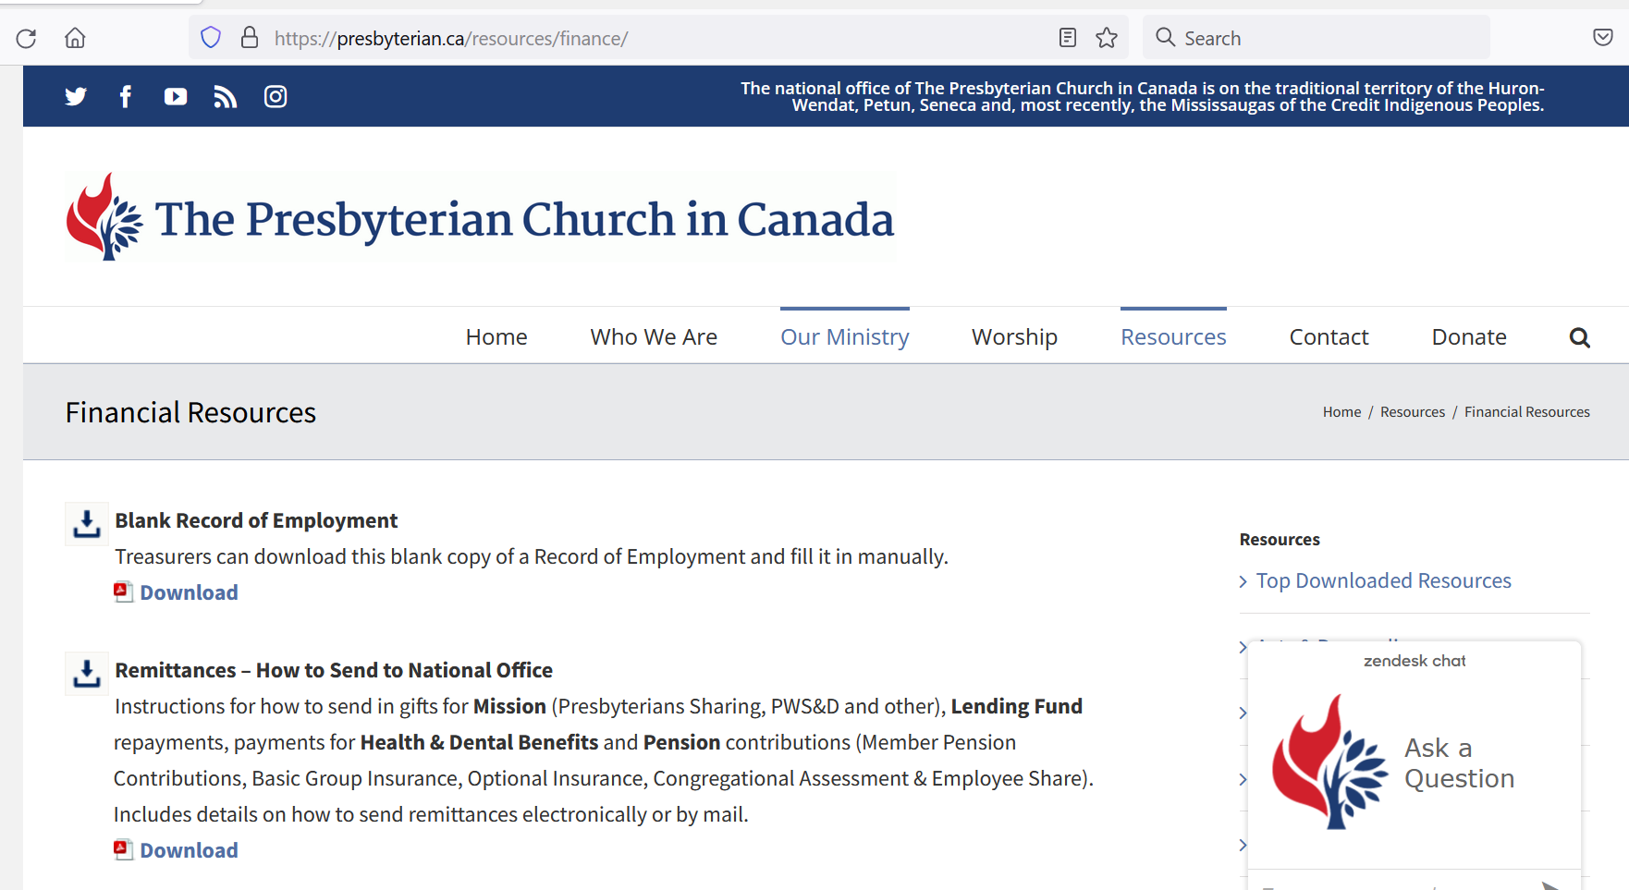
How to remit to PCC Payments presbyterian.ca/resources/finance
RW
PCC Account
Mission: Presbyterians Sharing, PWS&D, Gifts of Change, International & Canadian ministries, Indigenous ministries & PCC lending fund – with remittance form
Health & Benefit payments separate cheque with invoice
Other invoices – separate cheque with invoice
Pension Bank Account
Congregational Assessment, Member contributions, Employer Contributions, Life Insurance – one cheque & remittance form
Notes:
There are now more ways than ever to send your congregation's contributions and payments to the national office. With slow mail delivery and COVID-19 restrictions, more and more congregations are sending funds electronically. Funds may be sent via Electronic Fund Transfers (EFTs) or through bill payments (at Scotiabank and RBC).
Note: EFTs are different from Interac e-transfers, which are sent to an email address or mobile phone number. Unfortunately, the PCC cannot accept Interac e-transfers. EFTs are also different from wire transfers, which are most often international and more expensive. Many banks have EFTs to Canadian bank accounts included in their business account plans, but you need to enquire about your account’s plan to find out what fees you may have to pay. Automatic withdrawals can also be set up. Whether sending a cheque by mail or funds electronically, be sure to submit the appropriate remittance form so that it can be allocated to your congregation (there are many St. Andrew’s) and deposited to the proper accounts.
Every year the PCC handles over $20,000,000 from 800+ congregations, so ensuring the funds go to the right place is a big task! The Pension Board and PCC have different bank accounts, and gifts and payments are handled differently, so we need separate cheques for gifts and payments of invoices, according to the categories below.
However, cheques and remittance forms for all departments may be included in the same envelope and be sent to the attention of Financial Services, ensuring that each cheque has a corresponding remittance form. Automatic withdrawals can now be set up for all payments, using just one form! All remittance forms can now be found at presbyterian.ca/resources/finance.

Slide 64
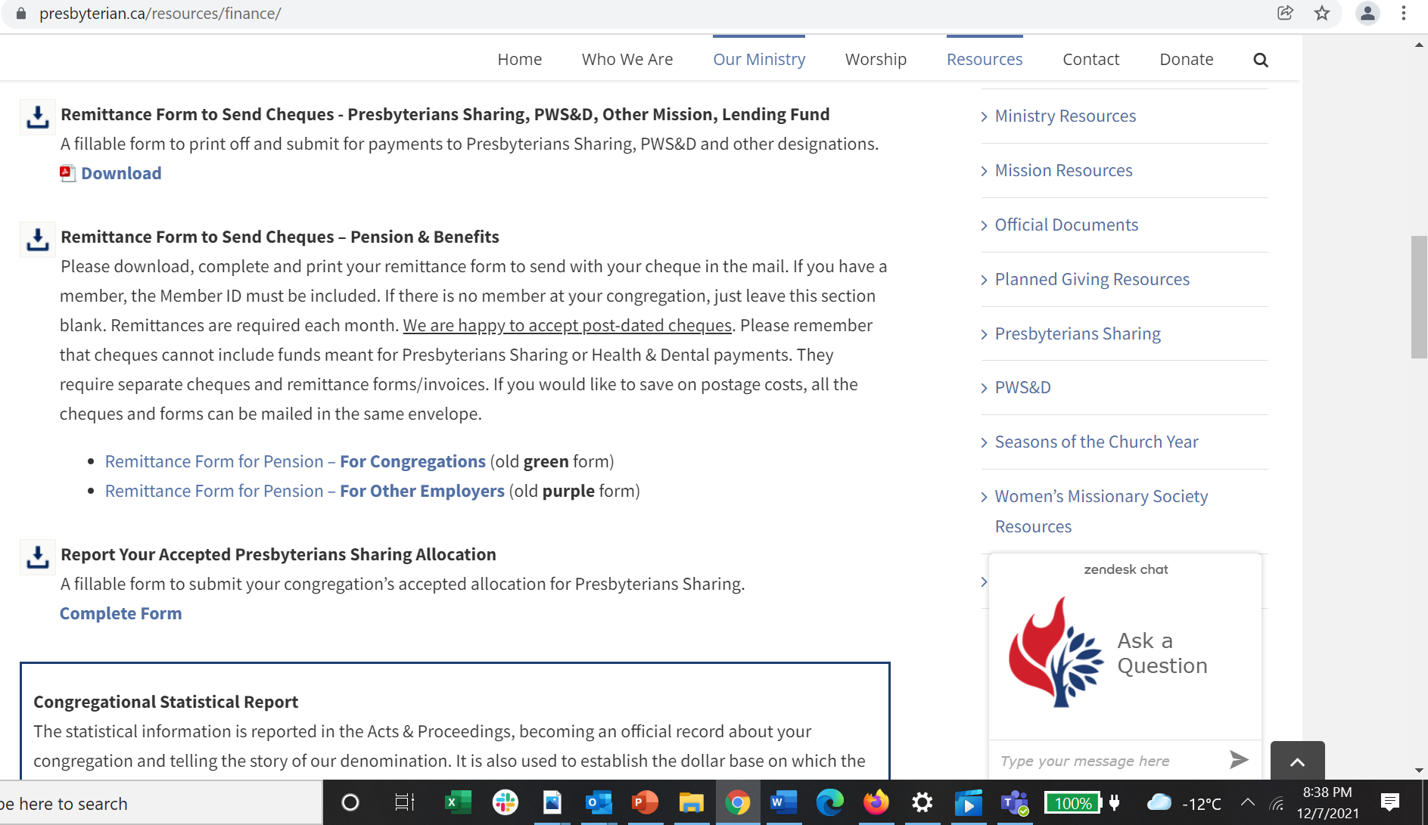
How to remit cheques presbyterian.ca/resources/finance
RW
Notes:
You can find the remittance forms for remitting cheques at presbyterian.ca/resources/finance – both the PCC one and the Pension forms. There are three options – one for the PCC and two for Pension.

Slide 65
PCC remittances cheques
RW
Notes:
This is a fillable pdf
It can include gifts for Presbyterians Sharing, PWS&D – undesignated at the top
Lending Fund
Other PWS&D designations, CM, IM, Gifts of Change – you need to write them in the section for other designations. Explain them the best you can and we will contact you if we don’t know where it is to go. We do honour designations!
It will auto calculate at the end.
Mail to Finance Department at 50 Wynford Dr.

Slide 66
Pension remittances cheques NOTE: PCC and Pension cheques can be sent in the same envelope! Be sure to include the appropriate remittance forms and/or invoice.
LM
Notes:
There are separate forms for congregational assessment and employee share.
Mail to Pension office or include with other remittances and we will ensure it is properly deposited.

Slide 67
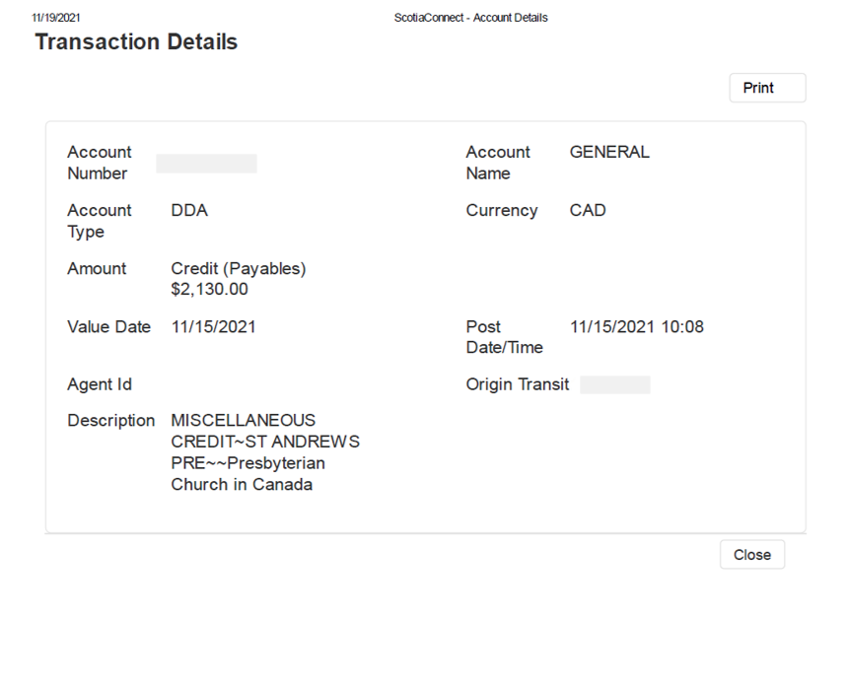
EFT
Sample
Notes:
This is an example of what I get when there is an EFT – as you can see, there is no way for me to identify what St. Andrew’s sent the funds

Slide 68
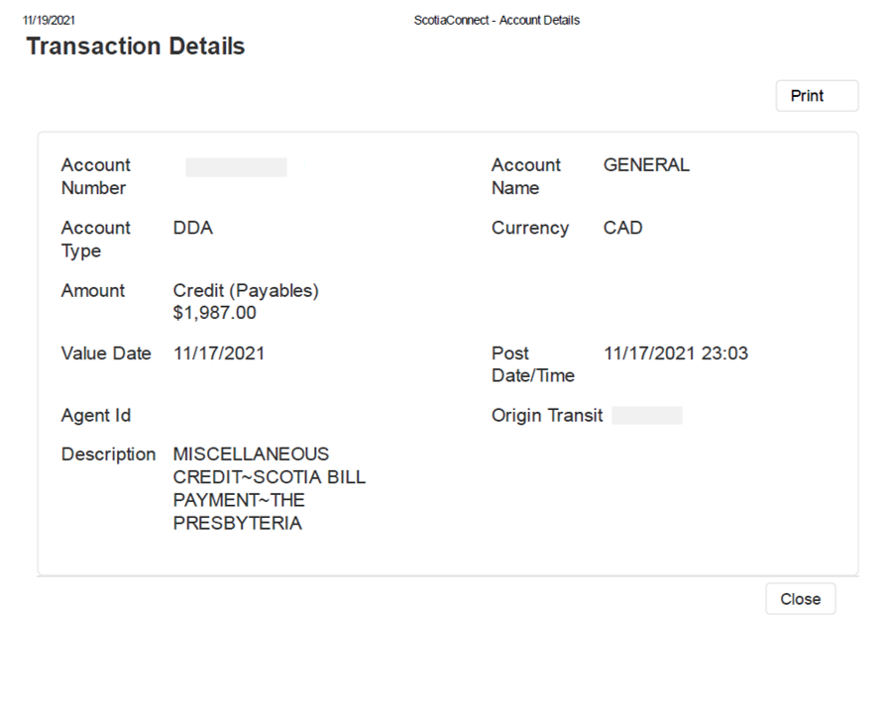
Bill
Payment
Sample
Notes:
It’s similar when there is a bill payment.
That’s why we need you to fill out the EFT ONLINE Form.

Slide 69
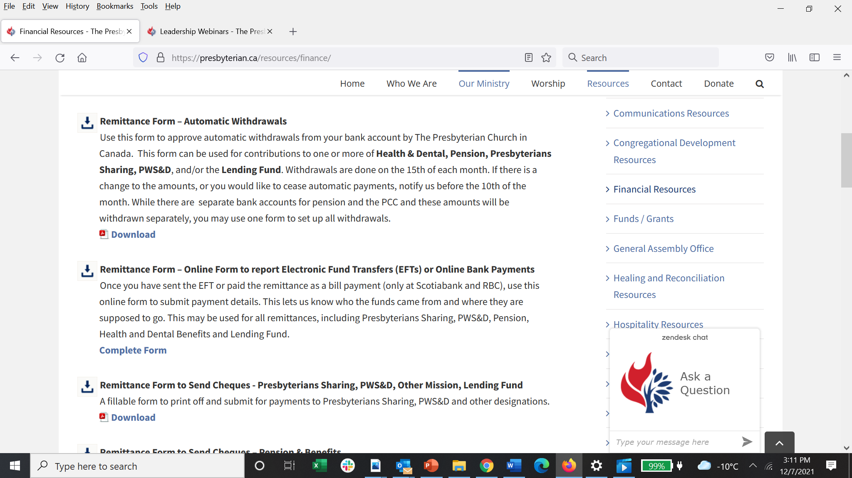
EFT/Bill Payments Remittance form presbyterian.ca/resources/finance
RW
Notes:
You can find the online form at presbyterian.ca/resources/finance/ - that’s where all the remittance forms are conveniently located now.

Slide 70
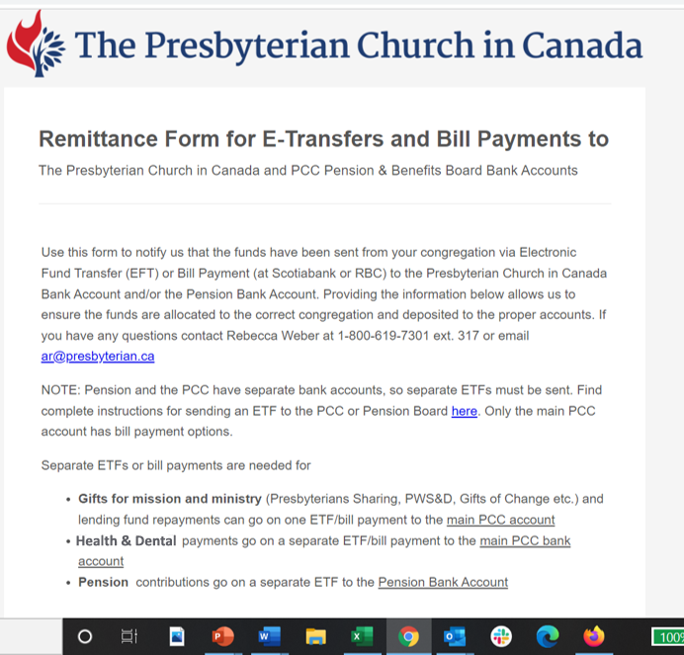
EFT/Bill Payments Remittance form
RW
Notes:
This shows the beginning of the online remittance form, where it has the instructions on how to fill it out.

Slide 71
EFT/Bill Payments Remittance form
RW
Notes:
You need to fill out the contact information of the person who sent the funds.

Slide 72
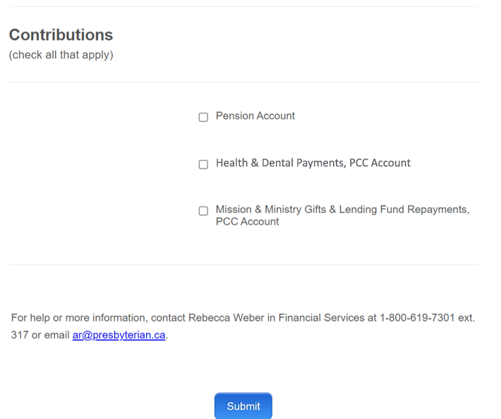
EFT/Bill Payments Remittance form
RW
Notes:
Then check who you are sending the EFTs for – if you have done more than one, you may fill them all in at the same time.
When you check one of the boxes, you are given the option to fill out more information.

Slide 73
EFT/Bill Payments Remittance form
RW
Notes:
For the Pension contributions you can fill out all the applicable information Liane discussed.

Slide 74
EFT/Bill Payments Remittance Health & Dental
RW
Notes:
And here is where you give the Health and Dental Information.

Slide 75
EFT/Bill Payments Remittance Mission & Lending Fund
RW
Notes:
Enter any mission contributions you are sending in.
At the very end press submit!

Slide 76
Automatic Withdrawals presbyterian.ca/resources/finance
RW
Notes:
You can find the form to set up automatic withdrawals at presbyterian.ca/resources/finance

Slide 77
Automatic withdrawal form
RW
Notes:
You can set up automatic withdrawals from your bank account by The Presbyterian Church in Canada for Health & Dental, Pension, Presbyterians Sharing and/or PWS&D and the lending fund.
Withdrawals are done on the 15th of each month. If there is a change to the amounts, or you would like to cease automatic payments, you must notify us before the 10th of the month. As there are separate bank accounts for pension and the PCC, these amounts will be withdrawn separately and may appear differently on your bank statement.
You use this form to indicate which payments you would like to have done by automatic withdrawals. You can check the payments you want and indicate the amounts where applicable. For Lending Fund withdrawals are based on your repayment schedule and Health and Dental they are based on your quarterly remittance.
You can indicate the breakdown of your pension payments, so you don’t need to submit another remittance form.
For PWS&D and Presbyterians Sharing, you can indicate the amounts you want taken out each month. The amounts need to remain the same for at least 6 months, but you can make adjustments at the end of the year for the last withdrawal, or the beginning of the next year, if you need to. This would mean you could have a different amount withdrawn in December or January or February, to make up for any differences in the year (a top up or reduction) then you could go back to a regular submission.

Slide 78
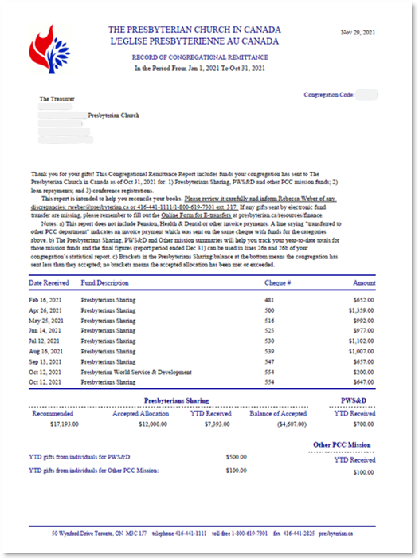
Reading your Congregation’s Remittance
KP
Notes:
This is what your congregational remittance report looks like. It comes quarterly, and a final one sent in January. Review them carefully to see that they have everything you have sent in for mission, lending fund, event registration etc.
At the bottom are summaries for Presbyterians Sharing, PWS&D, and other PCC Mission.
It has your Presbyterians Sharing recommended and accepted allocations (if reported) and shows the YTD you’ve sent to Presbyterians Sharing and the balance from your accepted allocation (if you’ve reported an accepted allocation.)
These forms also tell us if individuals have given directly to the PCC but have asked that your congregations be credited. If they gave to Presbyterians Sharing, it is reflected in your balance.
You can use these lines: Sharing and Other Mission + PWS&D when reporting on the statistical reports.

Slide 79
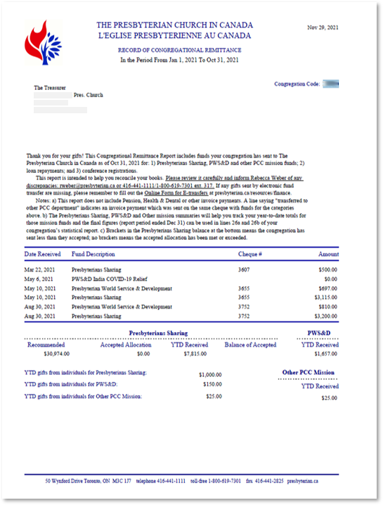
Reading your Congregation’s Remittance Report (Sharing, PWS&D & Other mission gifts)
KP

Slide 80
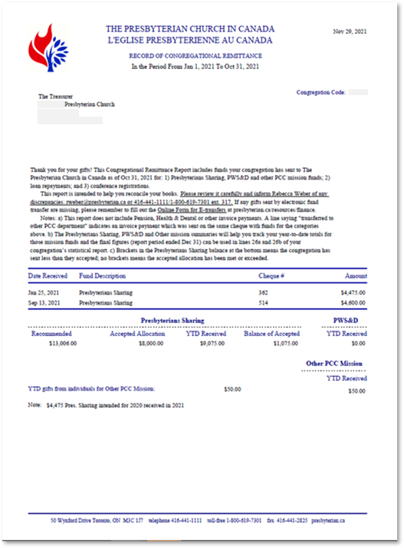
Reading your Congregation’s Remittance Report (2020 Presbyterians Sharing received in 2021)
KP
Notes:
Also if funds were sent in for 2020 but received after our books closed, so they are reflected in this report, that will be noted.

Slide 81
Property Management

Slide 82
Building Insurance
ON
Marsh has a special program for PCC congregations
Coverage:
D&O
boiler plant & equipment
wrongful dismissal
general and sexual abuse
Over 390 congregations on program
Contact info
Notes:
Special program for congregations of the PCC
For a price that is hard to beat, Marsh has set up a program that gives congregations coverage for:
D&O
boiler plant & equipment
wrongful dismissal
general and sexual abuse
Currently, there are over 390 congregations on this program
Contact: Brenda Cook, Marsh Canada @ 416 349 4898

Slide 83
Financial Resources Available through the PCC
ON
There are financial resources available for:
major capital expenditures
e.g. repairs to your building
starting new ministries within your church
Visit www.presbyterian.ca/Canadian-ministries/funds
Notes:
Financial Resource Available through The PCC
There are financial resources available for:
major capital expenditures
e.g. repairs to your building
starting new ministries within your church
Visit www.presbyterian.ca/Canadian-ministries/funds

Slide 84
Manse
MM
Annual inspections of Manse property
Plan renovations
Could update 1 room per year vs. leave until property is vacant; or a bit of both (major expenditures)
Notes:
Those with manses or those former manses now used as rental properties
are there at least annual inspections of the property by Board of Managers or Trustees?
Plan annual renovations
Say, re-decoration or update of 1 room per year,
or
leave until the property is vacant and then major expenditures incurred? – not recommended
Could do a bit of both

Slide 85
Coming Webinar
KP
Thurs., Jan. 13
2 – 3:15 pm Telling the Story Reporting & Communicating Finances
Notes:
This has been the third of four webinars on the ministry of managing money. The next webinar will be held on Thursday January 13th, 2022 at 2 pm:
Telling the Story: Reporting & Communicating Finances
This webinar focuses on the different ways of reporting finances - to Session, the congregation, Canada Revenue Agency, grant makers, lenders, and donors. Learn more about the ins and outs financial statements and how to use financial statements to share your story of mission.

Slide 86
Q & A
KP
What more do you want to know?
Use the chat
Notes:
I want to remind you that recordings will also be posted at https://presbyterian.ca/leadership-webinars/ for people to find and use in the future. If you have any questions, let’s see. Shall we continue with chat or do we unmute?

Slide 87
Thank You
KP
presbyterian.ca/
leadership-webinars
Share it around!
Notes:
Once again, thank-you for your attendance and remember you can find and share recordings online. Have a wonderful and merry Christmas everyone and we’ll see you at our next webinar in the new year.

