Slide 1
The Ministry of Managing Money
Congregational Finances and Stewardship
Notes:
The Ministry of Managing Money
Congregational Finances and & Stewardship
Webinars presented by The Presbyterian Church in Canada
with the support of Presbyterians Sharing

Slide 2
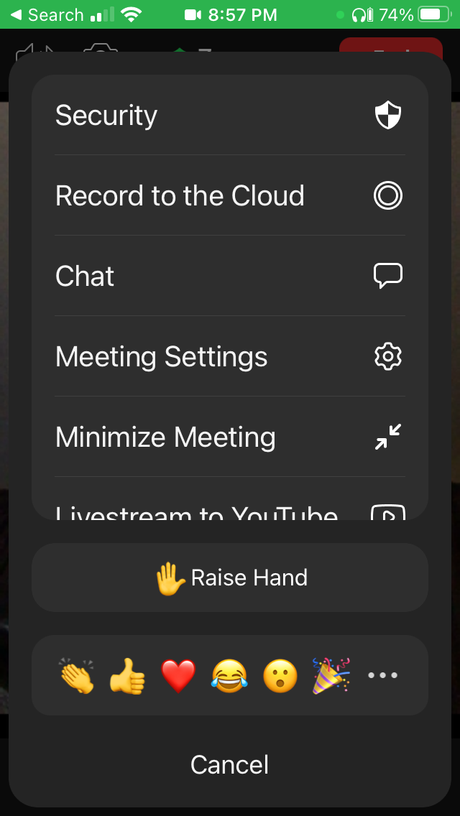
Protocol
Mobile
Stay muted and use chat to ask anything
Chat will be monitored and questions asked as we go along or at the end
There may be an opportunity to unmute at the end
PC

Slide 3
Webinar Series
Today Receiving & Receipting God’s Gifts Exploring Congregational Revenue
Thurs., Dec. 9 Sharing God’s Gifts Examining Congregational Expenditures
Thurs., Jan. 13 Telling the Story Reporting & Communicating Finances

Slide 4
Spread the word
Recording & Slides & Notes will be available at
presbyterian.ca/
leadership-webinars
Share it around!
Notes:
Recordings will also be posted at https://presbyterian.ca/leadership-webinars/ for people to find and use in the future.

Slide 5
Receiving & Receipting God’s Gifts Exploring Congregational Revenue
December 2021

Slide 6
Presenters
Karen Plater, Stewardship & Planned Giving
Maurice Mawhinney, Presbytery of West Toronto & PCC Finance Committee
Jim MacDonald, Stewardship & Planned Giving
Maggie Leung, Stewardship & Planned Giving
Oliver Ng, CFO, The PCC
Notes:
One of the benefits of a webinar is that you can pull in multiple people to present. This really is a collaborative effort.

Slide 7
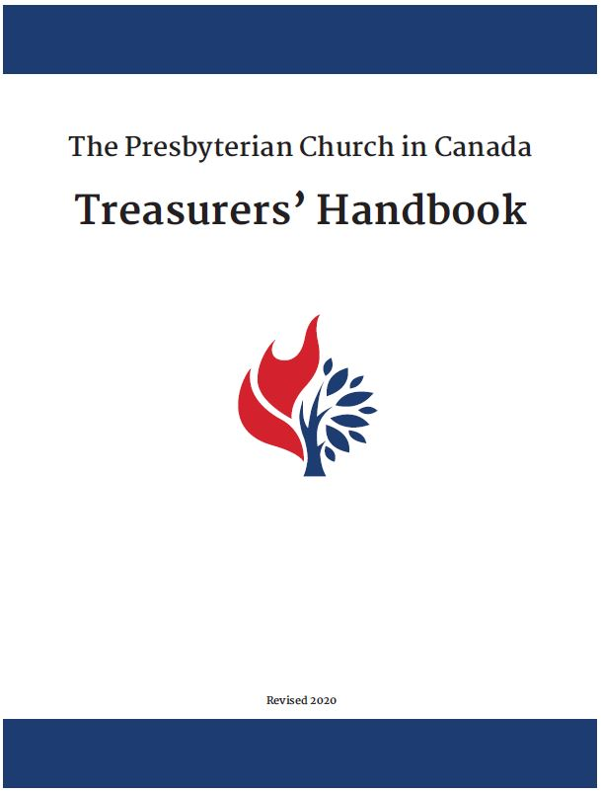
Treasurer’s Handbook
Download presbyterian.ca/resources/finance/
Notes:
Most of the information will be found in the Treasurer’s Handbook.

Slide 8
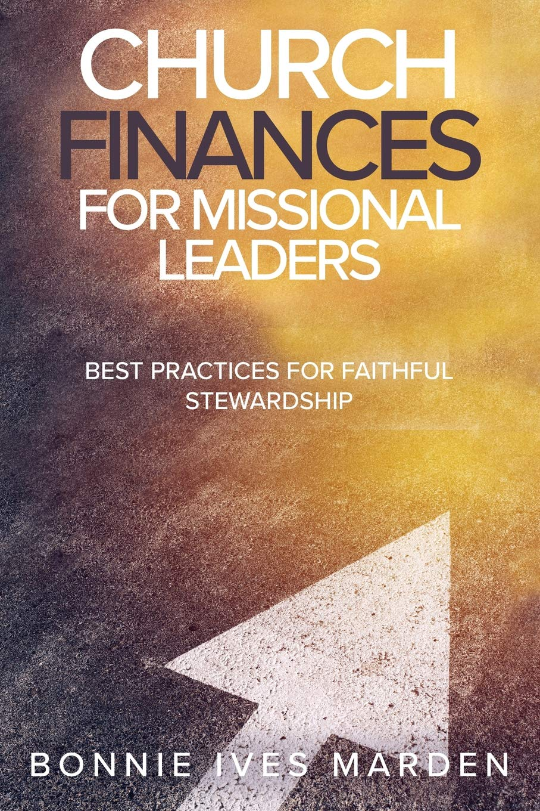
Best Practices
“Budget building and management work is sacred and will directly impact the morale and confidence of the whole community.”– Bonnie Ives Marden
Available on Amazon.ca
Notes:
Bonnie Ives Marden’s book Church Finances for Mission Leaders does an excellent job of integrating both stewardship and money management and biblical principals.

Slide 9
“We are inviting you to invest yourself through the resources that God has given you – your energy, your prayers and your money – in this work to which God has called us.”
Henri Nouwen, Spirituality of Fundraising
Notes:
If it’s not about giving to a budget – it’s about our lives. Look at what we have been given, how we use those resources, and what we can give back.
In the spirituality of fundraising – a great little book, simple read, Henri Nouwen sees encouraging giving as a ministry as a way we share the gifts God has given us.

Slide 10
Reclaim Stewardship
Stewardship is not about giving to a church budget.
It’s about responding to the call of God in our lives with all our gifts – time, treasure, talent.
Notes:
If we want to reclaim the biblical concept of stewardship – we need to reclaim it as a spiritual discipline. It isn’t just about finances – it’s about the way we live our lived. Some of you may have heard this from me before – but really, I can’t say it enough.
When your use of language about stewardship is centered on the need to raise sufficient funds to cover the bills—we can lose sight of what it means to be good stewards. We think more about the total needed and “how much is my fair share?” – rather than, what has God given to me, how am I using it and what can I give back to God.
Now some of you might be saying – BUT we need to pay the bills!!! The thing is, especially if the only message someone hears about stewardship = giving $ - we loose the richness of stewardship and people can begin to think of the church as another fundraising agency looking for my money – rather than stewardship as a spiritual discipline that I am part of.

Slide 11
Giving Money
Money is a symbol of life
Many examples of cash & non-cash gifts in the bible
How we give is important
Notes:
We can’t be stewards of God – whose very nature is giving - without giving resources away - time, talent, treasurer.
Giving is the act of sharing something of value. -
Money is a symbol of our lives, and giving money is a big part of stewardship.
Many examples of people giving money – to build the temple, to care for the stranger,
And the bible shows us that giving can care for the poor, build people up, instill dignity, celebrate life.
And it can also assert power differences, make people feel dependent, take advantage of people.
As Christians, we want to give the way God gives:
generously, abundantly, unconditional,
Sharing love joy and faith,

Slide 12
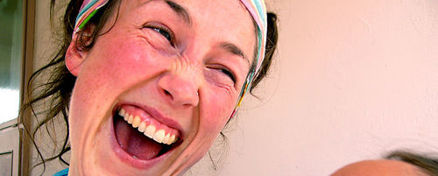
II Corinthians 9:7
Notes:
Each of you must give as you have made up your mind, not reluctantly or under compulsion for God loves a cheerful giver.
John McMullen, in his book Stewardship Unlimited, notes that when you ask people to give until it hurts, you quickly discover how low their pain threshold is!
In reflecting on McMullen’s statement, Al Winn, a Presbyterian minister in the States, suggested that we shouldn’t ask people to give until it hurts; instead, we should ask them to give until it feels good. Well, that is exactly what Paul was asking the first century Corinthians. “Don’t give reluctantly or under compulsion,” he wrote, “for God loves a cheerful giver.” In other words, Paul was urging the Corinthians to give until it felt good, because God loves a cheerful giver.
The Greek word translated as “cheerful” his hilarus, from which we get the English word, “hilarious.” Paul is saying that God loves hilarious givers – those who enjoy giving so much that they gleefully exclaim, “Yippee! Let me do it again!”

Slide 13
For if the eagerness is there, the gift is acceptable according to what one has – not according to what one does not have.
II Corinthians 8:12
Notes:
According to Paul, we are all rich, “rich enough to be generous.”
Sadly, we often look at ourselves on the basis of what we don’t have. We tend to compare ourselves to others and then put ourselves down: “I don’t have a big house or a prestigious job. I don’t have good looks or loads of talent or a 150 IQ.” Yes, we look at ourselves on the basis of what we don’t have and feel like I did in the Five and Dime – like poor cousins of a rich uncle. And in the process we convince ourselves that we have nothing worth giving. But Paul tells us that that is the wrong way to look at ourselves. We need to look at ourselves the way God himself looks at us. And God looks at us on the basis of what we have to give, not on the basis of what we don’t have.
When we begin to look at ourselves on the basis of what we have to give rather than what we don’t have, our inner dialogue begins to change from negative putdown to positive affirmation: “I may not have a big house, but I do have the ability to fix up my house or apartment so it looks and feels like home for me and my family. And I can welcome guests with warm hospitality so that they feel like they are at home when they come for a visit.”
“I don’t have many friends, and I may not be the most popular person around; but I know how it feels to be left out, and I can reach out to others when they feel rejected and lonely.”
“I don’t have oodles of talents, but I can fix things around the house. Why, I can even fix my neighbor’s lawn mower when it breaks down!” I’ll never forget a funeral at which I officiated. The chapel was packed with friends and neighbors of the deceased as they remembered the man fondly known as “Mr. Fix-It” in his neighborhood.

Slide 14
Giving to Make a Difference
Donors don’t give their money TO your ministry
they give to God THROUGH your ministry to touch the lives of other people
Donors will give generously when they feel their money is making a difference
Notes:
Donors don’t give their money TO your ministry
they give to God THROUGH your ministry to touch the lives of other people
Donors will give generously when they feel their money is making a difference

Slide 15
Charitable Registration, Purposes & Activities
Notes:
Every congregation should have CRA registration number. It is possible to loose this number, so it is important to stay on top of reporting and your processes. We have had congregations loose their registration, which leaves them unable to issue receipts – and their donors usually aren’t very happy with that. . .

Slide 16
Charitable Purposes
KP
relief of poverty
advancement of education
advancement of religion
certain other purposes
Notes:
Charitable purposes
To be a charitable organization, your purposes must fall within one or more of these categories:
relief of poverty
advancement of education –
advancement of religion - Congregations fall in here
certain other purposes that benefit the community in a way the courts have said is charitable
This category includes various purposes that do not fall within the other categories but which the courts have recognized as charitable, such as:
relieving a condition or disability associated with old age, which includes providing facilities for the care and rehabilitation of the elderly
preventing and relieving sickness and disability, both physical and mental (for example, hospitals)
providing certain public amenities to benefit the community (for example, public recreation grounds)
providing counselling services for people in distress
operating an animal shelter
operating a volunteer fire department

Slide 17
Advancement of Religion
KP
Defined as preaching and advancing the spiritual teachings of a religious faith, and maintaining the doctrines and spiritual observances on which those teachings are based
Notes:
Most congregational activities will fall neatly into this: worship, mission, Sunday School, care for the vulnerable, speaking for the voiceless, work for justice . . .

Slide 18
Charitable Activities
KP
What you do to accomplish your charitable purposes
Worship
Maintaining a building for ministry
Christian education
Mission & Outreach
Care for vulnerable & seeking justice
Notes:
Charitable activities
Activities are your organization's programs or the things you do to accomplish your purposes. Charitable activities are activities carried out to fulfill a charitable purpose. Without a charitable purpose, your organization cannot have charitable activities.

Slide 19
How can we carry out Charitable Activities?
KP
The Income Tax Act permits registered charities to operate in two ways
Carry out their own charitable activities
Give funds to qualified donees

Slide 20
Gifting to other organizations What is a Qualified Donee?
KP
Registered charities
Municipalities, Provinces, Territories
United Nations & its agencies
Public Bodies Performing a function of government
Registered Universities outside of Canada
Canada, Registered Journalism Organizations
Low Cost Housing Organizations
National Art Service Organizations
Canadian Amateur Athletic Associations
and more . . .
Notes:
Easier to answer the second one first. This will be most common for congregations. You can send to qualified donees, if it fits with your charitable purpose. If you do, the demands of maintaining direction and control aren’t the same – they are implementing for you. Most will be through Registered Charities – Food Bank, Shelter, Mission organizations, Refugee sponsorship groups
Reported in your T3010

Slide 21
Carrying out your own Charitable Activities
KP
A charity can carry on its own activities by
using its staff/volunteers
OR
through an intermediary
When using an intermediary, the charity must maintain direction and control of its resources.

Slide 22
Carrying out your own charitable activities Using an intermediary
KP
You might:
Hire a company or private contractor
Enter into an agreement with a non-profit organization
Pool resources with another organization to complete a project
Notes:
A joint venture participant is an organization a charity works with to carry on a charitable activity. The charity and one or more joint venture participants pool their resources to accomplish an agreed-upon goal under the terms of a joint venture agreement.
A co-operative participant is an organization that works side-by-side with a charity to complete a charitable activity. The charity and the other organization(s) each take on responsibility for specific parts of the project only. This is different from a joint venture, where participants pool their resources and share responsibility for the project as a whole.

Slide 23
Maintaining Direction & Control using an intermediary
KP
The church must make decisions and set parameters for the activities, on an ongoing basis
the overall goals
how it will be carried out
where the activity will happen
who will benefit
when it will begin and end

Slide 24
Maintaining Direction & Control using an intermediary
KP
Written agreements
Ongoing communication & direction
Excellent record keeping with separate books
Make periodic transfers of resources, based on demonstrated performance.
Notes:
The CRA recommends the following measures to maintain direction and control of activities through an intermediary everything needs to be “Complete, clear and detailed” – so they are pretty serious about that. Check out their website for more ideas and complete instructions.

Slide 25
Maintaining Direction & Control Foreign Activities
KP
“A charity can carry on its activities both inside and outside Canada. However, carrying on its activities outside Canada often presents significant challenges and requires substantial ongoing effort.
Before an organization begins carrying on activities outside Canada, the CRA recommends that it consider working with a charity or other qualified donee that has this type of experience.”
Notes:
The same requirements are for foreign activities – which isn’t easy to do – and why they recommend working through qualified donees. Some congregations do successfully have direct partners; others have lost their CRA (or been threatened loss) because of this.

Slide 26
Is it a Gift?

Slide 27
Questions to ask
KP
Was there a transfer of property?
YES = receipt
Was the property given voluntarily?
YES = receipt
Did donor relinquish control?
YES = receipt
Did the donor receive an advantage?
YES= deduct value from receipt with some exceptions
Notes:
Was the gift made voluntarily? YES
Was there a transfer of property? YES
Did donor relinquish control? If YES – get a receipt – this is an interesting one, because they can designate it, but once they give it, it is given
Did the donor receive an advantage?

Slide 28
Is it property?
KP
Cash
Includes debit, cheque, and credit card ,online payments
Non-cash gifts/ Gifts-in-Kind
Capital property (equipment, land, buildings, stocks, etc.)
Personal property (artwork, furniture, clothes, etc.)
Life insurance policy
Charitable Gift Annuities
Ecological land*/Canadian cultural property*
*special rules so not covered today
Notes:
We won’t look at Ecological Land or Canadian Cultural Property – but we will cover all the others today. First, we’ll start with Gifts-in-Kind

Slide 29
Was it given voluntarily?
KP
If it was ordered by a court, then it isn’t voluntary. You’ll be notified if it is a court order.
There may be other circumstances . . .if you know of any, share in chat!
Notes:
This is easy to answer, first we’ll look at the whether it was voluntarily given. . . and then we’ll explore what ‘property is’?

Slide 30
Designated Donations
KP
Did the donor relinquish control?
Donors may give a general direction or choose a particular program.
They cannot choose a specific beneficiary. (Conduit)
Charity is allowed to reallocate within that program.
A registered charity cannot return a donor's gift if a project is oversubscribed – need broad designations

Slide 31
How is it designated?
KP
Did the donor relinquish control?
Internally designated (Emergency appeals, Special offerings, Capital campaigns)
Externally designated by donor (Must fit charitable purpose and be accepted by congregation. Can’t be directed to a specific person, family, or non-qualified donee.)

Slide 32
Acting as a Conduit
KP
Did the donor relinquish control?
Conduit = it’s the donor telling you what to do and doesn’t fit what the congregation wants
You want to help your neighbour or family member, so give through the church to get a tax receipt, but congregation has no connection with the person, no process to help identify need, and no program.
Notes:
For example,
Your cousin has cancer, want to help them out, give $5000 to congregation for them to pass on.
Vs.
Your congregation is raising funds to support your cousin with cancer, identified by committee – type of thing they normally do. If they raise too much $, they forward to another person with cancer.

Slide 33
Returning Gifts
KP
Did the donor relinquish control?
Made by mistake
Ie. $4000 online and meant to give $40 – obvious error
Determined the gift doesn’t fit your charitable purposes – return before receipted
Notes:
A registered charity can’t return gifts UNLESS – made by mistake, given before receipted (ideally before deposited)
Otherwise – if you need to change designated – you have to go to court. If there is one original donor, you could go to them, to renegotiate terms – it’s a bit of a grey area because they have relinquished control when they gave the gift, but if they agree, it’s probably ok to reallocate. Better to have re-allocation terms in an acceptance policy or gift agreement or when you advertise special funds.

Slide 34
Externally Designated Gifts Gift Acceptance Policy
KP
Once gift is receipted, you can’t change the purpose so having policies about what you will and won’t accept, and what happens if a fund is oversubscribed can help.
Notes:
So be sure your counters know not to deposit designated gifts until purpose is approved
A few internally designated funds can help people who want to direct donations.

Slide 35
Externally Designated Gifts Gift Agreements
KP
Background
Purpose & Distribution (Be as broad as possible)
Oversight and Reporting
Re-allocation clause
Amalgamation/Dissolution clause
Signatures of donors
Signatures of two Trustee Board reps
Notes:
Gift agreements can help with large gifts.
The xx Presbyterian Church, xx, ON,
Xxxx Fund (ie Building Maintenance Fund)
Ask PCC if interested in samples.

Slide 36
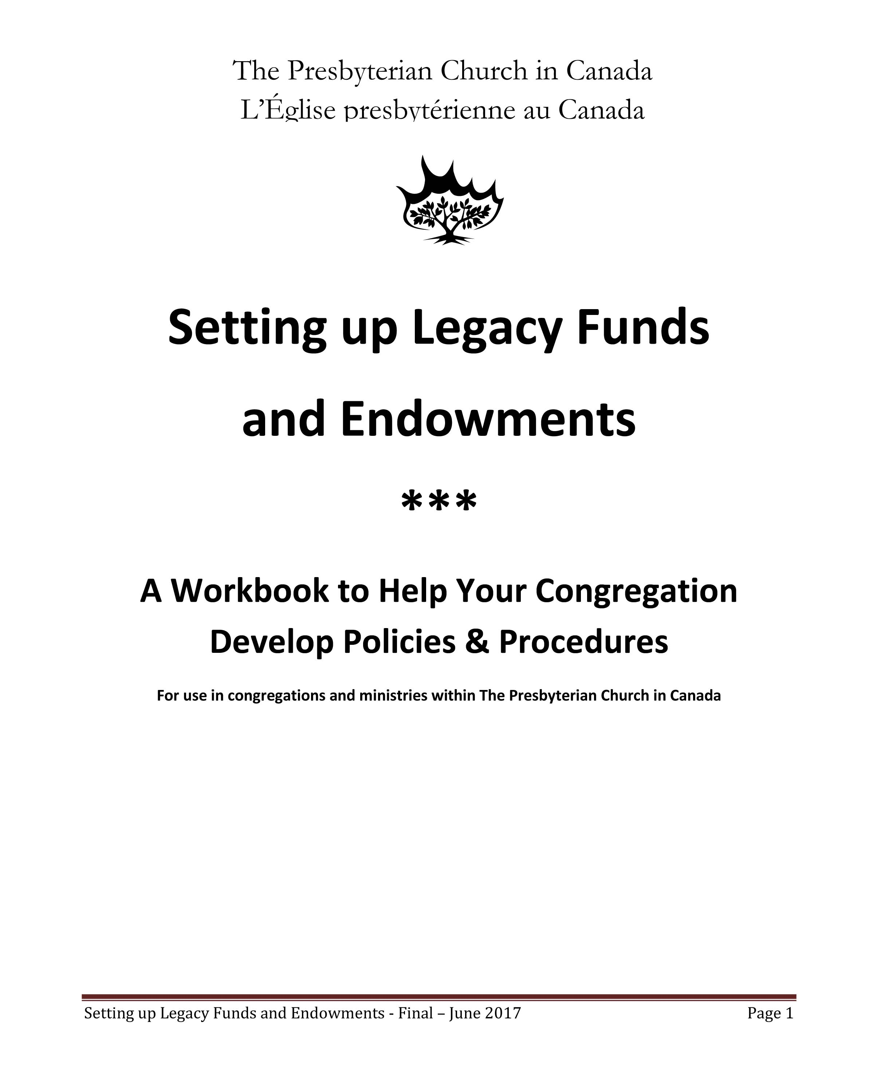
Legacy & Endowment Funds
KP
Did the donor relinquish control?
Setting up Legacy Funds & Endowments
contains sample policies and procedures to help your congregation create funds to ensure they are a blessing for your congregation’s mission and ministry.
presbyterian.ca/resources/ planned-giving-resources/
Notes:
Large legacy gifts can be a headache for congregations – if they are received and people don’t know what they will do with them. Fighting over Bequests is the easiest way to guarantee there won’t be future bequests.
Includes language you can cut and paste to customize one for your congregation.

Slide 37
Advantages
KP
Did the donor receive an advantage?
Dinner or Performance at a fundraising event
Promotional item, like a water bottle or t-shirt
Use of property, like sanctuary for wedding
No advantage = Receipt for full amount
Advantage = Deducted from receipt amount (with some exceptions)
Notes:
Church is not a concert
Congregational dinner – open to anyone, not an advantage . .

Slide 38
Advantages & Gifts-in-Kind Determining Value of the Gift
Based on the Fair Market Value (FMV) of the advantage.
Fair market value = The highest price in dollars that property would bring in an open and unrestricted market.
Willing buyer and a willing seller
Knowledgeable, informed, and prudent
Acting independently of each other
If FMV cannot be determined = No receipt

Slide 39
Tax Credits
Notes:
A word on tax credits – because that’s why we pay attention to our charitable status, and it can help people to give more.

Slide 40
KP
Tax Credits
Tax credit can reduce the donor’s tax bill by almost half of the gift’s value.
Most don’t give to your congregation because of the tax credits, but tax credits can help them give more
Notes:
Government of Canada encourages giving.
Most don’t give to your congregation because of the tax credits – they give because they believe in the mission – and they are giving to God , but tax credits can help people may give more than they think – so they are important

Slide 41
Tax Credits by Province
Alberta 50%
British Columbia 43%
Manitoba 46%
New Brunswick 47%
Newfoundland & Labrador 43%
Northwest Territories 43%
Nova Scotia 49%
Nunavut 40%
Ontario 40%
Prince Edward Island 45%
Quebec 53%
Saskatchewan 44%
Yukon 41%
Average = 45-46%
Sources:
canadahelps.org/en/tax-time/
mackenzieinvestments.com
charitable giving tax credit calculator
Notes:
Results do not include the 33% federal tax credit that is available to those with income over $200,000 (2016 $ equivalent). Information on this can be found on the CRA website.
The information is based on current marginal tax rates and is intended for illustration purposes only. The numbers may not capture all tax benefits available in provinces that have a surtax, and your marginal rate varies with your income – so it’s just to give you an idea. This information should not be relied upon or construed as legal or tax advice. Readers should consult with their advisors, lawyer and tax professionals for advice before employing any of these strategies.
https://www.canadahelps.org/en/tax-time/
https://www.mackenzieinvestments.com/en/services/mackenzie-charitable-giving-program/charitable-giving-tax-credit-calculator

Slide 42
75% of net income reportable in any one year (except Quebec)
Carry forward for 5 years
Spouses can split receipts
Tax Credits,
in Life

Slide 43
KP
Tax Credits in Life
A person with taxable income of $100,000 donates $3,000.
Federal tax credit
$30 (15% on the first $200)
$812 (29% of $2,800)
Provincial tax credit
$20 (10% on the first $200)
$588 (21% on the remaining $2,800)
$1,450 is their total tax credit.
Cost to make donation: $3,000 - $1,450 = $1,550
Notes:
(A little less than 50% - 48% - for illustration purposes we have used 46% - CAGP suggests 45%)
Ranges from 40% in Ontario to almost 49% in AB
Cost to make the donation assumes that they are paying tax and can use the tax credit.

Slide 44
Probably your largest tax bill because all property deemed disposed
Final (terminal) tax return and estate tax return
Graduated Rate Estate stretches savings to help use all tax credits.
Tax Credits
in death
Notes:
Graduated Rate Estate: Terminal Tax return (100%) and Prior Year Tax return (100%) and Estate return (75%)
It’s a great time to use credits to make it possible to give – doesn’t cost your heirs as much as you think.

Slide 45
Gift of Securities No Capital Gains Tax
KP
When given as a gift-in-kind to charity, there is no tax paid on publicly traded securities. So it’s a great way to give more, for less, now or through your estate.
Notes:
Tax receipt we send will indicate the # of shares and their value on the day of the gift

Slide 46
Ways to Receive & Receipt
KP

Slide 47
Ways to Receive & Receipt: Cash Gifts
KP
Includes debit, cheque, and credit card, online payments

Slide 48
Ways to Receive Offering Plate
MM
KP 2a
Cash
Cheques
Envelopes

Slide 49
Offering Plate
MM
Counted & recorded in church
Min. 2 counters (not related)
Take to deposit promptly
Exercise caution about time and location of the deposit and the safety of the depositor
Notes:
Many congregations use a night depository facility at their bank; the Sunday morning offering is deposited by the
counting team on their way home from Church. However, with COVID, that has been adjusted for when people could go in

Slide 50
Depositing Offering
MM
Bank account belonging to congregation
Separate accounts for operating fund and special funds recommended
On Jan 13 we’ll cover Recording & Reporting Offerings
Notes:
7.3 BANKING
The Book of Forms requires that the bank accounts be identified as belonging to the
congregation, and that all funds received be deposited without delay.
The Treasurer receives the duplicate deposit slip, which will be used in the monthly bank reconciliation. It is often desirable that a congregation maintain separate bank accounts for its Operating Fund, and any special funds, such as a Building Fund or any endowment funds.

Slide 51
Ways to Receive Digital Gifts
JM
Pre-Authorized Remittance (PAR)
E-transfers
Online
Terminals
Apps
Notes:
In these times of distance worship, it’s a good idea to make sure your congregation is able to give using digital giving methods. Let’s review each of these briefly, talking about

Slide 52
Ways to Receive Pre-Authorized Remittance (PAR)
JM
Intentional, proportional, faithful
Costs the church only $0.50/donor each month with a max $45/month
Requires PAR contact person
Administered by UCC
working from home
temp. mailing address
Notes:
Most PCC churches are now set-up for Pre-Authorized Remittance. The United Church of Canada administers the program for the PCC, keeping costs low for churches. It costs the church only $0.50/donor each month with a monthly maximum of $45/month for a congregation. A congregation can sign-up even if they have only one donor who wants to give in this way.
To set up PAR for your congregation, you’ll need to assign someone to be the contact person. The PAR contact person sends the completed PAR forms and void cheques with an explanatory letter to the PAR contact at the United Church of Canada. There are instructions online or you can contact the Stewardship Department for help.
By the way, the United Church of Canada staff are working from home, so you don’t mail PAR documents to the address listed on the PAR form. Instead, you mail them to the PAR administrator’s home office using a special address you can find on our website.

Slide 53
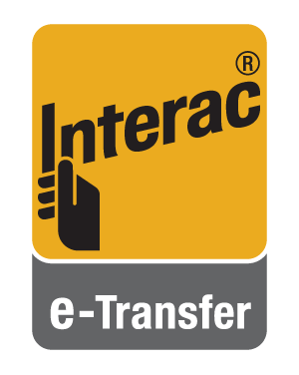
Ways to Receive Interac® eTransfer Donations
JM
Donor pays fees (if any)
Not available from all banking institutions
Often requires active debit card
Caution
Request contact info for tax receipt
Funds must come from donor’s account
Official church email (not gmail/hotmail etc.)
More secure with auto-deposit
2 people manage process
Notes:
Interac eTransfers are the most cost-effective way to receive donations
However, some credit unions are not part of the Interac network and some branches resist giving churches access to receiving eTransfers
Anecdotally, we’ve found that, in order to activate online banking, and thereby make it possible to receive eTransfers, many banks require the church to enable a debit card, usually with a minimum spending limit
The potential for problems of temptation with a debit card are such that a church should be cautious in setting this up
Ensure there is an electronic trail of the transfer of funds and email records for both the donor and the congregation.
Determine who is responsible for managing the e-Transfers. When the e- Transfer email is received, it can be forwarded to two people—perhaps the treasurer for deposit and the envelope steward to record the gift for receipt. Having two people involved helps safeguard the assets of the church and the reputation of those involved.
Use an official church email address to receive the gift rather than a personal email address. You might want to use or create a specific email address for gifts so that only the people who are responsible for receiving the gifts have access to it. Keep copies of the emails informing of the transfer in your financial files with other donation records.
Set up your account so that the e-Transfers are automatically deposited. This bypasses the Question & Answer password step (which can be insecure) and prevents someone from mistakenly depositing the funds into their personal bank account. When the donor is making the transfer, they will be informed that the e-Transfer money will be directly deposited.
Be sure to get the full name and address of the donor so that you can issue the charitable tax receipt. Remember that receipts must go to the person who sent the funds—so donors must send the funds from their own bank account.

Slide 54
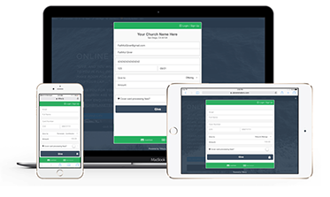
Ways to Receive Online
Donate button on website
Leads to form
Embedded or
On provider’s site
Available 24/7
Offers easy monthly giving
CanadaHelps.org and Tithe.ly
Notes:
Online donation forms on your website make it possible for people to give online, 24 hours a day and seven days a week. It’s a good option for people who have moved away from your congregation, but still want to give, and most services offer easy monthly giving. We once had a person who wanted to donate monthly to a former congregation. They had e-transfers but no donation form on their website. Once they learned someone wanted to give that way – they were quick to adapt! The donate button on your website leads to a form that is either embedded on your website, if you have the necessary security protections, or links to a proprietary form set-up for your church on the service’s website. Although there are a few more services out there, the Stewardship Department has found that either CanadaHelps.org or Tithe.ly seem to serve the majority of congregations, and I’ll explain the difference between them.

Slide 55
Online options
JM
New from JIM
DONATE
CanadaHelps.org
Foundation
Church has a “profile”
CanadaHelps provides tax receipt
Church receives funds from CanadaHelps
Donor is CanadaHelps’ donor
Tithe.ly
Payment system
Church has an account
Church provides tax receipt
Church receives funds from donor
Donor is church’s donor
Notes:
CanadaHelps.org is a foundation, so the donor is considered a donor of CanadaHelps. CanadaHelps collects the donor information and issues the tax receipt and the church merely receives the funds. The donor has to give permission for their personal information to be shared with the congregation. (Most do – but the church needs to claim its account to learn who gave the funds.) Some smaller churches are happy that the tax receipting responsibilities are taken care of, knowing they can get the donor’s information to send a thank you note. Others prefer to have more control over their donations.
Tithe.ly is a payment system. For churches, the experience is more like online banking. With Tithe.ly, the “donate” button on your church website is a tool for your church to receive the funds. The donor is the church’s donor and your church collects all the contact information and provides the tax receipt.

Slide 56
Online options
JM
DONATE
CanadaHelps.org
No set-up fee
Will mail cheque
or set-up auto-deposit
4% per transaction
3.75% if claim profile
Monthly lower
Gift under $30, CanadaHelps fee is lower
Tithe.ly
No set-up fee
Must set-up auto-deposit
Need bank info to set-up
2.9% + 30¢/transaction
PCC discount: 2.75% + 30¢
Gift over $30, Tithe.ly fee is lower
Jim MacDonald will help you set-up
Notes:
Both services do not charge a set-up fee. For single donations, CanadaHelps.org charges a fee of 4% per transaction but if your church claims its charity profile on CanadaHelps.org and sets-up a Customizable Donation Form (CDF), the fee is reduced to 3.75%. (There are different rates for monthly donations.)
Tithe.ly charges 2.9% + 30¢ per transaction but PCC churches get a special rate of 2.75% + 30¢ per transaction for VISA/Mastercard and debit transactions; the fee for American Express is higher.
How do these fee structures compare? For a gift of less than $30, CanadaHelps.org's transaction fee is lower than Tithe.ly's fee. For any gift over $30, Tithe.ly's fee is lower. However, the difference in fees isn't that great. The transaction fee for a $20 gift would be 75¢ for CanadaHelps.org and 85¢ for Tithe.ly. The transaction fee for a gift of $100 would be $3.75 for CanadaHelps.org and $3.05 for Tithe.ly. The more important difference is how the two organizations are structured. I would say for larger churches, they would prefer to have more control and be able to provide comprehensive tax receipts for their donors. However, for smaller churches, CanadaHelps.org makes things simple.

Slide 57
Ways to Receive Apps
Some PCC churches use Tithe.ly app (addl. $)
Custom branding and layout
Mobile giving
Groups and chat
Newsfeed/push notifications
Sermon/podcast player
Can be a good communication tool but must be updated or users learn to ignore
Notes:
Tithe.ly and other church management systems offer the ability to create an app platform for your church. If your church has or wants to attract a community of people who prefer to work with mobile devices, an app offers tools through an easy to install icon on their cellphone or tablet. For instance, with the Tithe.ly app, in addition to giving a donation members can take interactive sermon notes, listen to messages on the go, access small group material, check the prayer list, engage with your real time church newsfeed, and more. Because it’s more than just about giving, you need to have the rest of the church staff onboard.

Slide 58
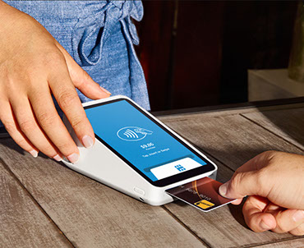
Ways to Receive Terminals
JM
Fewer people carry cash (50%)
esp. during/after pandemic
Terminals costs about $300
Square (most economical)
Debit (Interac 10¢/trans. w/WiFi)
Credit Card (2.65%/trans.)
Manual input (3.4% + 15¢)
Can add donor list to device
Tap makes giving fast/safe
Notes:
Nowadays fewer people carry cash. In a recent survey in the US, more than 50% of people said they carry cash only occasionally. I’m sure this is equally true for Canada. As a consequence, spontaneous in-person giving is made more difficult because people often make all their purchase with their card or mobile device. A credit/debit card terminal is the answer. There are three competitors in this space right now, Square, Stripe and Cloverflex and Square is the least expensive of the three. Fees charged for debit card transactions are ten cents per transaction, if the terminal is connected to the web and the transaction can be verified in real time. Credit cards cost more, as you can see, but the ability to tap makes these devices infinitely easier than setting-up a computer with a copy of your online giving form and expecting people to fill all that out in the narthex of the church. These devices can store your entire membership list, so an usher can quickly select the donor’s name from the list and the donor can tap to give rapidly. The process is still a little too slow for giving during the offering, but it’s rapid enough to be considered painless and convenient by the donor.

Slide 59
Donation Tracking
JM
12% use manual systems to track donations.
26% use Excel
Powerchurch 11% (CMS customizable for Canadians, no payroll)
Coopersoft 14% (smaller churches - Canadian)
Offering Helper (small company, users like)
Other Church management systems (Donarius, Churchwatch, Servant Keeper, Realm, Breeze)
Dedicated donation tracking
Most will issue tax receipts and generate reports
Notes:
Dedicated Donation tracking software can help congregations track donations and communicate with donors.
Most of these tools will issue tax receipts and generate reports.
Some offer additional features that help manage every aspect of church life including
membership data,
children’s check-in,
event management,
small-group management,
volunteer scheduling and management,
along with automated workflows and dashboards to measure and summarize it all.
This level of software serves little purpose without many parishioners and volunteers to manage. As such, it is designed to serve quite large churches and comes with commensurate costs.

Slide 60
Receipt Basics
JM
Notes:
Jim: I’ll hand over to Karen to talk about Receipt Basics

Slide 61
KP
Receipt Basics
Only registered charities or qualified donees can issue receipts.
Donors cannot claim a tax credit without a receipt.
Issue by end of February or earlier!
Notes:
Be sure to maintain your charitable registration!
Last week – it’s not the law that it be the end of Feb – and may be circumstances that you can’t, but it’s a best practice.

Slide 62
What should it look like?
KP
Design & format is up to the congregation but it must include the following info prescribed by law:
Notes:
Notes:
A receipt cannot be made out to anyone other than the person who gave the cash/property
i.e. someone gives $20 to the church and asks that the receipt be made out in someone else’s name - NO
Receipt must have donor’s address
if you don’t have the address you cannot issue the receipt – if it’s an individual, it should be their home address, a business could be a business address
Receipt format is left to the discretion of the congregation, but must contain specific information prescribed by law

Slide 63
Receipts Must Contain 1. Charity & CRA Details Static Elements
KP
Statement: Official receipt for income tax purposes
Name and address of charity
Charitable registration number
Serial number of receipt
Place or locality where the receipt was issued
Signature of an individual authorized by the charity
Name and Website address of CRA
www.canada.ca/charities-giving
Notes:
All official receipts must contain: (Part I)– this is the information that doesn’t change!
A statement that it is an official receipt for income tax purposes
Name and address of the charity
Charity’s registration number
Serial number of the receipt
Place or locality where the receipt was issued
Day or year donation was received
Day on which the receipt was issued if it differs from day of donation

Slide 64
Receipts Must Contain 2. Donation Details Variable Elements
KP
Date gift received
Consolidated (year) vs. One-per-gift (dd/mm/yr)
Day on which the receipt issued (dd/mm/yr)
Full name and address of donor
Amount of gift
Eligible amount of gift
Value and description of any advantage
Notes:
2019 Receipts (Cont’d.)
All official receipts must contain: (part II)
Full name, including middle initial, and address of the donor
Amount of the gift
Value and description of any advantage received by the donor
Eligible amount of the gift – different if there is an advantage
Signature of an individual authorized by the charity
Name and Website address of the Canada Revenue Agency – www.Canada.ca/en/services/taxes/charities

Slide 65
Annual Consolidated Receipt Sample
Notes:
This is what the PCC Receipt looks like. We do two copies on one page. It can be folded so the name and address can be seen in a window envelope. A brief thank you. When designing – don’t need a whole lot more. On the right and top ,static properties, in the center/bottom are the variable elements. This is for the annual consolidated receipt. Let’s look at the elements closer.

Slide 66
Annual Consolidated Receipt Sample
Notes:
No fund details, everything is included – date range. Should be all the financial gifts, if this is how you are doing them. If you are doing one-off, online donation receipts, separate from envelopes, be specific: online gifts vs. envelope gifts.
We don’t want duplicated receipts.

Slide 67
One-Receipt-per-Gift Sample
Notes:
On the one receipt per gift we include a fund description (note that we only have room to include 2 funds)
It has a specific date listed and issued.
Everything else is very similar to annual consolidated receipt.

Slide 68
Remember
KP
Details of person/business who gave cash/property
Someone else’s name? No!
Must have donor’s resident address
No address = no receipt
Notes:
Notes:
A receipt cannot be made out to anyone other than the person who gave the cash/property
i.e. someone gives $20 to the church and asks that the receipt be made out in someone else’s name - NO
Receipt must have donor’s address
if you don’t have the address you cannot issue the receipt – if it’s an individual, it should be their home address, a business could be a business address

Slide 69
Advantages Split Receipting
KP
$10 donation - $2 water bottle (advantage) = $8 receipt
Notes:
Church is not a concert
Congregational dinner – open to anyone, not an advantage . .

Slide 70
Receipt Sample with an Advantage

Slide 71
Advantages Intention to Give Threshold
KP
The value of the advantage received has to be less than 80% of the gift.
Example
$100 donation + $90 dinner (advantage) = no receipt
$150 donation + $90 dinner (advantage) = $60 receipt from charity (because dinner is 60% of the gift)
Notes:
.

Slide 72
Advantage De minimis rule
KP
If the advantage does not exceed either $75 or 10% of the gift (whichever is less), then the advantage is not deducted from the value of the gift.
Does not apply to:
Cash or near-cash equivalents
Core element of a fundraising event
Notes:
Church is not a concert
Congregational dinner – open to anyone, not an advantage . .

Slide 73
Advantage De minimis rule examples
KP
A donor gifts $200 to your congregation
You give the donor a t-shirt worth $15
The t-shirt is worth less than 10% of the $200 gift
Issue a receipt for the full $200.
A donor gifts $50 to your congregation
You give the donor a cross keychain valued at $10
Keychain is more than 10% of the value of the gift
Issue a receipt for $40.

Slide 74
Advantage De minimis rule examples
KP
A donor gifts $2000 to your congregation
You give the donor a wine bottle valued at $100
Wine is less than 10% of the gift but, it is greater than $75
Issue a receipt for $1900.

Slide 75
Ways to Receive & Receipt: Non-Cash Gifts
KP

Slide 76
Gifts-in-Kind: Determining the Fair Market Value (FMV)
KP
Property under $1,000
Competent person with sufficient knowledge can determine FMV. (Can be connected to charity.)
Property over $1,000
Professional appraiser not connected to the charity or donor should determine FMV.

Slide 77
Gifts-in-Kind: Deemed Fair Market Value (FMV)
KP
The deemed FMV = the cost to acquire the gift. It must be used when:
The donor acquired the gift less than three years before donating it; OR
The donor initially acquired the gift as part of a tax shelter arrangement; OR
The donor acquired the gift less than 10 years before donating it, with one of the main purposes being to give the property to a qualified donee.
The gift’s FMV OR Donor’s cost to acquire the gift – whichever is less.
Notes:
No speculation/income earned without paying tax. Buy communion tokens for $50 on e-bay and then donate them to the museum, valued at $5000.

Slide 78
Gifts-in-Kind (Deemed Fair Market Value)
KP
Example
A donor buys a communion tokens for $50 on e-bay and then six months later donates the work to the Presbyterian Church Heritage Center.
The tokens are appraised at $5,000;
The registered charity would issue the donor an official donation receipt for $50.
Notes:
If they were inherited, or in family for a long time, no problem.
If they were bought for the purpose of making a donation, need to keep for 10 years.
Have to ask the donor as part of your due diligence. It’s up to the donor to be honest.

Slide 79
Can I donate a service?
KP
No, service is not property
Exceptions
Gifted materials (which are property); and/or
Service provider voluntarily returns a payment as a gift.
6

Slide 80
Donation of Services Example
KP
Joseph’s Carpentry Inc. donates shelves for the church library
Building materials $200
Labour $300
Total cost $500
Option 1 Receipt: $200 for building materials
OR
Option 2 Receipt: Pay invoice, Joe writes a cheque for $500 and receives receipt for $500, Joe reports $500 income. This creates a paper trail and he pays tax. (can’t just endorse cheque)
Notes:
Can’t just endorse the cheque – needs to deposit it.

Slide 81
Gift certificates / gift cards
KP
If donated directly by the store (the issuer):
Receipt can only be issued when the gift certificate is redeemed.
If donated by a 3rd party:
Receipt can be issued immediately.
Notes:
= someone buys a gift certificate and gives it to the congregation (store has the income) vs. a store gives the gift certificate (they don’t have the income yet, because no one gave them cash.

Slide 82
Gift-in-Kind Receipts
KP
Brief description of property transferred to congregation
Name and address of appraiser
Fair market value of property
Notes:
For non-cash gifts (gifts in kind), the receipts must included these additional items:
Brief description of the property transferred to the congregation
Name and address of the appraiser (if it was appraised)
Deemed fair market value of the property in place of the amount of gift above

Slide 83
Gift-in-Kind Receipt Sample
KP

Slide 84
Ways to Receive Legacy & Planned Gifts
KP
KP 2a
Securities
Annuities
Insurance
Bequests
Gifts of Residual Interest
Charitable Remainder Trusts
Notes:
Planned Gifts – because they require planning
Legacy Gifts – because they tend to be given from savings to support future ministry of the church
Jim and Maggie are going to present these:

Slide 85
Ways to Receive Securities
ML
Selling appreciated publicly traded securities on a recognized stock exchange –capital gain is taxable to donor unless given directly to a charity.
Notes:
Some congregations have stock broker working with them, feel free to use your stock broker.
In any case, PCC is able to process stock donations for your congregation.
Canada Revenue Agency accepts the closing bid price of the share on the date it is received as the fair market value of the shares. It can also accept the midpoint between the high and the low trading prices for the day if that is a better indicator of fair market value on normal and active market trading. A charity may wish to get professional advice to determine the value of shares that are not publicly traded.

Slide 86
Securities Example
ML
Donates shares as a gift-in-kind
$50,000
$30,000
$0
$50,000
$23,000
$27,000
Giving securities as a gift-in-kind costs less to give more!
$50,000 securities to give, original cost $20,000. Donor’s marginal tax rate is 46%.
Sells shares donates proceeds
1. Value of shares $50,000
2. Capital gain $30,000
3. Capital gain tax (#2 x 50% x 46%) $6,900
4. Value of gift and tax receipt (#1 - #3) $43,100
5. Income tax credit (#4 x 46%) $19,826
6. Cost to make the gift (#1 - #5) $30,174
Notes:
If the person sells the $50,000, reserves the $ to pay the tax and then makes the gift, the gift will only be $43,100. Their tax credit is less . . .so the cost to make the gift is more.
However, if they donate the $50,000 as a gift-in-kind, they don’t have to pay the capital gains tax, and so the gift is MORE and their tax credit is more, so it actually costs them less to give more to the congregation. It’s a little mind boggling.

Slide 87
Ways to Receive Securities Donation at PCC
ML
PCC accepts gifts of securities for any congregation or ministry (Presbyterians Sharing, PWS&D, Indigenous ministries etc.)
Donor
Completes Gift of Publicly Traded Securities form
Send completed form to broker and national office
PCC broker
Sells stock shortly after received.
PCC national office
PCC issues charitable tax receipt to donor based on closing market value the day the PCC broker receives the stock
Stock sales proceeds less PCC broker fees go to beneficiaries
Notes:
Stock price fluctuates, sold amount may be different from the time the stock is received by PCC broker.

Slide 88
Gift of Securities Receipt Sample
ML
Notes:
The receipt needs to include the units of stock and the value of the stock received - because they will use it to not pay their capital gains taxes.

Slide 89
Ways to Receive Annuities
ML
Charitable Gift Annuities
Irrevocable gift made to any PCC congregation or ministry, and in return, the donor gets guaranteed stable income for life
Single or Joint (spouse or sibling)
One-time charitable tax receipt for min. of 20% of total annuity (% increase with age, when acquired and size of gift)
Notes:
Ideal planned giving vehicle for people 60 or older who would like to leave a gift to the church after they die, but also need to receive a steady income during their lifetime.
Self-insured annuity by PCC.
PCC is a member of the Canadian Charitable Annuity Association – works with its members to set standards, self monitors the ethical and technical aspects of charitable gift annuities.

Slide 90
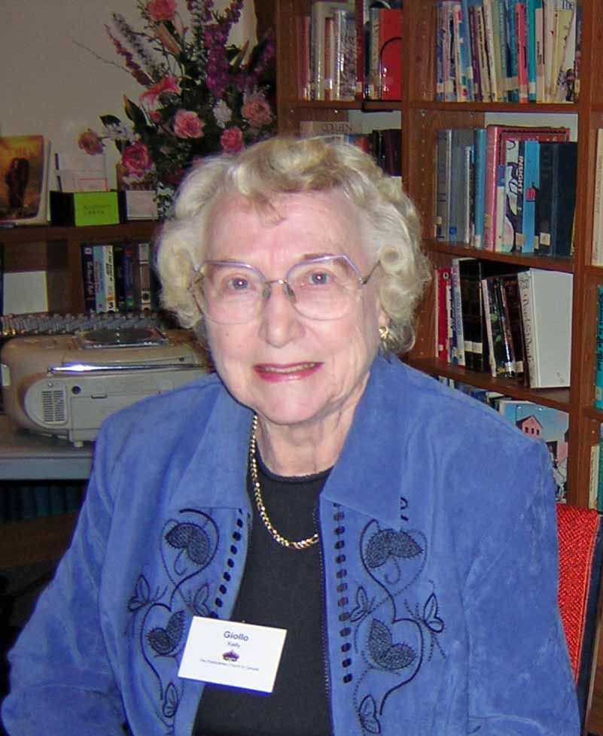
Ways to Receive Annuities
ML
Giollo Kelly bought a gift annuity: $10,000 for PCBC in 1994
When she died fifteen years later, she had received nearly $11,000 in total payments (87% tax-free)
Left a legacy of nearly $7,500 for PCBC

Slide 91
Ways to Receive Charitable Gift Annuity
Age 60 or older Minimum $10,000
Annuity Rate based on bond yield rates (update weekly)
Choice of payment frequency
Tax free and taxable payment portions
Provided by PCC to benefit any congregation or ministry
Notes:
Donors who are interested in getting a Charitable Gift Annuity can contact Maggie.
Start by collecting the donor’s information, esp. date of birth, and the amount they wish to donate, then we will run an annuity quote.
The quote forms the foundation of the terms on the Charitable Gift Annuity
Amount donated, receipted amount
Annuity rate (rate at which the annuity will pay out – it doesn’t change once set)
Annuity payment amount and frequency
Tax free and taxable payment portions
The donor is guaranteed the payment amount and frequency for life. When the donor dies, the money remaining in their annuity account will be sent to the designated beneficiaries (congregation or ministry).
The PCC provides them to benefit any Presbyterian congregation or ministry.

Slide 92
Ways to Receive Insurance – 4 Ways to Give
JM
Paid-up Policy
Transfer ownership to charity
Immediate tax receipt
portion of cash value
or, if continue to make payments (not to estate)
Named Beneficiary
Revocable
Tax receipt to estate
Notes:
A donor can transfer the ownership of an existing policy. The church will issue you an immediate tax receipt for a portion of the policy’s cash surrender value, if any. If you continue to pay annual premiums after transferring the policy, the church will issue regular tax receipts (and no tax receipt will be issued to your estate). Use the receipt for this year’s income tax return (up to 75% o your net income) and carry forward any unused portion for up to five years. (Note: there may be a tax liability when you transfer ownership of the policy to the church.)
If you already have a policy, you can change the beneficiary to The Presbyterian Church in Canada or your congregation. Because this is a revocable gift, we are unable to issue you an immediate tax receipt, but your estate will be issued a receipt for the entire amount of the life insurance policy in the year the gift is received. This receipt can be used on your final tax return (up to 100% of your net income, with unused credits applicable up to 100% of your net income for the previous year).

Slide 93
Ways to Receive Insurance – 4 Ways to Give
JM
New Policy
Church as owner and beneficiary
Tax receipt for payments (not to estate)
Combined Gift
E.g., use annuity payments to pay insurance premiums
Legacy to church or Inheritance for heirs
Notes:
You can purchase a new policy with the church as owner and beneficiary. The church will then issue a tax receipt for the annual premiums you pay after transferring the policy. In this case, no tax receipt will be issued to your estate because you benefit from the tax relief during your life. This is a creative way for those who are younger and may not have substantial assets to leave a significant legacy to the church.
Combine life insurance with another planned giving vehicle. For example, you could use the extra income you receive from a charitable gift annuity to purchase a life insurance policy. You could use this insurance to increase your legacy to the church or to provide a substantial inheritance for your heirs.

Slide 94
Insurance Sample
JM
Total premiums paid (10 years x $3,000) | $30,000
Total amount of charitable receipts issued | $30,000
After-tax* cost of policy | $16,200
Total Gift to the church will be | $150,000
*Assumes a combined provincial and federal charitable tax credit of 46 percent (after the first $200 in charitable givings. Note: Provincial tax credit rates differ).
Notes:
Ms. Lee, aged 45, wanted her congregation to receive a significant gift to help replace her annual givings to the church after she dies. However, she needed to keep her current capital assets intact. Ms. Lee learned that she could get a “term‐to‐100” life insurance policy of $150,000 that is guaranteed to be paid in 10 years.
As a non‐smoker, her policy will cost about $3,000 per year.
However, because of the charitable donation receipts she received, Ms. Lee was able to provide a substantial future gift of $150,000 for her church for a net after‐tax cost of only $16,200.

Slide 95
Insurance Receipt Sample
JM
Notes:
Indicates that it is an insurance premium, and the value of the premium.

Slide 96
Legacy (Major or Bequests)
JM
Optimal is no designations, restrictions or conditions from estate or donor
Have a legacy fund you can promote
Notes:
Best Kind - No designations, no restrictions and no conditions from estate or donor – the congregation decides how it is spent
Gifts or estates with conditions -- look before you leap. ALSO don’t deposit the cheque or accept the money until you can say yes to the conditions
Bequests from estates or gifts from third parties with conditions once accepted cannot be changed!!
If you want to avoid too many designations, then create one or two internally restricted funds and encourage people to give to them (don’t have too many). Conditions or restrictions set up internally can be changed by the originating and approving body – include it in the policy and let people know under what circumstances they can be changed.

Slide 97
Ways to Receive Bequests
JM
General Bequest directs that the church will receive a designated sum.
Percentage Bequest states that the church will receive a predetermined percentage of your estate (e.g. 10%).
Specific Bequest directs that the church will receive a speciﬁc piece of property such as a piece of real estate, the stock from a speciﬁc company or some other speciﬁed property.
Notes:
General Bequest directs that the church will receive a designated sum. You may prefer this arrangement because it is considered a primary charge against your estate, which means it will most likely be fulﬁlled. However it might be hard to decide how much you can leave, not knowing your circumstances at the time of death.
Percentage Bequest states that the church will receive a predetermined percentage of your estate (e.g. 10%). The advantage of is that it keeps your gift in line with the value of your assets as they change.
Specific Bequest directs that the church will receive a speciﬁc piece of property such as a piece of real estate, the stock from a speciﬁc company or some other speciﬁed property. Caution: A speciﬁc bequest can be satisﬁed only with the property designated. If that property has been removed from the estate, the church would receive nothing in its place.

Slide 98
Ways to Receive Bequests
JM
Residual Bequest designates that the church to receive all or a portion of whatever remains in your estate after beneﬁciaries, debts and administrative fees have been paid.
Contingent Bequest is “contingent” on some event. It might make a primary bequest for a spouse or child, with the contingency that if that relative should predecease the donor, the bequest would pass to the church instead.
Notes:
Residual Bequest designates that the church receive all or a portion of whatever remains in your estate after all named beneﬁciaries, debts and administrative fees for settling the estate have been paid. The advantage of a residual bequest is that your charitable intentions will not jeopardize the amount you want to bequeath to your primary heirs and beneﬁciaries. The disadvantage is that there may be nothing left over to fulﬁll your charitable goals.
Contingent Bequest As the name implies, this bequest is “contingent” on some event. Usually, you might make a primary bequest for a relative (e.g. a spouse or child), with the contingency that if that relative should predecease you, the bequest would pass to the church instead.

Slide 99
Ways to Receive Bequests
JM
Remember gift acceptance policy before receiving/receipting
Suggested wording for bequests:
presbyterian.ca/plannedgiving/ways-of-giving-estate-planning/
Notes:
There is specific wording for congregational bequests, esp with regards to amalgamation and dissolution of congregations and how designation might be re-allocated if need, which can be found online at presbyterian.ca

Slide 100
Bequest Receipt Sample
JM
Notes:
This receipt indicates it’s a bequest. Made out to the Estate. The thank you message is slightly changed so that it reflects that it is a legacy gift and will be received by an executor of the estate, rather than the donor – who has passed away.

Slide 101
Ways to Receive Other Planned Gifts
JM
Find out about others like Gifts of Residual Interest and Charitable Remainder Trusts at
presbyterian.ca/plannedgiving/ways-to-give-a-planned-gift/

Slide 102
Say thank-you!
KP
Gratitude is contagious
Gratitude is Biblical
Notes:
Always say thank-you!
Gratitude is contagious. Gratitude is biblical.
Research has shown that people will give 40% more if thanked and acknowledged. Without timely, meaningful and sincere thanks combined with detailed information on the impact of their donations, charitable organizations can lose as much as 60% of annual givings from donors within a one year period and over time, donations may drop by 80% to 90%. Most donors would appreciate a simple phone call thanking them for their donation.*
“For where your treasure is, there your heart will be also.”
Matthew 6:21
Here are a few ideas:
Session members could call everyone in January thanking them for their time, talents and treasures. They do not need to know how much was given; they only need to be provided with names and phone numbers. This is a simple way to say thank-you and enjoy a conversation with people in your church.
Personal, handwritten notes can be sent out with annual tax receipts.
Include photos and stories of the impact the donation is having in your thank-you letters so people can see God at work.
And never combine a thank you with an additional “ask.” You want your thanks to be sincere and genuine and not seen as a way to ask for more money.
Just as God has been abundant and generous with each one of us—we can empower the generosity that already exists in every human heart.

Slide 103
KP
Impact of thanking
People will give 40% more if thanked and acknowledged
Without timely, meaningful and sincere thank yous and information on the impact their donations, charitable organizations lose 60% of annual givings from donors within a one year period. Overtime this drops to 80%-90%.
Notes:
Fundraising research indicates that a high percentage of inidividuals that support a cause they care about will give 40% more if thanked and acknowleged

Slide 104
How to express gratitude
KP
Thank people in many ways
by letter
phone
Events (throw a party!)
Thank you notes
Throughout the year and with statements
Personalized and handwritten!
Acknowledge memorial gifts
Be positive and encouraging
Don’t ask for more at the same time! (You can say thank you again when you ask for more, but best practice is to have at least one thanks with no ask.)
Notes:
Click - “Thank people for their giving” appears.
Thank people for their giving every chance you get.
Click - “Thank you note with statements” appears.
Include a thank you with the statements. A copy of the thank you note from the child who attended church camp with the help of a scholarship is a simple but effective way of saying thanks. You can tell about some ministry that is taking place in the congregation or community because of contributions. Keep it short and simple, and be sure to say thanks.
Say “thank you” in as many ways as you can: from the pulpit, in the bulletin, in the newsletter, with personal thank you notes.
Acknowledge memorial gifts with a note to the donor as well as in the bulletin and/or newsletter.
Question to ask.
What ways of saying “thank you” have been used in your congregation?

Slide 105
Give regular feedback
KP
Report progress toward goals
Use visual ways of reporting
Provide regular updates via newsletter or e-news

Slide 106
Other Sources of Revenue Grants
MM
Grants from Foundations, Government, Non-profits, PCC, Presbytery
Not receipted, but can be acknowledged
Reported on different line on T3010
Notes:
Grants from Foundations, Government, Non-Profits, PCC

Slide 107
Other Sources of Revenue Rent
MM
Rental of Buildings/Facilities
Have a building use policy
Buildings & Parking spaces can be rented out when not being used as long as the income goes to support the mission of the congregation, it should be fine. Confirmed with CRA today.

Slide 108
Contact Info
KP
The Presbyterian Church in Canada 50 Wynford Drive, Toronto ON M3C 1J7
Tel: 416-441-1111 or 1-800-619-7301, Fax: 416-441-2825
www.presbyterian.ca
Oliver Ng, CFO & Treasurer, ext 316, ong@presbyterian.ca
Diana Kellington, Accountant, ext 312, dkellington@presbyterian.ca
Karen Plater, Stewardship & Planned Giving Associate Secretary ext. 272 kplater@presbyterian.ca
Jim MacDonald, Development Manager, ext. 257 jmacdonald@presbyterian.ca
Maggie Leung, Gifts Administrator, ext. 239 mleung@presbyterian.ca
Canada Revenue Agency - www.canada.ca/en/services/taxes/charities
Notes:
We are always happy to help. Contact us if you have questions!

Slide 109
Thank You
KP
Recording & Slides will be available at
presbyterian.ca/
leadership-webinars
Share it around!
Notes:
Recordings will also be posted at https://presbyterian.ca/leadership-webinars/ for people to find and use in the future.

Slide 110
Coming Webinars
KP
Thurs., Dec. 9 Sharing God’s Gifts Examining Congregational Expenditures
Thurs., Jan. 13 Telling the Story Reporting & Communicating Finances
Notes:
Sharing God’s Gifts: Examining Congregational Expenditures
Thursday, December 9, 2021 2:00-3:15pm ET
How will you spend the gifts you have received? This webinar focuses on the details of congregational expenditures including mission, payroll related matters (deductions, housing allowance, insurance, pension and benefits) property management, pulpit supply and committee budgets. It also touches on synod and presbytery assessents and how to remit to the national office.
Telling the Story: Reporting & Communicating Finances
Thursday, January 13, 2022 2:00-3:15pm ET
Gifts were received. Expenditures were made. Now it’s time to share the story of how the money was spent. This webinar focuses on the different ways of reporting finances - to Session, the congregation, Canada Revenue Agency, grant makers, lenders, and donors. Learn more about the ins and outs financial statements and how to use financial statements to share your story of mission.
Recordings will also be posted at https://presbyterian.ca/leadership-webinars/ for people to find and use in the future.

Slide 111
Q & A
KP
What more do you want to know?
Use the chat . . .
Notes:
Recordings will also be posted at https://presbyterian.ca/leadership-webinars/ for people to find and use in the future.

Slide 112
Thank You
KP
presbyterian.ca/
leadership-webinars
Share it around!

