Slide 1
The Ministry of Managing Money
Congregational Finances and Stewardship Webinar Series
PART ONE: WHERE DO I BEGIN?
Financial Roles, Vocabulary and Budgets
Notes:
Welcome to the The Ministry of Managing Money, Congregational Finances and & Stewardship Webinars presented by The Presbyterian Church in Canada with the support of Presbyterians Sharing

Slide 2
Webinar Series
Today Where Do I Begin? Finance Roles & Budgets in Congregations
Thurs., Dec. 2 Receiving & Receipting God’s Gifts Exploring Congregational Revenue
Thurs., Dec. 9 Sharing God’s Gifts Examining Congregational Expenditures
Thurs., Jan. 13 Telling the Story Reporting & Communicating Finances
Notes:
There are four webinars in The Ministry of Making Money series. EACH WEBINAR WILL GET MORE DETAILED.
Today’s webinar is
Where Do I Begin? Finance Roles & Budgets in Congregations
Thursday, November 25, 2021 2:00-3:15pm ET
This webinar introduces participants to the basics of finances in a congregation. It explores budgeting principles, accounting, software options, reporting, financial statements, audits, church budgets, and more.
Subsequent webinars will be:
Receiving & Receipting God’s Gifts: Exploring Congregational Revenue
Thursday, December 2, 2021 2:00-3:15pm ET
This webinar is all about gifts. It focuses on how to receive gifts, special considerations when handling gifts, digital giving, receipting guidelines and requirements and saying thank you.
Sharing God’s Gifts: Examining Congregational Expenditures
Thursday, December 9, 2021 2:00-3:15pm ET
How will you spend the gifts you have received? This webinar focuses on the details of congregational expenditures including mission, payroll related matters (deductions, housing allowance, insurance, pension and benefits) property management, pulpit supply and committee budgets. It also touches on synod and presbytery assessents and how to remit to the national office.
Telling the Story: Reporting & Communicating Finances
Thursday, January 13, 2022 2:00-3:15pm ET
Gifts were received. Expenditures were made. Now it’s time to share the story of how the money was spent. This webinar focuses on the different ways of reporting finances - to Session, the congregation, Canada Revenue Agency, grant makers, lenders, and donors. Learn more about the ins and outs financial statements and how to use financial statements to share your story of mission.
Recordings will also be posted at https://presbyterian.ca/leadership-webinars/ for people to find and use in the future.

Slide 3
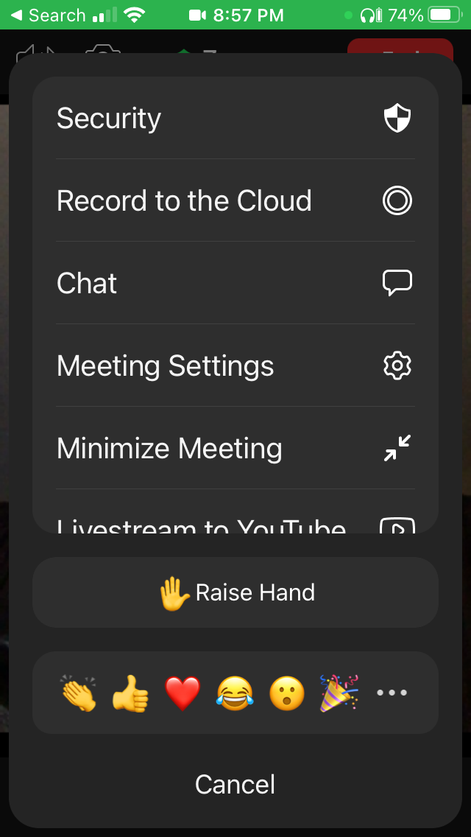
Protocol
Mobile
Stay muted and use chat
Chat will be monitored and questions asked as we go along or at the end
There may be an opportunity to unmute at the end
PC

Slide 4
Where Do I Begin? Financial Roles & Budgets
November 25, 2021
Notes:
Today’s webinar is entitled Where Do I Begin? Finance Roles & Budgets in Congregations

Slide 5
Presenters
Karen Plater, Stewardship & Planned Giving
Don Muir, General Assembly Office
Maurice Mawhinney, Presbytery of West Toronto & PCC Finance Committee
Oliver Ng, CFO, The PCC
Nicole Jeffrey, Pension & Benefits office
Jim MacDonald, Stewardship & Planned Giving
Notes:
One of the benefits of a webinar is that you can pull in multiple people to present. This really is a collaborative effort. We have with us:
Karen Plater, Associate Secretary Stewardship & Planned Giving
Don Muir, General Assembly Office
Maurice Mawhinney, Presbytery of West Toronto Treasurer & Finance Committee (and helped with the handbook)
Oliver Ng, Chief Financial Officer FO, The PCC
Nicole Jeffrey, Director of Pension & Benefits
Jim MacDonald, Stewardship & Planned Giving Development Manager

Slide 6
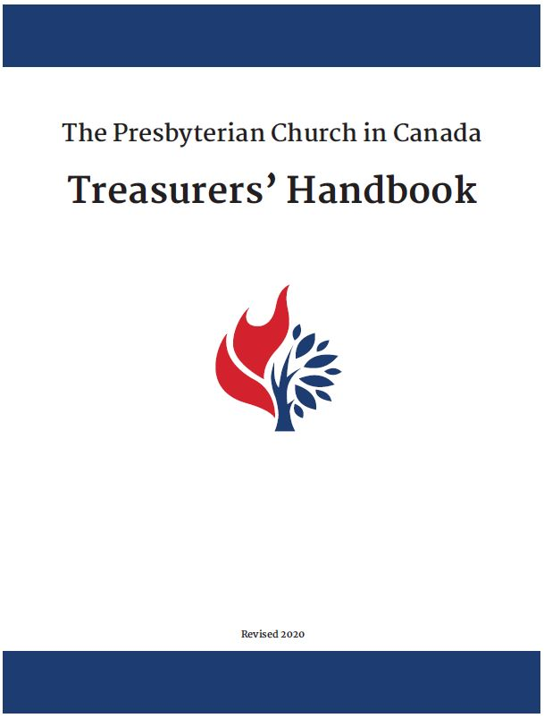
Treasurer’s Handbook
SECTION 1.0 ROLE OF THE TREASURER
1.1 THE BOOK OF FORMS
1.2 RESPONSIBILITIES
1.3 DUTIES CHECKLIST
SECTION 2.0 BUDGET
2.1 PREPARING A CONGREGATION’S BUDGET
2.2 AUTHORIZING THE BUDGET
2.3 ADMINISTERING THE BUDGET
2.4 ANALYSIS OF DIFFERENCES (VARIANCES)
Download presbyterian.ca/resources/finance/
Notes:
Most of the material we cover is found in the Treasurer’s Handbook.

Slide 7
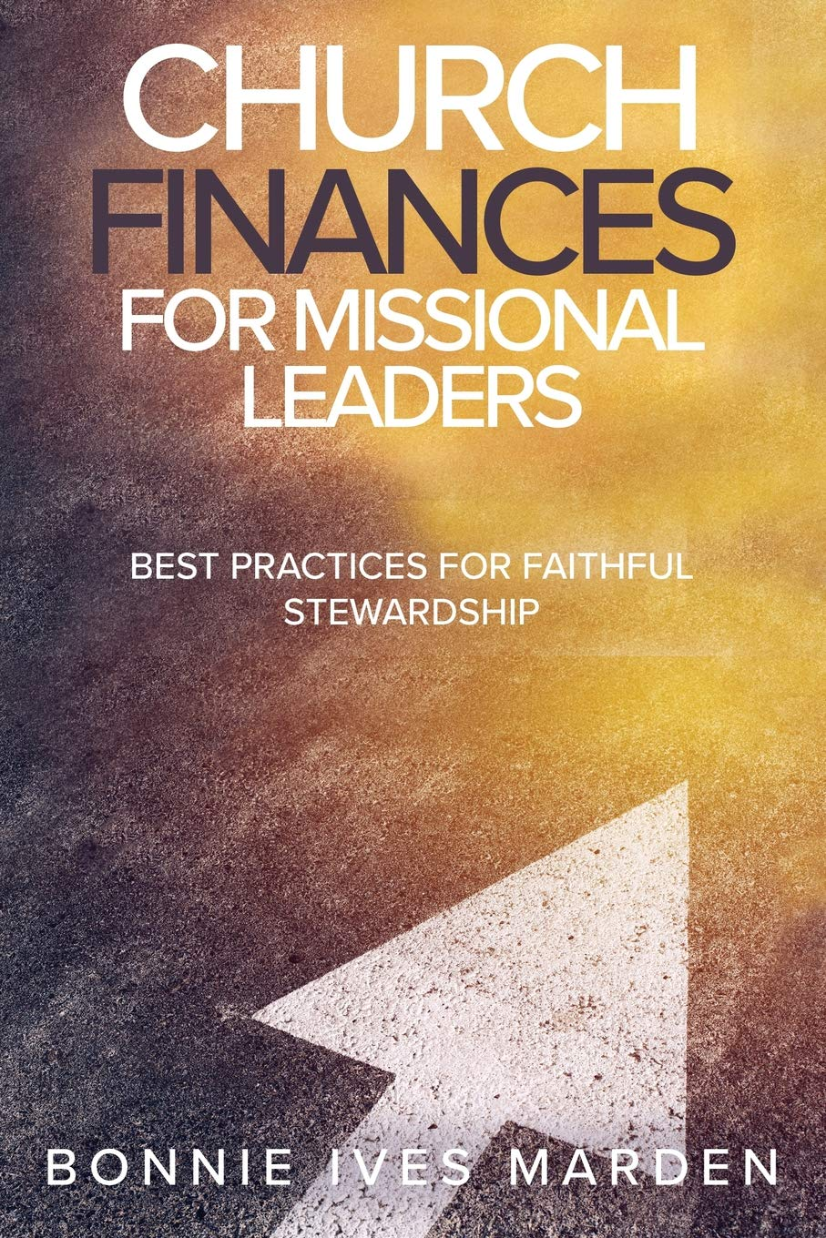
Best Practices
“Budget building and management work is sacred and will directly impact the morale and confidence of the whole community.”– Bonnie Ives Marden
Available on Amazon.ca
Notes:
As Bonnie Ives Marden writes in “Church Finances for Missional Leaders:”
“Budget building and management work is sacred and will directly impact the morale and confidence of the whole community.”
This is an excellent book which helps put best practices for finances, together with stewardship and biblical principles.

Slide 8
The Biblical Call to Stewardship
The earth is the LORD’s, and everything in it, the world, and all who live in it. Psalm 24:1
From the beginning and throughout the bible, God creates everything and owns everything. God has asked us to take care of it.
As stewards of God we try to use all the opportunities and resources entrusted to us to love God and our neighbour with all we have and all we are.

Slide 9
A Steward is a Manager
A good steward manages resources as God would.
“Every faculty you have, your power of thinking or of moving your limbs from moment to moment, is given you by God. If you devoted every moment of your whole life exclusively to His service, you could not give Him anything that was not in a sense His own already.”
~C. S. Lewis, Mere Christianity~
Notes:
This is the fundamental truth of biblical stewardship. God owns everything. We are simply managers or administrators acting on God’s behalf. This includes the church. As stewards, we are responsible to manage God’s holdings well and do something good with it according to God’s desires and purposes.

Slide 10
Generous & Joyful
Each of you must give as you have made up your mind, not reluctantly or under compulsion, for God loves a cheerful giver. 2 Cor. 9:7 (NRSV)
It’s difficult to ask people to be generous if church leaders are not generous.
Notes:
4. We are to be Generous
Generous stewardship is how your church ministry is funded. It is important to lead the way and disciple people in generous stewardship. You cannot ask people to be generous when the church board/leaders are not generous – both as leaders individually and as a church with
the poor and those in need in your community
your core budgret
the community for which God has called your church to accept responsibility.
How does your budget and financial statements reflect God’s generosity? How does it reflect God’s abundance, rather than a scarcity mindset?

Slide 11
Humble
Whatever you do, work at it with all your heart, as working for the Lord, not for men, since you know that you will receive an inheritance from the Lord as a reward. It is the Lord Christ you are serving.
Colossians 3:23-34
Notes:
3. We are to Serve with Joy and Humility
As Christians, we are called to serve rather than to be served. Biblical stewardship is more about developing a healthy concern for with the well-being of the other, as well as my own well-being (‘love your neighbour as your self’). As stewards of God we look to use all the opportunities and resources entrusted to us to love God and our neighbour with all of life, all we have, and all we are.

Slide 12
Accountable
Theological, moral, ethical and legal accountability:
to God, to whom the church belongs
to the people who generously give
to the denomination of whom the church is part of
to the government, the authority God places over us
Notes:
2. We are Accountable.
For we must all appear before the judgment seat of Christ; that every one may receive the things done in his body, according to that which he has done, whether it be good or bad (2 Corinthians 5:10; also see 2 Corinthians 8:12; 1 Corinthians 4:2; Luke 12:48).
We are all stewards of the resources, abilities and opportunities that God has entrusted to our care, and one day each one of us will be called to give an account for how we have managed what the God has entrusted to us. What we do today matters, and makes a difference – both now and in eternity.

Slide 13
Financial Roles in a congregation
Notes:
My part in this webinar it to provide an overview of the role of the treasurer and how it relates to work of other individuals and groups within a typical Presbyterian congregation so that, together, they help achieve the financial goals of the congregation.

Slide 14
Treasurer Connections
Treasurer
Session
Board of Managers
Trustees
Bookkeeper
Envelope Secretary / Gifts Coordinator
Stewardship Committee or Mission & Outreach Committee
Other committees
Notes:
This slide illustrates the other individuals and groups in the church whose work interacts with that of the treasure. As I go through these, you’ll see that the treasurer has closer contact with some than others. The degree of that contact may vary from congregation to congregation.

Slide 15
Congregation Members
Review Reports
Pass plans, including the budget
Support the plan with time, talent and treasurer
Establish policies
Appoint the auditors
Elect elders
Notes:
When you become a member of a congregation, you commit to participating in the life of the church. You might participate in programs and join committees. You will help call the minister. You will be asked to vote on a number of things at formal meetins of the congregation, including the Annual General Meeting. At the AGM you will
Review reports from the previous year
Pass a plan for the congregation for the coming year, including the budget
Support the congregation’s plan with your time, talent and treasurer
Establish policies which govern the congregation – in finances, these may be investment policies, endowment policies, spending policies
Appoint the auditors for the coming year
Elect elders to share with the minister in the leadership, pastoral care, and oversight of the congregation. Together, the minster and elders form the Session.

Slide 16
Session
Responsible of all aspects of stewardship and mission
Encourage support for Presbyterians Sharing
Notes:
Presbyterian congregations elect elders to share with the minister in the leadership, pastoral care, and oversight of the congregation. Together, the minster and elders form the Session.
The session is the governing body for the congregation. All other boards, committees, groups and organizations of the congregation are subject to the care and general supervision of the session.
The session is directly involved in two areas of the financial life of the congregation.
The session is ultimately for all aspects of stewardship and mission within the congregation.
Stewardship, of course, is not just about money. It also refers to the commitment of time and energy, the skills, knowledge, abilities and experience that people can offer to the support God’s mission as it is lived out through the congregation. But it is, about finances, too.
So, one of the jobs of the session is to keep the Christian understanding of stewardship before the congregation.
As one specific aspect of stewardship and mission, it is also the session’s responsibility to encourage the congregation’s support for Presbyterians Sharing which helps to finance so much of the PCC’s ministries nationally and internationally.

Slide 17
Stewardship Committee
Educates about stewardship
Encourages generosity
Recommends policies
A Statement of Christian Financial Stewardship
Legacy Giving Funds & Policies
Notes:
Stewardship Committee
The session might choose to accomplish their responsibilities in the areas of stewardship in general and Presbyterians Sharing in particular, by naming a committee that will be creative, enthusiastic and intentional about stewardship education and inspiration.
There are resources available through Stewardship and Planned Giving to help the work of such a committee.

Slide 18
Session & Board
Session and Board are expected
to work closely together to
ensure financial affairs of the
congregation are well managed
Notes:
The session and the board are expected to work closely together to ensure that all aspects of the financial affairs of the congregation are managed in keeping with the ministry plans of the local congregation and the directives of The Presbyterian Church in Canada.

Slide 19
Board of Managers
Elected by congregation
Responsible for care and maintenance of church facilities
Oversee day-to-day finances
Convener, secretary, treasurer
Notes:
The Board of Managers is elected by congregation. Each year, usually at the congregation’s annual meeting, one third of the board retires and their replacements are elected. Normally, a congregation will look for people are who exhibit skills for maintaining church buildings and managing the financial records of the congregation because those are the two main functions of this group.
At the time to the election, the congregation may appoint the convener, secretary and treasurer from among the board members. If this is not done, the board appoints these positions at its first meeting held after the election. §159-160
It’s the job of the convener to ensure that board meetings are well organized and managed. §168
The secretary is to keep an accurate record of board decisions. §169

Slide 20
Finance & Maintenance Committee
An alternative to electing a Board of Managers
Treasurer works more closely with the session in this scenario
Notes:
As an alternative to electing a Board of Managers, a session may choose to establish a committee of the session committee to look after the finance and maintenance concerns of the congregation.
Being a committee of the session, such a committee would include elders but would be open to other members and adherents of the congregation with finance and maintenance skills.
While this would eliminate the need for a Board of Managers, the role of the treasurer would remain unchanged other than having a much closer working relationship with the session.

Slide 21
Treasurer
Receive and Deposit revenues
Ensure stipend is paid
Ensure bills paid (direction of Board)
Keep accounts
Produce properly audited report
Notes:
The treasurer will have a very close working relationship with the Board.
In that role, the treasurer is expected to:
Receive and deposit revenues.
Ensure stipends are paid.
Ensure bills are paid subject to the direction of the board.
Keep the accounts of the congregation along with invoices and receipts.
Produce all accounts, properly audited, to the annual meeting of the congregation.

Slide 22
Auditors
External, licensed, public accountant
1) Formal Audit
2) Review
Audit Committee of Independent Volunteers
3) Scrutinize records to ensure that receipts and disbursements are accurately documented
Notes:
Although the word “audit” has assumed a precise and technical meaning in financial circles the church has said that there are three ways congregations within The Presbyterian Church in Canada may produce a “properly audited report.”
First, a congregation may request an external, licensed, public accountant do a formal audit.
This produces a high level of assurance that the accounts are properly kept but it will probably Come with a high price tag.
Second, a congregation may request a review by an external, licensed, public accountant. A review provides a more moderate level of assurance – and probably lower price tag.
Third, the method most commonly employed by a congregation is to have volunteers provide an independent and diligent scrutiny of the records to ensure that receipts received, and disbursements made are accurately documented. I should emphasize the word independent – close relatives to the treasurer should not audit the books.
Auditing is important is that it protects the treasurer from accusations of dishonest and can protect the congregation from the occasional treasurer who misappropriate funds in their care. Sadly this does happen from time to time.

Slide 23
More Audit Details
Acts and Proceedings 2008,
Pages 251-253
Declaratory Act – Audit
Dmuir@presbyterian.ca for copy
(We will explore this January 13, 2022)
Notes:
By the way, a declaratory act is a statement, adopted by a General Assembly, affirming what it understands to be the law of the church regarding any particular matter. In this case the particular matter is the auditing of church accounts.
I can send a copy of this declaratory act to any who request it.
dmuir@presbyterian.ca

Slide 24
Trustees
Elected by the congregation according to the terms of Trust Deed
Book of Forms Appendix C template
Pen in the hand of the congregation
Treasurer relationship varies
Notes:
Trustees are elected by the congregation according to the terms of the Trust Deed. The trust deed describes the role of the trustee, how they are elected, how long they serve, the work they are empowered to carry out and so on.
(See Book of Forms Appendix C – for a trust deed template)
It is important to know, trustees only have the authority and responsibilities assigned to them by the congregation.
For example, if the church wanted to buy a piece of property, the Trustees would be asked to sign all the legal documents associated with the purchase on behalf of the congregation.
Instead of having the whole congregation line up at the realtor’s office.
We sometimes say the trustees are the “pen in the hand of the congregation”.
The treasure would likely be involved in financial transactions conducted by the trustees unless the trustees have been given this authority by the congregation.

Slide 25
Bookkeeper (BK)
Treasurer can serve as:
Link between Board and BK
Advise BK – priority of payments
Second signature on checks
Provide financial updates to board, session and congregation
Notes:
Some congregations are not able to find someone within the congregation who has the time or ability to fulfill all the tasks of a treasurer.
It is wise to still have a congregational treasurer even if a bookkeeper is hired.
The treasurer can do things like …
be a link between the board of managers and the bookkeeper
advise the bookkeeper regarding payment priorities - which payments or urgent and which can wait
be the second signature on cheques as required. Sometimes a bookkeeper is only authorized to prepare cheques up to $500 for example. Higher amounts require a signature from someone in the congregation, such as a treasurer.
report on finances to the board, session, congregation - help with annual meeting report

Slide 26
Envelope Secretary/ Gifts Administrator
Maintain accurate, updated list of contributors w/ env. #
Supply new members with envelopes
Maintain records of contributions
Issue statements and receipts for income tax purposes
Ensure that the T3010 line 4500 agrees with their records
Handle administration for the PAR program
Communicate revenue with treasurer
Notes:
Maintain accurate, updated list of contributors w/ env. #
Supply new members with envelopes
Maintain records of contributions
Issue statements and receipts for income tax purposes
Ensure that the T3010 line 4500 agrees with their records
Handle administration for the PAR program
Communicate revenue with treasurer

Slide 27
Annual General Meeting
All members and adherents may vote at the annual congregational meeting, including voting on budget
Session determines who is on the membership roll and who is adherent
Notes:
All members and adherents have the right to vote at the annual congregational meeting including approving the proposed budget or recommending amendments to it.
There are certain legal decisions only members can vote on (calling a minister or selling church property for example, but most decisions at an annual meeting don’t fall into this category.
The session determines who is on the professing members roll and who are considered adherents of the congregation.

Slide 28
Treasure
God put the treasure
in treasurers.
Notes:
Sometimes when typing, I miss the ‘r’ on treasurer. But I think that’s fine, because God put the treasure in treasurers.

Slide 29
Financial Vocabulary and Concepts
Notes:
Let’s take a moment to review the key duties and dates pertinent to the financial management of a church.

Slide 30
Gifts/Donation (for tax receipt)
Given freely and without expectations
Transfer of ownership
money or gifts-in-kind (art, property, securities)
Donor relinquishes control
Can designate, which congregation must accept, but can not add or revise restrictions or give direction for use after given
Did donor receive an advantage?
Advantage/Benefit value (Dinner or concert tickets) deducted
Notes:
Gift/Donation – which can be designated or undesignated, has to meet the following requirements:
– an object given freely and without expectations is a gift, also representing a transfer of ownership from one party to another – money or gifts-in-kind (art, property, securities)
After the gift is completed, the donor relinquishes control over the gift and may not add or revise restrictions, or give direction for the use of the funds.
If the giver receives a tangible benefit (dinner or concert tickets) part of their gift is a transaction and must be deducted from their gift.

Slide 31
Designated/Restricted
Organizations create designations, also called internal restrictions
may be added or removed by organization
Donors create external restrictions
organization must accept or reject them
restrictions can only be changed by original donor or court order (varies by province)
Notes:
Designated/Restricted – Organizations create designations that may be added or removed based on current needs.
Donors create external restrictions that may be added or may not be acceptable to the receiving organization – cash counters may need to be aware, before a cheque is deposited, that the designation is acceptable.

Slide 32
Accounts and Funds
Account (n)
a category of money or a location where the money is placed
identify specific funds:
undesignated account
Vacation Bible School account
Music account
Fund (n)
a category of money or a location where the money is placed
a specific bank account
or sub-account within a financial recordkeeping system
or the title for a project or activity
Notes:
Accounts and Funds
These two terms are often used interchangeably, you may decide how it is used in your context.
Account (n) – a category of money or a location where the money is placed. We use accounts to identify specific funds: undesignated account, Vacation Bible School Account, Music Account,
Vs.
Fund (n) a category of money or a location where the money is placed. Fund may represent a specific bank account or sub-account within a financial recordkeeping system or the title of resources for a roject or activity such as Memorial Fund. Or s

Slide 33
Accounts and Funds
(Cont’d.)
In financial statements an Account is set up to track Funds.
Bank Account
differs from each account in your financial statement
one bank account may hold multiple funds/accounts
you may have separate bank accounts for different funds, esp. capital or endowment funds
Tracking & Precise Descriptive Titles are key
Notes:
For both Funds and Accounts precise descriptive titles provide important clarification.
Precise descriptive titles provide important clarification.
In Financial statements an account is set up to track the funds.
Account in a bank account is different from each account in your financial statement – you may have one bank account, which holds multiple funds
Some may have more than one bank account to track funds, esp capital funds – important is tracking

Slide 34
Budget
Budget
tracks financial transactions during a period of time
Helps plan and manage financial position with goals for income and expenses
Income
money received to support mission
Expenses
money paid out for costs of mission
Notes:
Budget – a system for tracking financial transactions during a period of time. They help leaders plan and manage the congregation’s financial position by setting goals for income and expenses.
Income – money received to support the mission
Expenses – money paid out for costs related to the mission work

Slide 35
Cash Flow
The money you have in the bank available to cover expenses
Managing cash flow ensures there is enough money to cover expenses
Fluctuates during the budget period
Notes:
Cash Flow Cash flow needs fluctuate as income and expenses occur during the budget period. Managing cash flow ensures that funds cover expenses so that bank account balances remain positive.

Slide 36
Investments
Funds placed in a financial institution
Stocks, bonds, GIC, mutual funds, Consolidated Portfolio (PCC)
subject to market fluctuations
Type of investment
risk-tolerance and time-horizon
Investment policy
can provide guideline on risks, ethics and social implications
Notes:
Investments –
funds placed in a financial institution that purchases and trades stocks or bonds.
They are subject to market fluctuations.
Risk tolerance and the time-horizon affect the type of investment to consider.
An investment policy can guide the congregation and include risks, ethics and social implications of investing.

Slide 37
Endowments
Permanently Protected fund
Principal not used without permission
in policy or bequest language
Earnings/income available for use
may be distributed or re-invested
Documentation important
will be stewarded by others in the future
Notes:
Endowment – a permanently protected fund created to generate future income.
The original gift, known as the principle or corpus, is not used unless permission is given in a policy or bequest language.
Generally, the earnings or income are available for use and may be distributed or re-invested.
They are invested – as they will exist for a long period of time.
Good documentation and recordkeeping are important because these long-term funds will be stewarded by others in the future.

Slide 38
Assets
Cash
Investments
Properties (building, land, internal fixtures)
Receivables (grants, HST)
Pre-paids
Notes:
Assets include:
Cash
Investments
Properties (building, land, internal fixtures)
Receivables (grants, HST)
Pre-paids

Slide 39
Liabilities
Debts such as loans and unpaid bills or accounts payable
Commitments made for future payments
over multiple budget periods
Notes:
Liability:
debts such as loans and unpaid bills or accounts payable are liabilities.
commitments made for future payments, often over multiple budget periods.
Taking on debt for a strategic project such as a capital expenditure,
but caution about debts to pay operating expense.

Slide 40
Operating Statement
Surplus
a positive fund balance after expenses are deducted from income
re-invest the surplus back into the mission
Operating Statement
a summary financial report over a specific time period
all sources of income and all liabilities due or in arrears during budget period
monthly or quarterly financial report serves as operating statement
Notes:
Surplus – a positive fund balance when expenses are deducted from income.
Operating Statement (Profit and Loss Statement) : a summary financial report of assets and liabilities during a specific period of time. – Financial reports should include all sources of income and all liabilities due or in arrears during the budget time period. A comprehensive monthly or quarterly financial report serves as the profit and loss statement, also known as a financial report.

Slide 41
Audits & Reviews (Learn more Jan. 13)
Audited = examined by someone other than the Treasurer
Prevents Fraud
Constitutional matter
Internal vs. External Audits & Reviews
Notes:
Don covered this above.
How to do audits and reviews will be covered more fully in the fourth and final webinar of the series on January 13th.
Audited = examined by someone other than the Treasurer
Prevents Fraud
Constitutional matter
Internal vs. External Audits

Slide 42
Assessments & Allocations
Presbyterians Sharing Allocation
Recommended Allocation = 10% of a congregation’s dollar base Accepted Allocation = what the congregation realistically thinks it can give
Presbytery & Synod Assessment
A congregation’s portion of Presbytery and Synod expenses – determined differently in different regions. Must be paid.
Pension Congregational Assessment
A congregation’s contribution to the pension of ministers 5% of dollar base (2021); 4.5% of dollar base (2022). It’s the employer’s portion to the pension fund for all PCC ordained and diaconal ministers. Must be paid.
Notes:
Assessments and Allocations (Karen and Nicole)
What's the difference between my congregation’s Presbyterians Sharing Allocation and the Pension Plan Congregational Assessment and Presbytery & Synod Assessment?
*A congregation’s dollar base can be found in the Acts & Proceedings of the previous year. The dollar base used in 2022 allocations and assessments is calculated from the 2020 statistics and found in the 2021 A&P. It is normal revenue minus expenses for mission and capital/renovations and debt . . . Gifts to Presbyterians Sharing supports the mission and ministry in Canada and around the world we do together as The Presbyterian Church in Canada. Together, we build strong congregations, serve vulnerable people, walk with Indigenous people, seek justice, support theological education and share God’s love around the world. The General Assembly recommends that congregations give 10% or more of their dollar base* each year (recommended allocation). Congregations accept the amount that they realistically think they can contribute in a year (accepted allocation). The gifts are voluntary, but every congregation is expected to participate. Congregations are encouraged to send remittances monthly or quarterly. Presbyterians Sharing Allocations are prepared and distributed early November.
Presbytery and Synod Assessment help pay for the ministry of Presbytery and Synod – it is set by the Presbytery and Synod and determined in different regions. It is sent to the Presbytery and Synod. NICOLE: Pension Plan Congregational Assessment: Every congregation is assessed an amount for their contribution to the pension plan, which supports ministers and professional church workers. As employers, congregations are legally required to pay their assessment. The 2021 Congregational Assessment is 5% of a congregation’s 2019 dollar base*. The 2022 Congregational Assessment is 4.5% of a congregation’s 2020 dollar base*. Payments are due monthly. The Pension Plan Congregational Assessment notice is prepared and distributed each November.

Slide 43
Duties & Dates
Notes:
Let’s take a moment to review the key duties and dates pertinent to the financial management of a church.

Slide 44
Receive Gifts (Learn more Dec. 2)
Ensure deposit promptly to church’s account in a chartered bank/credit union
Cash & Cheques
Monitor Transfers/Autodeposits into account
E-transfers & Online Gifts
External deposits (PAR, Canada Helps)
Gifts of Securities
Issue Receipts (envelope secretary or admin staff may do it)
Annual or One-off receipts
Gift-in-Kind, Life Insurance, Bequests, Securities
Notes:
The Job Of The Treasurer
Section 170 of the Book of Forms states:
“Where there is a chartered bank convenient to the congregation, it is the duty of the Treasurer to deposit therein, without delay, all money received by him/her, and in a separate account identifying it as belonging to the congregation”
The treasurer ensures that receipts are promptly deposited into the account in a chartered bank/credit union
Cash & Cheques
E-transfers & Online Gifts
External deposits (PAR, Canada Helps)
Gifts of Securities
The treasurer issues receipts, which may be delegated in whole or part to the envelope secretary or admin staff.
Annual or One-off receipts
Gift-in-Kind, Life Insurance, Bequests, Securities
Providing tax credit receipts will be covered more fully in the next webinar in the series on December second.

Slide 45
Disburse Money (Learn more Dec. 9)
Operating Budget
Payroll
Utilities
Worship
Maintenance
Programs
Mission & Outreach
Special Funds
Capital
Mission & Designated
Benevolence
Endowment/Legacy
Notes:
The treasurer is responsible to oversee how the church disburses money.
Operating Budget
Payroll
Utilities
Worship
Maintenance
Programs
Mission & Outreach
Special Funds
Capital
Mission & Designated
Benevolence
Endowment/Legacy
Disbursements will be covered more fully in the third webinar in the series on December ninth.

Slide 46
Produce Reports Financial Statements (Learn more Jan 13)
The Session
Members & Donors
Presbytery, Synod & National Office (Statistical Report)
Canadian Revenue Agency (CRA) (T3010)
Other: Loans, Grants, Insurance, Leases
Notes:
Who are the users of financial statements?
The Session
Members & Donors
Presbytery, Synod & National Office (Statistical Report)
Canadian Revenue Agency (CRA) (T3010)
Other: Loans, Grants, Insurance, Leases
Financial Statements will be covered more fully in the fourth and final webinar of the series on January 13th.

Slide 47
Review and Update
1. Signing Authorities for banking, tax receipting, payment authorization, etc.
2. Contact Information • CRA, national office, presbytery, etc.
3. Government filings and deadlines
4. Financial System • cash handling, budgeting, donation receipting, financial statements, etc.
5. National Office Remittances
6. Regular Agenda Items for which the Treasurer is responsible & Past Minutes
7. Bank Reconciliations
8. Insurance coverage & contact info
9. Computer Back–up system
10. Record Retention
11. Policies
13. Investments, restricted funds and long-term commitments (rentals of equipment, contracts)
Notes:
There is a long list in the treasurer’s handbook of things you will want to keep check out if you are a new treasurer and keep on top of and current if you are an experienced treasurer with many years in the post. We will go into more detail on most of these points. They are listed in the treasurers handbook on page 2.

Slide 48
Duties Checklist
Weekly
enter weekly income/receipts (total)
pay invoices
Monthly
remit pay stipends/salaries
employees’ deductions and pension & employer’s income tax, EI, CPP, EHT
reconcile bank accounts
remit Pension Assessment & Presbyterians Sharing
Semi-Annual
apply for GST/HST rebate
Annual
prepare annual financial statements and assist with budget preparation
complete and distribute T4s and T4As
prepare and submit CRA T3010
Notes:
Duties Checklist
Weekly
enter weekly contributions and cash receipts – rent, however it comes in
pay invoices that are due
Monthly
remit pay stipends/salaries
employees’ deductions and pension & employer’s income tax, EI, CPP, Employer Health Tax
reconcile bank accounts
Semi-Annual
apply for GST/HST rebate
Annual
prepare annual financial statements and assist with budget preparation
complete and distribute T4s and T4As

Slide 49
Annual Cycle
January / February / March
Prep annual reports and meetings;
AGM approval of budgets for current year and financial statements for prior year
HST/GST refund claims (min. 1x annum)
February 28
Deadline for donation receipts
Distribution of T4 slips to employees
Filing of payroll summaries with CRA
Return minister’s stipend to Presbytery (may not apply to all Presbyteries)
March/April
Accepted Presbyterians Sharing & Statistical Reports to Presbytery Clerk/national office
➔ Presb. Clerk to PCC by April 15
June 30
Deadline for filing T3010 (Dec 31 year end)
November / December
Next year’s budget & planning cycle begins
Notes:
An Annual Cycle
January / February / March
preparation of annual reports and annual meetings; approval of budgets for current year
HST/GST refund claims – at least, once annually
February 28 – it’s a soft deadline for receipts, but hard deadline for T4 slips
deadline for donation receipts, distribution of T4 slips to employees and filing of payroll summaries with CRA
reporting to Presbytery Clerk accepted Presbyterians Sharing… allocation revisions and minister’s stipend return
March
Annual statistical return to Presbytery Clerk (→ Presbytery Clerk to PCC by March 31)
June 30
deadline for filing T3010 with CRA (assuming December 31 year end)
November / December
next year’s budget / planning cycle begins
On-going monthly / quarterly
remittance of payroll deductions (incl. pension and H&D) and Presbyterians Sharing…

Slide 50
Important Dates for National and Presbytery Remittances
PCC National Office
Presbyterians Sharing - monthly or at least quarterly
Payroll – monthly pension deduction and insurance from minister’s stipend
Pension assessment – monthly – along with the minister’s deduction
Health and Dental – quarterly - on receipt of invoice from PCC.
Presbytery (depends on Presbytery)
Assessment – quarterly – Feb 1, May 1, Aug 1 and Nov 1
Notes:
Filing and remittance deadlines
Assessments - Who gets what?
PCC
Presbyterians Sharing… - monthly - or, at least, quarterly, as a minimum.
Payroll deductions – monthly pension deduction and insurance from minister’s stipend
Pension assessment – monthly – along with the minister’s deduction.
Health and Dental – quarterly - on receipt of invoice from PCIC.
Presbytery. Depends on Presbytery. West Toronto, for example:
Assessment – quarterly – Feb 1, May 1, Aug 1 and Nov 1.

Slide 51
The Art of Delegation
“The worst committee to be on is the one you don’t like.”
Delegate, collaborate, encourage, communicate and monitor
Break work down and match to skills
Ask, Let Do, Thank
Who needs to be at what meetings?
Notes:
The Art of Delegation
“..the worst committee to be on is the one you don’t like...”
The hard way is to have one person do everything
The better path is to delegate, collaborate, encourage, communicate and monitor
Break down what needs to be done and dole it out
Create projects and match what needs to be done to the skills you have at hand
Does everybody need to be there for every meeting
You need to
“..ask”
“...say thank you”
“..let people do it”

Slide 52
Budgets
Notes:
Let’s take a moment to review Budgets
A good congregational budget does the following:
• helps build a vision for the year ahead
• helps the congregation to implement and prioritize current programs or ministries
• provides a way for the church members to work together
• gives direction for using available funds
• encourages accountability and transparency
• challenges members to provide funds to ensure that the work of the congregation can be carried out
• authorizes congregational leaders to act within guidelines

Slide 53
Budgets Useful Characteristics
Understandable
Relevant
Reliable
Consistent/comparable
Notes:
Financial Statements
Financial statements should possess the following characteristics to be useful
Understandable – describe the financial information in a meaningful way
Relevant – providing timely information and context
Reliable – information is supported, accurate, and if estimated, conservative
Comparable – consistent application of accounting methods

Slide 54
Utilizing Budgets
Authorization of expenditures
Over or under expenditures
Projections = actuals + future months
Notes:
For what purpose do we utilize budgets to better manage church finances?
A budget makes it easier to authorize expenditures
Monitor whether or not an expenditure is over or under what was forcast
By adding actual expenditures to forecast expenditures for future months, we can update our projections as to whether or not we’ll be able to balance the budget at the end of the year.

Slide 55
Approaches to budgets
Traditional budgeting
Uses the preceding year's expenses as base data points with a factor for inflation and other known changes
Zero-based budgeting
Everything up for consideration, start from zero
What’s first?
set revenue to determine what you can afford OR
set expenses and see what you have to raise
Notes:
You can choose between two different approaches to budgeting; a choice that can affect complexity and accuracy.
Traditional budgeting is simplistic since it is done regularly with a similar approach;
zero-based budgeting is quite complicated since it encourages re-evaluation every time during usage.
Traditional budgeting is based on historic information, and so revolves around accounting.
Zero-based budgeting base on estimated data, so it revolves around decision making.
Traditional budgeting encourages similar costing of the previous year.
Zero-based budgeting supports cost-effectiveness.
Traditional budgeting is easier –
Zero-based budgeting needs to determine the cost of plans, some of which may be based on previous year
What’s first?
set revenue to determine what you can afford or set expenses and balance back the revenue – see what you have to raise - sometimes a little bit of both?
How do you plan for capital expenditures or major renovations / improvements
e.g. roof or furnace replacement?

Slide 56
Annual Budget
Deficit vs. Balanced Budget
Line-Item vs. Narrative Budget
Notes:
A budget deficit is a financial loss for during a period where expenses exceed revenues.
A balanced budget is a budget in which revenues are equal to expenditures. Thus, neither a budget deficit nor a budget surplus exists (the accounts "balance"). More generally, it is a budget that has no budget deficit, but could possibly have a budget surplus.
A line-item budget is an accounting tool. A line-item budget is one in which the individual financial statement items are grouped by category. It shows the comparison between the financial data for the past accounting or budgeting periods and estimated figures for the current or a future period.
A narrative budget is a marketing tool. A narrative budget re-sorts and summarizes a church’s line-item budget into “missional” categories like worship, nurture, service, and evangelism. It supports your congregation’s vision and explains how you plan to accomplish it. You might transform your line item budget into your narrative budget. You still have a line-item budget.

Slide 57
Don’t forget to consider…
How to plan for capital expenditures such as major renovations or improvements like a roof or furnace replacement?
Notes:
Development fund – might be used
Endowment/legacy fund
Put a little bit aside each year . . .
Sometimes bequests . . . Better for a separate fund – or the surplus roles forward . . .capital fund according to the budget amount,

Slide 58
Budgeting Process
Who draws up the operating budget?
Finance committee, includes the treasurer
Input from Board of Managers, Session, Committees
Timeline:
November & December (assuming Dec year-end)
Drafting
January
Final stages of plans and budgets
Preparing the prior year’s financial results to compare with your future forecasts/budget
Notes:
Planning and Budgeting
Budgeting probably starts in November / December each year
it’s probably too late to start in January
By January each year, you should probably in final stages of completing current year plans and budgets and preparing the prior year’s financial results for reporting to January / February / March meetings
Working on prior year’s reporting, including CRA reports (T4s), annual reports and PCC statistical return
Who draws up the operating budget(s)?
Finance committee
Input from Board of Managers and Session

Slide 59
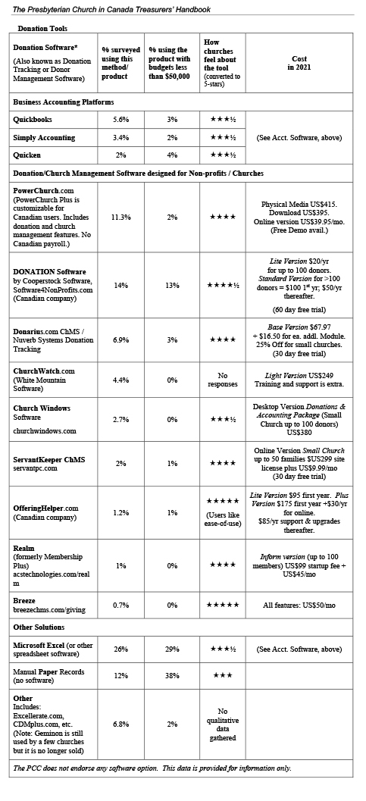
Accounting and Donation Software:
What should I consider when looking at software?
Section 5.1 in Treasurers’ Handbook
Notes:
JIM - Accounting and Donation software can help you build your budgets and produce your financial statements. You’ll find a table comparing the available software options in the newly updated Treasurers’ Handbook in Section 5.0 TOOLS AND RESOURCES. In 2021, congregations were surveyed to find out what software products they were using for accounting and to keep track of their donations. More than 400 churches responded. The newly updated Treasurers’ Handbook now includes charts that list the types of Accounting and Donation software products that the surveyed PCC congregations indicated they are using and how they feel about them. The PCC doesn’t endorse any software, as congregations’ needs are varied and diverse. In choosing an option, you might consider cost, size of the budget, reporting capacities, customization of the program, number of donors, compatibility with donation tools etc. Congregations are free to select their own software to suit their own requirements and can research to find out what will best serve their needs.
Additional information (probably not used in webinar)
Statistics from survey
9% of respondents indicated that they were still using manual systems for accounting software,
while 12% were using manual systems to track donations.
21% were using Excel spreadsheets for accounting,
while 26% were using Excel to track donations.
If this meets the needs of the congregation and the Treasurer is able to prepare financial statements in a timely and accurate manner, there is no requirement to switch.
However, these days there is generally much more work in maintaining accounting systems and handling donations, so many congregations are now using more sophisticated computer software.
Some packages are hosted fully online
Others allow desktop software to be downloaded and installed on a network, with the data shared between multiple computers
Dedicated Donation tracking software can help congregations track donations and communicate with donors.
Most of these tools will issue tax receipts and generate reports.
Some offer additional features that help manage every aspect of church life including
membership data,
children’s check-in,
event management,
small-group management,
volunteer scheduling and management,
along with automated workflows and dashboards to measure and summarize it all.
This level of software serves little purpose without many parishioners and volunteers to manage. As such, it is designed to serve quite large churches and comes with commensurate costs.

Slide 60
Thank You
Recording will be available at
presbyterian.ca/leadership-webinars
Notes:
Recordings will also be posted at https://presbyterian.ca/leadership-webinars/ for people to find and use in the future.

Slide 61
Coming Webinars
Thurs., Dec. 2 Receiving & Receipting God’s Gifts Exploring Congregational Revenue
Thurs., Dec. 9 Sharing God’s Gifts Examining Congregational Expenditures
Thurs., Jan. 13 Telling the Story Reporting & Communicating Finances
Notes:
Subsequent webinars will be:
Receiving & Receipting God’s Gifts: Exploring Congregational Revenue
Thursday, December 2, 2021 2:00-3:15pm ET
This webinar is all about gifts. It focuses on how to receive gifts, special considerations when handling gifts, digital giving, receipting guidelines and requirements and saying thank you.
Sharing God’s Gifts: Examining Congregational Expenditures
Thursday, December 9, 2021 2:00-3:15pm ET
How will you spend the gifts you have received? This webinar focuses on the details of congregational expenditures including mission, payroll related matters (deductions, housing allowance, insurance, pension and benefits) property management, pulpit supply and committee budgets. It also touches on synod and presbytery assessents and how to remit to the national office.
Telling the Story: Reporting & Communicating Finances
Thursday, January 13, 2022 2:00-3:15pm ET
Gifts were received. Expenditures were made. Now it’s time to share the story of how the money was spent. This webinar focuses on the different ways of reporting finances - to Session, the congregation, Canada Revenue Agency, grant makers, lenders, and donors. Learn more about the ins and outs financial statements and how to use financial statements to share your story of mission.
Recordings will also be posted at https://presbyterian.ca/leadership-webinars/ for people to find and use in the future.

Slide 62
Q & A
What more do you want to know?!
(use the chat . . .)
Notes:
Recordings will also be posted at https://presbyterian.ca/leadership-webinars/ for people to find and use in the future.

Slide 63
Thank You
presbyterian.ca/leadership-webinars

