Slide 1
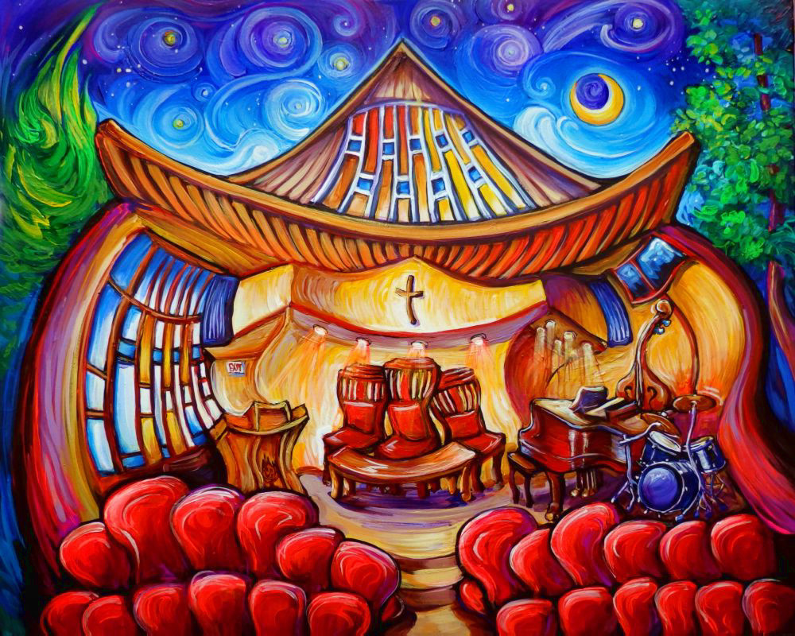
Vision Casting
Cultivating the Culture of Your Congregation
The Rev Dr Brian Fraser
Minister, Brentwood Presbyterian Church, Burnaby, BC
www. brentwoodpc.ca

Slide 2
Beginning Together in Prayer
Be with your people, O Lord, …

Slide 3
Convening Conversations that Cultivate Congregational Cultures
Casting a purpose (vision)
that aligns people
into a process
that opens up
positive possibilities

Slide 4
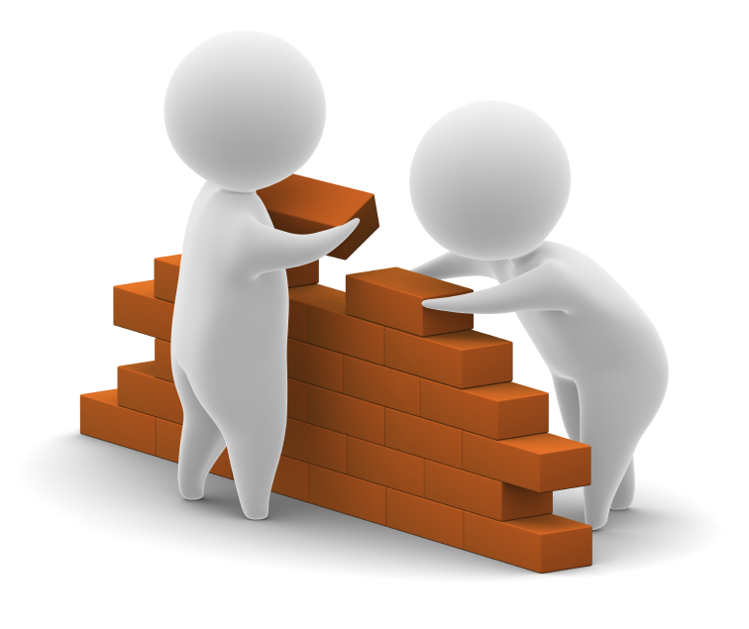
Three Foundational Principles
Get everyone involved from the very beginning, deeply aware that our triune God is at work in the process.
Build on your aspirations and strengths – and you do have them.
Focus on a few things that have great impact and do them well.

Slide 5
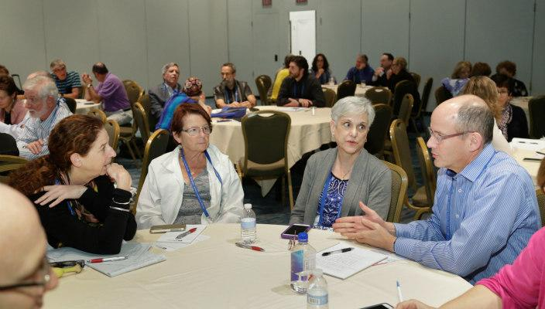
Curiosity is the First Step
“The church is Jesus Christ and his people
together with their government.”
The Rev Dr Thomas Wardlaw Taylor, Principal Clerk of the General Assembly (1925-1952)
What, then, is the people’s vision
of your congregation’s mission?
Just ask them!

Slide 6
In Search of Christ’s Vision for You
A vision is a declaration that clarifies what your congregation is inspired by and called to be and do.
To be effective, a vision must be owned and used. It must infuse every dimension of a congregation’s work and witness.

Slide 7
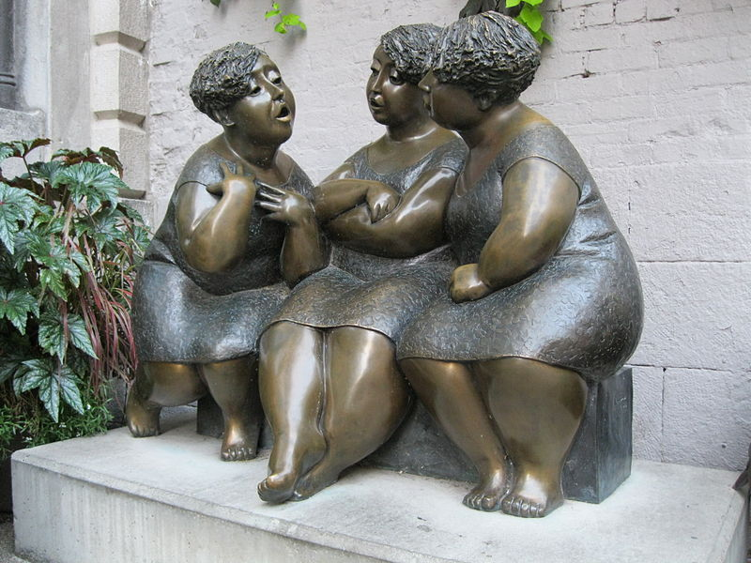
An Appreciative Awareness Survey
What do you value most about what this congregation offers you?
How is this congregation delivering those values?
What is preventing this congregation from delivering those values better?
What possibilities for improvements can you imagine?

Slide 8
The People’s Wisdom in Their Words
The Key Question in Generating The People’s Wisdom
What do you value most
about what this congregation
offers you?
Discuss in groups of 3-4
and record ideas on stickies
to ensure they get to use their words
and that they are heard.

Slide 9
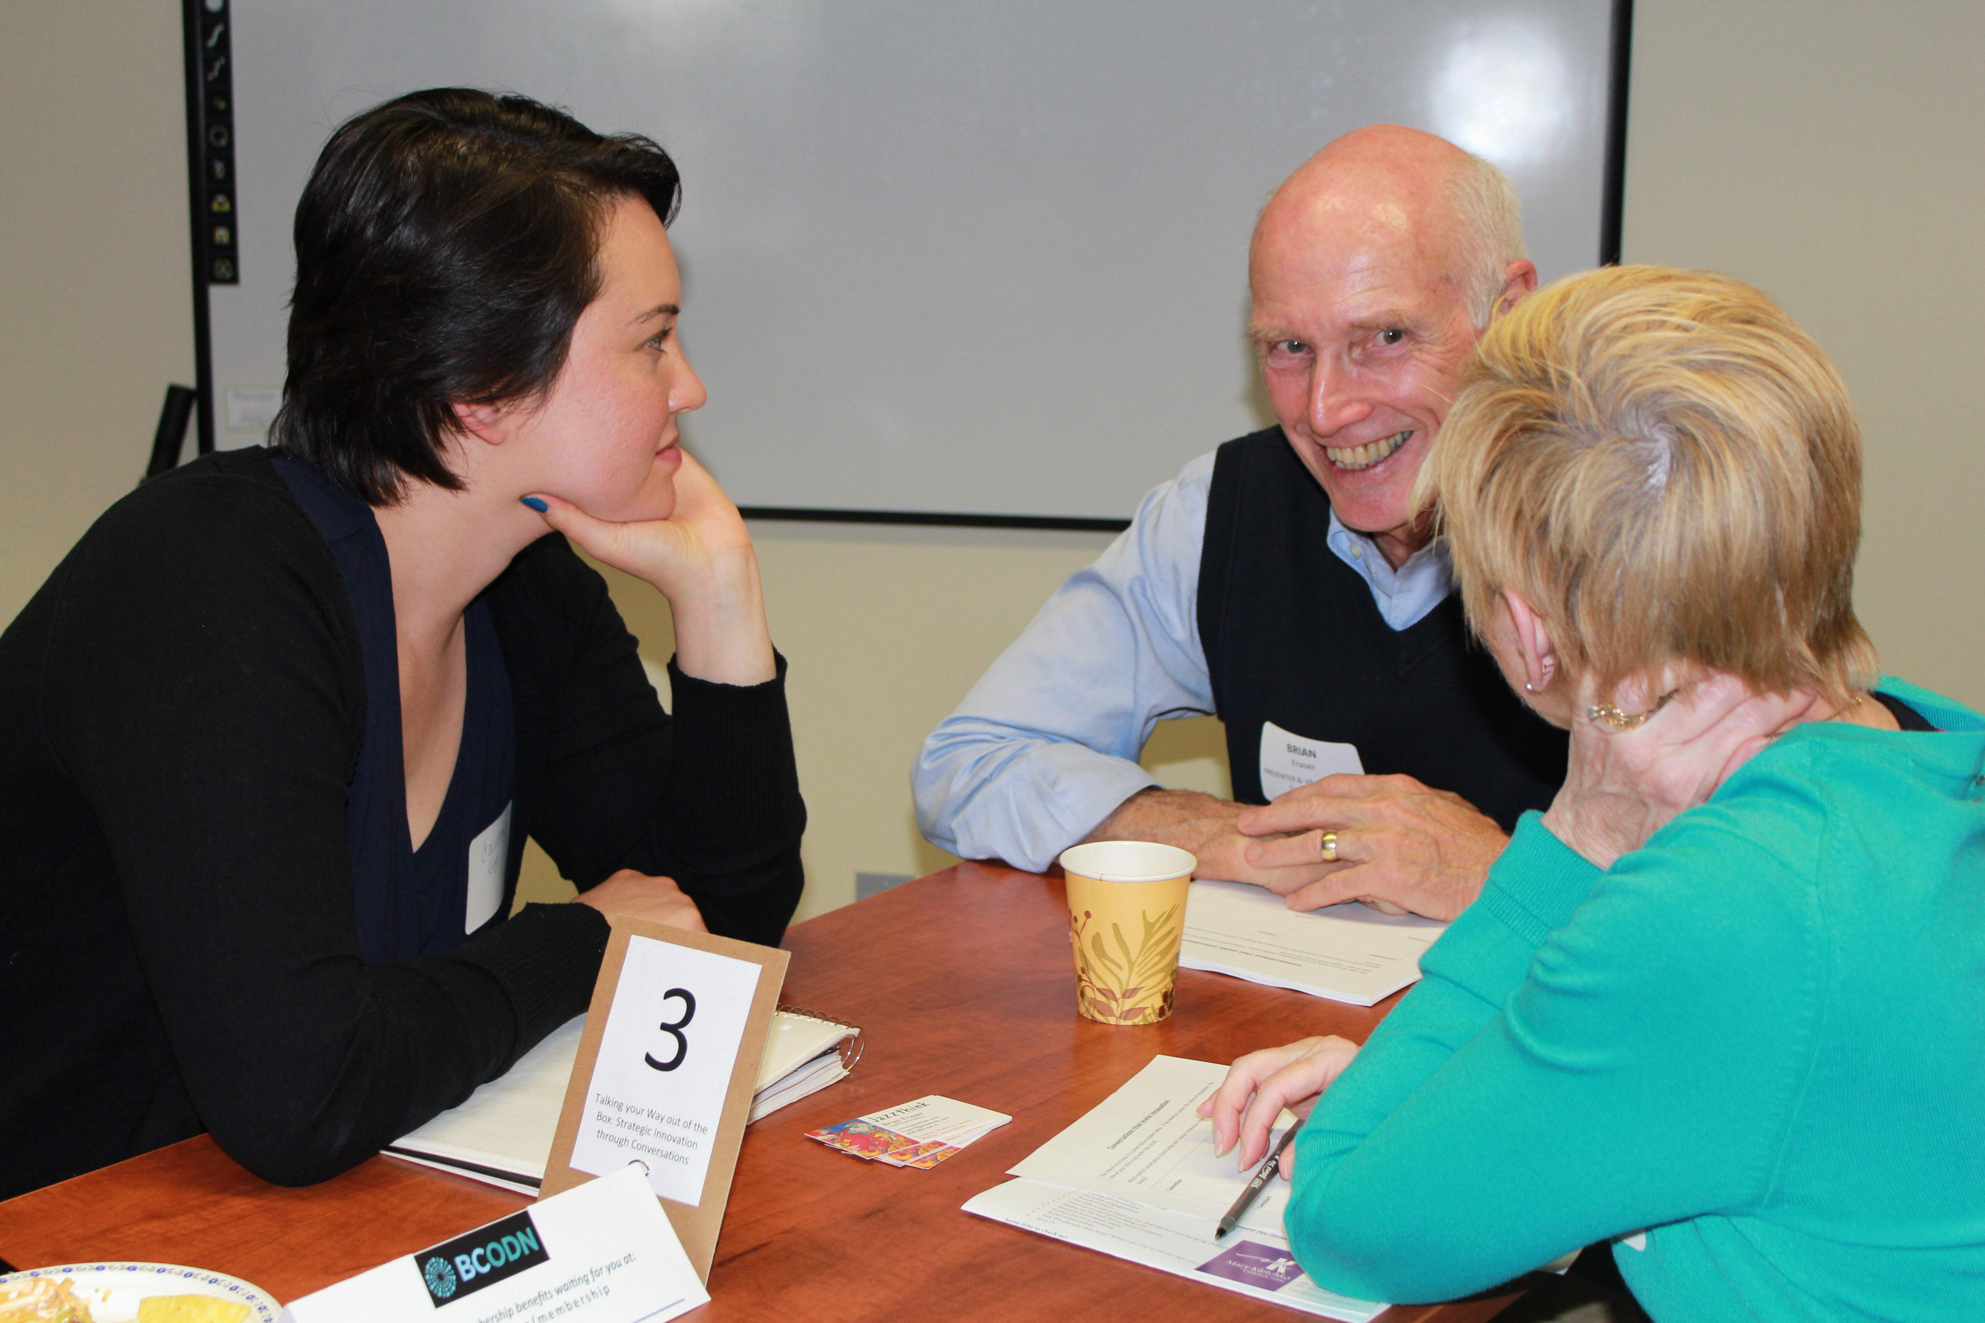
Invite Them to Listen & Learn
In the same groups of 3-4, continue to be curious.
Taking all the wisdom posted on the stickies, what are the 10 most powerful, positive words/phrases?
Do it once again with the lists of 10, to refine it down even further.

Slide 10
Draft a Vision Statement
Using the key words/phrases that have been chosen, draft a vision statement in 10-20 words that are memorable.
Have each group present theirs and say a bit about why they composed it the way they did.
Over lunch, have a small group draft a consolidated statement to test.
Compose an agreed upon first draft as a group.

Slide 11
Testing the Vision
Write the chosen wording on a flip chart and put in the narthex/lobby of the church for 2-3 weeks, inviting comments, pro and con, from all who read it.
Then the Session approves it with some or all of the suggested revisions for use for a year, with the invitation to the congregation to test its power to inspire and guide.

Slide 12
A Few Samples
Nourishing Souls to Flourish in the Grace of Jesus Christ through Worship, Learning, Fellowship, and Service | Nourishing an Inspiring Home for Spiritual Growth in Christ’s Grace through Worship & Music, Care & Fellowship, Prayer & Study, and Service & Outreach
In the grace of Jesus Christ, we are a vibrant and friendly community, passionate about worshiping, learning, praying, and serving | An affirming and diverse family in Christ rejoicing in serving our communities through Worship, Prayer, Learning, Fellowship, and Caring
We aspire to be a lively, multi-generational community of hope and compassion, constantly growing in faith and work | Engage, shape, and support vital congregations and agencies in mission with Jesus Christ

Slide 13
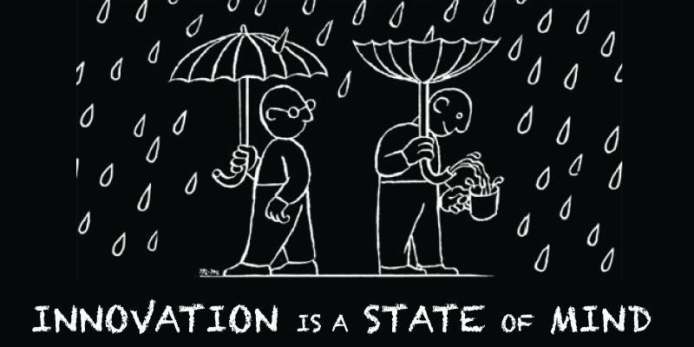
Intentions Aligned to Vision
Intentions arise from strengthening the things that are being done well to deliver the values. But that strengthening may involve doing these things in innovative ways.
In most congregations, it’s some version of worship, learning, fellowship, and service. These are the 5 marks of the NT church – liturgia, kerygma, didiche, koinonia, & diakonia. Innovating with these elements has been the key to success over the past two millenia.

Slide 14
Taking the Barriers Seriously
Taking the barriers (problems) seriously is crucial to the credibility of the whole process.
But not letting them define reality is equally crucial. Solutions are confined and restricted if they simply solve the problem.
The power of the process lies in its focus on positive potential and on implementing some of the possibilities imagined by the people to move through or adapt to the barriers.

Slide 15
Collaboration in Execution
Chose 2-3 strategic initiatives to focus on for the next 6-12 months that will have the greatest imaginable positive impact on your mission.
Clarify responsibilities and provide robust support.
Monitor and measure faithfulness both formally and informally.
Appreciate successes and learn from failures.
Do an annual review in a congregational consultation to refine and reform.

Slide 16
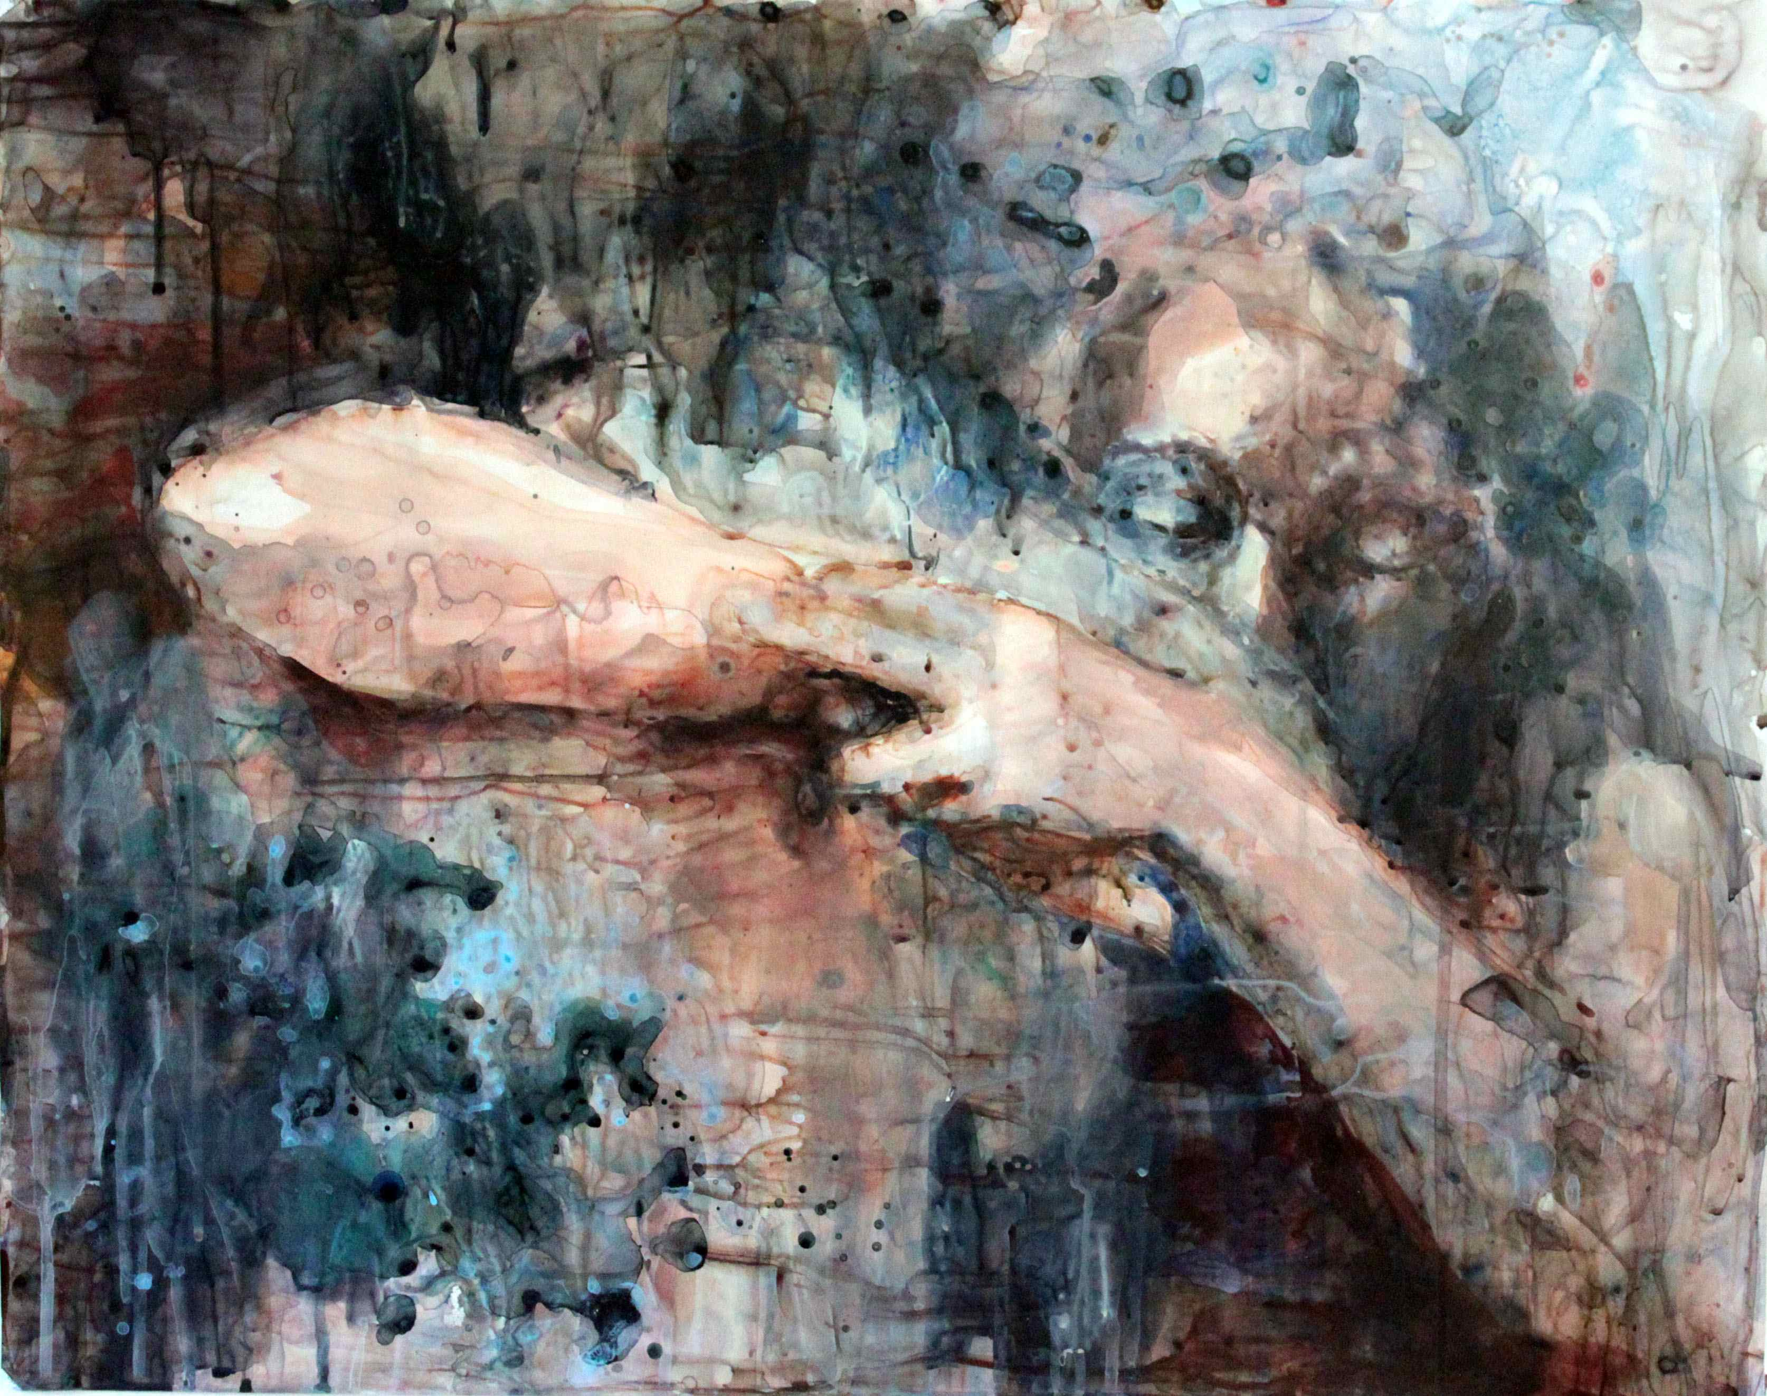
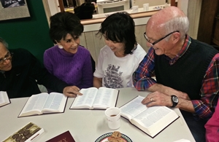
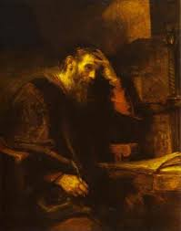
It’s All About the Conversations
With our triune God in prayer
With others in community
With yourselves in reforming according to the continual illumination of the Holy Spirit witnessing to God’s mission as revealed most clearly in Jesus Christ

Slide 17
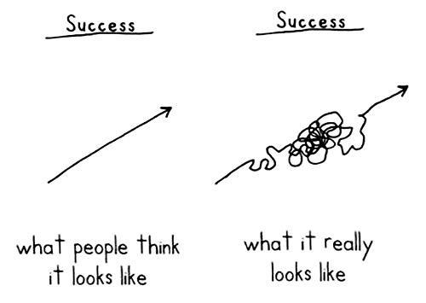
Realistic Expectations for Results
Faithful mission
is not a
straight line
process!!

Slide 18
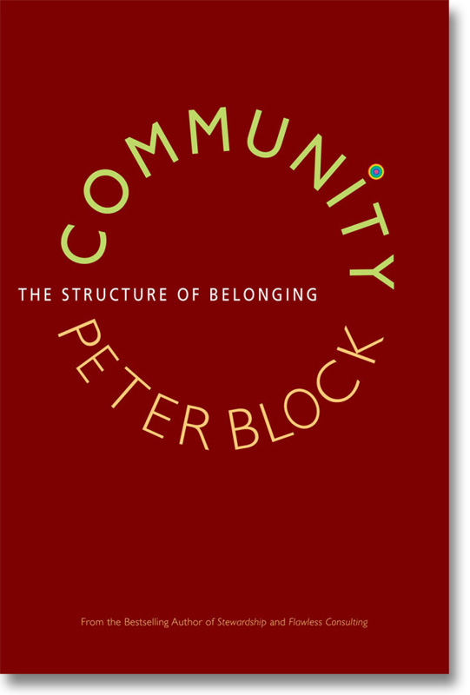
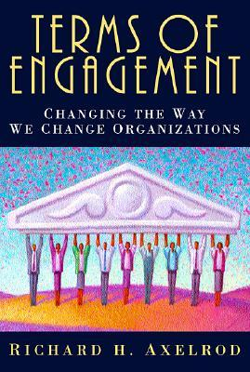
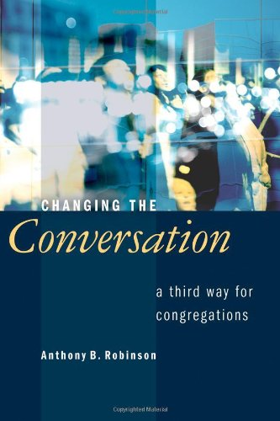
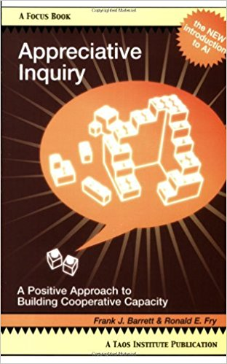
Reading to Enrich Faithful Vision Casting

