Slide 1

The Session As
Congregational Leaders

Slide 2
What is Leadership?
“Faithful and capable leadership” is a character quality of “vital and faithful congregations.”
Why? Leadership is contextual, and our
Our society is changing rapidly
The context that is our congregation is changing

Slide 3
What is Leadership?
“Leaders bring the future to the present” (Bruce Avolio)
“Tackling tough problems—problems that often require an evolution of values—is the end of leadership; getting that work done is its essence.” (Ron Heifetz)
“Leadership is influence—nothing more and nothing less.” (John C. Maxwell)

Slide 4

What is Leadership?

Slide 5
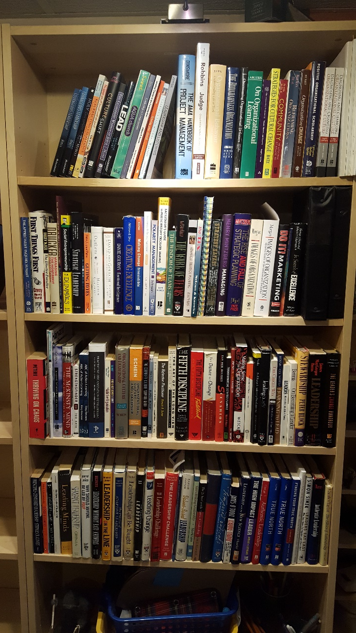

What is Leadership?

Slide 6
Scanning
It is being mindful of congregational life and the congregation’s wider context
Observing what is changing & emerging
Take note of what you see
Scanning is a pastoral practice

Slide 7
Sensemaking
Ask: “What is really going on here? What is the root cause?”
Move beyond superficial analysis
Scanning is a pastoral practice
Ask “Why?...Why?...Why?...”

Slide 8
Assess: “Is this a leadership mement?”
“Management Moments”: issue clearly understood for which there are accepted solutions
“Leadership Moments”: occur when the issue is NOT clearly understood and solutions NOT readily apparent
If your issue looks like a leadership moment, carry on with this process

Slide 9
Faith Reflection
Faith reflection calls us to go back to “first principles” in our faith:
At its core, what does God call the church to be?
How do we see in the New Testament the followers of Jesus pursuing these callings?
Sessions tend to overlook faith reflection, even though
we want “faithful and vital congregations”.

Slide 10
Bring Congregation into Conversation
Conversations need to start early focusing on the concern / the issue.
The congregation needs to understand and appreciate the issue IS a concern.
The goal in early conversation is to build concensus that “how things are now” is no longer acceptable.

Slide 11
Enter a Learning Phase
Once there is dissatisfaction with the status quo, the next step is obvious: imagine what needs to be done
The problem: “Leadership Moments” occur when the issue is not clearly understood and a solution is not readily apparent.
“We don’t know what to do” leads to getting stuck

Slide 12
Enter a Learning Phase
“We Must Change!

Slide 13

Enter a Learning Phase
“We Must Change!
“We Don’t Know
What To Do!!!”

Slide 14
Enter a Learning Phase
“We Must Change!
“We Don’t Know
What To Do!!!”

Slide 15
Enter a Learning Phase
“We Must Change!
“We Don’t Know
What To Do!!!”
…..so set learning goals…

Slide 16
Decide Direction, Implement & Learn
Most planned change efforts fail in implementation
…..so make excellent plans:
Goal: describe the outcome you desire in detailed way
Objectives: easily understandable, realistically achievable, assignable, measurable, controllable
This is still a “Leadership Moment” so learn more about the issue and the solution throughout implementation

Slide 17
A Leadership Process
Scan your context and note issues
Sensemaking: “what is really happening here?”
Assess whether this is a management moment or a leadership moment
Engage in faith reflection on the issue
Bring the congregation into the conversation to help them feel dissatisfaction with the status quo
Enter a learning phase seeking possible solutions for the issue
Decide direction, implement with determination and learn from the experience of implementation

Slide 18
Growing as a Leader
Ask Yourself:
“Am I going to benefit from this Webinar?”

Slide 19
Growing as a Leader
Believe you are a leader
You can learn the skills of leadership
Make leadership your craft
Leadership moments are opportunities to learn from experience

Slide 20



If you are looking for more…

Slide 21
Congregational Leadership
Discussion

Slide 22
The Top Ten Motivational Mistakes Leaders Make

Slide 23
Title
Title

Slide 24
#4: Not considering their motives
Motivations can be different
Kennon Callahan makes the observation:
Leaders often motivated by challenge, reasonability and commitment
Congregants often motivated by compassion, community and hope

