Slide 1
Pilgrimage
to Busan
A congregational resource

Slide 2
What do we mean by ecumenical Christianity?
By ecumenical Christians?
By ecumenical movement?

Slide 4
One ecumenical conviction is that being Christian today entails a genuine openness toward people very different from oneself—
Christians with different traditions and commitments
Christians in our own area whom we’ve never really met
Christians from very different contexts around the world
Christians struggling with social, economic, political problems
People of other faith traditions

Slide 5
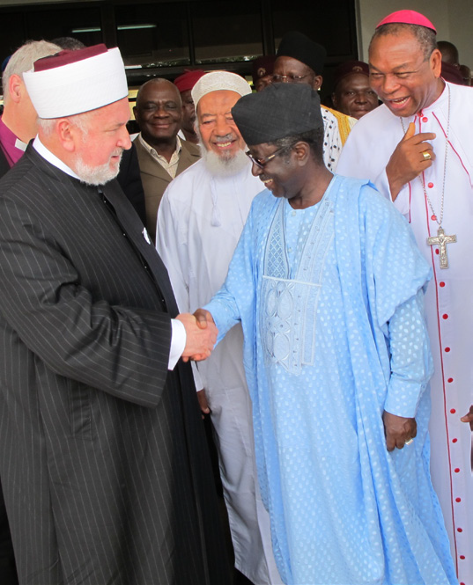

Slide 6
The WCC has published a new resource to engage congregations in ecumenical encounter and reflection—
Pilgrimage to Busan: An Ecumenical Journey into World Christianity
six units or sessions
meant to encourage local and global encounter
centered on chief ecumenical themes
guides for participants and leaders
accompany WCC to the 10th Assembly
for use in Advent, Lent, adult forums, one-day retreats

Slide 7
Each station on the pilgrimage
introduces a particular Christian context: Orthodox churches in Eastern Europe, churches in the Middle East, Christian churches in Africa
lifts up a particular theme: unity, mission, peace, justice, prayer, discipleship
sparks biblical and theological reflection
encourages concrete practical engagements—locally and globally

Slide 8
Our encounters with others can deepen our faith, enlarge our solidarity, and transform our spirituality
Perhaps ecumenical Christianity today means a globally oriented Christian discipleship

Slide 10
Please help us to get the word out about this resource—
Available now
Go to WCC Assembly webpage
www.wcc2013.info, under Resources
Encourage your contacts and churches to use the resource
See you in Busan!

